Slide 1
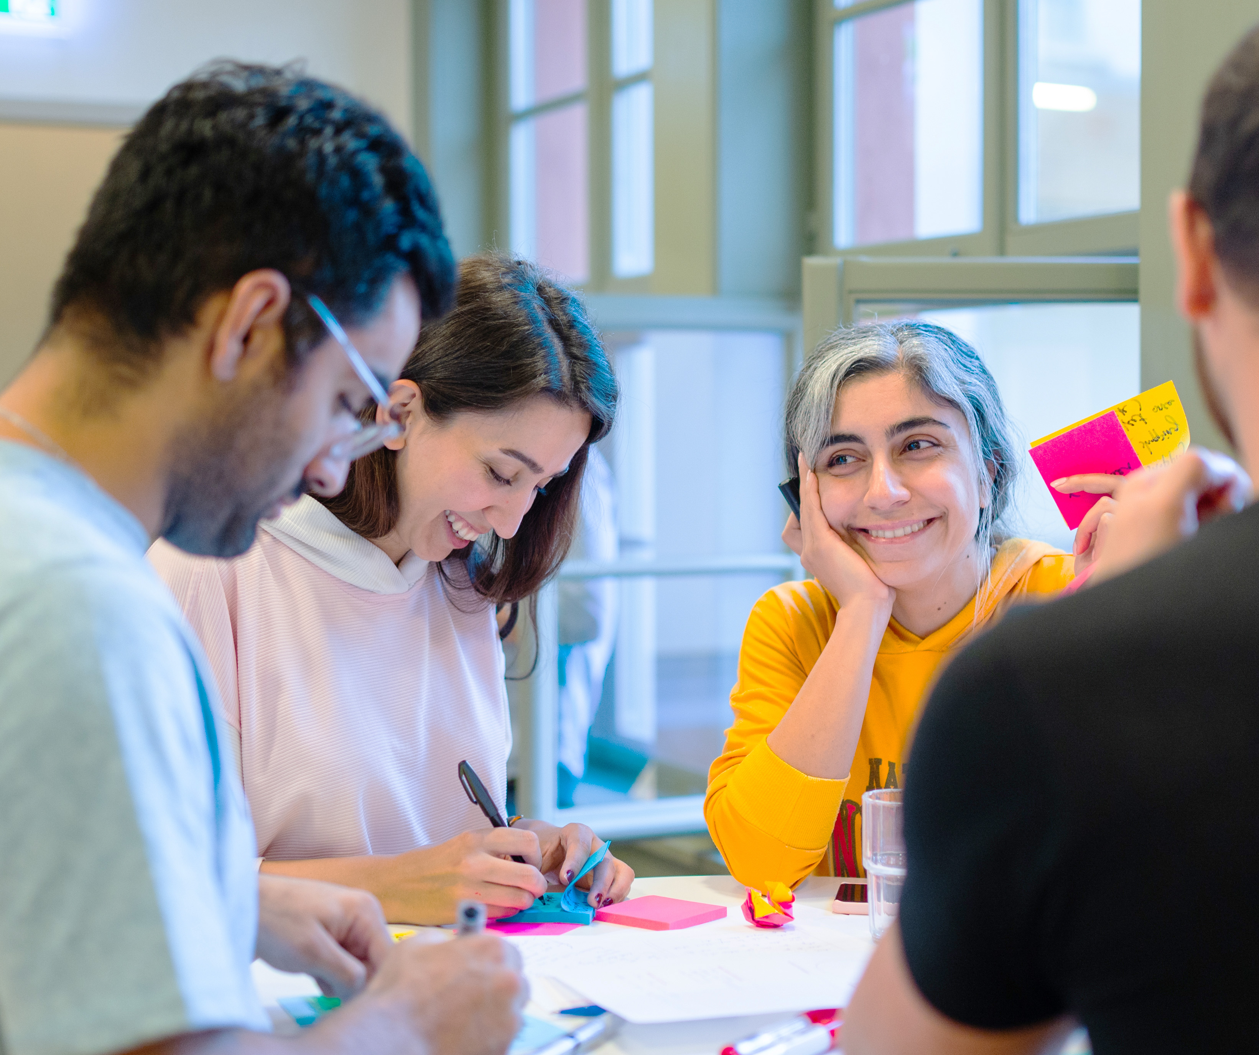
Workshop

Slide 2
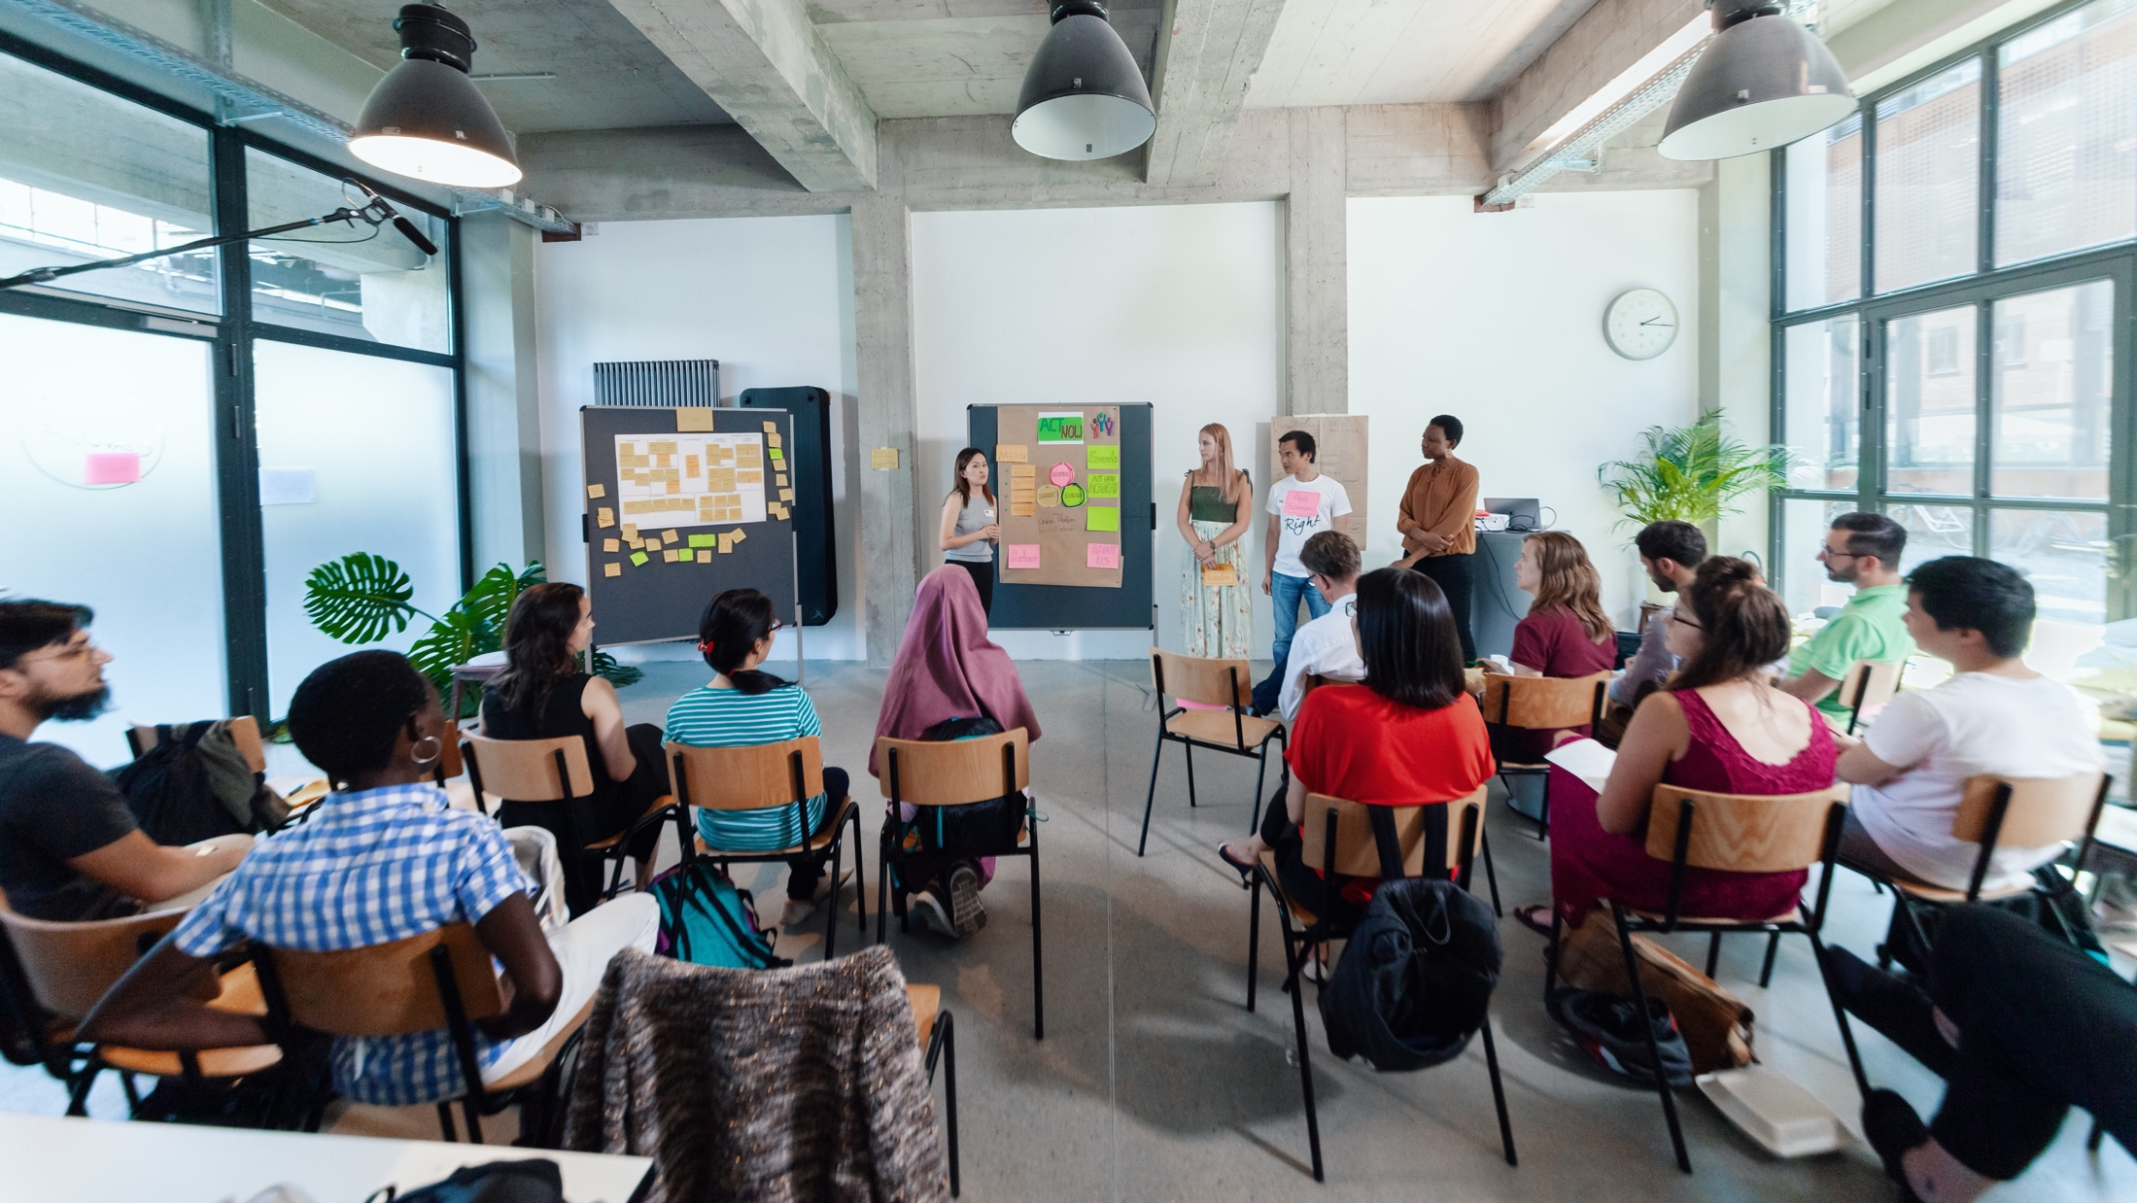
MEET THE TEAM
Notes:
So my name is XX, I‘m working as…
Moderating this session with me is XX. (M2 stellt sich selber vor)
And last but not least please meet the maybe most important (wo-)man in the room today: XX. XX is in charge of the technical support and is here to help with any technical problems.
XX in your role as techincal support would you please introduce us to some basic rules and tricks, that are important in our digital setup today?

Slide 3

Young Entrepreneurs in Science
opens up new career perspectives
for young researchers
part of the Falling Walls Foundation
enabled by Federal Ministry of Research, Technology and Space
www.youngentrepreneursinscience.com
Notes:
Young Entrepreneurs in Science (YES):
Originally started as an offline workshop series in various cities across Germany.
Now offers a diverse program of Offline and Online workshops tailored for PhDs, Postdocs and Master students
Project Team:
Comprises 12 team members.
Part of the Falling Walls Foundation, a non-profit organization based in Berlin.
Falling Walls Foundation:
Aims to communicate science and research to the public.
Promotes interdisciplinary exchange and collaboration.
Workshop Benefits:
Strongly supported by a broad network in academia and business.
Designed to foster entrepreneurial thinking and skills among researchers: cultural transfer
BMFTR:
Participation is made possible free of charge through funding from the BMFTR (Federal Ministry of Research, Technology and Space)

Slide 4
Netiquette
Be respectful & constructive
Use AI responsibly: Use it to support the process, not to produce final results
Mute when not speaking
Be present: keep your camera on. Feel free to eat, drink, or stretch
Need help? Reach out to us via the chat if experiencing technical issues
React & engage: Use emojis or reactions to share feedback
Drop your questions or ideas in the chat – we’re all here to learn together!
www.youngentrepreneursinscience.com
Notes:
Be respectful & constructive
We encourage open feedback – just make sure it’s respectful, kind, and constructive.
Use AI responsibly
If you’d like to use AI during group work, make sure your whole group agrees. Use it to support the process, not to produce final results.
Mute when not speaking
Help keep the space clear by muting your mic when you’re not talking.
Be present
Stay social – keep your camera on if possible. Feel free to eat, drink, or stretch as needed.
Need help?
Reach out to our coaches via the chat if you’re experiencing technical issues.
React & engage
Use emojis or reactions at the bottom of your screen to share quick feedback or show you’re engaged.
Use the chat for questions
Drop your questions or ideas in the chat – we’re all here to learn together!

Slide 5
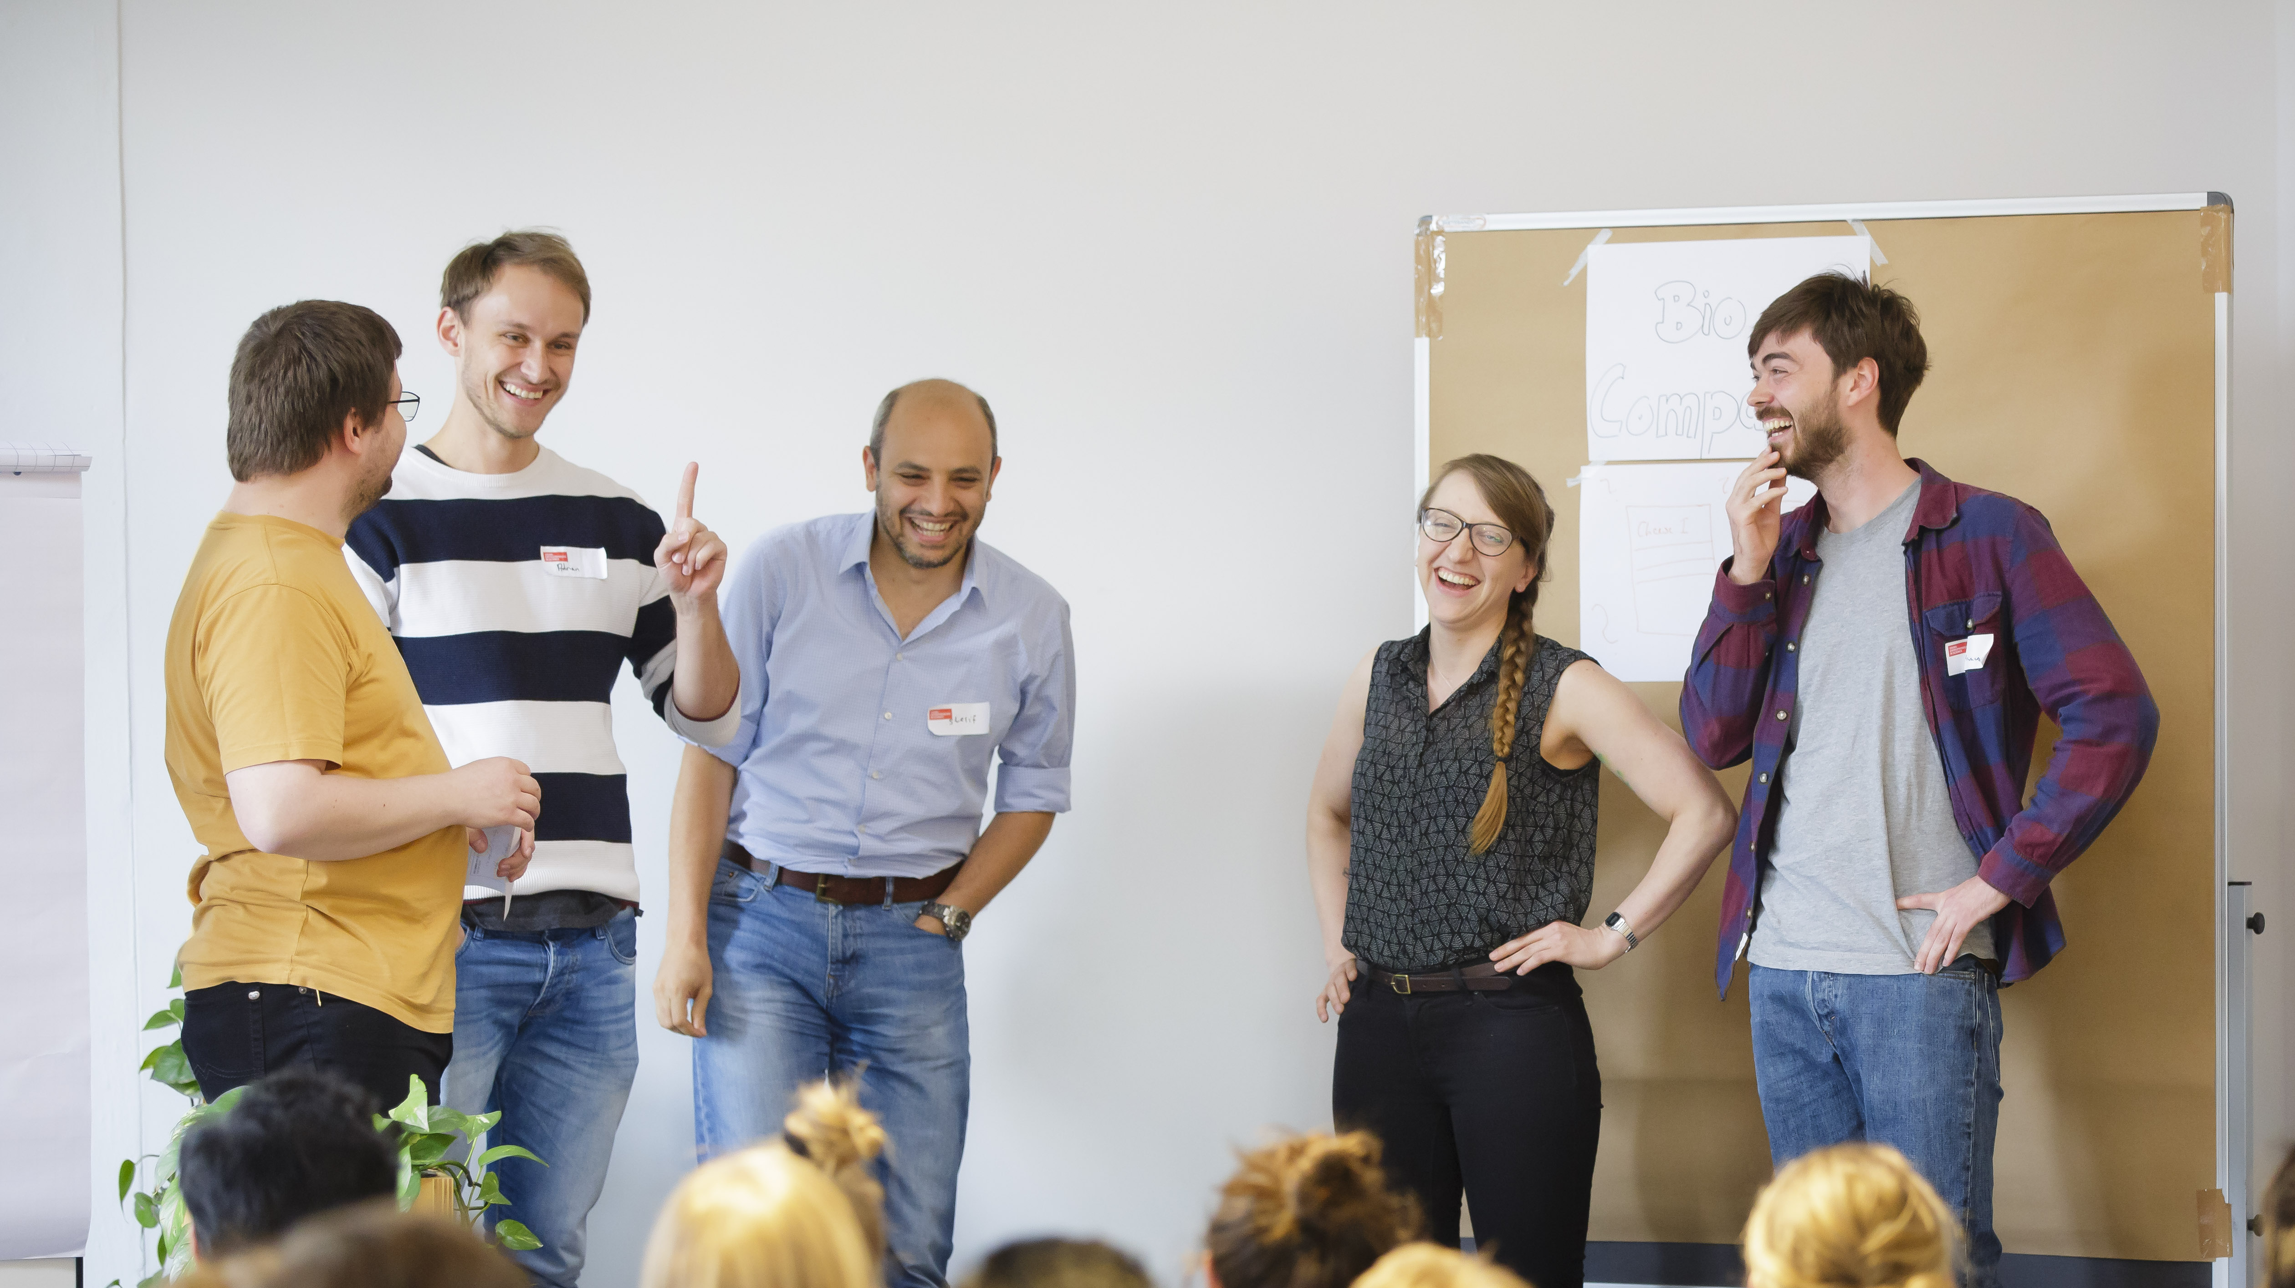
CHECK-IN
Notes:
Okay let’s start.
We always start our workshops with a check-in with the workshop-team – no matter if online or offline.
This is how it works (select next slide)

Slide 6

Emoji Check-In
Everbody, show us your emoji mood!

Slide 7

BREAK

Slide 8
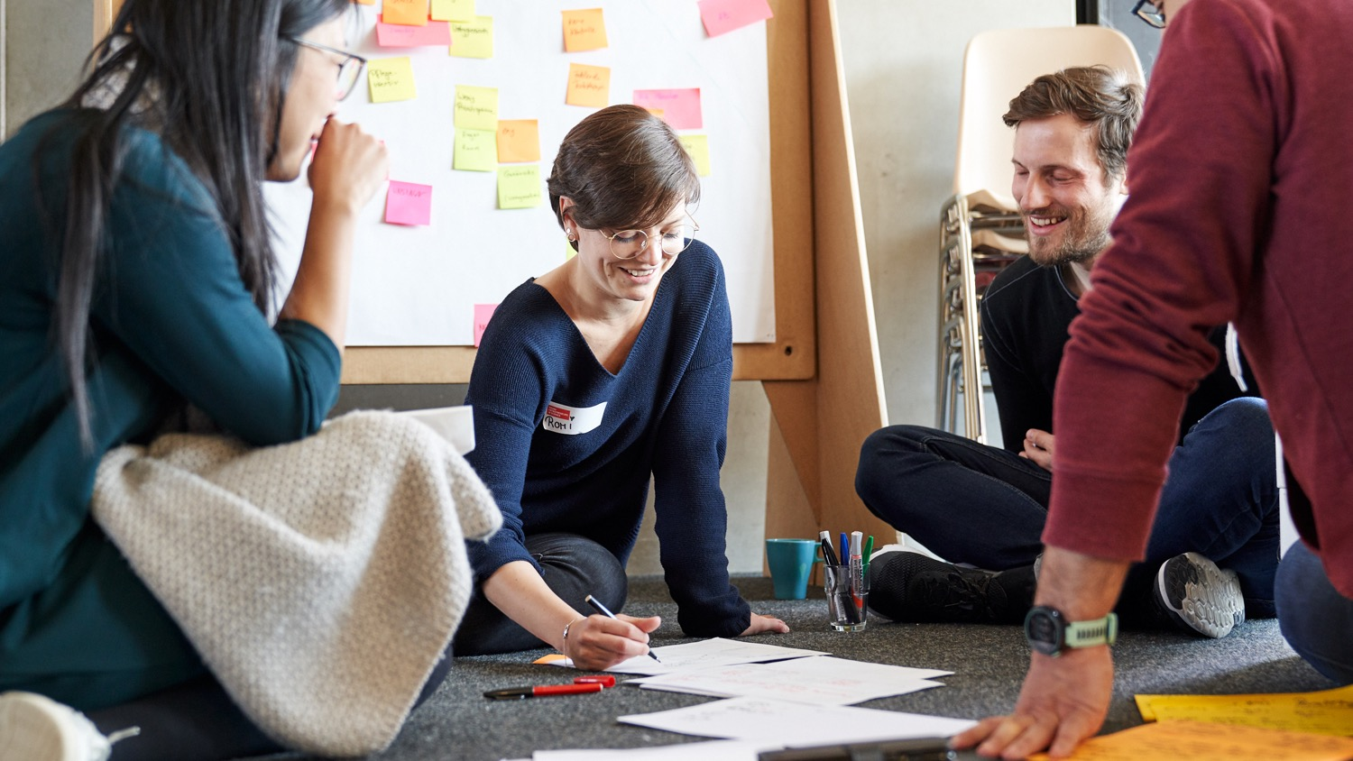
YOUR RESEARCH CANVAS
Notes:
Welcome everyone! [interaction with the participants until everyone is there]
Let‘s dive into our topic for today called: Your research canvas

Slide 9
Learning goals
Reflection about the potential of your own research topic/idea
Assessing potential through identifying users/stakeholders
Developing or extending potential use cases based on your research & network
Notes:
Our idea with this workshop is to close the gap between research and business idea or use case.
How can we help you translate your research into contexts for application.
[address the points on the slide]
The focus for this workshop is to work on your own research topic!! Time to reflect about it‘s potential and share thoughts with your peers!
We know from our experience that if you‘re working in the field of „basic research/Grundlagenforschung“ sometimes it can be a bit tricky to find fields for application.
So if you get stuck – please check in with us – we are happy to support!
And once again – in this part of the workshop you can work hands on!

Slide 10


Up for the challenge?
+
Work with your
own research topic
MIRO
(Digital Whiteboard)
Notes:
Let‘s get started.
Today we‘ll work on MIRO.
Who has worked with this tool before?

Slide 11
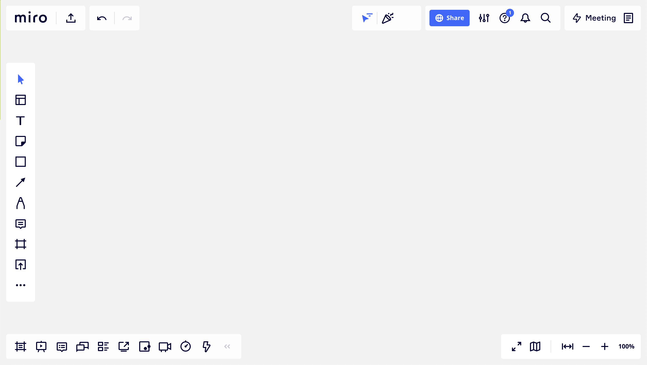
Welcome to miro …
text
sticky notes
navigation map
more functions,
like stickers and emojis
zoom
Notes:
In the next few minutes, we will take the time to familiarize ourselves with the Miro platform.
Our objectives are to understand how to navigate the board and learn how to add notes, images, and drawings to your workspace.
Let me give you an overview...
So the big grey area you see here is the white board.
On the lefthand side you find a panel with various functions.
I quickly want to show you the most important functions:
The T is for text – with this you can add a text box to the whiteboard.
Most of the time, we work with digital sticky notes, or post-it’s. When you click on this icon, you will find a variety of post-it’s. You can add them to your board via drag and drop.
There are more functions like adding stickers, pictures or emojis when you click on those two arrows.
On the lower panel you find the zoom function. So zoom our to get more orientation and zoom in to allow a closer look at the content.

Slide 12
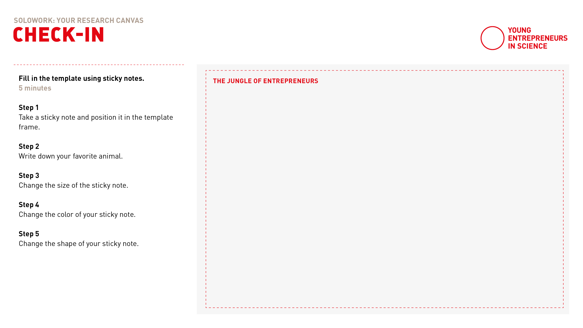
Experience miro
Notes:
Let‘s test working with Miro together.
Follow the link to the board
Find the section you see on this slide: „The jungle of entrepreneurs“
Play around with sticky notes and write down your favorite animal.
Get to know the functions of inserting text, adding sticky notes, stickers and zooming on the board.
Link zum Board: https://miro.com/app/board/uXjVOTizJLg=/

Slide 13
Solo work
Warm up with MIRO
5 minutes
Transfer to MIRO and find the Miro Experience board on the top
Take a sticky note and position it in the template frame
Write down your favourite animal
Change the size of the sticky note
Change the colour of your sticky note
Change the shape of your sticky note
Notes:
Please click on the link in the chat and use the passwort to login
Zoom a little out so that you can see the Experience miro box on the top.
[read out instructions]
[post link in chat]

Slide 14
Notes:
Welcome back!
Everything went well? Everybody back with us?
Thumbs up please!

Slide 15

Think big!
Science
Imagine it’s 2030.
Your research project has led
to pioneering results with breakthrough solutions and will be featured as title page in the recent edition of Science Magazine.
What could be the headline of
this magazine?
Magazine
Notes:
Now let‘s get started. It‘s your turn! We'd like you to think visionary!
Imagine this:
Within the last years you've been very successfull with your research which has lead to pioneering results.
Because of your research success you will get featured on the title page in the recent edition of Science Magazine.
Now it is your turn to get creative: What could be the headline of this magazine?

Slide 16



Think big!
Science
Imagine it’s 2030.
Your research project has led
to pioneering results with breakthrough solutions and will be featured as title page in the recent edition of Science Magazine.
What could be the headline of
this magazine?
Magazine
Artificial eye-brain interface restores vision in blind patients
Example by Yih-Shiuan
Notes:
[Read out example of Yih-Shiuan who‘s research break though has been to discover an artificial eye-brain interface that restores vision in blind patients]

Slide 17
Solo work
Think big!
7 min
Everyone stays in main room
Go to MIRO board
Imagine and collect on MIRO:
Claim one of the empty Science Magazines and mark it with your name
Fill the title page with your research vision
Add pictures, symbols or
other visuals
7 min time for yourself
We will call you back to the screen
Notes:
And this is how this works exactly:
It is individual work, so you can stay in the main room.
We'd like you to do this step with the help of Miro:
On the MIRO Board you find one science magazine next to another template for the Research Canvas
For now: Don‘t mind the Canvas, we work with the science magazine first
Claim one of the empty Magazines and mark it with your name. You can do it with sticky notes or with a text box

Slide 18
Notes:
Welcome back!
Everything went well? Everybody back with us?
Thumbs up please!
[check with participants if any problems have to be solved regarding working with Miro]

Slide 19

Sharing …
Raise your virtual hand or share in the chat!
What is the headline of Science Magazine
featuring your research?
What breakthrough does your research offer to whom?
Notes:
Now we all know the tools we‘ll use this afternoon – let‘s dive into the content!
Raise your virtual hand or share in the chat!
What is the headline of Science Magazine featuring your research?
What breakthrough does your research offer to whom?
[5min sharing]

Slide 20
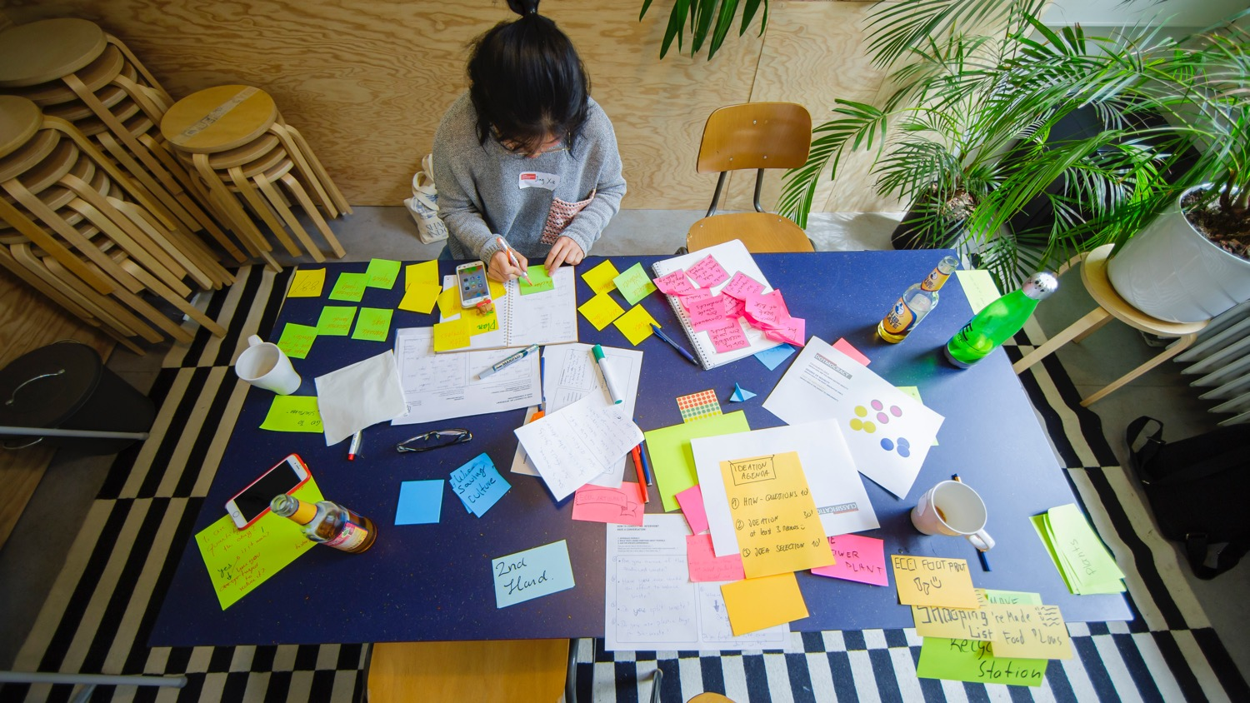
DEEP DIVE INTO YOUR RESEARCH
Notes:
To develop potential use cases, you have to know your research and your initial vision about it.
So let‘s build it up from the beginning with a tool we call the Research Canvas.
We developed the Reseach Canvas because, in various consultations, we found that scientists uncover a great deal of innovative potential in their research activities but have difficulty translating this into use cases or even business models
This is quite natural, because most of them are still thinking as scientists and not yet as entrepreneurs at this stage
We have created this canvas to support you in this transfer, the translation of your research into a commercially viable use case.

Slide 21
The research canvas
PROBLEM TO BE SOLVED | RESEARCH QUESTION & DESIGN
THEORY | RESEARCH RESULTS (and practical application)
POTENTIAL PRODUCT/SERVICE
RESEARCH
USE CASE
Notes:
Now about the tool:
On this template you see 5 areas.
The 4 of them on the lefthand side deal with your research.
The arrow on the right aims at the practical application as service or product.
Throughout the afternoon we will use this template and fill it the fields one by one.

Slide 22
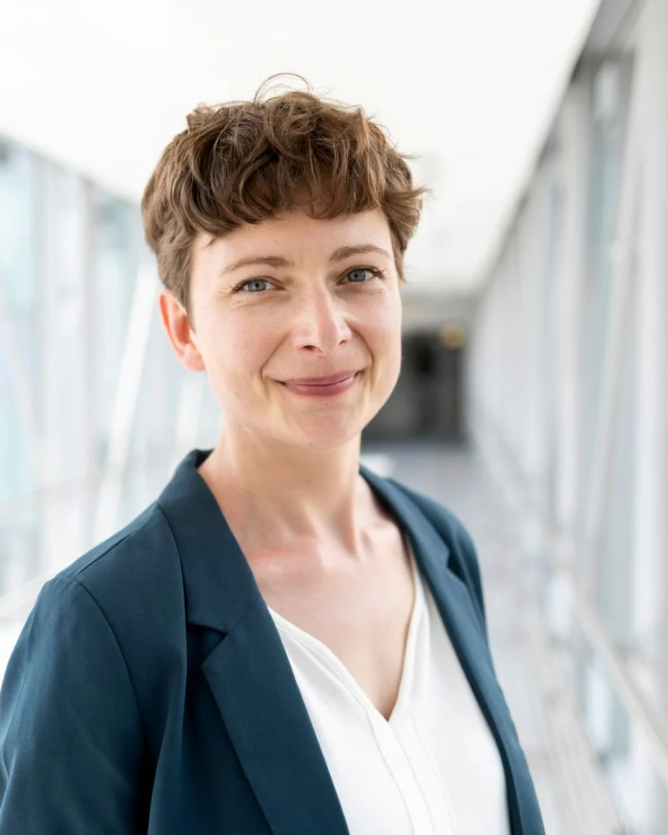
The Research Canvas Example
Getting ahead of
Alzheimer’s disease
Notes:
In order to make the canvas and its application more tangible for you we prepared an example from one of our alumni. It will accompany us through the workshop:
- Background: Cognitive neuroscience researcher Nadine Diersch from the DZNE (Forschungszentrum für neurogenerative Erkrankungen) in Magdeburg is exploring new ways to diagnose Alzheimer’s disease with the help of a universal device: our smartphone.
Her app prototype is a chance for people at risk to get ahead of time, opening up possibilities for treating the incurable disease.
We will now have a closer look how she managed to link her research with a use case/application

Slide 23
Problem to be solved
What is your object/topic of research?
What underlying problem or challenge are you addressing with your research?
EXAMPLE
So far, there is no efficient treatment available to cure Alzheimer's disease.
Thus, there is a need for an early diagnosis, when first changes in the brain occur.
Notes:
The top left side of the canvas covers your research topic and the problem you are solving with your research.
When you work with your canvas in a little bit: Describe your object of your research very briefly:
What is your object/topic of research?
What problem, what deficiency did you discover? Why is it important that you find answers to these?
What is the bigger problem to which you want to find solutions behind your research?
Let’s have a look at our example:
Nadine found out that so far, there is no efficient treatment available to cure Alzheimer's disease.
She realized a need for an early diagnosis because that is when the first changes occur in the brain.

Slide 24
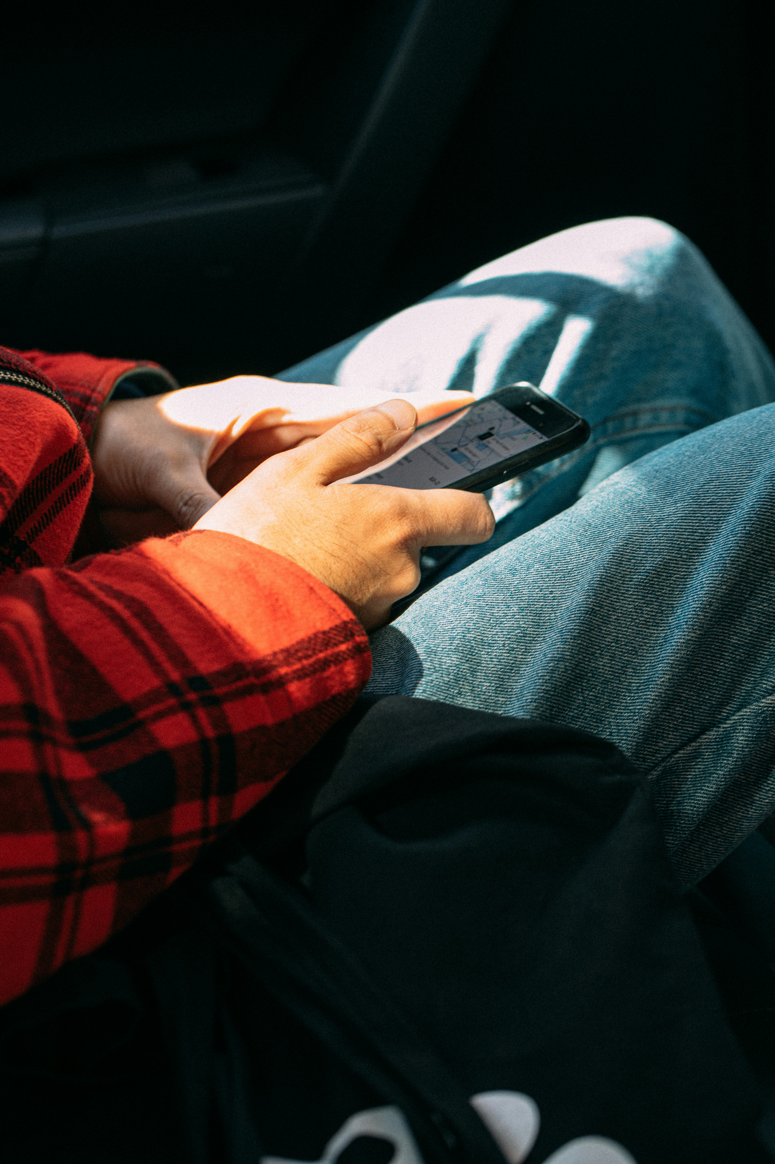

Problem to be
solved
Notes:
Nadines Example:
But: When the first cells in the brain change, the patients don‘t show any visible symptoms that can be detected in convetional memory tests.

Slide 25
Theory
What theoretical background underlies your research?
Note the state-of-the-art highlights!
EXAMPLE
Protein accumulations in certain brain regions at the earliest stages of the disease.
Notes:
Let’s move on to the next part.
On the bottom left you find the field “theory”
This field is about the theoretical reappraisal. Very briefly outline the theoretical context and summarize the scientific consensus on the research subject:
What theoretical background underlies your research?
Note the state-of-the-art highlights!
What contribution will you make to this?
Let’s have a look at our example:
Here is the answer from Nadines example:
Protein accumulations in certain brain regions at the earliest stages of the alzheimer disease, decades before memory problems are detected by standard neuropsychological assessments.
Let‘s move onto the next field of the research canvas.

Slide 26
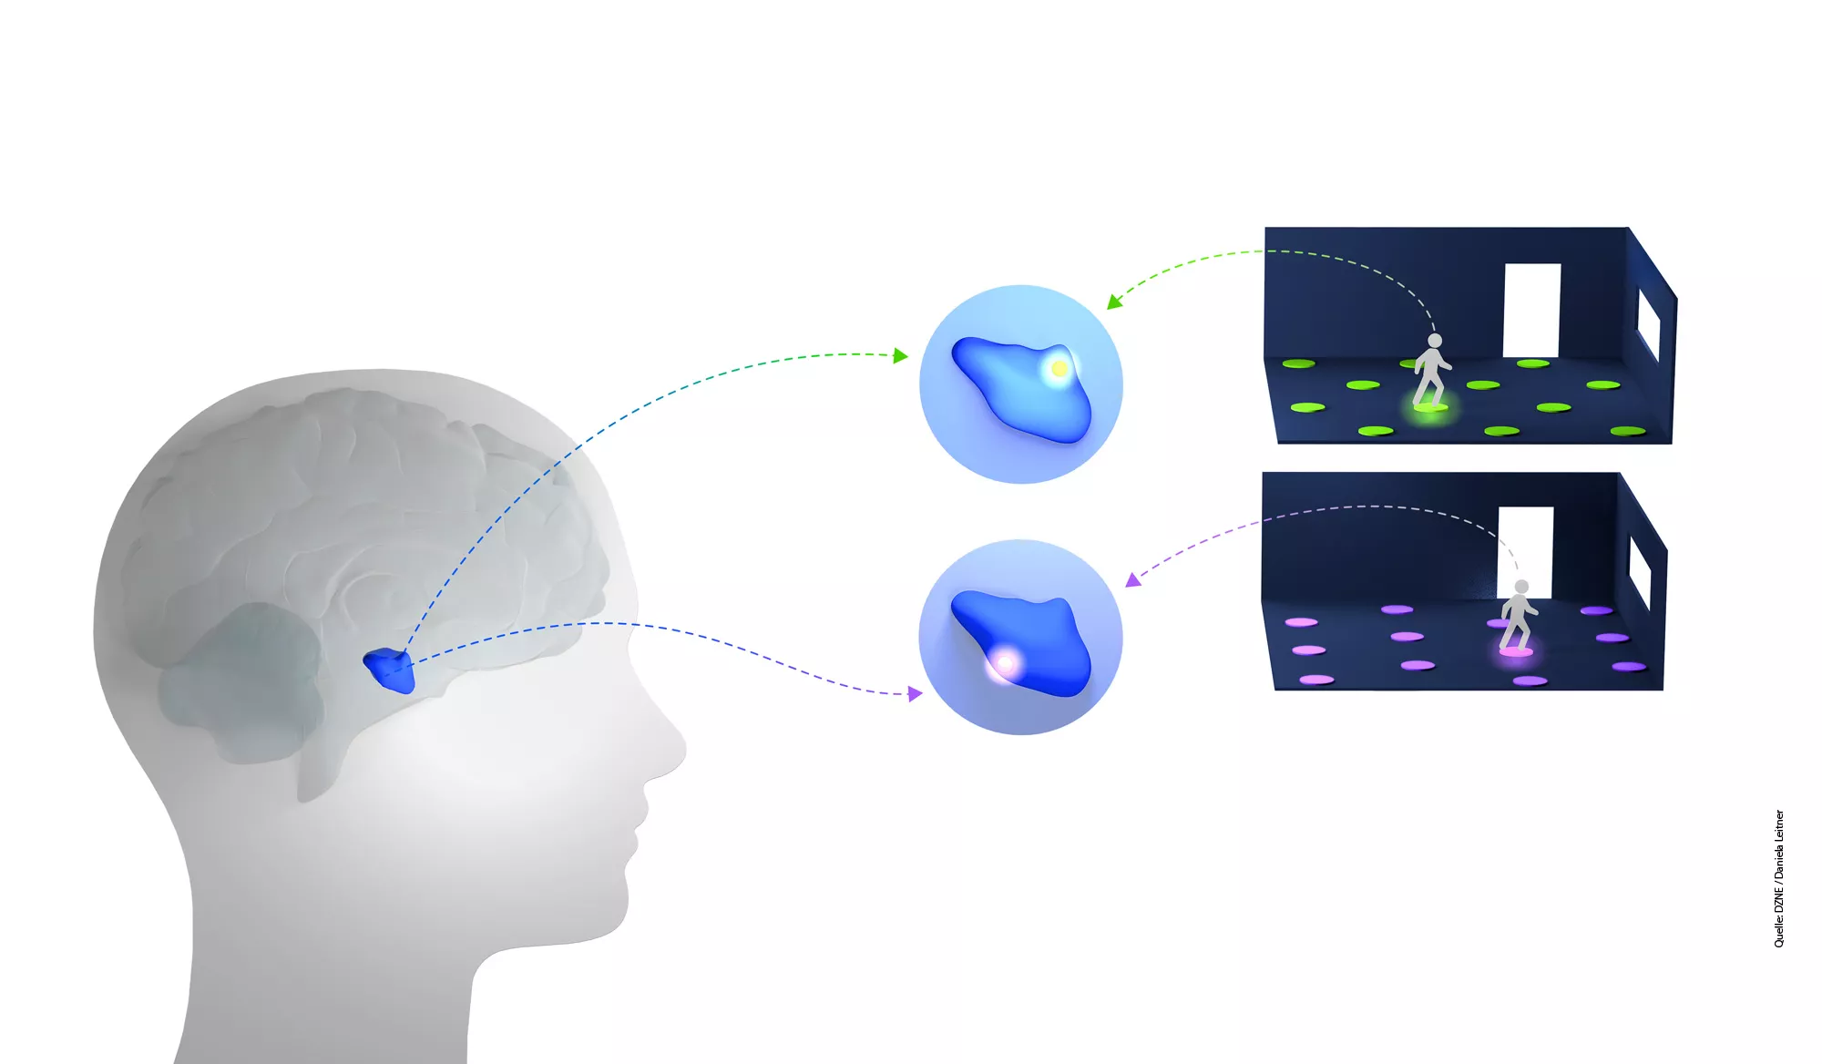
Theory
Notes:
Nadines Example: The proteins begin to accumulate in brain regions that are known to contain our “internal GPS system” -> Therefore the researchers identified links between spatial orientation and movement and the state of the brain cells.

Slide 27
Research Question & Design
What specific aspects of the problem/challenge are you researching?
Note some details about your research setting! (qualitative vs. Quantitative, samples etc.)
EXAMPLE
Can our movement patterns during wayfinding in our surroundings be used to detect early changes/degeneration in the brain?
Notes:
On the top right left you find the field “research question & research design”
Here you can write down:
How exactly do you do your research?
What specific aspects of the problem/challenge are you researching?
Note some details about your research setting!
Of course: a brief summary of the research design is sufficient.
Back to Nadine:
She researched around the question:
Can our movement patterns during wayfinding in our surroundings be used to detect early changes/degeneration in the brain?

Slide 28
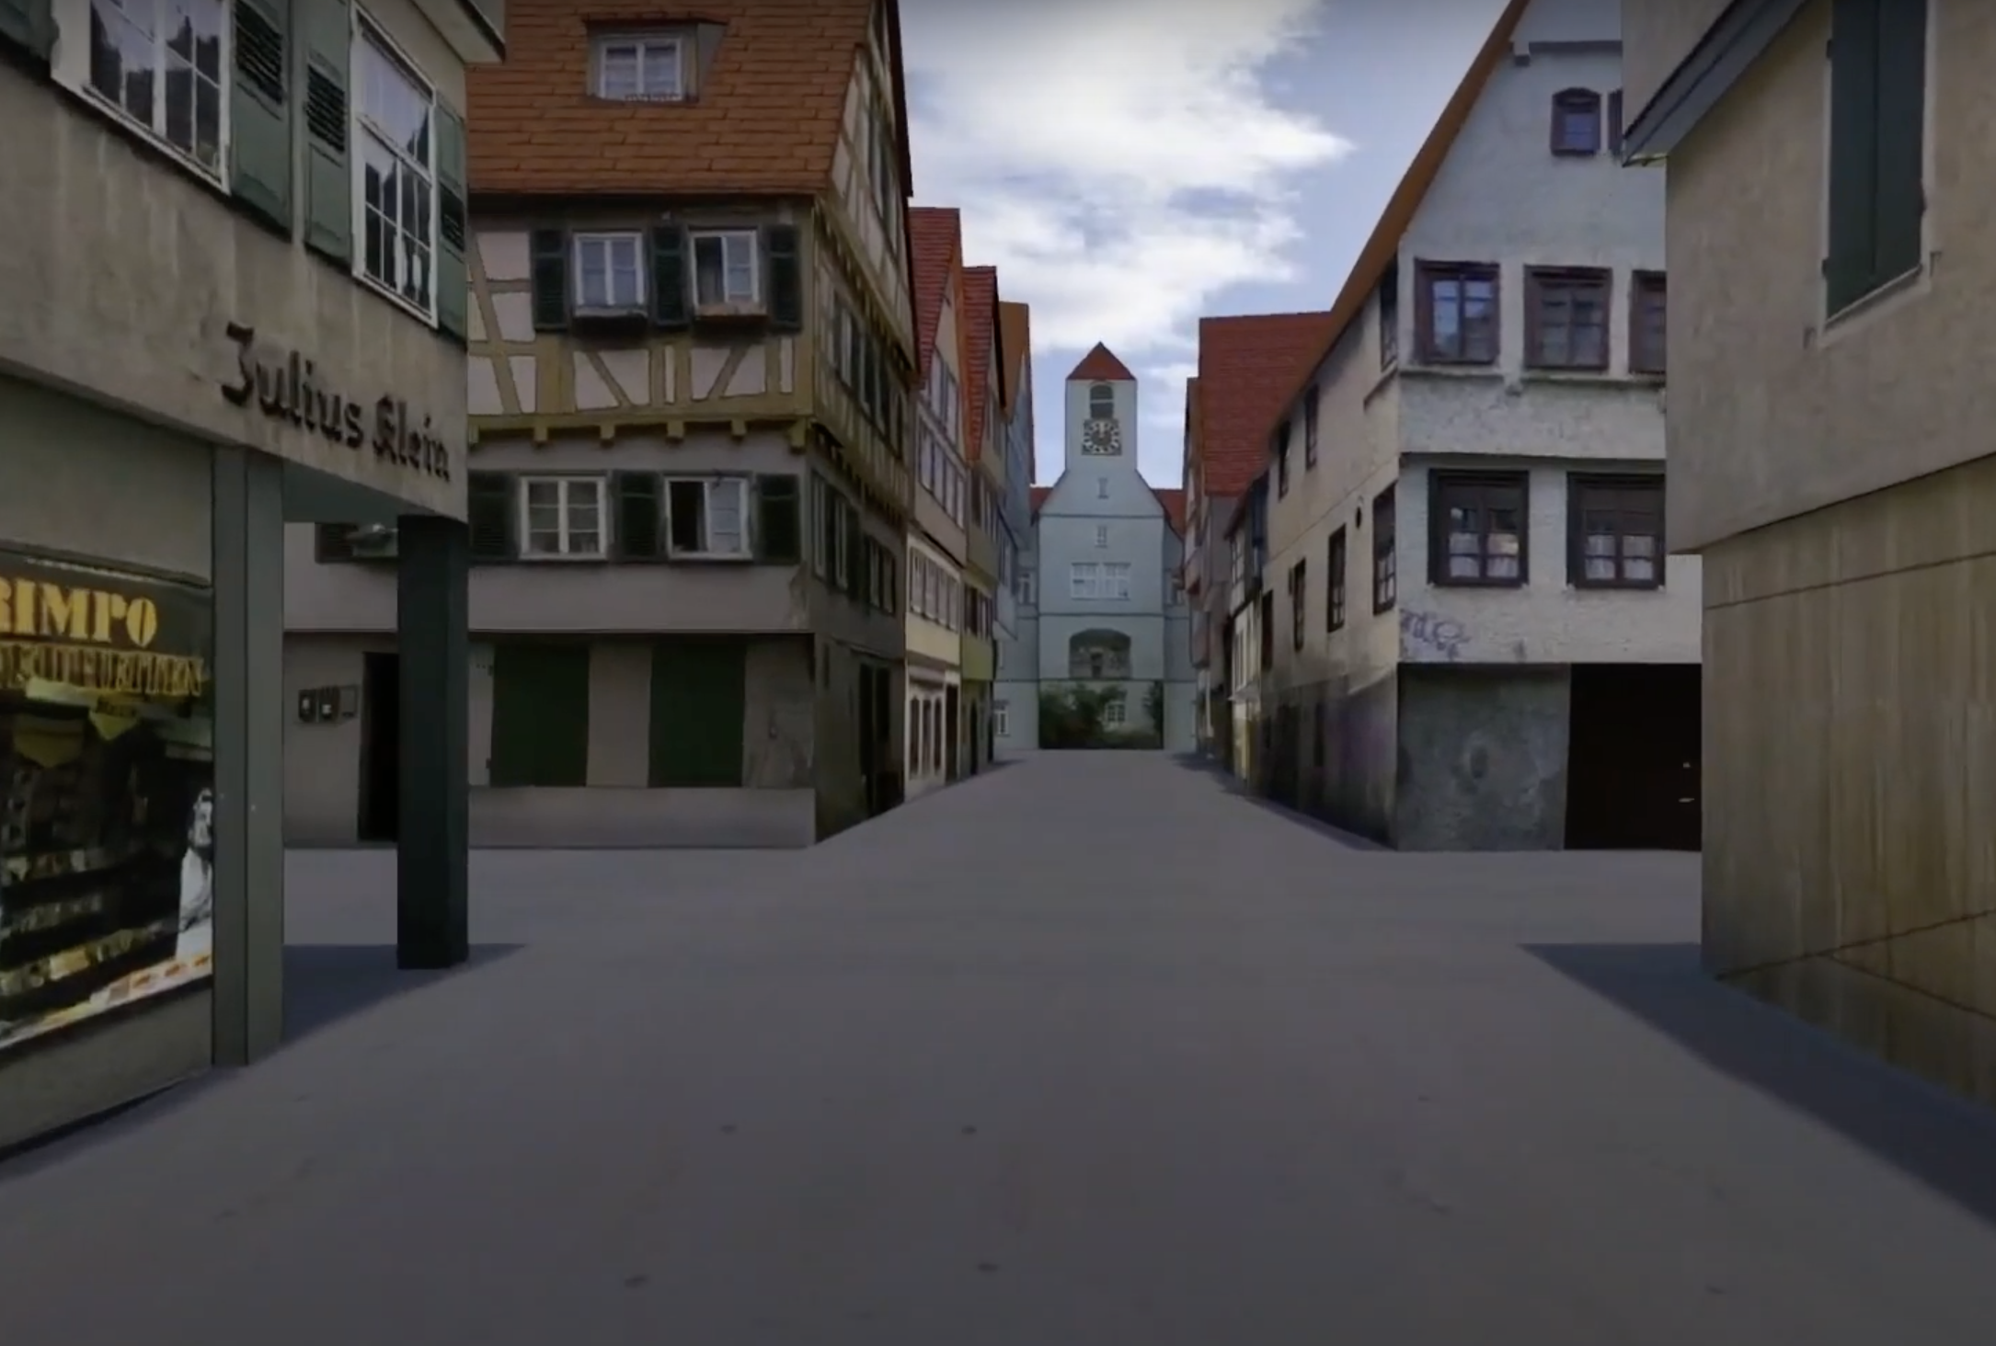
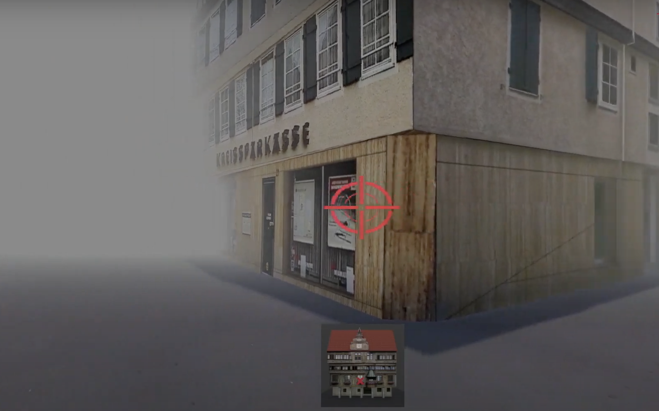
Research Question & Design
Notes:
uncover movement patterns that are indicative of certain neurological changes
In the study, test subjects got to know a virtual, unknown environment. The subjects were driven to an intersection and should move the crosshairs in the direction where the church is. From this Nadine calculated a learning curve. The high risk group needed more learning phases or they found it difficult to memorize the position of the buildings. In the young group only 2 to 3 learning phases were needed. At the same time, they also did an MRI, i.e. they measured the brain activity in the two groups while they solved the task. There were differences in activation patterns in the hippocampus, the region where the place cells are. In the young group, activity in the region decreased continuously over the different learning phases. In the older und high risk test subjects, the hippocampus was hyperactive. There appears to be a connection between hyperactivity in the hippocampus and protein deposits in place and grid cells.

Slide 29
Research Results
(+practical applications)
What are your results so far?
EXAMPLE
Tracking GPS and sensor data from smartphones can be used to study movement patterns and related brain change
Notes:
And on the bottom right it is all abour “your research results and the practical applications”
Here you have space to write down a brief presentation of the results you have achieved so far. If the research is not so far advanced, you can also put here the results that you suspect or want to achieve.
Just make sure that - when working with this canvas outside this workshop - you update your Canvas at regular intervals and also check what effects these changes have on the other fields of the Canvas. It is also important to note under which conditions your research results apply.
How did Nadine answer this?:
Her idea was to use GPS tracking and sensor data from smartphones to study movement patterns and related brain change

Slide 30
The research canvas
PROBLEM TO BE SOLVED | RESEARCH QUESTION & DESIGN
THEORY | RESEARCH RESULTS (and practical application)
POTENTIAL PRODUCT/SERVICE
RESEARCH
USE CASE
Notes:
That was the left side of the canvas which should not be too difficult for you as it probably deals with your daily work.
You will start with this side and then build up on it.
You can either enter your current research work, a past one you would like to work on or a future one you have in mind.
Later in this workshop you will get time on your own as well as support from the other participants to think about first use cases.
Which open questions are there about the Canvas itself or the individual fields? Do you feel ready to start working with it?

Slide 31
Solo work
The Research Canvas
15 min
Everyone stays in main room
Go to MIRO board
Reflect and collect on MIRO:
Claim one of the empty Research Canvases; mark it with your name & topic
Fill all the fields on the
LEFT side of the Canvas with sticky notes
Try to keep it short
and concise
15 min time for yourself
We will call you back to
the screen
Notes:
Great, here we go! Please go back to the Miro board and claim a canvas.
Please mark your canvas with a post-it with your name.
Then start working ON THE LEFT SIDE ONLY.
Remember that you will get feedback from other participants after the solo work. Make sure to express yourself as clearly as possible in the post-its.
And this is how this works exactly:
It is individual work, so you can stay in the main room.
Make sure you mute yourself.
If you like, you can turn off your camera.
You will have 15 minutes to fill in the canvas.
Remark: the Miro Board can be seen by all participants; feel free to share how much you feel comfortable to share
If you have any questions in between – we are happy to help. Please message us in the chat.
Let’s go!

Slide 32
Notes:
Welcome back!
Everything went well? Everybody back with us?
Thumbs up please!
Which open questions are there regarding the left side?
[interaction with the participants]
After the break we will look into the right side of the canvas, users and potential use cases.
Once again – please stay in the zoom meeting.
We‘ll continue at [time]

Slide 33
It’s coffee
o’ clock!

Slide 34
Potential Product/
Service
What about our walkling patterns? Why not use data from our smartphones to study our question?
Notes:
Welcome back, everyone! We hope everyone could get refreshed a little
In order to make the canvas and its application more tangible for you we prepared an example from one of our alumni. It will accompany us through the workshop:
- Background: Cognitive neuroscience researcher Nadine Diersch from the DZNE (Forschungszentrum für neurogenerative Erkrankungen) in Magdeburg is exploring new ways to diagnose Alzheimer’s disease with the help of a universal device: our smartphone.
Her app prototype is a chance for people at risk to get ahead of time, opening up possibilities for treating the incurable disease.
We will now have a closer look how she managed to link her research with a use case/application

Slide 35
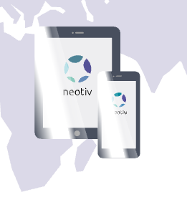
The Research Canvas Example
Translating the research result into a product, together with a team of other experts such as software developers and business experts.
Notes:
We had a closer look at the research canvas understanding how to link research with a potential product or service.
In our example Nadine linked her research with a use case and devleoped an application called neotiv together with a team. Her app prototype is a chance for people at risk to get a diagnosis ahead of time. Tracking movement patterns with the app.

Slide 36
“For somebody who wants to become an entrepreneur, it is crucial to be proactive in order to build up a network outside your lab.”
Nadine Diersch
Young Entrepreneurs in Science Alumna

Slide 37

FROM RESEARCH TO USE CASE
Notes:
Before the break we worked on the left side of the canvas...
Now it’s time to slowly turn to the right side.
You might have seen two words in bold on the canvas…

Slide 38
What is a use case?
Raise your virtual hand or share in the chat!
What comes to your mind when you think of users/use cases?
Notes:
… The two words are USE CASE.
Before we start, let's have a short check-in/sharing because we're curious if you are familiar with the term USE CASE.
Have you come across the word before?
What exactly is a use case and how do we get from your research to a use case?
These are our initial questions to jump into the second part of this workshop.
[interaction with the participants]

Slide 39

What is a use case?
“A specific situation in which a product/service/ solution can potentially be used.”
Lawrence Chapman for PMA
Notes:
Let’s have a look a definition of the term use case:
According to the Product Marketing Alliance, a use case is:
‚A specific situation in which a product or service could potentially be used.‘
‚beginning with a user's goal/need and ending when that goal/need is fulfilled‘
(PMA = Product Marketing Alliance)

Slide 40

From research to use case
Transfer
Potential
use case
Research
New theory
New state of the art
New technology
Thesis
Publications
Product
Service
Process
Context
Notes:
What does this mean in our case, for our workshop today?
Again, you‘ll now be looking at your own research topics:
Each research topic can result in new theories, new state of the art and of course publications.
Today, we invite you to look beyond this 'academic' focus or potential and think about the potential to transfer your research topic to (new) contexts for or fields of application. How can your research topic be transferred into an innovative use case?
Remember: A use case is a specific situation in which a product/service can potentially be used. Therefore it is a moment in which your idea/solution creates meaning for someone so that someone becomes a user.
This could mean that…
… your technology or research subject leads to a a completely new product or a service.
… it could be used to optimize a process or
… an already existing solution is applied to a different context in which it solves a problem or satisfies a need and this is regarded as new and innovative.

Slide 41

From research to use case
Potential
use case
Research
USER
Notes:
So to wrap it up: Your research serves as the foundation of innovation
The potential use case refers to the transformation of research insights into specific applications or products or services. The use case can only be meaningful and create value, when it addresses a need by a user.
So – who is the user? Any idea? [if you like: sharing verbally or in chat]

Slide 42



Identifying users
PROBLEM TO BE SOLVED | RESEARCH QUESTION & DESIGN
THEORY | RESEARCH RESULTS (and practical application)
POTENTIAL PRODUCT/SERVICE
RESEARCH
USER
USE CASE
Notes:
For that – let’s go back to the Canvas:
USERS are the people that connect our research to a certain use case
They are – so to say – the people who have an unfulfilled need – you could also say a problem – that you want to solve with your solution
So what we want to do next is to focus on potential users

Slide 43
Identifying users
Stakeholder
has an interest in, or is affected by what a business does
Stakeholders
Customers
Customer
is willing to pay for a product or service that satisfies an unmet need
Users
User (Beneficiary)
benefits from the value created by the product or service (though they might not be the one to pay for it)
Notes:
Let’s have a closer look: How do we identify users?
Usually, there are many people interested or affected by our research: the sum of them we call stakeholders
It’s important to differentiate between different groups of stakeholders.
To find the users it is important to have a look for a person that is affected with an unfulfilled need or a problem. Who would benefit from the solution?
Let’s think back to Nadines example: One of her user groups could be the elderly people getting confused. Another user group could be relatives or caretakers – depending on her focus and her use case.
Now – a user is regarded as the beneficiary of a solution. But they are not always the ones who pay. That is why it’s important to differentiate them from customers.
Sometimes, the customer and the user can be the same person, especially in consumer-focused products.
However, in cases like B2B (business to business) solutions, the customer could be a decision-maker or buyer within a company, while the user might be an employee who operates the product or service.
Recognizing this distinction helps in defining your use case.
Why is this relevant? Social Startups for example often have both – someone pays and someone else benefits from the product/service

Slide 44
Identifying users – example
Stakeholder
Society in General
Stakeholders
Customers
Customer
Health Care System
Medical Industry
Users
User (Beneficiary)
Patients with subjective
cognitive decline
Notes:
Coming back to our example once again, we could identify the following groups:
Stakeholders: Society in General – this solution is potentially interesting to anyone and many lobbies, politics etc.
Customers: the group that is mainly interested in buying the solution to market it. In this example that is the health care system and the medical industry
Users: The people that actually benefit from the solution are patients that suffer from subjective cognitive decline or that have a pre-disposition.
Here you see that the customers are not directly the end users of the solution but it’s a B2B channel. When developing the product/app however, it’s necessary though to think of the user and not the customer: the user has the problem that is solved!

Slide 45
Identifying users – example
Stakeholder
Policymakers and Regulatory Bodies
Research institutions
Advocacy Groups and Nonprofits
Diagnostic Companies
Stakeholders
Customers
Users
Notes:
Coming back to our example once again, we could identify the following groups:
Stakeholders: Society in General – this solution is potentially interesting to anyone and many lobbies, politics etc.
Customers: the group that is mainly interested in buying the solution to market it. In this example that is the health care system and the medical industry
Users: The people that actually benefit from the solution are patients that suffer from subjective cognitive decline or that have a pre-disposition.
Here you see that the customers are not directly the end users of the solution but it’s a B2B channel. When developing the product/app however, it’s necessary though to think of the user and not the customer: the user has the problem that is solved!

Slide 46
Identifying users – example
Stakeholder
Policymakers and Regulatory Bodies
Research institutions
Advocacy Groups and Nonprofits
Diagnostic Companies
Stakeholders
Customers
Customer
Healthcare Providers and Clinics
Insurance Companies
Patient + Family, Elderly care
Medical Industry
Users
Notes:
Coming back to our example once again, we could identify the following groups:
Stakeholders: Society in General – this solution is potentially interesting to anyone and many lobbies, politics etc.
Customers: the group that is mainly interested in buying the solution to market it. In this example that is the health care system and the medical industry
Users: The people that actually benefit from the solution are patients that suffer from subjective cognitive decline or that have a pre-disposition.
Here you see that the customers are not directly the end users of the solution but it’s a B2B channel. When developing the product/app however, it’s necessary though to think of the user and not the customer: the user has the problem that is solved!

Slide 47
Identifying users – example
Stakeholder
Policymakers and Regulatory Bodies
Research institutions
Advocacy Groups and Nonprofits
Diagnostic Companies
Stakeholders
Customers
Customer
Healthcare Providers and Clinics
Insurance Companies
Patient + Family, Elderly care
Medical Industry
Users
User (Beneficiary)
Patients with subjective cognitive decline (at risk patients, having a pre-disposition) and their families
Notes:
Coming back to our example once again, we could identify the following groups:
Stakeholders: Society in General – this solution is potentially interesting to anyone and many lobbies, politics etc.
Customers: the group that is mainly interested in buying the solution to market it. In this example that is the health care system and the medical industry
Users: The people that actually benefit from the solution are patients that suffer from subjective cognitive decline or that have a pre-disposition.
Here you see that the customers are not directly the end users of the solution but it’s a B2B channel. When developing the product/app however, it’s necessary though to think of the user and not the customer: the user has the problem that is solved!

Slide 48



From research to use case
PROBLEM TO BE SOLVED | RESEARCH QUESTION & DESIGN
THEORY | RESEARCH RESULTS (and practical application)
POTENTIAL PRODUCT/SERVICE
RESEARCH
USER
USE CASE
Notes:
Once we have identified our potential users, we can turn to the right side of the Canvas and think about specific use cases for these specific users
This part could be a bit more tricky – especially when you are doing ‚basic research/Grundlagenforschung‘ (hard and a long process sometimes to see potential for application)

Slide 49
Potential use case
In which context could your research find application?
What is a problem you could solve in that field
and who is having that problem?
Can you build a new product/service around
your research to solve their problem?
EXAMPLE
Smartphone App and state-of-the-art Machine Learning algorithms to classify individual movement patterns and to predict cognitive health status
Notes:
We encourage you to dive into these questions today:
In which (new) context could your research find application?
What is a problem you could solve in that field and who is having that problem?
Can you build a new product/service around your research to solve their problem?
EXAMPLE!
Sometimes there is still a lot of research work to be done before a finished product, service, etc. can be developed. That's perfectly okay; in this case, also write down the research steps that are still necessary until a first prototype, a first service outline can be completed)

Slide 50
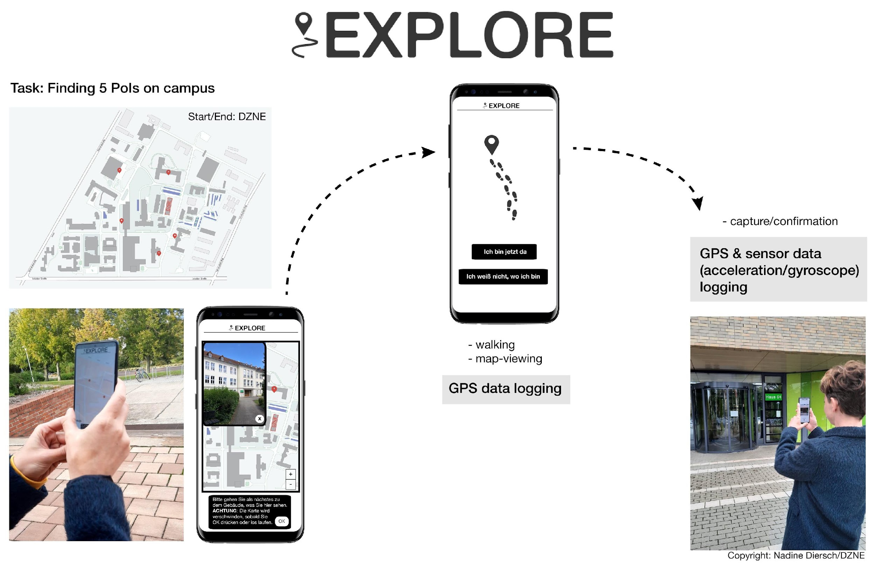
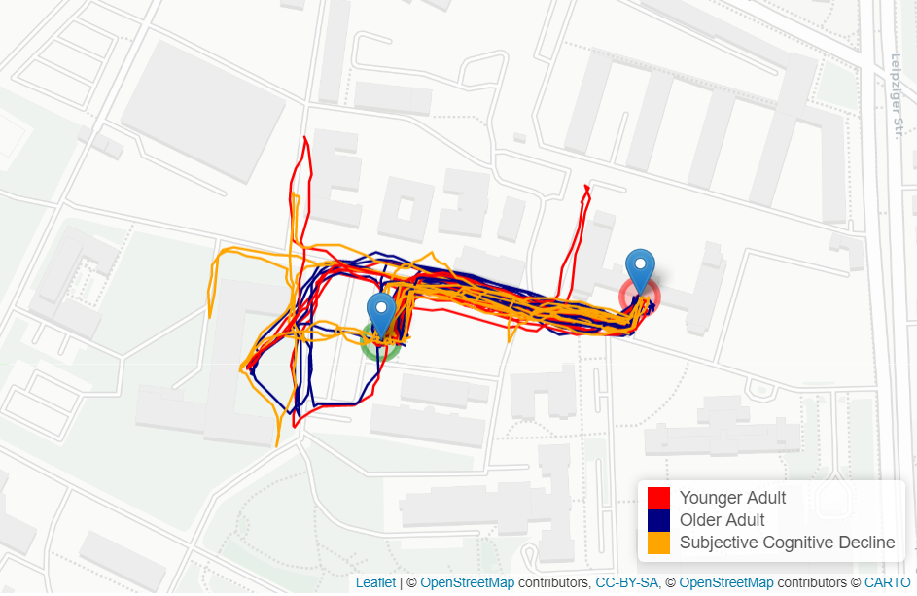
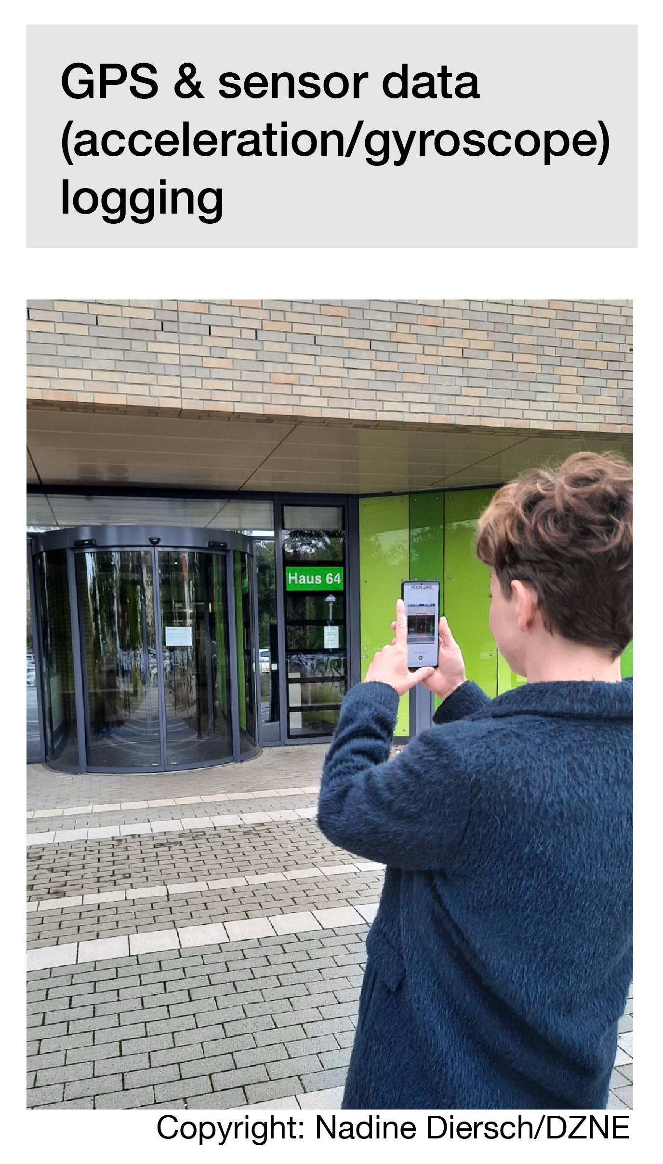
Explore-app
Notes:
And before you start… Let’s look at our example:
Nadine developed a smartphone App and state-of-the-art Machine Learning algorithms to classify individual movement patterns.
She uses this to predict cognitive health status of a person to identify who is at risk for the disease
Another potential use case Nadine and her research team are currently investigating is if the app could also be used as a tool to train the brain and, thus, maintain the navigational performance of the brain.
_______________
Further background information by Nadine Diersch:
…Also a graphic of my app, as it now actually exists and is being used in initial studies - to be more precise, we have carried out an initial proof-of-concept study at the DZNE with a few young and older test subjects, as well as an at-risk patient group (patients with subjective cognitive decline, these are people who do not yet show any abnormalities in standard neuropsychological tests, but say that something is no longer right, roughly speaking). The data does indeed indicate that there are differences (aka that, for example, SCD patients cover greater distances and stop more often), but we are currently still evaluating the data. I can also give another update in due course. Attached is a plot of the trajectories of our test subjects on one of the tracks.
On the left side you can see a prototype of the app how it currently exists. Data ist collected by observing the walking patterns of probands with different characteristics (younger people, elderly people, at risk patients = Patients with subjective cognitive decline).
On the right side the data has been evaluated and differences of walking patterns can be observed between those cohorts (SCD patients cover a longer distance to reach a location than younger people)

Slide 51

BRAINSTORM
Notes:
Okay, so let's take some time to think about potential use cases for your own research!

Slide 52
Solo work
Brainstorm
10 min
Everyone stays in main room
Go to MIRO board
Reflect and collect in your
canvas on MIRO:
Who are your stakeholders? Out of those: who are your potential users that use your product/service/process (middle box)?
What could be use cases for those users (right box)
10 min time for yourself
We will call you back to the screen
Notes:
The next step is a solo work with two tasks:
First: identify users and add them on sticky notes to the box between right and left side of the canvas (user box)
Who are your stakeholders? Out of those: who are your potential users that use your product/service/process?
Second: Brainstorm potential use cases and add sticky notes to the right box of the canvas
What could be use cases for those users?
Think about your Science Magazine Vision from the very beginning! Think big!
Like last time:
Go back to your research canvas on Miro
This step is an individual task, so you can stay in the main room.
Make sure you mute yourself.
If you like, you can turn off your camera.
Once again: Remember that you will get feedback from other participants afterwards. Therefore, express yourself as clearly as possible in the post-its.

Slide 53
From research to use case
Some questions to brainstorm
In which contexts and for whom could your research be useful as well? Think out of the box!
What would you do with your research if you
had 1 billion Euro?
With which add-ons or features could you
extend and improve your research (idea)?
Science
Magazine
Artificial eye-brain interface restores vision in blind patients
Notes:
Here are some further questions that could support you to brainstorm.
The questions are meant to inspire, no need to answer them all.
You can also think about your Science Magazine vision from the beginning of the webinar
Who else could be your users? People that are affected by your research

Slide 54
Notes:
Welcome back!
Everything went well? Everybody back with us?
Thumbs up please!

Slide 55

Build on each
other’s ideas
Notes:
Let‘s move on to the last step for today: building on each other‘s ideas/research canvasses!
So far, you have been working on your own research topics and ideas.
Now it's time to get some feedback from your peers!
We will now give you some time with two other peers to have a sparring with each other. Use this time as you feel is most beneficial for you. You could use it…
to get feedback to your ideas
to build on each other's ideas and brainstorm together
to ask questions to each other
We hope you will receive new impulses from this exchange!

Slide 56
Small teams
Build on each
other’s ideas
25 min
Digital Breakout Rooms
Go to MIRO board
Present your canvas
to each other:
Ask & discuss questions
Brainstorm new ideas
based on what you have understood
25 min in total –
8 min each canvas
Countdown for last 30sec
Automatic transfer back to main room
Notes:
How does it work?
We will send you into the breakout rooms and you can meet each other. Take a moment to say „hi“
Like I just said: This time is yours.
Present your canvas to each other:
Ask & discuss questions
Brainstorm new ideas based on what you have understood
You have [time] in total. Make sure everyone has an equal amount of time to share and receive feedback!
We will automatically transfer you into the rooms and also close them automatically.
We‘ll leave you alone in the rooms but if you have any questions or need help, please go to the bottom of the zoom panel and click on the „help button“. We‘ll come and support.
Which open questions are there before we start?
Great! Then let‘s go!

Slide 57
Notes:
Welcome back!
Everything went well? Everybody back with us?
Thumbs up please!

Slide 58

Next steps
Build up a network
Talk about your use case(s) with friends, family, colleagues > collect feedback
Get professional support
Train your entrepreneurial mindset
Exchange with role models
Take it step by step
Notes:
Now that you‘ve come that far, what could be potential next steps? Are there any ideas how to continue with what you worked on?
We‘d like to give you some ideas:
You could…
Build up a network: stay in touch with each other; exchange contact details; become part of the YES alumni community; visit meetups or other start-up events
Get professional support: You don't need to have a finalized product in order to talk to your startup centre, for instance
Train your entrepreneurial mindset: check out other YES workshops, for example ideation > Design Thinking etc., check out relevant literature
Exchange with role models: for instance in our YES workshops; visit startup talks
Take it step by step: don't get stuck in a big future vision, start where you are and with what you have, invest as much time and resources as you're willing to lose right now
Which other ideas do you have for a next step?

Slide 59

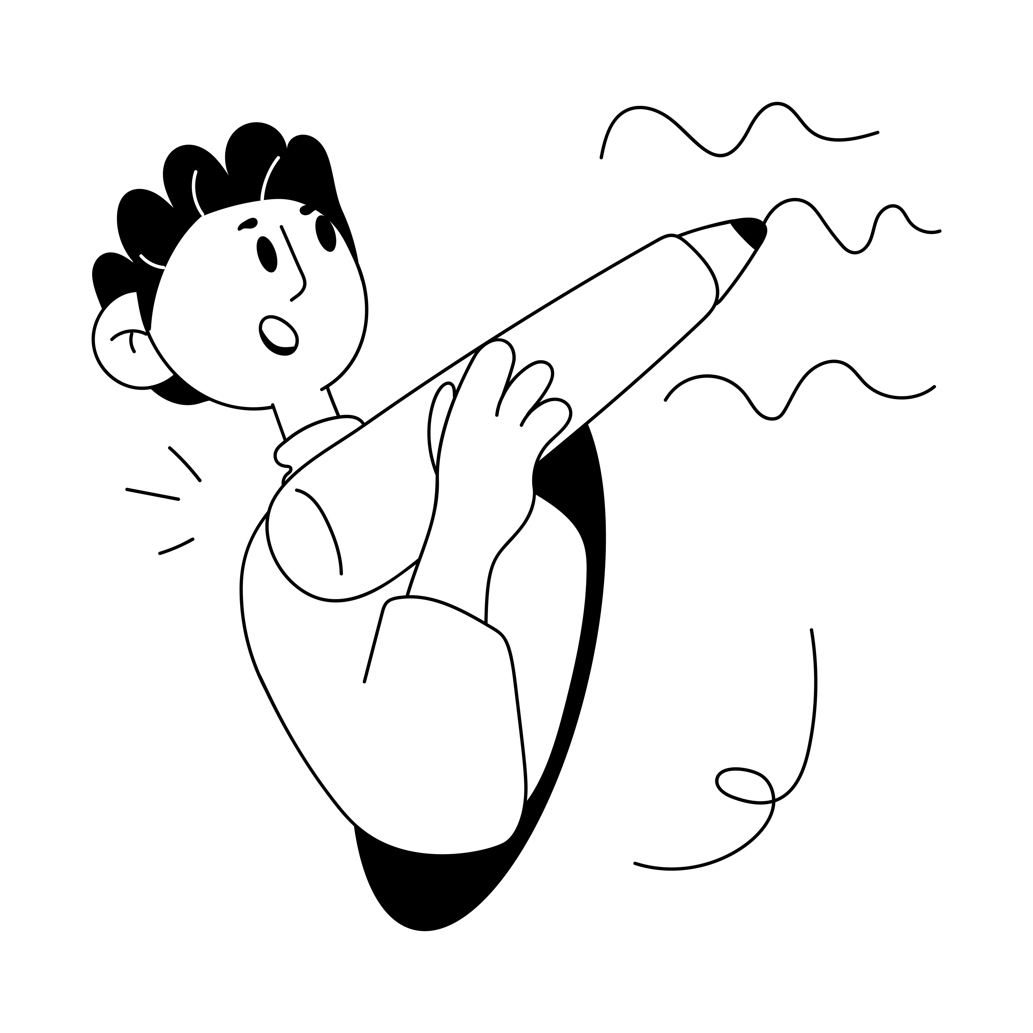
Time for feedback!
Please, follow the link in the chat window.
Notes:
Voting Link:
https://www.menti.com/v9peuuzor4
Live Results:
https://www.mentimeter.com/s/d2103d5f8c21f37ba61c7f97bf8930ef/b2a82eab8ce3

Slide 60
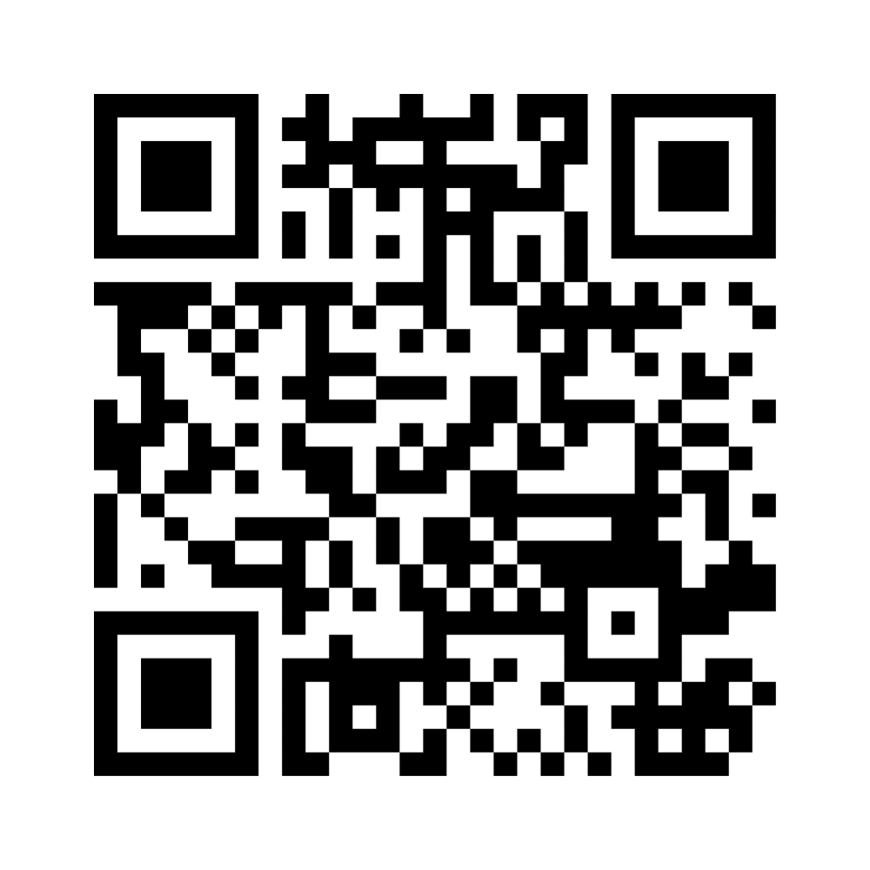
Wrapping up!
I like, I wish, I take away…
Notes:
Ggf. Menti-Link für Teilnehmende: https://www.menti.com/alaxnctncdyz

Slide 61

Sharing
Are there any comments, thoughts or questions
you would like to share?
Raise your hand.

Slide 62
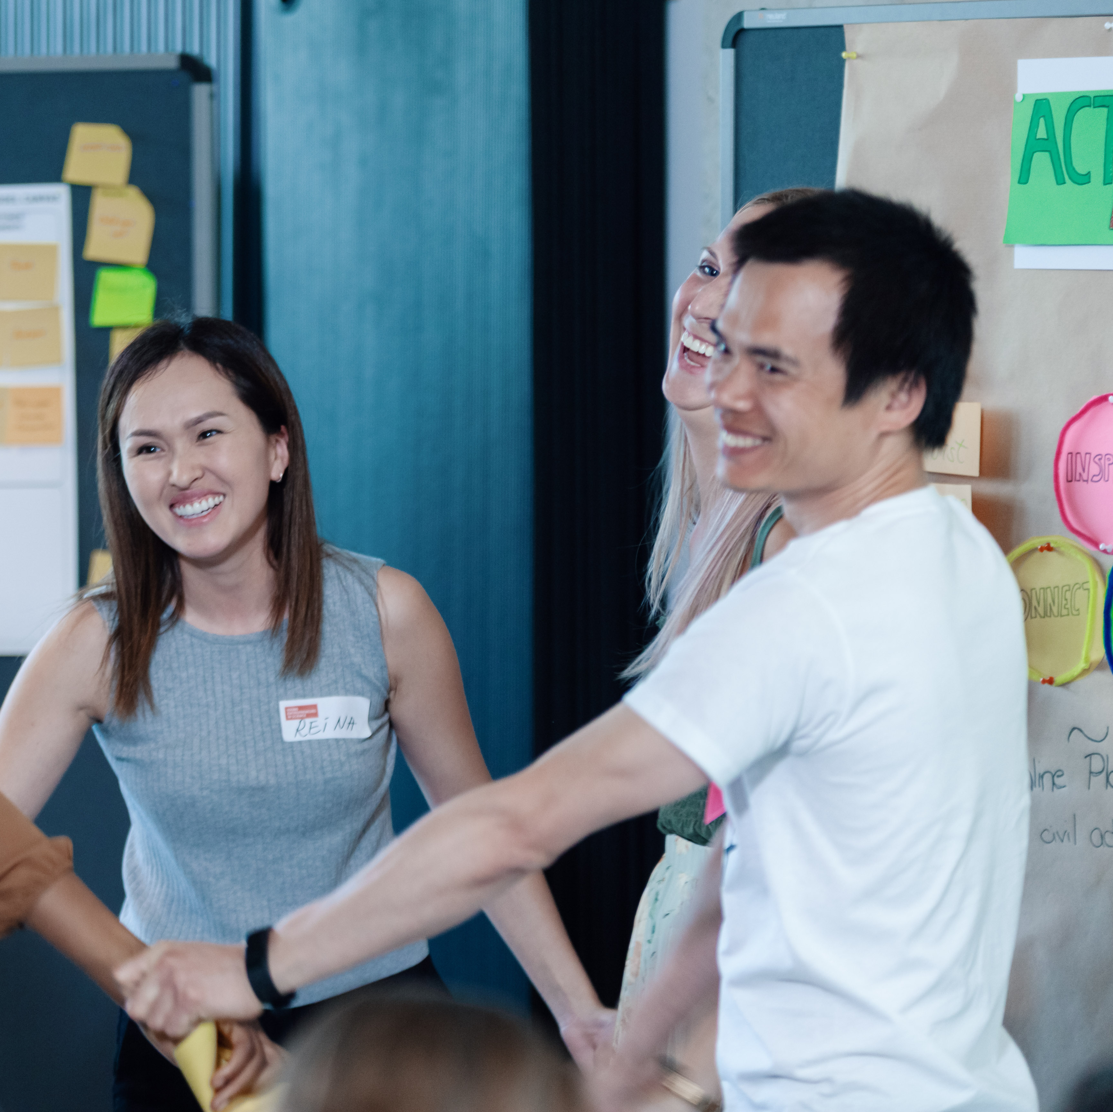

Stay connected with the YES community
Join our LinkedIn group
Take part in other (Online-) Workshops
Tell your peers and spread the word via social media
Stay active in our Alumni-Community
Keep learning from each other on your entrepreneurial journey
Notes:
Hinweis für die Coaches:
Die Einladung zu dem netzwerk FW Connect erhalten die TN nach dem Workshop in einer Email, genauso wie alle weiteren, genaueren Infos, wie sie sich connecten können und Teil unserer Community werden können.

Slide 63


Boost your career with your YES experience
Connect with YES and fellow participants on LinkedIn
Share your YES certificate on Social Media
Add YES to your trainings on LinkedIn
and your CV
… and carry the entrepreneurial spirit further.
Notes:
Hinweis für die Coaches:
Die Einladung zu dem netzwerk FW Connect erhalten die TN nach dem Workshop in einer Email, genauso wie alle weiteren, genaueren Infos, wie sie sich connecten können und Teil unserer Community werden können.

Slide 64
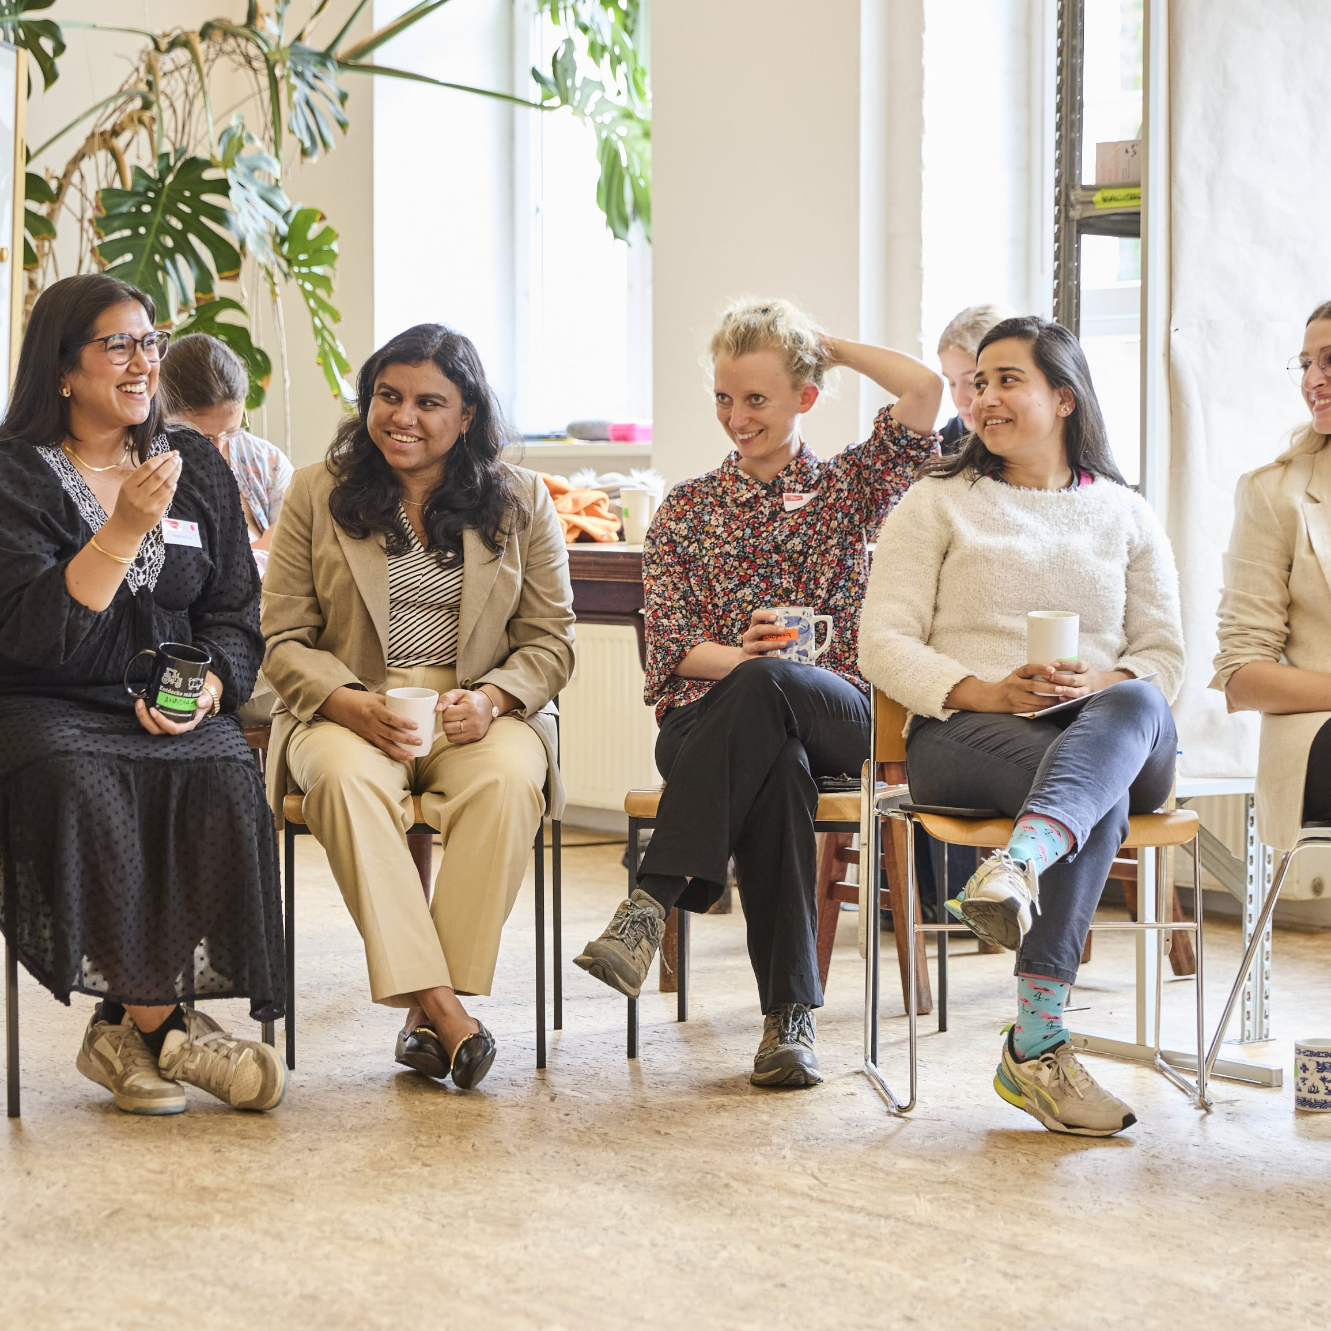
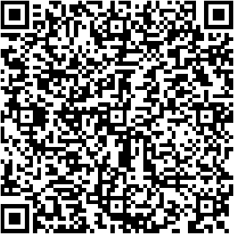
Top-Talents-Track
You’ve got a bold idea from your research – now what?
We are expanding our programme with the Top-Talents-Track, a three-month support programme for 20 highly qualified talents from our network. It combines workshops, individual coaching, peer-to-peer learning formats, and networking events.
If you’d like to be notified about the next application round, simply leave your email address and we’ll make sure you stay informed.
Notes:
Hinweis für Coaches:
Bitte die Teilnehmer:innen auf das neue Programm „Top-Talents-Track“ hinweisen Die Bewerbung startet am 15. Mai und endet am 16. Juni

Slide 65
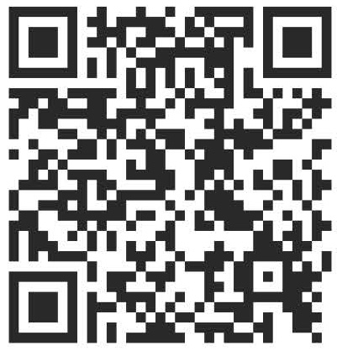

Time for feedback!
Notes:
Link
Bitte auf folgendes bei der Tonspur eingehen, um die Notwendigkeit der Evaluation zu betonen (Anmerkungen von YES):
Your feedback is key/We highly appreciate your feedback!
It is crucial not only for the constant improvement of our workshops, but also with regards to the future funding of our programme.
Future funding means more offers for you as alumni community (additional workshops, webinars, networking opportunities)
Thank you for taking the time (approx. 4 min)!

Slide 66




Thank you!
Connect with us and each other via Social Media …
LinkedIn
Page
LinkedIn
Group
Instagram
@sciencepreneurs
Newsletter
©️ Young Entrepreneurs in Science, 2025
Notes:
That‘s it!
Thanks a lot for participating
We hope you had fun
You will be added to the YES newsletter list to stay updated with the project and to read exciting alumni stories as well as get invited to our network Falling Walls Connect, to make contact with each other and take part in alumni webinars!
Please spread the word!!!
Instagram
https://www.instagram.com/sciencepreneurs/
LinkedIn Seite
https://www.linkedin.com/company/young-entrepreneurs-in-science/
LinkedIn Gruppe
https://www.linkedin.com/groups/8902012/
Newsletter
https://youngentrepreneursinscience.com/newsletter-registration/
Everybody else: Goodbye, have a nice day and see you soon!

Slide 67
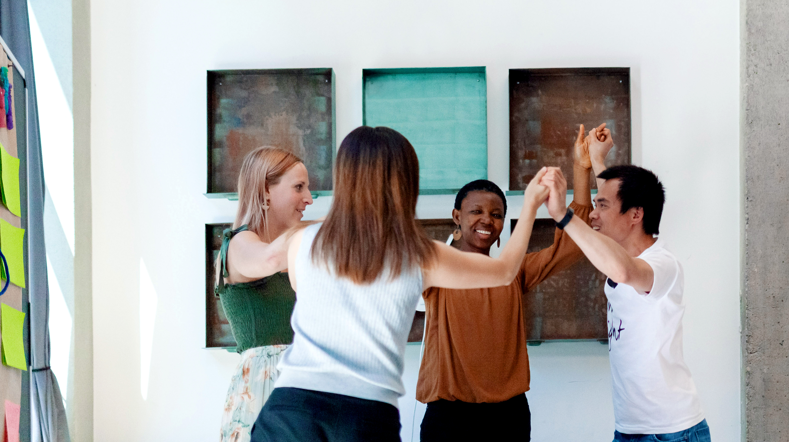
THE END

