Slide 1

Your Research‘s Potential

Slide 2
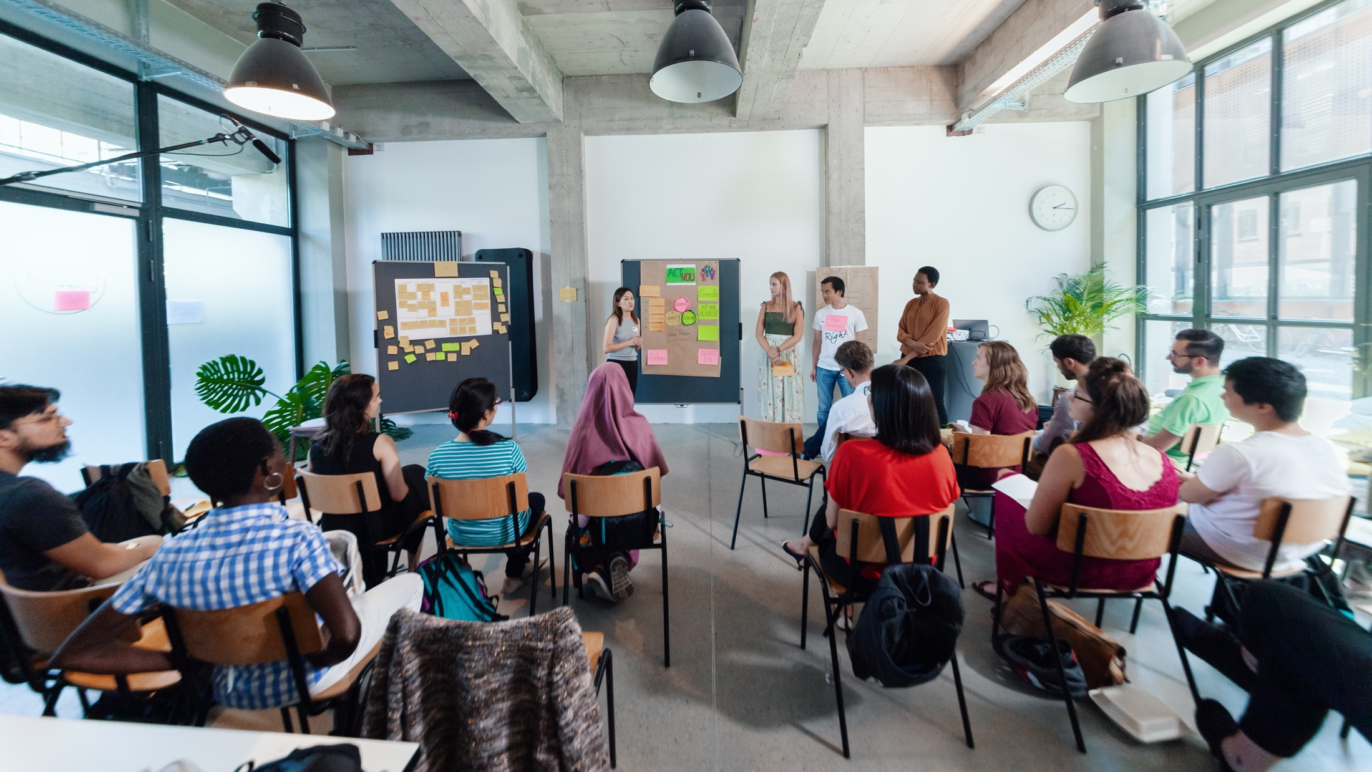
MEET THE TEAM
Notes:
So my name is XX, I‘m working as…
Moderating this session with me is XX. (M2 stellt sich selber vor)
And last but not least please meet the maybe most important (wo-)man in the room today: XX. XX is in charge of the technical support and is here to help with any technical problems.
XX in your role as techincal support would you please introduce us to some basic rules and tricks, that are important in our digital setup today?

Slide 3

Young Entrepreneurs in Science
opens up new career perspectives
for young researchers
part of the Falling Walls Foundation
enabled by Federal Ministry of Education and Research
www.youngentrepreneursinscience.com
Notes:
Young Entrepreneurs in Science (YES):
Originally started as an offline workshop series in various cities across Germany.
Now offers a diverse program of Offline and Online workshops tailored for PhDs, Postdocs and Master students
Project Team:
Comprises 12 team members.
Part of the Falling Walls Foundation, a non-profit organization based in Berlin.
Falling Walls Foundation:
Aims to communicate science and research to the public.
Promotes interdisciplinary exchange and collaboration.
Workshop Benefits:
Strongly supported by a broad network in academia and business.
Designed to foster entrepreneurial thinking and skills among researchers: cultural transfer
BMBF:
Participation is made possible free of charge through funding from the BMBF (Federal Ministry of Education and Research).

Slide 4
Agenda
Lunch Break
Part I
Part II
Modul 1: Your Research Canvas
Check-In
Learn about the relevance of users and potential use cases
Apply the Research Canvas to your own research
Get creative by brainstorming potential use cases for your research topic
Modul 2: Pitch Training
Key principles for a convincing pitch
Develop a storyline, set the stage, and use your voice
Get feedback and learn from your peers
Experiment, push and fail forward!
Wrap-Up

Slide 5
Netiquette
Be respectful & constructive
Use AI responsibly: Use it to support the process, not to produce final results
Mute when not speaking
Be present: keep your camera on. Feel free to eat, drink, or stretch
Need help? Reach out to us via the chat if experiencing technical issues
React & engage: Use emojis or reactions to share feedback
Drop your questions or ideas in the chat – we’re all here to learn together!
www.youngentrepreneursinscience.com
Notes:
Be respectful & constructive
We encourage open feedback – just make sure it’s respectful, kind, and constructive.
Use AI responsibly
If you’d like to use AI during group work, make sure your whole group agrees. Use it to support the process, not to produce final results.
Mute when not speaking
Help keep the space clear by muting your mic when you’re not talking.
Be present
Stay social – keep your camera on if possible. Feel free to eat, drink, or stretch as needed.
Need help?
Reach out to our coaches via the chat if you’re experiencing technical issues.
React & engage
Use emojis or reactions at the bottom of your screen to share quick feedback or show you’re engaged.
Use the chat for questions
Drop your questions or ideas in the chat – we’re all here to learn together!

Slide 6
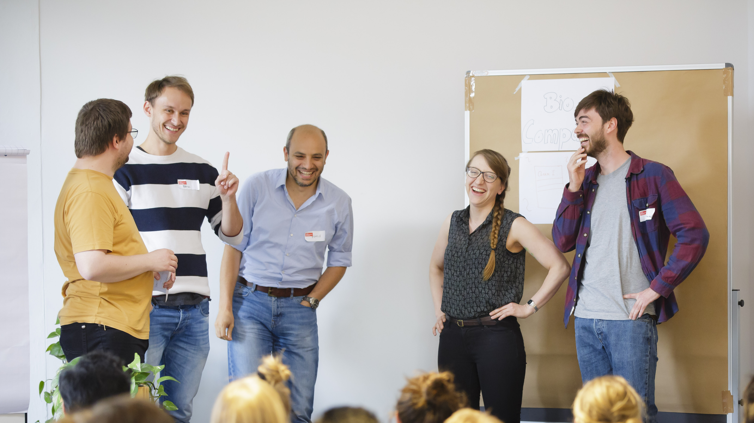
CHECK-IN
Notes:
Okay let’s start.
We always start our workshops with a check-in with the workshop-team – no matter if online or offline.
This is how it works (select next slide)

Slide 7

Emoji Check-In
Everbody, show us your emoji mood!

Slide 8
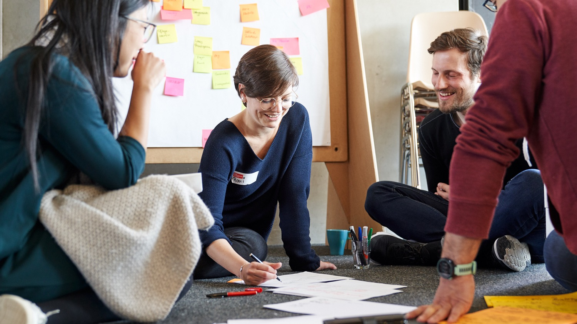
YOUR RESEARCH CANVAS
Notes:
Welcome everyone! [interaction with the participants until everyone is there]
Let‘s dive into our topic for today called: Your research canvas

Slide 9
Learning goals
Reflection about the potential of your own research topic/idea
Assessing potential through identifying users/stakeholders
Developing or extending potential use cases based on your research & network
Notes:
Our idea with this workshop is to close the gap between research and business idea or use case.
How can we help you translate your research into contexts for application.
[address the points on the slide]
The focus for this workshop is to work on your own research topic!! Time to reflect about it‘s potential and share thoughts with your peers!
We know from our experience that if you‘re working in the field of „basic research/Grundlagenforschung“ sometimes it can be a bit tricky to find fields for application.
So if you get stuck – please check in with us – we are happy to support!
And once again – in this part of the workshop you can work hands on!

Slide 10


Up for the challenge?
+
Work with your
own research topic
MIRO
(Digital Whiteboard)
Notes:
Let‘s get started.
Today we‘ll work on MIRO.
Who has worked with this tool before?

Slide 11
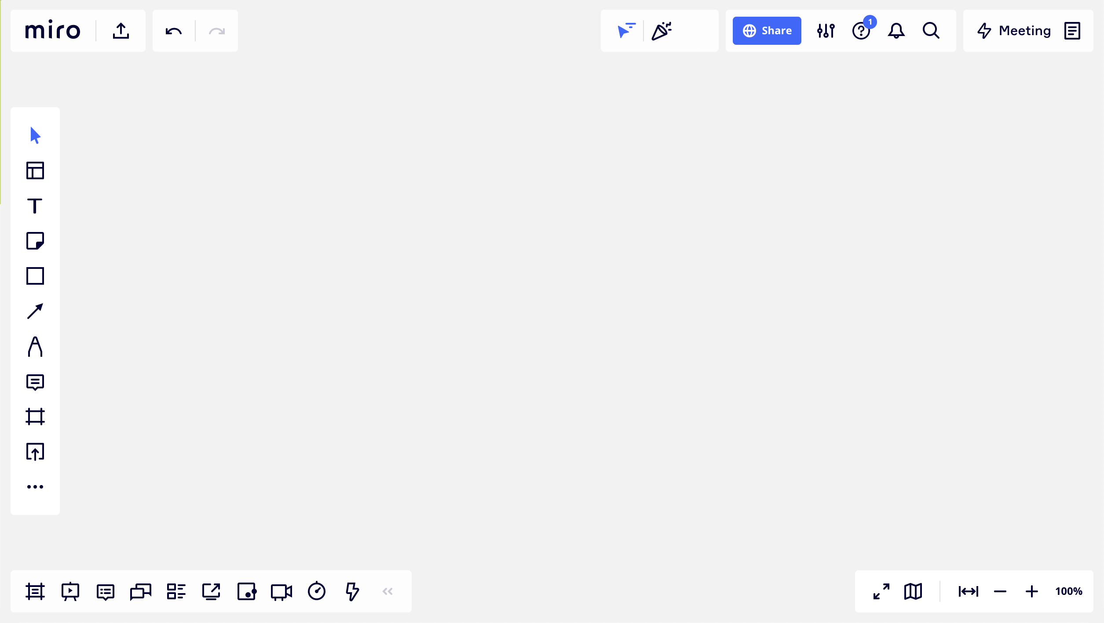
Welcome to miro …
text
sticky notes
navigation map
more functions,
like stickers and emojis
zoom
Notes:
In the next few minutes, we will take the time to familiarize ourselves with the Miro platform.
Our objectives are to understand how to navigate the board and learn how to add notes, images, and drawings to your workspace.
Let me give you an overview...
So the big grey area you see here is the white board.
On the lefthand side you find a panel with various functions.
I quickly want to show you the most important functions:
The T is for text – with this you can add a text box to the whiteboard.
Most of the time, we work with digital sticky notes, or post-it’s. When you click on this icon, you will find a variety of post-it’s. You can add them to your board via drag and drop.
There are more functions like adding stickers, pictures or emojis when you click on those two arrows.
On the lower panel you find the zoom function. So zoom our to get more orientation and zoom in to allow a closer look at the content.

Slide 12
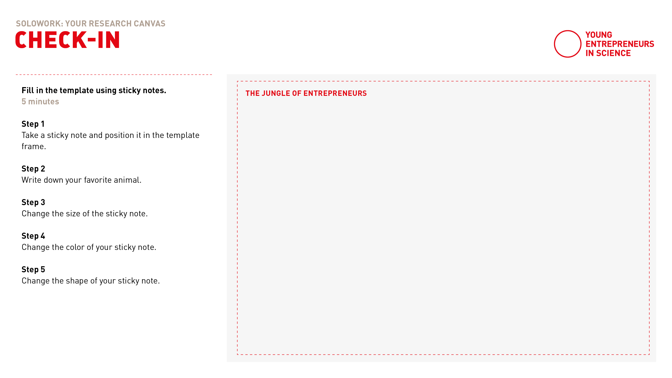
Experience miro
Notes:
Let‘s test working with Miro together.
Follow the link to the board
Find the section you see on this slide: „The jungle of entrepreneurs“
Play around with sticky notes and write down your favorite animal.
Get to know the functions of inserting text, adding sticky notes, stickers and zooming on the board.
Link zum Board: https://miro.com/app/board/uXjVOTizJLg=/

Slide 13
Solo work
Warm up with MIRO
5 minutes
Transfer to MIRO and find the Miro Experience board on the top
Take a sticky note and position it in the template frame
Write down your favourite animal
Change the size of the sticky note
Change the colour of your sticky note
Change the shape of your sticky note
Notes:
Please click on the link in the chat and use the passwort to login
Zoom a little out so that you can see the Experience miro box on the top.
[read out instructions]
[post link in chat]

Slide 14
Notes:
Welcome back!
Everything went well? Everybody back with us?
Thumbs up please!

Slide 15

Think big!
Science
Imagine it’s 2030.
Your research project has led
to pioneering results with breakthrough solutions and will be featured as title page in the recent edition of Science Magazine.
What could be the headline of
this magazine?
Magazine
Notes:
Now let‘s get started. It‘s your turn! We'd like you to think visionary!
Imagine this:
Within the last years you've been very successfull with your research which has lead to pioneering results.
Because of your research success you will get featured on the title page in the recent edition of Science Magazine.
Now it is your turn to get creative: What could be the headline of this magazine?

Slide 16



Think big!
Science
Imagine it’s 2030.
Your research project has led
to pioneering results with breakthrough solutions and will be featured as title page in the recent edition of Science Magazine.
What could be the headline of
this magazine?
Magazine
Artificial eye-brain interface restores vision in blind patients
Example by Yih-Shiuan
Notes:
[Read out example of Yih-Shiuan who‘s research break though has been to discover an artificial eye-brain interface that restores vision in blind patients]

Slide 17
Solo work
Think big!
7 min
Everyone stays in main room
Go to MIRO board
Imagine and collect on MIRO:
Claim one of the empty Science Magazines and mark it with your name
Fill the title page with your research vision
Add pictures, symbols or
other visuals
7 min time for yourself
We will call you back to the screen
Notes:
And this is how this works exactly:
It is individual work, so you can stay in the main room.
We'd like you to do this step with the help of Miro:
On the MIRO Board you find one science magazine next to another template for the Research Canvas
For now: Don‘t mind the Canvas, we work with the science magazine first
Claim one of the empty Magazines and mark it with your name. You can do it with sticky notes or with a text box

Slide 18
Notes:
Welcome back!
Everything went well? Everybody back with us?
Thumbs up please!
[check with participants if any problems have to be solved regarding working with Miro]

Slide 19

Sharing …
Raise your virtual hand or share in the chat!
What is the headline of Science Magazine
featuring your research?
What breakthrough does your research offer to whom?
Notes:
Now we all know the tools we‘ll use this afternoon – let‘s dive into the content!
Raise your virtual hand or share in the chat!
What is the headline of Science Magazine featuring your research?
What breakthrough does your research offer to whom?
[5min sharing]

Slide 20
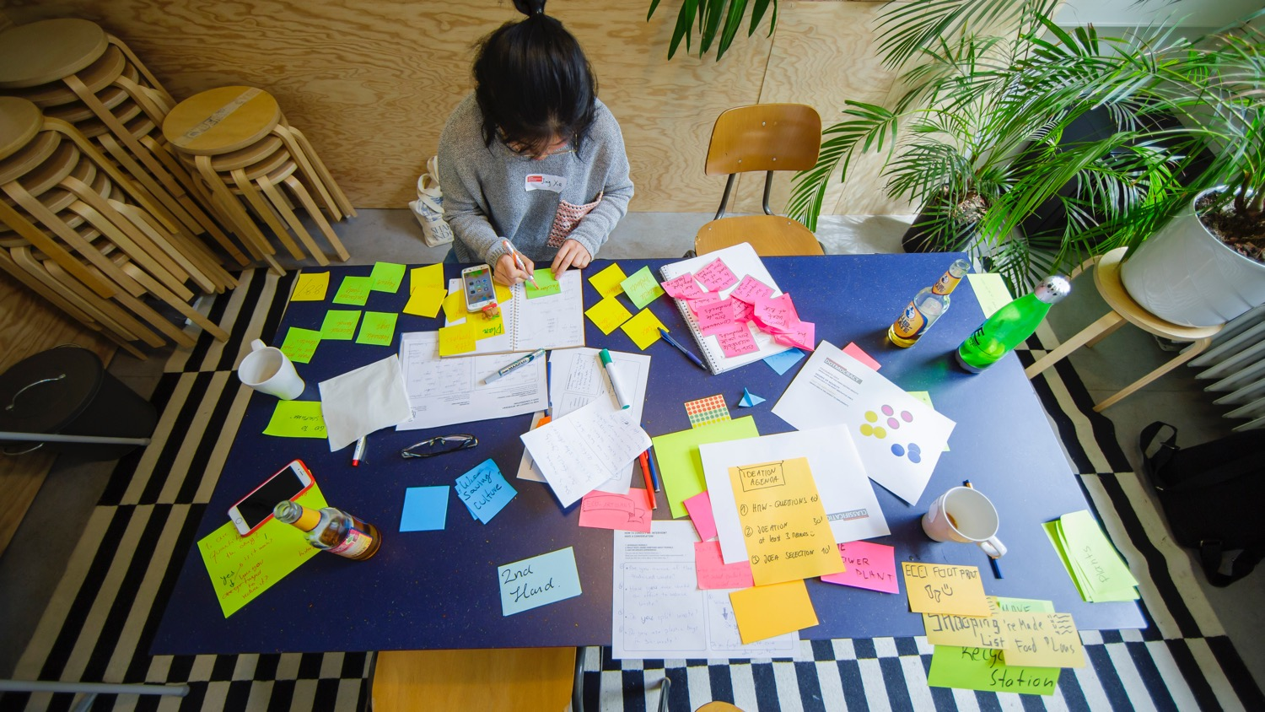
DEEP DIVE INTO YOUR RESEARCH
Notes:
To develop potential use cases, you have to know your research and your initial vision about it.
So let‘s build it up from the beginning with a tool we call the Research Canvas.
We developed the Reseach Canvas because, in various consultations, we found that scientists uncover a great deal of innovative potential in their research activities but have difficulty translating this into use cases or even business models
This is quite natural, because most of them are still thinking as scientists and not yet as entrepreneurs at this stage
We have created this canvas to support you in this transfer, the translation of your research into a commercially viable use case.

Slide 21
The research canvas
PROBLEM TO BE SOLVED | RESEARCH QUESTION & DESIGN
THEORY | RESEARCH RESULTS (and practical application)
POTENTIAL PRODUCT/SERVICE
RESEARCH
USE CASE
Notes:
Now about the tool:
On this template you see 5 areas.
The 4 of them on the lefthand side deal with your research.
The arrow on the right aims at the practical application as service or product.
Throughout the afternoon we will use this template and fill it the fields one by one.

Slide 22
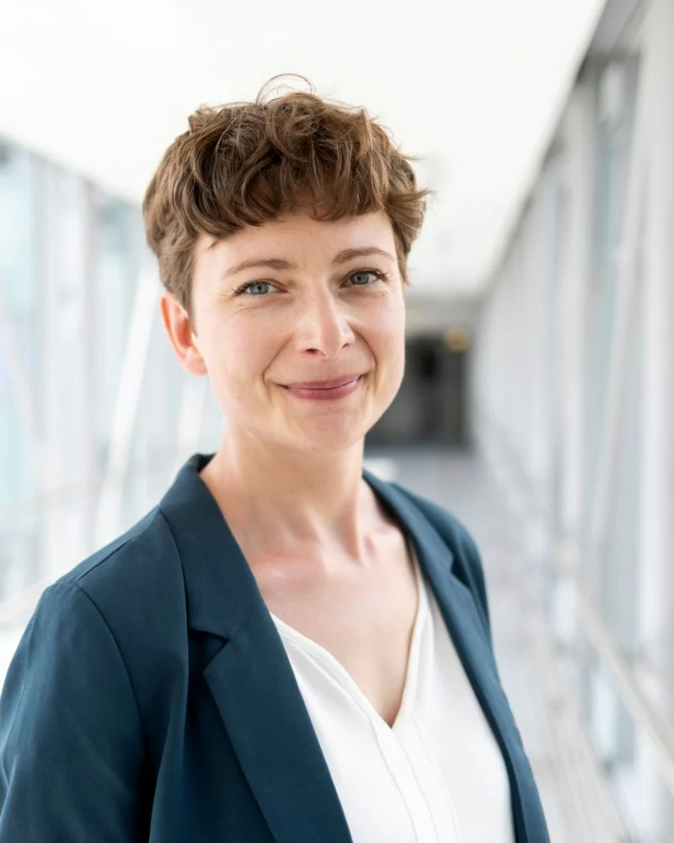
The Research Canvas Example
Getting ahead of
Alzheimer’s disease
Notes:
In order to make the canvas and its application more tangible for you we prepared an example from one of our alumni. It will accompany us through the workshop:
- Background: Cognitive neuroscience researcher Nadine Diersch from the DZNE (Forschungszentrum für neurogenerative Erkrankungen) in Magdeburg is exploring new ways to diagnose Alzheimer’s disease with the help of a universal device: our smartphone.
Her app prototype is a chance for people at risk to get ahead of time, opening up possibilities for treating the incurable disease.
We will now have a closer look how she managed to link her research with a use case/application

Slide 23
Problem to be solved
What is your object/topic of research?
What underlying problem or challenge are you addressing with your research?
EXAMPLE
So far, there is no efficient treatment available to cure Alzheimer's disease.
Thus, there is a need for an early diagnosis, when first changes in the brain occur.
Notes:
The top left side of the canvas covers your research topic and the problem you are solving with your research.
When you work with your canvas in a little bit: Describe your object of your research very briefly:
What is your object/topic of research?
What problem, what deficiency did you discover? Why is it important that you find answers to these?
What is the bigger problem to which you want to find solutions behind your research?
Let’s have a look at our example:
Nadine found out that so far, there is no efficient treatment available to cure Alzheimer's disease.
She realized a need for an early diagnosis because that is when the first changes occur in the brain.

Slide 24
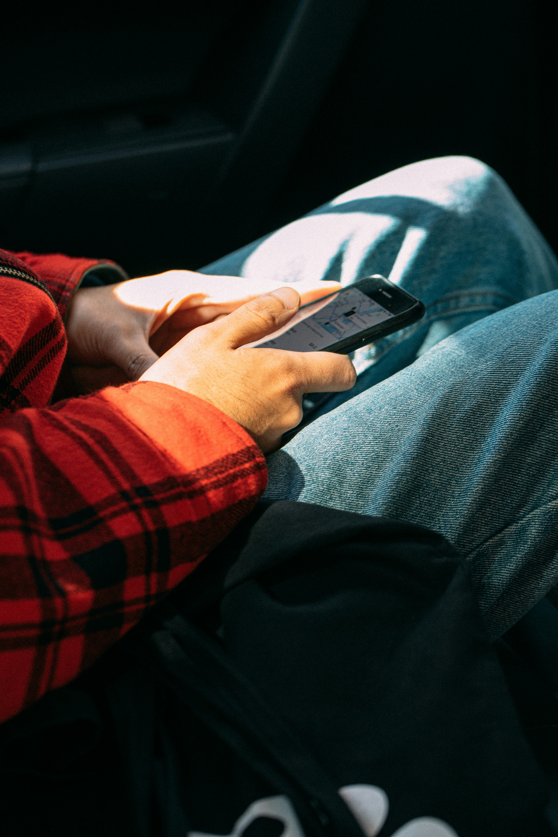

Problem to be
solved
Notes:
Nadines Example:
But: When the first cells in the brain change, the patients don‘t show any visible symptoms that can be detected in convetional memory tests.

Slide 25
Theory
What theoretical background underlies your research?
Note the state-of-the-art highlights!
EXAMPLE
Protein accumulations in certain brain regions at the earliest stages of the disease.
Notes:
Let’s move on to the next part.
On the bottom left you find the field “theory”
This field is about the theoretical reappraisal. Very briefly outline the theoretical context and summarize the scientific consensus on the research subject:
What theoretical background underlies your research?
Note the state-of-the-art highlights!
What contribution will you make to this?
Let’s have a look at our example:
Here is the answer from Nadines example:
Protein accumulations in certain brain regions at the earliest stages of the alzheimer disease, decades before memory problems are detected by standard neuropsychological assessments.
Let‘s move onto the next field of the research canvas.

Slide 26
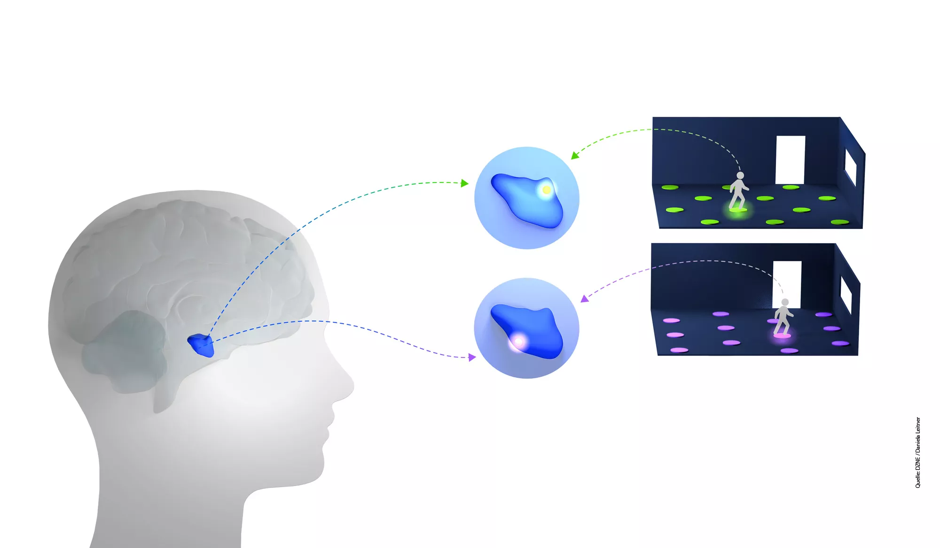
Theory
Notes:
Nadines Example: The proteins begin to accumulate in brain regions that are known to contain our “internal GPS system” -> Therefore the researchers identified links between spatial orientation and movement and the state of the brain cells.

Slide 27
Research Question & Design
What specific aspects of the problem/challenge are you researching?
Note some details about your research setting! (qualitative vs. Quantitative, samples etc.)
EXAMPLE
Can our movement patterns during wayfinding in our surroundings be used to detect early changes/degeneration in the brain?
Notes:
On the top right left you find the field “research question & research design”
Here you can write down:
How exactly do you do your research?
What specific aspects of the problem/challenge are you researching?
Note some details about your research setting!
Of course: a brief summary of the research design is sufficient.
Back to Nadine:
She researched around the question:
Can our movement patterns during wayfinding in our surroundings be used to detect early changes/degeneration in the brain?

Slide 28
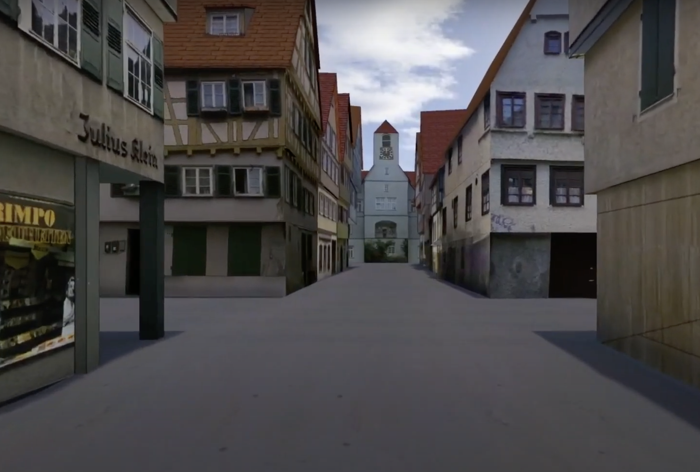
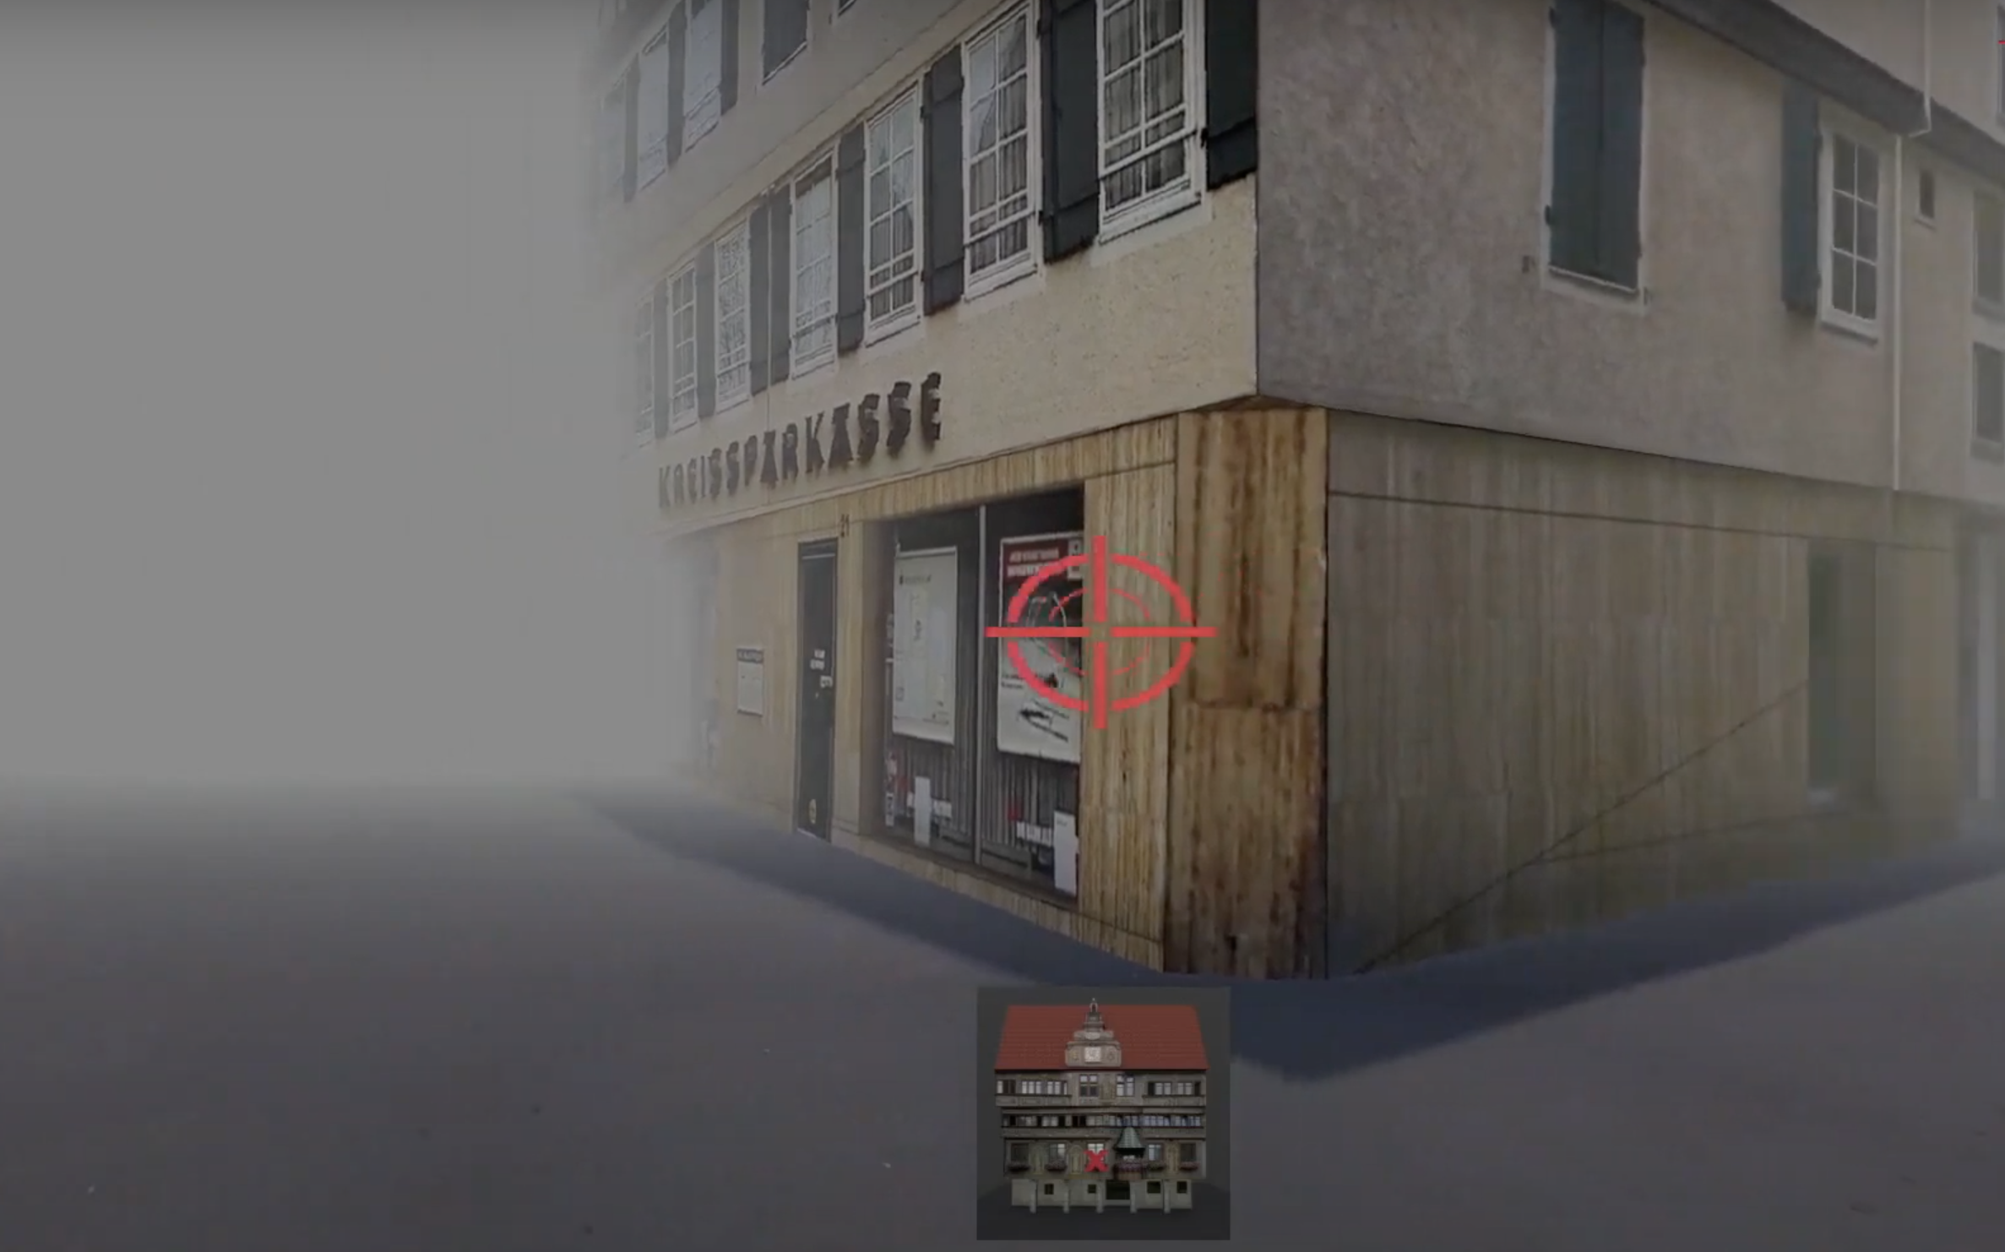
Research Question & Design
Notes:
uncover movement patterns that are indicative of certain neurological changes
In the study, test subjects got to know a virtual, unknown environment. The subjects were driven to an intersection and should move the crosshairs in the direction where the church is. From this Nadine calculated a learning curve. The high risk group needed more learning phases or they found it difficult to memorize the position of the buildings. In the young group only 2 to 3 learning phases were needed. At the same time, they also did an MRI, i.e. they measured the brain activity in the two groups while they solved the task. There were differences in activation patterns in the hippocampus, the region where the place cells are. In the young group, activity in the region decreased continuously over the different learning phases. In the older und high risk test subjects, the hippocampus was hyperactive. There appears to be a connection between hyperactivity in the hippocampus and protein deposits in place and grid cells.

Slide 29
Research Results
(+practical applications)
What are your results so far?
EXAMPLE
Tracking GPS and sensor data from smartphones can be used to study movement patterns and related brain change
Notes:
And on the bottom right it is all abour “your research results and the practical applications”
Here you have space to write down a brief presentation of the results you have achieved so far. If the research is not so far advanced, you can also put here the results that you suspect or want to achieve.
Just make sure that - when working with this canvas outside this workshop - you update your Canvas at regular intervals and also check what effects these changes have on the other fields of the Canvas. It is also important to note under which conditions your research results apply.
How did Nadine answer this?:
Her idea was to use GPS tracking and sensor data from smartphones to study movement patterns and related brain change

Slide 30
The research canvas
PROBLEM TO BE SOLVED | RESEARCH QUESTION & DESIGN
THEORY | RESEARCH RESULTS (and practical application)
POTENTIAL PRODUCT/SERVICE
RESEARCH
USE CASE
Notes:
That was the left side of the canvas which should not be too difficult for you as it probably deals with your daily work.
You will start with this side and then build up on it.
You can either enter your current research work, a past one you would like to work on or a future one you have in mind.
Later in this workshop you will get time on your own as well as support from the other participants to think about first use cases.
Which open questions are there about the Canvas itself or the individual fields? Do you feel ready to start working with it?

Slide 31
Solo work
The Research Canvas
15 min
Everyone stays in main room
Go to MIRO board
Reflect and collect on MIRO:
Claim one of the empty Research Canvases; mark it with your name & topic
Fill all the fields on the
LEFT side of the Canvas with sticky notes
Try to keep it short
and concise
15 min time for yourself
We will call you back to
the screen
Notes:
Great, here we go! Please go back to the Miro board and claim a canvas.
Please mark your canvas with a post-it with your name.
Then start working ON THE LEFT SIDE ONLY.
Remember that you will get feedback from other participants after the solo work. Make sure to express yourself as clearly as possible in the post-its.
And this is how this works exactly:
It is individual work, so you can stay in the main room.
Make sure you mute yourself.
If you like, you can turn off your camera.
You will have 15 minutes to fill in the canvas.
Remark: the Miro Board can be seen by all participants; feel free to share how much you feel comfortable to share
If you have any questions in between – we are happy to help. Please message us in the chat.
Let’s go!

Slide 32
Notes:
Welcome back!
Everything went well? Everybody back with us?
Thumbs up please!
Which open questions are there regarding the left side?
[interaction with the participants]
After the break we will look into the right side of the canvas, users and potential use cases.
Once again – please stay in the zoom meeting.
We‘ll continue at [time]

Slide 33

It’s coffee
o’ clock!

Slide 34
Potential Product/
Service
What about our walkling patterns? Why not use data from our smartphones to study our question?
Notes:
Welcome back, everyone! We hope everyone could get refreshed a little
In order to make the canvas and its application more tangible for you we prepared an example from one of our alumni. It will accompany us through the workshop:
- Background: Cognitive neuroscience researcher Nadine Diersch from the DZNE (Forschungszentrum für neurogenerative Erkrankungen) in Magdeburg is exploring new ways to diagnose Alzheimer’s disease with the help of a universal device: our smartphone.
Her app prototype is a chance for people at risk to get ahead of time, opening up possibilities for treating the incurable disease.
We will now have a closer look how she managed to link her research with a use case/application

Slide 35

The Research Canvas Example
Translating the research result into a product, together with a team of other experts such as software developers and business experts.
Notes:
We had a closer look at the research canvas understanding how to link research with a potential product or service.
In our example Nadine linked her research with a use case and devleoped an application called neotiv together with a team. Her app prototype is a chance for people at risk to get a diagnosis ahead of time. Tracking movement patterns with the app.

Slide 36
“For somebody who wants to become an entrepreneur, it is crucial to be proactive in order to build up a network outside your lab.”
Nadine Diersch
Young Entrepreneurs in Science Alumna

Slide 37

FROM RESEARCH TO USE CASE
Notes:
Before the break we worked on the left side of the canvas...
Now it’s time to slowly turn to the right side.
You might have seen two words in bold on the canvas…

Slide 38
What is a use case?
Raise your virtual hand or share in the chat!
What comes to your mind when you think of users/use cases?
Notes:
… The two words are USE CASE.
Before we start, let's have a short check-in/sharing because we're curious if you are familiar with the term USE CASE.
Have you come across the word before?
What exactly is a use case and how do we get from your research to a use case?
These are our initial questions to jump into the second part of this workshop.
[interaction with the participants]

Slide 39

What is a use case?
“A specific situation in which a product/service/ solution can potentially be used.”
Lawrence Chapman for PMA
Notes:
Let’s have a look a definition of the term use case:
According to the Product Marketing Alliance, a use case is:
‚A specific situation in which a product or service could potentially be used.‘
‚beginning with a user's goal/need and ending when that goal/need is fulfilled‘
(PMA = Product Marketing Alliance)

Slide 40

From research to use case
Transfer
Potential
use case
Research
New theory
New state of the art
New technology
Thesis
Publications
Product
Service
Process
Context
Notes:
What does this mean in our case, for our workshop today?
Again, you‘ll now be looking at your own research topics:
Each research topic can result in new theories, new state of the art and of course publications.
Today, we invite you to look beyond this 'academic' focus or potential and think about the potential to transfer your research topic to (new) contexts for or fields of application. How can your research topic be transferred into an innovative use case?
Remember: A use case is a specific situation in which a product/service can potentially be used. Therefore it is a moment in which your idea/solution creates meaning for someone so that someone becomes a user.
This could mean that…
… your technology or research subject leads to a a completely new product or a service.
… it could be used to optimize a process or
… an already existing solution is applied to a different context in which it solves a problem or satisfies a need and this is regarded as new and innovative.

Slide 41

From research to use case
Potential
use case
Research
USER
Notes:
So to wrap it up: Your research serves as the foundation of innovation
The potential use case refers to the transformation of research insights into specific applications or products or services. The use case can only be meaningful and create value, when it addresses a need by a user.
So – who is the user? Any idea? [if you like: sharing verbally or in chat]

Slide 42



Identifying users
PROBLEM TO BE SOLVED | RESEARCH QUESTION & DESIGN
THEORY | RESEARCH RESULTS (and practical application)
POTENTIAL PRODUCT/SERVICE
RESEARCH
USER
USE CASE
Notes:
For that – let’s go back to the Canvas:
USERS are the people that connect our research to a certain use case
They are – so to say – the people who have an unfulfilled need – you could also say a problem – that you want to solve with your solution
So what we want to do next is to focus on potential users

Slide 43
Identifying users
Stakeholder
has an interest in, or is affected by what a business does
Stakeholders
Customers
Customer
is willing to pay for a product or service that satisfies an unmet need
Users
User (Beneficiary)
benefits from the value created by the product or service (though they might not be the one to pay for it)
Notes:
Let’s have a closer look: How do we identify users?
Usually, there are many people interested or affected by our research: the sum of them we call stakeholders
It’s important to differentiate between different groups of stakeholders.
To find the users it is important to have a look for a person that is affected with an unfulfilled need or a problem. Who would benefit from the solution?
Let’s think back to Nadines example: One of her user groups could be the elderly people getting confused. Another user group could be relatives or caretakers – depending on her focus and her use case.
Now – a user is regarded as the beneficiary of a solution. But they are not always the ones who pay. That is why it’s important to differentiate them from customers.
Sometimes, the customer and the user can be the same person, especially in consumer-focused products.
However, in cases like B2B (business to business) solutions, the customer could be a decision-maker or buyer within a company, while the user might be an employee who operates the product or service.
Recognizing this distinction helps in defining your use case.
Why is this relevant? Social Startups for example often have both – someone pays and someone else benefits from the product/service

Slide 44
Identifying users – example
Stakeholder
Society in General
Stakeholders
Customers
Customer
Health Care System
Medical Industry
Users
User (Beneficiary)
Patients with subjective
cognitive decline
Notes:
Coming back to our example once again, we could identify the following groups:
Stakeholders: Society in General – this solution is potentially interesting to anyone and many lobbies, politics etc.
Customers: the group that is mainly interested in buying the solution to market it. In this example that is the health care system and the medical industry
Users: The people that actually benefit from the solution are patients that suffer from subjective cognitive decline or that have a pre-disposition.
Here you see that the customers are not directly the end users of the solution but it’s a B2B channel. When developing the product/app however, it’s necessary though to think of the user and not the customer: the user has the problem that is solved!

Slide 45



From research to use case
PROBLEM TO BE SOLVED | RESEARCH QUESTION & DESIGN
THEORY | RESEARCH RESULTS (and practical application)
POTENTIAL PRODUCT/SERVICE
RESEARCH
USER
USE CASE
Notes:
Once we have identified our potential users, we can turn to the right side of the Canvas and think about specific use cases for these specific users
This part could be a bit more tricky – especially when you are doing ‚basic research/Grundlagenforschung‘ (hard and a long process sometimes to see potential for application)

Slide 46
Potential use case
In which context could your research find application?
What is a problem you could solve in that field
and who is having that problem?
Can you build a new product/service around
your research to solve their problem?
EXAMPLE
Smartphone App and state-of-the-art Machine Learning algorithms to classify individual movement patterns and to predict cognitive health status
Notes:
We encourage you to dive into these questions today:
In which (new) context could your research find application?
What is a problem you could solve in that field and who is having that problem?
Can you build a new product/service around your research to solve their problem?
EXAMPLE!
Sometimes there is still a lot of research work to be done before a finished product, service, etc. can be developed. That's perfectly okay; in this case, also write down the research steps that are still necessary until a first prototype, a first service outline can be completed)

Slide 47
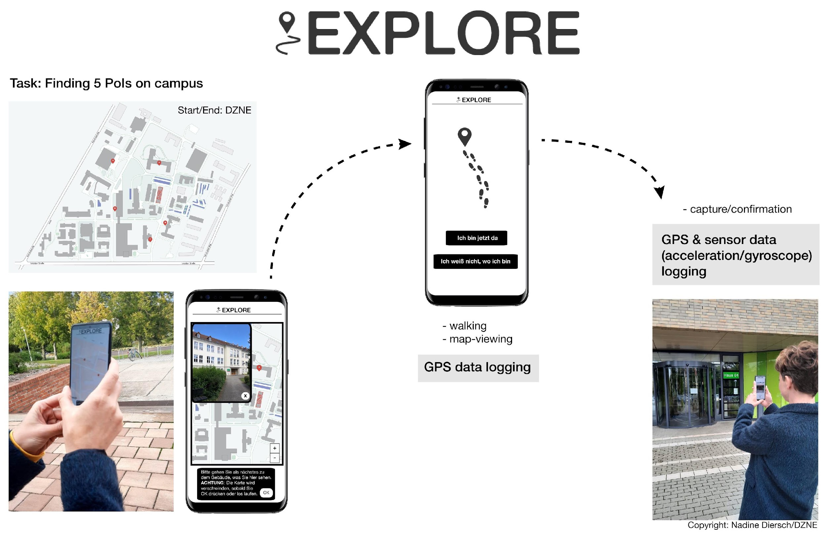
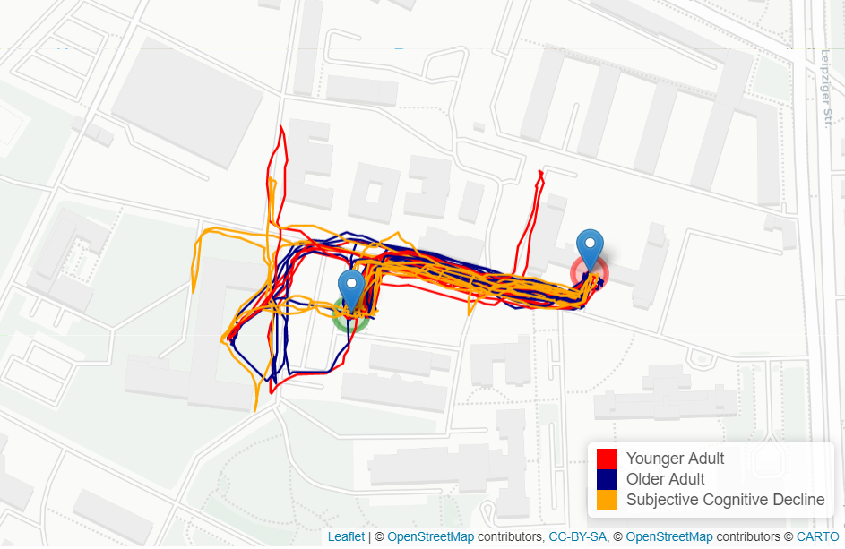
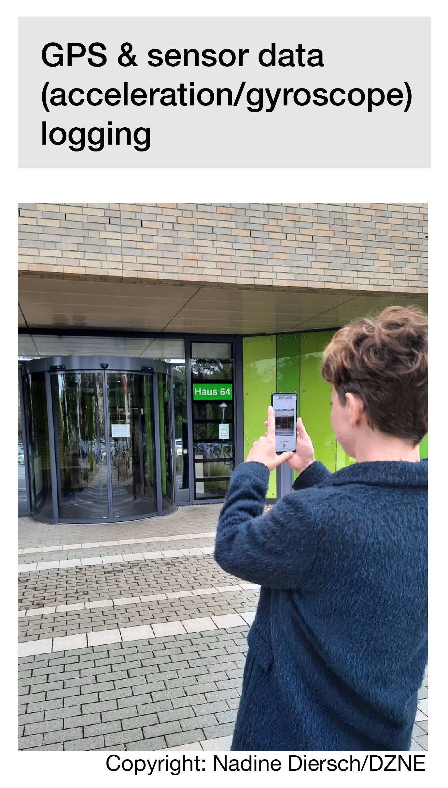
Explore-app
Notes:
And before you start… Let’s look at our example:
Nadine developed a smartphone App and state-of-the-art Machine Learning algorithms to classify individual movement patterns.
She uses this to predict cognitive health status of a person to identify who is at risk for the disease
Another potential use case Nadine and her research team are currently investigating is if the app could also be used as a tool to train the brain and, thus, maintain the navigational performance of the brain.
_______________
Further background information by Nadine Diersch:
…Also a graphic of my app, as it now actually exists and is being used in initial studies - to be more precise, we have carried out an initial proof-of-concept study at the DZNE with a few young and older test subjects, as well as an at-risk patient group (patients with subjective cognitive decline, these are people who do not yet show any abnormalities in standard neuropsychological tests, but say that something is no longer right, roughly speaking). The data does indeed indicate that there are differences (aka that, for example, SCD patients cover greater distances and stop more often), but we are currently still evaluating the data. I can also give another update in due course. Attached is a plot of the trajectories of our test subjects on one of the tracks.
On the left side you can see a prototype of the app how it currently exists. Data ist collected by observing the walking patterns of probands with different characteristics (younger people, elderly people, at risk patients = Patients with subjective cognitive decline).
On the right side the data has been evaluated and differences of walking patterns can be observed between those cohorts (SCD patients cover a longer distance to reach a location than younger people)

Slide 48

BRAINSTORM
Notes:
Okay, so let's take some time to think about potential use cases for your own research!

Slide 49
Solo work
Brainstorm
10 min
Everyone stays in main room
Go to MIRO board
Reflect and collect in your
canvas on MIRO:
Who are your stakeholders? Out of those: who are your potential users that use your product/service/process (middle box)?
What could be use cases for those users (right box)
10 min time for yourself
We will call you back to the screen
Notes:
The next step is a solo work with two tasks:
First: identify users and add them on sticky notes to the box between right and left side of the canvas (user box)
Who are your stakeholders? Out of those: who are your potential users that use your product/service/process?
Second: Brainstorm potential use cases and add sticky notes to the right box of the canvas
What could be use cases for those users?
Think about your Science Magazine Vision from the very beginning! Think big!
Like last time:
Go back to your research canvas on Miro
This step is an individual task, so you can stay in the main room.
Make sure you mute yourself.
If you like, you can turn off your camera.
Once again: Remember that you will get feedback from other participants afterwards. Therefore, express yourself as clearly as possible in the post-its.

Slide 50
From research to use case
Some questions to brainstorm
In which contexts and for whom could your research be useful as well? Think out of the box!
What would you do with your research if you
had 1 billion Euro?
With which add-ons or features could you
extend and improve your research (idea)?
Science
Magazine
Artificial eye-brain interface restores vision in blind patients
Notes:
Here are some further questions that could support you to brainstorm.
The questions are meant to inspire, no need to answer them all.
You can also think about your Science Magazine vision from the beginning of the webinar
Who else could be your users? People that are affected by your research

Slide 51
Notes:
Welcome back!
Everything went well? Everybody back with us?
Thumbs up please!

Slide 52

Build on each
other’s ideas
Notes:
Let‘s move on to the last step for today: building on each other‘s ideas/research canvasses!
So far, you have been working on your own research topics and ideas.
Now it's time to get some feedback from your peers!
We will now give you some time with two other peers to have a sparring with each other. Use this time as you feel is most beneficial for you. You could use it…
to get feedback to your ideas
to build on each other's ideas and brainstorm together
to ask questions to each other
We hope you will receive new impulses from this exchange!

Slide 53
Small teams
Build on each
other’s ideas
25 min
Digital Breakout Rooms
Go to MIRO board
Present your canvas
to each other:
Ask & discuss questions
Brainstorm new ideas
based on what you have understood
25 min in total –
8 min each canvas
Countdown for last 30sec
Automatic transfer back to main room
Notes:
How does it work?
We will send you into the breakout rooms and you can meet each other. Take a moment to say „hi“
Like I just said: This time is yours.
Present your canvas to each other:
Ask & discuss questions
Brainstorm new ideas based on what you have understood
You have [time] in total. Make sure everyone has an equal amount of time to share and receive feedback!
We will automatically transfer you into the rooms and also close them automatically.
We‘ll leave you alone in the rooms but if you have any questions or need help, please go to the bottom of the zoom panel and click on the „help button“. We‘ll come and support.
Which open questions are there before we start?
Great! Then let‘s go!

Slide 54
Notes:
Welcome back!
Everything went well? Everybody back with us?
Thumbs up please!

Slide 55

Next steps
Build up a network
Talk about your use case(s) with friends, family, colleagues > collect feedback
Get professional support
Train your entrepreneurial mindset
Exchange with role models
Take it step by step
Notes:
Now that you‘ve come that far, what could be potential next steps? Are there any ideas how to continue with what you worked on?
We‘d like to give you some ideas:
You could…
Build up a network: stay in touch with each other; exchange contact details; become part of the YES alumni community; visit meetups or other start-up events
Get professional support: You don't need to have a finalized product in order to talk to your startup centre, for instance
Train your entrepreneurial mindset: check out other YES workshops, for example ideation > Design Thinking etc., check out relevant literature
Exchange with role models: for instance in our YES workshops; visit startup talks
Take it step by step: don't get stuck in a big future vision, start where you are and with what you have, invest as much time and resources as you're willing to lose right now
Which other ideas do you have for a next step?

Slide 56
Agenda
Lunch Break
Part I
Part II
Modul 1: Your Research Canvas
Check-In
Learn about the relevance of users and potential use cases
Apply the Research Canvas to your own research
Get creative by brainstorming potential use cases for your research topic
Modul 2: Pitch Training
Key principles for a convincing pitch
Develop a storyline, set the stage, and use your voice
Get feedback and learn from your peers
Experiment, push and fail forward!
Wrap-Up

Slide 57
BREAK

Slide 58

Break
Notes:
We meet back here at xx (check agenda).
Happy lunch break!

Slide 59
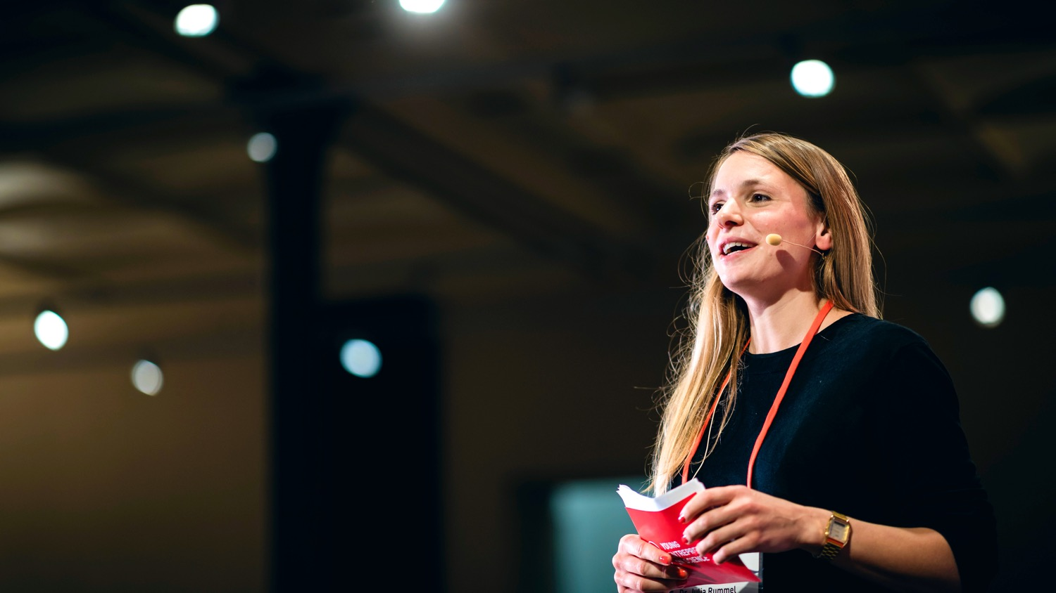
PITCHING
Notes:
Welcome to the pitch training.

Slide 60
Learning goals
Getting to know a relevant structure for a pitch
Learning about how to pitch online
Building a pitch on your own
Practise to hold a pitch in front of an audience
Notes:
Now it‘s time to have a look at how to communicate potential start-up ideas in a way that it is remembered!
Our learning goals for the next part are [read out loud and explain]

Slide 61

PITCH & STORYTELLING
Notes:
Let‘s go!

Slide 62
What is pitching?
A short but effective explanation
that is intended to persuade someone to buy a product or accept an idea.
Cambridge Dictionary
Notes:
So, let‘s have a look at what a pitch actually is: [read out definition]
Why pitch? The goal ist to win new customers, investors ot other supporters for your business.
The question is: what needs to be in a pitch to make it on point?
We have prepared 7 steps that we think are important to include.
The good thing: this structure of presenting your idea can also help to talk about it in general.
So you should have these facts ready to talk about your idea.
And talking about the idea is super important to learn about it and develop it.

Slide 63
How to build a pitch
Problem
Target Group
Notes:
Let‘s take a look at the steps:
Problem: Come up with one sentence about what the problem you are solving with your research is
When you have a problem you are solving, I am sure that s.o. is also affected by that problem:
Target group: Who is this person? For whom are you trying to solve the problem? Who is your target group? Who will be using it?
It‘s always tempting to say: it‘s for everyone. Really make sure to make it concrete and define a clear user group.

Slide 64
How to build a pitch
Problem
Target Group
The solutions
User experience: how does it work?
Notes:
Next...
Present your solution: Explain the product and tell how it works.
Make sure you define a good problem-solution fit: means: those aspects should really work well together: make sure your solution ANSWERS your problem
Keep your explanation short & simple. Especially with tech. solutions: It is tempting to deep dive into technical details.
Don‘t do it. People will ask if they have questions. This is a pitch: You want to keep the attention of the audience
User experience: You can show a prototype, ask s.o. to try your product or make a video of s.o. interacting with it.

Slide 65
How to build a pitch
Problem
Target Group
The solutions
User experience: how does it work?
Create trust (team / market / finances)
Notes:
Create trust: Show that you know what you are doing when developing the idea
Who is working on the idea? Which people do you have for it in the team? Why is your team a great fit?
Show that you know the market you are operating in: What is the competition?
Present an overview of your financial plan: Make transparent what happens with the money. Show them how you plan on growing the business financially.

Slide 66
How to build a pitch
Problem
Target Group
The solutions
User experience: how does it work?
Create trust (team / market / finances)
Punchline
Notes:
Then come up with a little wrap-up/reminder:
The Punchline: In one sentence: Tell the name of the product and what it does.
Keep it short and simple for everyone to remember!

Slide 67
How to build a pitch
Problem
Target Group
The solutions
User experience: how does it work?
Create trust (team / market / finances)
Punchline
Call to action
Notes:
And as step 7: Include a call to action!
Call to action = a small assignment.
Communicate what it is you want from the audience, eg:
to sign up for my newsletter?
to come over and ask questions?
to invest into a beta-version?
To formulate a call to action - make sure to really know whom your pitch is aiming at: What is your audience? What do you want from those poeple?
Keep in mind that there is a difference between pitching in front of an investor or a customer!
So much for the different steps... 1-7

Slide 68
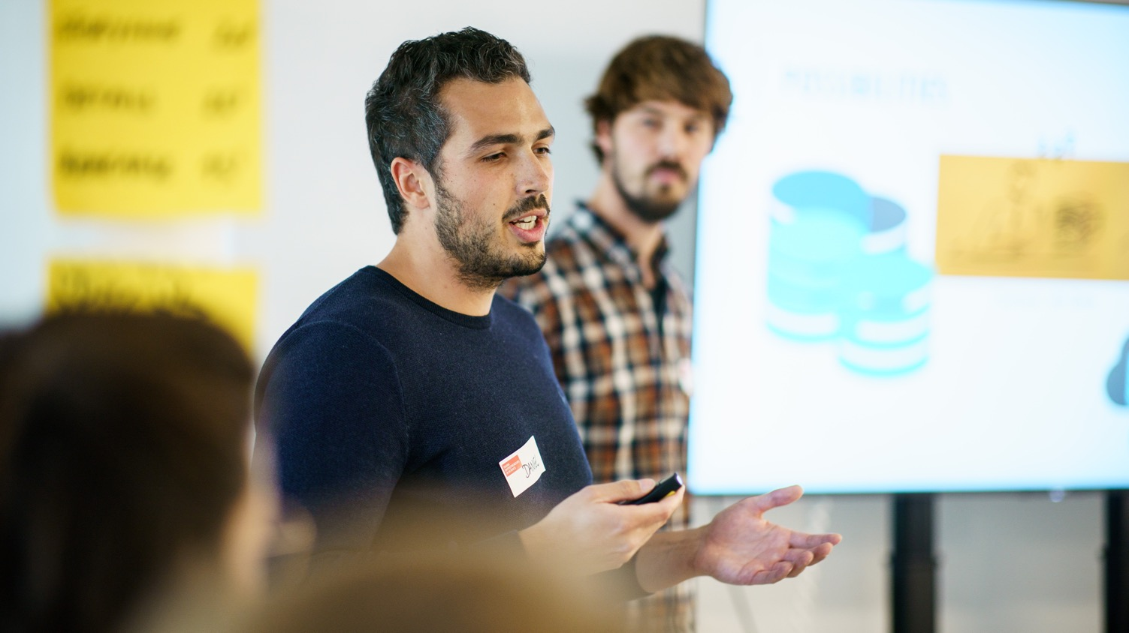
STORYTELLING
Notes:
Now that you have the facts, it is time to think about a good story/anecdote which introduces your pitch
You could for example introduce a hero or person that is really affected by the problem
(… once upon a time there was...)
Then show how big that probplem really is for the target group
Make sure the audience can feel the pain of the affected person.
Expecially as scientists this embedding of emotions and surprises might really feel weird because you leave out quite a lot of facts that you would usually include in a presentation.
But – once again – keep in mind that your aim is to keep the attention and interest of the audience
Also it‘s important to find your own style when presenting. Therefore you need to practise pitching quite a few times to find with which story you feel comfortable and authentic.

Slide 69
Why tell stories?
… because they draw us in emotionally
… because we can learn from them
… because they connect us
… because it’s easier this way for our brain to understand connections
… because they help us remember
Notes:
But why is storytelling so important?
Like I just said:
Especially as scientists, it might feel strange to focus on stories and emotions rather than raw data or detailed explanations.
But remember, stories draw us in emotionally, which keeps the audience connected to your message and helps maintain their attention.
Our brains are wired to understand patterns and connections better when they are simplified.
Therefore stories make it easier for us to grasp complex ideas, not because they remove facts, but because they present them in a more relatable and structured ways.
Finally, stories stick with us: They help us remember information better because they activate more areas of the brain – emotion, imagery, and context – which makes the content far more memorable than a list of facts or data points.
Let‘s have a look at how this looks in the real world…

Slide 70
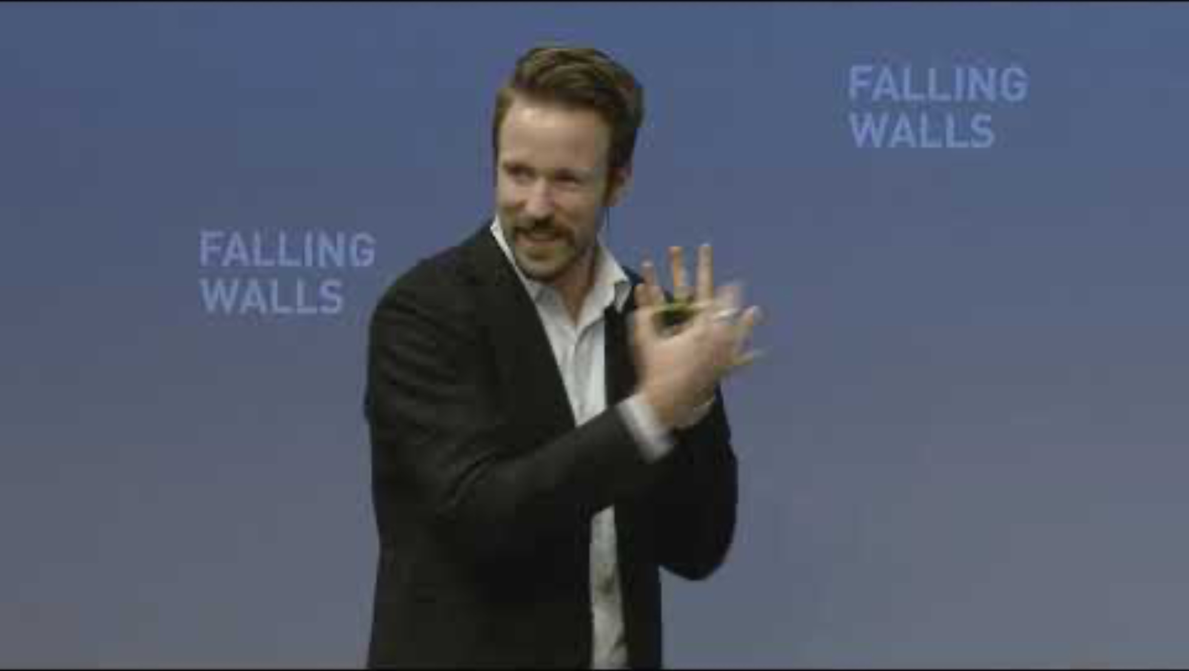
Notes:
…. Next we‘ll show you a video (around 3 mins) by Tom Bieling, Falling Walls Young Innovator of the Year 2014
He‘ll pitch his ides around the topic of Deaf-Blind Isolation.
Tom has developed a communication device for the deaf-blind, allowing to communicate with anybody, anytime.
Important: When you look at the video: It‘s not so much about the content, rather look at the structure & how the pitch is build / what the storyline is.
[after showing the clip: interaction with the participants]
___________________________________
Tom Bieling and his team at the Design Research Lab developed a communication technology for deaf-blind people, through which they can interact with anyone at any time. The Lorm Hand is an installation, which connects deaf-blind people with twitter or other social networks. Using touch sensory technology, the Lorm Hand enables deaf-blind people to compose text messages by applying the tactile hand-touch alphabet LORM, a common way of communication used by the deaf-blind. After typing a message on the Lorm Hand, it can immediately be tweeted or shared with social networks.

Slide 71
In summary …
… everybody needs to find her/his own style
based on the storyline!
Notes:
[refer to what has been said]
Make sure to take time to find your own style and your own storyline that you feel comfortable with.

Slide 72
What is next …
PART 1
Build your pitch individually
PART 2
Test your pitch and get feedback in groups
Notes:
The next exercise is divided into two parts:
Part I: You will have the chance to work on your skills on how to build a 2-minutes pitch and put it in an engaging story.
This part will be an exercise you will work on by yourself.
Part II: The entrepreneurial mindset is all about getting feedback, learning by doing and iterating your idea?
And this is what we will do in part two:
You‘ll have the chance to actually test your pitch right away.
You‘ll work in teams of 3, test your pitch and then get immidiate feedback from your team.

Slide 73
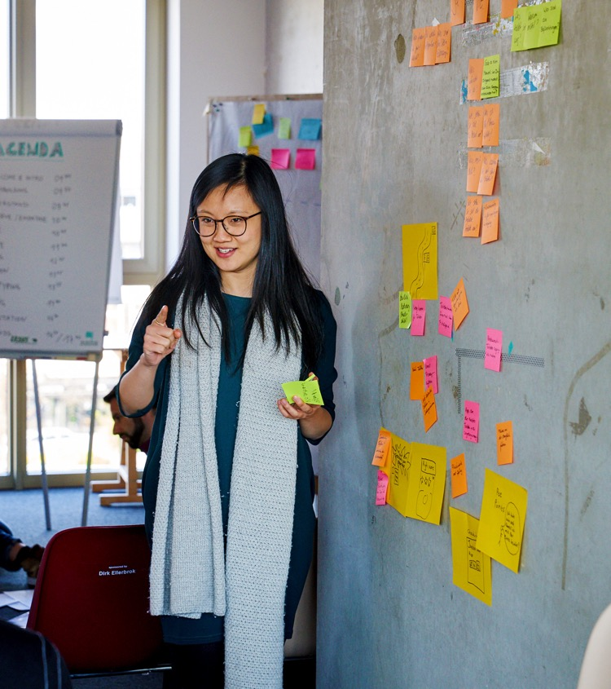
Build your pitch
Notes:
Let‘s go!

Slide 74
Build your pitch
Choose the topic of your pitch.
Your own startup idea
Your PhD topic
Notes:
In order to build a pitch of course you first of all need an idea or project that you actually want to pitch
We know that some of you already have ideas or projects, that they are working on and others not yet.
Since this webinar is about learning methods and skills you don‘t need to have a real project in order to learn how to pitch!
So when it comes to WHAT it is that you want to pitch today, you have options to choose from:
You can either chosse to go with your own idea
OR you just choose an object in in your direct environment that somehow speaks to you, like a pen or a book for example

Slide 75
Build your pitch
Step 1: Problem-solution-fit
Based on what we just learned, build the foundation of your pitch.
Problem & target group
Solution & how it works
Call to Action
Notes:
Let‘s have a look at step 1:
So once you know what you want to pitch, let‘s have a look on how to build a pitch!
Since we will not have the time to build your pitch step by step all togethter today, we will focous an the core of each pitch:
The most important aspect of a pitch is a strong »problem-solution fit«
Who are your users?
What is their problem?
How is your idea/product solving that problem?

Slide 76
Build your pitch
Step 2: Storyline
Based on your foundation (problem-solution-fit) think about how to transport this in an emotional story!
Who is your protagonist?
What’s his/her problem in what context?
How do you make his/her life better?
Make it tangible and relatable for your audience!
Notes:
Step 2: Once you defined the problem-solution-fit it‘s all about putting together a story, that people can relate to and that people will remember.
Now your might be thinking: »How the hell should I work on that if I don‘t have my own idea yet?«
Well, you can wonderfully practise your pitching skills by pitching a random object and pretend that you just had the idea to develop that exact object and you now want to pitch it to potential investors.
Just give it a try and if you have any questions – we are here for you!!

Slide 77
Solo work
Build your pitch
10 min
Stay in main room
Prepare your 2 min pitch
Problem-solution-fit
Emotional storyline
Countdown for last minute
Notes:
[read out slide]
[emphasise that the pitch should be 2 minutes long]

Slide 78
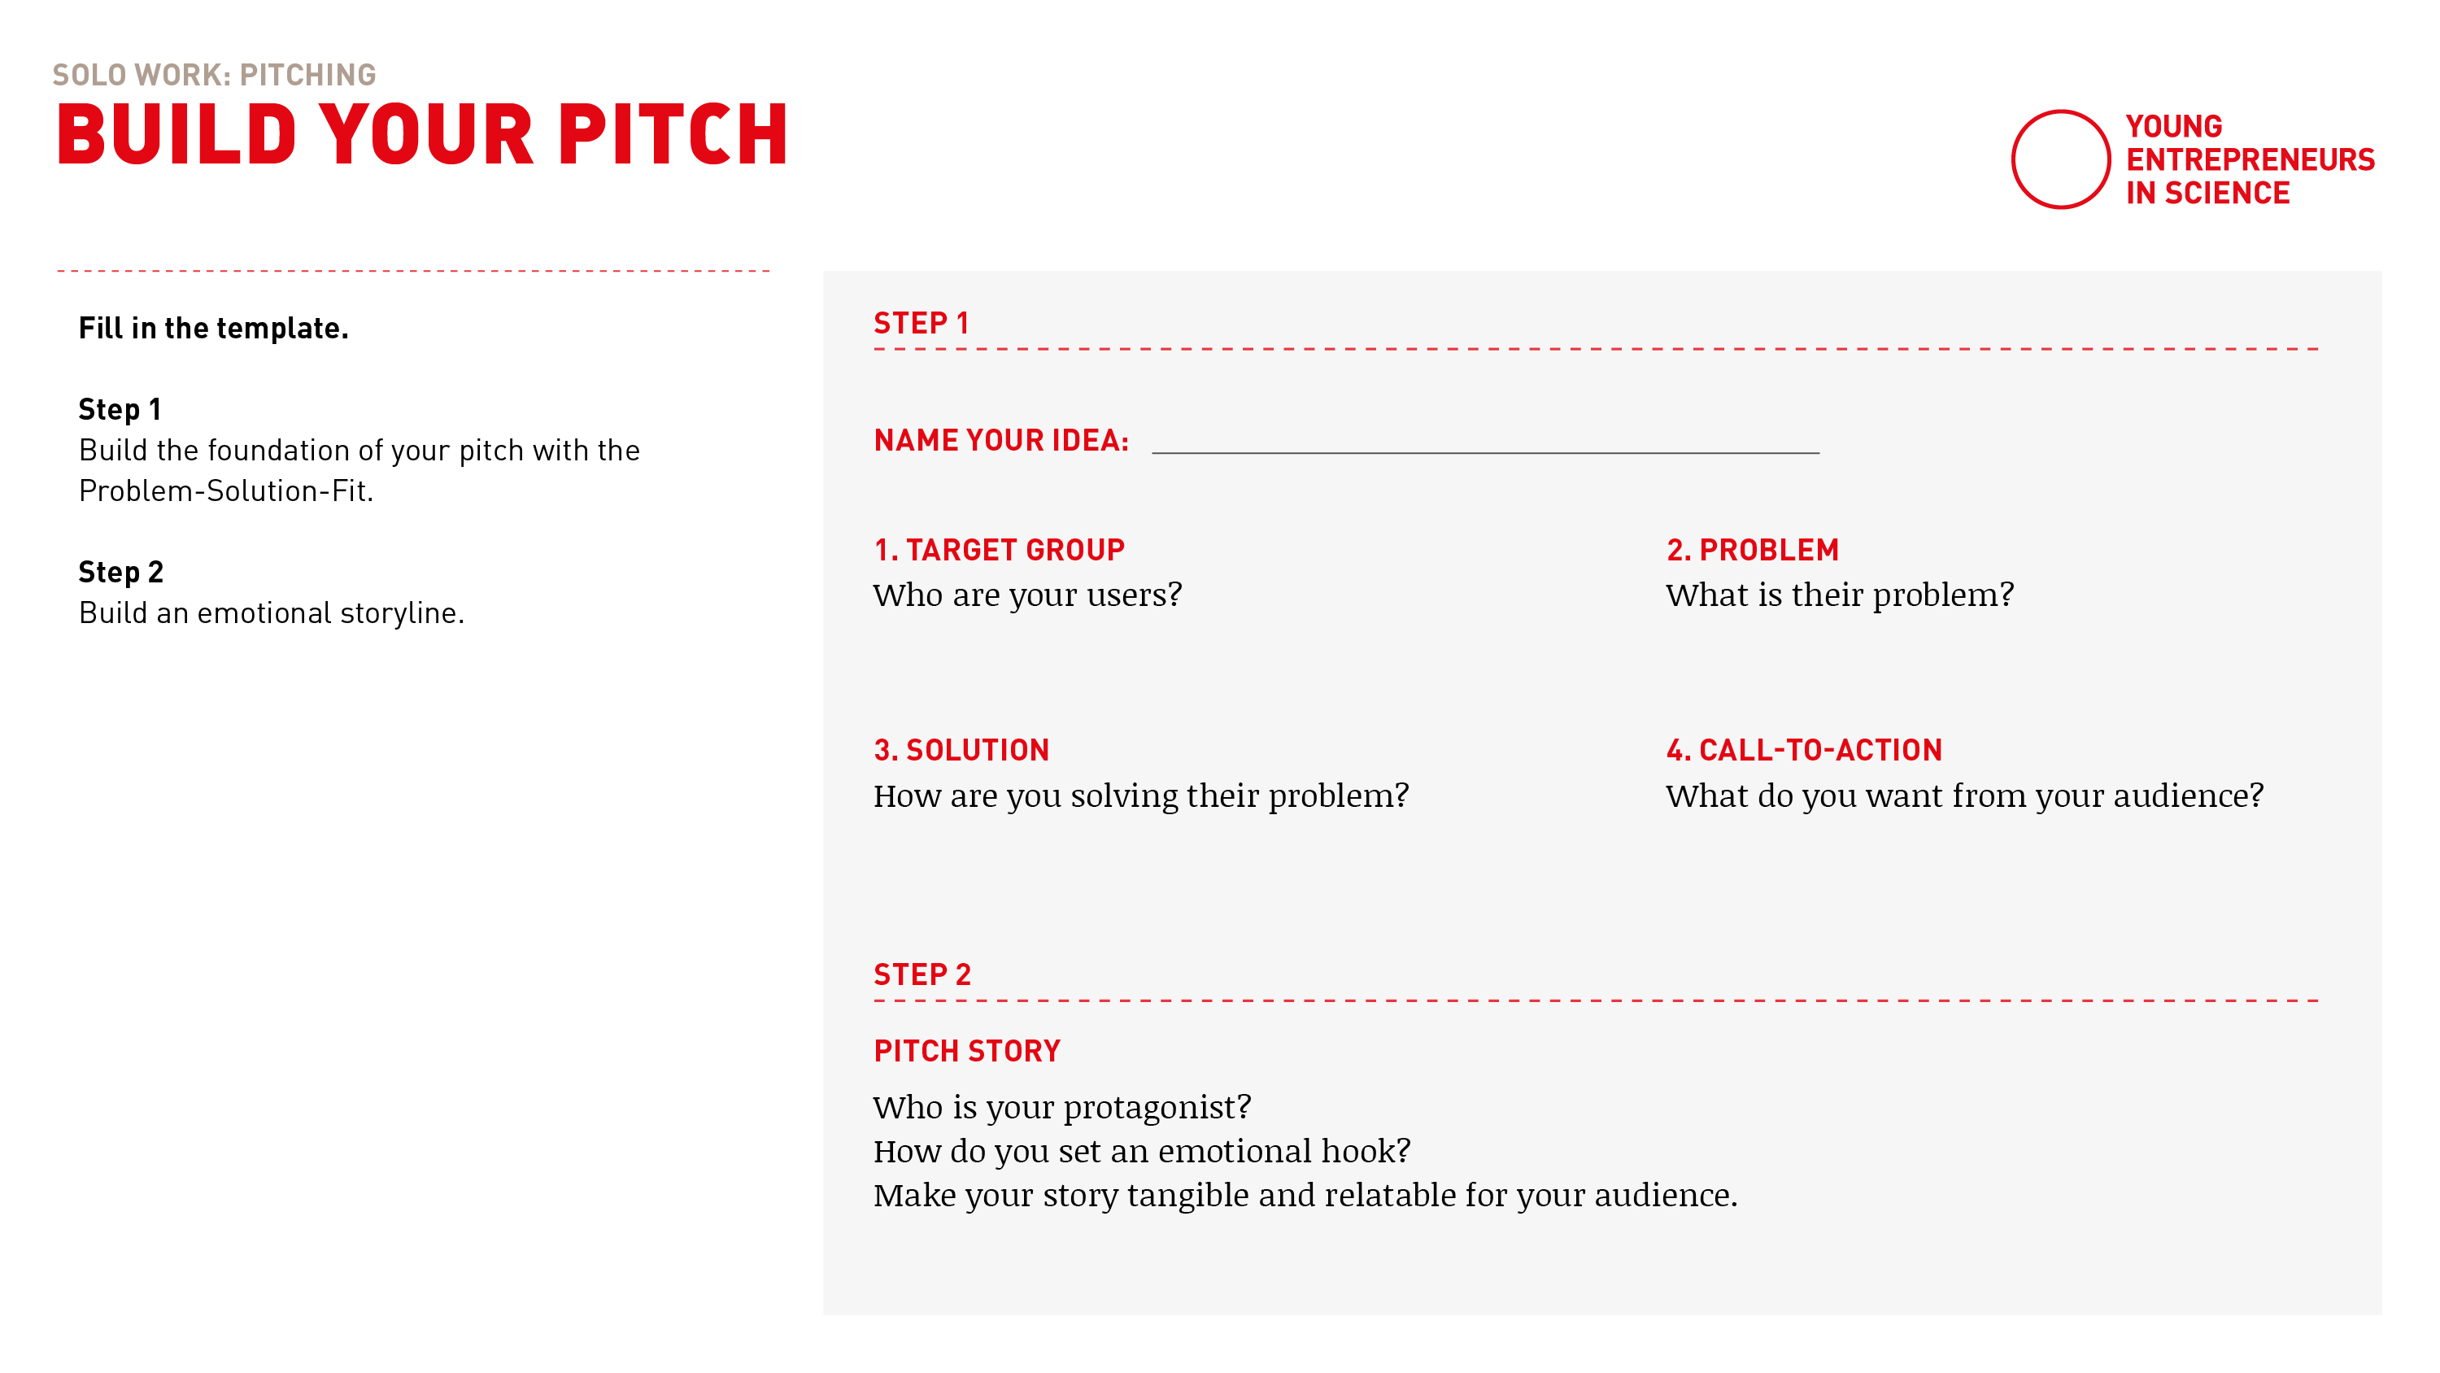
Build your pitch
Notes:
Take a piece of paper
Work your way through step 1 first
and based on that then build an engaging storyline in step 2!
You have got 10 minutes in total.
Stay in main room please, if you want to you can turn off the camera.
We will stay here and give you a heads up, when 5 minutes are over

Slide 79
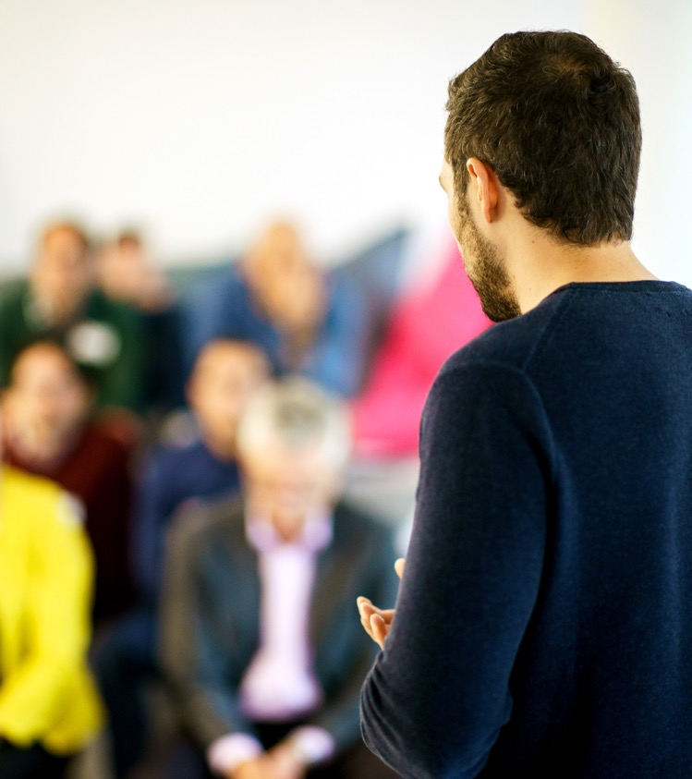
Test your pitch & get feedback
Notes:
Now we would like to give you some time to get into the groove and practice your pitch with the group.
As you will give and receive feedback – here is a little how to to do this in an effective way.

Slide 80

How to give feedback
Notes:
Some basic ground rules:
Make sure your feedback is clear and actionable, so please highlight what could be improved and why.
Feedback should address actions and outcomes, not personal traits. This makes the feedback easier to accept and act upon.
Begin with something positive to build trust. This way the recipient can accept critical feedback way better.

Slide 81
Feedback grid
I like …
I wish …
New ideas
Open questions
Notes:
We love to use this feedback grid when giving and receiving feedback:
1. I Like: Highlight what works well, e.g., “I like how clear and engaging your storyline was.”
2. I Wish: Suggest areas for improvement, e.g., “I wish the call to cation summarized your key message more clearly.”
3. New Ideas: Offer creative suggestions, e.g., “You could try to make the person more tangible to make your message more relatable.”
4. Open Questions: Pose questions for reflection and further development, e.g., “How might you make your pitch more interactive for the audience?”

Slide 82
How to receive feedback
Embrace feedback!
  Understand feedback as a learning opportunity
  Don’t defend your idea or your pitch (listen and learn!)
  Take notes
Notes:
But giving feedback is only one side of the medal. As you will also give your pitch it‘s also important for you to embrace the feedback you get.
So:
Understand feedback as a learning opportunity
Don’t defend your idea or your pitch (listen and learn!)
Take notes

Slide 83
Teamwork
Test your pitch &
get feedback
15 min
Transfer into digital
breakout rooms
Automatic transfer back
One after another:
Pitch your pitch (2 min)
Get feedback (2 min)
2 min for self-introduction
12 min for three pitches
& feedback
Countdown for last minute
Notes:
[read out instuctions]
TIME YOUR OWN PITCH! THEY SHOULD BE 2 MINUTES LONG!
We will transfer you to your breakout rooms with 3 people in the next step
If you have any questions – like always: please call us in!
Have fun and see you back here in 15 minutes!

Slide 84
Let’s go!

Slide 85
Notes:
Everybody is back? All went well?
Thumbs up if you’re with me please!

Slide 86
After the break …
PART 1
How to pitch digitally
PART 2
Pitches and expert feedback
Notes:
It‘s time for a break! Let‘s refresh a little bit (drink some water, get some fresh air, stretch)!
After the break we‘ll introduce to you how to pitch digitally.
And we’ll also have some guests with us [introduce guests].
Up to 6 people will be able to practice and give their pitch in front of our experts that will join us.
They will also give you some feedback on how to improve
We know this might sound frightening, but we can assure you – this is a very safe setting to try this!
We are all here for you and there is no pressure at all to be “perfect”

Slide 87
Who is pitching?
Please type into the group chat:
Your name + your pitch title
Notes:
Up to 6 participants can pitch 2 min pitch – 3 min feedback
First come, first serve
If you would like to pitch:
Please type into the group chat:
Your name + your pitch title

Slide 88
It’s coffee
o’ clock!
Notes:
M1: ONBOARDING EXPERTS in separate breakout room:
After the break, there will be a short input »Pitch digitally«
Then we will introduce you as the experts.
Each of you will have 2 minutes to introduce yourself individually (please also explain your function & why/what you are here as)
After that:
Max. 6 pitches
We introduce the pitches and hand over to the participants:
2 minutes pitch, then GONG
2-3 minutes feedback of you, then GONG
Please clarify who of you starts with feedback
Note that the pitches were created in a short time and which steps should be included (problem/solution fit, target audience, call to action, storyline)
Please give feedback on the pitch rather than on the idea: I like / I wish / open questions / new ideas
After that, everyone meets in the main room and max. 10 minutes input from the start-up centers: What is your offer? What could be the next steps for the participants?
We will explains setting & gong in the room
_______
M2: List/order for the pitches/breakouts

Slide 89
Notes:
Everybody is back? All went well?
Thumbs up if you’re with me please!

Slide 90
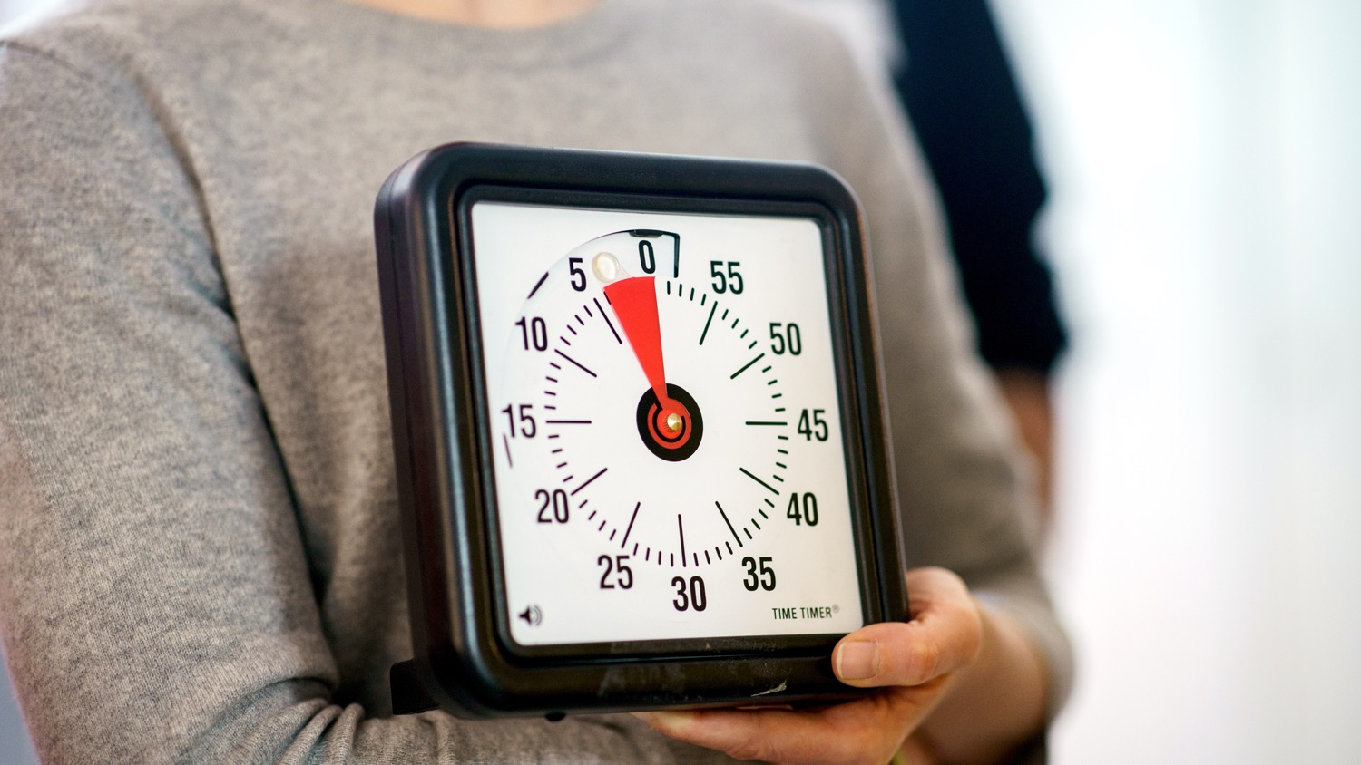
HOW TO PITCH … DIGITALLY!
Notes:
Now before we start…
… let‘s have a look at how to pitch in a digital setting!

Slide 91
Technical setting
Test technical setup prior to your pitch: sound, camera, internet connection
How do you want to show your idea?
What medium fits best to you and your product:
  Slidedeck?
  Digital/analogue prototype?
Notes:
Always test your sound, camera, and internet connection beforehand to avoid technical issues during your pitch.
Think about how you want to present your idea: What medium works best for you and your product?
Would a slidedeck show your idea clearly, or is a digital/analog prototype more effective to bring it to life? To really make it tangible?

Slide 92
Framing
The art of focus on perspective and framing … GONE WRONG!
Notes:
[Show these camera setups live to show everyone how not to do it]
Not: the giant (camera from below)
Not: Closeup (Just nose in the picture)
Not: The conceptual artist (half on camera with lamp in artistic setting)
Not: The Guru (the mystical one with lots of backlight)

Slide 93
Framing
The art of focus on perspective and framing … DOING IT RIGHT
Webcam should be positioned at the same height as your eyes
Leave some room in the upper part of the shot
Now you can decide where to be in the shot:
frontal or three quarters with head facing the camera
Notes:
The art of focus on perspective and framing
Let‘s do it right and please follow along everyone:
Webcam should be positioned at the same height as your eyes
Leave some room in the upper part of the shot
Now you can decide where to be in the shot: frontal or three quarters and letting the face front (looks like a painting to me)

Slide 94
Background
The background is just as important as you,
because it helps to define the composition of the shot.
Avoid big windows behind you
Avoid big flat walls behind you, because they literally flatten your image
Create depth – it’s always nice to bring some space between you and your background
Notes:
And a little about the background…
Avoid big windows behind you (remember – guru effect?)
Avoid big flat walls behind you, because they flatten your image, its always nice to feel some air between the subject and the background

Slide 95
Behavior & interaction
Remember to speak slowly and work with pauses
Look directly into the camera every now and then
Ask your audience to interact with you (thumbs up, etc.)
People do not tend to smile when they watch you digitally
– don’t be irritated and have fun!
Notes:
And how about behaviour and interaction?
People tend to speed up their speech when they are nervous.
Aim to speak a little slower than normal, and it should be perfect!
Look directly into the camera every now and then.
Remember: The camera is NOT your screen! Ist a difference [show difference when looking directly into the camera or on screen]
Last but not least:
People do not tend to smile when they watch you digitally – don’t be irritated and have fun!

Slide 96
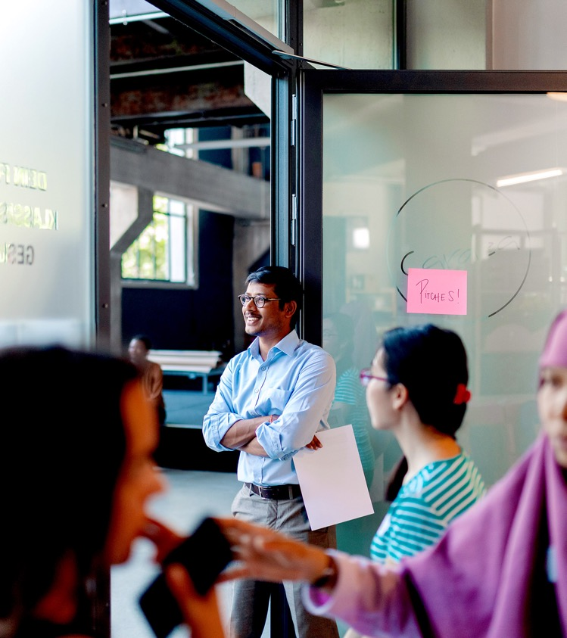
The pitches!
Notes:
You may have already noticed some new faces here with us after the break …

Slide 97

PLEASE WELCOME OUR EXPERT!
Notes:
… Please meet our experts! It‘s lovely to have you with us
Dear guests: Could you please briefly introduce yourselves?
[interaction with the guests so everyone feels welcome]

Slide 98
Main room
Pitch presentations
2 min each
Pitches in the main room
2 min pitch each
2-3 min expert feedback
Moderators will set a timer
Notes:
Let‘s have a look at how how this will work:
Our pitching volunteers: We will call your name, say: ready, set, go! And from then on you‘ll have 2 minutes for your pitch.
After 2 minutes you‘ll hear a GONG – this is when your time is over.
Then we will start the feedback round for another 3 minutes.
After 3 minutes you‘ll hear the GONG again and the next pitch has its turn.

Slide 99

Let’s go!

Slide 100
OUR EXPERTS CAN OFFER …
Notes:
[Info zu den Gründerzentren/ Info about the incubators]
[If necessary, switch here to the guests' slides]
[Say thank you an goodbye to the guests]

Slide 101
It’s coffee
o’ clock!

Slide 102
Agenda
Lunch Break
Part I
Part II
Modul 1: Your Research Canvas
Check-In
Learn about the relevance of users and potential use cases
Apply the Research Canvas to your own research
Get creative by brainstorming potential use cases for your research topic
Modul 2: Pitch Training
Key principles for a convincing pitch
Develop a storyline, set the stage, and use your voice
Get feedback and learn from your peers
Experiment, push and fail forward!
Wrap-Up

Slide 103


Time for feedback!
Please, follow the link in the chat window.
Notes:
Voting Link:
https://www.menti.com/v9peuuzor4
Live Results:
https://www.mentimeter.com/s/d2103d5f8c21f37ba61c7f97bf8930ef/b2a82eab8ce3

Slide 104
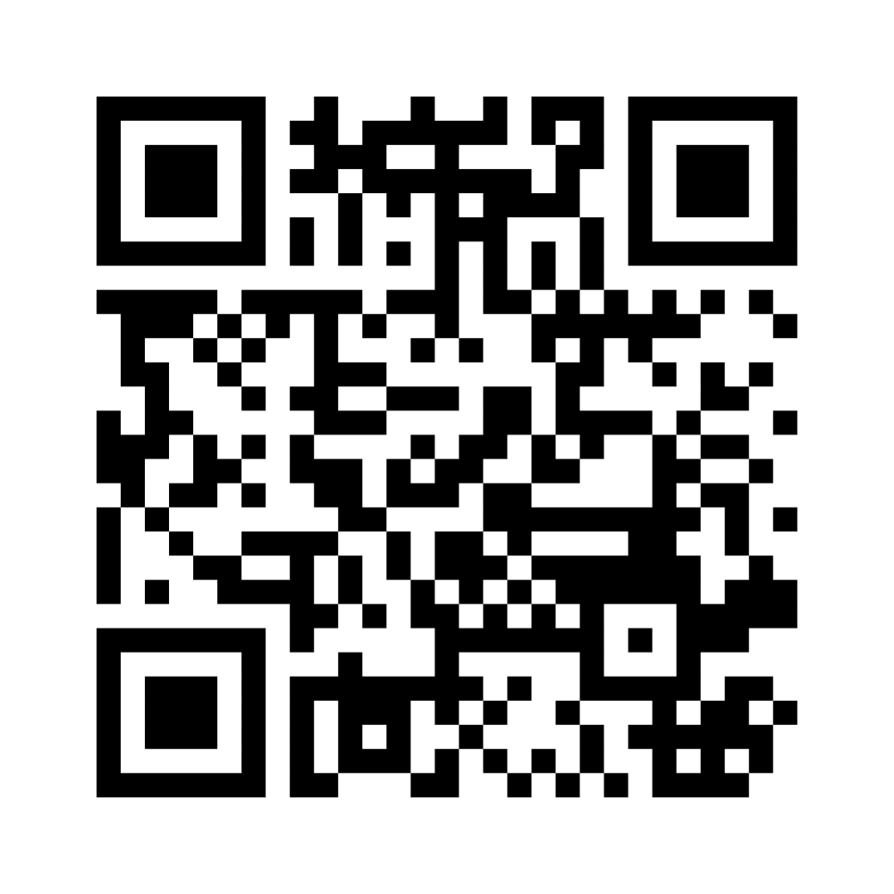
Wrapping up!
I like, I wish, I take away…
Notes:
Ggf. Menti-Link für Teilnehmende: https://www.menti.com/alaxnctncdyz

Slide 105

Sharing
Are there any comments, thoughts or questions
you would like to share?
Raise your hand.

Slide 106


Stay connected with the YES community
Join our LinkedIn group
Take part in other (Online-) Workshops
Tell your peers and spread the word via social media
Stay active in our Alumni-Community
Keep learning from each other on your entrepreneurial journey
Notes:
Hinweis für die Coaches:
Die Einladung zu dem netzwerk FW Connect erhalten die TN nach dem Workshop in einer Email, genauso wie alle weiteren, genaueren Infos, wie sie sich connecten können und Teil unserer Community werden können.

Slide 107


Boost your career with your YES experience
Connect with YES and fellow participants on LinkedIn
Share your YES certificate on Social Media
Add YES to your trainings on LinkedIn
and your CV
… and carry the entrepreneurial spirit further.
Notes:
Hinweis für die Coaches:
Die Einladung zu dem netzwerk FW Connect erhalten die TN nach dem Workshop in einer Email, genauso wie alle weiteren, genaueren Infos, wie sie sich connecten können und Teil unserer Community werden können.

Slide 108
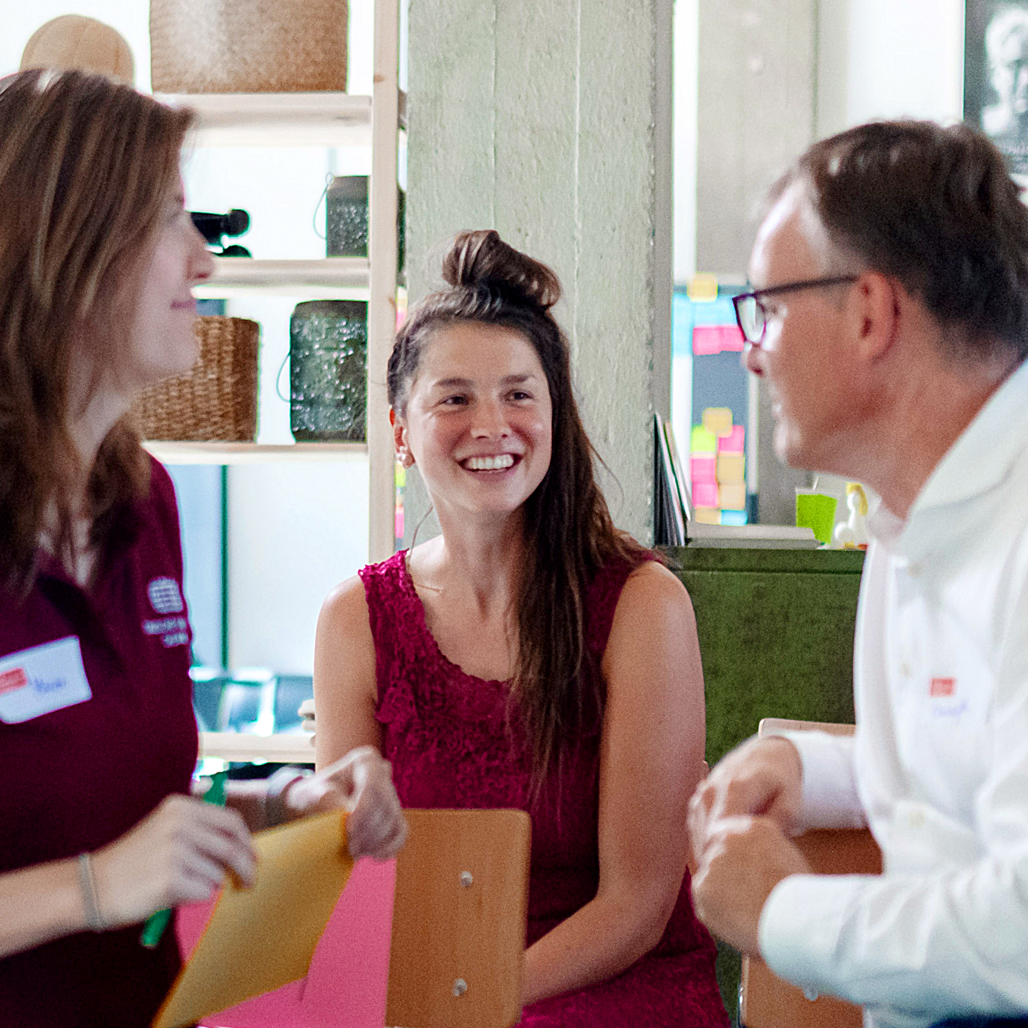
Top-Talents-Track
You’ve got a bold idea from your research – now what?
NEW
We are expanding our programme with the Top-Talents-Track, a three-month support programme for 20 highly qualified talents from our network. It combines workshops, individual coaching, peer-to-peer learning formats, and networking events.
Notes:
Hinweis für Coaches:
Bitte die Teilnehmer:innen auf das neue Programm „Top-Talents-Track“ hinweisen Die Bewerbung startet am 15. Mai und endet am 16. Juni
Link for Application: https://youngentrepreneursinscience.com/wp-content/uploads/2025/04/YES-Top-Talents-Track-Application-2025.pdf

Slide 109
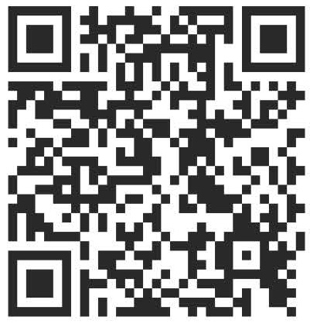

Time for feedback!
Notes:
Link
Bitte auf folgendes bei der Tonspur eingehen, um die Notwendigkeit der Evaluation zu betonen (Anmerkungen von YES):
Your feedback is key/We highly appreciate your feedback!
It is crucial not only for the constant improvement of our workshops, but also with regards to the future funding of our programme.
Future funding means more offers for you as alumni community (additional workshops, webinars, networking opportunities)
Thank you for taking the time (approx. 4 min)!

Slide 110




Thank you!
Connect with us and each other via Social Media …
LinkedIn
Page
LinkedIn
Group
Instagram
@sciencepreneurs
Newsletter
©️ Young Entrepreneurs in Science, 2025
Notes:
That‘s it!
Thanks a lot for participating
We hope you had fun
You will be added to the YES newsletter list to stay updated with the project and to read exciting alumni stories as well as get invited to our network Falling Walls Connect, to make contact with each other and take part in alumni webinars!
Please spread the word!!!
Instagram
https://www.instagram.com/sciencepreneurs/
LinkedIn Seite
https://www.linkedin.com/company/young-entrepreneurs-in-science/
LinkedIn Gruppe
https://www.linkedin.com/groups/8902012/
Newsletter
https://youngentrepreneursinscience.com/newsletter-registration/
Everybody else: Goodbye, have a nice day and see you soon!

Slide 111
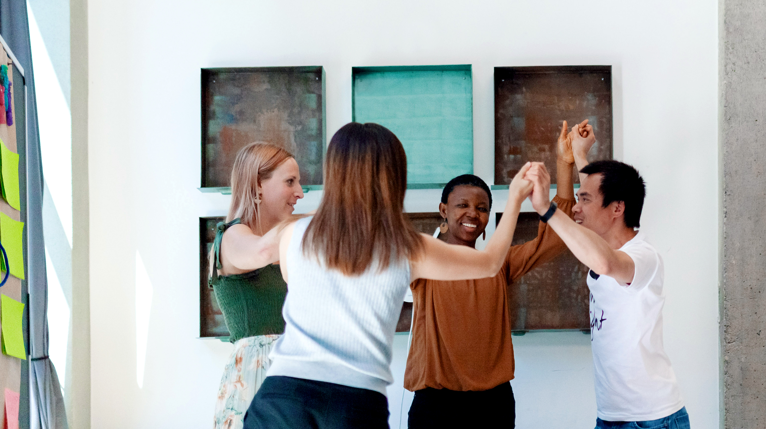
THE END

