Slide 1

Workshop

Slide 2
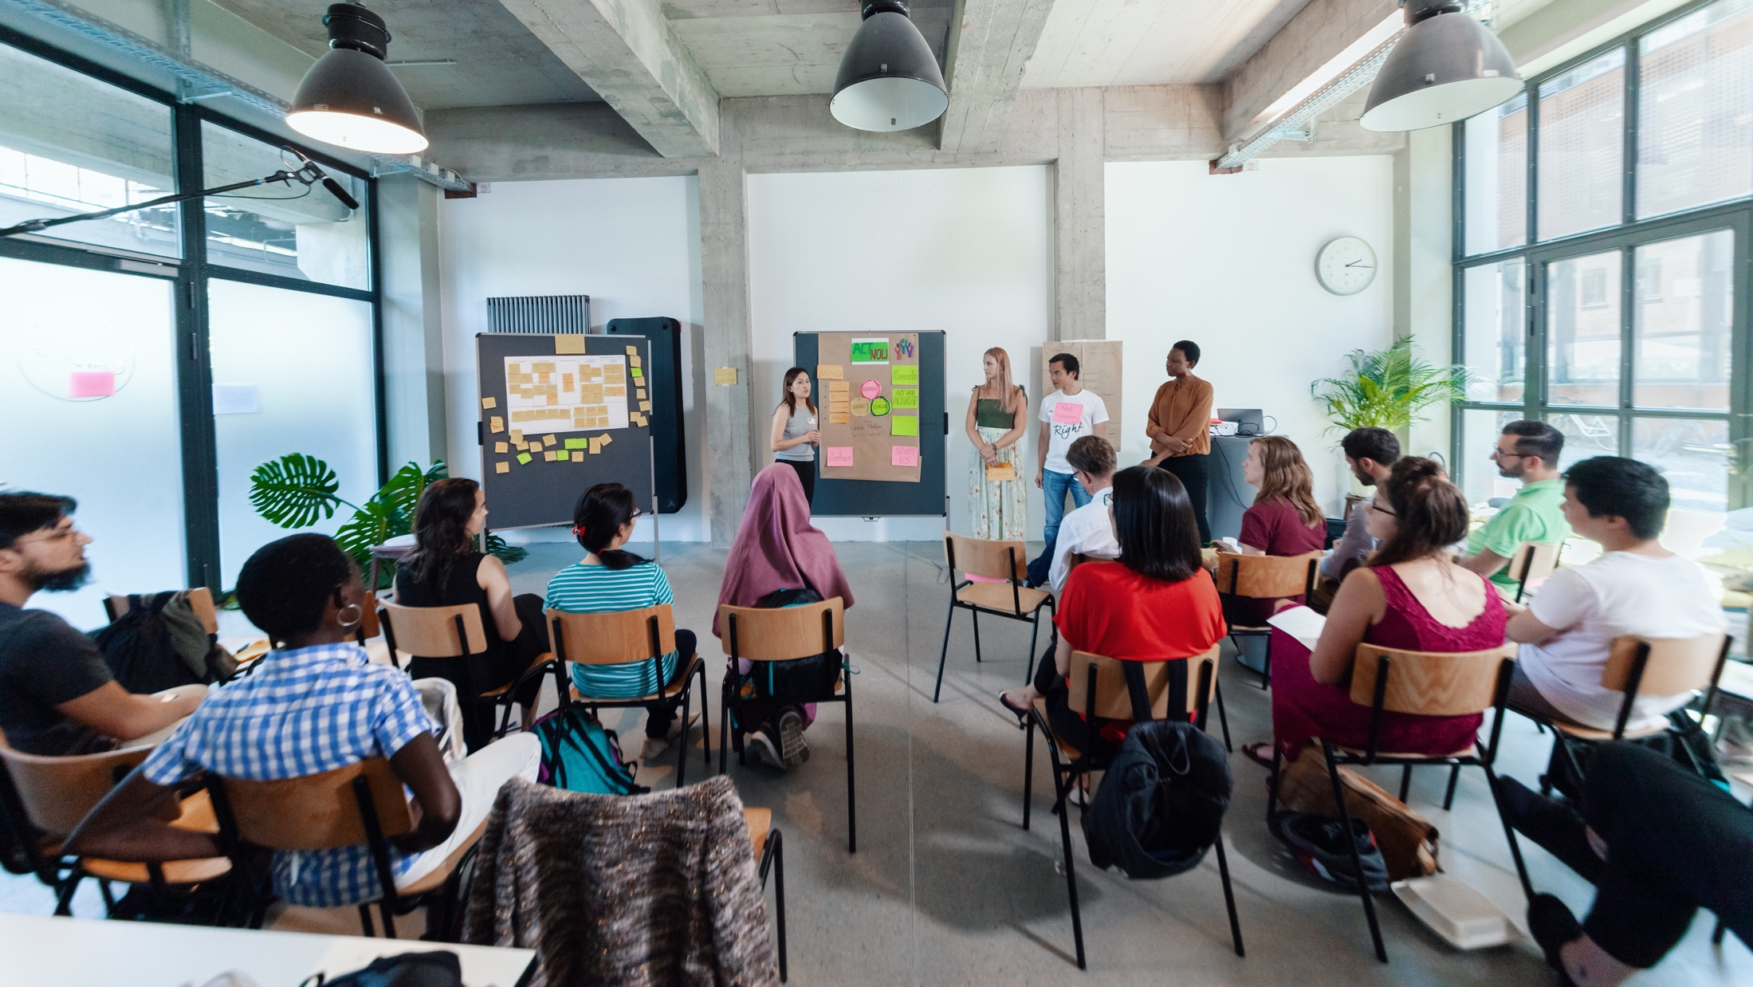
WELCOME BACK!
Notes:
So again, a warm welcome to all of you! We are so happy that we can meet in person again!
This is how we started 6 years ago.

Slide 3
Workshop programme
Day 1
Day 2
FOKUS/MODUL
FOKUS/MODUL
FOKUS/MODUL
FOKUS/MODUL
Thema 1
Thema 1
Thema 1
Thema 1

Slide 4
Agenda
Lunch Break
Part I
Part II
Modul 1
Check-In
Modulinhalte
Modul 2
Modulinhalte
Wrap-Up
Notes:
Wähle je nach Workshoplänge diese oder die kommende Slide aus.

Slide 5
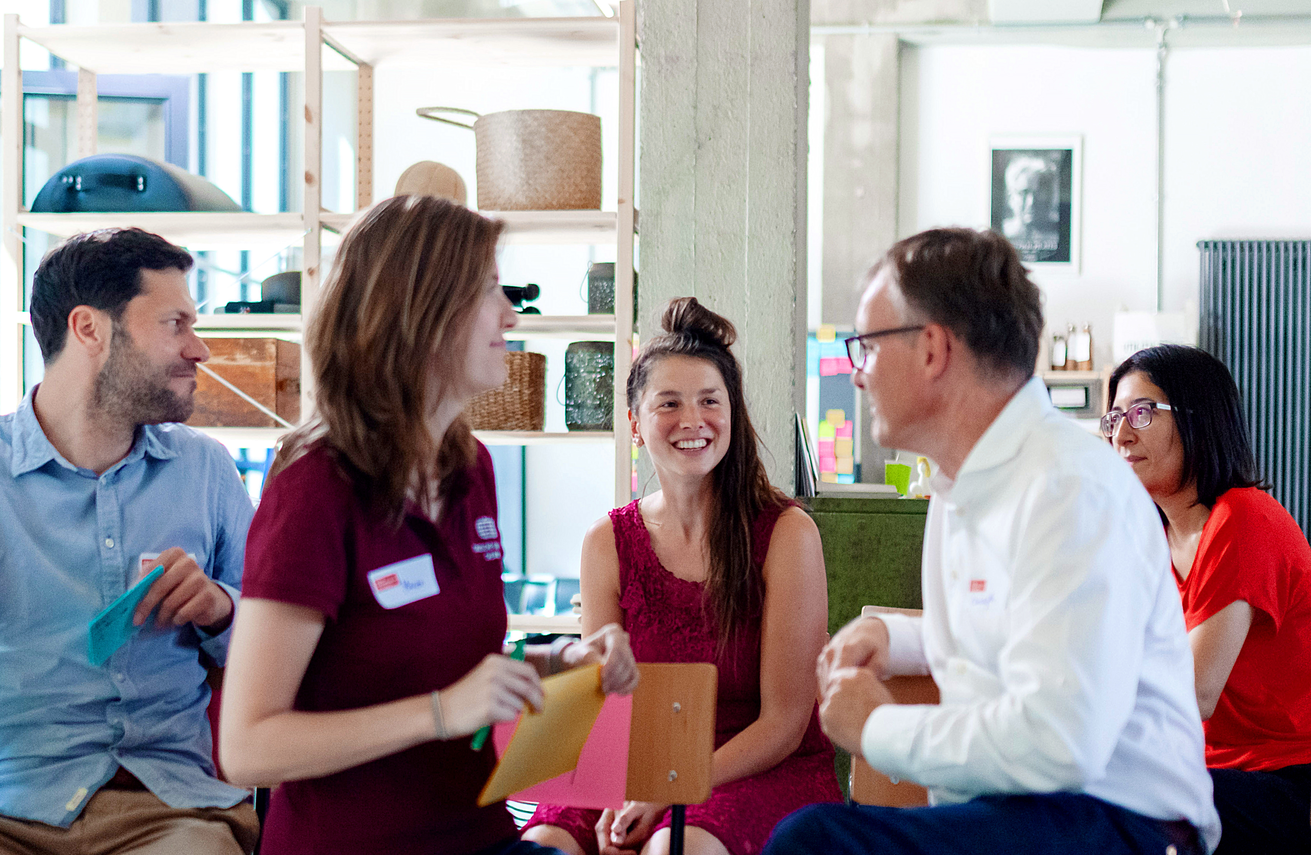
Check-In

Slide 6
Answer the question by yourself.
How are you feeling this morning?
When you think of yesterday:
What was an aha-moment?
What would you like to incorporate into your work today?

Slide 7

BREAK

Slide 8
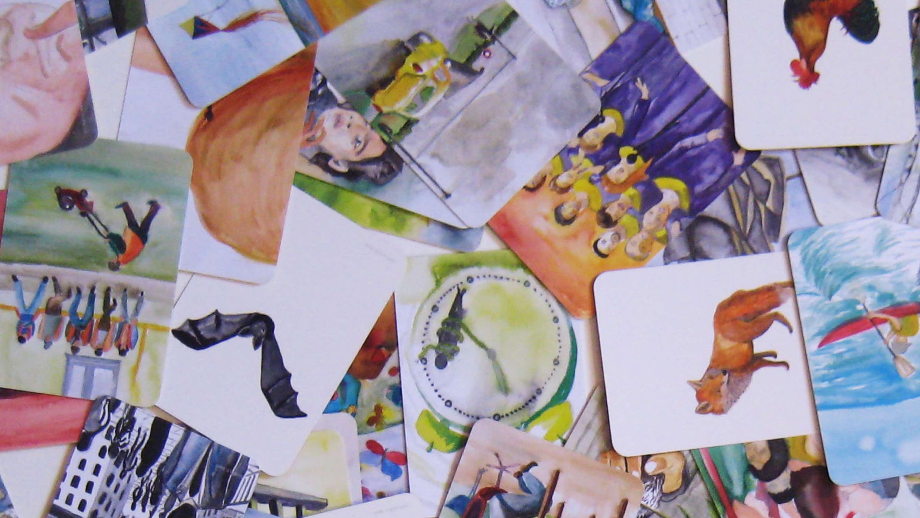
REFLECTION

Slide 9
I like, I wish, I take away…
Notes:
Time for feedback…
“I like, I wish, I take away…“
On sticky notes!

Slide 10
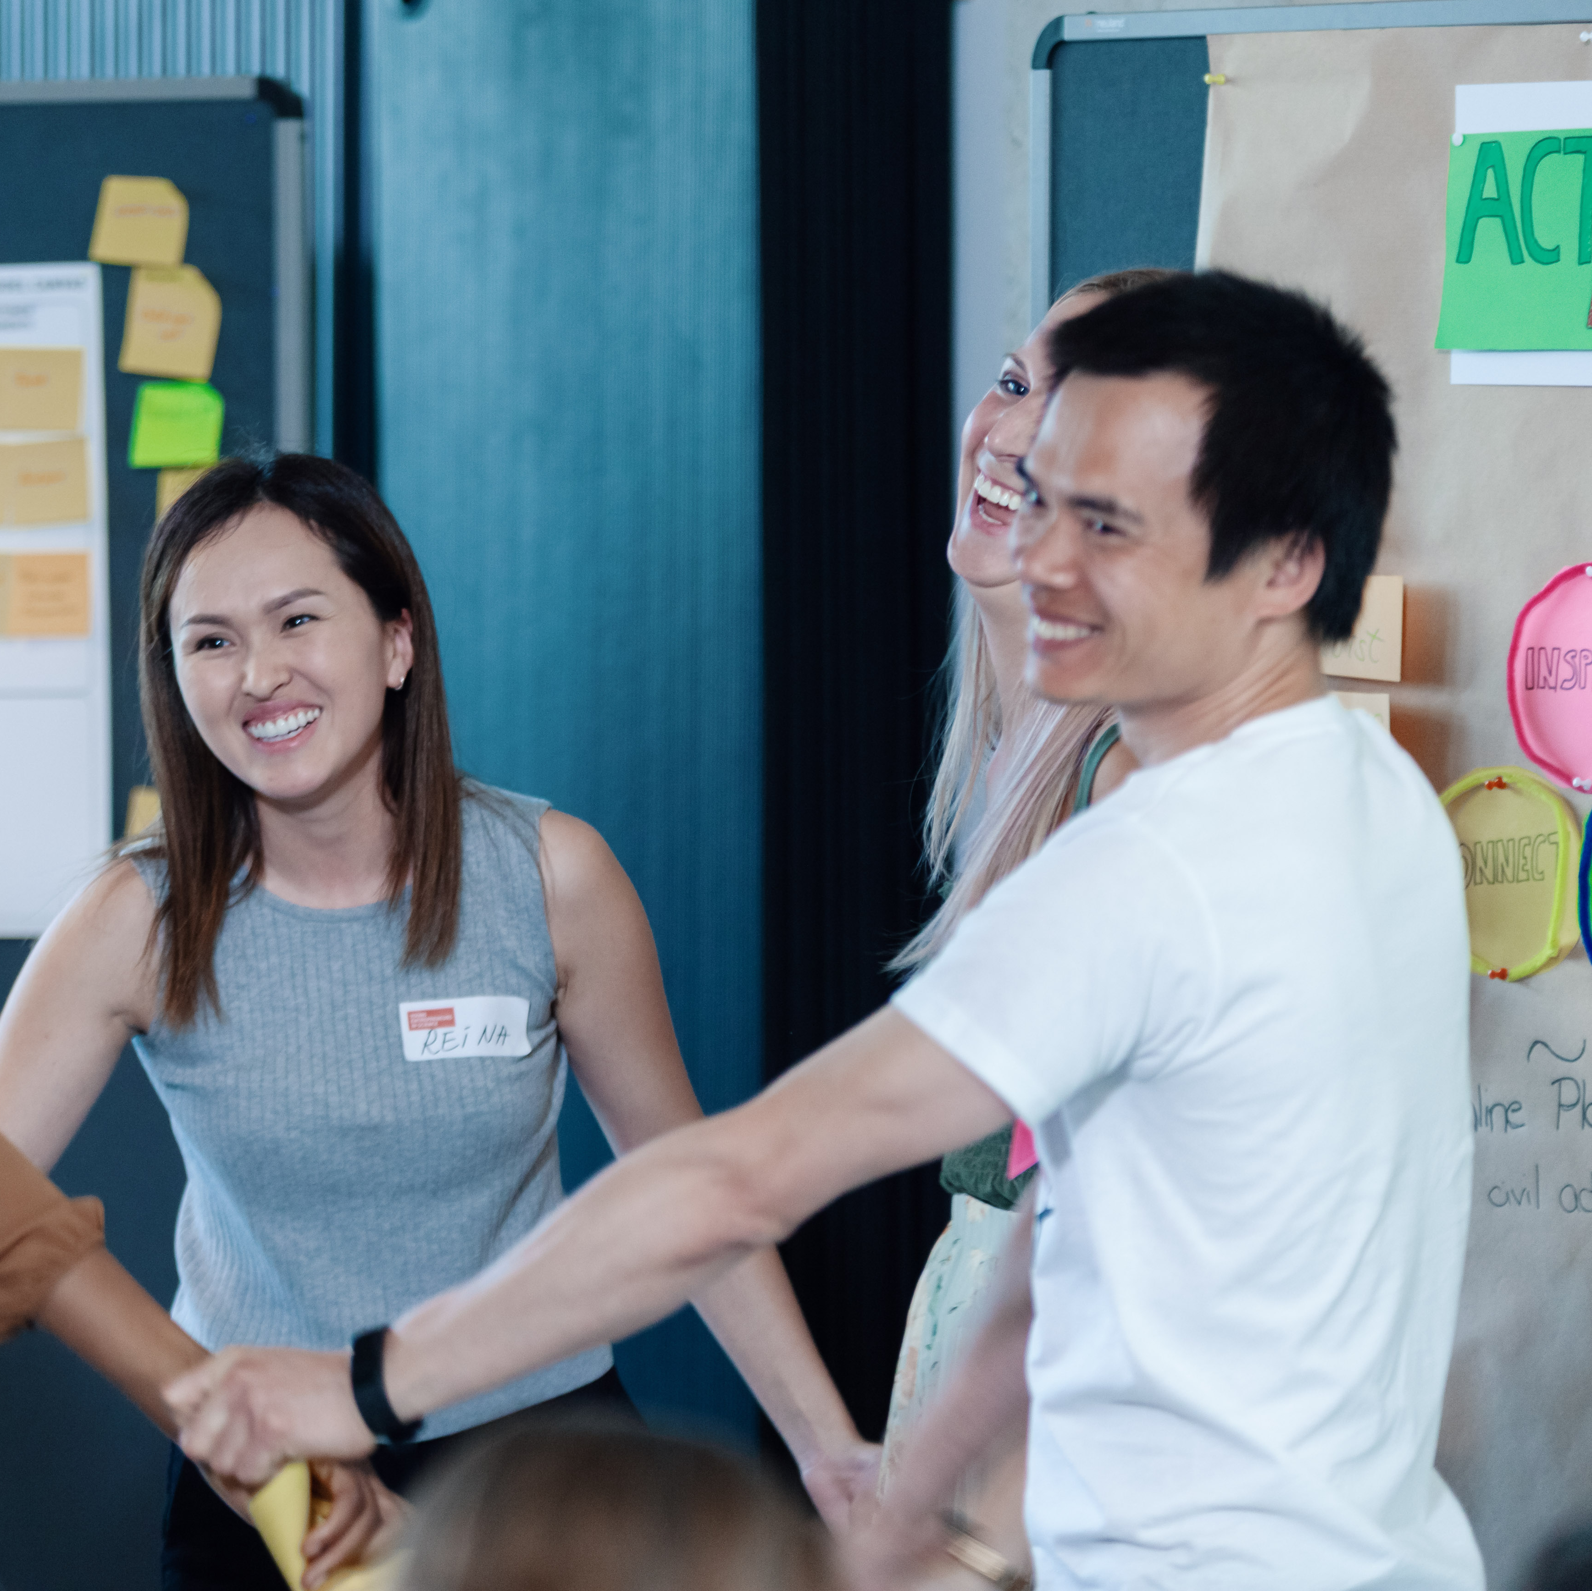

Stay connected with the YES community
Join our LinkedIn group
Take part in other (Online-) Workshops
Tell your peers and spread the word via social media
Stay active in our Alumni-Community
Keep learning from each other on your entrepreneurial journey
Notes:
Hinweis für die Coaches:
Die Einladung zu dem netzwerk FW Connect erhalten die TN nach dem Workshop in einer Email, genauso wie alle weiteren, genaueren Infos, wie sie sich connecten können und Teil unserer Community werden können.

Slide 11


Boost your career with your YES experience
Connect with YES and fellow participants on LinkedIn
Share your YES certificate on Social Media
Add YES to your trainings on LinkedIn
and your CV
… and carry the entrepreneurial spirit further.
Notes:
Hinweis für die Coaches:
Die Einladung zu dem netzwerk FW Connect erhalten die TN nach dem Workshop in einer Email, genauso wie alle weiteren, genaueren Infos, wie sie sich connecten können und Teil unserer Community werden können.

Slide 12
Top-Talents-Track
You’ve got a bold idea from your research – now what?
NEW
We are expanding our programme with the Top-Talents-Track, a three-month support programme for 20 highly qualified talents from our network. It combines workshops, individual coaching, peer-to-peer learning formats, and networking events.
Notes:
Hinweis für Coaches:
Bitte die Teilnehmer:innen auf das neue Programm „Top-Talents-Track“ hinweisen Die Bewerbung startet am 15. Mai und endet am 16. Juni
Link for Application: https://youngentrepreneursinscience.com/wp-content/uploads/2025/04/YES-Top-Talents-Track-Application-2025.pdf

Slide 13
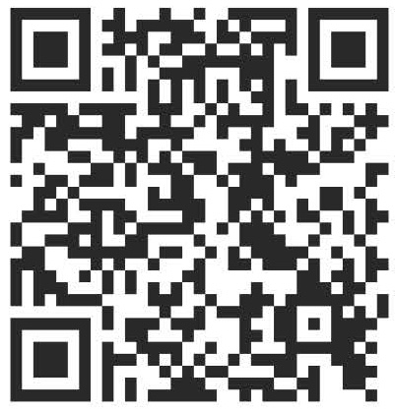

Time for feedback!
Notes:
Link
Bitte auf folgendes bei der Tonspur eingehen, um die Notwendigkeit der Evaluation zu betonen (Anmerkungen von YES):
Your feedback is key/We highly appreciate your feedback!
It is crucial not only for the constant improvement of our workshops, but also with regards to the future funding of our programme.
Future funding means more offers for you as alumni community (additional workshops, webinars, networking opportunities)
Thank you for taking the time (approx. 4 min)!

Slide 14




Thank you!
Connect with us and each other via Social Media …
LinkedIn
Page
LinkedIn
Group
Instagram
@sciencepreneurs
Newsletter
©️ Young Entrepreneurs in Science, 2025
Notes:
That‘s it!
Thanks a lot for participating
We hope you had fun
You will be added to the YES newsletter list to stay updated with the project and to read exciting alumni stories as well as get invited to our network Falling Walls Connect, to make contact with each other and take part in alumni webinars!
Please spread the word!!!
Instagram
https://www.instagram.com/sciencepreneurs/
LinkedIn Seite
https://www.linkedin.com/company/young-entrepreneurs-in-science/
LinkedIn Gruppe
https://www.linkedin.com/groups/8902012/
Newsletter
https://youngentrepreneursinscience.com/newsletter-registration/
Everybody else: Goodbye, have a nice day and see you soon!

Slide 15

THE END

