Slide 1
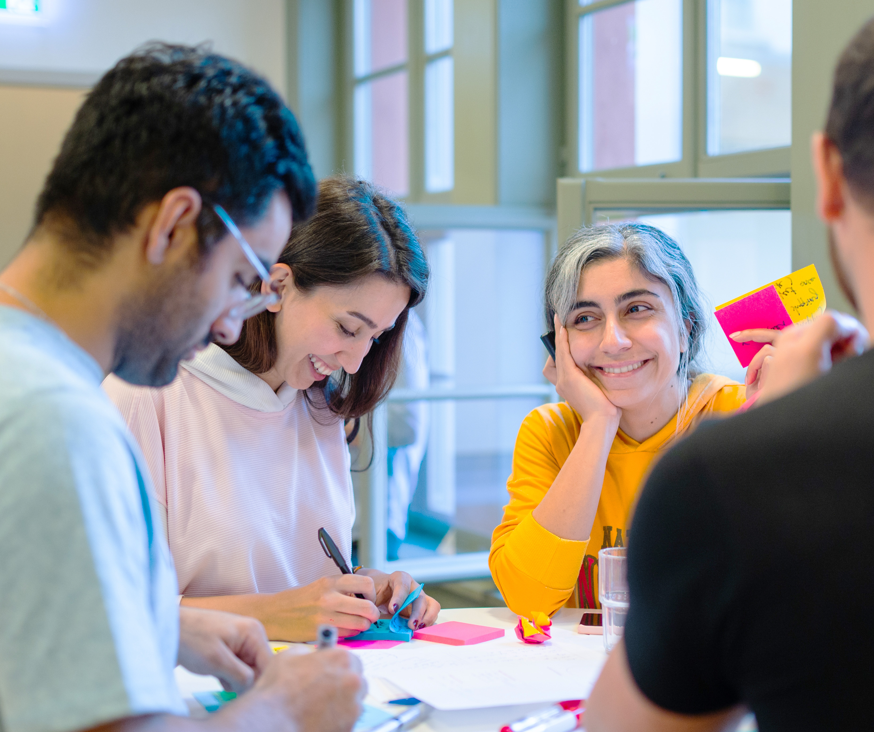
Workshop

Slide 2
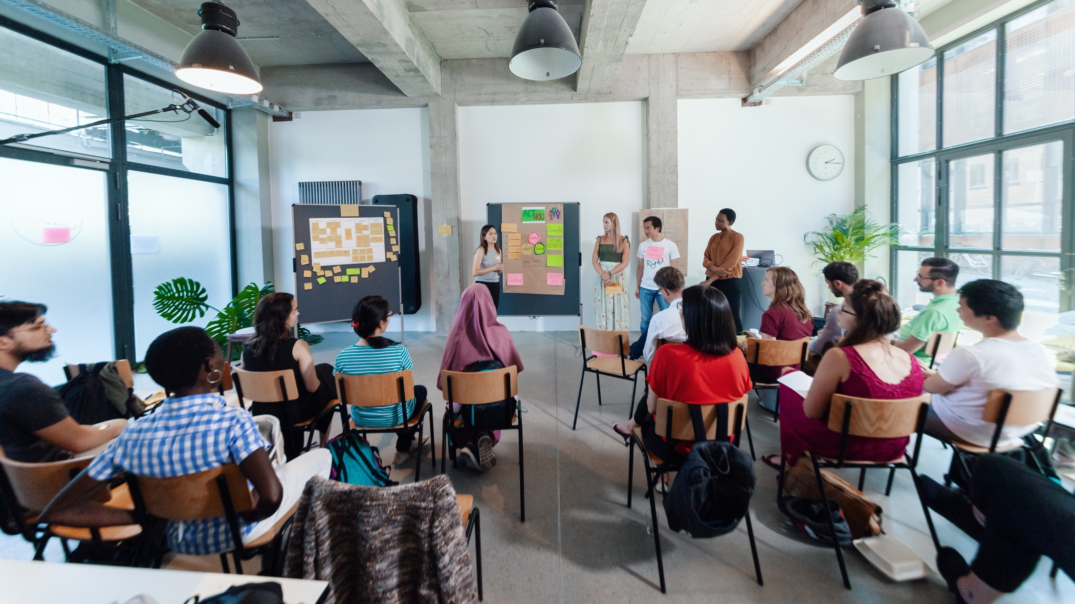
MEET THE TEAM
Notes:
So my name is XX, I‘m working as…
Moderating this session with me is XX. (M2 stellt sich selber vor)
And last but not least please meet the maybe most important (wo-)man in the room today: XX. XX is in charge of the technical support and is here to help with any technical problems.
XX in your role as techincal support would you please introduce us to some basic rules and tricks, that are important in our digital setup today?

Slide 3
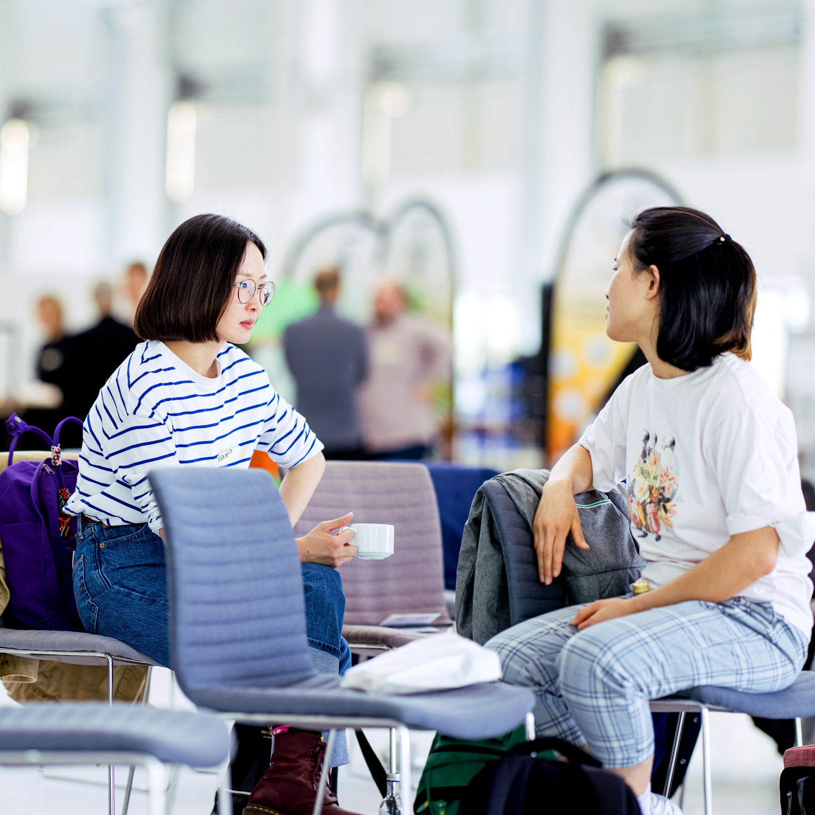
Young Entrepreneurs in Science
opens up new career perspectives
for young researchers
part of the Falling Walls Foundation
enabled by Federal Ministry of Research, Technology and Space
www.youngentrepreneursinscience.com
Notes:
Young Entrepreneurs in Science (YES):
Originally started as an offline workshop series in various cities across Germany.
Now offers a diverse program of Offline and Online workshops tailored for PhDs, Postdocs and Master students
Project Team:
Comprises 12 team members.
Part of the Falling Walls Foundation, a non-profit organization based in Berlin.
Falling Walls Foundation:
Aims to communicate science and research to the public.
Promotes interdisciplinary exchange and collaboration.
Workshop Benefits:
Strongly supported by a broad network in academia and business.
Designed to foster entrepreneurial thinking and skills among researchers: cultural transfer
BMFTR:
Participation is made possible free of charge through funding from the BMFTR (Federal Ministry of Research, Technology and Space)

Slide 4
Netiquette
Be respectful & constructive
Use AI responsibly: Use it to support the process, not to produce final results
Mute when not speaking
Be present: keep your camera on. Feel free to eat, drink, or stretch
Need help? Reach out to us via the chat if experiencing technical issues
React & engage: Use emojis or reactions to share feedback
Drop your questions or ideas in the chat – we’re all here to learn together!
www.youngentrepreneursinscience.com
Notes:
Be respectful & constructive
We encourage open feedback – just make sure it’s respectful, kind, and constructive.
Use AI responsibly
If you’d like to use AI during group work, make sure your whole group agrees. Use it to support the process, not to produce final results.
Mute when not speaking
Help keep the space clear by muting your mic when you’re not talking.
Be present
Stay social – keep your camera on if possible. Feel free to eat, drink, or stretch as needed.
Need help?
Reach out to our coaches via the chat if you’re experiencing technical issues.
React & engage
Use emojis or reactions at the bottom of your screen to share quick feedback or show you’re engaged.
Use the chat for questions
Drop your questions or ideas in the chat – we’re all here to learn together!

Slide 5
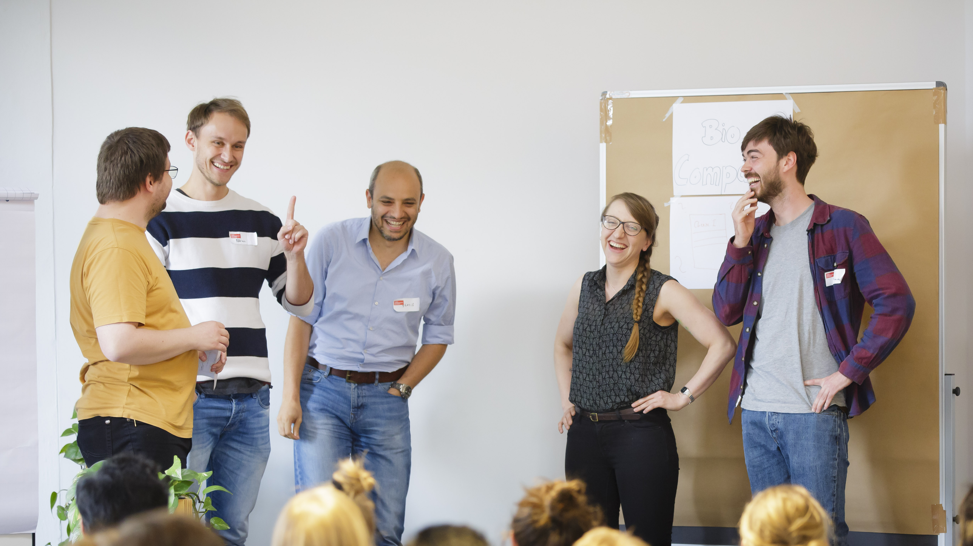
CHECK-IN
Notes:
Okay let’s start.
We always start our workshops with a check-in with the workshop-team – no matter if online or offline.
This is how it works (select next slide)

Slide 6

Emoji Check-In
Everbody, show us your emoji mood!

Slide 7

BREAK

Slide 8

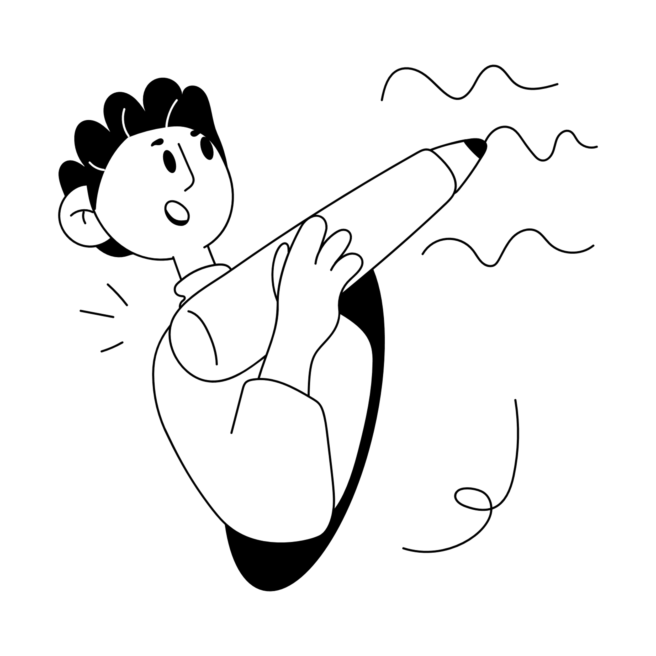
Time for feedback!
Please, follow the link in the chat window.
Notes:
Voting Link:
https://www.menti.com/v9peuuzor4
Live Results:
https://www.mentimeter.com/s/d2103d5f8c21f37ba61c7f97bf8930ef/b2a82eab8ce3

Slide 9
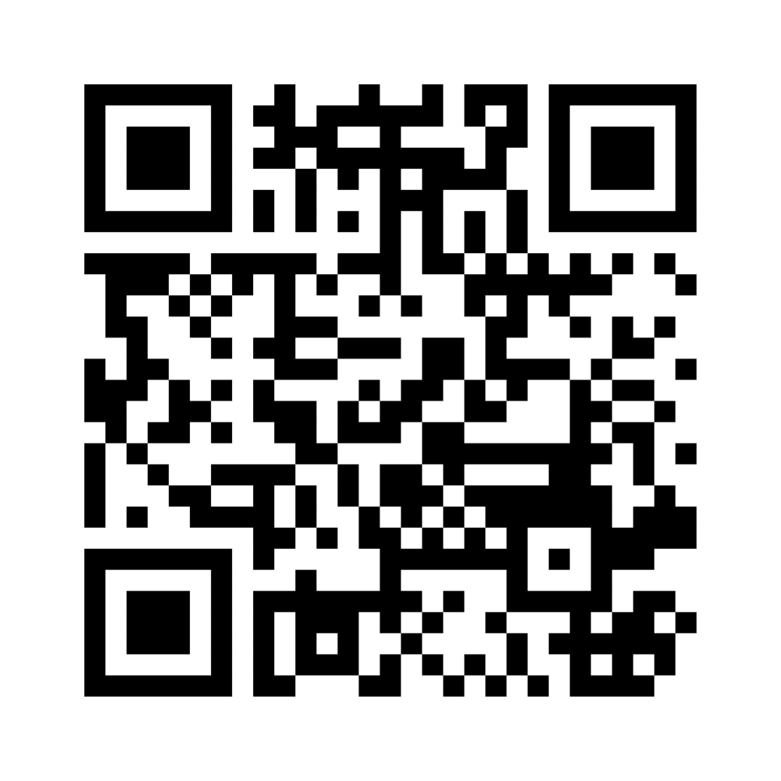
Wrapping up!
I like, I wish, I take away…
Notes:
Ggf. Menti-Link für Teilnehmende: https://www.menti.com/alaxnctncdyz

Slide 10

Sharing
Are there any comments, thoughts or questions
you would like to share?
Raise your hand.

Slide 11
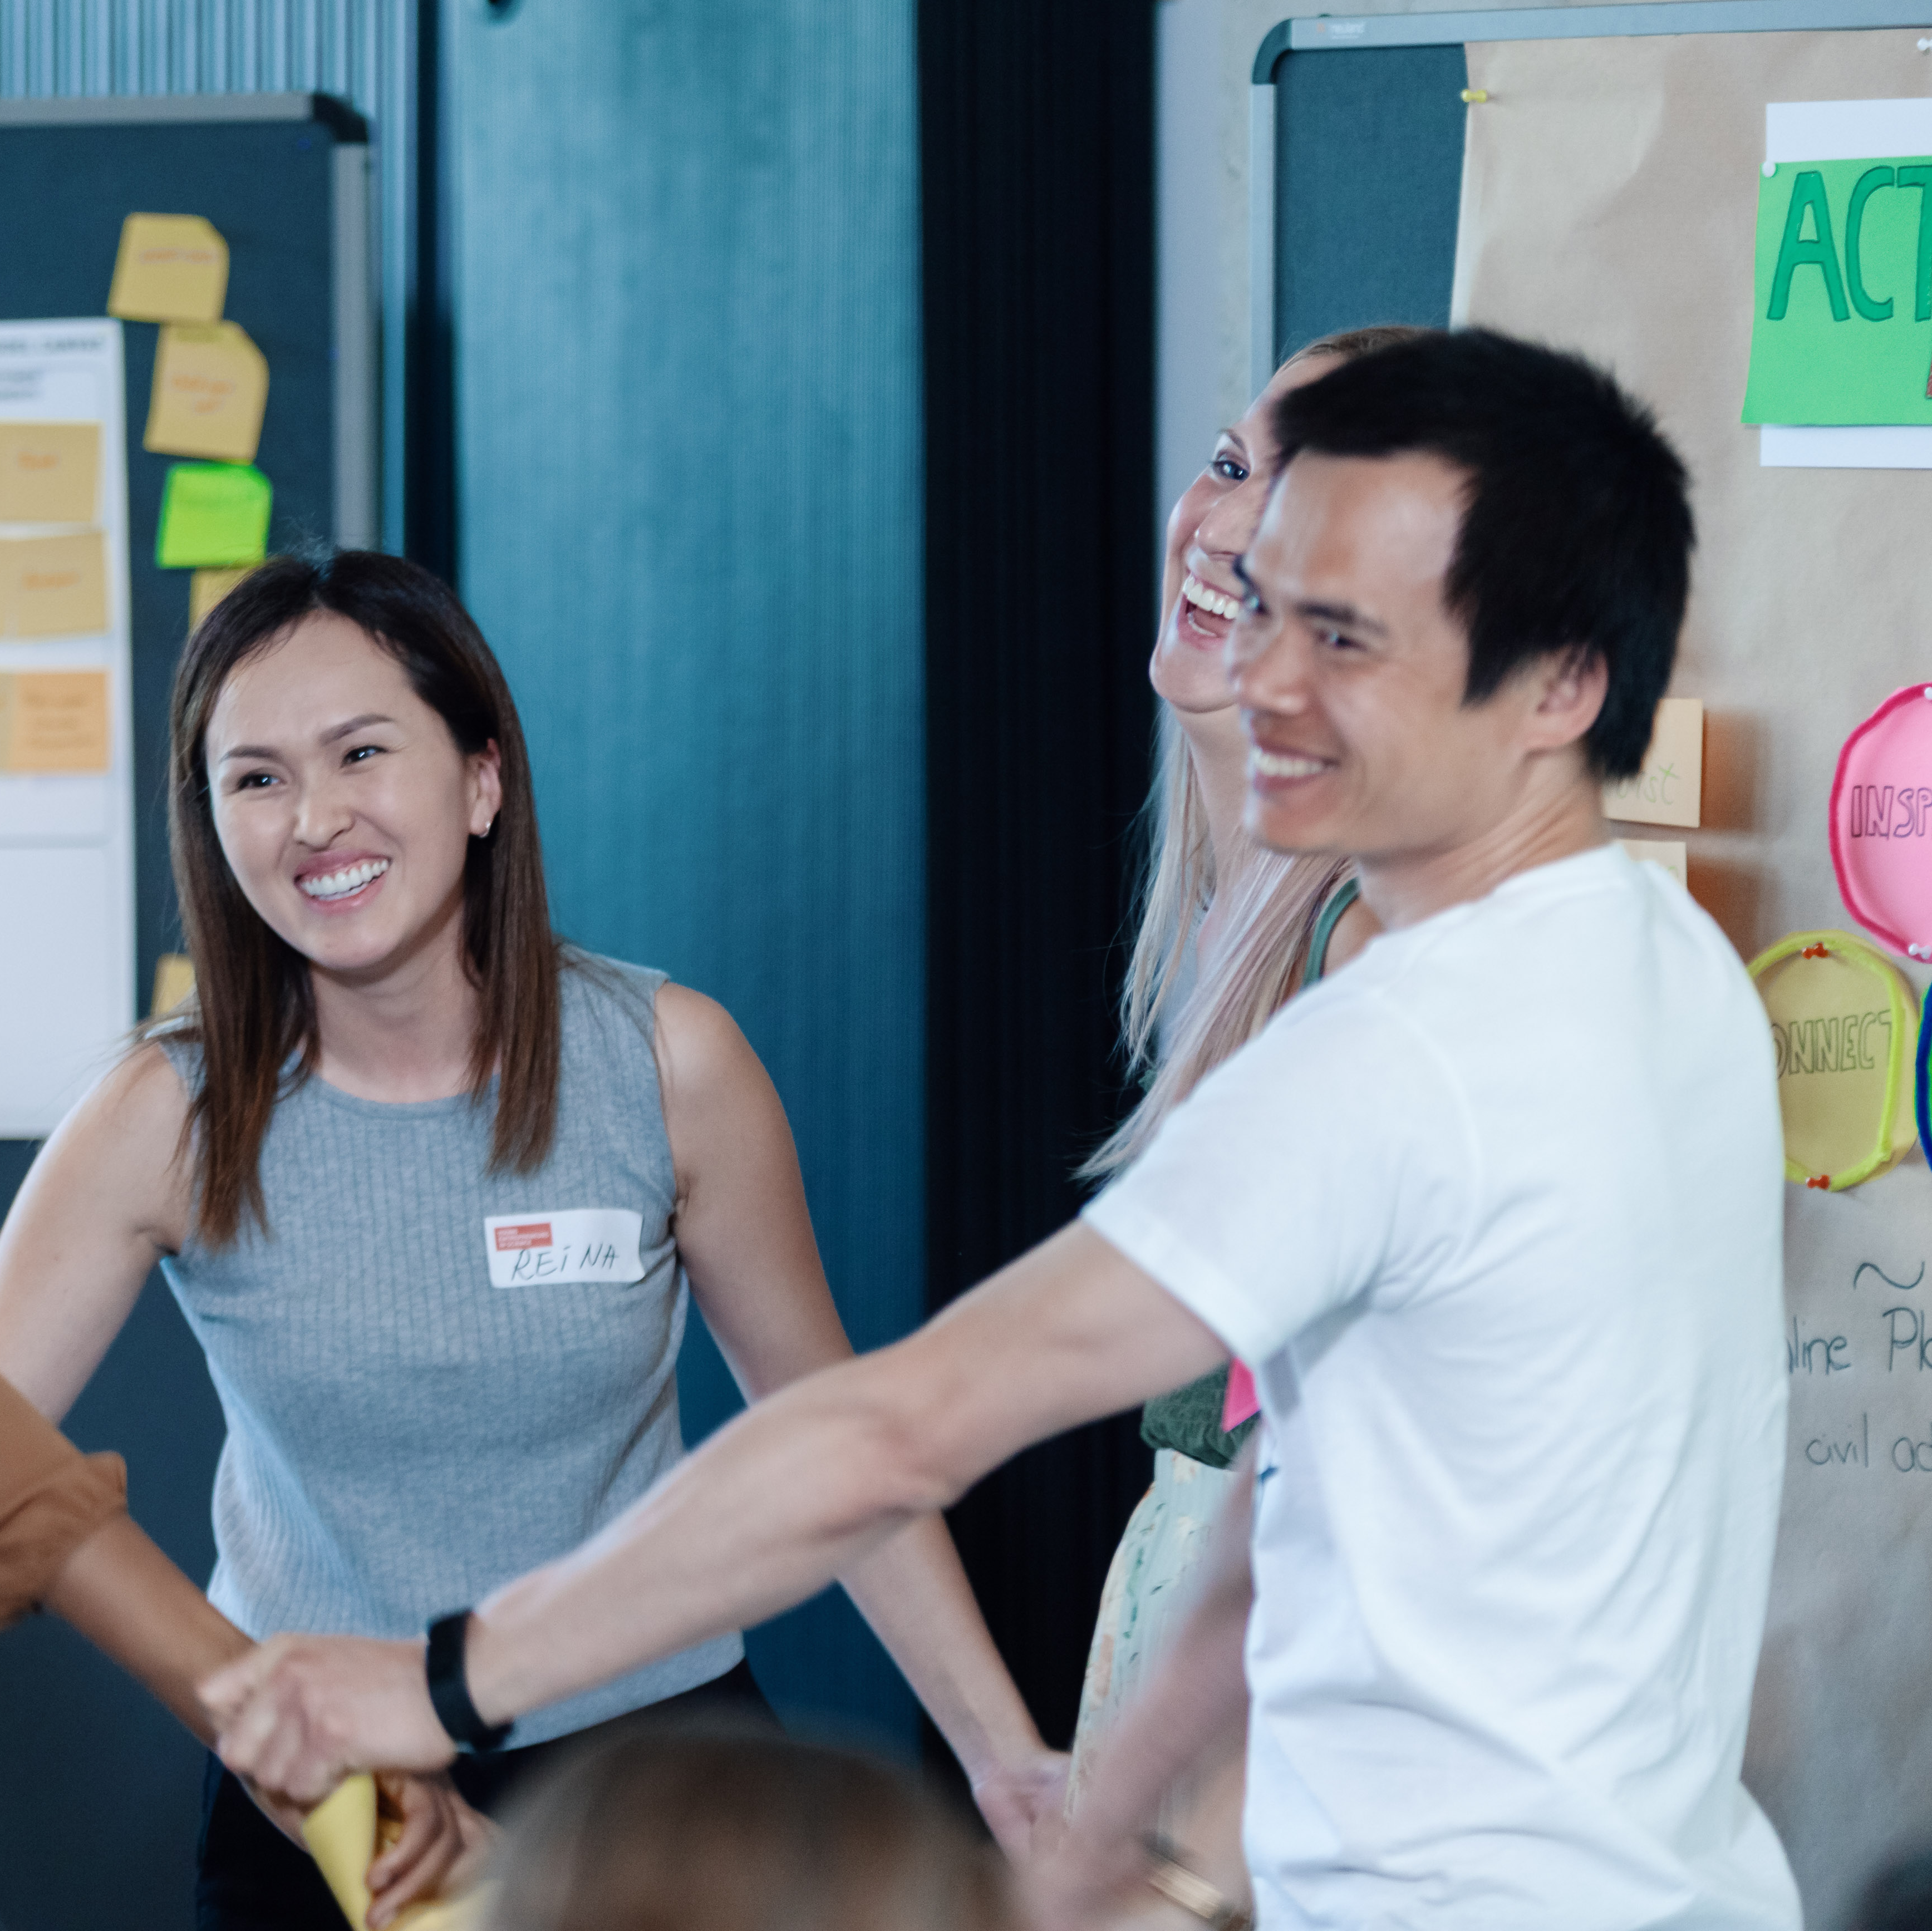

Stay connected with the YES community
Join our LinkedIn group
Take part in other (Online-) Workshops
Tell your peers and spread the word via social media
Stay active in our Alumni-Community
Keep learning from each other on your entrepreneurial journey
Notes:
Hinweis für die Coaches:
Die Einladung zu dem netzwerk FW Connect erhalten die TN nach dem Workshop in einer Email, genauso wie alle weiteren, genaueren Infos, wie sie sich connecten können und Teil unserer Community werden können.

Slide 12


Boost your career with your YES experience
Connect with YES and fellow participants on LinkedIn
Share your YES certificate on Social Media
Add YES to your trainings on LinkedIn
and your CV
… and carry the entrepreneurial spirit further.
Notes:
Hinweis für die Coaches:
Die Einladung zu dem netzwerk FW Connect erhalten die TN nach dem Workshop in einer Email, genauso wie alle weiteren, genaueren Infos, wie sie sich connecten können und Teil unserer Community werden können.

Slide 13
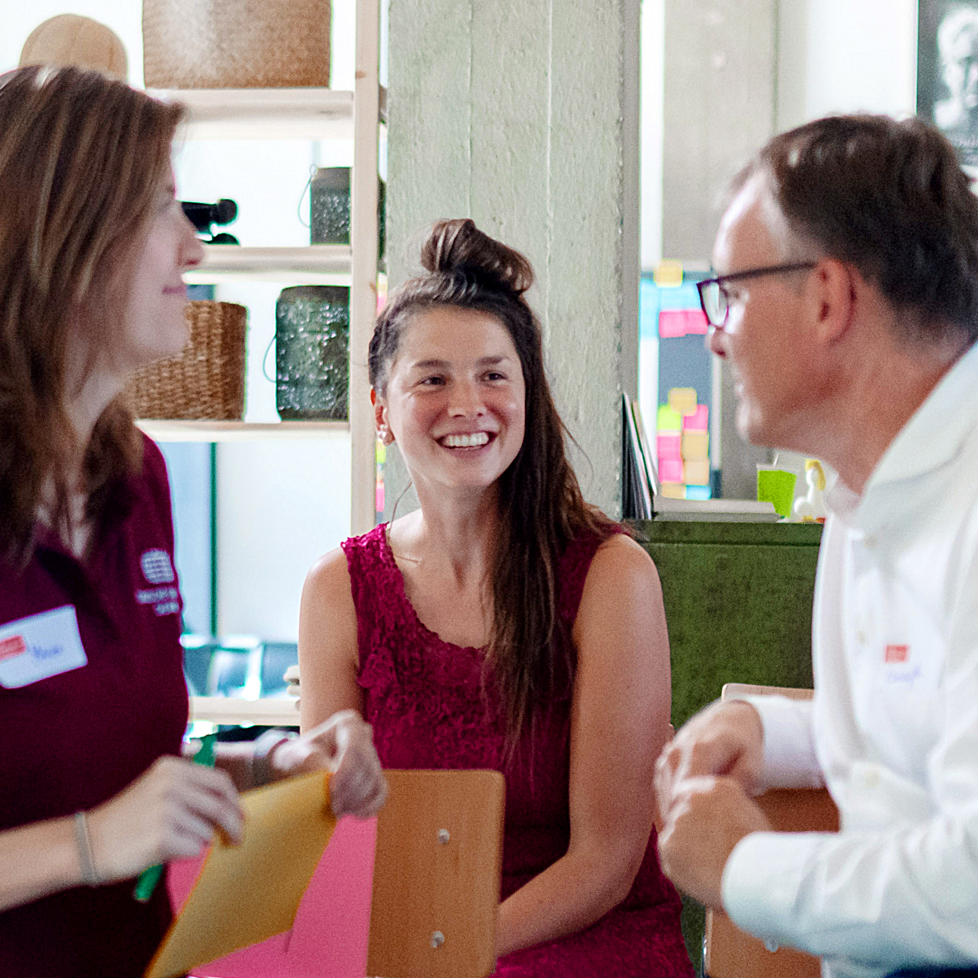
Top-Talents-Track
You’ve got a bold idea from your research – now what?
NEW
We are expanding our programme with the Top-Talents-Track, a three-month support programme for 20 highly qualified talents from our network. It combines workshops, individual coaching, peer-to-peer learning formats, and networking events.
Notes:
Hinweis für Coaches:
Bitte die Teilnehmer:innen auf das neue Programm „Top-Talents-Track“ hinweisen Die Bewerbung startet am 15. Mai und endet am 16. Juni
Link for Application: https://youngentrepreneursinscience.com/wp-content/uploads/2025/04/YES-Top-Talents-Track-Application-2025.pdf

Slide 14
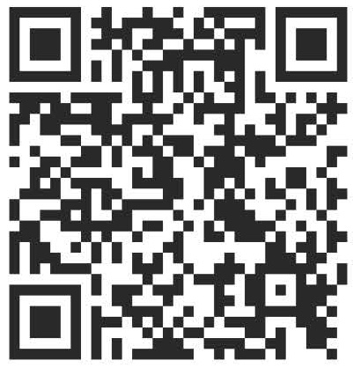

Time for feedback!
Notes:
Link
Bitte auf folgendes bei der Tonspur eingehen, um die Notwendigkeit der Evaluation zu betonen (Anmerkungen von YES):
Your feedback is key/We highly appreciate your feedback!
It is crucial not only for the constant improvement of our workshops, but also with regards to the future funding of our programme.
Future funding means more offers for you as alumni community (additional workshops, webinars, networking opportunities)
Thank you for taking the time (approx. 4 min)!

Slide 15




Thank you!
Connect with us and each other via Social Media …
LinkedIn
Page
LinkedIn
Group
Instagram
@sciencepreneurs
Newsletter
©️ Young Entrepreneurs in Science, 2025
Notes:
That‘s it!
Thanks a lot for participating
We hope you had fun
You will be added to the YES newsletter list to stay updated with the project and to read exciting alumni stories as well as get invited to our network Falling Walls Connect, to make contact with each other and take part in alumni webinars!
Please spread the word!!!
Instagram
https://www.instagram.com/sciencepreneurs/
LinkedIn Seite
https://www.linkedin.com/company/young-entrepreneurs-in-science/
LinkedIn Gruppe
https://www.linkedin.com/groups/8902012/
Newsletter
https://youngentrepreneursinscience.com/newsletter-registration/
Everybody else: Goodbye, have a nice day and see you soon!

Slide 16
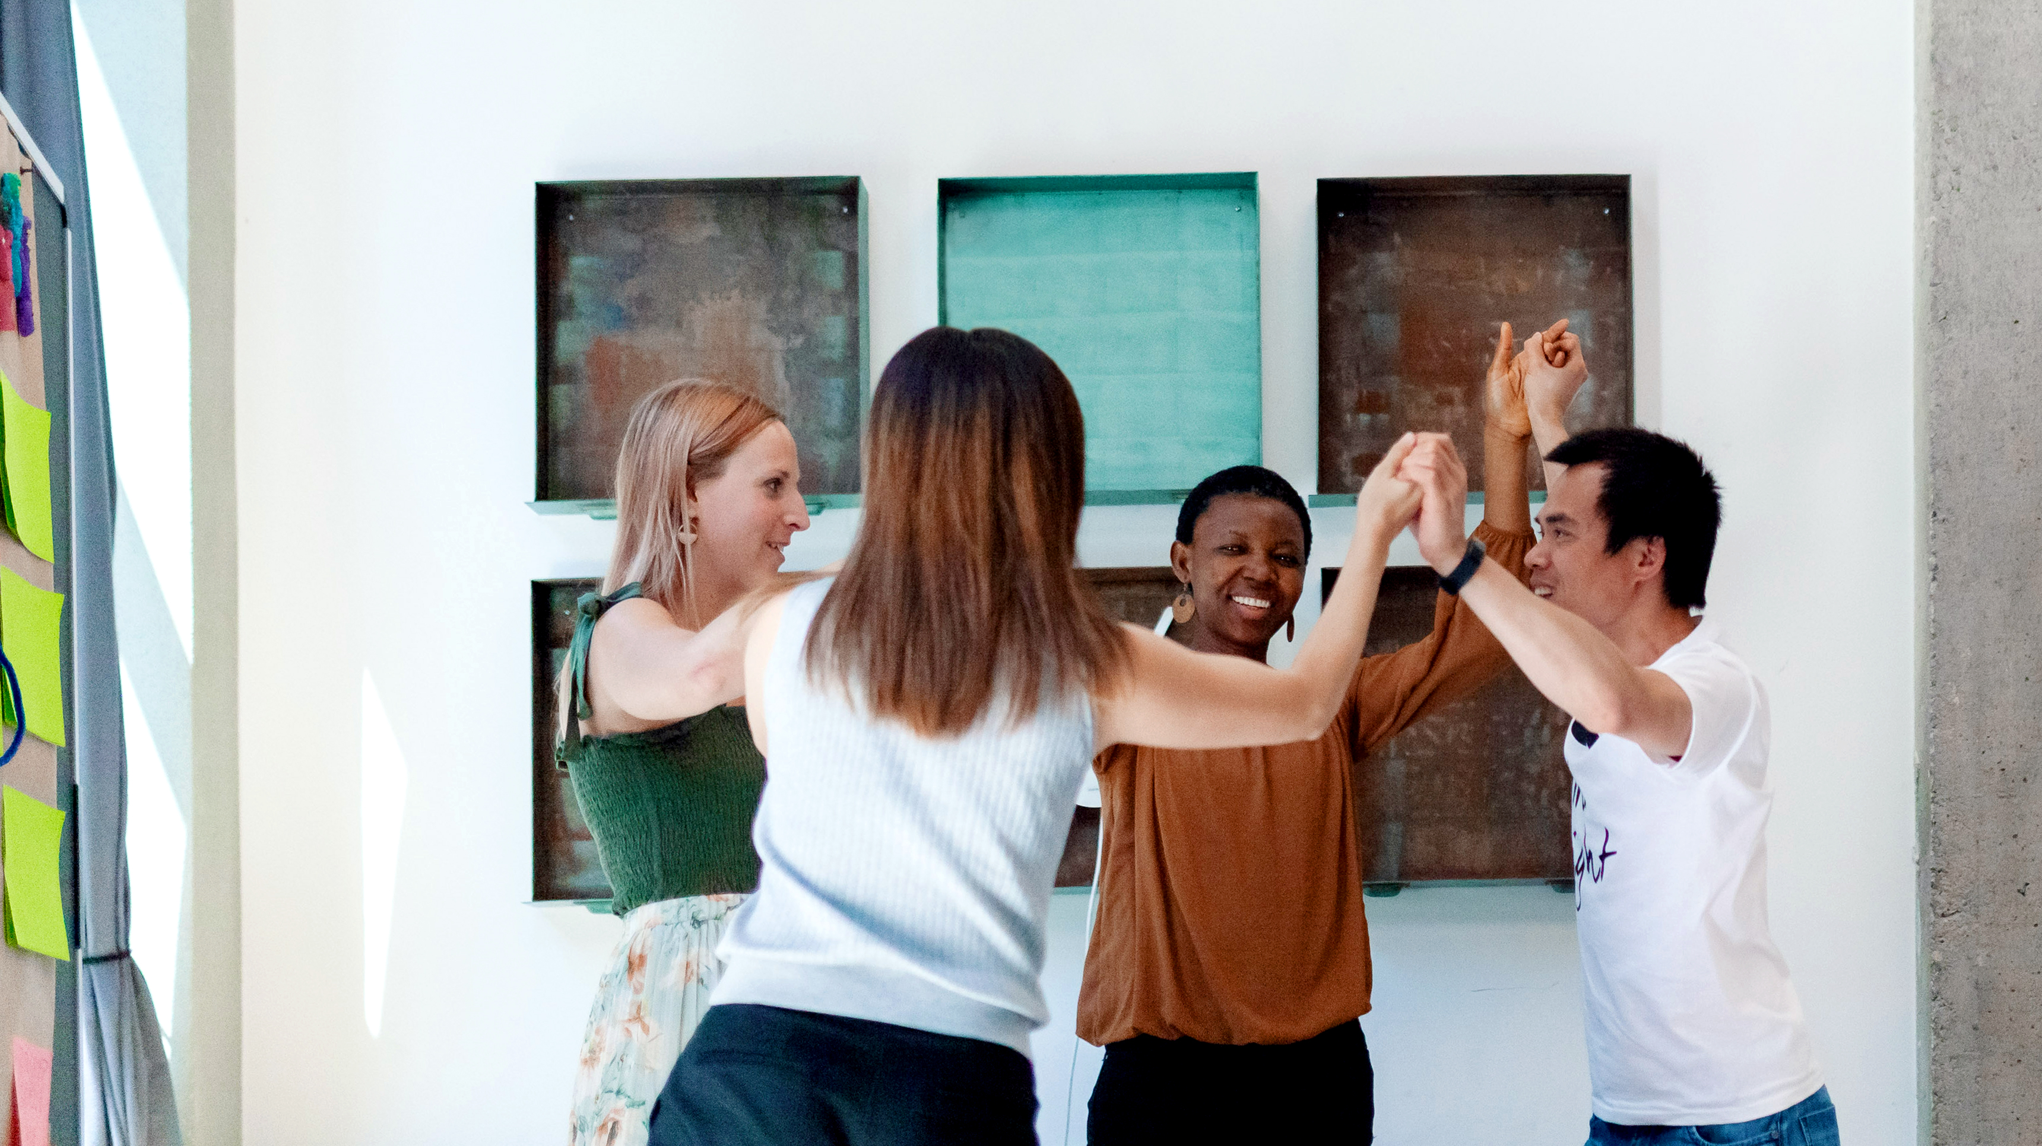
THE END

