Slide 1
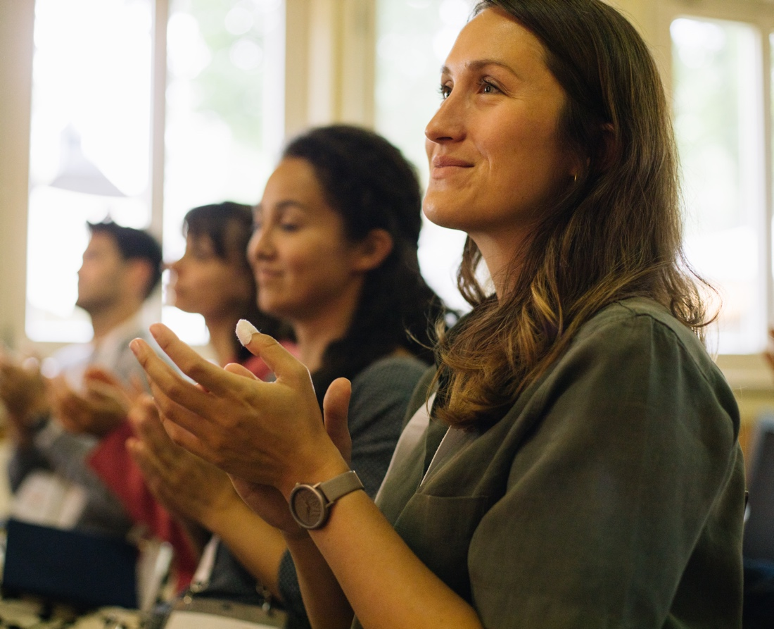

Slide 2
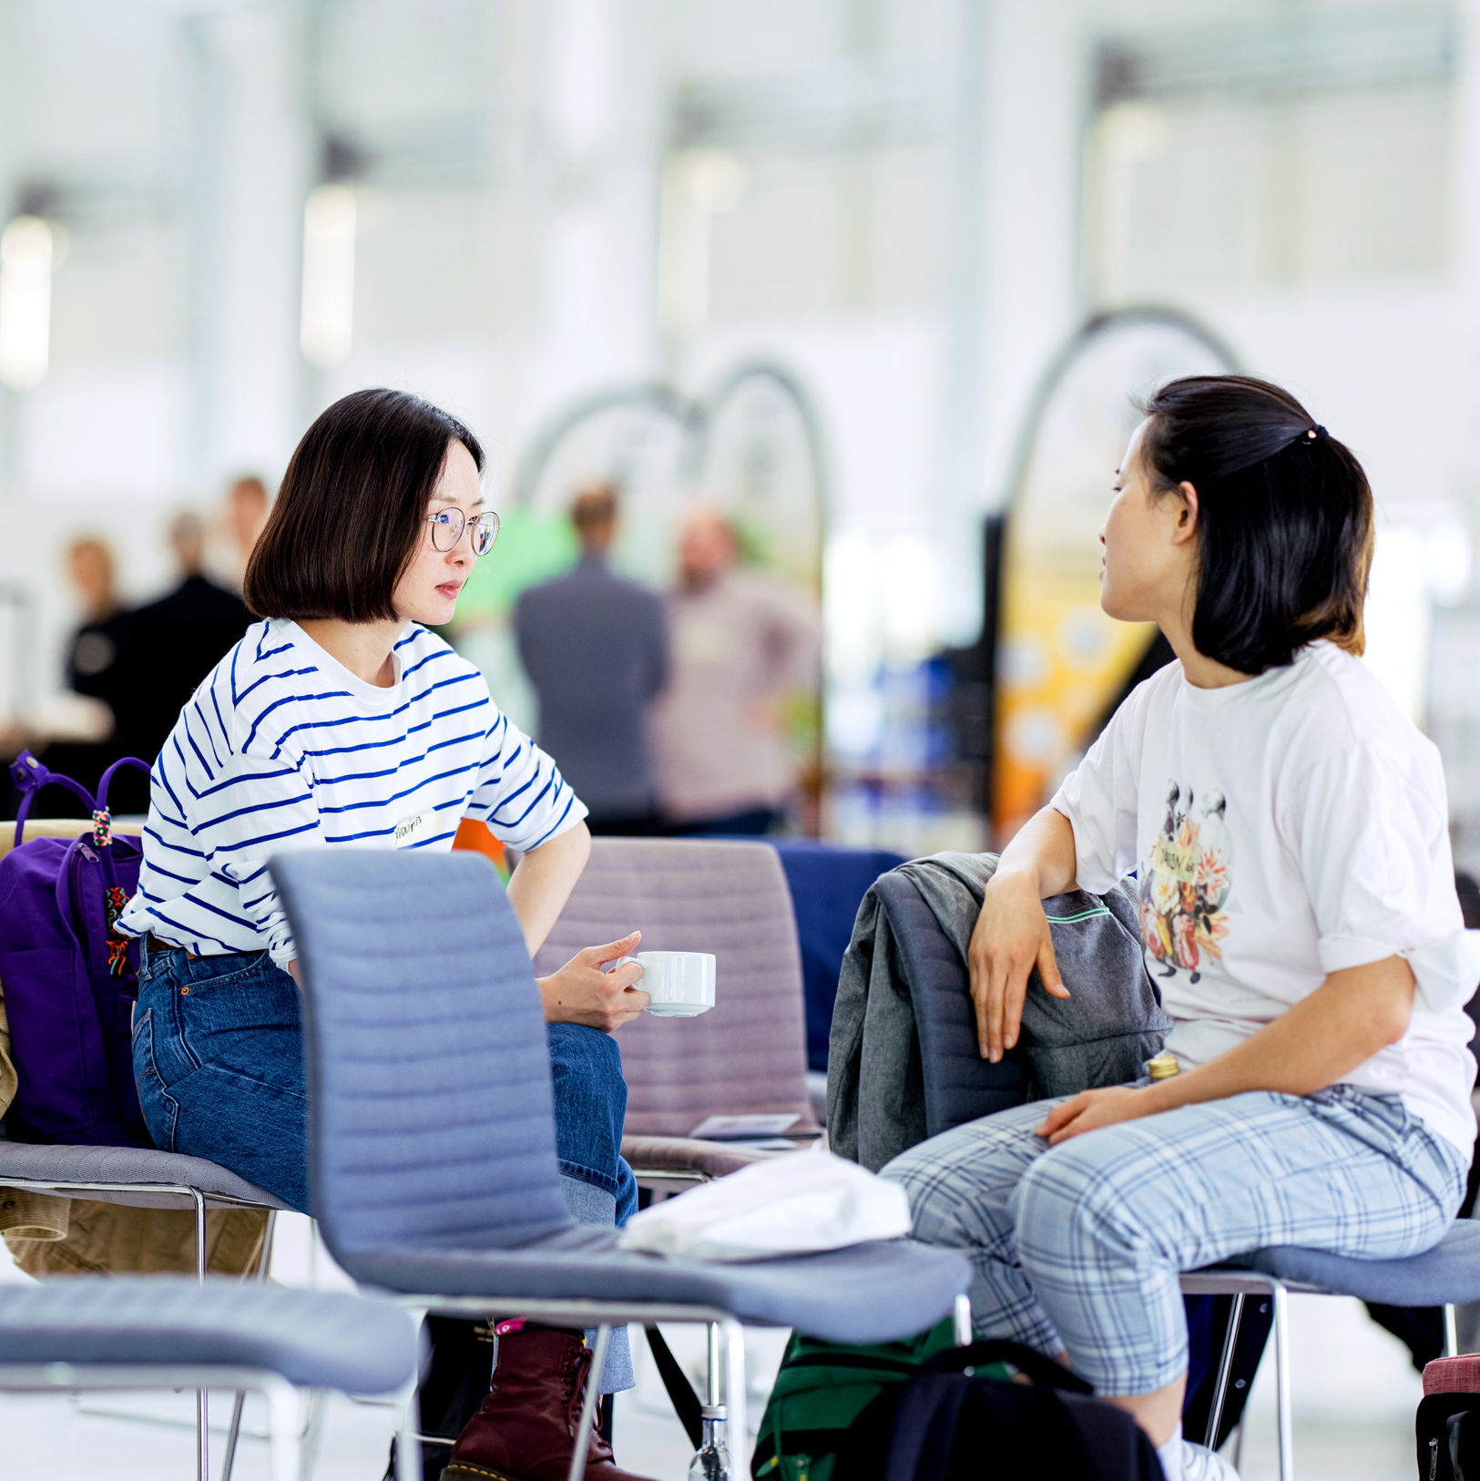
Young Entrepreneurs in Science
opens up new career perspectives
for young researchers
part of the Falling Walls Foundation
enabled by Federal Ministry of Research, Technology and Space
www.youngentrepreneursinscience.com
Notes:
Young Entrepreneurs in Science (YES):
Originally started as an offline workshop series in various cities across Germany.
Now offers a diverse program of Offline and Online workshops tailored for PhDs, Postdocs and Master students
Project Team:
Comprises 12 team members.
Part of the Falling Walls Foundation, a non-profit organization based in Berlin.
Falling Walls Foundation:
Aims to communicate science and research to the public.
Promotes interdisciplinary exchange and collaboration.
Workshop Benefits:
Strongly supported by a broad network in academia and business.
Designed to foster entrepreneurial thinking and skills among researchers: cultural transfer
BMFTR:
Participation is made possible free of charge through funding from the BMFTR (Federal Ministry of Research, Technology and Space).

Slide 3
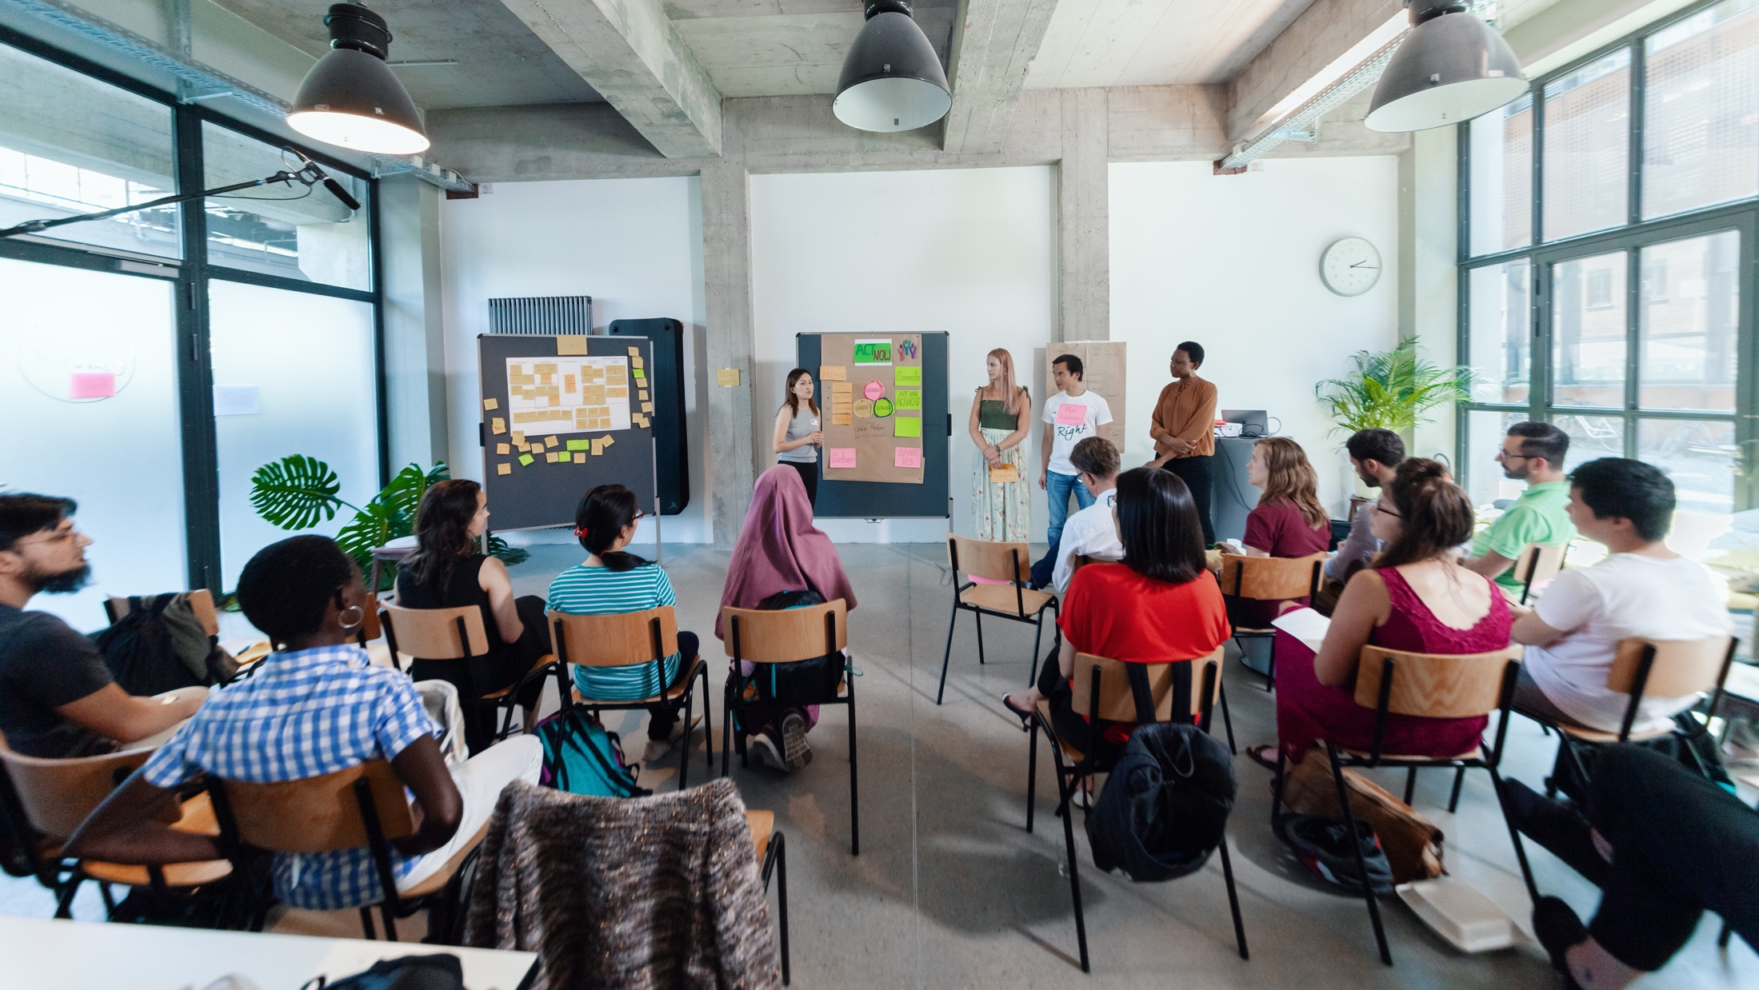
MEET THE TEAM
Notes:
So my name is XX, I‘m working as…
Moderating this session with me is XX. (M2 stellt sich selber vor)
And last but not least please meet the maybe most important (wo-)man in the room today: XX. XX is in charge of the technical support and is here to help with any technical problems.
XX in your role as techincal support would you please introduce us to some basic rules and tricks, that are important in our digital setup today?

Slide 4
Agenda
Lunch Break
Part I
Part II
Modul 1
Check-In
Modulinhalte
Modul 2
Modulinhalte
Wrap-Up
Notes:
Wähle je nach Workshoplänge diese oder die kommende Slide aus.

Slide 5
Agenda
Lunch Break
Part I
Part II
Modul 1
Check-In
Modulinhalte
Modul 2
Check-In
Modulinhalte
Modul 3
Modulinhalte
Wrap-Up
Notes:
Wähle je nach Workshoplänge diese oder die kommende Slide aus.

Slide 6
Netiquette
Be respectful & constructive
Use AI responsibly: Use it to support the process, not to produce final results
Mute when not speaking
Be present: keep your camera on. Feel free to eat, drink, or stretch
Need help? Reach out to us via the chat if experiencing technical issues
React & engage: Use emojis or reactions to share feedback
Drop your questions or ideas in the chat – we’re all here to learn together!
www.youngentrepreneursinscience.com
Notes:
Be respectful & constructive
We encourage open feedback – just make sure it’s respectful, kind, and constructive.
Use AI responsibly
If you’d like to use AI during group work, make sure your whole group agrees. Use it to support the process, not to produce final results.
Mute when not speaking
Help keep the space clear by muting your mic when you’re not talking.
Be present
Stay social – keep your camera on if possible. Feel free to eat, drink, or stretch as needed.
Need help?
Reach out to our coaches via the chat if you’re experiencing technical issues.
React & engage
Use emojis or reactions at the bottom of your screen to share quick feedback or show you’re engaged.
Use the chat for questions
Drop your questions or ideas in the chat – we’re all here to learn together!

Slide 7
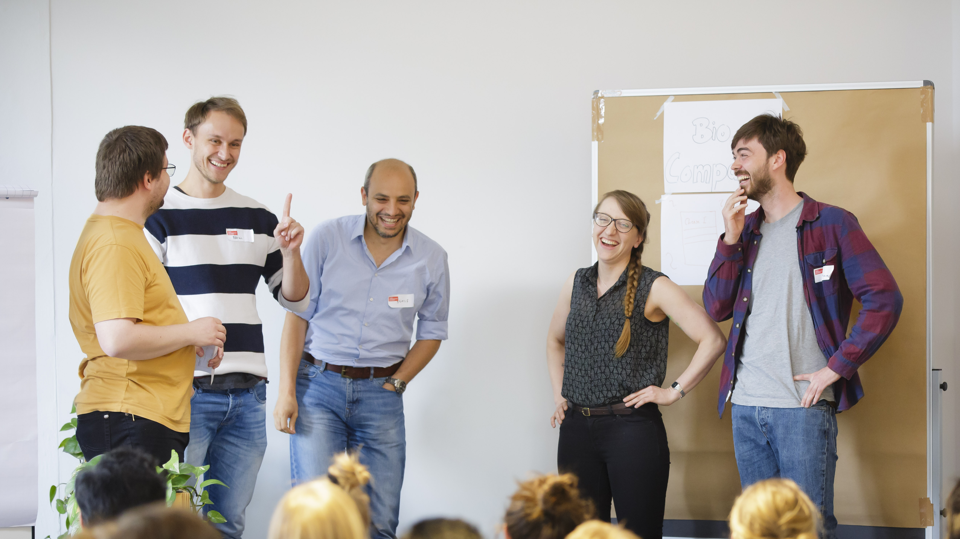
CHECK-IN
Notes:
Okay let’s start.
We always start our workshops with a check-in with the workshop-team – no matter if online or offline.
This is how it works (select next slide)

Slide 8





Emoji Check-In
1
2
Everybody, make a gesture how you are feeling today!
One after another: Introduce yourself with your name, location, and research topic. Then, pass on the speaking ball to somebody else.
Notes:
kurze Vorstellungsrunde:
Emotion als Geste alle zusammen
Vorstellen: Name/Wohnort/ Forschungsthema (kurz fassen)
Die Person, die gerade dran war gibt den digitalen Ball weiter an die nächste Person.
Wrap-up durch Moderation

Slide 9

BREAK

Slide 10
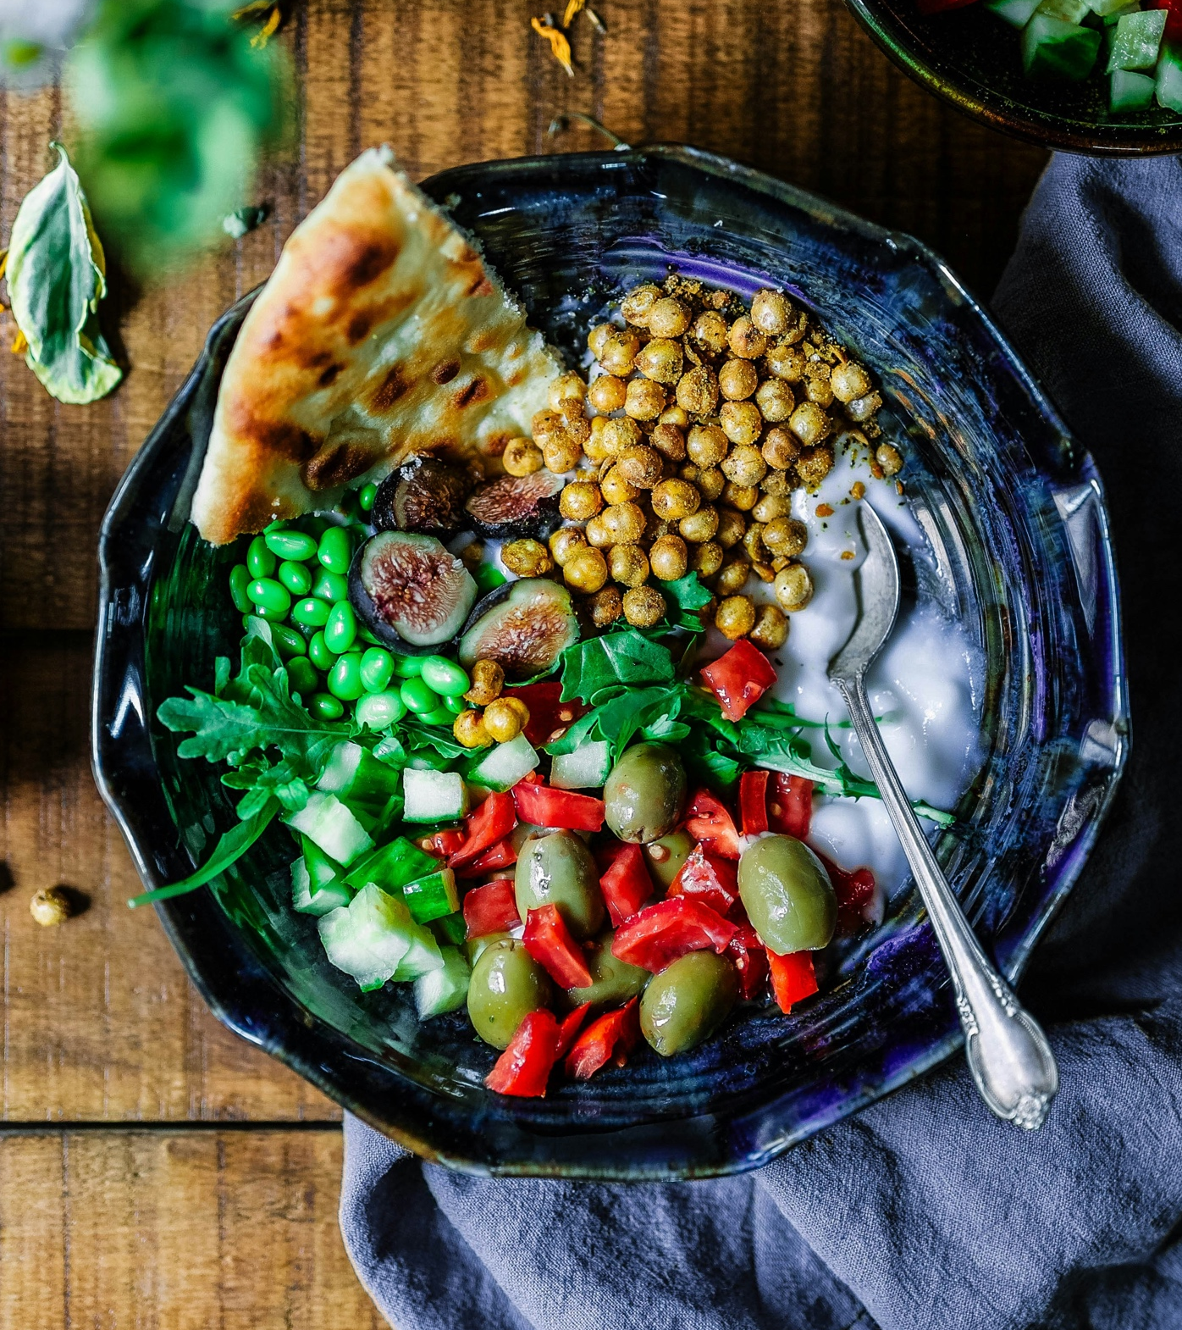
Lunch Break

Slide 11
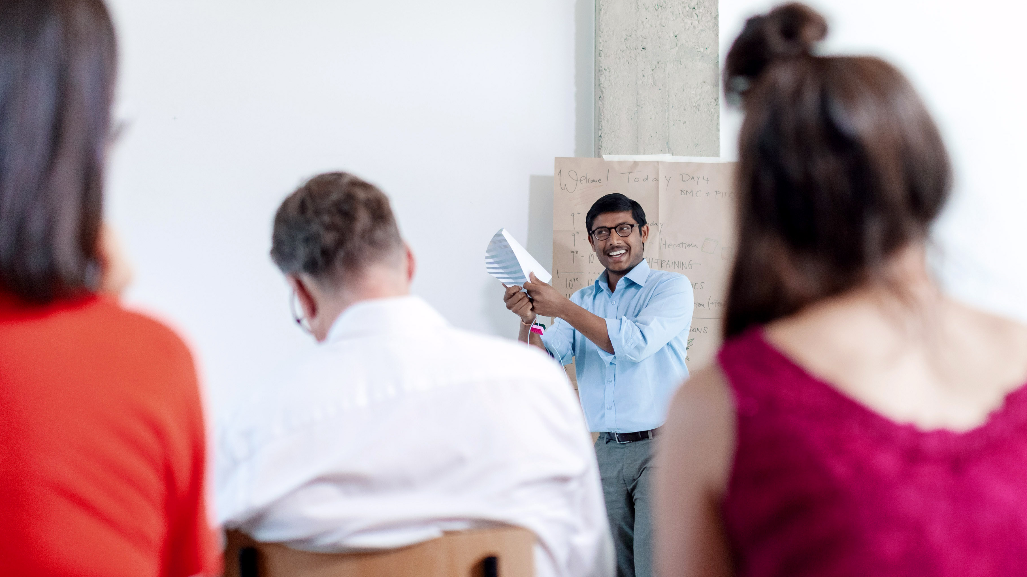
FEEDBACK
Notes:
Okay let’s start.
We always start our workshops with a check-in with the workshop-team – no matter if online or offline.
This is how it works (select next slide)

Slide 12

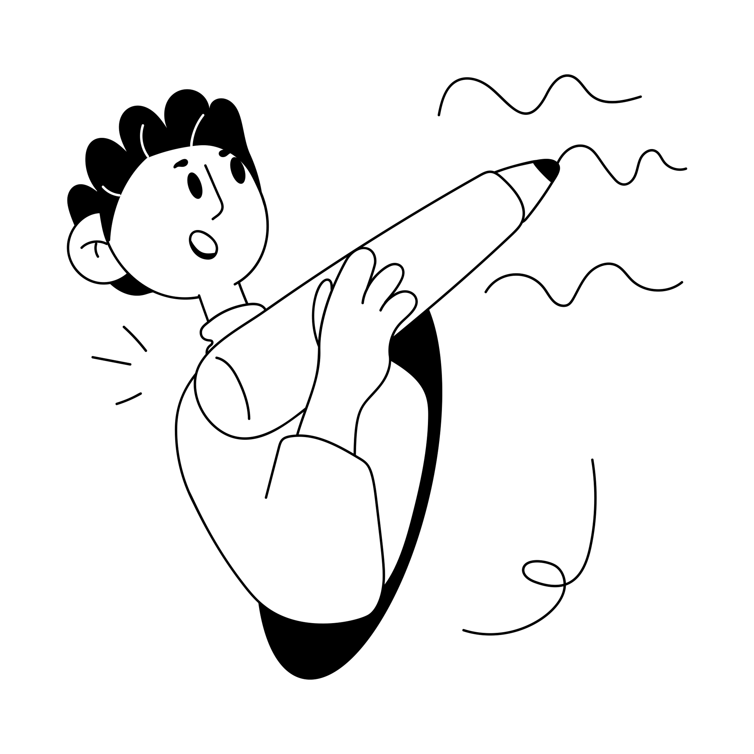
Time for feedback!
Please, follow the link in the chat window.
Notes:
We are slowly coming closer to the end of our webinar.
Voting:
https://www.menti.com/8e6ep9x69v
Live Results:
https://www.mentimeter.com/s/329967d62d62600663ea12c57edcd833/89373f032a29
And before we say goodbye we would love to know and share with all the participants:
your main insights or learnings you take away from today.
Therefore we gonna use a different tool and I will hand over to Roman now to explain to you how that works!
Roman, it‘s your turn ☺

Slide 13

Sharing
Are there any comments, thoughts or questions
you would like to share?
Raise your hand.
Notes:
Live-Interaktion im Hauptraum

Slide 14
What‘s next?
Back in the same virtual room
Via the same link
Starting at [insert time]

Slide 15
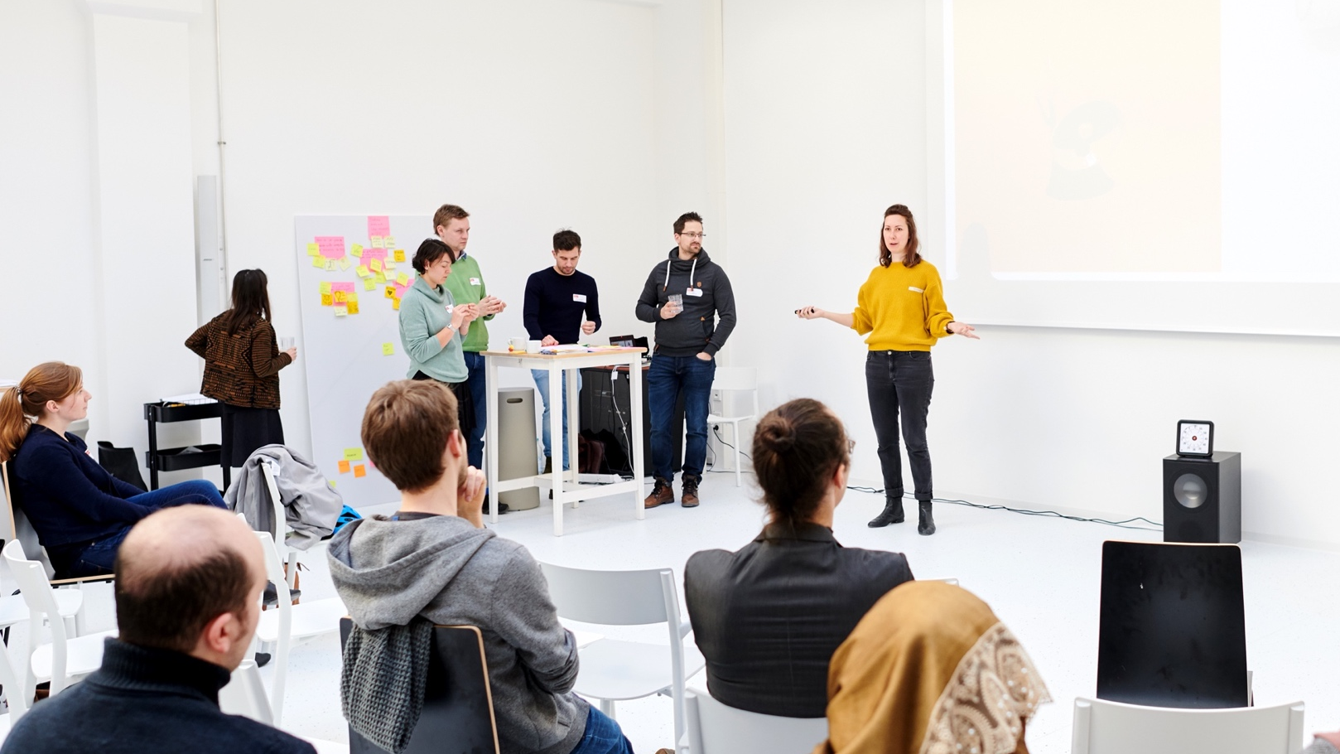
END OF DAY 1
Notes:
Check-in mit den TN, s. Agenda

