Slide 1

Your Power, your Story
Online

Slide 2
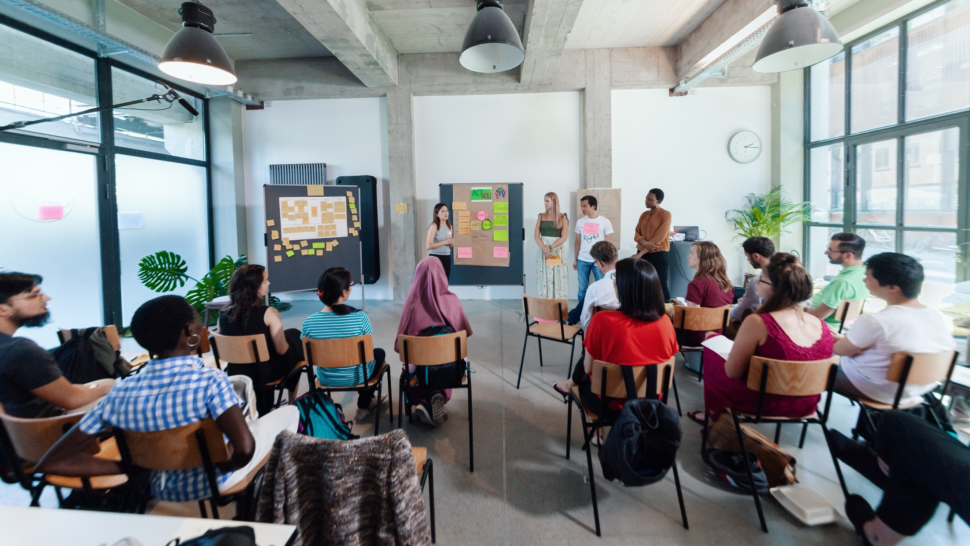
MEET THE TEAM
Notes:
So my name is XX, I‘m working as…
Moderating this session with me is XX. (M2 stellt sich selber vor)
And last but not least please meet the maybe most important (wo-)man in the room today: XX. XX is in charge of the technical support and is here to help with any technical problems.
XX in your role as techincal support would you please introduce us to some basic rules and tricks, that are important in our digital setup today?

Slide 3

Young Entrepreneurs in Science
opens up new career perspectives
for young researchers
part of the Falling Walls Foundation
enabled by Federal Ministry of Education and Research
www.youngentrepreneursinscience.com
Notes:
Young Entrepreneurs in Science (YES):
Originally started as an offline workshop series in various cities across Germany.
Now offers a diverse program of Offline and Online workshops tailored for PhDs, Postdocs and Master students
Project Team:
Comprises 12 team members.
Part of the Falling Walls Foundation, a non-profit organization based in Berlin.
Falling Walls Foundation:
Aims to communicate science and research to the public.
Promotes interdisciplinary exchange and collaboration.
Workshop Benefits:
Strongly supported by a broad network in academia and business.
Designed to foster entrepreneurial thinking and skills among researchers: cultural transfer
BMBF:
Participation is made possible free of charge through funding from the BMBF (Federal Ministry of Education and Research).

Slide 4





Netiquette
Mute yourself when you’re not talking
Be social and leave on your camera. Feel free to eat, drink, or stretch!
If you have technical issues, please write to our coaches
For direct feedback you can use the emojis you find on the bottom of the operating panel
For questions or feedback, please use the chat window

Slide 5
Entrepreneurial Empowerment Journey
Pitch Training
Introduction to key principles for a convincing pitch
Develop your own pitch and get feedback
Present your pitch on stage
Associations with entrepreneurship
Your resource profile & sources of support
Retro & next steps

Slide 6
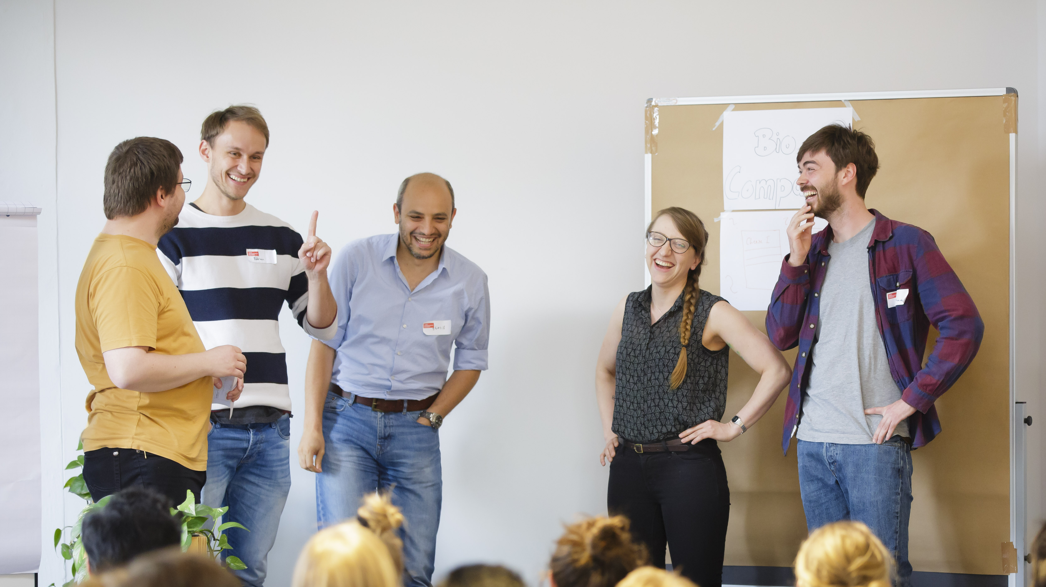
CHECK-IN
Notes:
Okay let’s start.
We always start our workshops with a check-in with the workshop-team – no matter if online or offline.
This is how it works (select next slide)

Slide 7

Emoji Check-In
Everbody, show us your emoji mood!

Slide 8
Learning goals
Gain confidence for yourself on the subject of founding
Reflect on your own resources and potential support
Get inspired by female founder personalities

Slide 9



Up for the journey?
+
MIRO
(Digital Whiteboard)
Short videos from
women founders
Notes:
Our training setting for today:
Work on MIRO for those who don't know it
Get inspired by short videos from women founders with scientific background
Any questions so far?

Slide 10
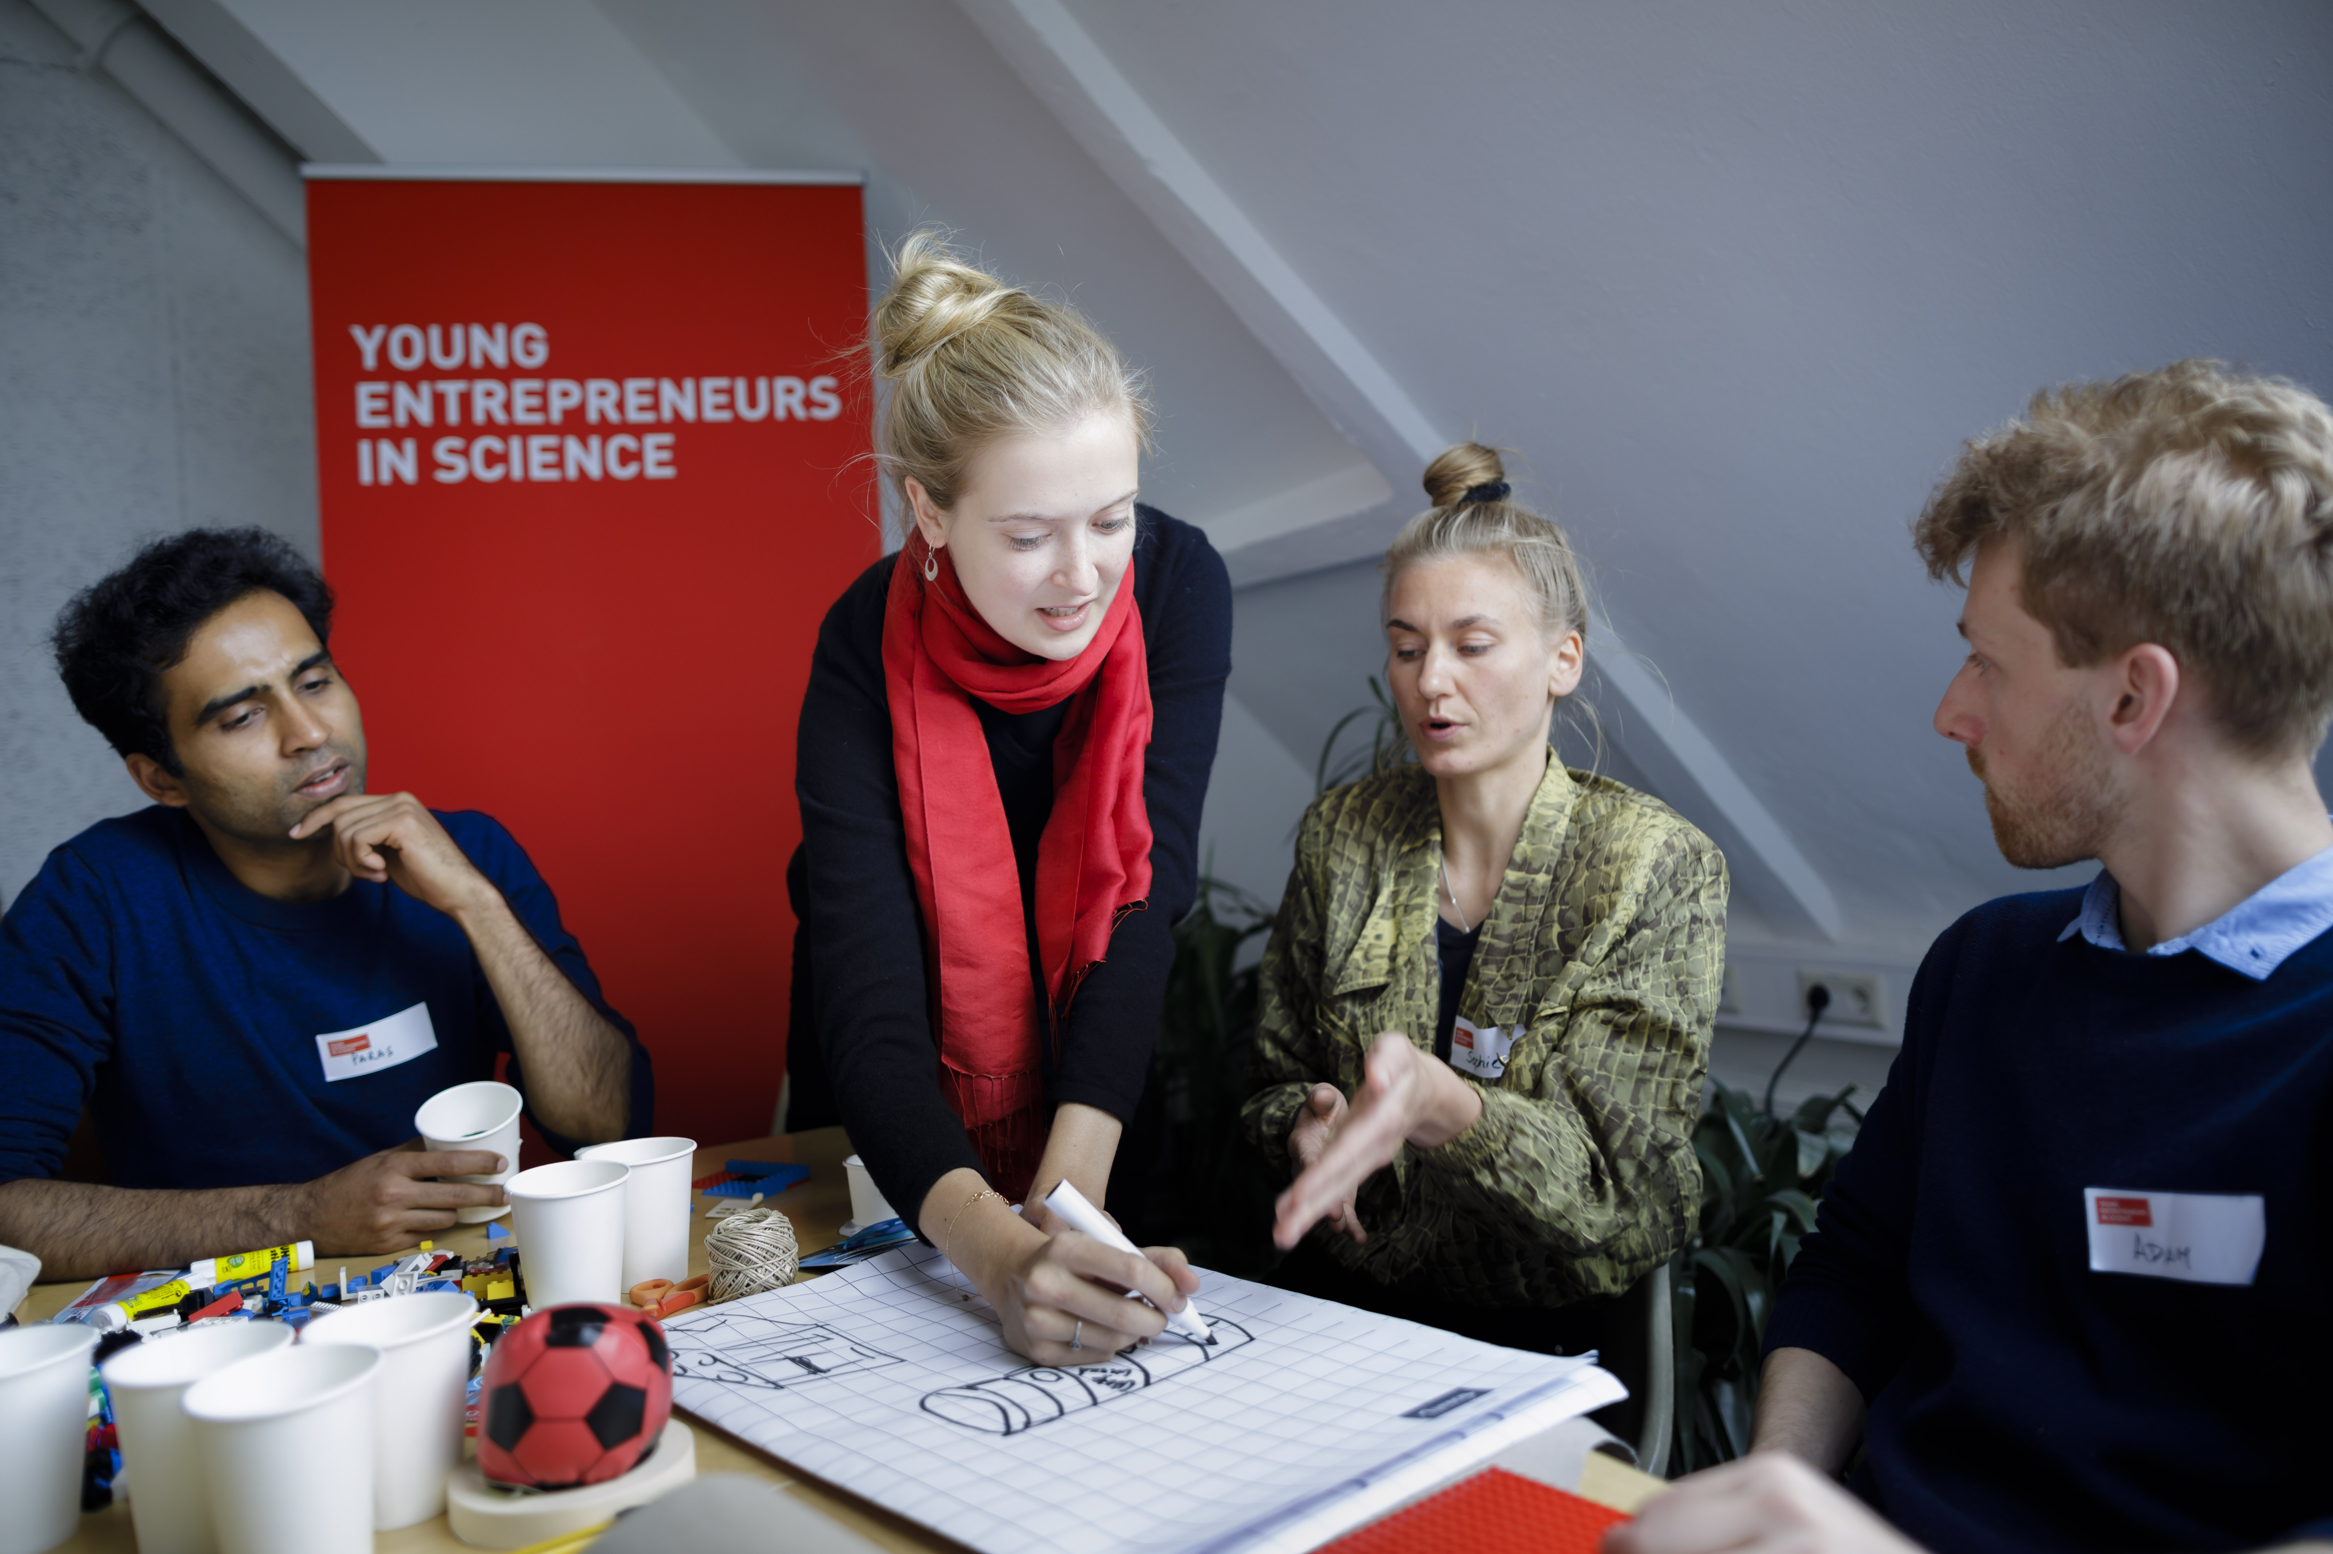
Let’s look at
the context …
Notes:
There is a big need to support and promote entrepreneurship for women…and why is that…let’s look at following graph.

Slide 11
Please guess ...
87%
80%
77%
65%
51%
53%
35%
20%
49%
47%
5%
1%
Total population
High school
Venture capital volume
Source: Female Founders Monitor 2022, p. 3
Notes:
It’s time for you to guess here – you see two lines that touch each other on the left side and that move further and further apart to the right. On the left you see the total population and high school degrees, on the very right you see the percentage of venture capital volume or said differently external investment. What do you believe do those two lines represent? And what could the other figures represent?

Slide 12
And here the resolution
87%
80%
77%
Men
65%
51%
53%
35%
20%
49%
47%
5%
1%
Women
University students
in subjects relevant for entrepreneurship
Venture capital deals
Venture capital volume
Total population
High school
Founders
Source: Female Founders Monitor 2022, p. 3
Notes:
The line above shows the percentage of men and the line below the percentage of women in different phases (whole population, high school diploma, students, founders of start-ups/compared to Selbständigkeit/freelancing, number of venture capital deals, venture capital volume)
Definition startups: young startups (less than 10 years) with a highly innovative/scalable business model, growth-oriented
Definition of Existenzgründung/freelancing: any kind of self-employment
You can recognize this huge gap and it is high time to close it. That’s why we are here today to reflect on the topic of entrepreneurship for women and all those that identify themselves as female and share your thoughts, ideas and concerns with each other.
One important thing that needs to be said: in the current statistics, sources and papers you’ll only find a binary division (men, women), all data showing gender identity is binary > this unfortunately cannot represent the whole reality, nevertheless we use the data to show the tendency.
More information if necessary:
Gender stereotypes influence the educational preferences of girls and boys from an early age and lead to different educational trajectories
the educational path already lays the foundation for the fact that women more often start up in areas where the activity is freelance and the entrepreneurial activity is less characterized by technical innovation.
Differences in the choice of field of study may explain gender-specific start-up activities.
For example, the high proportion of women graduating in medicine, law or literature and linguistics is a determining factor for the fact that women are so strongly represented in start-ups in the liberal professions.
their lower proportion in engineering and computer science is one reason why women are less likely to be found among the founders of startups
Due to the increased level of technology and digitization of innovative business models in recent years ("software is eating the world"), these disciplines are of particular importance for startups.
Women are more likely to start up as sideline entrepreneurs, less likely to be part of a founding team and less likely to have employees, more likely to be in the service sector, less likely to have a focus on end customers and less likely to want to grow, etc.

Slide 13
Female founders’ have high impact potential
Of all female founder teams:
90%
89%
81%
Are profitable
Have high societal or ecological impact
Grow rapidly
Source: Female Founders Monitor 2022, p. 21
Notes:
The statistics show – there is great innovative and impact potential when women found startups…and this is also what our female founders say.
Women who start up are less visible but no less successful than their male counterparts.
Companies run by women are more stable and tend to stay on the market longer.
And: They have different, more impact oriented motives for founding than men.
Women's teams are characterized by a stronger focus on sustainability in their corporate strategy,
61% also identify with the area of social entrepreneurship.
Almost half of the female founders orient their company to societal or social issues. For men, the figure is just over one-third.
Money also plays a more decisive role for men: While economic success is essential for almost three quarters, only slightly more than half of the female founders are primarily interested in it.
women identify particularly strongly with sustainability objectives. (Green Startup Monitor 2023)
There is great potential in this, and it also shows that women are needed to tackle major societal problems and, of course, earn money at the same time.
Today, we'll talk about why, in addition to the big structural issues, it's also about how you look at the issue yourself and create awareness about it....
Wichtig: Videos immer eine Slide früher ankündigen, da sie automatisch abgespielt werden
But let‘s first introduce to our female founders and in a second following video you will hear why they believe that we need mor women entrepreneurship out of science…

Slide 14

Videosnippet:
Intro Role Models +
We need more Sciencepreneurship by women because…
Notes:
But let‘s first introduce them to you…

Slide 15

Notes:
And now let‘s hear why they believe we need more entrepreneurship by women…

Slide 16

Your entrepreneurial empowerment journey

Slide 17






Our journey today…
1
3
2
4
My beliefs about entrepreneurship
My sources
of support
My entrepreneurial resources
Retro &
next steps
Notes:
Together we will go on an entrepreneurial empowerment journey the next 2 hours and we’ll shortly want to introduce you the steps included.
1. We’ll talk and share about the associations that you have on entrepreneurship
2. You will have time to look at the resources that you already have and to build your entrepreneurial profile
3. We want to support each other and learn how what cooperation and support could be helpful for our own projects
4. We will look back and reflect on potential next steps
In the end: share with each other your takeaways from this workshop

Slide 18
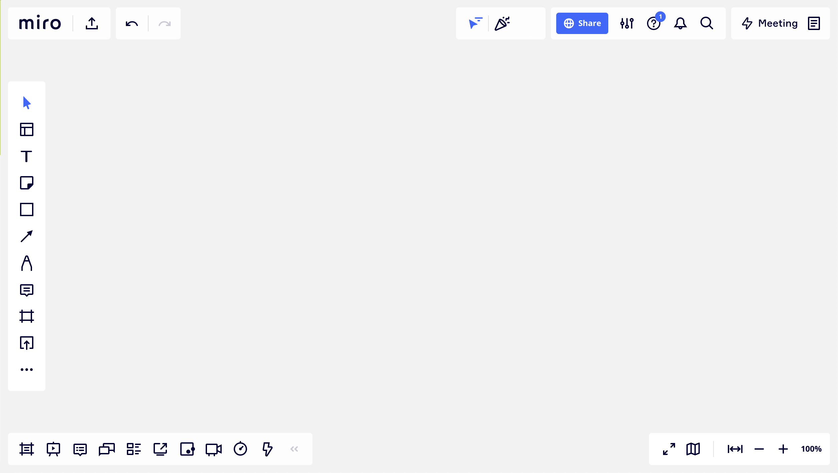
Welcome to miro …
text
sticky notes
navigation map
more functions, like stickers and emojis
zoom
Notes:
Short intro to Miro and most relevant features > ask: who of you has used Miro before?

Slide 19

Experience miro
Play around with sticky notes and write down your favorite women personality.
Notes:
In order to practice working with Miro a bit: Write down one female character/person that you admire/that inspired you (can be a founder or not)

Slide 20
Solo work
Warm up with MIRO
5 minutes
Transfer to MIRO and
find the Miro experience board on the top
Take a sticky note and post it in the template frame
Write down your favorite women personality
Change the size, the color and the shape of the sticky note

Slide 21




Beginning with step 1
1
3
2
4
My beliefs about entrepreneurship
My sources
of support
My entrepreneurial resources
Retro &
Next steps
Notes:
Together we will go on an entrepreneurial empowerment journey the next 2 hours and we’ll shortly want to introduce you the steps included.
1. We’ll talk and share about the associations that you have on entrepreneurship
2. You will have time to look at the resources that you already have and to build your entrepreneurial profile
3. We want to support each other and learn how what cooperation and support could be helpful for our own projects
4. We will look back and reflect on potential next steps
In the end: share with each other your takeaways from this workshop

Slide 22
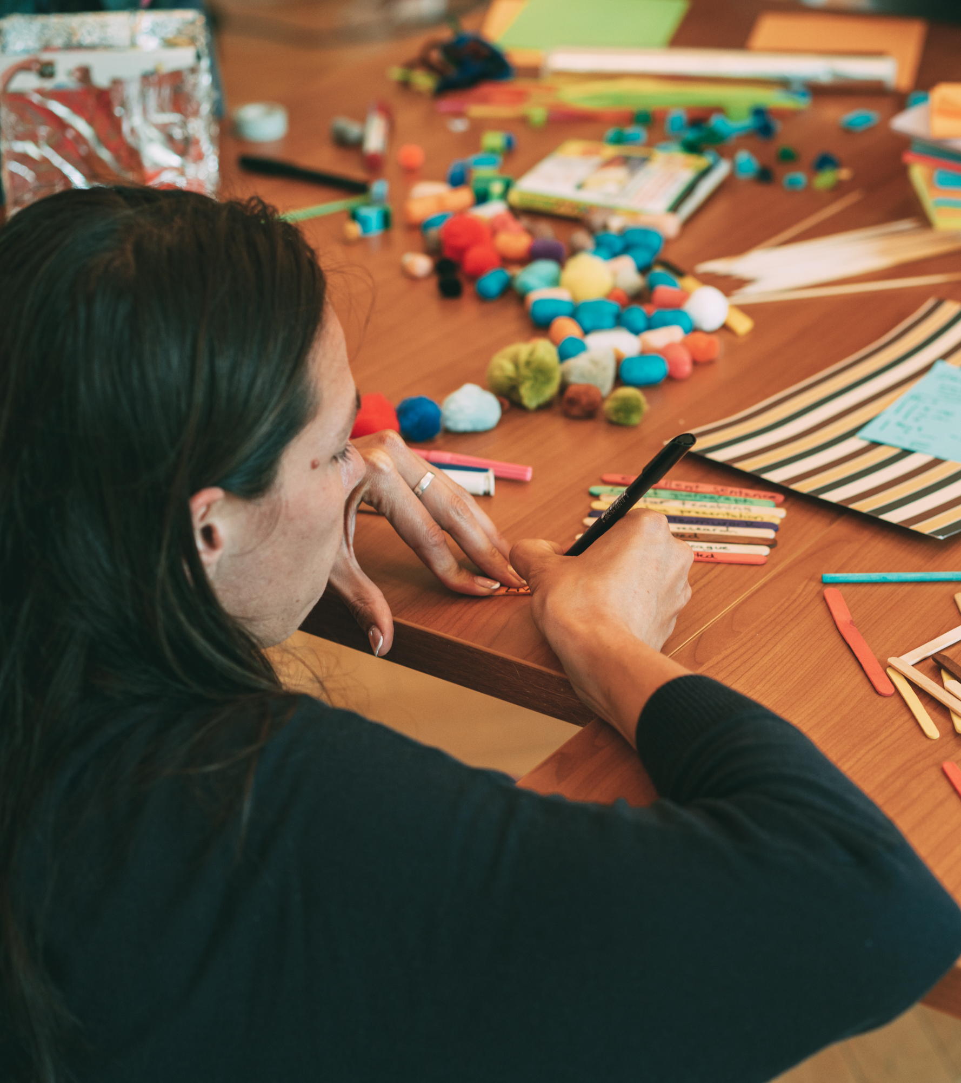
Step 1:
Your beliefs
Notes:
Let’s now begin with our journey and walk the first (baby) steps – what do you actually associate with entrepreneurship. We want to dedicate a moment to this question.

Slide 23





Step 1
When I think of entrepreneurship,
what comes to my mind is…
Notes:
Reflect on this question – what comes to your mind, when you think of entrepreneurship
What pulls me there and what pushes me away?
You‘re also invited to post any fears or negative thoughts there.

Slide 24
Solo work
Your beliefs:
5 minutes
Stay in main room
and mute yourself.
Use the Miro template
for Step 1.
Take a moment and write down all your thoughts to following sentence:
When I think of entrepreneurship, what comes to my mind is…
Put your sticky notes on the relevant area.

Slide 26
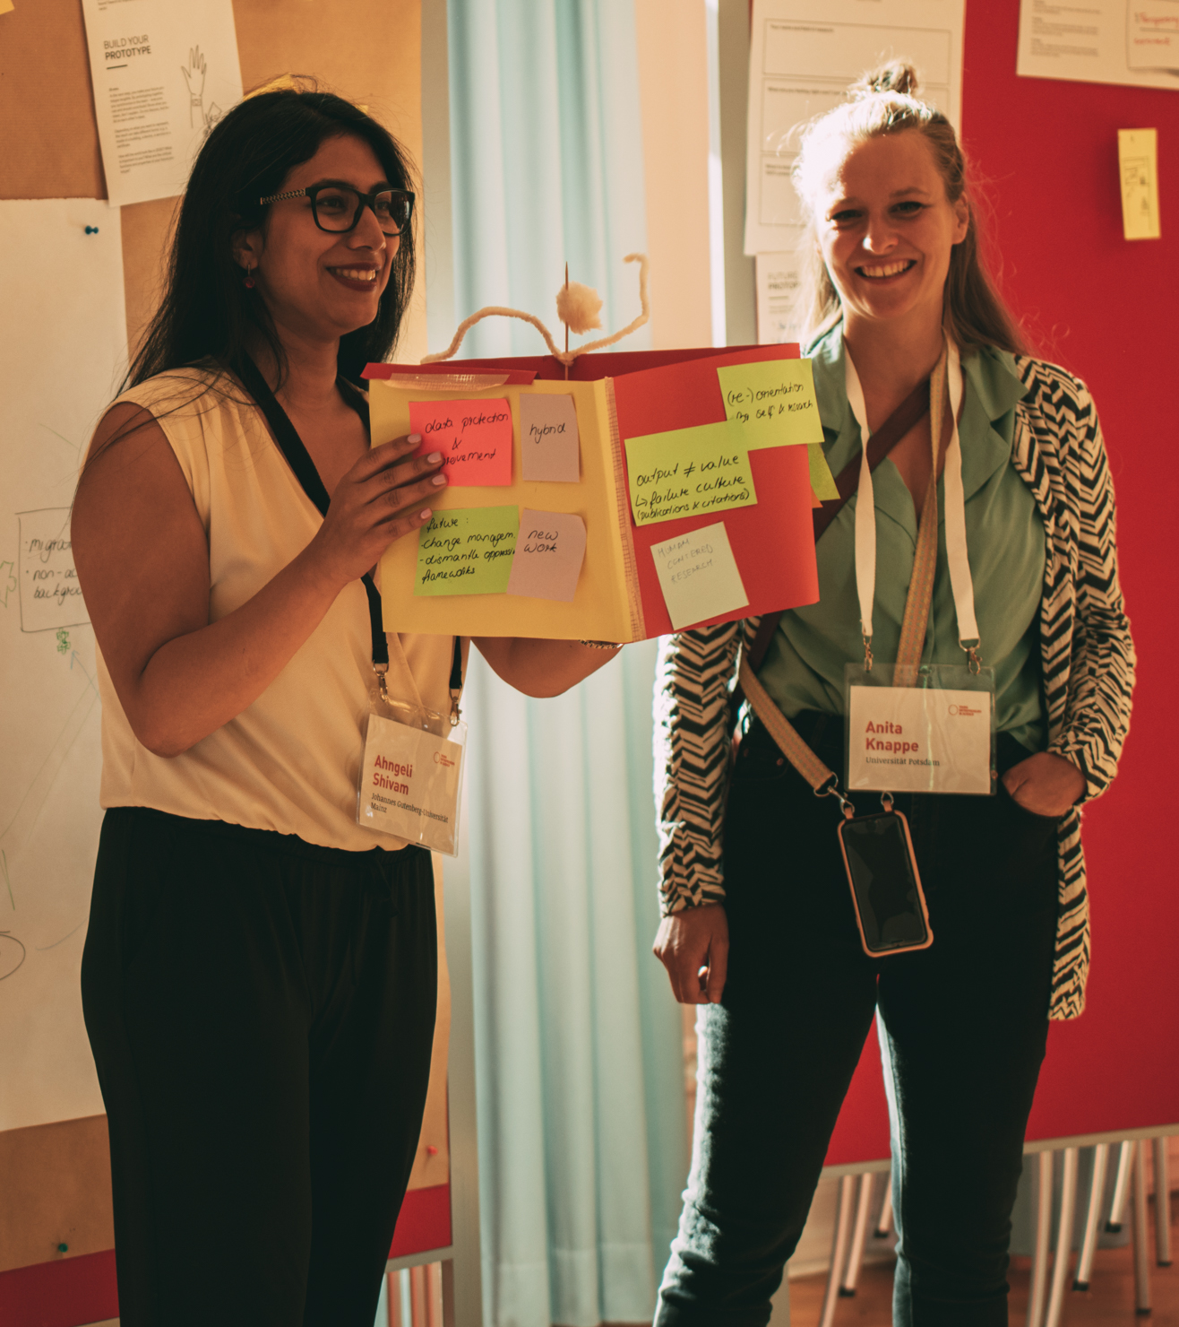

Share your beliefs
Notes:
We want to give you some time to share your thoughts and associations in small groups. For this we will send you in breakouts for 10min.

Slide 27
Teamwork
Share your beliefs:
10 minutes
Digital Breakout Rooms
Use the Miro template
for Step 1.
Share your beliefs in the group and exchange with others.
If you want,
add new sticky notes.

Slide 28
Notes:
Next Video: You might have seen a diversity of different beliefs and thoughts about entrepreneurship, not necessarily reflecting the stereotype that we often have in mind. Now let‘s hear what our female founders say about the meaning of entrepreneurship to them.

Slide 29

Videsnippet: To me entrepreneurship means…
Notes:
You might have seen a diversity of different beliefs and thoughts about entrepreneurship, not necessarily reflecting the stereotype that we often have in mind. Now let‘s hear what our female founders say about the meaning of entrepreneurship to them.

Slide 30
Continuing with step 2
1
3
2
4
My beliefs about entrepreneurship
My sources
of support
My entrepreneurial resources
Retro &
Next steps
Notes:
Let’s walk further on our journey to step 2 – your resources

Slide 31
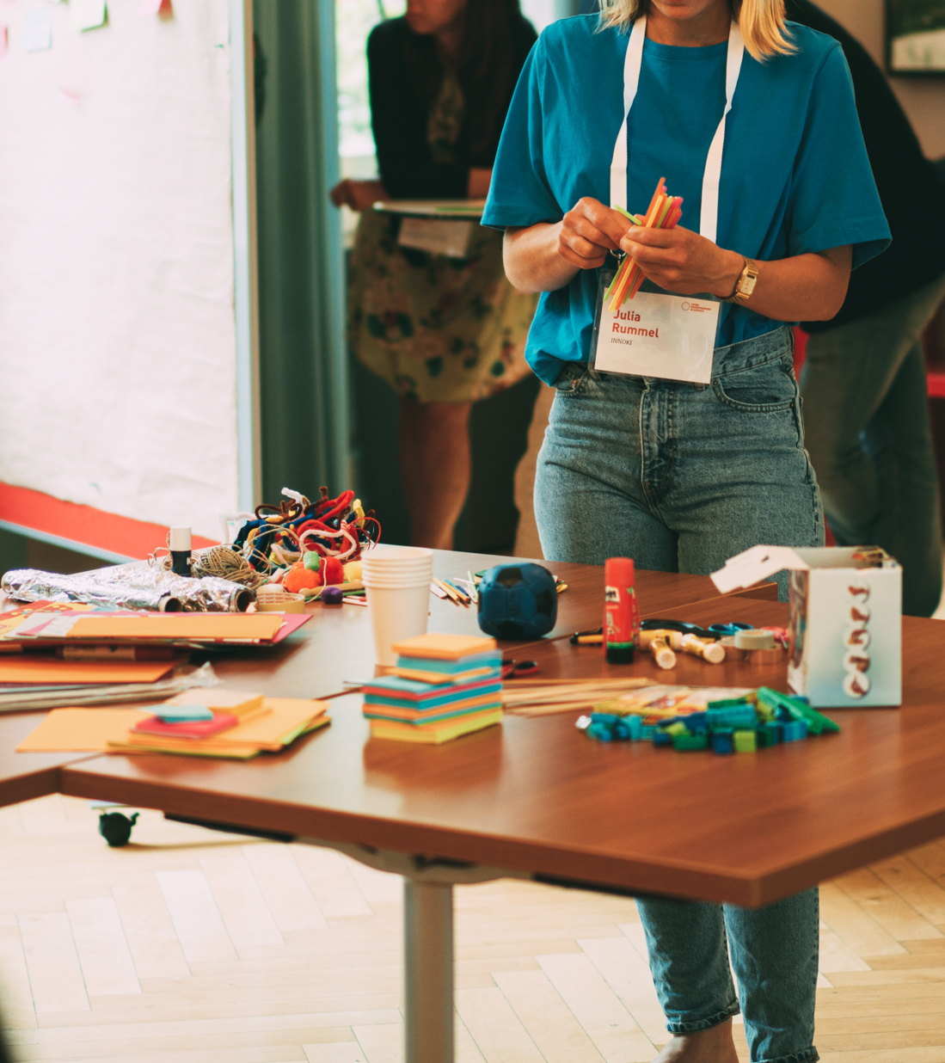

Step 2:
Your resources
Notes:
Next video: We would like to start again with a little video snippet by our female founders on their resources and gifts they bring to the world as an entrepreneur…

Slide 32

Videsnippet: The gift I bring to the world as an entrepreneur is…
Notes:
We would like to start again with a little video snippet by our female founders on their resources and gifts they bring to the world as an entrepreneur…

Slide 33

Step 2: Your resources profile
My professional & private experiences
My training & background
My expertise & skills
My successes (professional & private)
What I still need…
Notes:
So, gaining awareness for what you already bring to the table, for all your skills and experiences that you have and to know what you are especially good in and what not so much is very important.
It helps to be brave moving forward, to ask for support and be able to reflect on potential fields of improvement. We believe that writing it down, and showing it to others can also feel quite empowering. And that‘s what we invite you to do in the next exercise by filling out your own entrepreneurial profile with your background, experiences, qualitifactions, successes…
If it helps you please look at the example profile on the top on the Miro Board
You don‘t need to fill out the blue box on the bottom > we will come to that later

Slide 34
Solo work
Create your profile:
15 minutes
Stay in main room
and mute yourself.
Use the Miro template
for Step 2.
Fill out your resources profile by using sticky notes.
If you want, add visuals
and icons.

Slide 36
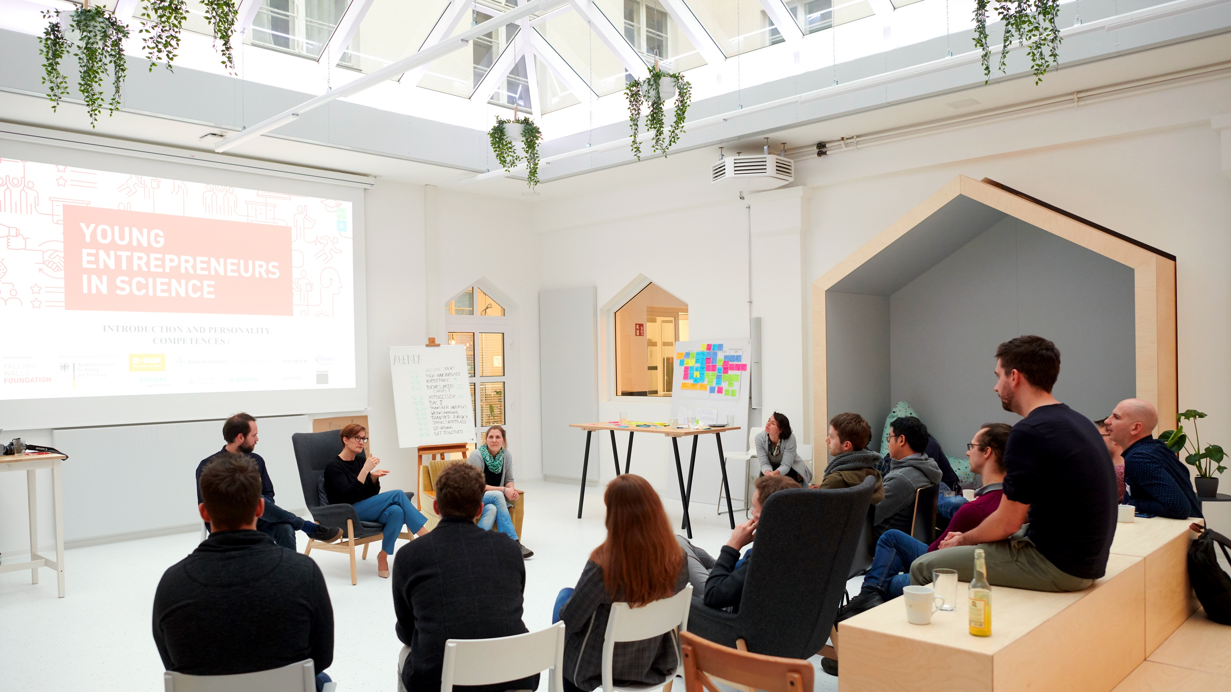
NEXT UP …
Notes:
We gonna have a little break now and will continue with our journey afterwards

Slide 37

It’s coffee
o’ clock!

Slide 38
On to step 3
1
3
2
4
My beliefs about entrepreneurship
My sources
of support
My entrepreneurial resources
Retro &
next steps
Notes:
Let’s walk further on our journey to step 3 – your sources of support

Slide 39
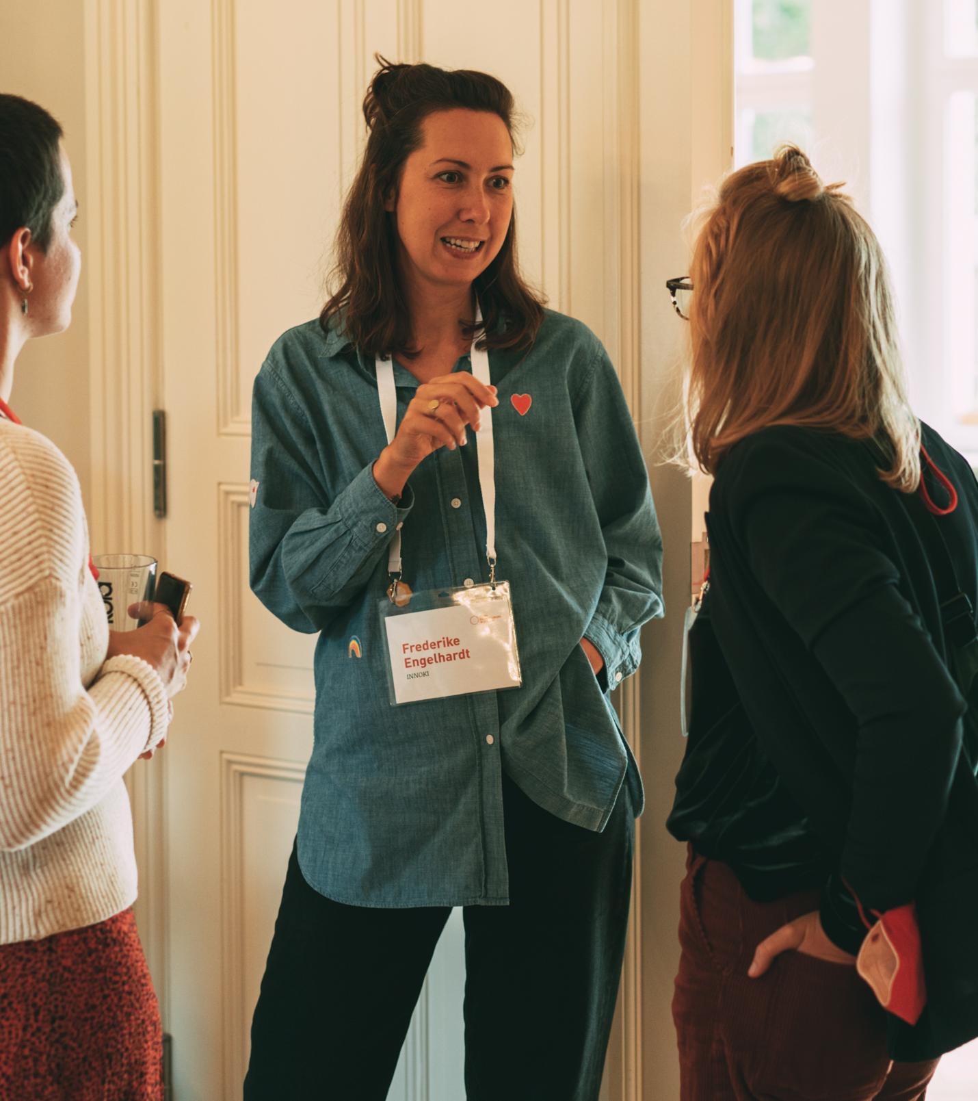
Step 3:
Your sources
of support
Notes:
Support and cooperation is something everybody needs and depends on when going an entrepreneurial path (or in general in life). You do not have to do it all by yourself and it’s allowed to ask for help ☺
Statistics also show that women in entrepreneurship have less access to networks but in case they do have access to networking opportunities they evaluate the effects of it as more positive than men.
We believe that cooperation and support also amongst women is a key aspect in order to foster female entrepreneurship in general.
Let‘s have a look at our next video snippet because all of our female founders were dependent on support from outside.

Slide 40
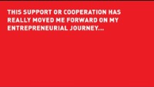
Videsnippet: What support or cooperation has really moved me forward…?
Notes:
Let‘s have a look at our next video snippet because all of our female founders were dependent on support from outside.

Slide 41


Let’s start with exercise 1
Exercise 1
Exercise 2
Appreciate the
other profiles
Brainstorm together on potential sources of support
Notes:
The idea is to support each other on the way; we also want to do that today here in this group in two exercises.

Slide 42
Solo work
Value the other profiles:
10 minutes
Stay in main room
and mute yourself.
Got to the entrepreneurial profiles on Miro.
Look through the resources profiles of the others.
Appreciate the other profiles with comments or visuals.
Notes:
Let‘s start with the first little exercise…
Feel free to use the appreciation icons in the star on the top – please copy paste instead of moving the icons

Slide 44


On to Exercise 2
Exercise 1
Exercise 2
Appreciate the
other profiles
Brainstorm together on potential sources of support
Notes:
The idea is to support each other on the way; we also want to do that today here in this group in two exercises.

Slide 45
Teamwork
Exchange with others:
15 minutes
Digital Breakout Rooms of 3
Go to the template on Miro
for Step 3.
Everyone, shortly introduce yourself and your project.
Brainstorm together, what support do you need to move your project(s) forward?
Write them on sticky notes
on the board.
Do you have any advise for
the other persons?
appr. 5 min brainstorming
for each person
Notes:
Thinking about a situation in which you‘re working on our own idea, you want to push it forward (maybe that‘s happening already, maybe not > future scenario) > what could be sources of support in this case? What kind of sources you can think of?
Examples for options of support to mention: closest friends to talk to, family/partner, mentor or coach, institutions like universities for infrastructure and equipment, startup communities, female founder communities – could be technical support, support with expertise, mental support…

Slide 47
Finishing with step 4
1
3
2
4
My beliefs about entrepreneurship
My sources
of support
My entrepreneurial resources
Retro &
next steps
Notes:
Let’s walk further on our journey to step 4 – looking back to what has happened in this workshop and looking forward, what are potential next steps?

Slide 48

Step 4:
Retro & next steps
Notes:
But before you are doing that, llet‘s see what our female founders say….what would they have done differently on their journey

Slide 49

Videsnippet:
This is what I would have done differently today…
Notes:
Llet‘s see what our female founders say….

Slide 50


Look back and look forward
1
2
Pick the aspects from the steps
before that are most relevant to you,
note them down.
What are the next 3 concrete steps to take after this workshop?
Notes:
Examples for the second step: contacting one of the persons in this digital room, talking to your friend about this workshop, sharing your project/ideas with someone close, visiting another female entrepreneurship event and learn more about it, taking a deeper look into your skills…

Slide 51
Solo work
Retro & next steps
5 minutes
Stay in main room
and mute yourself.
Go to the template on Miro
for Step 4.
Take a moment and make notes to following questions:
Looking back at the journey, what were the most relevant aspects to you?
What are the next one or two concrete steps that you can take tomorrow?
Notes:
Step 1: could also be notes and impulses from the others in the group
Examples: contact a person in this group…
Wichtig zu sagen, da es sonst sehr allgemein wird: be as concrete as possible > what exactly could you do tomorrow?

Slide 52
Share with us what you take away!
Notes:
One last time, let‘s hear the wishes from our founders to all women from science/to you

Slide 53

Notes:
One last time, let‘s hear the wishes from our founders to all women from science/to you

Slide 54

BREAK

Slide 55
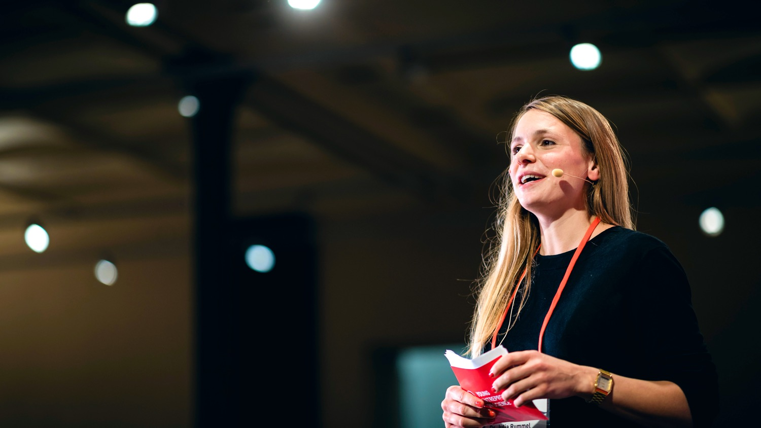
PITCH TRAINING
Notes:
Welcome to the pitch training.

Slide 56
Learning goals
Getting to know a relevant structure for a pitch
Learning about how to pitch online
Building a pitch on your own
Practise to hold a pitch in front of an audience
Notes:
Now it‘s time to have a look at how to communicate potential start-up ideas in a way that it is remembered!
Our learning goals for the next part are [read out loud and explain]

Slide 57

PITCH & STORYTELLING
Notes:
Let‘s go!

Slide 58
What is pitching?
A short but effective explanation
that is intended to persuade someone to buy a product or accept an idea.
Cambridge Dictionary
Notes:
So, let‘s have a look at what a pitch actually is: [read out definition]
Why pitch? The goal ist to win new customers, investors ot other supporters for your business.
The question is: what needs to be in a pitch to make it on point?
We have prepared 7 steps that we think is important to include.
The good thing: this structure of presenting your idea can also help to talk about it in generall.
So you should have these facts ready to talk about your idea.
And talking about the idea is super important to learn about it and develop it.

Slide 59
How to build a pitch
Problem
Target Group
Notes:
Let‘s take a look at the steps:
Problem: Come up with one sentence about what the problem you are solving with your problem is
When you have a problem you are solving, I am sure that s.o. is also affected by that problem:
Target group: Who is this person? For whom are you trying to solve the problem? Who is your target group? Who will be using it?
It‘s always tempting to say: it‘s for everyone. Really make sure to make it concrete and define a clear user group.

Slide 60
How to build a pitch
Problem
Target Group
The solutions
User experience: how does it work?
Notes:
Next...
Present your solution: Explain the product and tell how it works.
Make sure you define a good problem-solution fit: means: those aspects should really work well together: make sure your solution ANSWERS your problem
Keep youe explanation short & simple. Especially with tech. solutions: It is tempting to deep dive into technical details.
Don‘t do it. People will ask if they have questions. This is a pitch: You want to keep the attention of the audience
User experience: You can show a prototype, ask s.o. to try your product or make a video of s.o. interacting with it.

Slide 61
How to build a pitch
Problem
Target Group
The solutions
User experience: how does it work?
Create trust (team / market / finances)
Notes:
Create trust: Show that you know what you are doing when developing the idea
Who is working on the idea? Which people do you have for it in the team? Why is your team a great fit?
Show that you know the market you are operation in: What is the competition?
Present an overview of your financial plan: Make it transparent what happens with the money. Show them how you plan on growing the business financially.

Slide 62
How to build a pitch
Problem
Target Group
The solutions
User experience: how does it work?
Create trust (team / market / finances)
Punchline
Notes:
The come up with a little wrap-up/reminder:
The Punchline: In one sentence: Tell the mame of the product and what it does.
Keep it short and simple for everyone to remember!

Slide 63
How to build a pitch
Problem
Target Group
The solutions
User experience: how does it work?
Create trust (team / market / finances)
Punchline
Call to action
Notes:
And as step 7: Include a call to action!
Call to action = a small assignment.
Communicate what it is you want from the audience, eg:
to sign up for my newsletter?
to come over and ask questions?
to invest into a beta-version?
To formulate a call to action - make sure to really know whom your pitch is aiming at: What is your audience? What do you want from those poeple?
Keep in mind that there is a difference between pitching in front of an investor or a customer!
So much for the different steps... 1-7

Slide 64
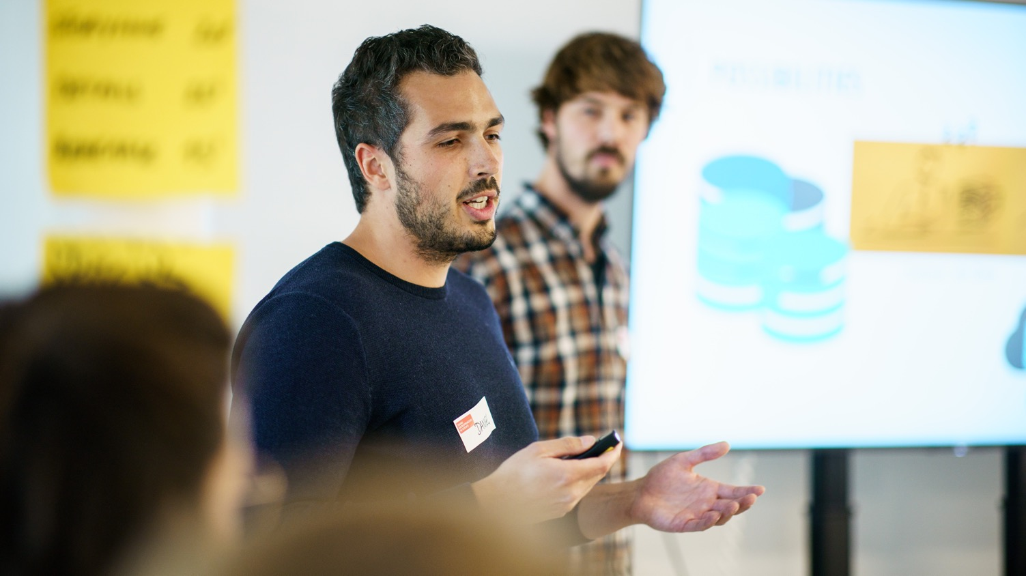
STORYTELLING
Notes:
Now that you have the facts, ist time to think about a good story/anecdote which introduces your pitch
You could for example introduce a hero or person that is really affected by the problem
(… once upon a time there was...)
Then show how big that probplem really is for the target group
Make sure the audience can feel the pain of the affected person.
Expecially as scientists this embedding of emotions and surprises might really feel weird because you leave out quite a lot of facts that you would usually include in a presentation.
But – once again – keep in mind that your aim is to keep the attention and interest of the audience
Also it‘s important to find your own style when presenting. Therefore you need to practise pitching quite a few times to find with which story you feel comfortable and authentic.

Slide 65
Why tell stories?
… because they draw us in emotionally
… because we can learn from them
… because they connect us
… because it’s easier this way for our brain to understand connections
… because they help us remember
Notes:
But why is storytelling so important?
Like I just said:
Especially as scientists, it might feel strange to focus on stories and emotions rather than raw data or detailed explanations.
But remember, stories draw us in emotionally, which keeps the audience connected to your message and helps maintain their attention.
Our brains are wired to understand patterns and connections better when they are simplified.
Therefore stories make it easier for us to grasp complex ideas, not because they remove facts, but because they present them in a more relatable and structured ways
Finally, stories stick with us: They help us remember information better because they activate more areas of the brain – emotion, imagery, and context – which makes the content far more memorable than a list of facts or data points.
Let‘s have a look at how this looks in the real world…

Slide 66
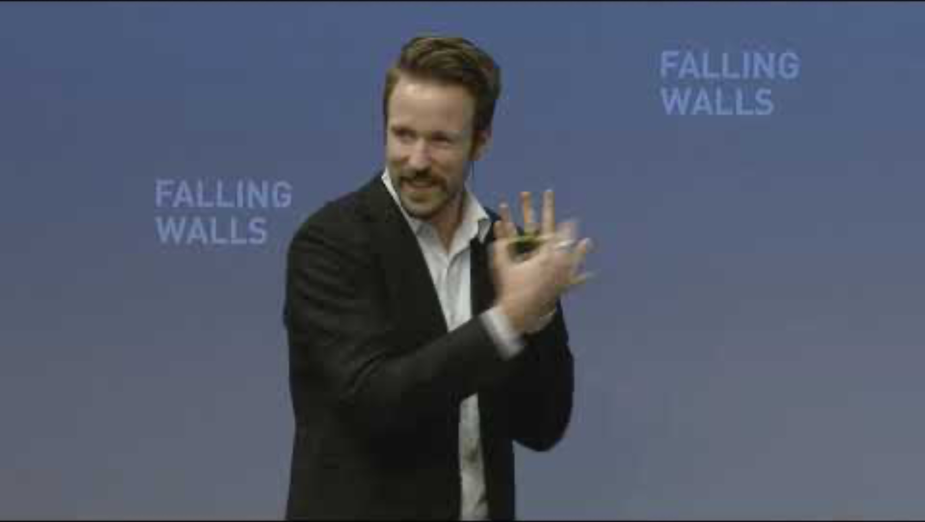
Notes:
…. Next we‘ll show you a video (around 3 mins) by Tom Bieling, Falling Walls Young Innovator of the Year 2014
He‘ll pitch his ides around the topic of Deaf-Blind Isolation.
Tom has developed a communication device for the deaf-blind, allowing to communicate with anybody, anytime.
Important: When you look at the video: It‘s not so much about the content, rather look at the structure & how the pitch is build / what the storyline is.
[after showing the clip: interaction with the participants]
___________________________________
Tom Bieling and his team at the Design Research Lab developed a communication technology for deaf-blind people, through which they can interact with anyone at any time. The Lorm Hand is an installation, which connects deaf-blind people with twitter or other social networks. Using touch sensory technology, the Lorm Hand enables deaf-blind people to compose text messages by applying the tactile hand-touch alphabet LORM, a common way of communication used by the deaf-blind. After typing a message on the Lorm Hand, it can immediately be tweeted or shared with social networks.

Slide 67
In summary …
… everybody needs to find her/his own style
based on the storyline!
Notes:
[refer to what has been said]
Make sure to take time to find your own style and your own storyline that you feel comfortable with.

Slide 68
What is next …
PART 1
Build your pitch individually
PART 2
Test your pitch and get feedback in groups
Notes:
The next exercise is divided into two parts:
Part I: You will have the chance to work on your skills on how to build a 2-minutes pitch and put it in an engaging story.
This part will be an exercise you will work on by yourself.
Part II: If you remember what we been talking about yesterday: The entrepreneurial mindset is all about getting feedback, learning by doing and iterating your idea?
And this is what we will do in part two:
You‘ll have the chance to actually test your pitch right away.
You‘ll work in teams of 3, test your pitch and then get immidiate feedback from your team.

Slide 69
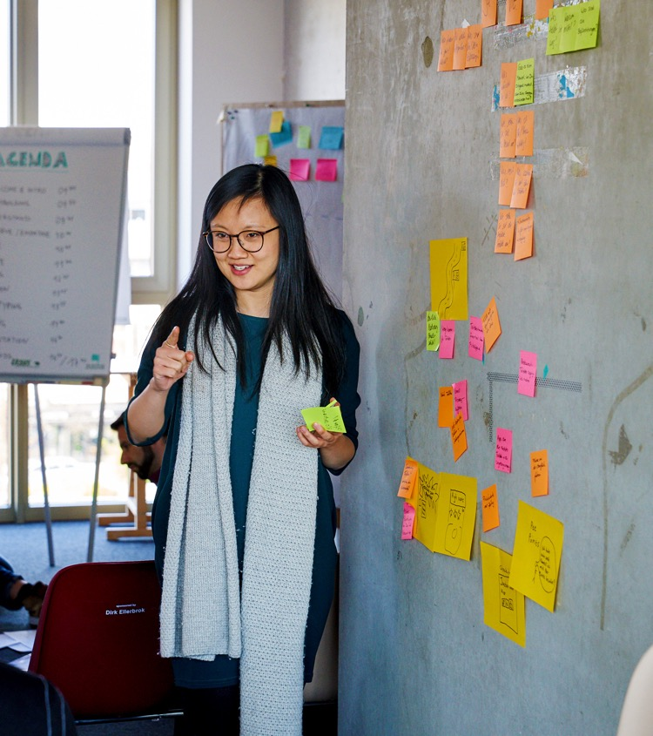
Build your pitch
Notes:
Let‘s go!

Slide 70
Build your pitch
Choose the topic of your pitch.
Your own startup idea
Your PhD topic
Notes:
In order to build a pitch of course you first of all need an idea or project that you actually want to pitch
We know that some of you already have ideas or projects, that they are working on and others not yet.
Since this webinar is about learning methods and skills you don‘t need to have a real project in order to learn how to pitch!
So when it comes to WHAT it is that you want to pitch today, you have options to choose from:
You can either chosse to go with your own idea
OR you just choose an object in in your direct environment that somehow speaks to you, like a pen or a book for example

Slide 71
Build your pitch
Step 1: Problem-solution-fit
Based on what we just learned, build the foundation of your pitch.
Problem & target group
Solution & how it works
Call to Action
Notes:
Let‘s have a look at step 1:
So once you know what you want to pitch, let‘s have a look on how to build a pitch!
Since we will not have the time to build your pitch step by step all togethter today, we will focous an the core of each pitch:
The most important aspect of a pitch is a strong »problem-solution fit«
Who are your users?
What is their problem?
How is your idea/product solving that problem?

Slide 72
Build your pitch
Step 2: Storyline
Based on your foundation (problem-solution-fit) think about how to transport this in an emotional story!
Who is your protagonist?
What’s his/her problem in what context?
How do you make his/her life better?
Make it tangible and relatable for your audience!
Notes:
Step 2: Once you defined the problem-solution-fit it‘s all about putting together a story, that people can relate to and that people will remember.
Now your might be thinking: »How the hell should I work on that if I don‘t have my own idea yet?«
Well, you can wonderfully practise your pitching skills by pitching a random object and pretend that you just had the idea to develop that exact object and you now want to pitch it to potential investors.
Just give it a try and if you have any questions – we are here for you!!

Slide 73
Solo work
Build your pitch
10 min
Stay in main room
Prepare your 2 min pitch
Problem-solution-fit
Emotional storyline
Countdown for last minute
Notes:
[read out slide]
[emphasise that the pitch should be 2 minutes long]

Slide 74
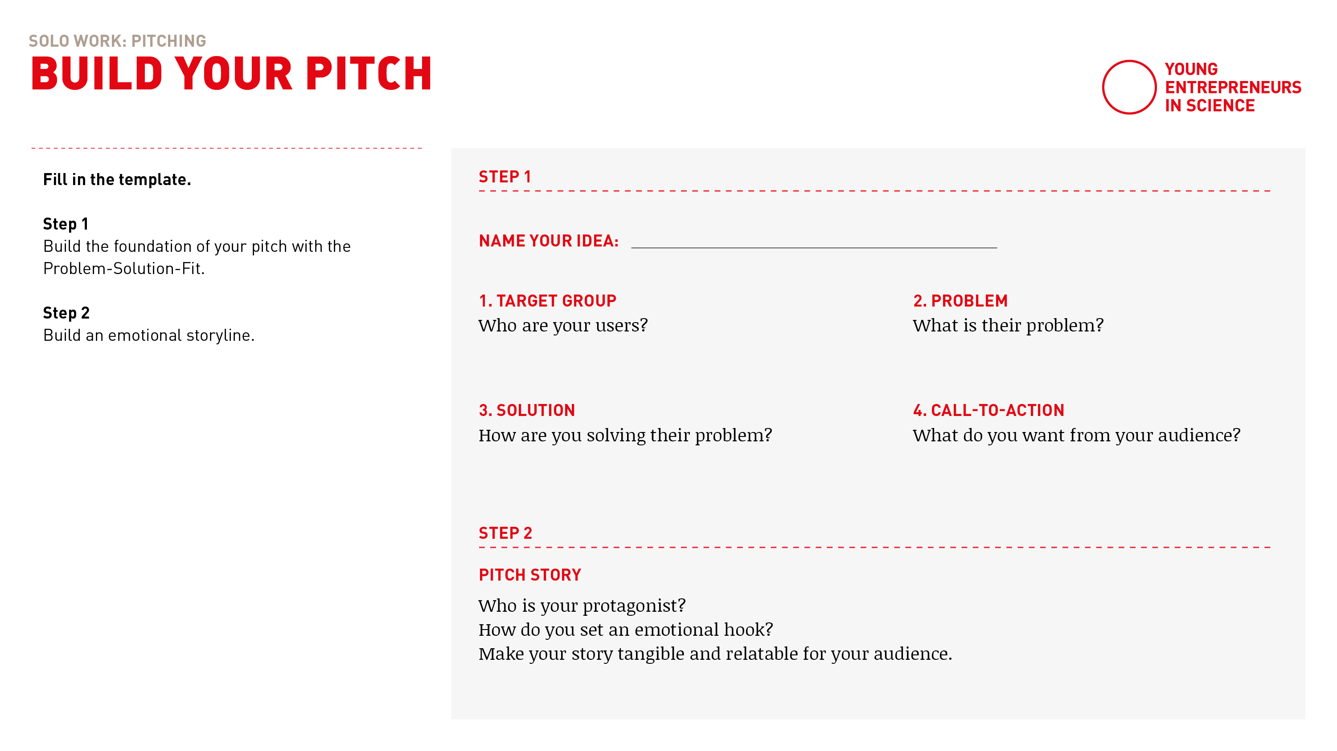
Build your pitch
Notes:
Take a piece of paper
Work your way through step 1 first
and based on that then build an engaging storyline in step 2!
You have got 10 minutes in total.
Stay in main room please, if you want to you can turn off the camera.
We will stay here and give you a heads up, when 5 minutes are over

Slide 75

Test your pitch & get feedback
Notes:
Now we would like to give you some time to get into the groove and practise your pitch with the group.
As you will give and receive feedback – here is a little how to to do this in en effective way.

Slide 76

How to give feedback
Notes:
Some basic ground rules:
Make sure your feedback is clear and actionable, so please highlight what could be improved and why.
Feedback should address actions and outcomes, not personal traits. This makes the feedback easier to accept and act upon.
Begin with something positive to build trust. This way the recipient can accept critical feedback way better.

Slide 77
Feedback grid
I like …
I wish …
New ideas
Open questions
Notes:
We love to use this feedback grid when giving and receiving feedback:
1. I Like: Highlight what works well, e.g., “I like how clear and engaging your storyline was.”
2. I Wish: Suggest areas for improvement, e.g., “I wish the call to cation summarized your key message more clearly.”
3. New Ideas: Offer creative suggestions, e.g., “You could try to make the person more tangible to make your message more relatable.”
4. Open Questions: Pose questions for reflection and further development, e.g., “How might you make your pitch more interactive for the audience?”

Slide 78
How to receive feedback
Embrace feedback!
  Understand feedback as a learning opportunity
  Don’t defend your idea or your pitch (listen and learn!)
  Take notes
Notes:
But giving feedback is only one side of the medal. As you will also give your pitch it‘s also important for you to embrace the feedback you get.
So:
Understand feedback as a learning opportunity
Don’t defend your idea or your pitch (listen and learn!)
Take notes

Slide 79
Teamwork
Test your pitch &
get feedback
15 min
Transfer into digital
breakout rooms
Automatic transfer back
One after another:
Pitch your pitch (2 min)
Get feedback (2 min)
2 min for self-introduction
12 min for three pitches
& feedback
Countdown for last minute
Notes:
[read out instuctions]
TIME YOUR OWN PITCH! THEY SHOULD BE 2 MINUTES LONG!
We will transfer you to your breakout rooms with 3 people in the next step
If you have any questions – like always: please call us in!
Have fun and see you back here in 15 minutes!

Slide 80
Let’s go!

Slide 81
Notes:
Everybody is back? All went well?
Thumbs up if you’re with me please!

Slide 82
After the break …
PART 1
How to pitch digitally
PART 2
Pitches and expert feedback
Notes:
It‘s time for a break! Let‘s more. Around and refesh!
After the break we‘ll introduce to you how to pitch digitally.
And we’ll also have some guests with us [introduce guests].
Up to 6 people will be able to practice and give their pitch in front of our experts that will join us.
They will also give you some feedback on how to improve
We know this might sound frightening, but we can assure you – this is a very safe setting to try this!
We are all here for you and there is no pressure at all to be “perfect”

Slide 83
Who is pitching?
Please type into the group chat:
Your name + your pitch title
Notes:
Up to 6 participants can pitch 2 min pitch – 3 min feedback
First come, first serve
If you would like to pitch:
Please type into the group chat:
Your name + your pitch title

Slide 84
It’s coffee
o’ clock!
Notes:
M1: ONBOARDING EXPERTS in separate breakout room:
After the break, there will be a short input »Pitch digitally«
Then we will introduce you as the experts.
Each of you will have 2 minutes to introduce yourself individually (please also explain your function & why/what you are here as)
After that:
Max. 6 pitches
We introduce the pitches and hand over to the participants:
2 minutes pitch, then GONG
2-3 minutes feedback of you, then GONG
Please clarify who of you starts with feedback
Note that the pitches were created in a short time and which steps should be included (problem/solution fit, target audience, call to action, storyline)
Please give feedback on the pitch rather than on the idea: I like / I wish / open questions / new ideas
After that, everyone in the main room and max. 10 minutes input from the start-up centers: What is your offer? What could be the next steps for the participants?
We will explains setting & gong in the room
_______
M2: List/order for the pitches/breakouts

Slide 85
Notes:
Everybody is back? All went well?
Thumbs up if you’re with me please!

Slide 86

HOW TO PITCH … DIGITALLY!
Notes:
Now before we start…
… let‘s have a look at how to pitch in a digital setting!

Slide 87
Technical setting
Test technical setup prior to your pitch: sound, camera, internet connection
How do you want to show your idea?
What medium fits best to you and your product:
  Slidedeck?
  Digital/analogue prototype?
Notes:
Always test your sound, camera, and internet connection beforehand to avoid technical issues during your pitch.
Think about how you want to present your idea: What medium works best for you and your product?
Would a slidedeck show your idea clearly, or is a digital/analog prototype more effective to bring it to life? To really make it tangible?

Slide 88
Framing
The art of focus on perspective and framing … GONE WRONG!
Notes:
[Show these camera setups live to show everyone how not to do it]
Not: the giant (camera from below)
Not: Closeup (Just nose in the picture)
Not: The conceptual artist (half on camera with lamp in artistic setting)
Not: The Guru (the mystical one with lots of backlight)

Slide 89
Framing
The art of focus on perspective and framing … DOING IT RIGHT
Webcam should be positioned at the same height as your eyes
Leave some room in the upper part of the shot
Now you can decide where to be in the shot:
frontal or three quarters with head facing the camera
Notes:
The art of focus on perspective and framing
Let‘s do it right and please follow along everyone:
Webcam should be positioned at the same height as your eyes
Leave some room in the upper part of the shot
Now you can decide where to be in the shot: frontal or three quarters and letting the face front (looks like a painting to me)

Slide 90
Background
The background is just as important as you,
because it helps to define the composition of the shot.
Avoid big windows behind you
Avoid big flat walls behind you, because they literally flatten your image
Create depth – it’s always nice to bring some space between you and your background
Notes:
And a little about the background…
Avoid big windows behind you (remember – guru effect?)
Avoid big flat walls behind you, because they flatten your image, its always nice to feel some air between the subject and the background

Slide 91
Behavior & interaction
Remember to speak slowly and work with pauses
Look directly into the camera every now and then
Ask your audience to interact with you (thumbs up, etc.)
People do not tend to smile when they watch you digitally
– don’t be irritated and have fun!
Notes:
And how about behaviour and interaction?
People tend to speed up their speech when they are nervous.
Aim to speak a little slower than normal, and it should be perfect!
Look directly into the camera every now and then.
Remember: The camera is NOT your screen! Ist a difference [show difference when looking directly into the camera or on screen]
Last but not least:
People do not tend to smile when they watch you digitally – don’t be irritated and have fun!

Slide 92
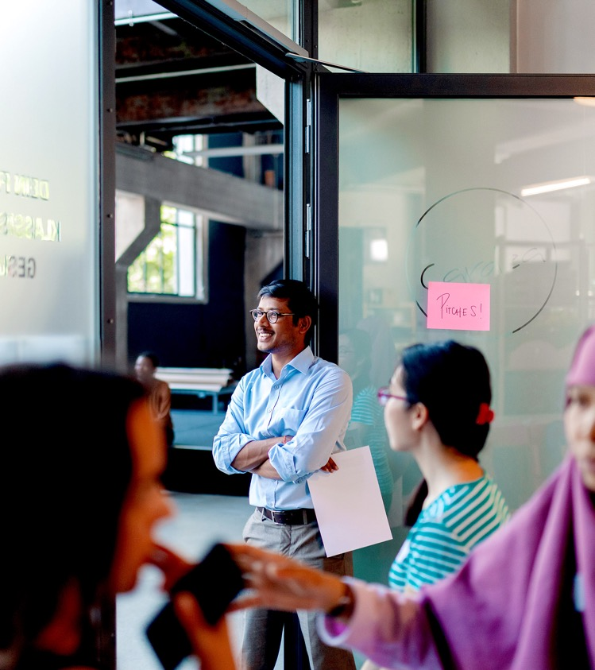
The pitches!
Notes:
You may have already notices some new faces here with us after the break …

Slide 93

PLEASE WELCOME OUR EXPERTS!
Notes:
… Please meet our experts! It‘s lovely to have you with us
Dear guests: Could you please briefly introduce yourselves?
[interaction with the guests so everyone feeld welcome]

Slide 94
Main room
Pitch presentations
2 min each
Pitches in the main room
2 min pitch each
2-3 min expert feedback
Moderators will set a timer
Notes:
Let‘s have a look at how how this will work:
Our pitching volunteers: We will call your name, say ready stead go! And from then on you‘ll have 2 minutes for your pitch
After 2 minutes you‘ll here a GONG – this is when your time is over
Then we will start the feedback round for another 3 minutes.
After 3 minutes you‘ll hear the GONG again and the next pitch has its turn

Slide 95

Let’s go!

Slide 96
OUR EXPERTS CAN OFFER …
Notes:
[Info zu den Gründerzentren/ Info about the incubators]
[If necessary, switch here to the guests' slides]
[Say thank you an good bye to the guests]

Slide 97


Time for feedback!
Please, follow the link in the chat window.
Notes:
Voting Link:
https://www.menti.com/v9peuuzor4
Live Results:
https://www.mentimeter.com/s/d2103d5f8c21f37ba61c7f97bf8930ef/b2a82eab8ce3

Slide 98
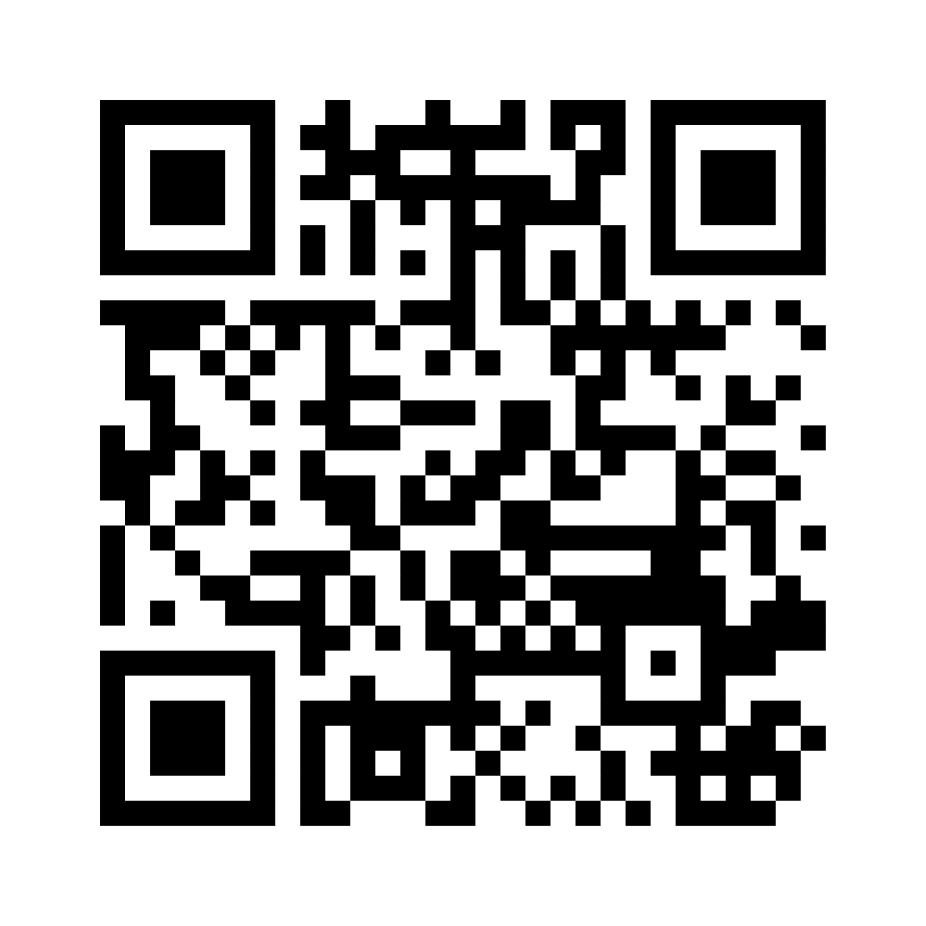
Wrapping up!
I like, I wish, I take away…
Notes:
Ggf. Menti-Link für Teilnehmende: https://www.menti.com/alaxnctncdyz

Slide 99

Sharing
Are there any comments, thoughts or questions
you would like to share?
Raise your hand.

Slide 100


Stay connected with the YES community
Join our LinkedIn group
Take part in other (Online-) Workshops
Tell your peers and spread the word via social media
Stay active in our Alumni-Community
Keep learning from each other on your entrepreneurial journey
Notes:
Hinweis für die Coaches:
Die Einladung zu dem netzwerk FW Connect erhalten die TN nach dem Workshop in einer Email, genauso wie alle weiteren, genaueren Infos, wie sie sich connecten können und Teil unserer Community werden können.

Slide 101


Boost your career with your YES experience
Connect with YES and fellow participants on LinkedIn
Share your YES certificate on Social Media
Add YES to your trainings on LinkedIn
and your CV
… and carry the entrepreneurial spirit further.
Notes:
Hinweis für die Coaches:
Die Einladung zu dem netzwerk FW Connect erhalten die TN nach dem Workshop in einer Email, genauso wie alle weiteren, genaueren Infos, wie sie sich connecten können und Teil unserer Community werden können.

Slide 102


Time for feedback!
Notes:
Link
Bitte auf folgendes bei der Tonspur eingehen, um die Notwendigkeit der Evaluation zu betonen (Anmerkungen von YES):
Your feedback is key/We highly appreciate your feedback!
It is crucial not only for the constant improvement of our workshops, but also with regards to the future funding of our programme.
Future funding means more offers for you as alumni community (additional workshops, webinars, networking opportunities)
Thank you for taking the time (approx. 4 min)!

Slide 103




Thank you!
Connect with us and each other via Social Media …
LinkedIn
Page
LinkedIn
Group
Instagram
@sciencepreneurs
Newsletter
©️ Young Entrepreneurs in Science, 2025
Notes:
That‘s it!
Thanks a lot for participating
We hope you had fun
You will be added to the YES newsletter list to stay updated with the project and to read exciting alumni stories as well as get invited to our network Falling Walls Connect, to make contact with each other and take part in alumni webinars!
Please spread the word!!!
Instagram
https://www.instagram.com/sciencepreneurs/
LinkedIn Seite
https://www.linkedin.com/company/young-entrepreneurs-in-science/
LinkedIn Gruppe
https://www.linkedin.com/groups/8902012/
Newsletter
https://youngentrepreneursinscience.com/newsletter-registration/
Everybody else: Goodbye, have a nice day and see you soon!

Slide 104
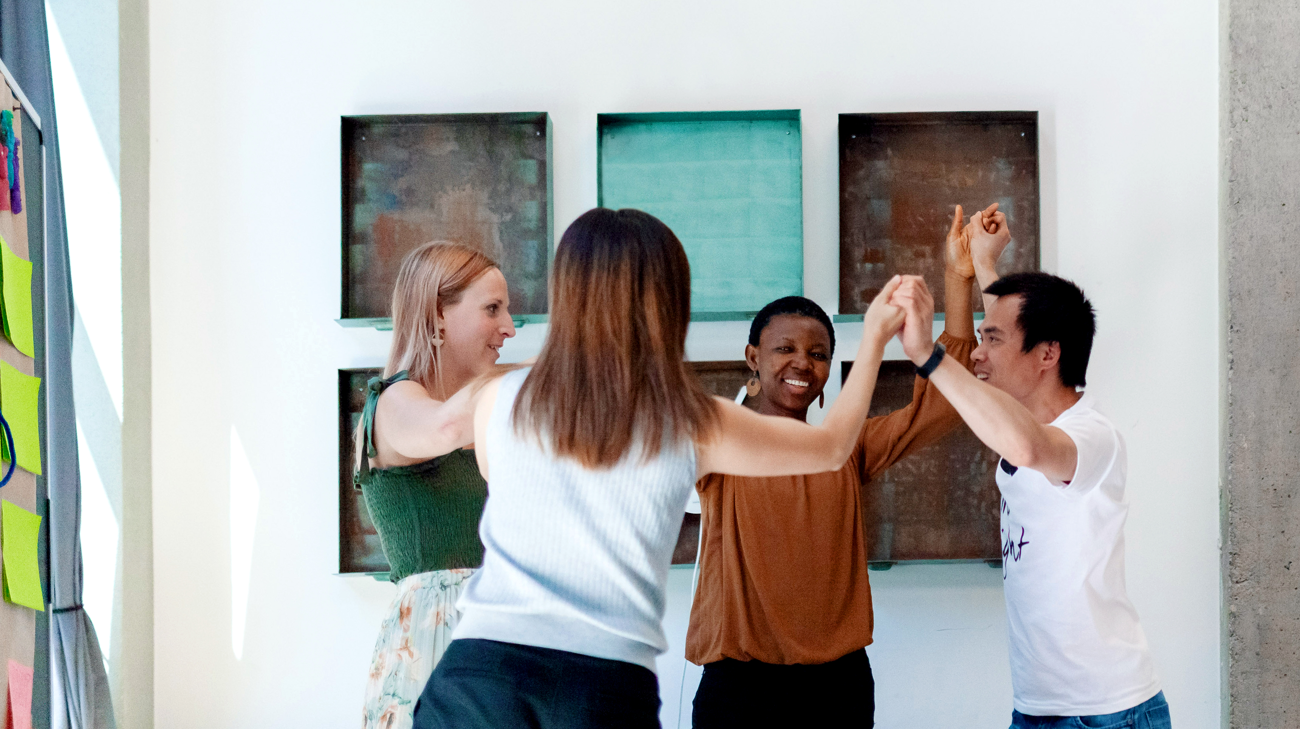
THE END

