Slide 1
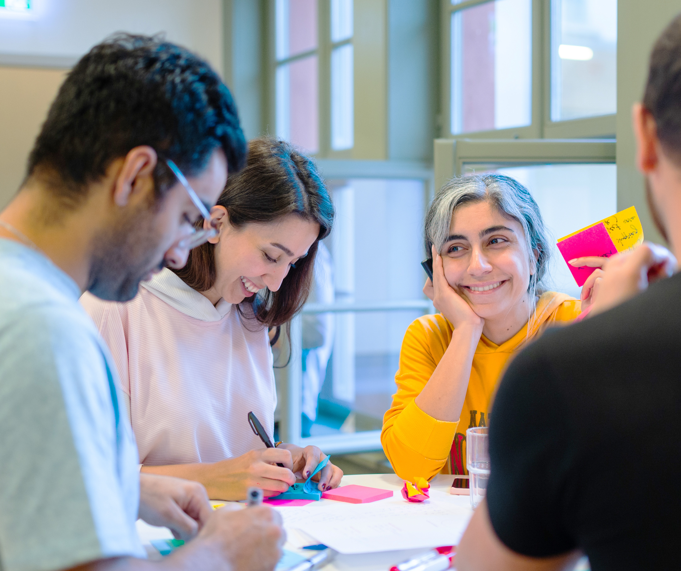
Pathway to Impact
Präsenz

Slide 2
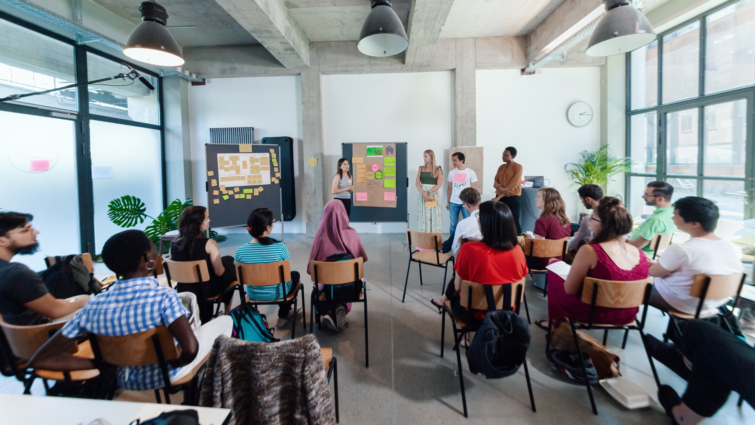
WELCOME
Notes:
A warm welcome to all of you!
This is how we started 6 years ago.

Slide 3



Workshop setting
YES
Coaches
Partner
Notes:
Please shortly explain the workshop setting so that everyone is familiar with the parties involved and what their role is. (can be adapted from location to location)
YES:
Workshop organizers responsible for developing workshop concepts and content.
Concepts are created in collaboration with external trainers and coaches.
Ensure the overall structure and success of the event.
Coaches:
Facilitate workshops by guiding participants through the process.
Professional trainers and coaches working on behalf of YES.
Partner:
The academic partner of YES, hosting the workshop at their institution.
Involved in planning, coordinating logistics, and inviting guests.

Slide 4

Young Entrepreneurs in Science
opens up new career perspectives for young researchers
part of the Falling Walls Foundation
enabled by Federal Ministry of Education and Research
www.youngentrepreneursinscience.com
Notes:
Young Entrepreneurs in Science (YES):
Originally started as an offline workshop series in various cities across Germany.
Now offers a diverse program of Offline and Online workshops tailored for PhDs, Postdocs and Master students
Project Team:
Comprises 12 team members.
Part of the Falling Walls Foundation, a non-profit organization based in Berlin.
Falling Walls Foundation:
Aims to communicate science and research to the public.
Promotes interdisciplinary exchange and collaboration.
Workshop Benefits:
Strongly supported by a broad network in academia and business.
Designed to foster entrepreneurial thinking and skills among researchers: cultural transfer
BMBF:
Participation is made possible free of charge through funding from the BMBF (Federal Ministry of Education and Research).

Slide 5
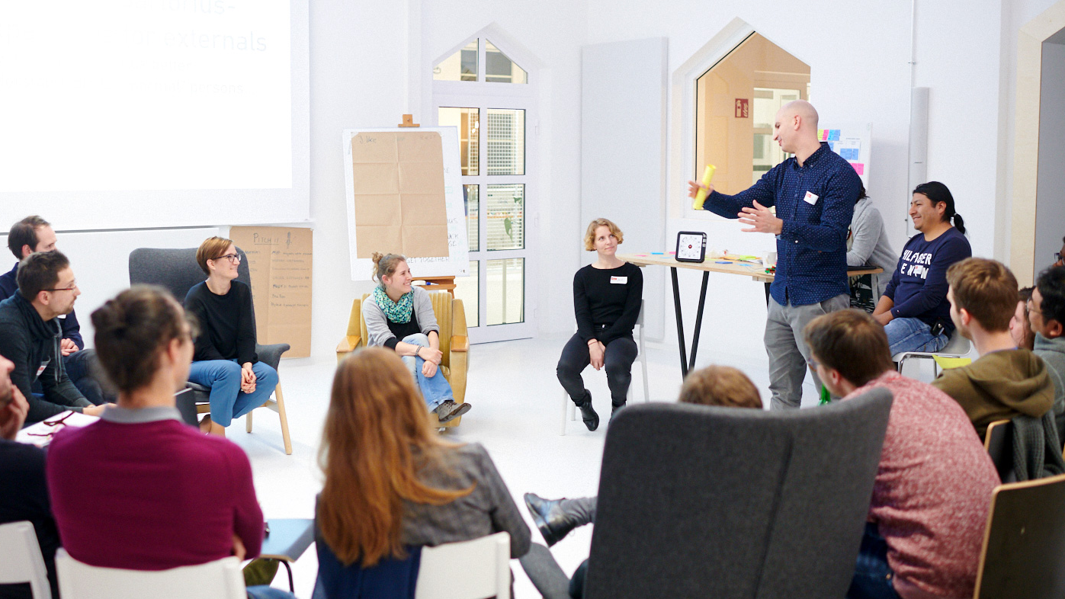
WELCOME FROM OUR
UNIVERSITY PARTNERS
Notes:
(Academic) Partners welcome the participants

Slide 6

WELCOME FROM OUR YES COACH
Notes:
The Coaches introduce themselves to the group

Slide 7
Agenda
Lunch Break
Part I
Part II
Innovate for Impact
Check-In
Learn about the golden circle and the concepts of purpose and impact
Reflect on the WHY behind your research work
Think about potential areas of impact that your research can contribute to
Your Research Canvas
Reflect about the potential of your own research topic/idea
Assess potential through identifying users/stakeholders
Develop or extend potential use cases based on your research & network
Wrap-Up

Slide 8



Your learning materials
Download link: You will receive a download link for the handout and your certificate within 3–5 days after the workshop
Template: Blank templates will be included
Photos: If you want to document your results, please take photos after getting consent from you team

Slide 9
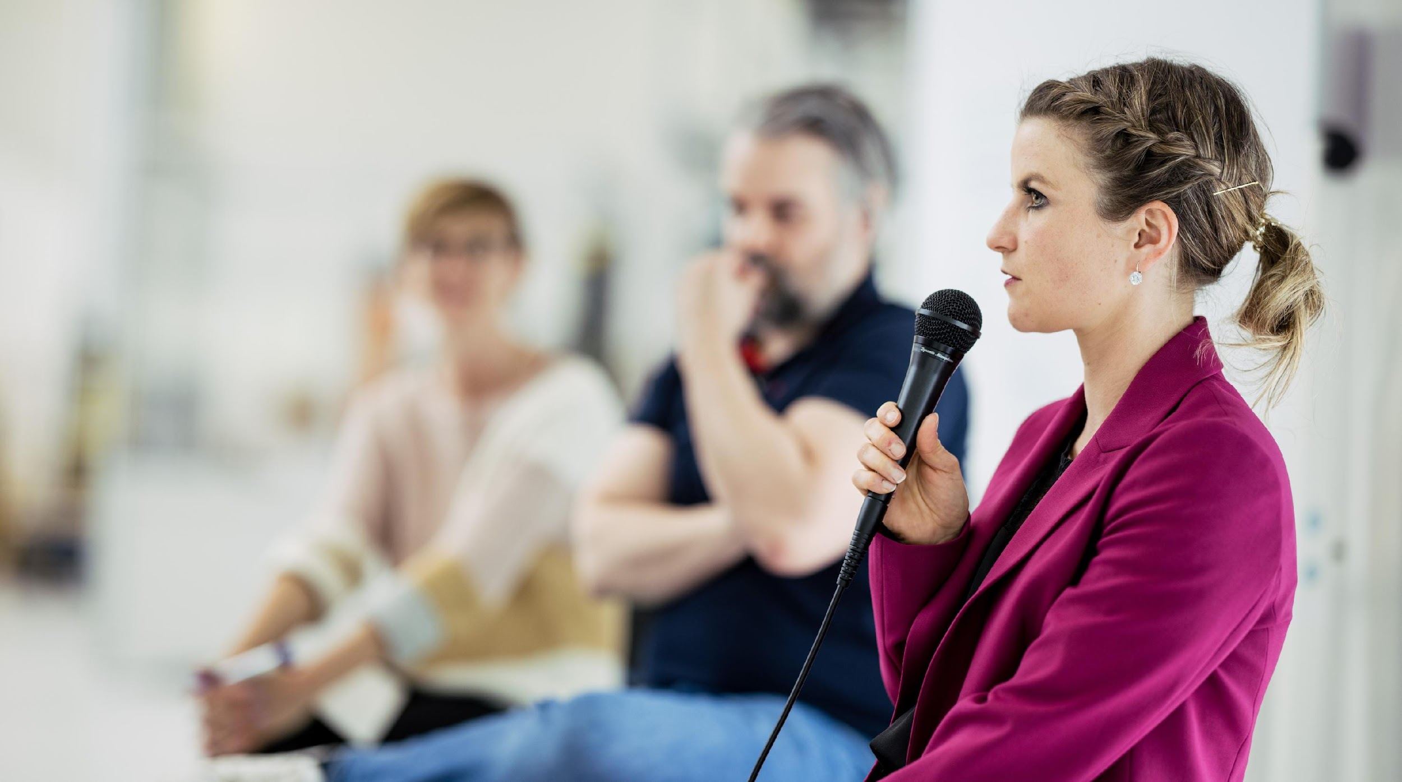
INNOVATE FOR IMPACT

Slide 10
Learning goals
Learn about the golden circle and the concepts of purpose and impact
Reflect on the WHY behind your research work
Get to know the Sustainable Development Goals (SDGs)
Think about potential areas of impact that your research can contribute to

Slide 11



How purpose-driven are you?
Please use the annotate function to place a mark of your choice!
I don’t care about purpose
Purpose is somehow important to me
I live for my purpose
Notes:
Let‘s start with a little survey – put yourself on this bar „How purpose driven are you?“
You can do this by using the editing feature of Zoom:
Go to the operating panel on the top > choose comment > choose stamping
If the feature doesn‘t work for you you can also write in the chat
Wichtig nach der Übung zu erwähnen: Please close the editing bar again now! (sonst wird fleißig weiter gestempelt) UND wichtig, dass Co-Moderation die Stempel wieder löscht

Slide 12
Why does innovation need purpose?
What’s the business case?
Who wants it and why?
INNOVATION
Can you make it and deliver it?
What impact can you create with your purpose?
Notes:
Purpose refers to all different areas of life. Today we want to focus on purpose and what it has to do with innovation.
When we talk about innovation (the sweet spot of innovation) we usually like to show this graphic.
An innovation is always something new, a new solution, a new offer. Basically, there are 4 crucial elements that make up innovation:
The new thing must be realizable (technology)
The new thing must prove itself (e.g. on the market) find economic application, in the form of a business model
The new thing must be wanted/used (customers/users) Solution to a problem/challenge --> this is where DT comes in
The new thing should create an impact (for environment & society); how does your innovation impact society and the planet as a whole?
Today we want to focus on the latter (integrity) without loosing sight of the other three elements.
The question of why we do something and what impact we have is a fundamentally needed part of our lifes, we are craving for some purpose.
Science shows that people who live and work with purpose have a higher quality of life, are more productive members of society and they make a greater impact

Slide 13

Let’s talk about the WHY
Notes:
That‘s why we should talk about the WHY – focusing on your research work/context today.

Slide 14

THE GOLDEN CIRCLE
WHAT
Every individual or organisation knows what they do.
What describes e.g. your research topic or products and services companies offer.
Notes:
The golden circle of Simon Sinek (famous author of the book „start with why“) explains it very well. There are three different layers:
1. What: Every organisation/every single person knows what they do

Slide 15
THE GOLDEN CIRCLE
WHAT
Some individuals or organisations can say how they do what they do.
This might be their USP (unique selling proposition). The how makes e.g. products and services special and sets them apart from competition.
HOW
Notes:
2. HOW: Some individuals/organisations can say HOW they do what they do.
This might be their USP (unique selling proposition). The “How” makes their products and services special and sets them apart from their competition.

Slide 16
THE GOLDEN CIRCLE
WHAT
HOW
But very few can articulate why they do what they do. Earning money is only the result of your actions.
Your why should give an answer to your purpose, cause and beliefs. Why do you get out of bed in the morning?
WHY
Notes:
3. WHY: only very few people/organisations know why they do what they do
Why means what's your purpose, your cause, your belief? Why does your organisation exist? Why do you get out of bed in the morning?
The goal is to communicate and act from the inside out > from the why to the how and what
People don't buy what you do, they buy why you do it
The goal is to make business with people who believe what you believe
While your WHAT and HOW might need to be iterated from time to time, especially in the early phase of your start-up, a long-term vision helps everyone involved to understand where your journey is heading.

Slide 17
THE GOLDEN CIRCLE
WHAT
HOW
WHY
Begin with why!
Notes:
A company’s purpose or your individual purpose is not only to deliver a product or services/to do research because of the sake of research but to create a long lasting positive impact.
It answers the question to WHY you are doing what you are doing in contrast to how and what you are doing.
Why are you working on the research you are working on? What is your motivation behind it?

Slide 18
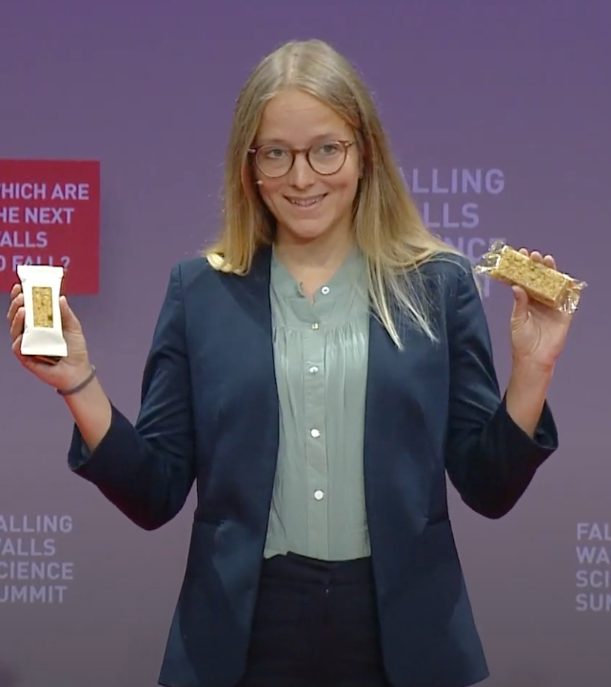
The Why of TRACELESS
Circular bioeconomy startup offering a holistically sustainable alternative to conventional plastics.
“We want to create a world free of pollution and waste.”
Dr. Anna Lamp at Falling Walls Science Summit 2022
traceless.eu
Notes:
We brought two examples of start-ups of our alumni network at Falling Walls. They show very well the WHY behind what they are doing.
Traceless Materials:
- Founders: Anne Lamp / Johanna Baare in Hamburg
- Traceless materials is a circular bioeconomy startup that developed a technology for sustainable plastic alternatives. They put a lot of focus on making their impact transparent. Their WHY is „We want to create a world free of pollution and waste“.

Slide 19
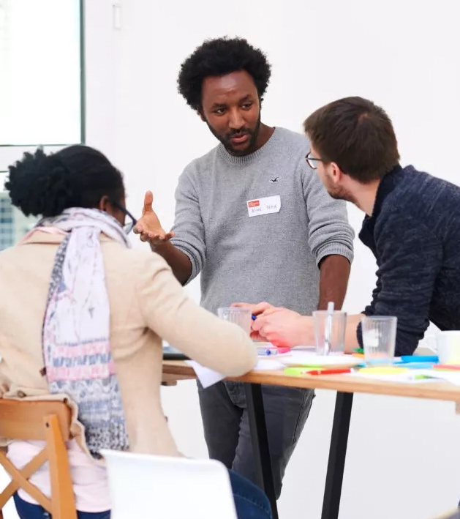
The Why of LESAN.AI
Building translation APIs for under-represented languages, starting with Ethopian
“We want to make sure that everyone has equal access to information to help them understand the world.”
Check out our interview at: bit.ly/yeslesanai
Asmelash Teka at a YES seminar
lesan.ai
Notes:
Lesan.AI was founded by the YES alumnus Asmelash Teka Hadgu in 2019 in Berlin.
They build machine translation systems for languages with millions of speakers, starting in Ethiopia.
Their purpose is to make sure that everyone has equal access to information to help them understand the world.
A few years ago YES did a very insightful interview with Asmelash. We‘ve put the link here on the slide in case you are interested to read it after the workshop

Slide 20
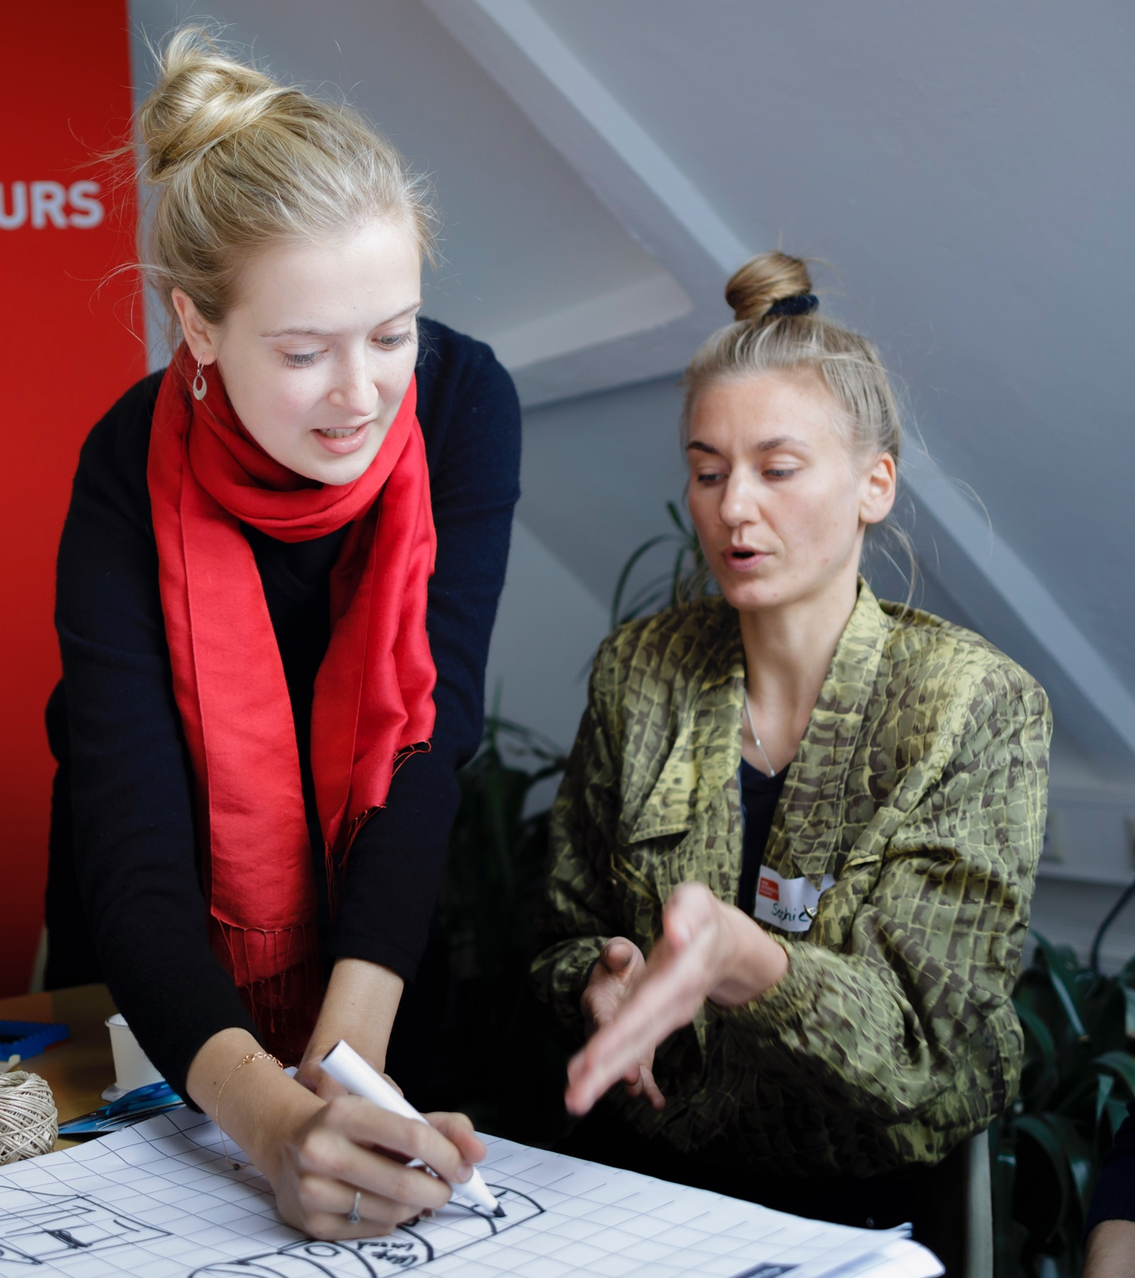
Think about the WHY of your research…
Notes:
Now it’s up to you to think about the WHY of your research. Why are you doing what you’re doing…

Slide 21
Solo work
Reflect on the WHY of your research
10 min
Take a moment and make notes to following questions:
What was your motivation to do research in your field?
Why do you get out of bed every day to work on your research topic(s)?

Slide 22
Share your WHY behind your research!

Slide 23
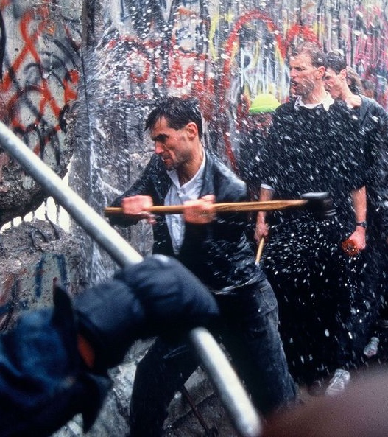
From purpose to impact
Notes:
When we think about the WHY or the purpose of what we do, we need to go one step further and find the courage to live it. So, purpose put into action leads us to impact creation.
Just like the fall of the Berlin Wall (connection to Falling Walls Foundation ☺) > once you have a purpose in mind, change can come quickly and create impact > there was a strong purpose of unity in Germany end of the 80s; you can see how people became active on this picture literally tearing down the Berlin Wall

Slide 24
What do you associate with impact?
Notes:
When you hear the term impact – what do you associate with it? What comes to mind? Write in the chat or raise your hand.
Impact can happen on very different levels (as you‘ve also shown with your associations):
Impact comes with positive and negative impacts – not always intended > creating an impact means that you can prevent and create a problem at the same time
Impact can be temporary or long-term: e.g. a footprint in the sand is a very short-term impact
Impact is contextual and the time matters

Slide 25
Positive Impact
Positive impact is defined by products and services that are created with the purpose of solving societal problems.
Scholarly Community Encyclopedia
Notes:
Today we want to focus on the idea of positive impact and we find that this definition from the Scholarly Community Encyclopedia fits very well to our understanding in the framework of this workshop:
It‘s about a specific and concrete use case > a product or a service
The goal is to solve societal problems, to create a more sustainable world

Slide 26
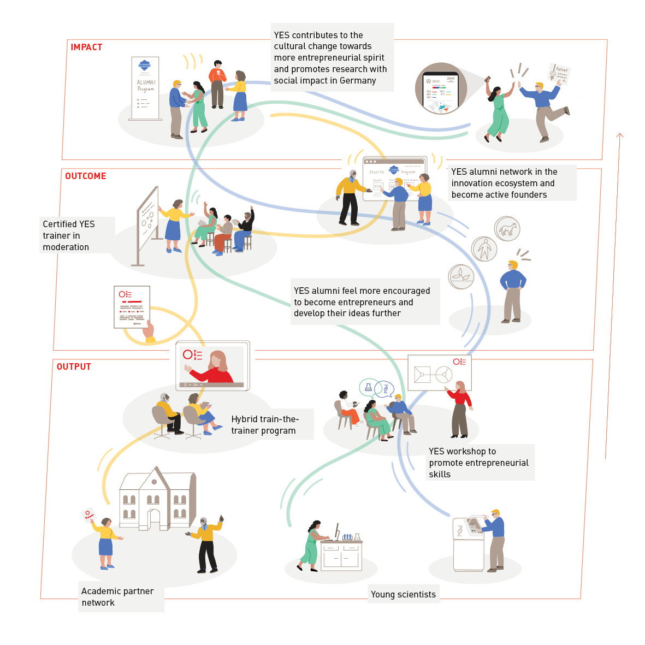
Our impact
logic
Notes:
Just to give you an example and differentiate what ist what, here ist how YES has defined their Impact.
Note the defference between output, outcome and impact.
• Output: Immediate results of activities (e.g., number of workshops held). • Outcome: Short-term effects on participants or systems (e.g., improved skills and use them). • Impact: Long-term, broader changes resulting from outcomes (e.g., increased entrepreneurial spirit)

Slide 27

THE SUSTAINABLE DEVELOPMENT GOALS (SDGs)
Notes:
We want to look into the meaning of impact for creating a more sustainable world. Therefore, the SDGs are a helpful tool or guidance towards it…
And by the way, coming back to the beginning of the module, The Why of the SDGs is ‚leave no one behind‘

Slide 28

Overview of the SDGs
Notes:
The UN Sustainable Development Goals (SDGs) are one of the biggest trends in sustainability.
They include 17 goals and 169 sub targets, reflecting a comprehensive summary of the challenges our society faces that we must address in order to create a more equitable and sustainable world.
They came into effect in 2016 and have a term until 2030
We won‘t go through all of the goals in detail now, you will have time for it later. I just want to pick 2-3 to give some more background information:
Goal 3: Good health and well-being > the goal is to "Ensure healthy lives and promote well-being for all at all ages“; targets are e.g. to decrease maternal mortality or fight communicable diseases
Goal 9: Industry, innovation and infrastructure > "Build resilient infrastructure, promote inclusive and sustainable industrialization, and foster innovation“, targets are e.g. enhance scientific research
Goal 13: Climate action > „Take urgent action to combat climate change and its impacts by regulating emissions and promoting developments in renewable energy“; targets are e.g. strengthening resilience and adaptive capacity to climate-related disasters, build knowledge and capacity to meet climate change
We all need to contribute to those goals – the question is how can we do that, How can you create an impact with your research and contribute to those goals? Those are the questions we would like to address together with you next.

Slide 29




The impact of TRACELESS
Prevents plastic pollution
Avoids harmful chemicals
Combats climate change
Eco-friendly end-of-life
Saves fossil energy
Protects land & water resources
traceless.eu/impact
Notes:
But before that, let‘s come back to the startup example of the beginning – traceless materials and its impact
Traceless is very transparent on its impact on their website. They define clear impact goals that can be matched with different sustainable development goals.
As you can see here, their impact contributes to at least 4 different SDGs – responsible consumption and production, climate change, affordable and clean energy and clean water and sanitation.

Slide 30
3-STEP-EXERCISE
1
2
3
Get familiar with the SDGs
Develop solution with the SDGs
Joint brainstorming
Notes:
Now it’s your turn again – we want you to think about your areas of impact with your research work. We will do it in a 3-step approach:
Step > get familiar with the SDGs > break
Step after the break > you will reflect on your own research and collect ideas
Step > you will be put in breakouts with a partner to brainstorm together and give each other feedback

Slide 31
STEP 1: Get familiar with the SDGs
Notes:
Let‘s start with step one – get familiar with the SDGs

Slide 32
Solo work
Get familiar with the SDGs
10 min
Take a couple of minutes to get familiar with the different SDGs.
Read through the descriptions.

Slide 33
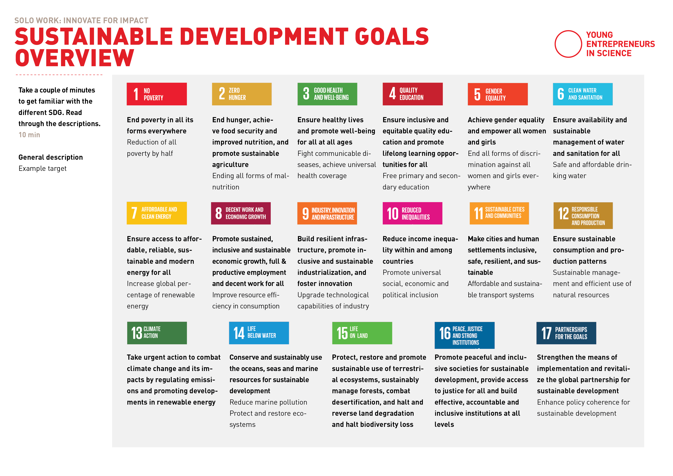
OVERVIEW OF SDG
Notes:
Hier Template mit SDGs als Überblick verteilen + auf die großen Plakate im Raum verweisen > evtl. googlen

Slide 34
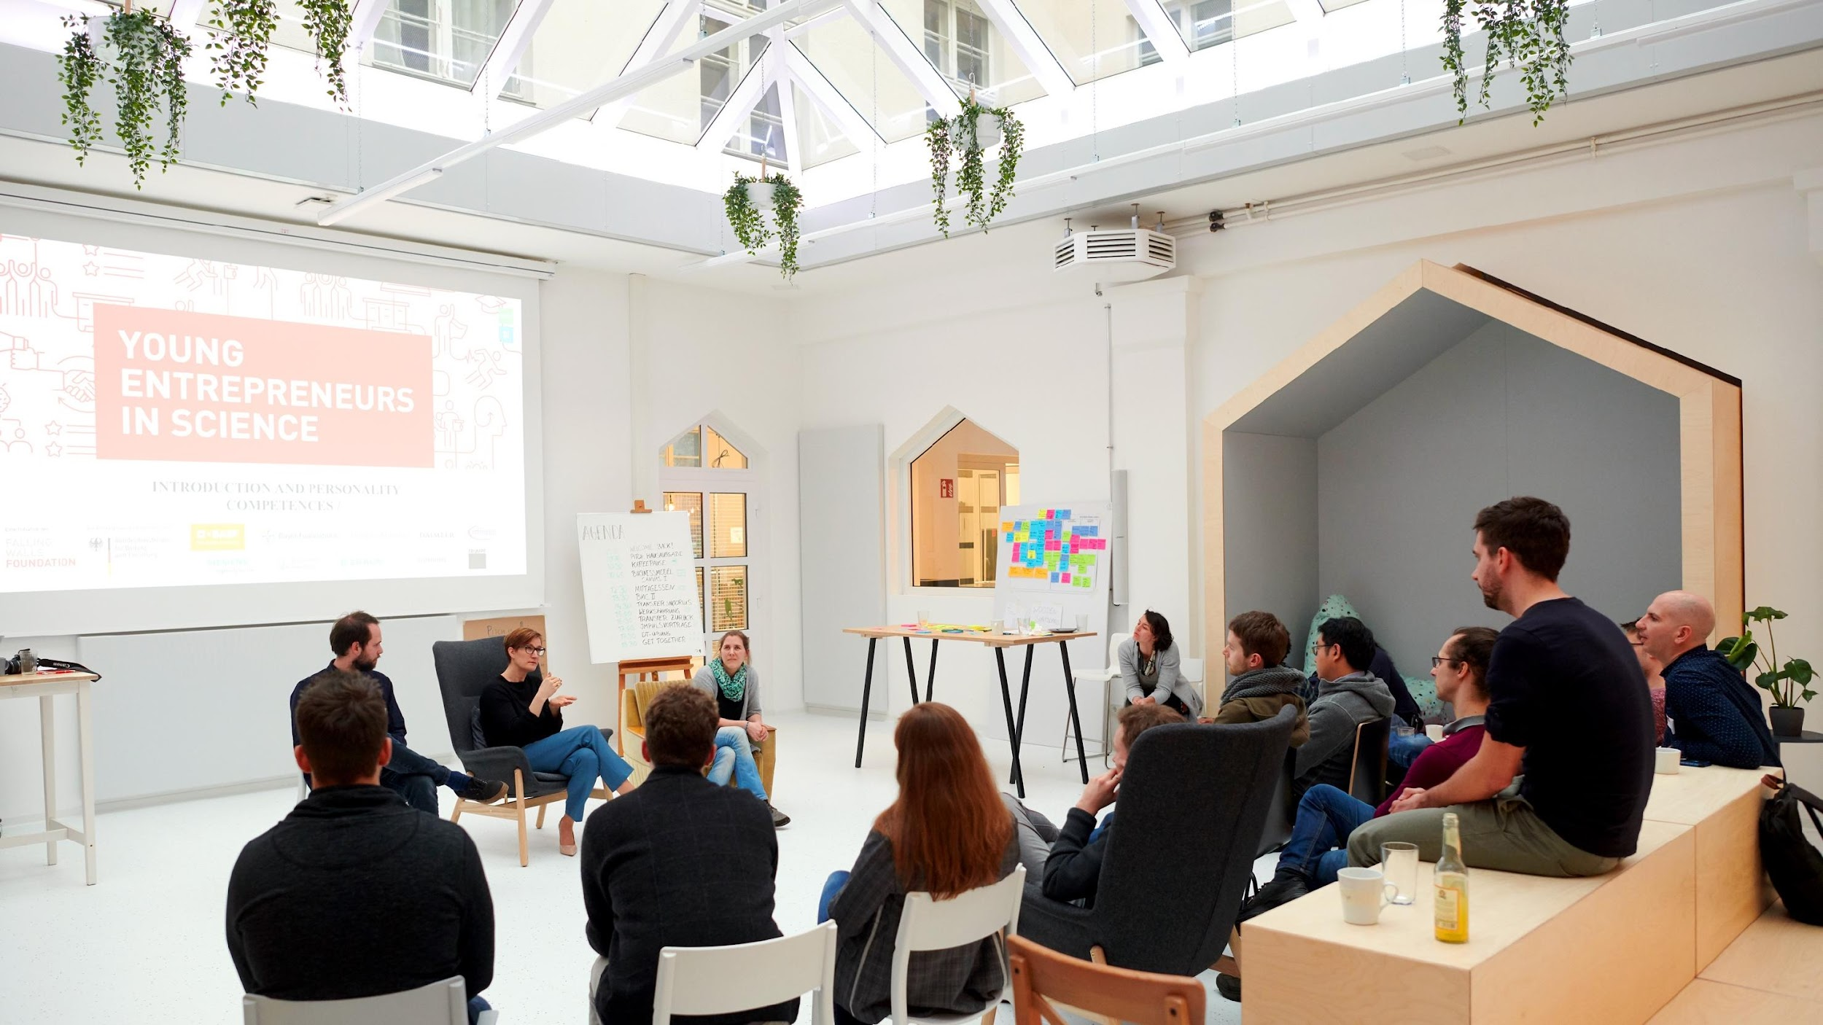
NEXT UP …

Slide 35

It’s coffee o’ clock!

Slide 36
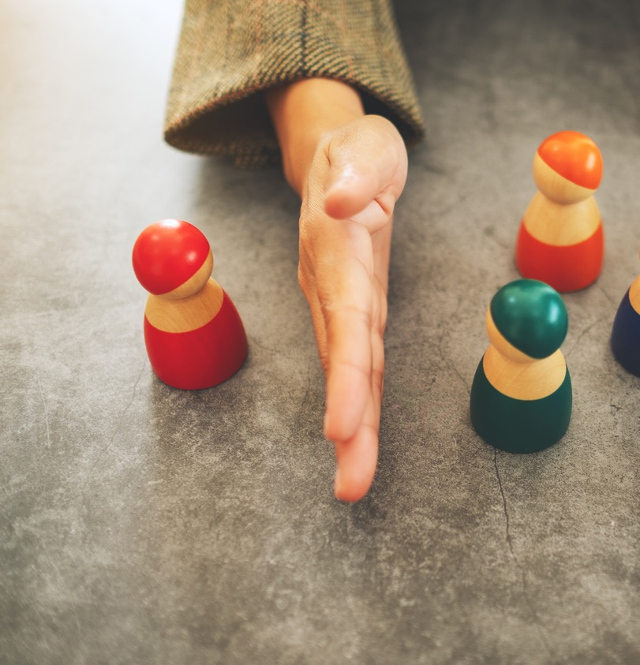
STEP 2: Solo work
Notes:
Let‘s come to the second step now.

Slide 37
Solo work
Consider your own research
10 min
Select up to 4 SDGs that your research might contribute to. Note them on the template.
What could be practical applications? Write down 1-3 ideas in the respective field.

Slide 38



Research example
Topic from our alumnus Hossam Shafy:
Developing Prediction models of process interruption in Steel Production
4 Quality education: support research work, reduce the gap between university study and work at the industry
8 Economic growth: higher production rate reached, less interruptions in the production
13 Climate action: help to reduce the CO2 emissions per produced ton of steel, energy saving.
Potential practical application: feeding the automative steel production system with accurate setup and values for optimum production based on scientific results from the lab
Notes:
So just to give you another example: Hossam Shafy he was a participant at a few of our Workshops
Hossam did his Phd in Metallurgy and Process Optimization
His Ph.D. research focused on developing prediction models for process interruptions in steel production.
Typically, steel production relies on automatic systems guided by rules set through experience.
He improved these rules using data analytics and lab work.
His research produced decision trees that predict potential problems, validated by historical data.
By integrating these into a company's automation system, production setups for various steel grades could be optimized,
Particularly automative industry can reduce interruptions, save materials, protect machinery, increase efficiency, and lower energy consumption and carbon dioxide emissions.
We asked him in which SDGs he sees potential for a practical application of his research and he identified these 3 fields:
4 Quality education: because he used scientific data and academic research to tackle industrial challenges, therefore bridged the gap between university study and work at the industry
8 his results enhanced Economic growth: higher production rate reached, less interruptions in the production (high impact in terms of money
13 Climate action: help to reduce the carbon dioxide emissions per produced ton of steel. Energy saving.

Slide 39
Solo work
Consider your own research
10 min
Select up to 4 SDGs that your research might contribute to. Note them on the template.
What could be practical applications? Write down 1-3 ideas in the respective field.

Slide 40
Reflect on the impact of your research
In which fields do you see potential practical applications of your research? Note them on the template.
What could be those potential practical applications? Write down 1-3 ideas in the respective field.
15 minutes

Slide 41
Solo work
Consider your own research:
10 minutes
Stay in main room and mute yourself.
Claim one of the Google templates and mark it with your name and research topic
1. Select up to 4 SDGs that your research might contribute to. Move those goals to the right field.
2. What could be potential practical applications? Write down 1-3 ideas in the respective field.
5 min matching of SDGs
5 min collecting ideas
Notes:
We invite yout to work on a template that we’ve created for you
You will have 10mins in total to reflect about the connection between your research topic and the different SDGs that you just got familiar with.
We brought you these 2 questions and you can mark your results on the template…
To make it a bit more concrete and easier to understand, let me show you an example:

Slide 42
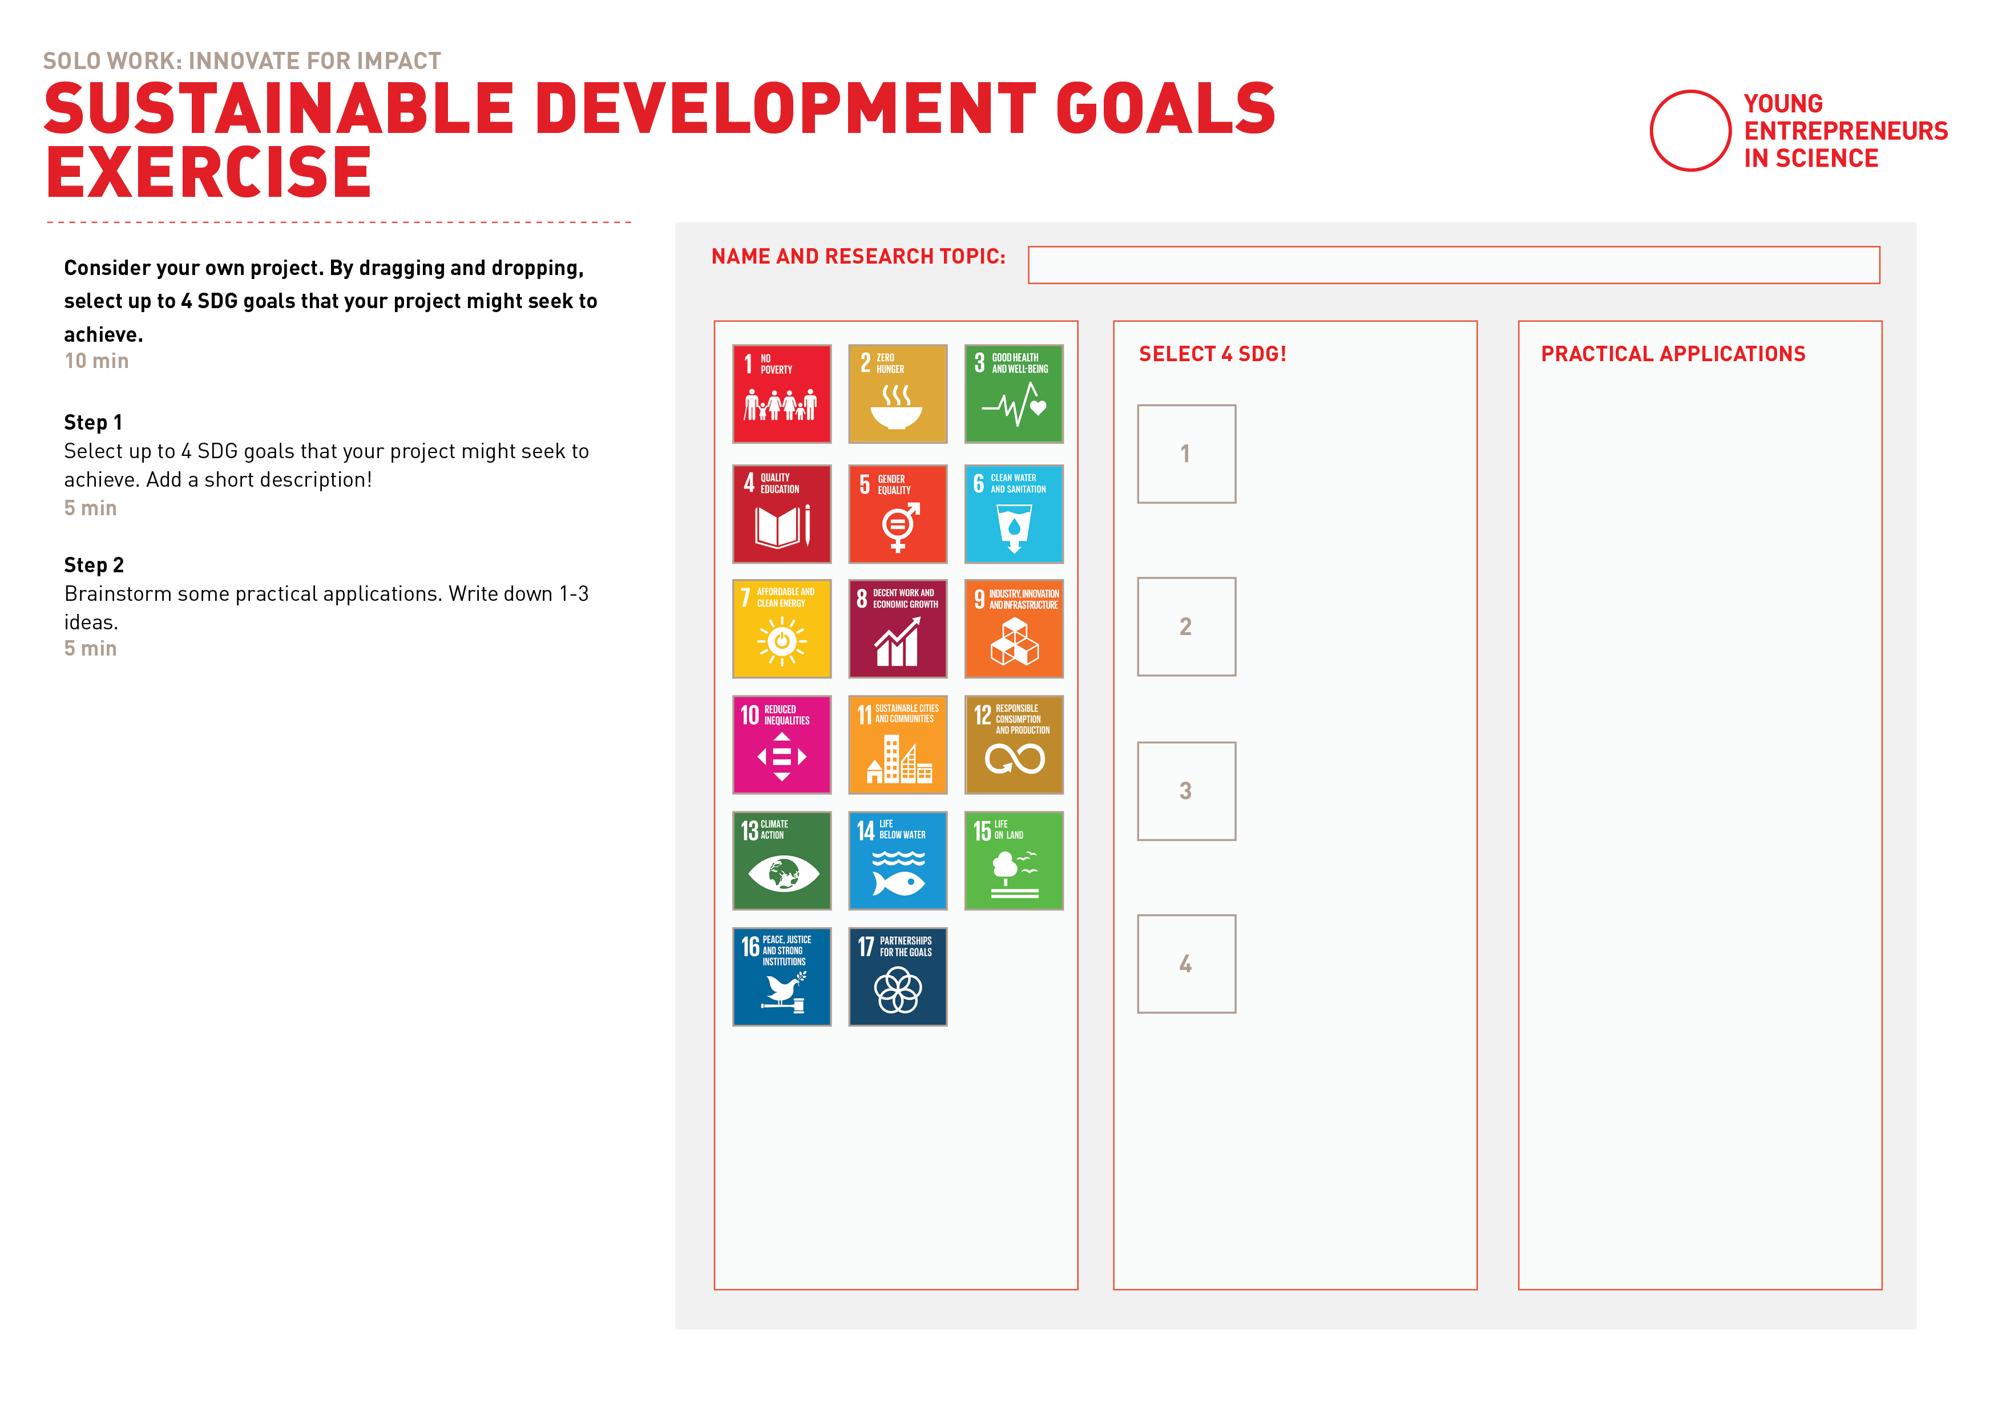
SDG Goals Exercise
Notes:
https://docs.google.com/presentation/d/1aIyCTZNsuDxygpK1ca4Ix8JkU9m80dNF/edit#slide=id.p1
We prepared this template for you with all the SDGs on the left
You can drag and drop each one of them to the right - so we’d ask you to pick 4 SDGs that you can relate to your research topic
There’s space next to the 4 fields to write a short description why/how your research offers potential for this SDG
And then on the very right field you can start brainstorm rough ideas - what could be practical applications, trying to make this link as concrete as you can at the moment.

Slide 43
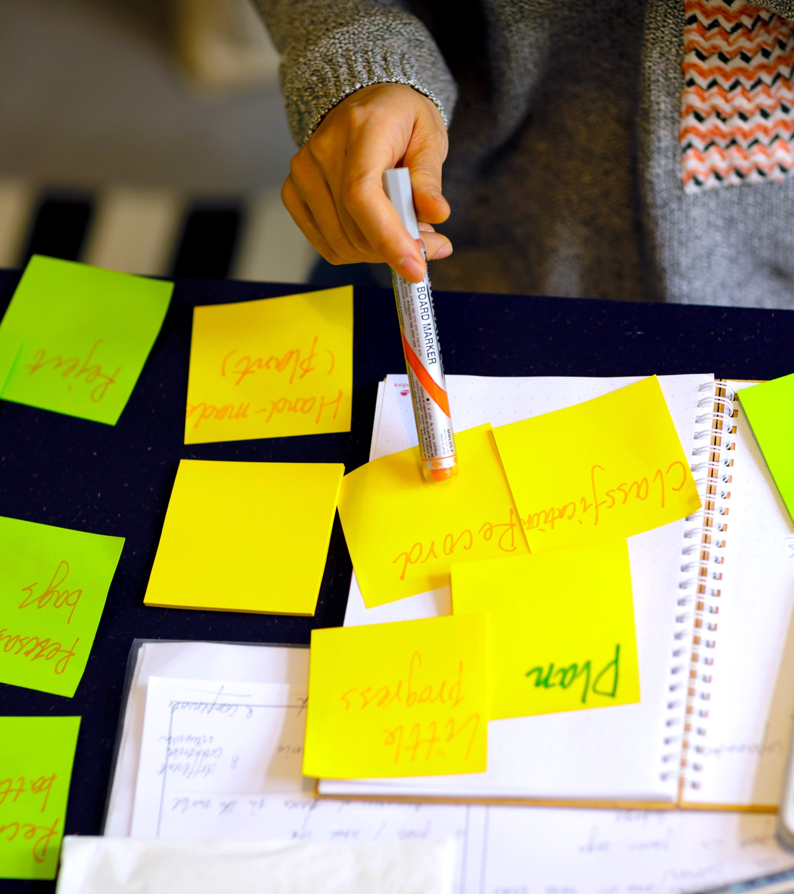
STEP 3: Joint brainstorming & feedback
Notes:
Let‘s come to the third step now.
We would like to offer you support of 2 of your peers to continue brainstorming together.

Slide 44
Team work
Joint brainstorming
30 min
Introduce your research topic, your identified SDGs and your ideas of application to the other persons.
The other persons give feedback. Brainstorm together additional ideas and SDGs that could fit.

Slide 45
Helpful questions
Do the chosen SDGs fit the research topic/use cases?
Are there other SDGs that could be a good fit? Which ones?
Which (other) ideas for practical applications do you have when looking at each SDG?
Notes:
Following questions could be helpful for the exchange in the breakouts – you can take them as guidance to talk about the idea and templates of all members from the brainstorming session.

Slide 46
What SDGs have you identified? Which potential ideas have come up?
Notes:
Gerne SDG Worksheets auf Pinnwand pinnen und gemeinsam angucken

Slide 47
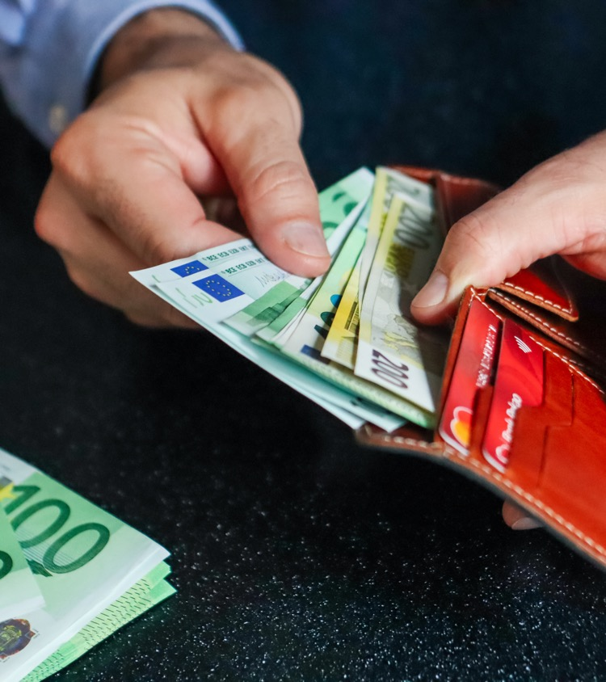
Value creation is also about money
Notes:
We‘ve focused a lot on the Why, the purpose and the impact of your research. Now coming to the end of this module we want to remind you that you are allowed and you also should be able to make money with what you do.

Slide 48
The sweet spot of innovation
What’s the business case?
Who wants it and why?
VIABLE
DESIRABLE
INNOVATION
FEASIBLE
INTEGRITY
Can you make it and deliver it?
What impact can you create with your purpose?
Notes:
Remember this graphic from the beginning, you need to have a viable business case in order to create robust innovation.

Slide 49
THE GOLDEN CIRCLE
What describes e.g. your research topic or products and services companies offer.
WHAT
HOW
The How might be the USP (unique selling proposition). The How makes their products and services special and sets them apart from their competition.
WHY
Notes:
And after having started with the why, it’s always important to get back to the what and the how.

Slide 50

Business model of TRACELESS
“With traceless materials, we are bringing a novel biomaterial to the market. We sell traceless as a drop-in solution to conversion, plastic coating and packaging industries.”
Plastic-free packaging innovation: Sock hooks, formerly made of conventional plastics, *now made of traceless®
Notes:
Coming back to traceless materials their business model is B2B selling of their packages. This is a rather traditional model. There are many other approaches to business models such as Discovering hands…(hier gerne auch noch ein anderes Bsp. einbringen, falls Zeit ist)

Slide 51



Learn more about the value of your research
Social Entrepreneurship
Business Model Canvas
Research Canvas
Notes:
For a deep dive into different business models and the creation of your own Business model as well as dealing with potential applications and use cases for your research we can highly recommend following YES courses:
Social Entrepreneurship > alternative business models
The BMC > create a business model canvas with your own idea
Your Research Canvas > brainstorming on potential use cases of your research in more depth

Slide 52

Lunch Break

Slide 53
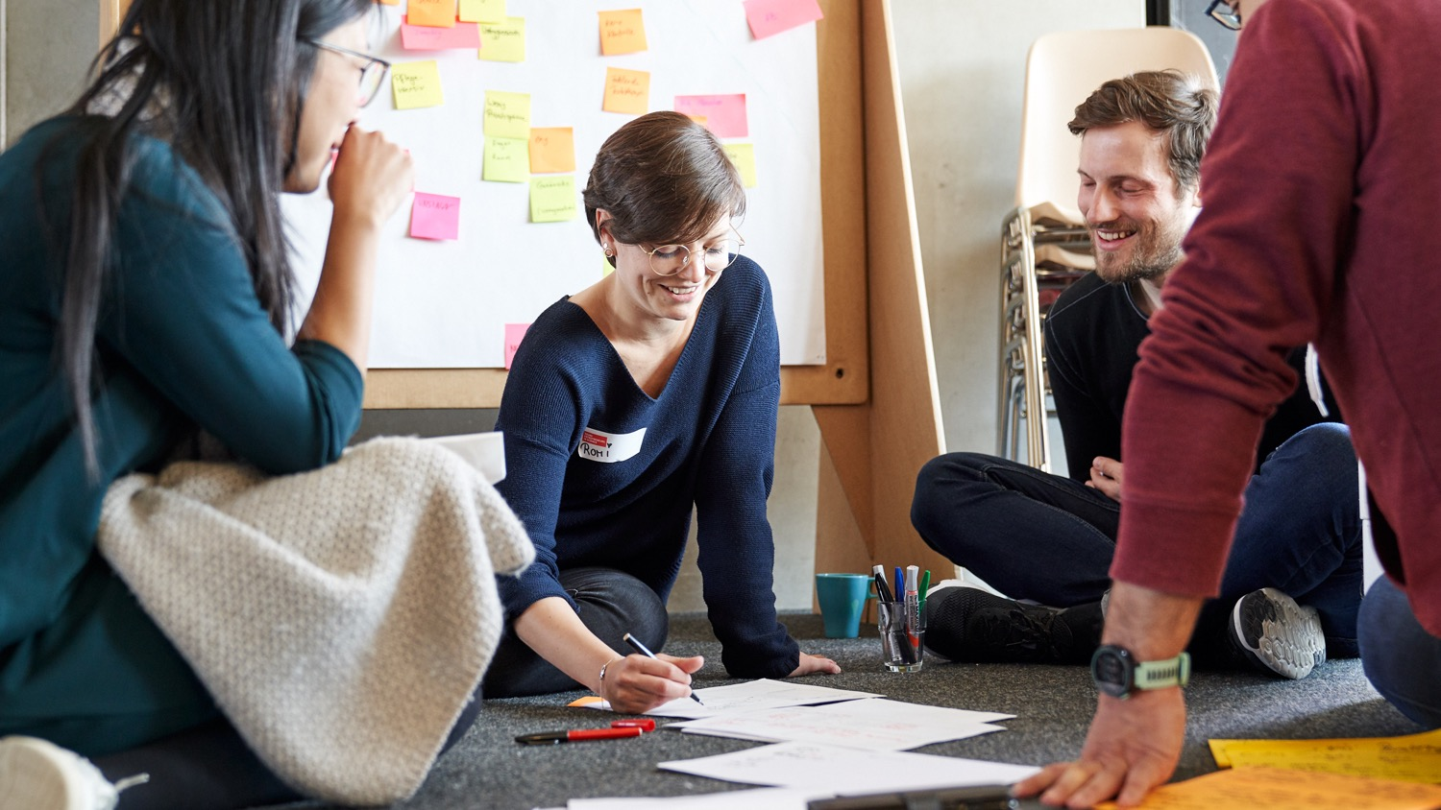
YOUR RESEARCH CANVAS

Slide 54
Learning goals
Reflect about the potential of your own research topic/idea
Assess potential through identifying users/stakeholders
Develop or extend potential use cases based on your research & network
Notes:
Our idea with this workshop is to close the gap between research and business idea or use case.
How can we help you translate your research into contexts for application.
[address the points on the slide]
The focus for the afternoon part of this workshop is to work on your own research topic!! Time to reflect about it‘s potential and share thoughts with your peers!
We know from our experience that if you‘re working in the field of „basic research/Grundlagenforschung“ sometimes it can be a bit tricky to find fields for application.
So if you get stuck – please check in with us – we are happy to support!
And once again – in this part of the workshop you can work hands on!

Slide 55
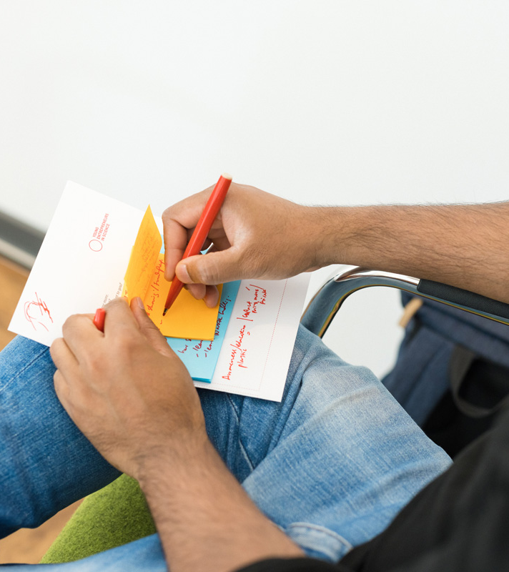
Your Research Vision
Notes:
Now it’s your turn…

Slide 56

Think big!
Science
Magazine
Imagine it’s 2030.
Your research project has led to pioneering results with breakthrough solutions and will be featured as title page in the recent edition of Science Magazine.
What could be the headline of this magazine?
Notes:
Now let‘s get started. It‘s your turn! We'd like you to think visionary!
Imagine this:
Within the last years you've been very successfull with your research which has lead to pioneering results.
Because of your research success you will get featured on the title page in the recent edition of Science Magazine.
Now it is your turn to get creative: What could be the headline of this magazine?

Slide 57

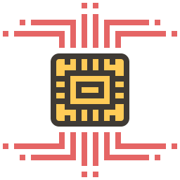

Think big!
Science
Magazine
Imagine it’s 2030.
Your research project has led to pioneering results with breakthrough solutions and will be featured as title page in the recent edition of Science Magazine.
What could be the headline of this magazine?
Artificial eye-brain interface restores vision in blind patients
Example by Yih-Shiuan
Notes:
[Read out example of Yih-Shiuan who‘s research break though has been to discover an artificial eye-brain interface that restores vision in blind patients]

Slide 58
Solo work
Think big!
7 min
Fill the title page of the Science Magazine template with your research vision!
Add pictures, symbols or other visuals
15 min time for yourself

Slide 59
What is the headline of the Science Magazine featuring your research?
What breakthrough does your research offer to whom?
Notes:
Insights or open questions?
What is the headline of Science Magazine featuring your research?
What breakthrough does your research offer to whom?

Slide 60
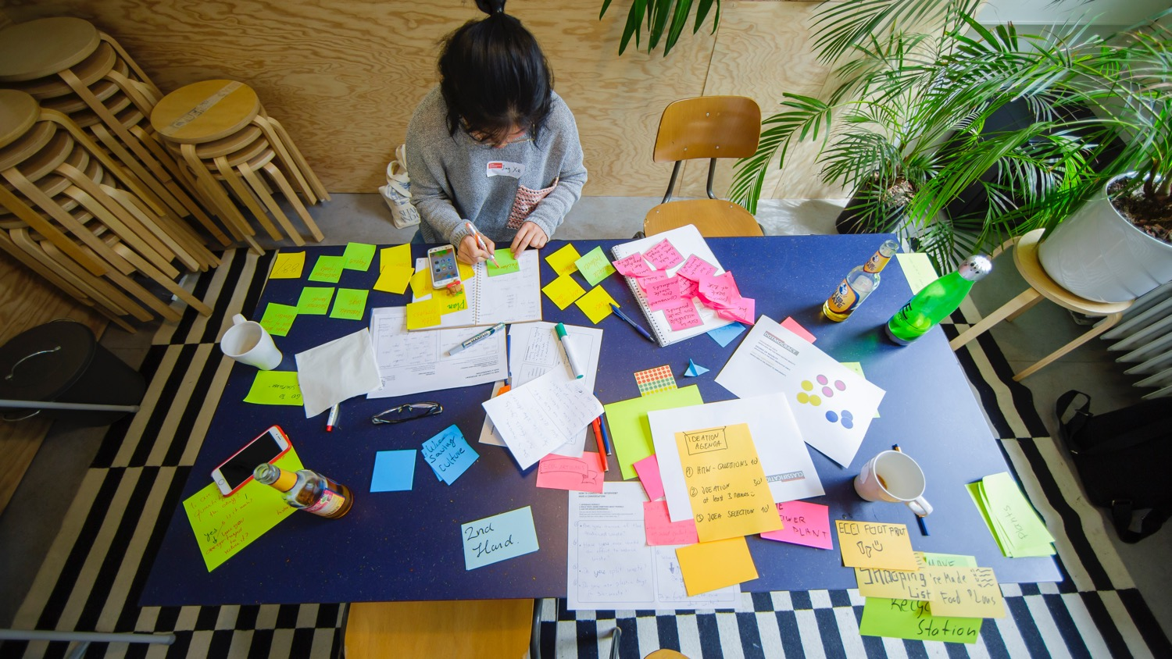
DEEP DIVE INTO YOUR RESEARCH
Notes:
To develop potential use cases, you have to know your research and your initial vision about it.
So let‘s build it up from the beginning with a tool we call the Research Canvas.
We developed the Reseach Canvas because, in various consultations, we found that scientists uncover a great deal of innovative potential in their research activities but have difficulty translating this into use cases or even business models
This is quite natural, because most of them are still thinking as scientists and not yet as entrepreneurs at this stage
We have created this canvas to support you in this transfer, the translation of your research into a commercially viable use case.

Slide 61
The research canvas
PROBLEM TO BE SOLVED | RESEARCH QUESTION & DESIGN
THEORY | RESEARCH RESULTS (and practical application)
POTENTIAL PRODUCT/SERVICE
RESEARCH
USE CASE
Notes:
Now about the tool:
On this template you see 5 areas.
The 4 of them on the lefthand side deal with your research.
The arrow on the right aims at the practical application as service or product.
Throughout the afternoon we will use this template and fill it the fields one by one.

Slide 62
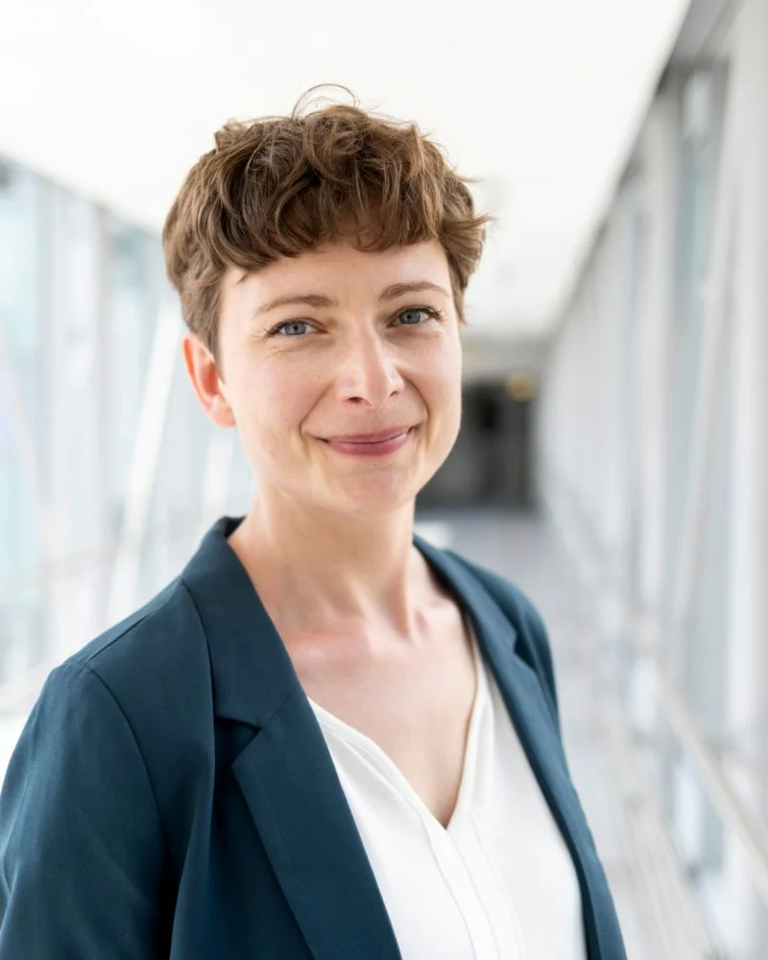
The Research Canvas Example
Getting ahead of Alzheimer’s disease
Notes:
In order to make the canvas and its application more tangible for you we prepared an example from one of our alumni. It will accompany us through the workshop:
- Background: Cognitive neuroscience researcher Nadine Diersch from the DZNE (Forschungszentrum für neurogenerative Erkrankungen) in Magdeburg is exploring new ways to diagnose Alzheimer’s disease with the help of a universal device: our smartphone.
Her app prototype is a chance for people at risk to get ahead of time, opening up possibilities for treating the incurable disease.
We will now have a closer look how she managed to link her research with a use case/application

Slide 63
Problem to be solved
What is your object/topic of research?
What underlying problem or challenge are you addressing with your research?
EXAMPLE
So far, there is no efficient treatment available to cure Alzheimer's disease. Thus, there is a need for an early diagnosis, when first changes in the brain occur.
Notes:
The top left side of the canvas covers your research topic and the problem you are solving with your research.
When you work with your canvas in a little bit: Describe your object of your research very briefly:
What is your object/topic of research?
What problem, what deficiency did you discover? Why is it important that you find answers to these?
What is the bigger problem to which you want to find solutions behind your research?
Let’s have a look at our example:
Nadine found out that so far, there is no efficient treatment available to cure Alzheimer's disease.
She realized a need for an early diagnosis because that is when the first changes occur in the brain.

Slide 64
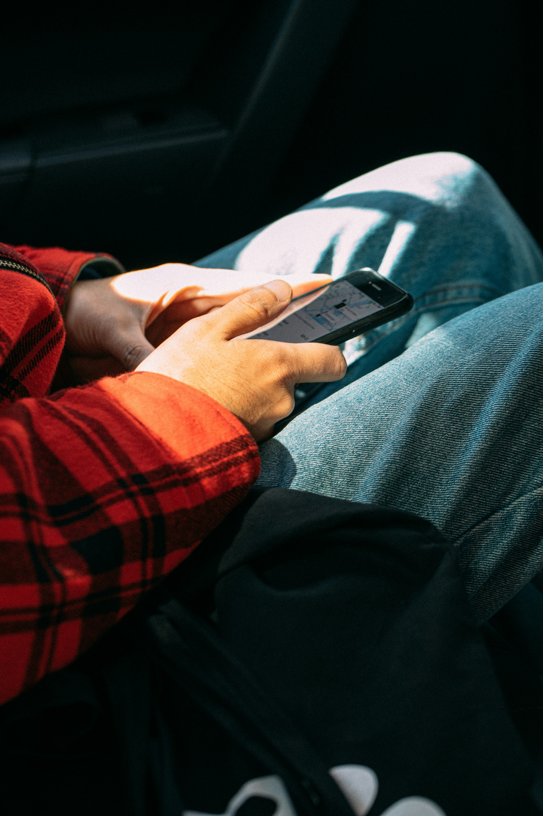

Problem to be
solved
Notes:
Nadines Example:
But: When the first cells in the brain change, the patients don‘t show any visible symptoms that can be detected in convetional memory tests.

Slide 65
Theory
What theoretical background underlies your research?
Note the state-of-the-art highlights!
EXAMPLE
Protein accumulations in certain brain regions at the earliest stages of the disease.
Notes:
Let’s move on to the next part.
On the bottom left you find the field “theory”
This field is about the theoretical reappraisal. Very briefly outline the theoretical context and summarize the scientific consensus on the research subject:
What theoretical background underlies your research?
Note the state-of-the-art highlights!
What contribution will you make to this?
Let’s have a look at our example:
Here is the answer from Nadines example:
Protein accumulations in certain brain regions at the earliest stages of the alzheimer disease, decades before memory problems are detected by standard neuropsychological assessments.
Let‘s move onto the next field of the research canvas.

Slide 66
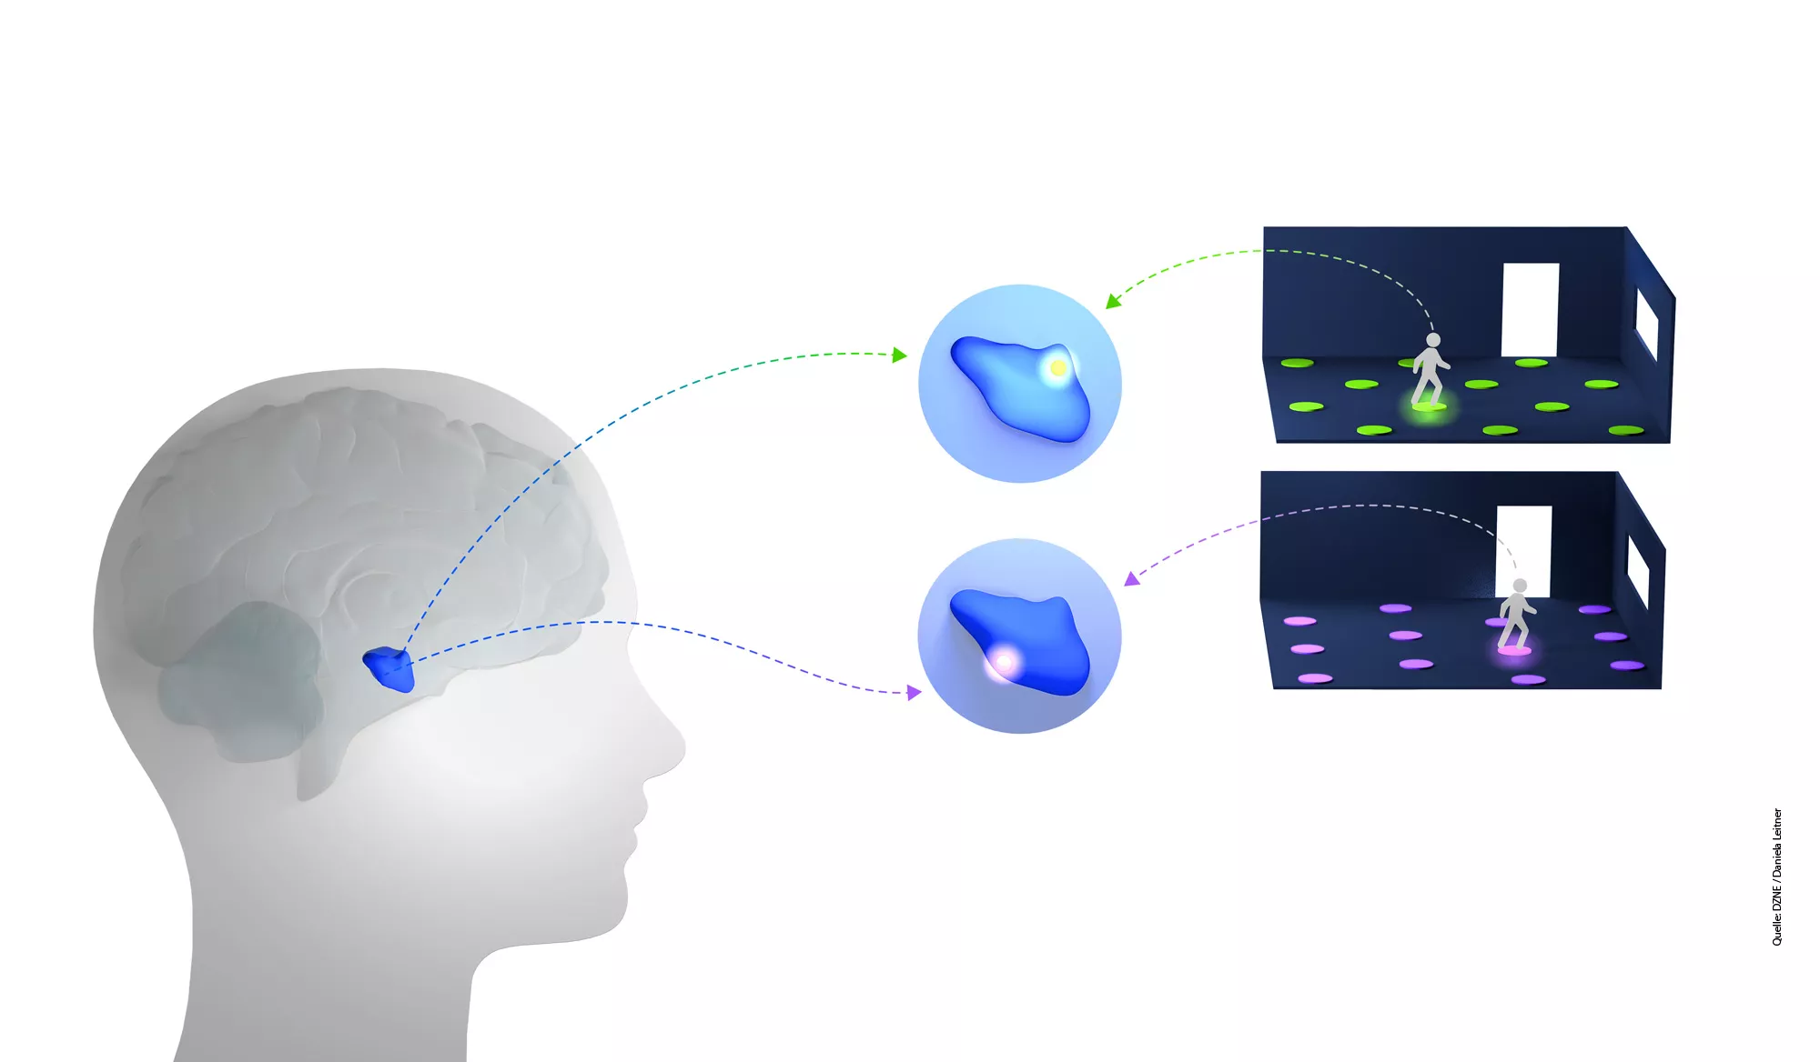
Theory
Notes:
Nadines Example: The proteins begin to accumulate in brain regions that are known to contain our “internal GPS system” -> Therefore the researchers identified links between spatial orientation and movement and the state of the brain cells.

Slide 67
Research Question & Design
What specific aspects of the problem/challenge are you researching?
Note some details about your research setting! (qualitative vs. Quantitative, samples etc.)
EXAMPLE
Can our movement patterns during wayfinding in our surroundings be used to detect early changes/degeneration in the brain?
Notes:
On the top right left you find the field “research question & research design”
Here you can write down:
How exactly do you do your research?
What specific aspects of the problem/challenge are you researching?
Note some details about your research setting!
Of course: a brief summary of the research design is sufficient.
Back to Nadine:
She researched around the question:
Can our movement patterns during wayfinding in our surroundings be used to detect early changes/degeneration in the brain?

Slide 68
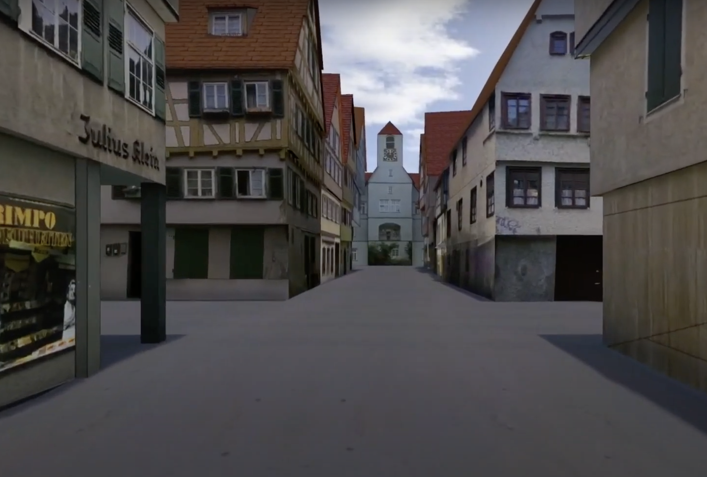
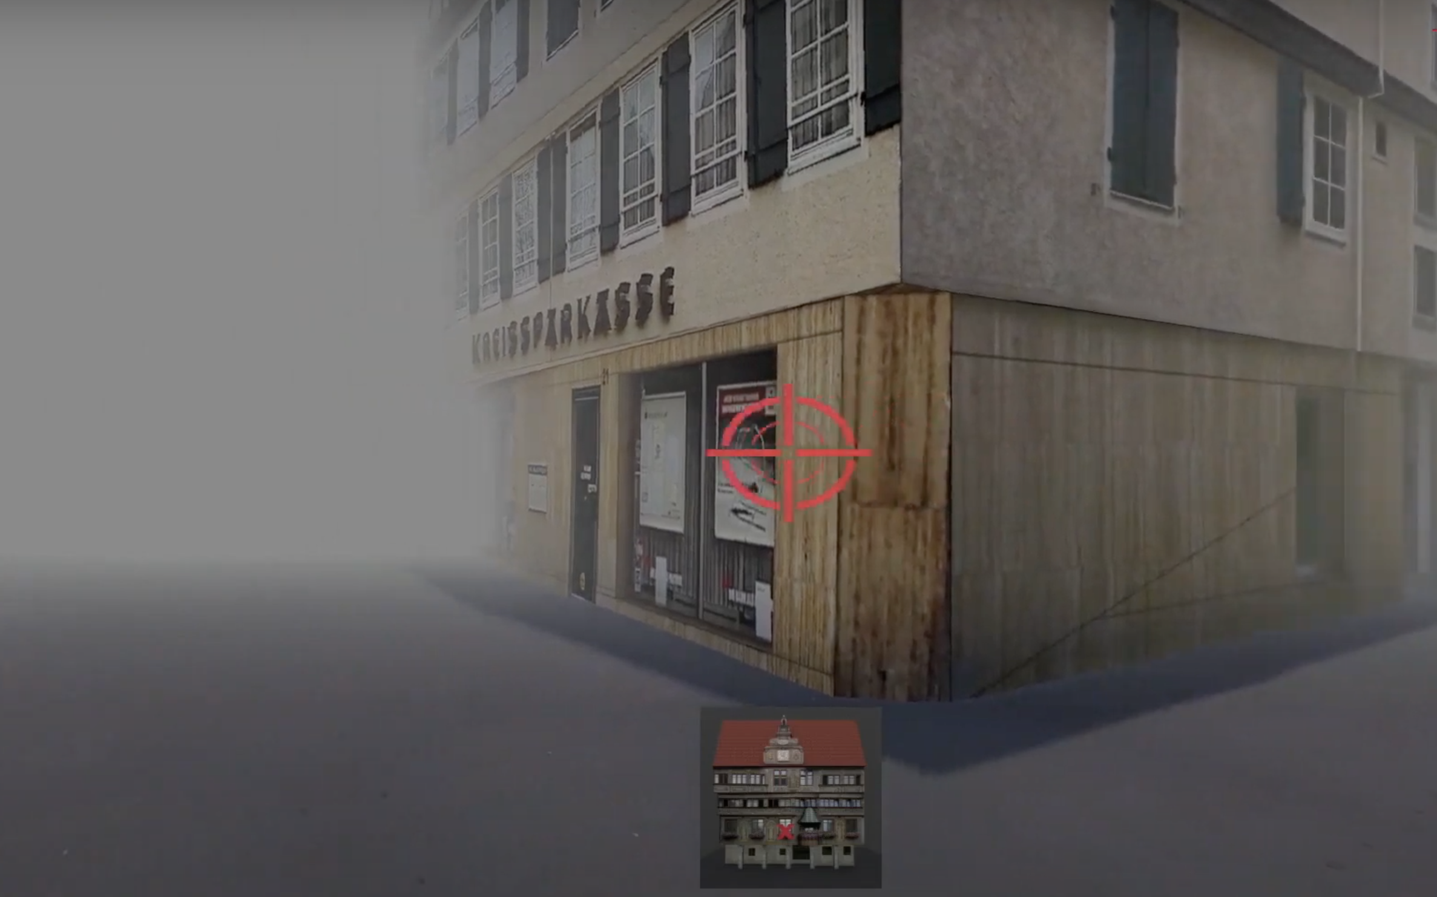
Research Question & Design
Notes:
uncover movement patterns that are indicative of certain neurological changes
In the study, test subjects got to know a virtual, unknown environment. They subjects were driven to an intersection and should move the crosshairs in the direction where the church is. From this Nadine calculated a learning curve. The high risk group needed more learning phases or they found it difficult to memorize the position of the buildings. In the young group only 2 to 3 learning phases were needed. At the same time, they also did an MRI, i.e. they measured the brain activity in the two groups while they solved the task. There were differences in activation patterns in the hippocampus, the region where the place cells are. In the young group, activity in the region decreased continuously over the different learning phases. In the older und high risk test subjects, the hippocampus was hyperactive. There appears to be a connection between hyperactivity in the hippocampus and protein deposits in place and grid cells.

Slide 69
Research Results
(+practical applications)
What are your results so far?
EXAMPLE
Tracking GPS and sensor data from smartphones can be used to study movement patterns and related brain change
Notes:
And on the bottom right it is all abour “your research results and the practical applications”
Here you have space to write down a brief presentation of the results you haveachieved so far. If the research is not so far advanced, you can also put here the results that you suspect or want to achieve.
Just make sure that - when working with this canvas outside this workshop - you update your Canvas at regular intervals and also check what effects these changes have on the other fields of the Canvas. It is also important to note under which conditions your research results apply.
How did Nadine answer this?:
Her idea was to use GPS tracking and sensor data from smartphones to study movement patterns and related brain change

Slide 70
The research canvas
PROBLEM TO BE SOLVED | RESEARCH QUESTION & DESIGN
THEORY | RESEARCH RESULTS (and practical application)
POTENTIAL PRODUCT/SERVICE
RESEARCH
USE CASE
Notes:
That was the left side of the canvas which should not be too difficult for you as it probably deals with your daily work.
You will start with this side and then build up on it.
You can either enter your current research work, a past one you would like to work on or a future one you have in mind.
Later in this workshop you will get time on your own as well as support from the other participants to think about first use cases.
Which open questions are there about the Canvas itself or the individual fields? Do you feel ready to start working with it?

Slide 71
Solo work
The Research Canvas
15 min
Fill all the fields on the LEFT side of the Canvas.
Try to keep it short and concise
15 min time for yourself
We will call you back to the screen
Notes:
Great, here we go! Please go back to the Miro board and claim a canvas.
Please mark your canvas with a post.it with your name.
Then start working ON THE LEFT SIDE ONLY.
Remember that you will get feedback from other participants after the solo work. Make sure to express yourself as clearly as possible in the post-its.
And this is how this works exactly:
It is individual work, so you can stay in the main room.
Make sure you mute yourself.
If you like, you can turn off your camera.
You will have 15 minutes to fill in the canvas.
Remark: the Miro Board can be seen by all participants; feel free to share how much you feel comfortable to share
If you have any questions in between – we are happy to help. Please message us in the chat.
Let’s go!

Slide 72
Potential Product/
Service
What about our walkling patterns? Why not use data from our smartphones to study our question?
Notes:
In order to make the canvas and its application more tangible for you we prepared an example from one of our alumni. It will accompany us through the workshop:
- Background: Cognitive neuroscience researcher Nadine Diersch from the DZNE (Forschungszentrum für neurogenerative Erkrankungen) in Magdeburg is exploring new ways to diagnose Alzheimer’s disease with the help of a universal device: our smartphone.
Her app prototype is a chance for people at risk to get ahead of time, opening up possibilities for treating the incurable disease.
We will now have a closer look how she managed to link her research with a use case/application

Slide 73
Notes:
Welcome back!
Everything went well? Everybody back with us?
Thumbs up please!
Which open questions are there regarding the left side?
[interaction with the participants]
After the break we will look into the right side of the canvas, users and potential use cases.
Once again – please stay in the zoom meeting.
We‘ll continue at [time]

Slide 74
It’s coffee o’ clock!

Slide 75
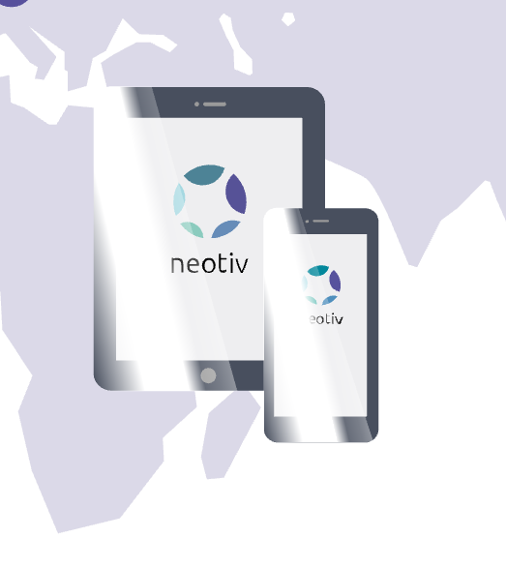
The Research Canvas Example
Translating the research result into a product, together with a team of other experts such as software developers and business experts.
Notes:
We had a closer look at the research canvas understanding how to link research with a potential product or service.
In our example Nadine linked her research with a use case and devleoped an application called neotiv together with a team. Her app prototype is a chance for people at risk to get a diagnosis ahead of time. Tracking movement patterns with the app.

Slide 76
“For somebody who wants to become an entrepreneur, it is crucial to be proactive in order to build up a network outside your lab.”
Nadine Diersch
Young Entrepreneurs in Science Alumna

Slide 77

FROM RESEARCH TO USE CASE
Notes:
Welcome back, everyone! We hope everyone could get refreshed a little
Before the break we worked on the left side of the canvas...
Now it’s time to slowly turn to the right side.
You might have seen two words in bold on the canvas…

Slide 78

What is a use case?
What comes to your mind when you think of users/use cases?
Notes:
… The two words are USE CASE.
Before we start, let's have a short check-in/sharing because we're curious if you are familiar with the term USE CASE.
Have you come across the word before?
What exactly is a use case and how do we get from your research to a use case?
These are our initial questions to jump into the second part of this workshop.
[interaction with the participants]

Slide 79

What is a use case?
“A specific situation in which a product/service/ solution can potentially be used.”
Lawerence Chapman for PMA
Notes:
Let’s have a look a definition of the term use case:
According to the Product Marketing Alliance, a use case is:
‚A specific situation in which a product or service could potentially be used.‘
‚beginning with a user's goal/need and ending when that goal/need is fulfilled‘
(PMA = Product Marketing Alliance)

Slide 80


From research to use case
Transfer
Potential
use case
Research
New theory
New state of the art
New technology
Thesis
Publications
Product
Service
Process
Context
Notes:
What does this mean in our case, for our workshop today?
Again, you‘ll now be looking at your own research topics:
Each research topic can result in new theories, new state of the art and of course publications.
Today, we invite you to look beyond this 'academic' focus or potential and think about the potential to transfer your research topic to (new) contexts for or fields of application. How can your research topic be transferred into an innovative use case?
Remember: A use case is a specific situation in which a product/service can potentially be used. Therefore it is a moment in which your idea/solution creates meaning for someone so that someone becomes a user.
This could mean that…
… your technology or research subject leads to a a completely new product or a service.
… it could be used to optimize a process or
… an already existing solution is applied to a different context in which it solves a problem or satisfies a need and this is regarded as new and innovative.

Slide 81

From research to use case
Potential
use case
Research
USER
Notes:
So to wrap it up: Your research serves as the foundation of innovation
The potential use case refers to the transformation of research insights into specific applications or products or services. The use case can only be meaningful and create value, when it addresses a need by a user.
So – who is the user? Any idea?

Slide 82



Identifying users
PROBLEM TO BE SOLVED | RESEARCH QUESTION & DESIGN
THEORY | RESEARCH RESULTS (and practical application)
POTENTIAL PRODUCT/SERVICE
RESEARCH
USER
USE CASE
Notes:
For that – let’s go back to the Canvas:
USERS are the people that connect our research to a certain use case
They are – so to say – the people who have an unfulfilled need – you could also say a problem – that you want to solve with your solution
So what we want to do next is to focus on potential users

Slide 83
Identifying users
Stakeholder
has an interest in, or is affected by what a business does
Stakeholders
Customers
Customer
is willing to pay for a product or service that satisfies an unmet need
Users
User (Beneficiary)
benefits from the value created by the product or service (though they might not be the one to pay for it)
Notes:
Let’s have a closer look: How do we identify users?
Usually, there are many people interested or affected by our research: the sum of them we call stakeholders
It’s important to differentiate between different groups of stakeholders.
To find the users it is important to have a look for a person that is affected with an unfulfilled need or a problem. Who would benefit from the solution?
Let’s think back to Nadines example: One of her user groups could be the elderly people getting confused. Another user group could be relatives or caretakers – depending on her focus and her use case.
Now – a user is regarded as the beneficiary of a solution. But they are not always the ones who pay. That is why it’s important to differentiate them from customers.
Sometimes, the customer and the user can be the same person, especially in consumer-focused products.
However, in cases like B2B (business to business) solutions, the customer could be a decision-maker or buyer within a company, while the user might be an employee who operates the product or service.
Recognizing this distinction helps in defining your use case.
Why is this relevant? Social Startups for example often have both – someone pays and someone else benefits from the product/service

Slide 84
Identifying users – example
Stakeholder
Society in General
Stakeholders
Customers
Customer
Health Care System
Medical Industry
Users
User (Beneficiary)
Patients with subjective
cognitive decline
Notes:
Coming back to our example once again, we could identify the following groups:
Stakeholders: Society in General – this solution is potentially interesting to anyone and many lobbies, politics etc.
Customers: the group that is mainly interested in buying the solution to market it. In this example that is the health care system and the medical industry
Users: The people that actually benefit from the are patients that suffer from subjective cognitive decline or that have a pre-disposition.
Here you see that the customers are not directly the end users of the solution but it’s a B2B channel. When developing the product/app however, it’s necessary though to think of the user and not the customer: the user has the problem that is solved!

Slide 85



From research to use case
PROBLEM TO BE SOLVED | RESEARCH QUESTION & DESIGN
THEORY | RESEARCH RESULTS (and practical application)
POTENTIAL PRODUCT/SERVICE
RESEARCH
USER
USE CASE
Notes:
Once we have identified our potential users, we can turn to the right side of the Canvas and think about specific use cases for these specific users users
This part could be a bit more tricky – especially when you are doing ‚basic research/Grundlagenforschung‘ (hard and a long process sometimes to see potential for application)

Slide 86
Potential use case
In which context could your research find application?
What is a problem you could solve in that field and who is having that problem?
Can you build a new product/service around your research to solve their problem?
EXAMPLE
Smartphone App and state-of-the-art Machine Learning algorithms to classify individual movement patterns and to predict cognitive health status
Notes:
We encourage you to dive into these questions today:
In which (new) context could your research find application?
What is a problem you could solve in that field and who is having that problem?
Can you build a new product/service around your research to solve their problem?
EXAMPLE!
Sometimes there is still a lot of research work to be done before a finished product, service, etc. can be developed. That's perfectly okay; in this case, also write down the research steps that are still necessary until a first prototype, a first service outline can be completed)

Slide 87
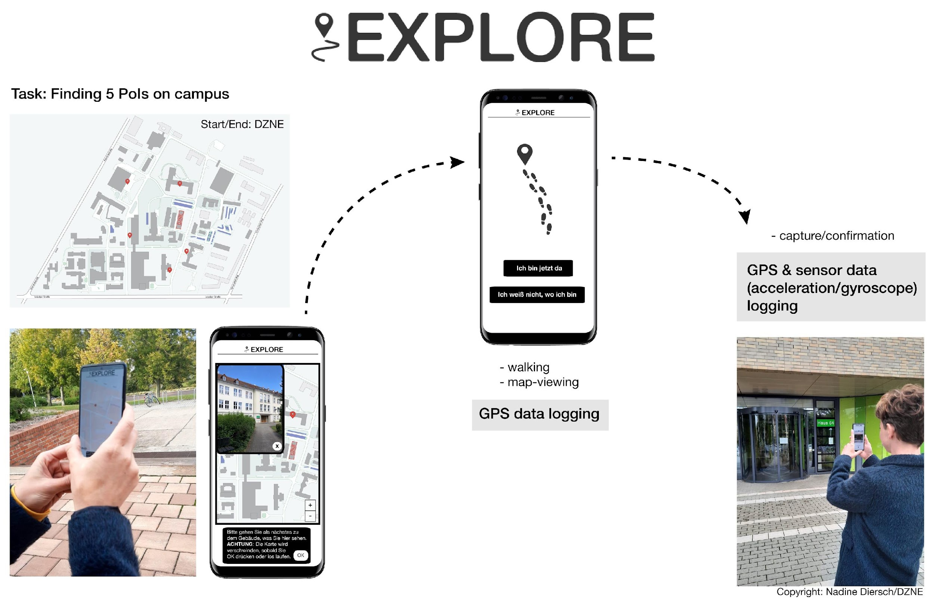
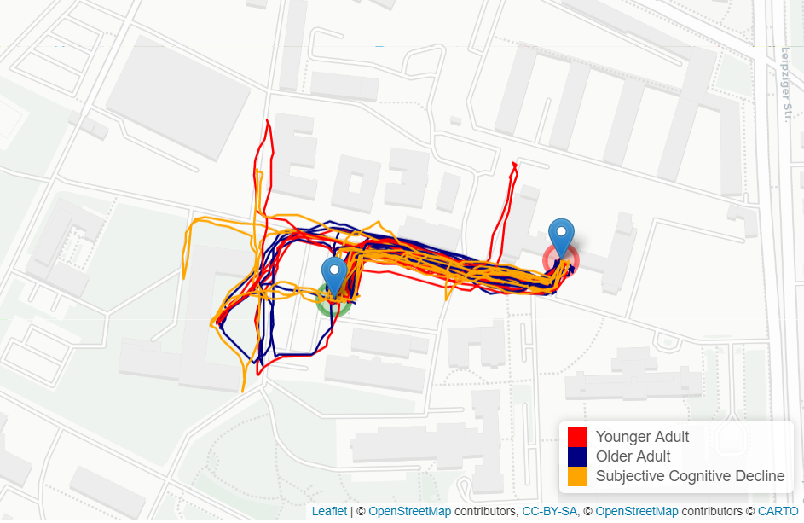
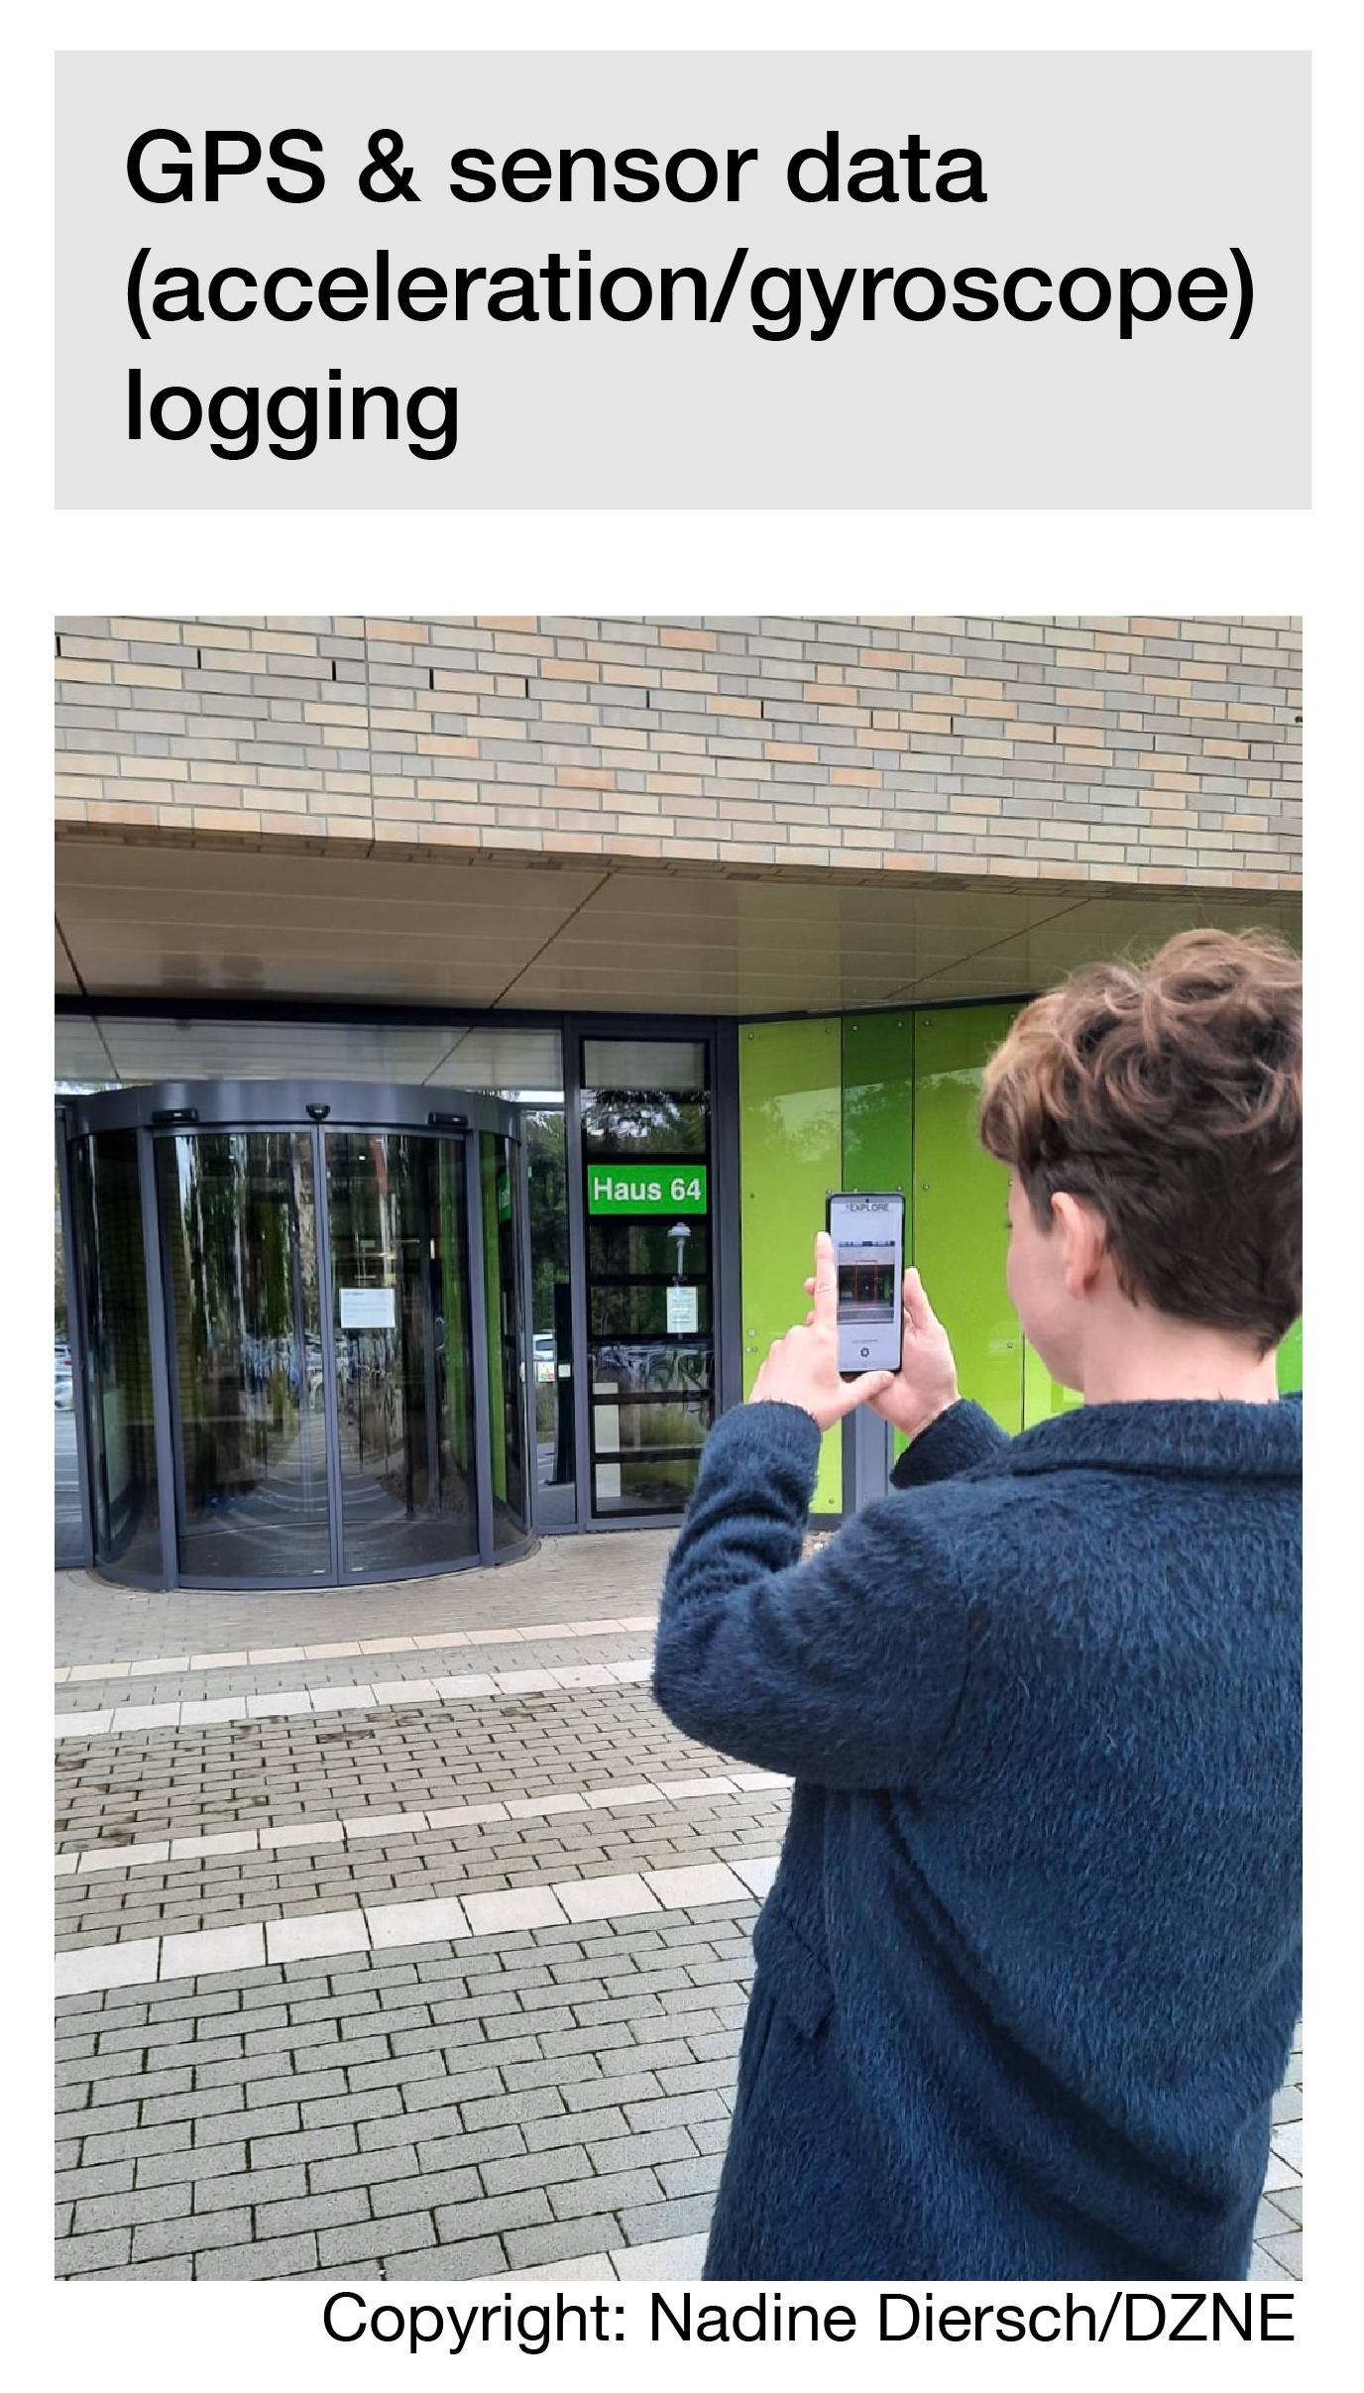
Explore-app
Notes:
And before you start… Let’s look at our example:
Nadine developed a smartphone App and state-of-the-art Machine Learning algorithms to classify individual movement patterns.
She uses this to predict cognitive health status of a person to identify who is at risk for the disease
Another potential use case Nadine and her research team are currently investigating is if the app could also be used as a tool to train the brain and, thus, maintain the navigational performance of the brain.
_______________
Further background information by Nadine Diersch:
…Also a graphic of my app, as it now actually exists and is being used in initial studies - to be more precise, we have carried out an initial proof-of-concept study at the DZNE with a few young and older test subjects, as well as an at-risk patient group (patients with subjective cognitive decline, these are people who do not yet show any abnormalities in standard neuropsychological tests, but say that something is no longer right, roughly speaking). The data does indeed indicate that there are differences (aka that, for example, SCD patients cover greater distances and stop more often), but we are currently still evaluating the data. I can also give another update in due course. Attached is a plot of the trajectories of our test subjects on one of the tracks.
On the left side you can see a prototype of the app how it currently exists. Data ist collected by observing the walking patterns of probands with different characteristics (younger people, elderly people, at risk patients = Patients with subjective cognitive decline).
On the right side the data has been evaluated and differences of walking patterns can be observed between those cohorts (SCD patients cover a longer distance to reach a location than younger people)

Slide 88

BRAINSTORM
Notes:
Okay, so let's take some time to think about potential use cases for your own research!

Slide 89
Solo work
Stakeholders and use cases
10 min
Reflect and collect on your sheet of paper:
Who are your stakeholders? Out of those: who are your potential users that use your product/service/process (middle box)?
What could be use cases for those users (right box)
Time for yourself

Slide 90
From research to use case
Some questions to brainstorm
In which contexts and for whom could your research be useful as well? Think out of the box!
What would you do with your research if you had 1 billion Euro?
With which add-ons or features could you extend and improve your research (idea)?
Science
Magazine
Artificial eye-brain interface restores vision in blind patients
Notes:
Here are some further questions that could support you to brainstorm.
The questions are meant to inspire, no need to answer them all.
You can also think about your Science Magazine vision from the beginning of the webinar
Who else could be your users? People that are affected by your research

Slide 91

Build on each other’s ideas
Notes:
Let‘s move on to the last step for today: building on each other‘s ideas/research canvasses!
So far, you have been working on your own research topics and ideas.
Now it's time to get some feedback from your peers!
We will now give you some time with two other peers to have a sparring with each other. Use this time as you feel is most beneficial for you. You could use it…
to get feedback to your ideas
to build on each other's ideas and brainstorm together
to ask questions to each other
We hope you will receive new impulses from this exchange!

Slide 92
Small teams
Build on each other’s ideas
30 min
Find two people and build a group!
Present your canvas to each other:
Ask & discuss questions
Brainstorm new ideas based on what you have understood
30 min in total – 10 min each canvas
Countdown for last 30 sec

Slide 93
What did you learn from this exercise? What was interesting to you?
Notes:
Insights or open questions

Slide 94

Next steps
Build up a network
Talk about your use case(s) with friends, family, colleagues > collect feedback
Get professional support
Train your entrepreneurial mindset
Exchange with role models
Take it step by step
Notes:
Now that you‘ve come that far, what could be potential next steps? Are there any ideas how to continue with what you worked on?
We‘d like to give you some ideas:
You could…
Build up a network: stay in touch with each other; exchange contact details; become part of the YES alumni community; Visit meetups or other start-up events
Get professional support: You don't need to have a finalized product in order to talk to your startup centre, for instance
Train your entrepreneurial mindset: check out other YES workshops, for example ideation > DEsign Thinking etc., check out relevant literature
Exchange with role models: for instance in our YES workshops; visit startup talks
Take it step by step: don't get stuck in a big future vision, start where you are and with what you have, invest as much time and resources as you're willing to lose right now
Which other ideas do you have for a next step?

Slide 95
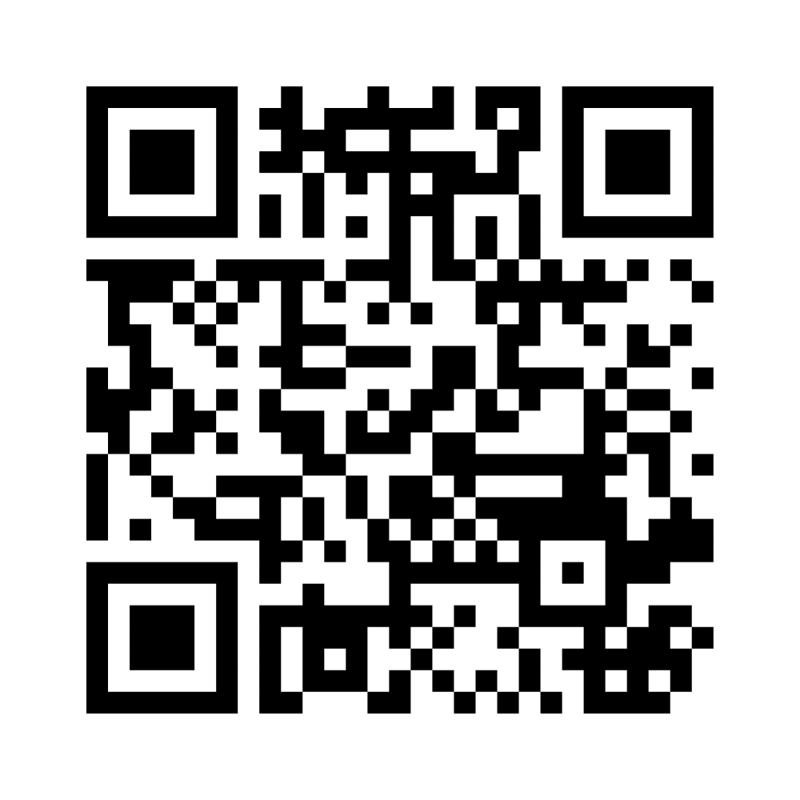
Wrapping up!
I like, I wish, I take away…
Notes:
Ggf. Menti-Link für Teilnehmende: https://www.menti.com/alaxnctncdyz

Slide 96

Stay connected with the YES community
Join our LinkedIn group
Take part in other (Online-) Workshops
Tell your peers and spread the word via social media
Stay active in our Alumni-Community
Keep learning from each other on your entrepreneurial journey
Notes:
Hinweis für die Coaches:
Die Einladung zu dem netzwerk FW Connect erhalten die TN nach dem Workshop in einer Email, genauso wie alle weiteren, genaueren Infos, wie sie sich connecten können und Teil unserer Community werden können.

Slide 97


Boost your career with your YES experience
Connect with YES and fellow participants on LinkedIn
Share your YES certificate on Social Media
Add YES to your trainings on LinkedIn and your CV
… and carry the entrepreneurial spirit further.
Notes:
Hinweis für die Coaches:
Die Einladung zu dem netzwerk FW Connect erhalten die TN nach dem Workshop in einer Email, genauso wie alle weiteren, genaueren Infos, wie sie sich connecten können und Teil unserer Community werden können.

Slide 98
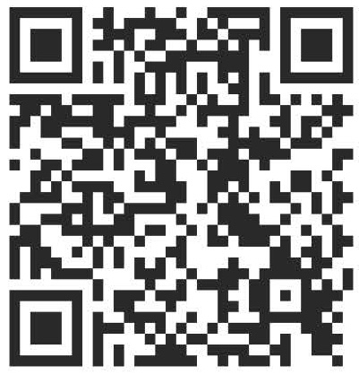

Time for feedback!
Notes:
Link
Bitte auf folgendes bei der Tonspur eingehen, um die Notwendigkeit der Evaluation zu betonen (Anmerkungen von YES):
Your feedback is key/We highly appreciate your feedback!
It is crucial not only for the constant improvement of our workshops, but also with regards to the future funding of our programme.
Future funding means more offers for you as alumni community (additional workshops, webinars, networking opportunities)
Thank you for taking the time (approx. 4 min)!

Slide 99




Thank you!
Connect with us and each other via Social Media …
LinkedIn Page
LinkedIn Group
Instagram @sciencepreneurs
Newsletter
©️ Young Entrepreneurs in Science, 2025
Notes:
That‘s it!
Thanks a lot for participating
We hope you had fun
You will be added to the YES newsletter list to stay updated with the project and to read exciting alumni stories as well as get invited to our network Falling Walls Connect, to make contact with each other and take part in alumni webinars!
Please spread the word!!!
Instagram
https://www.instagram.com/sciencepreneurs/
LinkedIn Seite
https://www.linkedin.com/company/young-entrepreneurs-in-science/
LinkedIn Gruppe
https://www.linkedin.com/groups/8902012/
Newsletter
https://youngentrepreneursinscience.com/newsletter-registration/
Everybody else: Goodbye, have a nice day and see you soon!

Slide 100

THE END

