Slide 1

Navigating through Team Dynamics
Präsenz

Slide 2
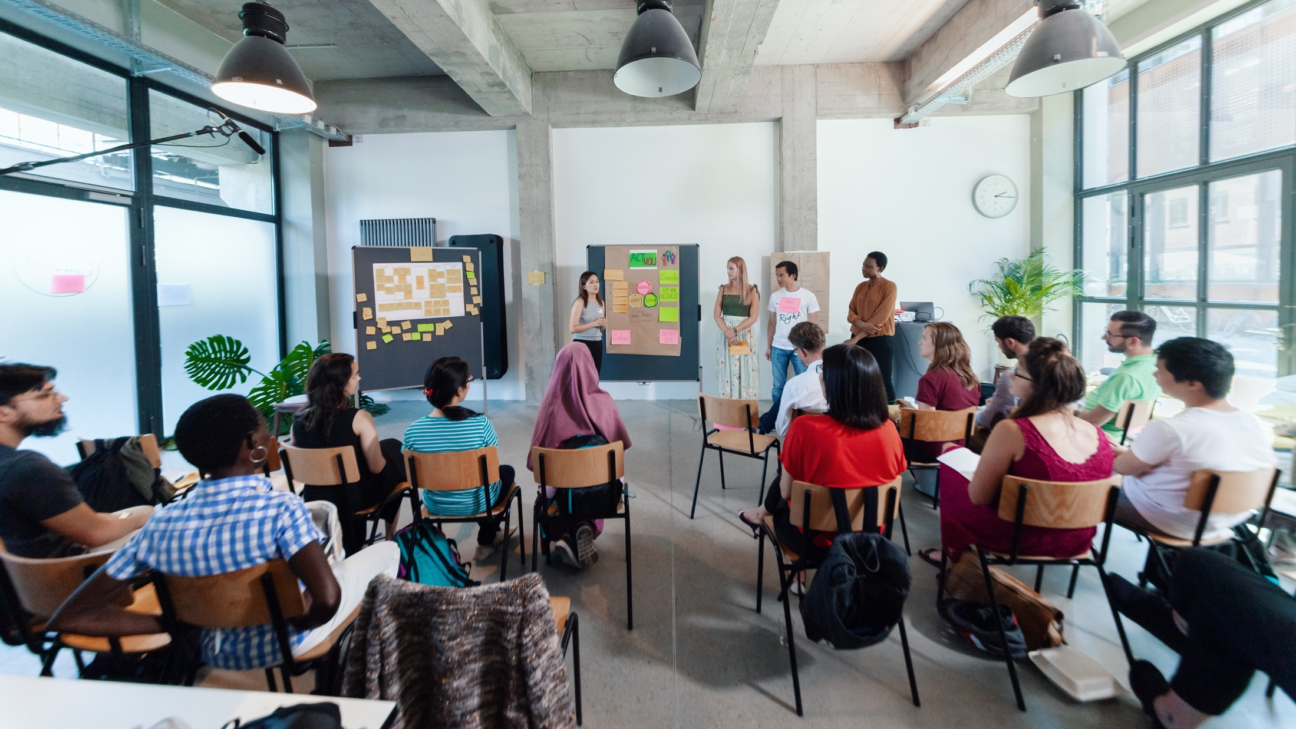
WELCOME
Notes:
So again, a warm welcome to all of you! We are so happy that we can meet in person again!
This is how we started 6 years ago.

Slide 3



Workshop setting
YES
Coaches
Partner
Notes:
Please shortly explain the workshop setting so that everyone is familiar with the parties involved and what their role is. (can be adapted from location to location)
YES > workshop organizers; development of workshop concepts and content
Coaches > facilitation of workshops; professional trainers and coaches working for YES
Partner > academic partner of YES; those who host a workshop and are involved in the planning of guests etc.

Slide 4

Young Entrepreneurs in Science
opens up new career perspectives for young researchers
part of the Falling Walls Foundation
enabled by Federal Ministry of Education and Research
www.youngentrepreneursinscience.com
Notes:
Started as an offline workshop series in various cities throughout Germany, now YES is offering a programme of different online workshops and webinars for PhDs and Postdocs
Young Entrepreneurs in Science is a project team of 12 team members and is part of Falling Walls Foundation, a non profit located in Berlin
FW is a non-profit organisation located in Berlin, which aims to communicate science & research to the public and promote exchange across disciplines
Our workshops benefit from our broad network in academia and business
BMBF (Federal Ministry of Education and Research) enables your participation free of charge
(JR: Which are the next walls to fall down?)

Slide 5
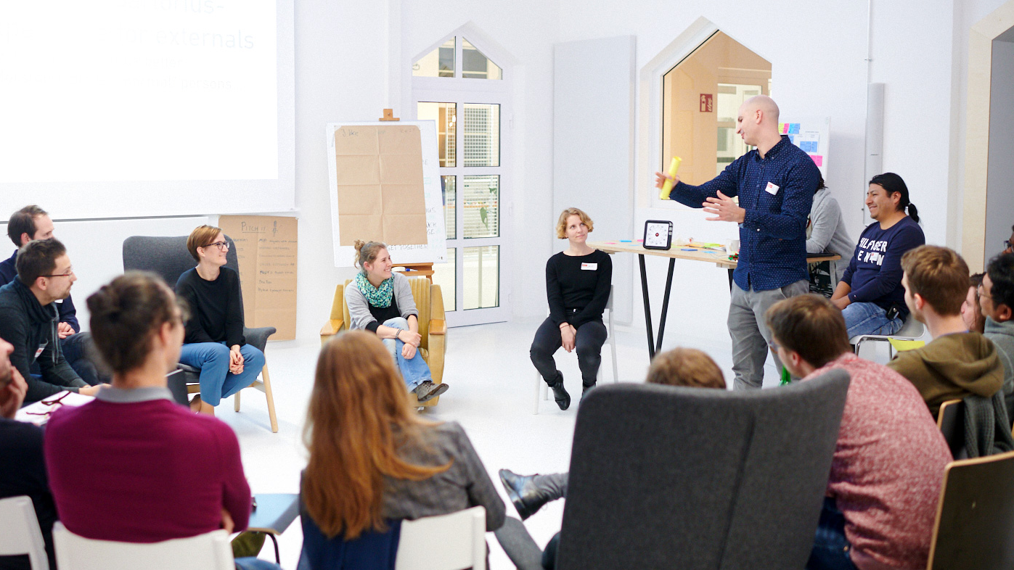
WELCOME FROM OUR
UNIVERSITY PARTNERS
Notes:
Uni Partner begrüßen

Slide 6

WELCOME FROM OUR YES COACH
Notes:
Coaches stellen sich vor

Slide 7
Agenda
Lunch Break
Part I
Part II
Navigating Conflicts
Check-In
Was steckt hinter Konflikten und warum ist es wichtig, ihnen nicht aus dem Weg zu gehen
Unterschiedliche Konfliktverhalten: Thomas Kilmann Modell
Konflikte ansprechen: Wahrnehmung, Effekt, Wunsch
Teamwork Essentials
Theorie: Was ist ein Team und welche Arten von Teams gjbt es? (Riemann/Thomann - Gruppenfeld-Typen)
Die eigene Rolle im Team - Team Rollen nach Belbin
Ein:e Gründerin teilt ihre Erfahrung mit Teams in der Q&A Session
Wrap-Up
Notes:
Wähle je nach Workshoplänge diese oder die kommende Slide aus.

Slide 8



Your learning materials
Download link: You will receive a download link for the handout and your certificate within 3–5 days after the workshop
Template: Blank templates will be included
Photos: If you want to document your results, please take photos after getting consent from you team

Slide 9
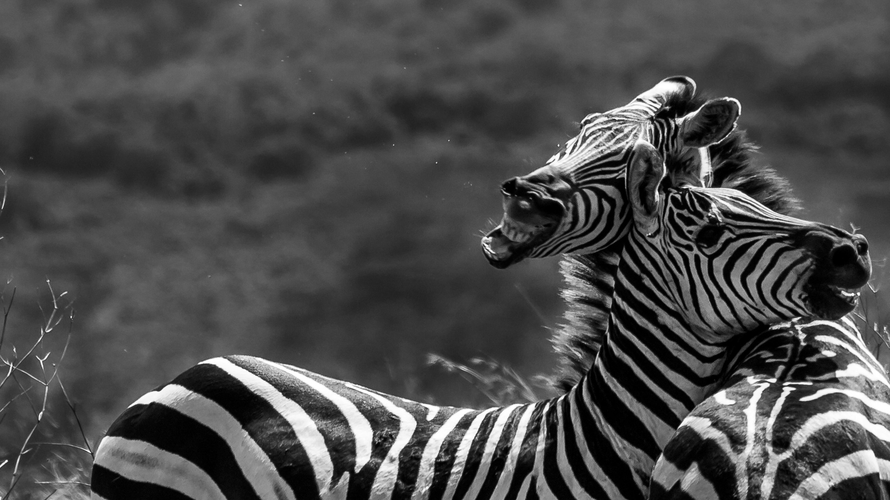
NAVIGATING CONFLICTS

Slide 10
Agenda
Part I
Part II
Check-In
Exercise 1: Conflict note
Input: Let’s talk about conflict
Exercise 2: Different behaviours in conflict
Input: How to address a conflict
Exercise 3: Address a conflict
Transfer
Summary & Check-Out

Slide 11


Learning goals
Understand what conflicts stand for and how they can be useful.
Understand the role of empathy and a change of perspective in conflict situations.
Get to know strategies for dealing with conflicts and experiment with new strategies.
Notes:
Let‘s have a look at our learning goals for todays‘ workshop…

Slide 12

Let’s talk about
conflict
Notes:
But before we start to talk about conflict, let‘ have a look what…

Slide 13

Sharing…
What association do you connect with the term „conflict“?
Notes:
… you all associate with the term…
(sharing)
Now – you could ask why we address the topic here in the context of „Young Entrepreneurs in Science“.
For this we‘d like to take a look at some reasons for failure start-ups face:

Slide 14



Reasons for failure
42%
No market need
29%
Ran out of cash
23%
Not the right team
https://www.cbinsights.com/research/startup-failure-reasons-top/ (06.11.2019)^
Notes:
These are the 3 main reasons why start-ups fail
No market need
Ran out of cash
Not the right team
Still nearly a quarter of startups fail because the team is not right or the team can’t work together in the right way.
((bring in your personal experiences if you want/can))
That why we think it really is worth looking at the topic of conflict and learn how to deal with conflict well.
This is what we want to do in this module and we‘ll start with one definition of what conflict actually is…

Slide 15
A conflict by definition
Conflicts are not just opposites, but the current inability of a system to constructively deal with differences.
Daniel Steinitz
Notes:
A system can be many different things:
Two people
A Team
A Family
An Organisation, …
Current inability means → It‘s not forever
Constructively deal with differences → there is a way that helps you deal with conflicts

Slide 16
Oh conflict, I need you so badly!
Importance of conflict
Conflicts are natural and happen in every ongoing relationship (work environment, family, friendships ...).
Since conflict is unavoidable we must learn to manage it.
Conflict is a sign of a need for change and an opportunity for growth, new understanding, and improved communication.
https://clarke.edu/campus-life/health-wellness/counseling/articles-advice/tips-for-managing-conflict/
Notes:
Conflicts are therefore quite normal and transformatory
So it is important to gain or strenghten the ability to endure conflicts and deal with them in a constructive way!
Tensions/conflicts serve to bring change

Slide 17

When problem becomes conflict
Problem
Conflict
Source: Roland Kunkel-van Kaldenkerken, Carla van Kaldenkerken in: Peter Knapp (Hrsg.), Konflikte lösen in Teams und großen Gruppen, ManagerSeminareVerlag
Notes:
In our language the terms problem and conflict are often used interchangeably.
But: They have different „drivers“ and therefore need to be solved differently. And by looking at the difference between them you can find a lot of insight of what a conflict actually is.

Slide 18
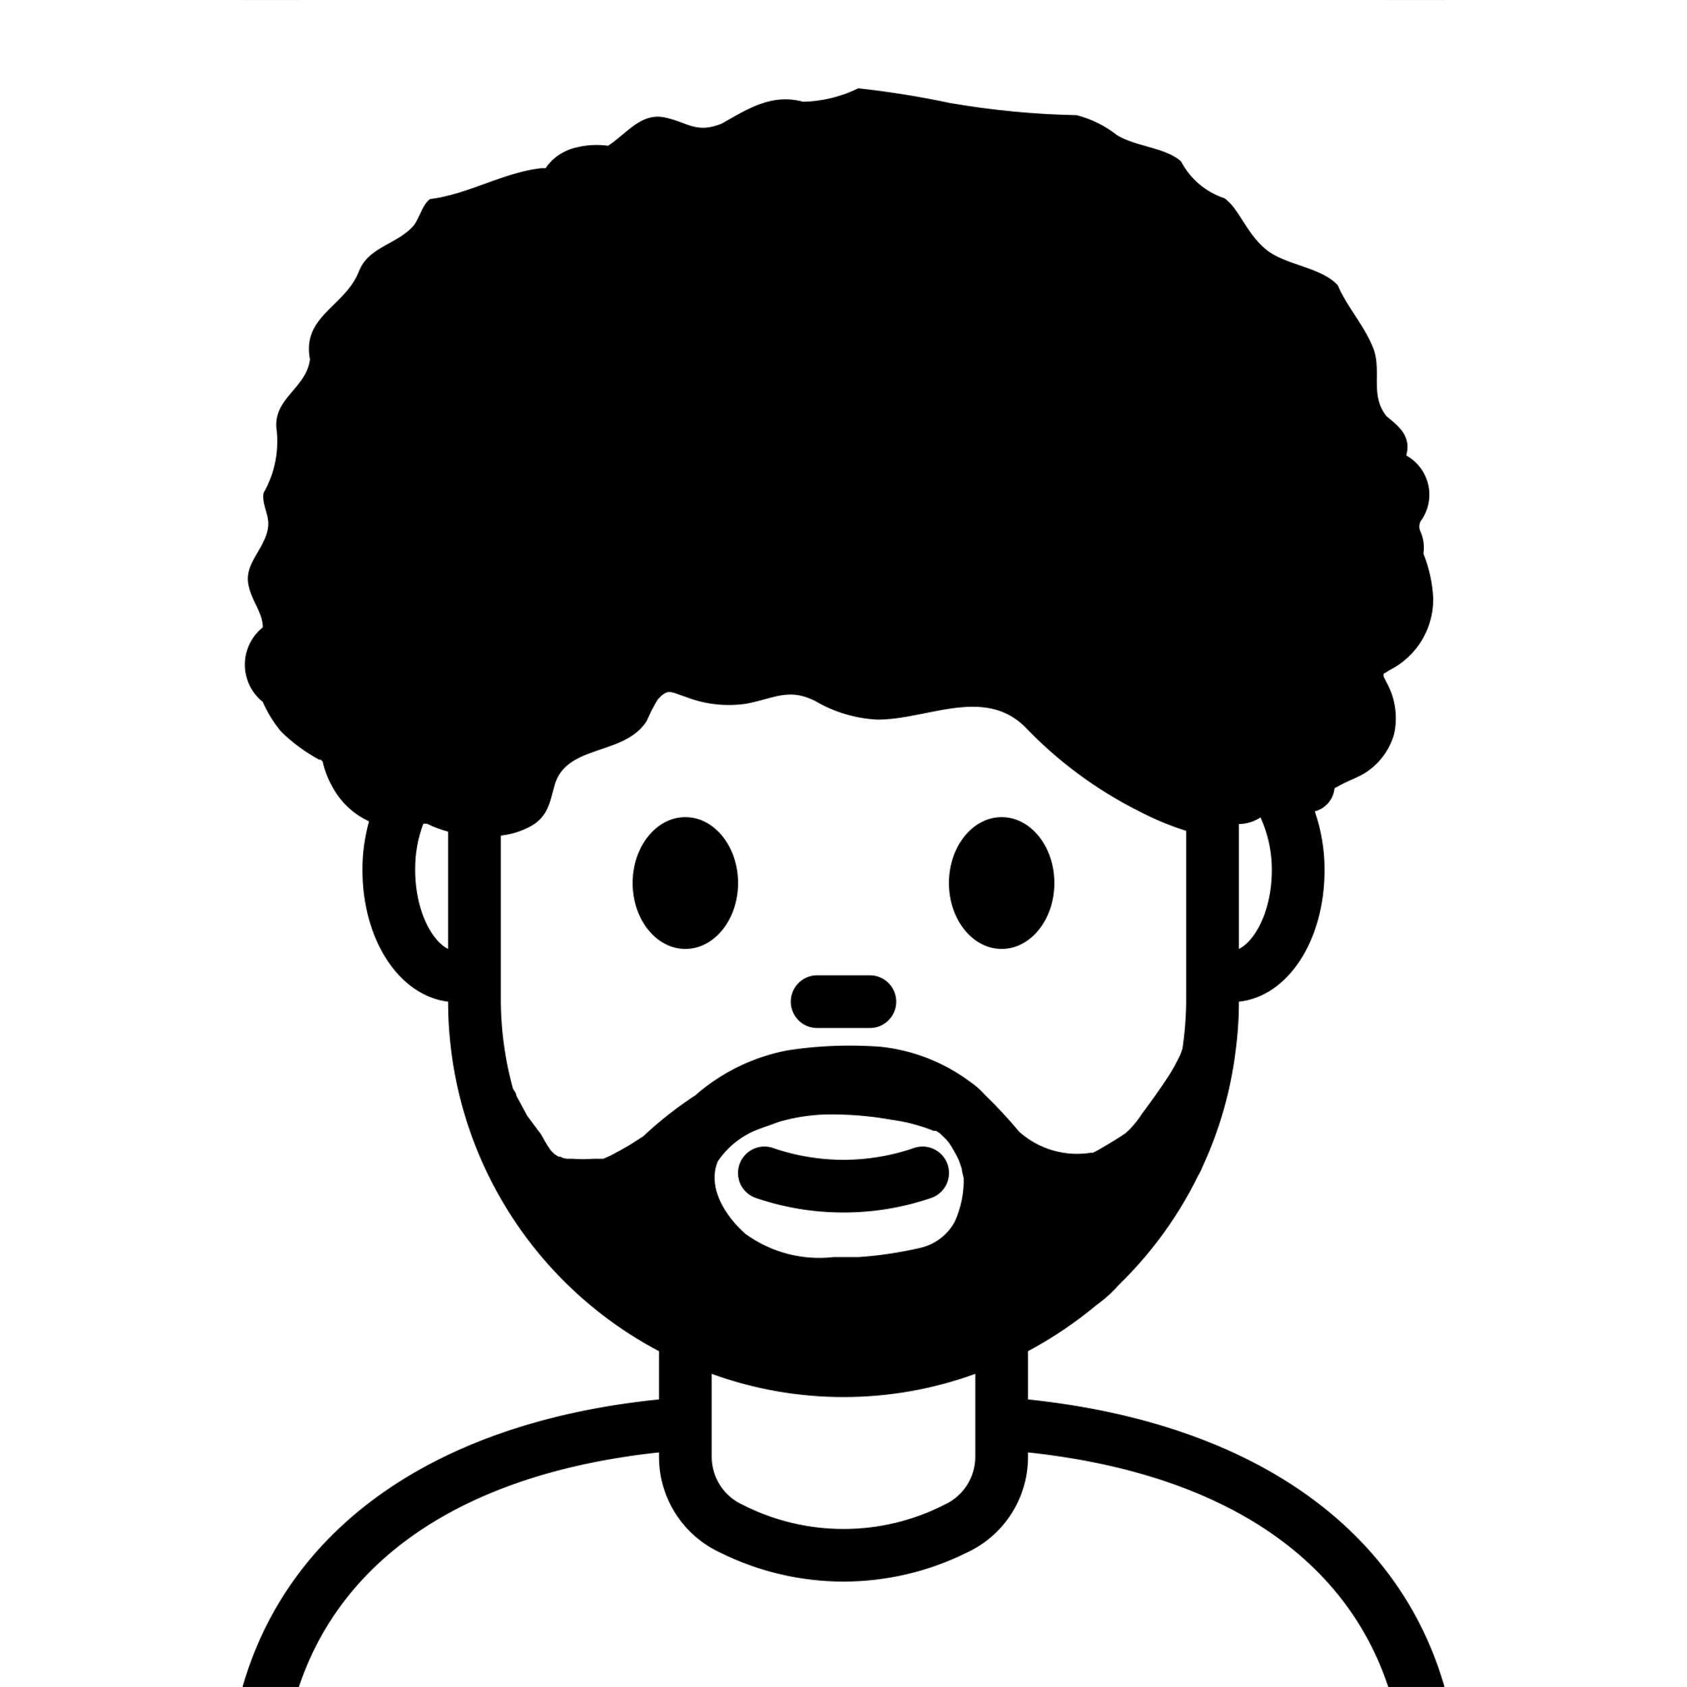

Please meet…
Our Protagonists Flo and Max
Flo and Max are co-workers
They both freelance
They are sharing an office together
Their shared office also includes a shared kitchen
Max
Flo
Source: Roland Kunkel-van Kaldenkerken, Carla van Kaldenkerken in: Peter Knapp (Hrsg.), Konflikte lösen in Teams und großen Gruppen, ManagerSeminareVerlag
Notes:
Let‘s look at the difference between a problem and a conflict and use a simple example!

Slide 19


The problem
For one month the water tab in the kitchen has been dripping…
Max
Flo
Source: Roland Kunkel-van Kaldenkerken, Carla van Kaldenkerken in: Peter Knapp (Hrsg.), Konflikte lösen in Teams und großen Gruppen, ManagerSeminareVerlag

Slide 20
The problem
For one month the water tab in the kitchen has been dripping…
All this time none of the two has been taking care of it and it's starting to get worse
Max
Flo
Source: Roland Kunkel-van Kaldenkerken, Carla van Kaldenkerken in: Peter Knapp (Hrsg.), Konflikte lösen in Teams und großen Gruppen, ManagerSeminareVerlag
Notes:
So here is the problem: They have the problem that none of them has got time to fix the tab.
--------
Background infos on problems:
Problems want to be solved
often pose a challenge for those affected because it is unclear how the solution looks like
There is open and uncomplicated communication and discussion (pro and con) are the focus
Source: Roland Kunkel-van Kaldenkerken, Carla van Kaldenkerken in: Peter Knapp (Hrsg.), Konflikte lösen in Teams und großen Gruppen, ManagerSeminareVerlag

Slide 21
When problem becomes conflict
Problem
Conflict
Notes:
They could take it for what it is: a problem that needs attention and that needs to be taken care of

Slide 22

The „dream scenario“
Taking care of the problem as long as it’s a problem
Flo and Max have a short meeting where one of them or both state the problem of the dripping tab.
They brainstorm, if a solution could be to repair it themselves
After a quick look on their very busy schedules they decide to hire somebody to come and fix it for them
Max
Flo
Source: Roland Kunkel-van Kaldenkerken, Carla van Kaldenkerken in: Peter Knapp (Hrsg.), Konflikte lösen in Teams und großen Gruppen, ManagerSeminareVerlag
Notes:
What would be a very straight forward approach to deal with the problem?
{... describe scenario}
If they deal with the problem like this,
… the climate is characterized by goodwill and the goal and the matter are in the foreground.
… There is open and straightforward communication, and the discussion is aimed at problem-solving.
… Issues can be clearly addressed and coordinated here.
Source (theorie): Roland Kunkel-van Kaldenkerken, Carla van Kaldenkerken in: Peter Knapp (Hrsg.), Konflikte lösen in Teams und großen Gruppen, ManagerSeminareVerlag

Slide 23
When problem becomes conflict
Problem
Conflict
Notes:
They are not talking about what the problem is and emotions are building up because none of them is taking any action…

Slide 24

The „conflict scenario“
The problem gets charged with a lot of emotions
Flo gets super mad:
“Why isn‘t Max finally taking care of this? He‘s the more handy person and he knows it. Is he trying to teach me a lesson here?
No way!
Flo
Notes:
… Flos‘ perspective

Slide 25
The „conflict scenario“
The problem gets charged with a lot of emotions
Max gets mad as well:
How is it possible that Flo is always relying on me with those things? I mean, its really no biggie to fix this. I‘m so busy this month, doesn‘t Flo see?
Can‘t he take care of it for once?
Max
Notes:
… Max‘ perspective

Slide 26
The „conflict scenario“
And what usually happens is this …
Max
Flo
Notes:
... two co-workers getting very mad and emotional over a simple thing like a dripping tab.
This getting upset at one another could be internal or expressed.
In those situations
Needs and emotions are coming into play
the use of accusations and insinuations (Unterstellung)
the idea of ​​being right or in the right
It involves the violation of internal boundaries of fairness and a sense of imbalance.
This often manifests in the clear naming of those to blame, such as 'because of him/her, we are not making progress“.

Slide 27
Raise your hand…
... how familiar is this kind of scenario for you?
Do you remember situations in which a problem could have easily been solved on a problem basis but turned into a conflict?
Notes:
(with a smile) and who can share maybe a similar situation?

Slide 28
When problems become conflict
unadressed problem + → conflict
emotions
/need
Source: Roland Kunkel-van Kaldenkerken, Carla van Kaldenkerken in: Peter Knapp (Hrsg.), Konflikte lösen in Teams und großen Gruppen, ManagerSeminareVerlag
Notes:
Usually: if problems are not resolved they tend to get more and more personal
the two conflict parties move away from each other even further and take more extreme sides eventhough the source of the conflict is not personal at all.
Emotions play an important role in conflicts.

Slide 29
When problems become conflict
unadressed problem + → conflict
emotions
Understanding and acknowledging
Source: Roland Kunkel-van Kaldenkerken, Carla van Kaldenkerken in: Peter Knapp (Hrsg.), Konflikte lösen in Teams und großen Gruppen, ManagerSeminareVerlag
Notes:
If these emotions are not acknowledged but instead are suppressed, they persist or intensify and often escalate.
In conflicts, the primary aim is to calm strong emotions by understanding and acknowledging their significance and message.
Only then can one switch to problem-solving mode and discuss matters with goodwill and calmness.

Slide 30

Different behaviour
in conflict
Notes:
Now that we have differentiated problems and conflicts – let‘s take a look on how people tend to behave in conflicts ...

Slide 31
Conflict behaviours
Understanding your own conflict behavior pattern can help you
Increase your self-awareness
Improve your communication skills
Helps you to be more flexible and adaptable in the conflice resolution
Can reduce stress and anxiety because it helps to handle disputes more confidently and calmly
Notes:
Understanding your own conflict behavior pattern is important for several reasons, because…
-------- more info to explain the points on the slide:
Increase Self-awareness: It helps you understand your default reactions in conflict situations and recognize the strengths and weaknesses of your approach.
Improve your communication skills: allows you to approach conflicts more thoughtfully, choosing strategies that are more likely to result in positive outcomes.
Being more flexible and adaptable in the conflice resolution: Different conflicts may require different approaches. Knowing your own pattern allows you to be more flexible and adaptable, choosing the most effective conflict resolution strategy for the specific situation.
Reduce Stress: Understanding and managing your conflict behavior can reduce the stress and anxiety that often accompany unresolved conflicts. It empowers you to handle disputes more confidently and calmly – ultimately also preventing escalation

Slide 32
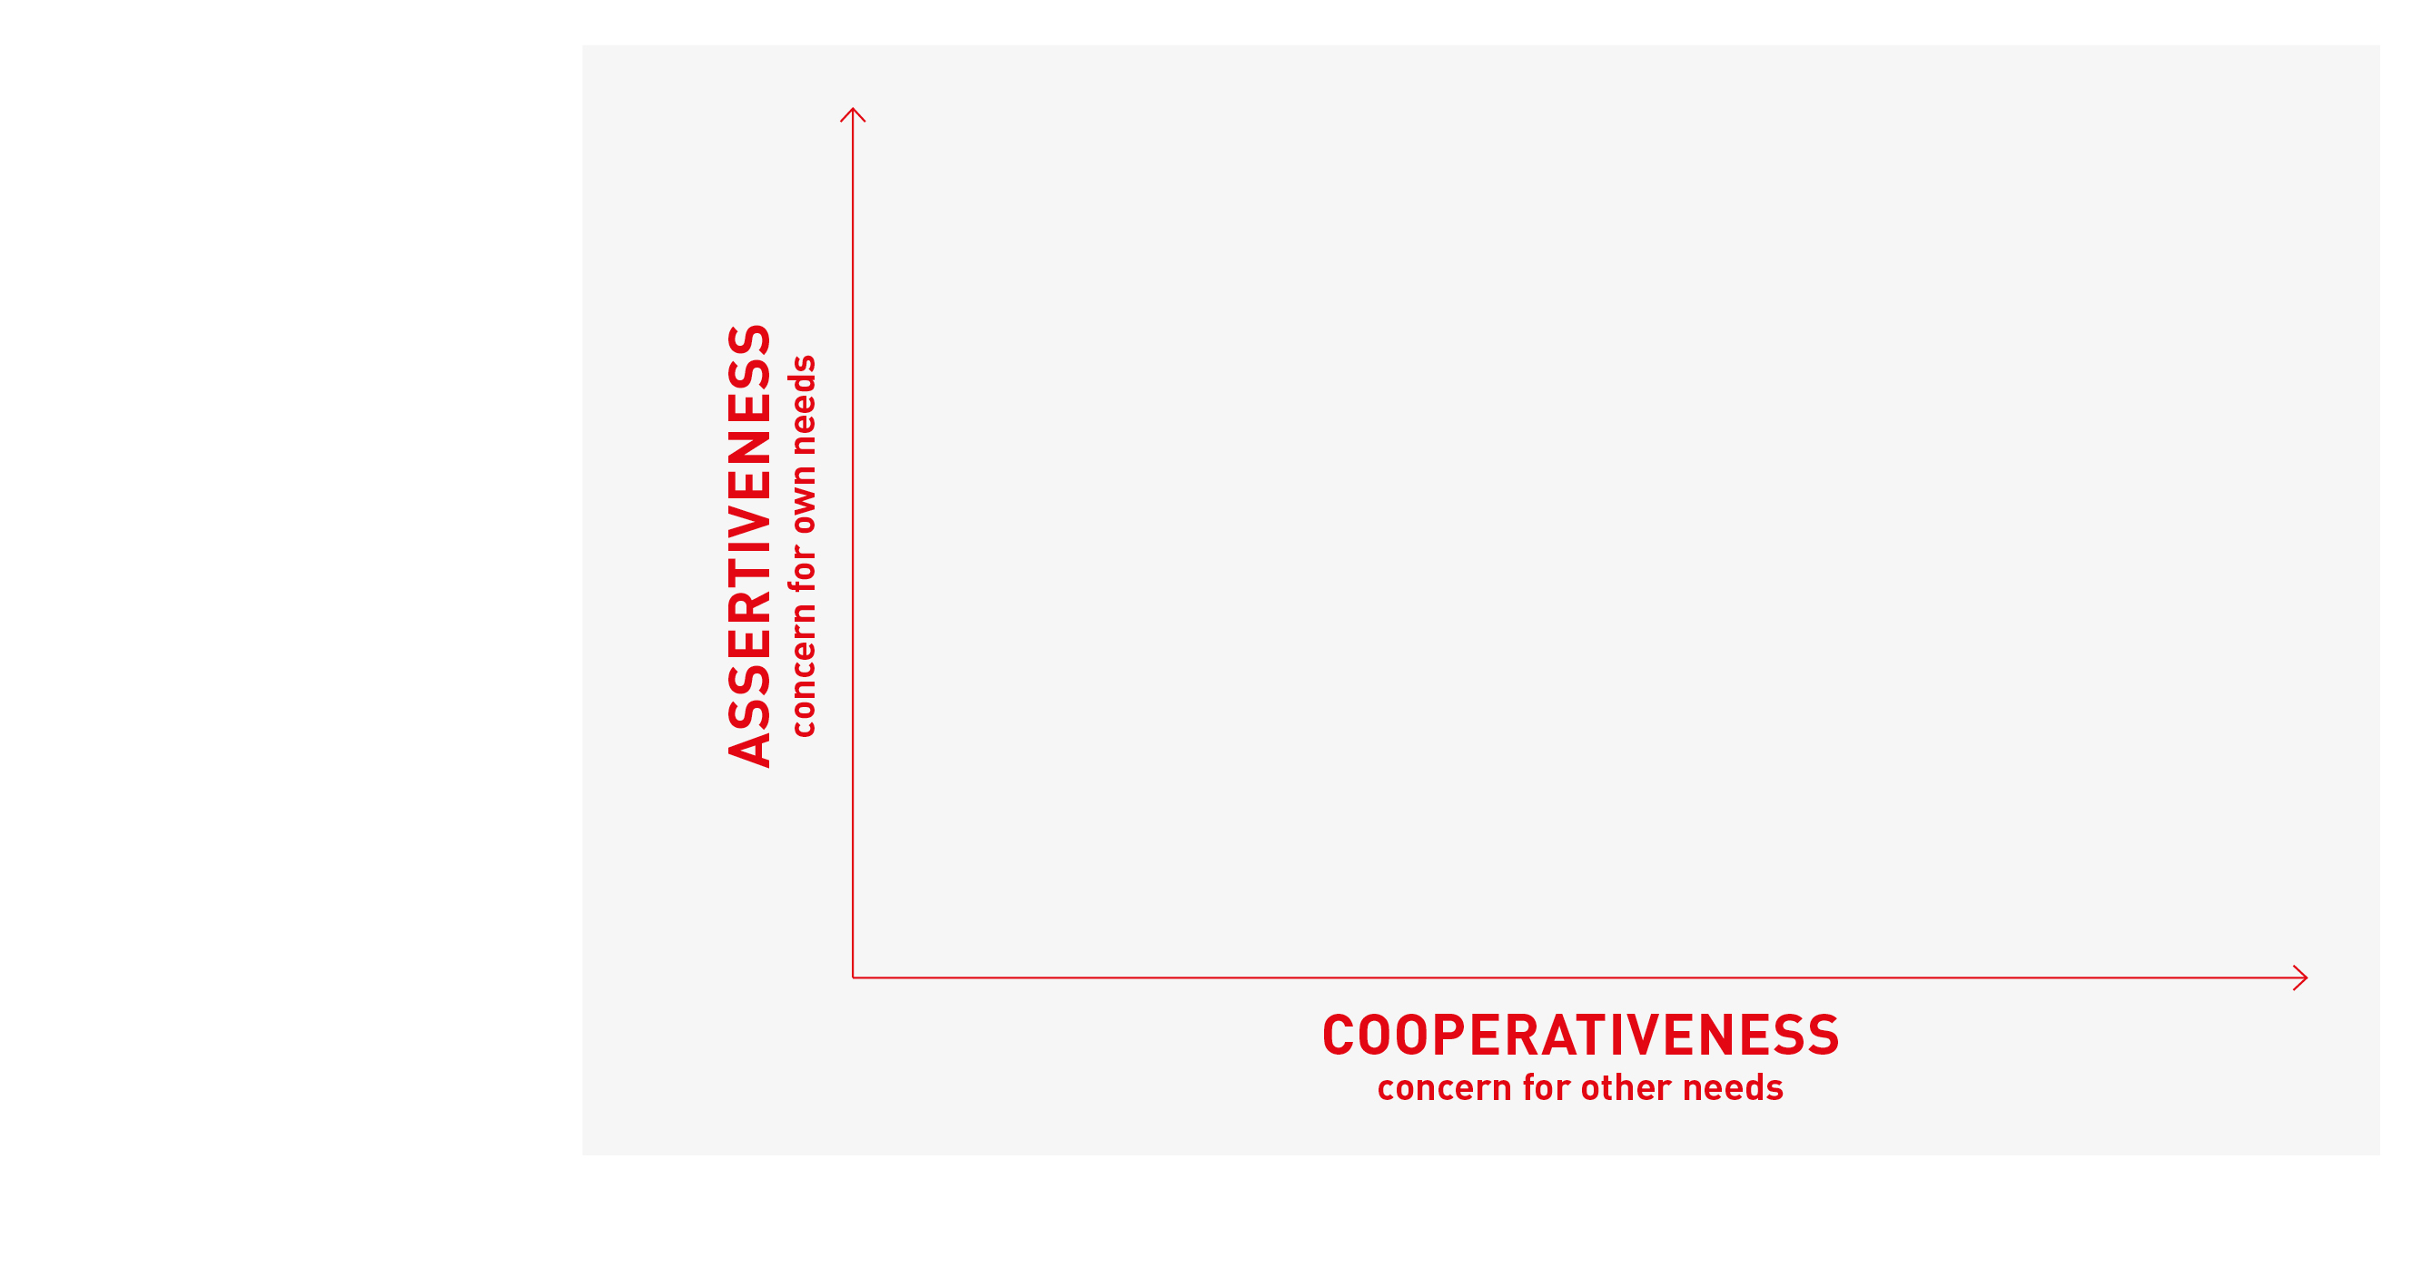
Thomas Kilmann Conflict Model
Thomas Kilmann Model of Conflict
Notes:
The model is structured around two dimensions
Assertiveness: the degree to which one attempts to satisfy their own concerns
Cooperativeness: the degree to which one attempts to satisfy others' concerns.
The intersection of these dimensions defines five conflict-handling modes.

Slide 33
Thomas Kilmann Conflict Model
Competing WIN : LOSE
I‘m right, you‘re wrong.
Collaborating WIN : WIN
Let‘s work together.
Compromising
WIN : WIN
Let‘s find the middle ground.
Avoiding LOSE : LOSE
After you, no after you
Accomodating LOSE : WIN
You‘re right, I‘m wrong.
Thomas Kilmann Model of Conflict
Notes:
(Anmerkung an die Moderation: Wenn du magst, kannst du hier das Beispiel von Max und Flo in der Erklärung anwenden)
There are many different models of how to look at roles one can take in a conflict.
This can also be depending on the situation and context.
Competing: A high assertiveness and low cooperativeness approach. Leaders who compete aim to win, often at the expense of others. This mode is effective in urgent situations where quick, decisive action is required.
Collaborating: High assertiveness and high cooperativeness. Collaboration involves working together to find a solution that satisfies all parties. It’s ideal for complex issues where different perspectives can lead to a more robust outcome.
Compromising: Moderate assertiveness and cooperativeness. This mode seeks a middle ground where both parties give up something to reach an agreement. It’s useful when the goal is to achieve a temporary or expedient solution.
Avoiding: Low assertiveness and cooperativeness. Avoiding means sidestepping the conflict, which can be appropriate when the issue is trivial or when more information is needed before making a decision.
Accommodating: Low assertiveness and high cooperativeness. Accommodation involves yielding to the other party’s concerns, often to maintain harmony. It’s useful when the relationship is more important than the issue at hand.

Slide 34

EXERCISE
Different behaviours
in conflicts
Notes:
To know when emotions arise in a conflict situation it can be really useful to understand ones own behaviour pattern

Slide 35
Step 1: Self-reflection
Me, Myself & Conflicts
5 min
Take notes for yourself
Have a look at the five conflict handling modes.
Think back to past conflicts and…
For each quadrant, find a situation in which you behaved in that mode.
If you were not happy with how you dealt in one of the situations: How would you rather have reacted? What could help you to do so?
Notes:
It‘s your turn now to explore your own conflict behaviours…
@Moderation: Diese Folie offen lassen bei der Durchführung, damit die Teilnehmenden die Fragen sehen (gerne auch in den Chat kopieren)

Slide 36
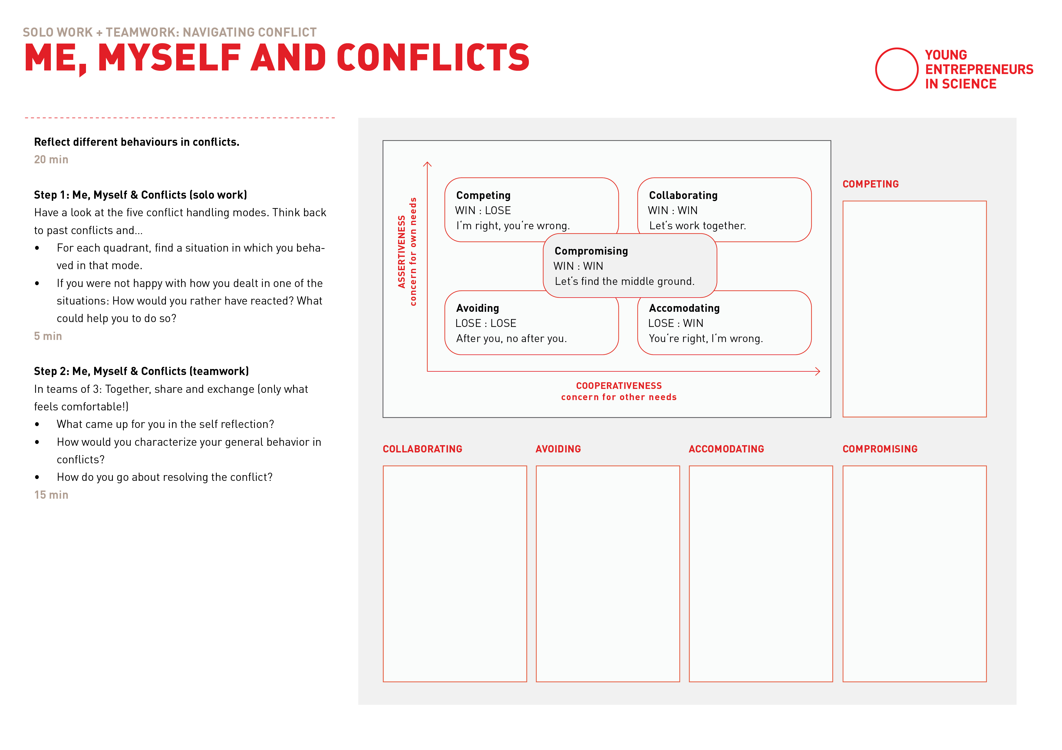
Thomas Kilmann Conflict Model

Slide 37
Step 2: Exchange in Groups
Me, Myself & Conflicts
15 min
In teams of 3
Together, share and exchange (only what feels comfortable!)
What came up for you in the self reflection?
How would you characterize your general behavior in conflicts?
How do you go about resolving the conflict?
Notes:
@Moderation: Diese Reflexionsfragen bitte mit in den Chat kopieren, damit die Teilnehmenden sie mit in die Breakouts nehmen können

Slide 40

It’s coffee o’ clock!

Slide 42
Agenda
Part I
Part II
Check-In
Input: Let’s talk about conflict
Exercise 1: Different behaviours in conflict
Input: How to address a conflict
Exercise 2: Address a conflict
Input: Being confronted with criticism
Transfer
Summary & Check-Out

Slide 43

Dealing with
conflicts
Notes:
Ok everyone…
Before the break we discussed how problems develop into conflicts…
… and you had time to assess your own typical conflict behaviour(s)…

Slide 44


Tools to deal with conflicts
The Challenge: A conflict can hardly be solved on a fact basis.
First: calm strong emotions by understanding and acknowledging their significance and message
Then you can switch to problem-solving mode
Tool 1: Changing perspectives
Tool 2: Addressing a conflict
Notes:
We‘ve said this before but when dealing with a conflict you got to
first…
then…
Now we want to introduce 2 tools to you that can help you understand your own feelings and get a sence for your conflict partner.
Then we‘ll introduce a way of addressing the conflict and for that we also have an exercise.
Don‘t worry, you won‘t have to fight with each other :p

Slide 45

TOOL 1
Changing
perspectives
Notes:
Since conflicts always arise between at least two people and have to do with their differences, there (mostly) is no right or wrong.
But offen we feel like we‘re in the right having the conflict and what happens often is that we forget about the other side.
What helps is to change perspective and build empathy for the other person. This can be done by talking to each other. But as that‘s sometimes scary, not possible or the conflict is not out in the open, a reflection can help

Slide 46


Changing perspectives
The two islands
Most people know their own island best
Every interaction between two participants differs depending on the context in which it takes place.
Conflict Party A: Max
Conflict Party B: Flo
Thomas Kilmann Model of Conflict
Notes:
Imagine two islands on which each of the conflicting parties live on…
… The two islands do not only look different in terms of vegetation (their own world of thoughts and experiences), but are also located in different places and are exposed to different weather conditions (context factor)…
… Every interaction between two participants differs depending on the context in which it takes place…
-> Most people know their own island best: it is our view from which we observe the world.

Slide 47
Changing perspectives
The two islands
We both want to have a well functioning office that we can enjoy together.
Step 1: Think of your common goal
Why is it worth having the conflict?
What is our common goal?
Conflict Party A: Max
Conflict Party B: Flo
Thomas Kilmann Model of Conflict
Notes:
Think of why it actually is worth having the conflict:
Often, the understanding, that there is a common goal of both conflict sides already calmes down the situation as it becomes clear why it‘s worth arguing for.
(you could also do that as the first step of the reflection)

Slide 48
Changing perspectives
The two islands
Step 1: Think of your common goal
Step 2: Reflect your own side
What goals and positions do you state?
What lies behind it? Which values, interests, needs, emotions, fears/concerns are affected?
Conflict Party A: Max
Conflict Party B: Flo
Thomas Kilmann Model of Conflict
Notes:
The issue is that, although we often talk about our goals and positions in a conflict, most inner influencing factors are „under the surface“, so they are hidden and not visible.
This applies to both sides
What helps is to first reflect upon your own perspective: Where are you coming from with your position?

Slide 49
Changing perspectives
I always have to take care of everything. It's annoying. I really wish we could share things better and it wouldn't always be my responsibility. That doesn't feel fair.
The two islands
Step 1: Think of your common goal
Step 2: Reflect your own side
What goals and positions do you state?
What lies behind it? Which values, interests, needs, emotions, fears/concerns are affected?
Conflict Party A: Max
Conflict Party B: Flo
Thomas Kilmann Model of Conflict
Notes:
Let‘s get back to Max and Flo:
Max is thinking/reflecting: „I always have to take care of everything. It's annoying. I really wish we could share things better and it wouldn't always be my responsibility. That doesn't feel fair.“
Emotions Max might have: she feels dissatisfied, annoyed, has had enough
Needs Max might have: Need for support, balanced participation, change in how they devide tasks

Slide 50
Changing perspectives
Yes, I know, Flo has a lot on her mind at the moment. I have the feeling that she‘s under a lot of pressure right now. She seems stressed. And she doesn't find manual work easy. She has to work hard to understand it.
The two islands
Step 1: Think of your common goal
Step 2: Reflect your own side
Step 3: Reflect the other side
What goals and positions do you hear?
What could be behind it? Which values, interests, needs, emotions, fear/concern could be affected?
Conflict Party A: Max
Conflict Party B: Flo
Thomas Kilmann Model of Conflict
Notes:
Once you‘re done reflecting your own side, switch perspective and build some empathy for your „oponent“/conflict partner.
When you are done reflecting both positions…

Slide 51
Any questions?

Slide 52
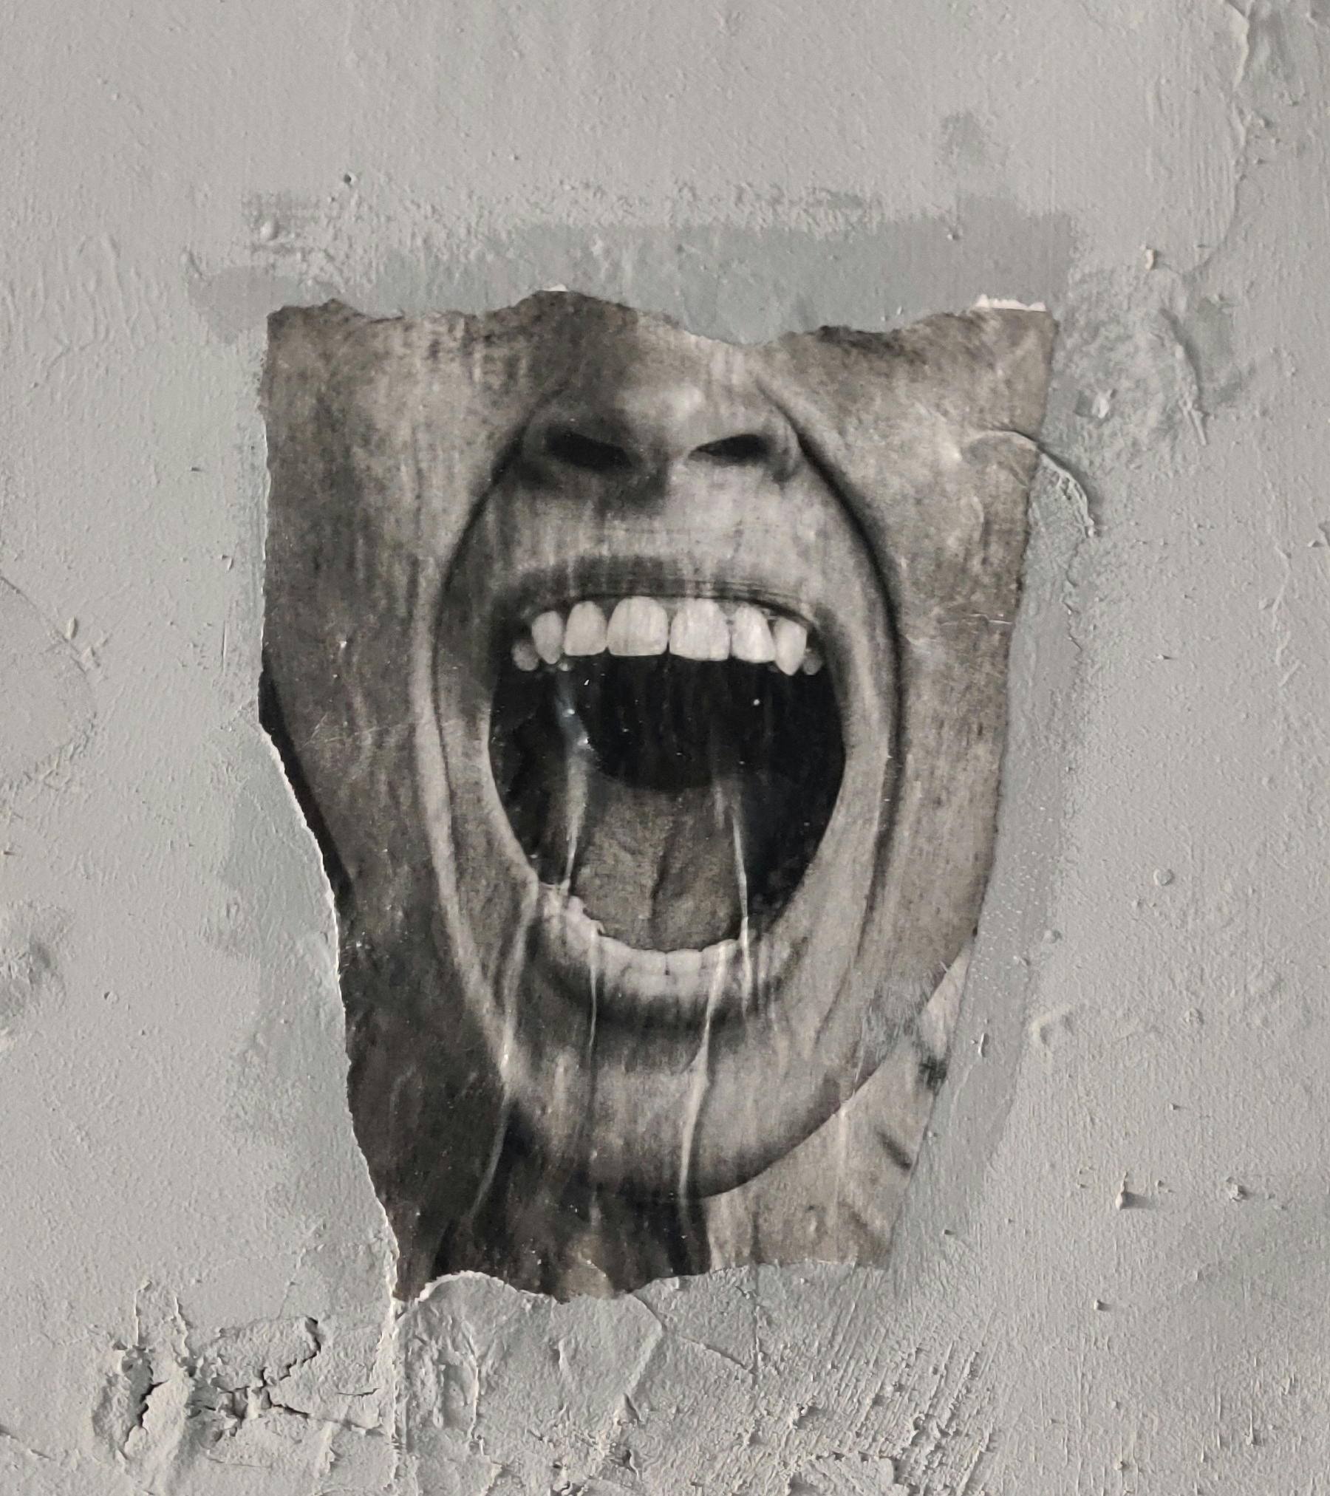
TOOL 2
Addressing a conflict
Notes:
Now that you have reflected on the two islands and the common goal, you might want to start a conversation with the other side to resolve the argument.

Slide 53
How not to a conflict
Let‘s have a look on how Max should not address the conflict
"You’re completely blind to how busy I am. You don’t care about how much I already have to do.
If you can’t even handle a simple thing like this, why should I trust you with anything bigger?”
Max
Flo
Based on Rosenbergs‘ "Non-violent communication"

Slide 54



Addressing a conflict
3 steps for addressing a conflict:
First: Perception
Second: Effect
Third: Wish/Request
Notes:
There are many different communication tools of how to do that and we want to you to show a 3 step model, based on Rosenbergs Nonviolent Communication
This method helps to communicate clear, understandable, and in a respectful way. What makes it great is that it incorporates the invisible perspective we just learned about.
So, how does it work…

Slide 55
Addressing a conflict
Step 1: Describe your perception
Describe what you perceive - without judgment
Focus on specific observations that others could also notice.
Example: “I noticed that the water tab had been running for weeks and none of us took any action.”
Based on Rosenbergs‘ "Non-violent communication"

Slide 56
Addressing a conflict
Step 1: Describe your perception
Important:
Use numbers, data, and facts to ensure objectivity. Helpful question: "Am I really describing what others could also perceive?”
Talk from your own perspective: “I observed that…” or “I noticed that…”, instead of “You did …”
No Assumptions, interpretations, or generalizations
Based on Rosenbergs‘ "Non-violent communication"

Slide 57
Addressing a conflict
Step 2: Explain the effect it has on you
Explain the emotional impact the situation has/had on you
Doing this connects the observation to your feelings and needs
In doing so you provide context and relevance (the invisible parts under your island)
Example: “The situation really makes me feel frustrated and stressed because it makes me feel like I need to automatically be responsible for those (manual) tasks.”
Based on Rosenbergs‘ "Non-violent communication"

Slide 58
Addressing a conflict
Step 3: Formulate a wish/request
express a specific wish/request for future behavior
focus on actionable changes that can improve the situation for the better
Example: “I would like us to discuss how we can reorganize responsibility for “handicrafts” in our office.”
Based on Rosenbergs‘ "Non-violent communication"

Slide 59
Addressing a conflict
3 steps for addressing a conflict:
First: Perception
Second: Effect
Third: Wish/Request
Notes:
There are many different communication tools of how to do that and we want to you to show a 3 step model, based on Rosenbergs Nonviolent Communication
This method helps to communicate clear, understandable, and in a respectful way. What makes it great is that it incorporates the invisible perspective we just learned about.
So, how does it work…

Slide 60
How to a conflict
Let‘s have a look on how Max could address the conflict
Perception: "I see that the faucet has been dripping for some time, and I haven’t been able to address it because of my workload this month.
Effect: I feel overwhelmed and a bit uneasy about not being able to help as much as I’d like.
Wish: Could we discuss how we might split these kinds of tasks in a way that feels fair for both of us?”
Max
Flo
Based on Rosenbergs‘ "Non-violent communication"

Slide 61

EXERCISE
Let‘s practice…

Slide 62
Exercise: Address the conflict
Scenario:
You are a doctoral student who has recently started working on a startup idea with a fellow doctoral student. Both of you are passionate about developing a new product and are sharing responsibilities for different aspects of the project. It has happened several times now that your co-founder hasn't completed their tasks on time. You had agreed that they would handle the market research and initial customer outreach, but they have missed several deadlines. You are frustrated because these delays are impacting your ability to move forward with the development and planning. Additionally, you are concerned that the lack of market insights could negatively affect your product strategy.

Slide 63
Teams of 2
Address the conflict
15 min
In Teams
Read the scenario
Discuss together: What could be the common overarching goal? Why is it worth having the conflict? (5 min)
On your own: Think of how you would address the conflict using the „perception, effect, wish/request“ logic (5 min)
One by one: Person 1: Address the conflict Person 2: Share how it felt (5 minutes for each person)

Slide 64
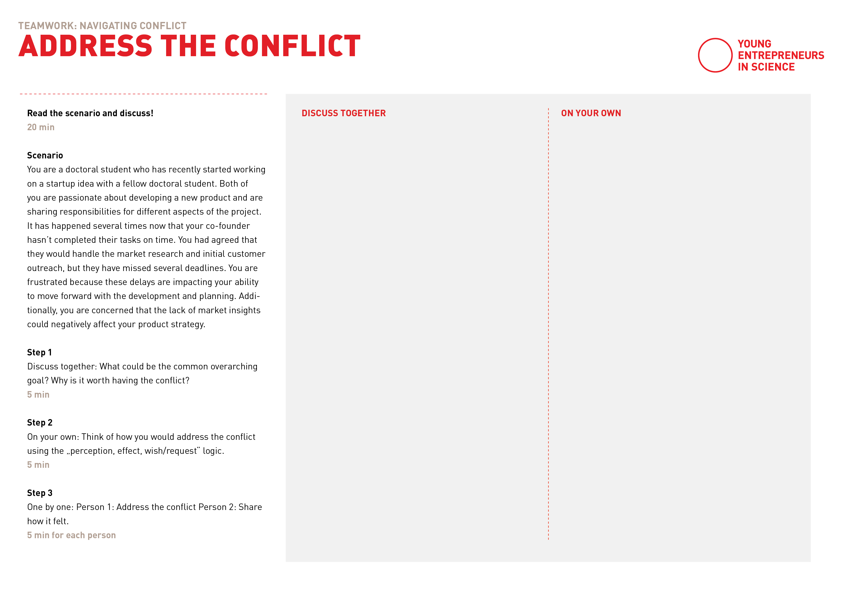
Thomas Kilmann Conflict Model

Slide 67

The other side:
Being confronted
with a conflict
Notes:
Now that you have reflected on the two islands and the common goal, you might want to start a conversation with the other side to resolve the argument.

Slide 68
Fall in love with your partners‘ need!

Slide 69
Fall in love with your partners‘ need!
Switch from defense mode to a curious researchers‘ mindset
Notes:
And we believe that you are very much professionals in applying the „curious researchers‘ mindset“ ☺

Slide 70
Fall in love with your partners‘ need!
What helps to do that:
Listen Actively: Pay close attention to what is being said without interrupting. Show that you are listening.
Observe the „invisible needs and emotions“ your partner expresses
Reflect and Evaluate: Take time to consider the criticism objectively. Is the feedback valid for you? How could you use it to improve?
Ask for Clarification: If the criticism is unclear, ask for specific examples or suggestions.

Slide 71
Fall in love with your partners‘ need!
What isn‘t so helpful:
Avoid getting defensive or argumentative.
Don't Take It Personally: Try to separate the criticism of your work or behavior from your self-worth.

Slide 72

WRAPPING UP
Transfer to your own
work

Slide 73
Solo work
Transfer
5 min
Take notes for yourself.
Think of one existing conflict you have right now
What from todays‘ input can help you deal with the conflict?
What could be a first step in resolving the conflict?

Slide 75

Any questions?

Slide 76

Lunch Break

Slide 77

TEAMWORK ESSENTIALS

Slide 78
Learning goals
Diving into the concept of teams and team dynamics
Reflecting and exchanging about own team experiences
Understanding team roles and reflecting on your own

Slide 79

Teams and teamwork

Slide 80
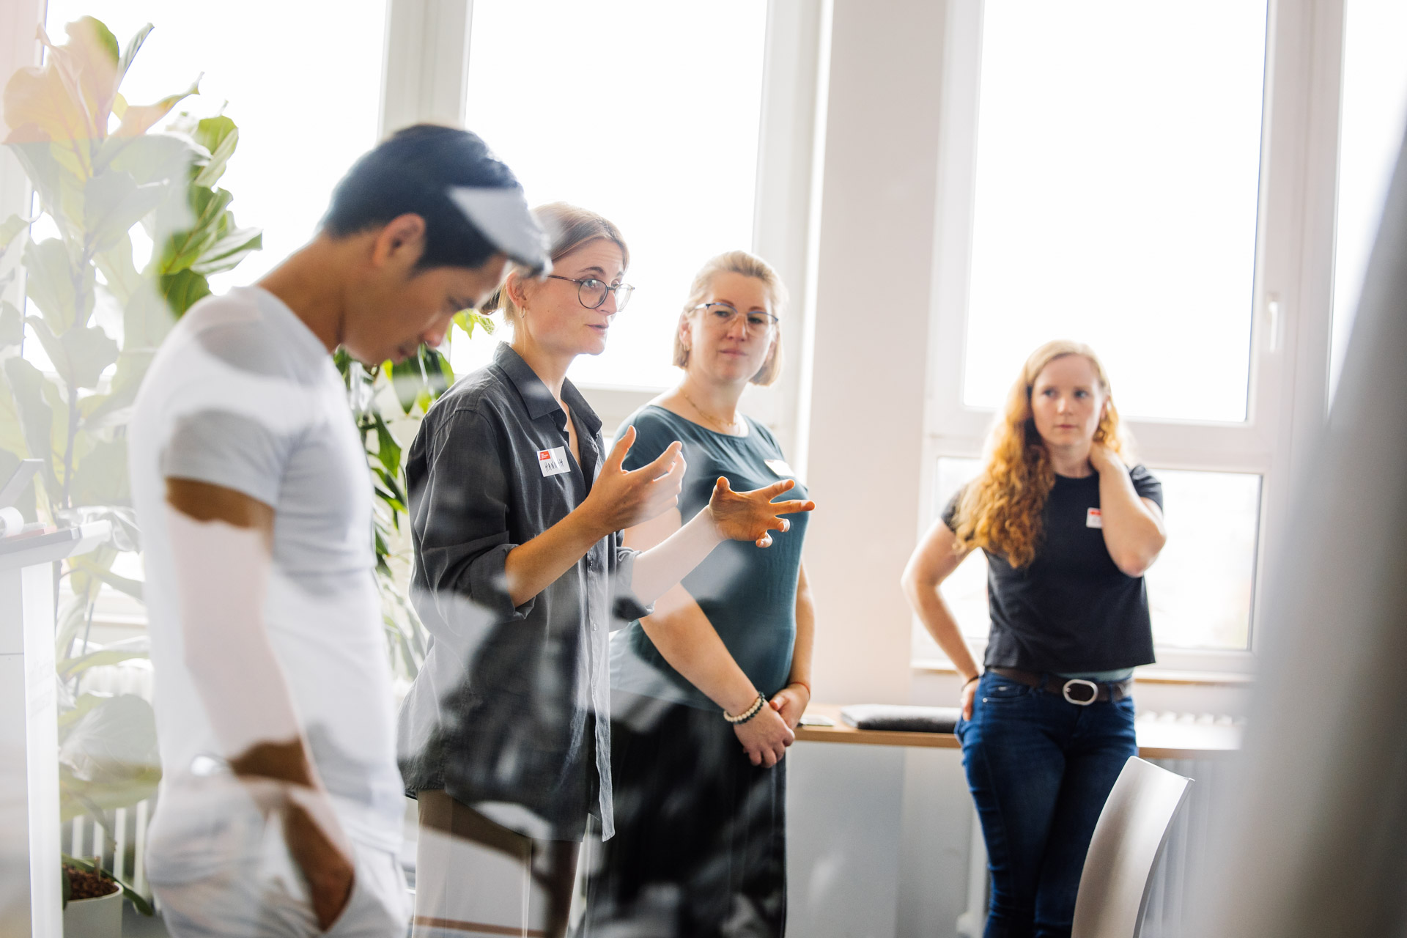
WHAT IS A TEAM
AND WHY IS IT SO IMPORTANT?
Notes:
What is needed: Fast and agile speed boats!
Instead or in addition to large steamships

Slide 81
Reasons for failure
42%
No market need
29%
Ran out of cash
23%
Not the right team
https://www.cbinsights.com/research/startup-failure-reasons-top/ (06.11.2019)^
Notes:
The aspect of team is super important when we talk about starting your own business
It‘s Reason No.3 why startups fail
No 1: Market Need for the product and Reason No 2: financial problems.
And: Very important aspect that is considered by investors. They look at How is your team built up? What competences are there? For how long do you already know each other?
__
Quelle: https://www.cbinsights.com/research/startup-failure-reasons-top/

Slide 82
Definition
A number of people associated in some joint action.
The Dictionary
Notes:
https://www.dictionary.com/browse/team

Slide 83




Different kind of “teams”
Community
Troop
Continuity
Closeness
Distance
Change
Team
Crowd
Notes:
There are different kind of teams
the Riemann-Thomann-model is one model that is used to understand what kind of team you find yourself in and maybe also what kind of team you feel most comfortable in working
Lets take a closer look on whats what in the next slides
___
Hier Hintergrund Info für Coaches; https://karrierebibel.de/riemann-thomann-modell/

Slide 84
Different kind of “teams”
Continuity
Togetherness, harmony, empathy, trust, compassion
Autonomy, individuality, intellect, distance, respect
Closeness
Distance
Change
Notes:
the x-axis stands for the orientation of a team towards either closeness or Distance
on the left side you see closeness, which can be described with characteristics like Togetherness, harmony, empathy, trust and compassion
on the right side you see Distance, which can be described with characteristics like autonomy, individuality, distance and respect
Hier Hintergrund Info für Coaches; https://karrierebibel.de/riemann-thomann-modell/

Slide 85
Different kind of “teams”
Principles, values, safety, organisation, control
Continuity
Togetherness, harmony, empathy, trust, compassion
Autonomy, individuality, intellect, distance, respect
Closeness
Distance
Change
Development, change, flexibility, spontaneity
Notes:
the x-axis stands for the orientation of a team towards either closeness or Distance
the y-axis stands for the orientation of a team towards either continuity or change
Hier Hintergrund Info für Coaches; https://karrierebibel.de/riemann-thomann-modell/

Slide 86
Different kind of “teams”
Troop
Continuity
Closeness
Distance
Change
Notes:
Continuity-distance teams are called Troops
Advantage:
The team is very well organised and tends to work together objectively.
Clear structures and processes are practised here, resulting in a high degree of predictability.
The motto: Discipline and adherence to predefined processes.
Disadvantage:
The ‘we-feeling’ can fall by the wayside and the social component is not particularly strong.

Slide 87
Different kind of “teams”
Troop
Continuity
Closeness
Distance
Change
Crowd
Notes:
Change-distance teams are called Crowds
Advantage:
The exciting thing here: There is a team, but the independence of each individual plays a major role.
Everyone has their own area of responsibility, which often overlaps with that of others.
This can lead to great different ideas that result in creative innovations.
Disadvantage:
There can be a lack of commitment and consistency.
The separate areas can lead to competition.
The desire for something new generates ideas, but these quickly fizzle out.
Why? Because the next one is likely to come along that is also incredibly exciting.

Slide 88
Different kind of “teams”
Troop
Continuity
Closeness
Distance
Change
Team
Crowd
Notes:
Change-Closeness teams are called Teams
Advantage:
Everyone wants to create something creative and innovative together.
This team can be flexible and sometimes take risks.
Team spirit is emphasised.
Disadvantage:
Conflicts can arise here: Project team members who are very change-orientated tend to be unpredictable, which can be annoying or stressful for colleagues who need to be close.

Slide 89
Different kind of “teams”
Community
Troop
Continuity
Closeness
Distance
Change
Team
Crowd
Notes:
Continuity-Closeness teams are called Community
Advantage:
Colleagues are very close to each other here (on a professional level, of course).
Helpfulness and reliability in the team play a major role.
Everyone feels comfortable in the team and the potential for conflict is low.
Disadvantage:
If the need for harmony is too strong, discussions with different views can be suppressed.
There is hardly any critical scrutiny because of all the ‘I don't want to step on your toes’.

Slide 90
The startup team
Home territory of startup teams
Community
Troop
Rapid changing environment
High dynamism and flexibility
Strong vision and passion
Flat hierarchies
Scarcity of resources
Entrepreneurial mindset
Collaborative culture
Continuity
Closeness
Distance
Change
Team
Crowd
Notes:
Where are many startup teams based?
As startup teams navigate in environments characterized by change, uncertainty, and complexity, most startups are at home in the Change Closeness quadrant.
As small teams and especially co-founders spend a lot of time together and also go through challenging times together, the home territory can also be more in the community quadrant, depending on the personalities in the team

Slide 91
Finding the “right” team
The model can help you to …
Community
Troop
… reflect on where you feel comfortable and when it comes to teamwork
… engage in a dialogue with your team on where you want to position yourselves as a team.
Continuity
Closeness
Distance
Change
Team
Crowd
Notes:
Which quadrant a team is in depends heavily on the personalities that make up the team.
As a founder, it is therefore important to reflect: where do I feel comfortable and how do I want to work?
The model can help you reflect on this and engage in dialogue with your team

Slide 92
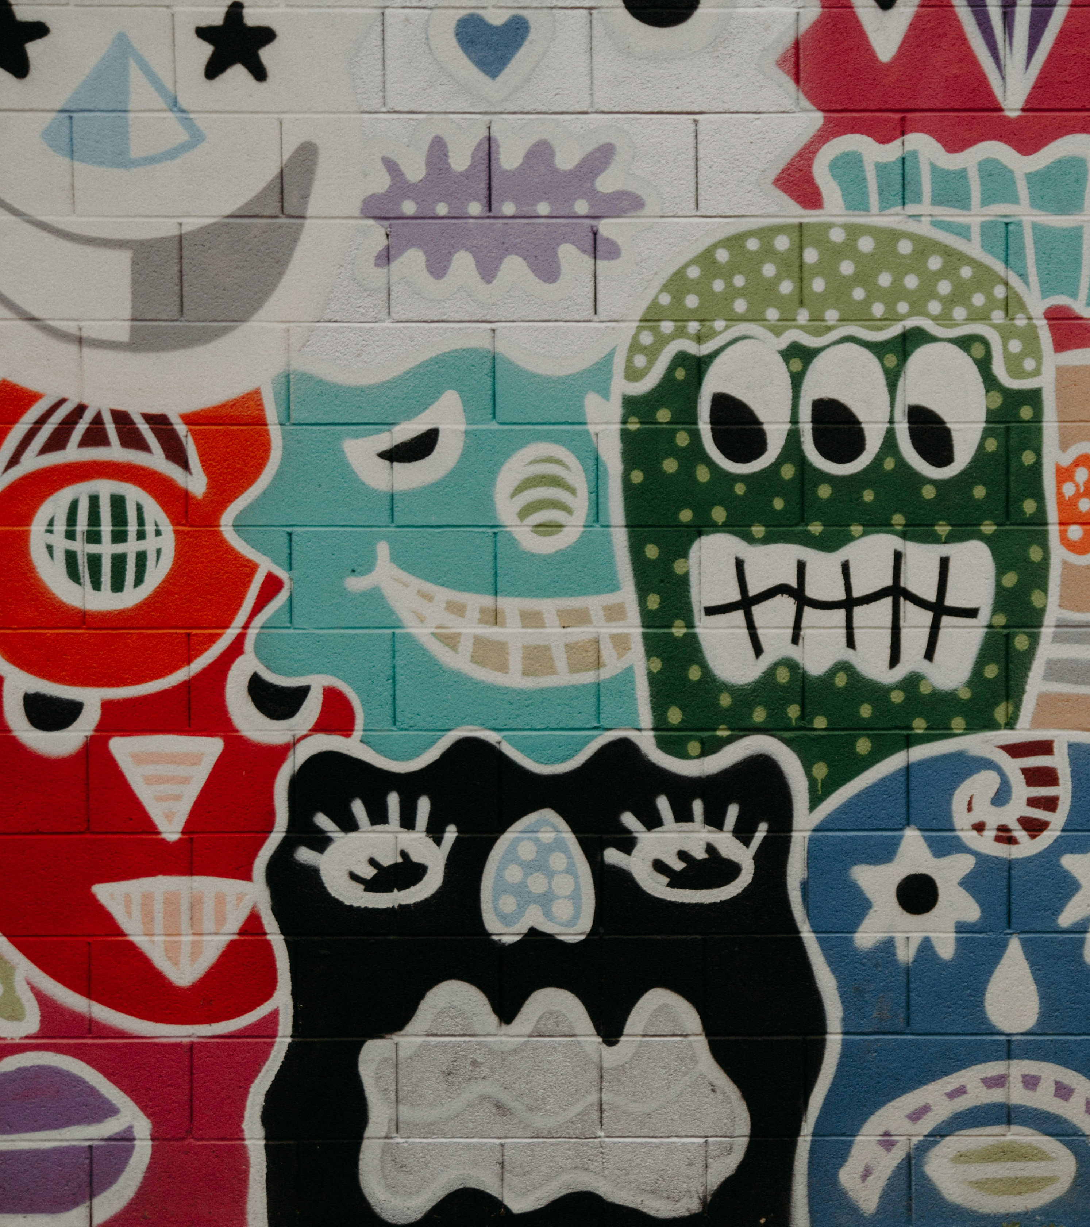
EXERCISE
My “team feelgood-area”

Slide 93
Your „team feelgood-area“
Knowing about the different teams position yourself in the Riemann-Thomann:
Where would you position your team that you last find yourself in / are finding yourself in the moment?
In what quadrant do you feel most comfortable when it comes to teamwork?
Notes:
Based on your own experiences and what we talked about the last minutes when it comes to different teams and their home territories:
What do I need to feel comfortable in a team?
How does a team recognize that I feel good in that team?
What would cause me to stop enjoying working in a team?

Slide 94
EXERCISE
Me in teams

Slide 95
Me in teams
Think about all the experiences you made in teams so far:
What do I need to feel comfortable in a team?
How does a team recognize that I feel good in that team?
What would cause me to stop enjoying working in a team?
Notes:
Based on your own experiences and what we talked about the last minutes when it comes to different teams and their home territories:
What do I need to feel comfortable in a team?
How does a team recognize that I feel good in that team?
What would cause me to stop enjoying working in a team?

Slide 96
Team work
Reflection
30 min
Self reflection
Sharing in teams
10 min Silent reflection: Individually reflect and take notes for yourself using the template
20 min Introduce yourselves and get to know each other. Each team member shares what they feel comfortable sharing
Time yourself as a team of 3.

Slide 97
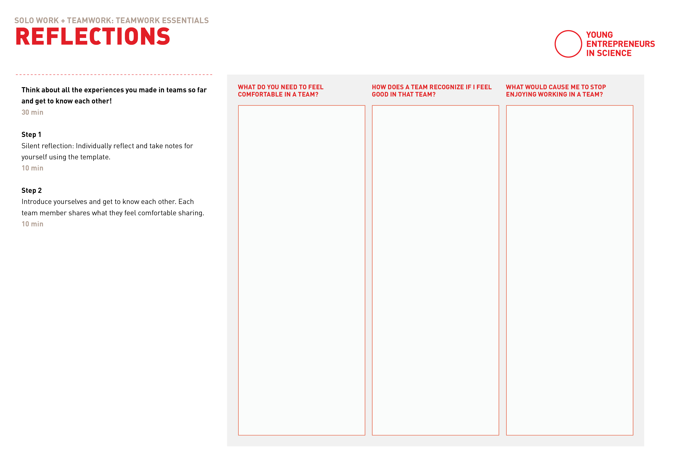
Template preview
Notes:
Miro Link teilen

Slide 98
Any insights, ideas or questions you would like to share?

Slide 99
It’s coffee o’ clock!

Slide 100
TEAM ROLES
Notes:
What is needed: Fast and agile speed boats!
Instead or in addition to large steamships

Slide 101
Definition
Team roles represent a tendency to interact with others in a specific way to make the progress of the team easier.
developerexperience.io
Notes:
https://developerexperience.io/articles/team-roles-definition
There a plenty of models for teams and team roles
Before we introduce you to one of them its important for us to stress, that those roles describe tendencies we all have in interactions within teams
And those tendencies can differ and change in different teams, in different situations or simply over time.
They do not describe a job profile but rather your social and personal skills, as opposed to technical and methodological skills.

Slide 102
Team contribution
“The types of behaviour in which people engage are infinite.
But the range of useful behaviours, which make an effective contribution to team performance, is finite.
These behaviours are grouped into a set number of related clusters, to which the term Team Role is applied.”
Meredith Belbin, Team Roles at Work
Notes:
Meredith Belbin's research showed that the most successful teams were made up of a diverse mix of behaviors.
To build high-performing teams, it helps to have each of the nine Belbin Team Role behaviors on board.
One person can take over several roles.
The roles we take depend on the team we are in and can change over time.
However, there ist a ragne of roles that we are more comfortable with than others.
The roles are understood without judgement.Tthere are no ‘good’ and ‘bad’ behaviours. All are relevant for the success of a team.
The nine Belbin Team Roles are devided in behavior clusters:
The Social roles
The Thinking roles
The Action or Task roles
https://www.belbin.com/about/belbin-team-roles

Slide 103
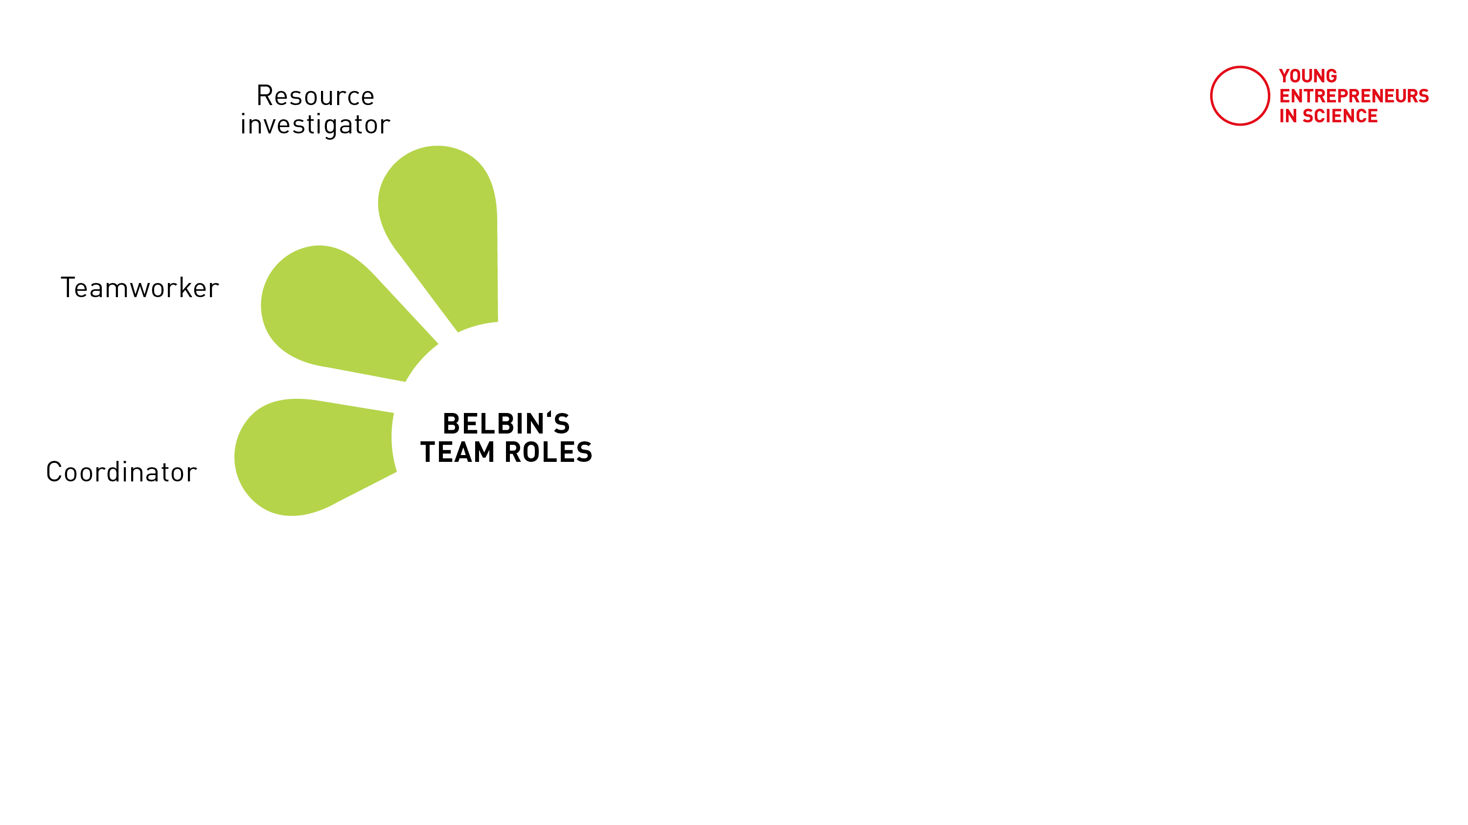
Belbin’s team roles
Notes:
The Social roles: Resource Investigator, Teamworker and Co-ordinator
----------------------------------
Aufgabenorientierte Teamrollen
Macher (Shaper). Steht für Teamverbesserung. Macher fordern ihr Team stetig dazu auf, sich zu verbessern. Sie stellen das Bestehende in Frage, fokussieren auf dass Wesentliche und wollen Probleme gelöst sehen.
Umsetzer (Implementer). Steht für Umsetzung. Umsetzer legen los. Sie gehen Dinge sofort und systematisch an. Und sie hören damit nicht auf, bis das Ziel erreicht ist.
Perfektionist (Finisher-Completer). Steht für Perfektion. Perfektionisten bringen Dinge zur Perfektion und zum glänzenden Abschluss – und zwar termingerecht. Dabei halten sie sich streng an den Plan und achten auf Details. Sie hassen Abweichungen und Fehler, „polieren alle kleinen Dellen und Kratzer aus“.
Wissensorientierte Teamrollen
Spezialist (Specialist). Steht für Fachexpertise. Spezialisten sind die absoluten Experten in ihrem Fachbereich. Sie geben dem Team das Wissen und die Expertise, das es für gute Lösungen und erfolgreiche Arbeit braucht.
Beobachter (Monitor-Evaluator). Steht für Urteilsvermögen. Beobachter sind die Realisten im Team mit einem guten Urteilsvermögen. Sie behalten den distanzierten Überblick über das große Ganze und treffen rational und nüchtern Bewertungen.
Neuerer (Plant). Steht für Innovation. Neuerer tragen unkonventionelle Ideen und alternative Perspektiven bei. Mit frischem Denken fördern sie neue Lösungsansätze und Innovation.
Menschenorientierte Rollen
Koordinator (Coordinator). Steht für Teamleitung. Koordinatoren können Aufgaben effektiv delegieren. Sie lenken die Gruppe immer wieder zum gemeinsamen Ziel hin. Sie übernehmen die klassischen Teamleiter-Fuktionen.
Teamarbeiter (Teamworker). Steht für Zusammenhalt. Arbeitet am Wir-Gefühl und Zusammenhalt im Team. Teamarbeiter fördern gute Zusammenarbeit und ein gutes Klima im Team. Sie achten auf entstehende Konflikte und lösen bestehende Konflikte.
Wegbereiter (Resource Investigator). Steht für Networking. Wegbereiter suchen und knüpfen wichtige Kontakte außerhalb des Teams. Als extrovertierte, kommunikative und gesellige Menschen erschließen sie so wichtige Informationen, Chancen und Ressourcen für das Team.

Slide 104
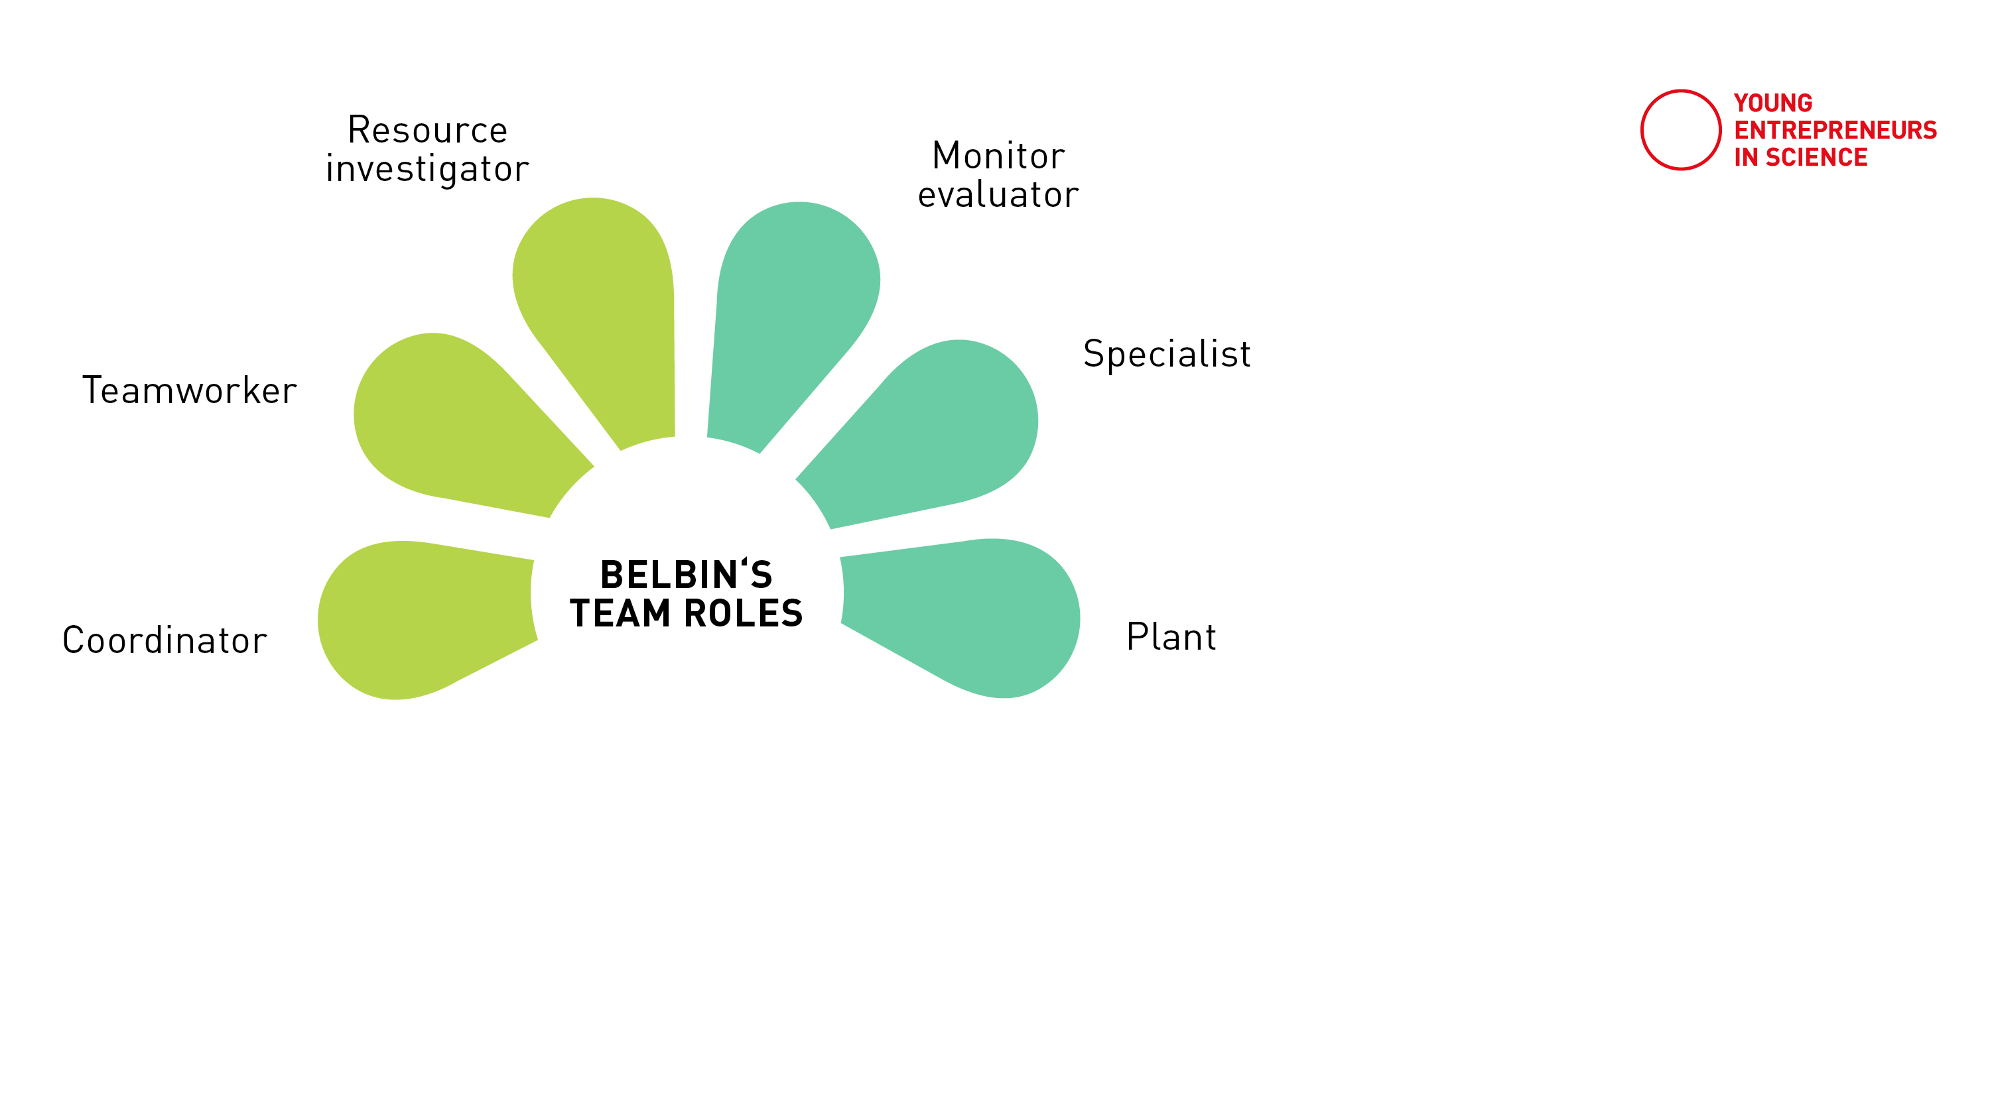
Belbin’s team roles
Notes:
The Thinking roles: Plant, Monitor Evaluator and Specialist

Slide 105
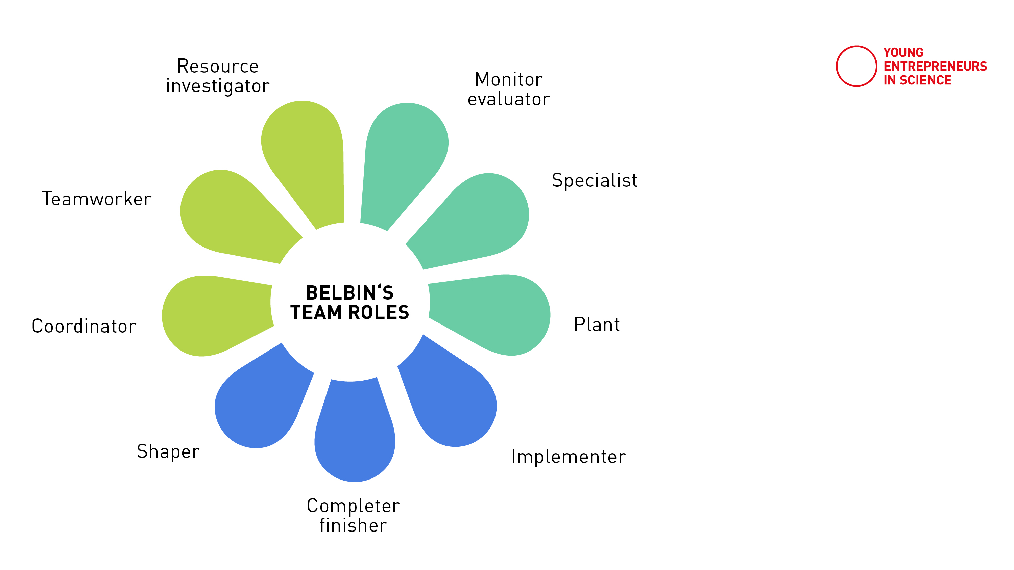
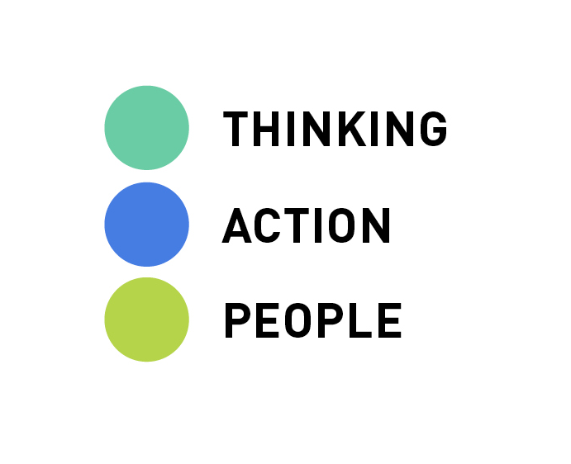
Belbin’s team roles
Notes:
The Action or Task roles: Shaper, Implementer and Completer Finisher

Slide 106
Successful teams
Various roles and tendencies are needed in a team
To build high-performing teams, it helps to have all behavior clusters on board
The roles are to be understood without judgement.
All are relevant for the success of a team.
Notes:
To build high-performing teams, it helps to have each of the nine Belbin Team Role behaviors on board
The roles are understood without judgement.Tthere are no ‘good’ and ‘bad’ behaviours.
All are relevant for the success of a team.

Slide 107
Belbin’s team roles
What tendencies resonate with you?
Coordinator is needed to focus on the team's objectives, draw out team members and delegate work appropriately.
Teamworker helps the team to gel, using their versatility to identify the work required and complete it on behalf of the team.
Resource Investigator uses their inquisitive nature to find ideas to bring back to the team.
Source: www.belbin.com/about/belbin-team-roles
Notes:
Lets take a quick look at the different roles or how we like to say: tendencies
The »social roles« are…
https://www.belbin.com/about/belbin-team-roles

Slide 108
Belbin’s team roles
What tendencies resonate with you?
Monitor Evaluator provides a logical eye, making impartial judgments where required and weighs up the team's options in a dispassionate way.
Specialist brings in-depth knowledge of a key area to the team.
Plant tends to be highly creative and good at solving problems in unconventional ways.
Source: www.belbin.com/about/belbin-team-roles
Notes:
The »thinking roles« are…
https://www.belbin.com/about/belbin-team-roles

Slide 109
Belbin’s team roles
What tendencies resonate with you?
Shaper provides the necessary drive to ensure that the team keeps moving and does not lose focus or momentum.
Completer Finisher most effectively used at the end of tasks to polish and scrutinize the work for errors, subjecting it to the highest standards of quality control.
Implementer needed to plan a workable strategy and carry it out as efficiently as possible.
Source: www.belbin.com/about/belbin-team-roles
Notes:
The »action roles« are…
https://www.belbin.com/about/belbin-team-roles

Slide 110
EXERCISE
My team role
tendencies

Slide 111
Belbin’s team roles
Example profile
Associated Weakness
Strengths
RI
TW
CO
PL
ME
SP
SH
IMP
CF
Nobody takes on only one role. We all have tendencies, that can vary and develop over time.
Source: www.belbin.com/about/belbin-team-roles
Notes:
Whats really important with this model as with many others as well:
Its a simplification
We as humans can show very different behaviors depending on the context or team we navigate in.
But we do tend to have tendencies for some behavioral patterns, that allow us to contribute to teams
Those patterns are not bound to one role only as you can see in this example profile.
We can unite a more than one role within us with maybe one or two stronger expressions
https://www.belbin.com/media/3213/individual-report-for-aliblue-sample-report.pdf

Slide 112
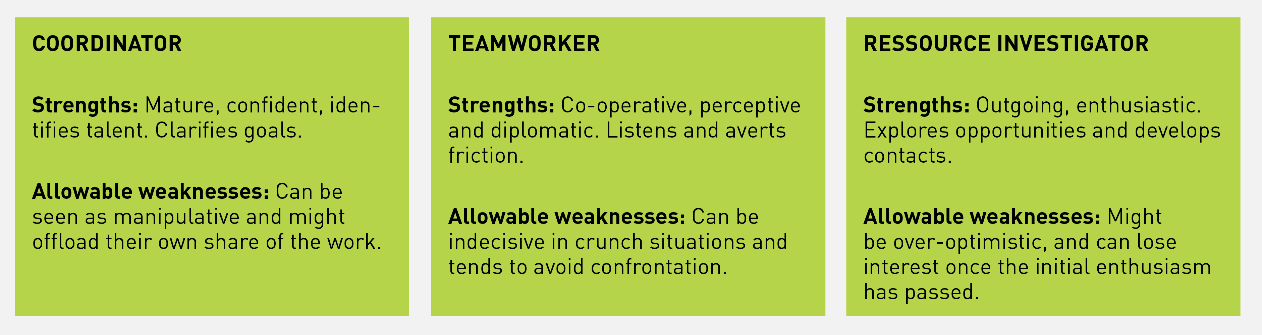
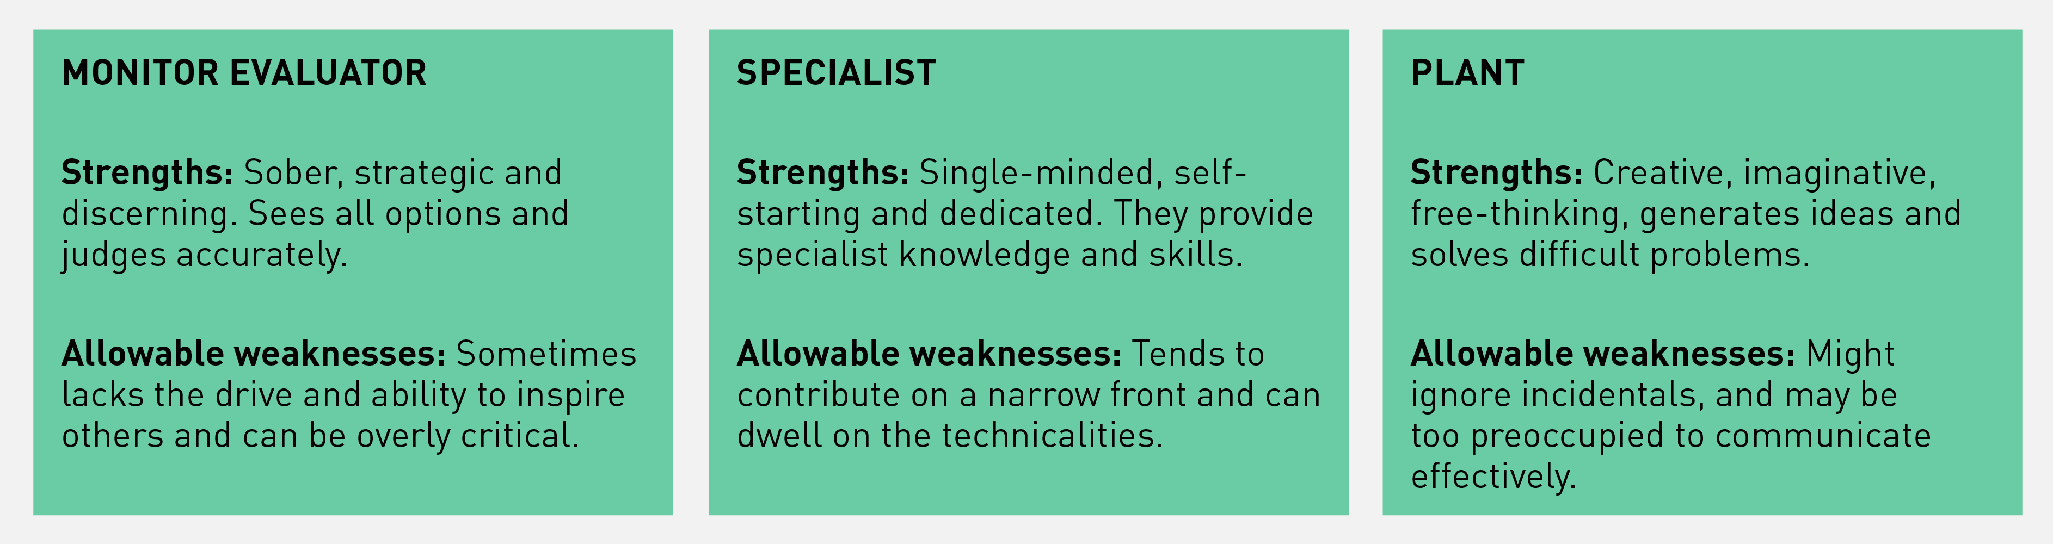
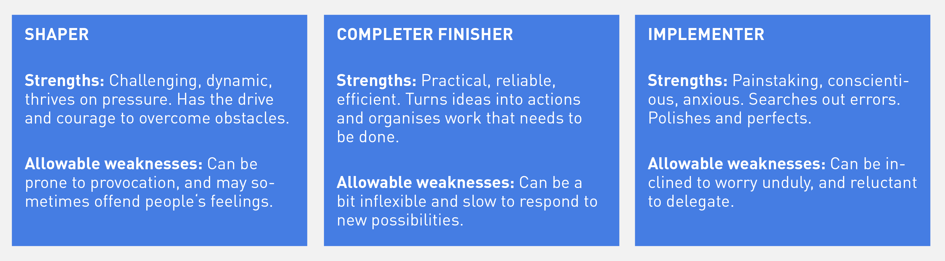
My team roles
Think about how you tend to interact in teams:
How do you enjoy contributing to a team?
What do co-workers or colleagues appreciate in you?
In what role would you like to grow?

Slide 113
Solo work
Self-reflection
25 min
Self-reflection
team exchange
Find a free space to work
Go through the behavioural clusters (roles) and reflect:
Mark and visualize how much of that role you see in yourself (0=not at all, 5 = that’s so me!)
Share with your peers.
15 min self-reflection
10 min sharing in teams of 3
Notes:
As a next step you have some time to reflect on your own profile

Slide 114
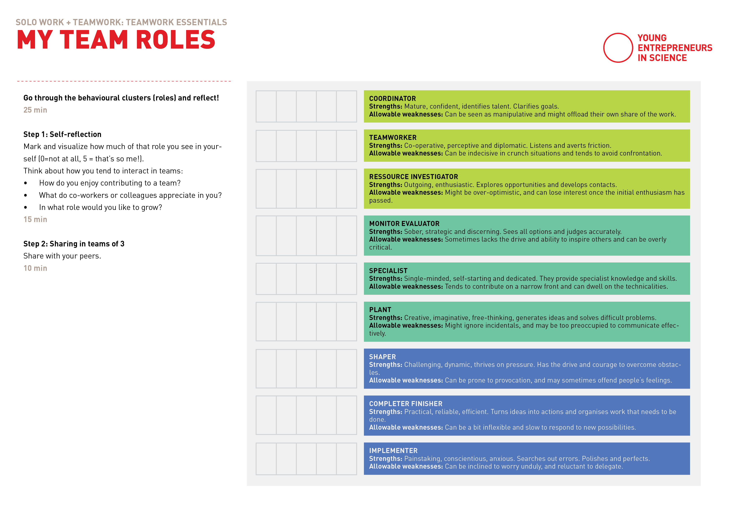
Template: Preview
Source: www.belbin.com/about/belbin-team-roles

Slide 115
My team roles
Think about how you tend to interact in teams:
Coordinator
Teamworker
Ressource Investigator
Strengths
Mature, confident, identifies talent. Clarifies goals.
Co-operative, perceptive and diplomatic. Listens and averts friction.
Outgoing, enthusiastic. Explores opportunities and develops contacts.
Allowable
weaknesses
Can be seen as manipulative and might offload their own share of the work.
Can be indecisive in crunch situations and tends to avoid confrontation.
Might be overopti-mistic, and can lose interest once the initial enthusiasm has passed.
Notes:
ACHTUNG: Falls die Zeit reicht, können auch die typischen Schattenseiten der jeweiligen Rollen besprochen werden.

Slide 116
My team roles
Think about how you tend to interact in teams:
Monitor evaluator
Specialist
Plant
Strengths
Sober, strategic and discerning. Sees all options and judges accurately.
Single-minded, self-starting and dedicated. They provide specialist knowledge and skills.
Creative, imaginative, free-thinking, generates ideas and solves difficult problems.
Allowable
weaknesses
Sometimes lacks the drive and ability to inspire others and can be overly critical.
Tends to contribute on a narrow front and can dwell on the technicalities.
Might ignore incidentals, and may be too preoccupied to communicate effectively.

Slide 117
My team roles
Think about how you tend to interact in teams:
Shaper
Completer Finisher
Implementer
Strengths
Challenging, dynamic, thrives on pressure. Has the drive and courage to overcome obstacles.
Practical, reliable, efficient. Turns ideas into actions and organises work that needs to be done.
Painstaking, conscientious, anxious. Searches out errors. Polishes and perfects.
Allowable
weaknesses
Can be prone to provocation, and may sometimes offend people's feelings.
Can be a bit inflexible and slow to respond to new possibilities.
Can be inclined to worry unduly, and reluctant to delegate.

Slide 118
What do you take away from the self-reflection on team roles?
Notes:
How do you think this Model could be applied?
Conclusion: When in a team or putting together a team, we can keep an eye on:
Am I within the framework of my natural patterns with the roles I'm currently taking on or do I have to completely adjust myself?
In the event of conflicts or difficult work processes, we can use this model to analyze the image of ourselves and others and discuss where the distribution of roles might need to be readjusted.
Diversity wins! If we have 5 really great inventors on the team, but nobody finishes the ideas, it doesn't work. And when 7 super organized perfectionists work together, nothing innovative ever happens.

Slide 119

Evolving together
Notes:
ACHTUNG: Wenn in Kombination mit Conflict, lohnt sich diese Folie um den Bogen zur Werigkeit von konstruktiven Konflikten zu schließen.

Slide 120
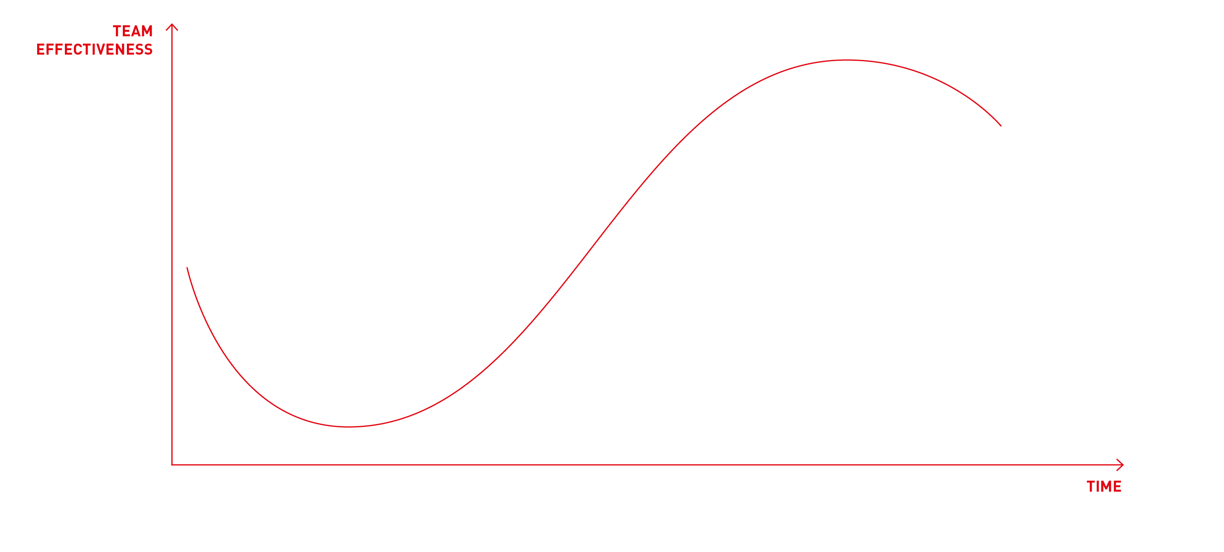
Tuckman’s model
performing
adjourning
forming
norming
storming
Tuckman B. W., Jensen M. A. C. (1977). Stages of Small-Group Development Revisited. Group & Organization Management, 2(4), p.419-427.
Notes:
describes the dynamics in smaller groups.
Describes the natural stages every team goes through.
Theses stages repeat in an infinite loop.
Just to make you aware the these dynamics exist. We encourage you to read up and deepen your knowledge once you are there or get support from outside.
Forming stage
The forming stage involves a period of orientation and getting acquainted. Uncertainty is high during this stage, and people are looking for leadership, authority and getting clear on what roles are there and who has which role. Team members are asking such questions as “What does the team offer me?” “What is expected of me?” “Will I fit in?” Most interactions are social as members get to know each other.
Storming stage
The storming stage is the most difficult and critical stage to pass through. It is a period marked by conflict and competition as individual personalities emerge. Team performance may actually decrease in this stage because energy is put into unproductive activities. Members may disagree on team goals, and subgroups may form around strong personalities or areas of agreement.
To get through this stage, members must work to overcome obstacles, to accept individual differences, and to work through conflicting ideas on team tasks and goals. Teams can get stuck in this stage. Failure to address conflicts may result in long-term problems.
Norming stage
If teams get through the storming stage, conflict is resolved and some degree of unity emerges. In the norming stage, consensus develops around who the leader or leaders are, and individual member’s roles. Interpersonal differences begin to be resolved, and a sense of cohesion and unity emerges. Team performance increases during this stage as members learn to cooperate and begin to focus on team goals. However, the harmony is precarious, and if disagreements re-emerge the team can slide back into storming.
Performing stage
In the performing stage, consensus and cooperation have been well-established and the team is mature, organized, and well-functioning. There is a clear and stable structure, and members are committed to the team’s mission. Problems and conflicts still emerge, but they are dealt with constructively. The team is focused on problem solving and meeting team goals.
Adjourning stage
In the adjourning stage, most of the team’s goals have been accomplished. The emphasis is on wrapping up final tasks and documenting the effort and results. As the work load is diminished, individual members may be reassigned to other teams, and the team disbands. There may be regret as the team ends, so a ceremonial acknowledgement of the work and success of the team can be helpful. If the team is a standing committee with ongoing responsibility, members may be replaced by new people and the team can go back to a forming or storming stage and repeat the development process.
Lot of input. I don't think it is so crucial to this point to rember this model in detail. However I think it will be very helpful for you to be aware that these dynamics are inevitable once you build up a team. Storming is neither your fault or the fault of your team members but a natural procosess that needs to happen in order to be well-performing!

Slide 121

MEET OUR EXPERT
Notes:
1. What is your situation regarding team work?
2. What was you best/ worst experience? Why?
3. How does working in a team differ from your experience within the academic work life?
4. What are your greatest learning?
5. Where did you find your team mates?
6. What are the greates challenges?
7. How to become a team player?
8. How and where to get help with team conflicts?
9. What is your advice?
> Sum up: What are the most important factors for a successful team?

Slide 122
Any questions?

Slide 123

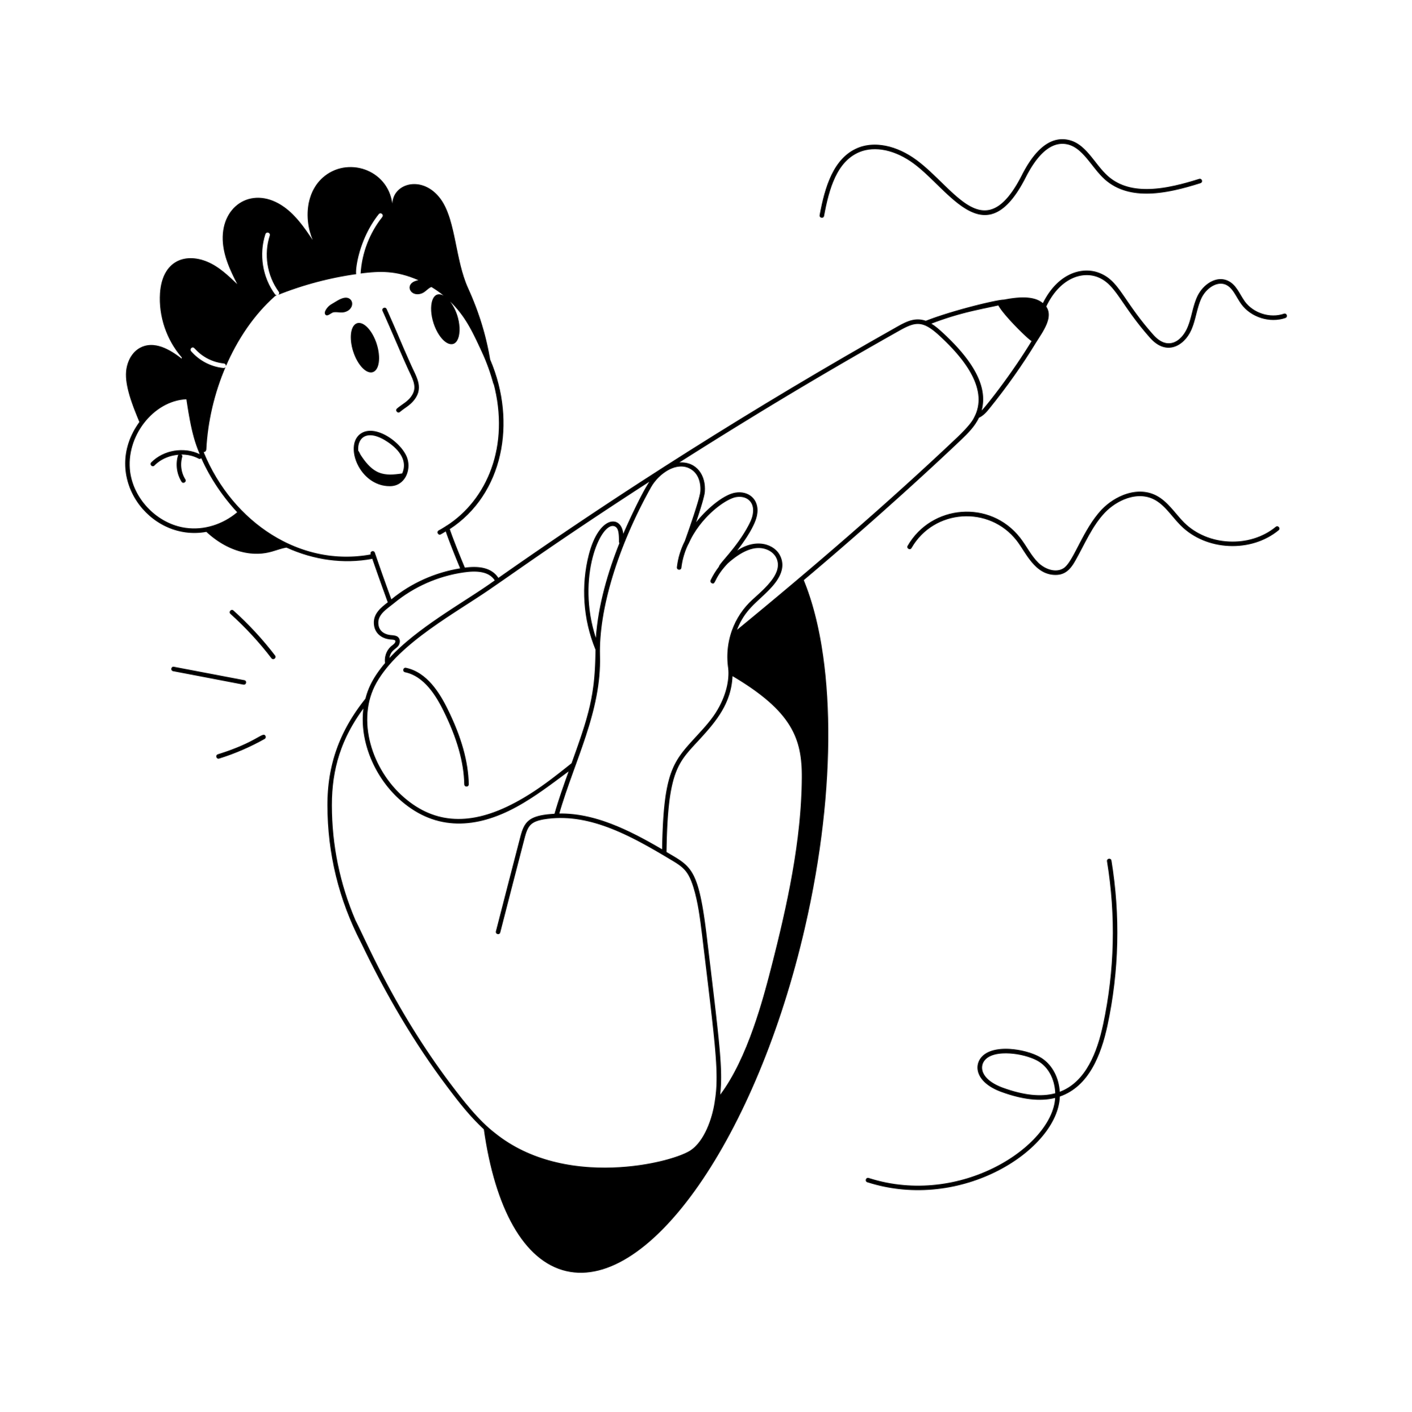
Time for feedback!
Please, follow the link in the chat window.
Notes:
Voting Link:
https://www.menti.com/v9peuuzor4
Live Results:
https://www.mentimeter.com/s/d2103d5f8c21f37ba61c7f97bf8930ef/b2a82eab8ce3

Slide 124
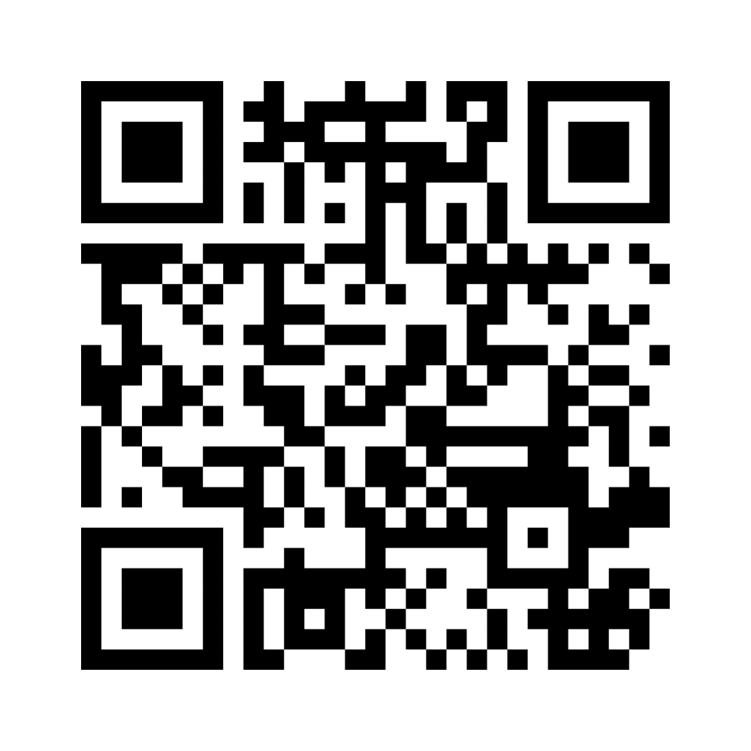
Wrapping up!
I like, I wish, I take away…
Notes:
Ggf. Menti-Link für Teilnehmende: https://www.menti.com/alaxnctncdyz

Slide 125
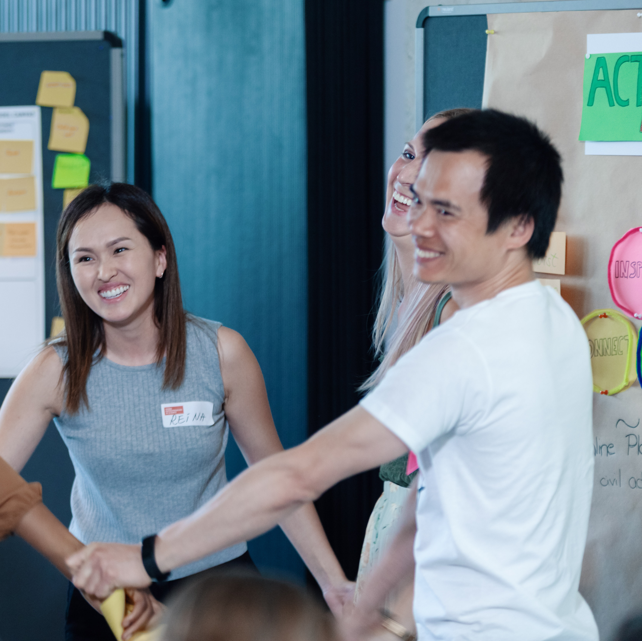
Stay connected with the YES community
Join our LinkedIn group
Take part in other (Online-) Workshops
Tell your peers and spread the word via social media
Stay active in our Alumni-Community
Keep learning from each other on your entrepreneurial journey
Notes:
Hinweis für die Coaches:
Die Einladung zu dem netzwerk FW Connect erhalten die TN nach dem Workshop in einer Email, genauso wie alle weiteren, genaueren Infos, wie sie sich connecten können und Teil unserer Community werden können.

Slide 126


Boost your career with your YES experience
Connect with YES and fellow participants on LinkedIn
Share your YES certificate on Social Media
Add YES to your trainings on LinkedIn and your CV
… and carry the entrepreneurial spirit further.
Notes:
Hinweis für die Coaches:
Die Einladung zu dem netzwerk FW Connect erhalten die TN nach dem Workshop in einer Email, genauso wie alle weiteren, genaueren Infos, wie sie sich connecten können und Teil unserer Community werden können.

Slide 127


Time for feedback!
Notes:
Link
Bitte auf folgendes bei der Tonspur eingehen, um die Notwendigkeit der Evaluation zu betonen (Anmerkungen von YES):
Your feedback is key/We highly appreciate your feedback!
It is crucial not only for the constant improvement of our workshops, but also with regards to the future funding of our programme.
Future funding means more offers for you as alumni community (additional workshops, webinars, networking opportunities)
Thank you for taking the time (approx. 4 min)!

Slide 128




Thank you!
Connect with us and each other via Social Media …
LinkedIn Page
LinkedIn Group
Instagram @sciencepreneurs
Newsletter
©️ Young Entrepreneurs in Science, 2025
Notes:
That‘s it!
Thanks a lot for participating
We hope you had fun
You will be added to the YES newsletter list to stay updated with the project and to read exciting alumni stories as well as get invited to our network Falling Walls Connect, to make contact with each other and take part in alumni webinars!
Please spread the word!!!
Instagram
https://www.instagram.com/sciencepreneurs/
LinkedIn Seite
https://www.linkedin.com/company/young-entrepreneurs-in-science/
LinkedIn Gruppe
https://www.linkedin.com/groups/8902012/
Newsletter
https://youngentrepreneursinscience.com/newsletter-registration/
Everybody else: Goodbye, have a nice day and see you soon!

Slide 129

THE END

