Slide 1
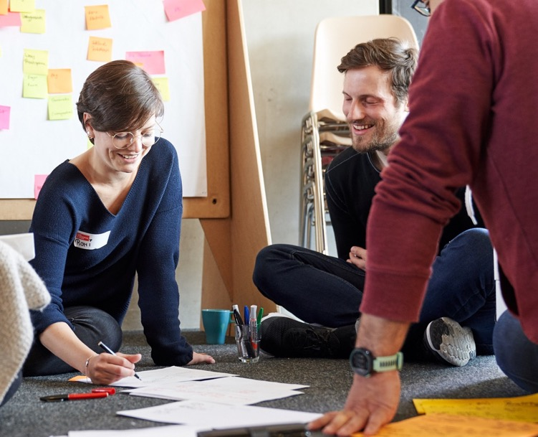
FROM PHD TO INNOVATOR
DAY 2
online
Notes:
Welcome back to the second day of our Workshop „From PhD to innovator“!

Slide 2
Workshop Programme
Day 1
Day 2
YOUR ENTREPRENEURIAL CAREER
YOUR RESEARCH CANVAS
IDEATION
PITCH TRAINING
Introduction to entrepreneurship & intrapreneurship
Open up to new career perspectives
Networking and Q&A with role models
Learn about the relevance of users and potential use cases
Apply the Research Canvas to your own research
Brainstorming potential use cases for your research topic
The Ideation Process & the Problem-Solution-Fit
Brainstorm & filter ideas: What makes a good idea?
How to think outside the box
Key principles for a convincing pitch
Develop a storyline, set the stage, and use your voice
Get feedback and learn from your peers
Notes:
To remind you about our content today:
We will kick it off with Ideation where you will experience a structured process that allows you to think outside the box and that yields ideas that do tackle a real problem.
In the afternoon, we will continue with a pitch training, in which we provide you an overview of the key principles of pitching, invite you to develop your own convincing pitch and finally to get feedback and learning oportunities from your peers.

Slide 3
Day 2
IDEATION
PITCH TRAINING
Key principles for a convincing pitch
Develop a storyline, set the stage, and use your voice
Get feedback and learn from your peers
Experiment, push and fail forward!
The Ideation Process & the Problem-Solution-Fit
Brainstorm & filter ideas: What makes a good idea?
How to think outside the box
Notes:
Taking a closer look into todays programme:
We will again start with a check-in
Then dive into the ideation process
Today, we will have our lunch break from x to x (also post in chat)
In the afternoon it will be all about pitching
We wrap it up and close the workshop at around x o‘clock.
As you can see, we do have another sweet programme designed for you and we are very much looking forward to this!

Slide 4
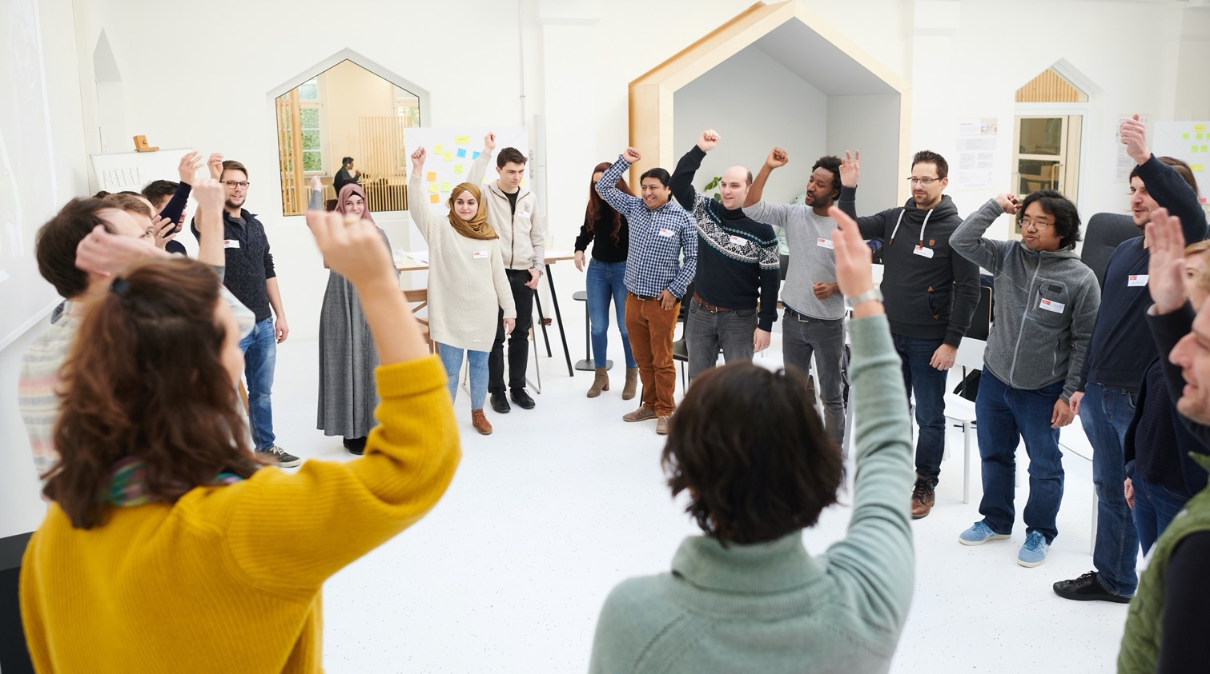
CHECK-IN
Notes:
Today‘s Check-in will be a little bit different than yesterday…

Slide 5
Check-in
To start the day, let us share and reflect in groups:
A. How are you feeling this morning?
B. When you think of yesterday:
What was an AHA-moment?
What would you like to incorporate into your work today?
Notes:
For today, we brought you some check-in questions.
In a moment, you will be transfered into breakouts and you will have 15 minutes to share with each other:
A. How are you feeling this morning? B. When you think of yesterday… ...What was a AHA-moment? ... What would you like to incorporate into your work today? All good?
Okay, then enjoy checkin-in together and we will meet back here in 15!

Slide 6
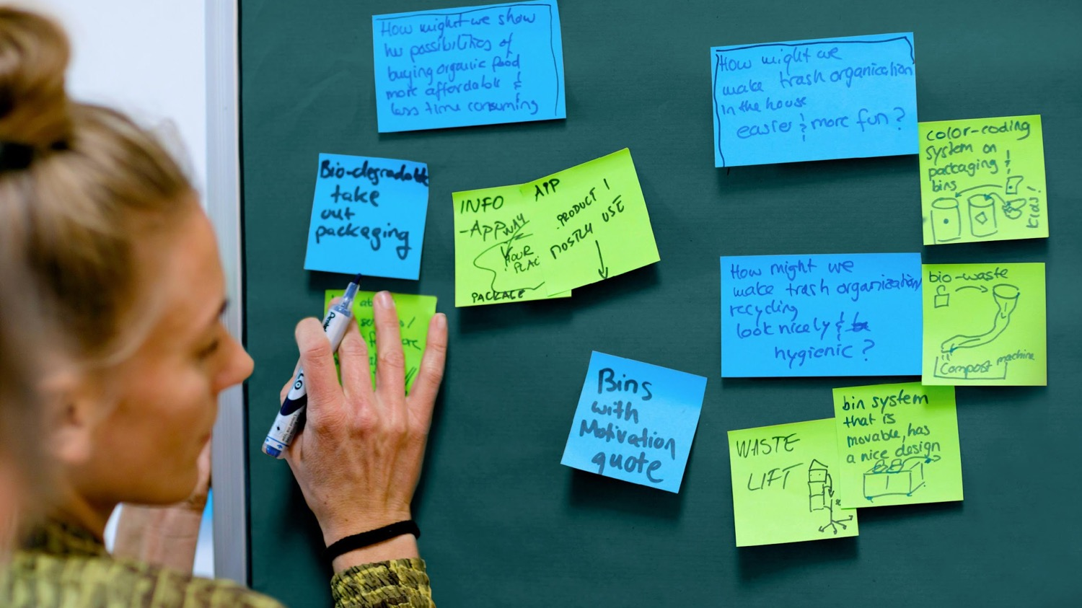
IDEATION
Notes:
Welcome back everyone!
I hope you had a nice conversation and are ready to get started!
So lets dive into the topic of ideation.

Slide 7
Learning goals
Getting to know the different elements of an ideation process
Applying the concept of the problem-solution fit
Finding solutions with the help of innovation guidelines
Learning how to structure ideas
Notes:
The learning goals for this module are:
Getting to know the different elements of an ideation process - we will guide you through this step by step.
Applying the concept of the problem-solution fit. For those of you, who are wondering now, what this problem-solution-fit is: don‘t worry – we will explain this concept to you!
Finding solutions with the help of innovation guidelines and
Learning how to structure ideas and how to select ideas in the end of an ideation process.

Slide 8

IDEATION
Notes:
What exactly is ideation?

Slide 9
What is ideation?
The formation or conception of ideas by the mind.
Collins Dictionary
Notes:
Well, we asked the Collins dictionary about it. It says:
Ideation ist the formation or conception of ideas by the mind.
But how does this happen? How does our mind generate ideas and can we somehow support it doing so?

Slide 10

HOW DO WE FORM IDEAS?
Notes:
Often, one says that great ideas come while taking a shower.
Even though I don‘t know the science behind this saying and whether this has been investigated, but what I do know is that our mind it likely to come up with ideas when it has something to do that is rather automated. We are awake and we do something, but this activity doesn‘t need too much of our attention. Same goes for example when riding your bike or going for a run.
So is the message now that we need to take showers whenever we need an idea? Does it only work like this?
Luckily, the answer is no!

Slide 11

Develop ideas in a structured way
Notes:
The good news is: There is a structured way to come up with ideas.
And even better: this structure – or process - can either be followed alone but it also works excellently in a team!
Today, we will show you the core elements of this structure and guide you through it step by step.

Slide 12
Ideation process
1. FINDING THE PROBLEM
What is the user’s problem?
British Design Council “Eleven lessons. A study of the design process.” available at www.designcouncil.org.uk —Retrieved 9 November 2016
Notes:
And this is how it looks like:
In total, you find 4 phases that are indicated with those bright grey separation lines
You find two diamonds indicated in red. I will tell you in a second what this is about.
The first phase is all about finding the problem.
And this is very important and maybe surprising: We do NOT start the ideation process by actually talking or thinking about ideas! But: we do focus in the problem!
Why do we do this? Because we observe, that people come up with ideas that adress a problem that nobody really has. And this is why sometimes startups fail!
So we don‘t want this to happen to you and this is why it is really important to get started with a real problem first! A problem that users really do experience!

Slide 13
Ideation process
1. FINDING THE PROBLEM
What is the user’s problem?
2. ASKING THE RIGHT QUESTION
What is the question you want to find answers to?
British Design Council “Eleven lessons. A study of the design process.” available at www.designcouncil.org.uk —Retrieved 9 November 2016
Notes:
Even the second step is not about coming up with ideas!
Here it says: Asking the right question. Within the problem that you identified within step 1, this might be a rather complex problem with many different aspects that you could adress.
So here, in this 2. step, you want to find focus within the identified problem. With aspect do you want to adress? From which perspective do you want to look at the problem?
What is the question you want to find answers to?
Only in the 3. step, it is finally about defeloping ideas…

Slide 14
Ideation process
1. FINDING THE PROBLEM
What is the user’s problem?
2. ASKING THE RIGHT QUESTION
What is the question you want to find answers to?
3. DEVELOPING SOLUTIONS
How do you want to solve the users problem?
British Design Council “Eleven lessons. A study of the design process.” available at www.designcouncil.org.uk —Retrieved 9 November 2016
Notes:
… and developing solutions.
After you have identified a real problem and you defined a focus within that problem by formulating specific questions, You finally enter the solution space and develop ideas, for example through brainstorming.

Slide 15
Ideation process
1. FINDING THE PROBLEM
What is the user’s problem?
2. ASKING THE RIGHT QUESTION
What is the question you want to find answers to?
3. DEVELOPING SOLUTIONS
How do you want to solve the users problem?
4. EVALUATION Which are the most promising solutions you came up with?
British Design Council “Eleven lessons. A study of the design process.” available at www.designcouncil.org.uk —Retrieved 9 November 2016
Notes:
And finally, one needs to select the ideal solution by evaluating the ideas that were developed in step 3.
Because obviously we cannot realize all of the ideas and not all of them are promising enough.
So these are the 4 steps of our ideation process:
Finding the problem
Asking the right question
Developing ideas
And finally: Evaluate the ideas!
Now what are the two diamons about. Well, firstly, they do represent two different spaces:
The first one is the so called problem-space: Here, it is all about finding and describing the problem We do not care about any idea or solution yet!
The second diamond is the so called solution-space. Here, it is all about ideas! We first develop ideas and we then evaluate and select ideas.
And why are they shaped as diamonds (if you have enough time, this might be an open question to the participants to let them guess)?
The shap of the arrows indicate the mindset that we need within each step.
Arrows that are opening up indicate a mindset that is opening up, that creates more options, more insights, discovers more problems, develops more solutions.
We call this a divergent mindset.
After opening up and creating options, we do need to select and find focus again. And this is indicated by the convergent arrows. So here we need to make decisions and let other options go. We call this the convergent mindset.

Slide 16
Divergent/convergent thinking
Banathy, Bela H. (1996). Designing Social Systems in a Changing World. Springer US. p. XV, 372
Notes:
It is very important for our work flow AND for our brain to know in which phase and mindset you are in.
Because they really are completely different.
So make sure that you and your team mates know whether you step into a divergent or convergent phase. This helps a lot!

Slide 17
Ideation process
This is how we do it
We will fast-forward through the whole ideation process today.
You can either develop an idea based on your PhD or develop an example idea with us.
Notes:
This was the ideation process in a nut shell.
Today, we will fast-forward through the whole process!
You can do this either by developing ideas that are based on your research project OR you develop an example idea with us, that is completely independent of your reasearch.
Are you ready? Okay, so lets go!

Slide 18
Ideation process
1. FINDING THE PROBLEM
What is the user’s problem?
2. ASKING THE RIGHT QUESTION
What is the question you want to find answers to?
3. DEVELOPING SOLUTIONS
How do you want to solve the users problem?
4. EVALUATION Which are the most promising solutions you came up with?
British Design Council. "Eleven lessons. A study of the design process".available at www.designcouncil.org.uk. Retrieved 9 November 2016.
Notes:
Lets get started with step 1: Finding the problem!

Slide 19
The Ideation Process
1. Finding a problem
Notes:
Ideas do not arise from a vacuum. But we find ideas when we are confronted with a problem!

Slide 20
Finding a problem
Wherein is the source of a powerful idea?
in a real user’s problem
in a solution that offers true value for the user
Understanding problems as opportunities!
Notes:
And of course we do not want to waste our resources by adressing a made-up problem, but we want to adress REAL problems that people REALLY have!
Because only then our solution offers true values for our users!
So don‘t be scared of a problem, use it as an enabler to create something new and something meaningful!

Slide 21

Find a problem
Notes:
To do so, we prepared a teamwork excercise for you:

Slide 22
Find a problem
It can either be a problem, that you …
A. … are working on in the context of your research.
B. … observed or found in your day to day life:
Where did you recently experience a challenge?
Where did you observe a problem that somebody was facing?
Notes:
As said before, you may either identify problems that you are working on in the context of your research, OR:
You may also think about problems that you observed or found in your day to day life:
Maybe you experienced a challenge recently or
You observed somebody else facing a problem?
It is really up to you!
Today, we want to show you the process, let you experience it. It is about the application of it and NOT about the idea today!

Slide 23
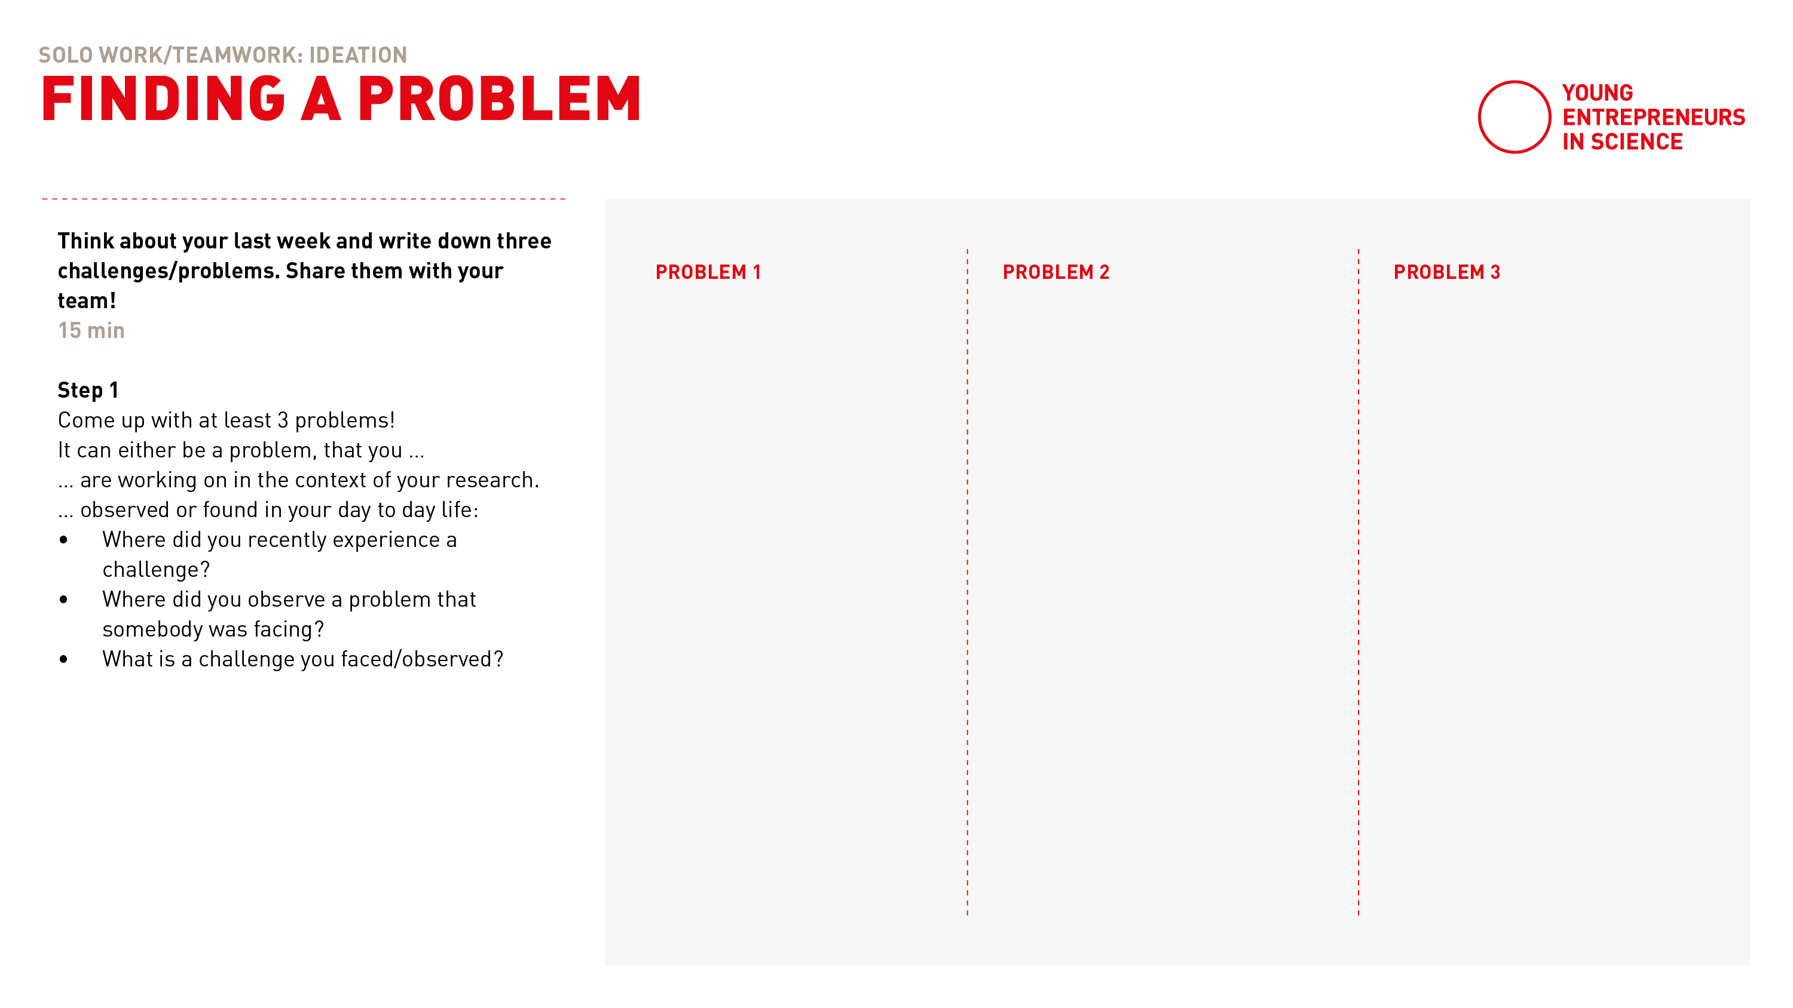
Finding a problem
Notes:
So: step 1 today is to come up with at least 3 problems!

Slide 24
Finding a problem
An old woman having troubles crossing a busy street.
Watering my plants when I am not at home.
Notes:
For example: Maybe I recently observed …(read out)

Slide 25
Teamwork
Find a problem
15 minutes
Digital Breakout Rooms
Automatic transfer back
On your own: Think about your last week and write down three challenges/problems
Share them with your team!
2 min self introduction
13 min writing & sharing
Countdown for last minute
Notes:
So the first exercise for todays works as follows (read out)

Slide 26
Let’s go!
Notes:
All good? Then lets go!

Slide 27
Notes:
Everybody is back? All went well?
Thumbs up if you’re with me please!

Slide 28
What problems did you think of?
Notes:
Lets listen to some of the problems that you identified.
Who wants to get started? Just unmute yourself, raise your hand or post in our chat. As you like!

Slide 29
Ideation process
1. FINDING THE PROBLEM
What is the user’s problem?
2. ASKING THE RIGHT QUESTION
What is the question you want to find answers to?
3. DEVELOPING SOLUTIONS
How do you want to solve the users problem?
4. EVALUATION Which are the most promising solutions you came up with?
British Design Council. "Eleven lessons. A study of the design process".available at www.designcouncil.org.uk. Retrieved 9 November 2016.
Notes:
Now lets move on to step 2!
Here, you select one of the problems from step 1 and you develop different questions for the selected problem.

Slide 30
The Ideation Process
2. Asking the right questions
Notes:
Maybe this step is a bit surprising. Why not dive into the soltion space right away?
Well, there are several answers to this.
For example, our brains are more likely to generate ideas when confronted with questions than with problems.

Slide 31
How might we …?
Asking the right questions
Problems usually offer various entry points for possible solutions
Be very clear about what specific question you want to find answers to!
Notes:
Also, problems do offer various entry points for possible solutions.
Formulating different questions allow us to make use of those various entry points.
The questions we are talking about have a specific name. They are called „How might we-Questions“, because they always start with these 3 words: How might we.
Let me give you an example to make this more clear:
Now I take the problem I observed earlier about the elderly women that has troubles crossing a busy street.

Slide 32
How might we …?
EXAMPLE
Problem
An old woman having troubles crossing a busy street.
HMW question
How might we help the lady cross the street?
Notes:
Then a very obvious HMW-Q could be: (read out)
Facing this question, I am positive that you all come up with first ideas on how to solve it, don‘t you?
Now lets take a look at differents HMW-Q!

Slide 33
How might we …?
EXAMPLE
Problem
An old woman having troubles crossing a busy street.
HMW question
How might we help the lady cross the street?
How might we slow down the traffic for her?
How might we help her getting from A to B without crossing the street?
<
Notes:
Now you can play with the scope by defining different entry points to the problem. For example: (read them out)
If you chose different HMW-Q you open up different solution spaces!
And you'll come up with ideas you probably wouldn't think of just by looking at the problem itself!
When brainstorming in a team: it is crucial to chose one question at a time.

Slide 34
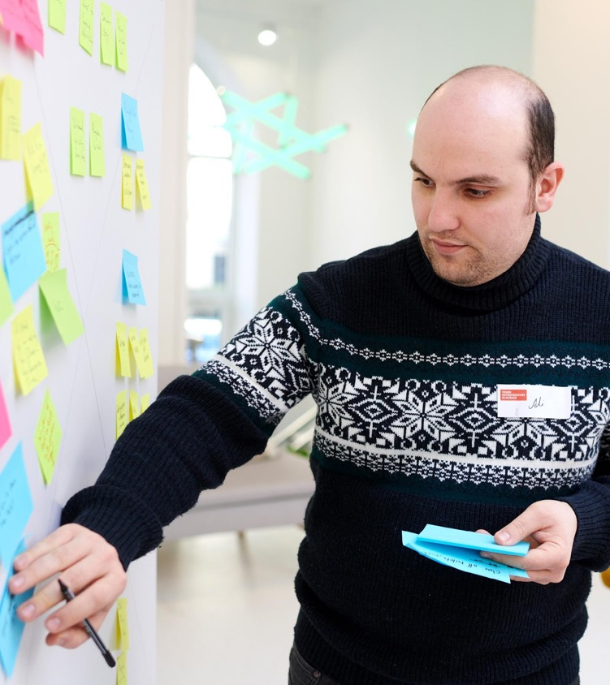
Define your questions
Notes:
Your next step in the ideation process is to define your How-might-we-questions.

Slide 35
HOW IT WORKS …
Define your questions
10 minutes
Stay in main room and mute yourself.
Choose the one problem you think is the most interesting
Try to define at least 3 different How Might We questions for it
Notes:
This will be solo work again, so please (read out)
For some more orientation and inspiration, we prepared the following template for you (next slide):

Slide 36
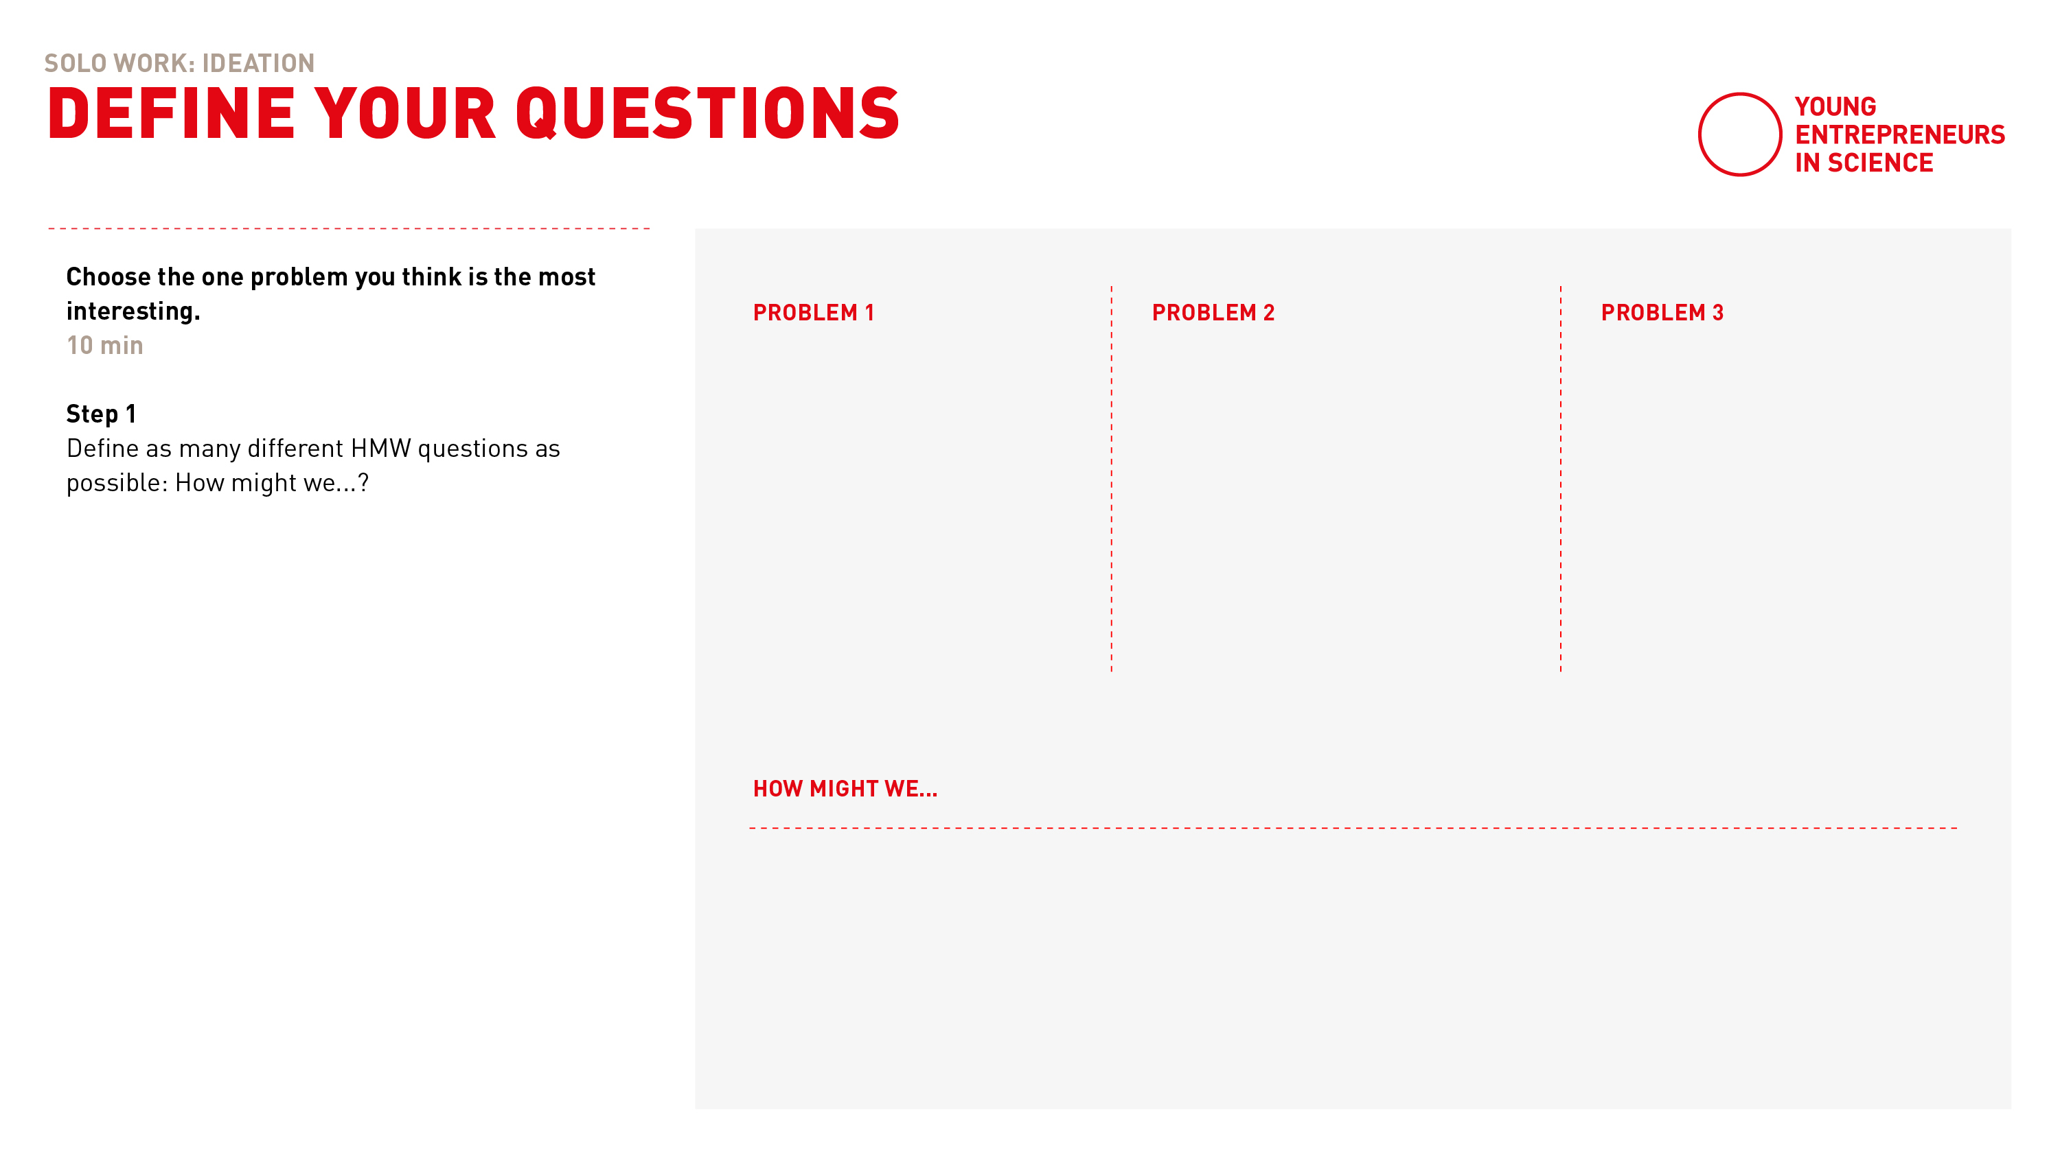
Define questions
Define questions
An old woman having troubles crossing a busy street.
An old woman having troubles crossing a busy street.
Watering my plants when I am not at home.
Watering my plants when I am not at home.
How might we … help the lady cross the street?
How might we … slow down the traffic for her?
How might we … help her getting from A to B without crossing the street?
Notes:
I here picked the problem number 1 – an old woman hading troubles crossing a busy street.
And I come up with different HMW-Q that have different perspectives on the problem. For instance: What is really the problem here? It is the traffic! So how might we slow this down?
Or: Maybe we could change the status quo completely and wonder: HMW help her getting from A to B without crossing the street?
You get the idea! There is no right or wrong when it comes to formulating HMWQ- They really should simpliy provide you the entry point into different mental solution spaces.
Ready? Then the 10 minutes are starting now!

Slide 37
Notes:
Everybody is back? All went well?
Thumbs up if you’re with me please!

Slide 38
After the break …
IDEATION PROCESS Ideation & Idea evaluation SHARING Share what you’ve been working on!
Notes:
We will have a short break coming up.
After the breakt we will continue with the ideation process and dive into creating ideas and evaluting ideas.
And then we are of course very curious and excited to learn what you delevoped over the course of this workshop and this is why we will finish up this moduel with a short sharing round. I am very looking forward to this already!
But first: lets take a break!

Slide 39

BREAK
Notes:
Please stay in our zoom room and be back at xx

Slide 40
Ideation process
1. FINDING THE PROBLEM
What is the user’s problem?
2. ASKING THE RIGHT QUESTION
What is the question you want to find answers to?
3. DEVELOPING SOLUTIONS
How do you want to solve the users problem?
4. EVALUATION Which are the most promising solutions you came up with?
British Design Council. "Eleven lessons. A study of the design process".available at www.designcouncil.org.uk. Retrieved 9 November 2016.
Notes:
Welcome back everybody!
I hope that you are fresh and full of energy now after our break – because this is what you‘ll need for the 3. step of the ideation process!

Slide 41
The Ideation Process
3. Developing solutions
Notes:
After focussing on the problem, asking questions, finally, it is really about developing ideas and solutions!

Slide 42
Ideation
Now that we have the right question, we can start to think about innovative solutions!
Notes:
We often observe that people jump into finding solutions right away. And yes, they do come up with some solutions. But: We want to be innovative and come up with innovative and meaningful ideas and this is why it is so crucial to first be clear about the problem and tthen we are ready to dive into finding solutions.

Slide 43




Ideation settings
In teams
Silent
Alone
Loud
Notes:
There are many different settings suitable for ideation:
You can do brainstorming alone
You can do brainstorming in a team
Brainstorming can be quite loud
But it can also be rather silent.
So as you can see, there is not the one fits all setting.
What is true independent of the setting you chose are the follwing ideation guidelines:

Slide 44

Ideation guidelines
1. Timeboxing
Notes:
The first and ideation guideline is the principle of timeboxing.
We do work with analog timers, called time timers, that you can see on this slide. There are also apps for this and also the normal timer on your mobile phone will do it.
The main idea behind this principle is to prevent us from getting lost in discussions. And this is what would happen if we had unlimited time.
But it is only about generating ideas now and the evaluation will come only afterwards!

Slide 45
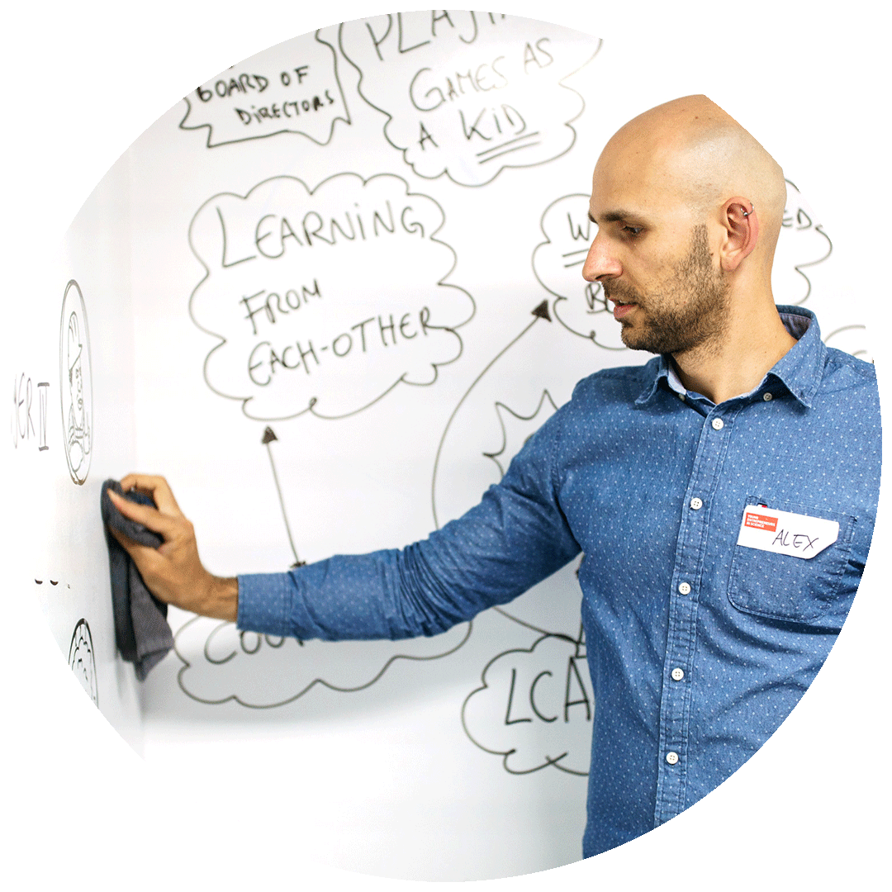
Ideation guidelines
2. Be visual
Notes:
Secondly, we want to be visual.
Imagine you have a whiteboard covered with post-ist, each post-it has an idea written on it.
It will be very difficult to remember the idea and to find the idea again- because you need to read through all of the post-ist over and over again.
But adding a little visualisation helps our brain to remember the idea better and to spot it more easily. So this really helps the process, even though this might feel tidious in the beginning.

Slide 46

Ideation guidelines
3. Go for quantity
Notes:
The other guideline is: Go for quantitiy!
Yes, of course quality also matters. But not every single idea can be of high quality. And it doeesn‘t need to be! Maybe the idea you write down inspires yourself or your team mates to great ideas. So go for quantitiy and develop a great foundation for inspiration!

Slide 47

Ideation guidelines
4. Think outside the box
Notes:
Also: Encourage your team to find wild and new ideas. Who thinks outside the box, wins! Be brave!

Slide 48

Ideation guidelines
5. Build on the ideas of others
Notes:
Another principle is: „Build on the ideas of others:
Ideation is a team sport
It shouldn‘t matter who had THE idea in the idea
Ideally, you treat the ideas like pingpong ball and they go back and forth within the team, with changes and adaptations and add-ons.
In the end, maybe you don‘t even know who had the origin of the idea and it really shouldn‘t matter! It is only the idea that counts!

Slide 49
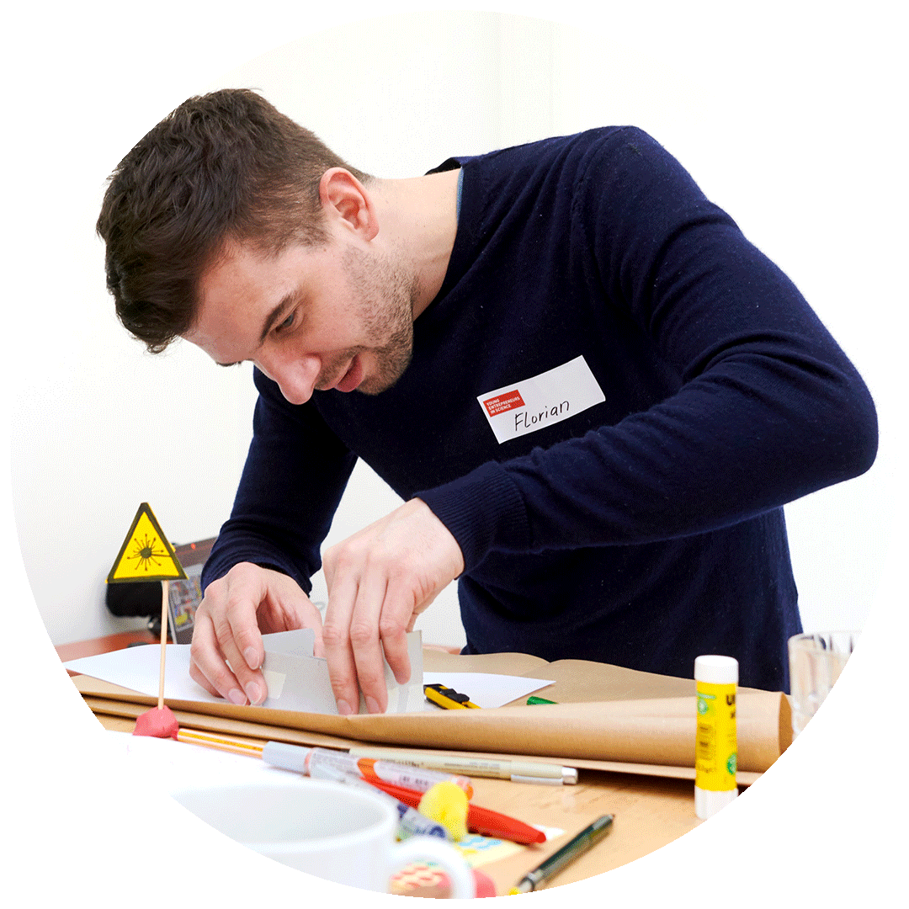
Ideation guidelines
6. Stay on topic
Notes:
Going wild, moving the ideas back and forth – YES! But: Also stay on the topic.

Slide 50
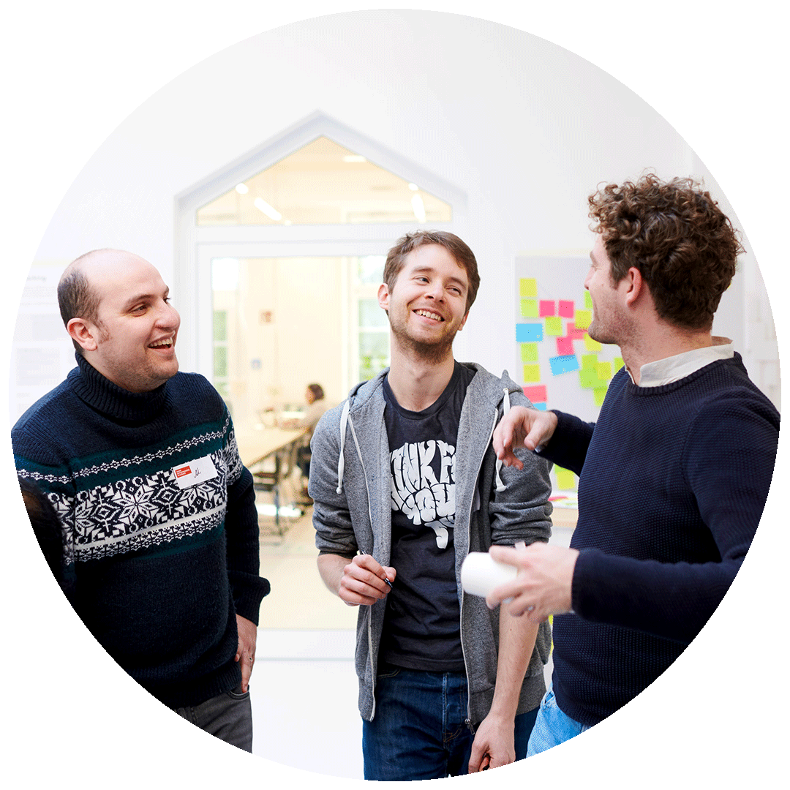
Ideation guidelines
7. Defer judgement
Notes:
Lastly, but very imporant: Defer judgement.
Ideation is about opening up, going wild, daring to think outside the box.
Being judgemental with yourself or your team mates doesn‘t help here!
The ideas will be evaluated, but NOT while brainstorming but AFTER!

Slide 51
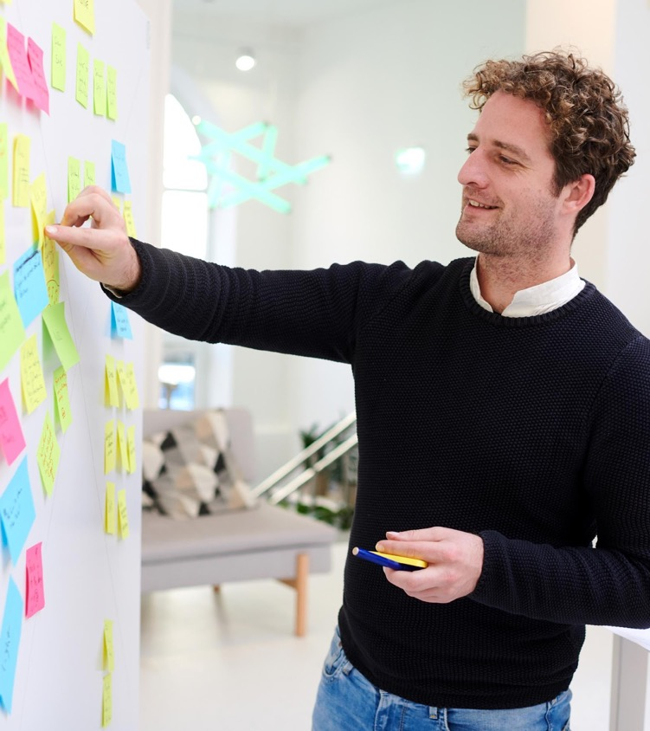
Brainstorming
Notes:
Okay, with all this being said: Next we prepared different brainstomring methods for you

Slide 52
Solo work
Brainstorming
10 minutes
Stay in main room and get your pen and paper ready.
Select the most interesting HMW question. Follow our brainstorming instructions
Notes:
Firstly, you can take a moment to pick on of your HMW-Q.
With this, we will guide you through the methods step by step.
Make sure that you have something to write and ideally to draw at hand.
... if you‘re working on your own PhD topic you may already have ideas – nevertheless!
Join us in the brainstorming methods and maybe you‘ll find new approaches to possible solutions or maybe innovative add-ons to your excisting idea
Now, please take 30 seconds to pick your HMW-Q starting now!
(Jede Brainstormmethode live anmoderieren! Pro Methode haben die Teilnehmer 2 Minuten Zeit, dann geht es gemeinsam und moderiert weiter)

Slide 53
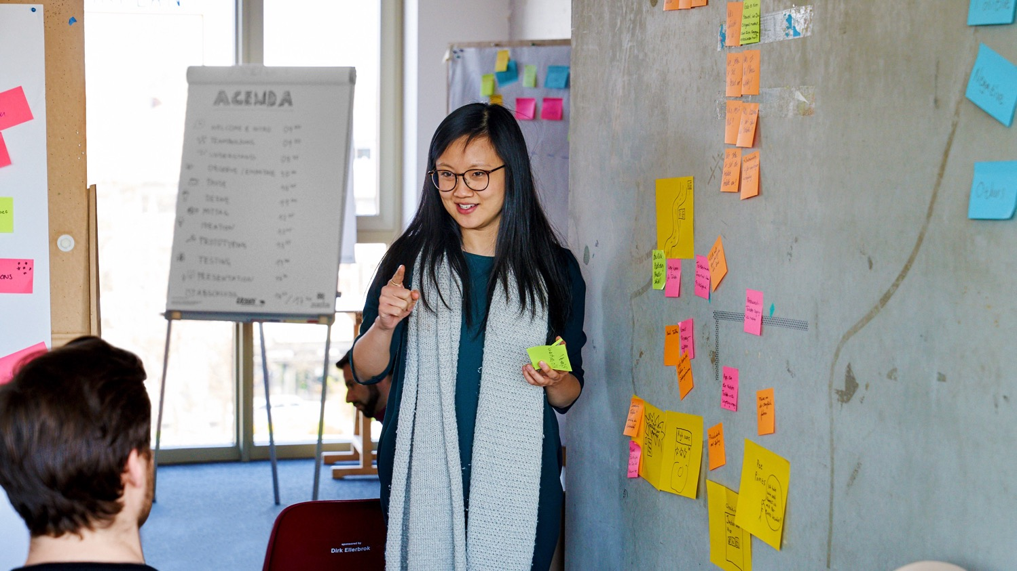
BRAINSTORMING METHODS
Notes:
Everyone has a HMW-Q that you want to work on?
Great, so lets go!

Slide 54
Silent brainstorm
Think about your HMW question & silently write down as many different solutions as you can.
Notes:
We always start with the so called silent brainstorming.
Here, you write down (in silence) as many different solutions to the problem as you can within 2 minutes.
Remember: There are no bad ideas! Just get into the flow, write down all the ideas that come into your mind!
Okay, so the 2 min start now!

Slide 55

Reverse brainstorming
Reverse the problem or challenge by asking: “How could I possibly cause the problem?”
Notes:
The second method is called „Reverse Brainstorming"
And this is how it works:
Reverse the problem or challenge by asking: “How could I possibly worsen the problem?” or “How could I possibly achieve the opposite effect?”
Brainstorm to generate „Anti-ideas“. Allow the brainstorm ideas to flow freely. Do not reject anything at this stage. Do this for 1 min starting now!
Now reverse these anti-ideas into something positive and constructive again! You have one minute to do so starting now!

Slide 56



Super hero brainstorming
Put yourself into the shoes of a superhero.
How would this superhero with their superpowers solve the problem at hand?
Notes:
The last method we prepared is called the Super hero brainstorming.
Here, you put yourself into the shoes of a super hero.
Imagine: How would this super hero with their super powers solve the problem at hand?
Of course it doesn‘t need to be a marvel super hero but this could be any inspiring figure. Please take a moment now to decide for such a hero now.
All good? You all came up with one? Good!
Now: How would this super hero with their super powers solve the problem at hand? Brainstorm ideas for 2 minutes starting now!
Okay, welcome back! I am curious, who found more then 2 ideas in total? Who more than 5? 10?
Please share in the chat which method you liked best: Silent, reverse or super hero?
Now let‘s see…. (comment on chat)

Slide 57
Ideation process
1. FINDING THE PROBLEM
What is the user’s problem?
2. ASKING THE RIGHT QUESTION
What is the question you want to find answers to?
3. DEVELOPING SOLUTIONS
How do you want to solve the users problem?
4. EVALUATION Which are the most promising solutions you came up with?
British Design Council. "Eleven lessons. A study of the design process".available at www.designcouncil.org.uk. Retrieved 9 November 2016.
Notes:
Now we are approaching the last step of the ideation process.

Slide 58
The Ideation Process
4. The idea evaluation
Notes:
The idea evaluation!
We came up with many ideas. But what makes an idea a good idea?
This highly depend on the project and the goals of the project.

Slide 59

Idea Filter
Use the idea filter to find the best ideas.
Degree of Novelty: Which ideas are the most innovative ones?
Easy to implement: Which ideas are the easiest to implement?
Favorite idea: Which ideas are you most excited about?
Notes:
A tool that helps filter ideas is the idea filter ☺
You could use those filter criterass for example ...(read out)
and this is excactly what we will do next!

Slide 60

Filter your ideas
Notes:
You will now have the opportunity to go through all of you ideas again and filter out the best.

Slide 61
Solo work
Filter your ideas
5 minutes
Stay in the main room.
Choose your most innovative ideas
Think about which ones are the most easy to implement.
Out of those: Choose your favorite idea
Follow the instructions from the coaches.
Notes:
Again, this is solo work
We will apply the three filters that you can see here one after the other.
I will guide you through this.

Slide 62
Let’s go!
Finding the best idea:
Degree of Novelty: Which ideas are the most innovative ones?
Notes:
Please take 1 Minute and circle the most innovative ideas.

Slide 63
Let’s go!
Finding the best idea:
Degree of Novelty: Which ideas are the most innovative ones?
Easy to implement: Which ideas are the easiest to implement?
Notes:
Now, out of the circled ones: Mark the easiest to implement

Slide 64
Let’s go!
Finding the best idea:
Degree of Novelty: Which ideas are the most innovative ones?
Easy to implement: Which ideas are the easiest to implement?
Favorite idea: Which ideas are you most excited about?
Notes:
And now: Out of the circled and marked: Choose your favorite!
Hurray, you successfully made through the entire ideation process! Congrats!
Now lets take a look at your ideas!

Slide 65

SHARE YOUR IDEAS!
Notes:
We invite you to share your ideas!
And in order to be able to follow along, it would be great if you could…

Slide 66
Share your ideas
Share your ideas
Structure for the presentation
What is the problem?
What is your HMW question?
What is your solution?
Notes:
… share with us not only the idea but (read out)

Slide 67
Main room
Presentations
3 x 3 minutes
If you want to share your developed idea: Type your name in the chat
First come, first serve!
Please time yourself.
Sound when time has run out.
Notes:
Unfortunaltey we cannot listen to everyone but we do have time for 3 presentations.
(read out)

Slide 68

The stage is yours!
Notes:
Alright, so we do have the running order and with this: The stage is yours!

Slide 69
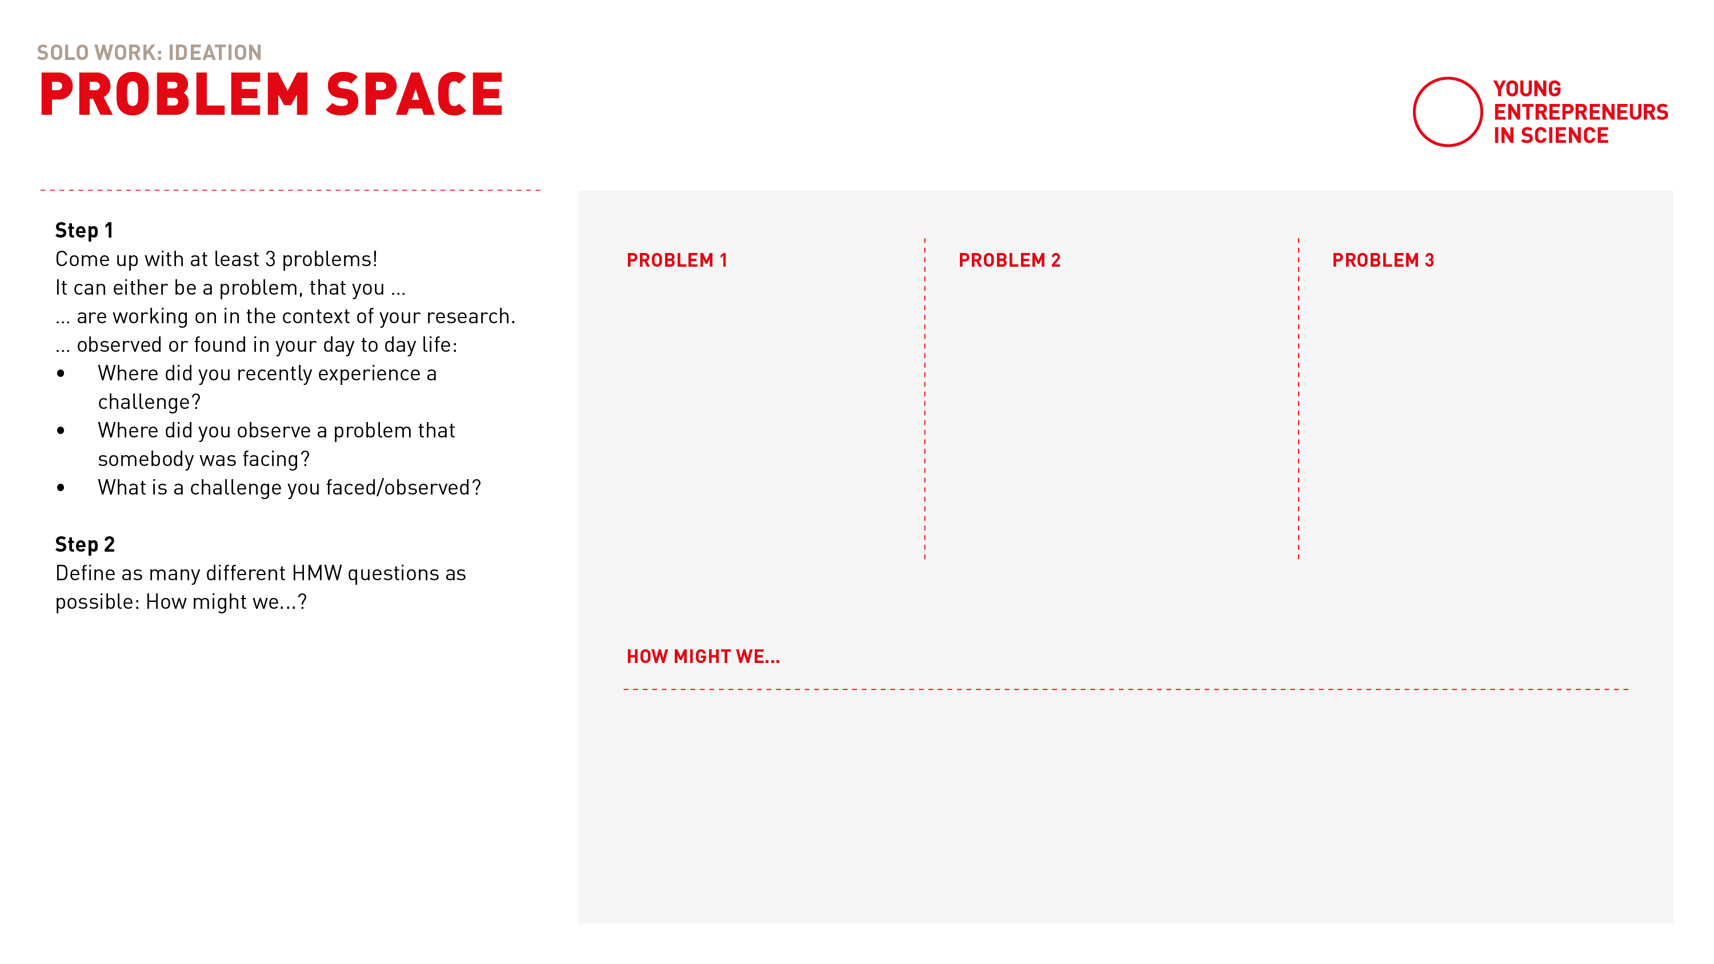
Problem Space
Notes:
Fantastic! Thank you so much for sharing your process and your ideas!
We hope that this process will help you not only in this workshop but also for your future projects.
So afterwards you will receive this template that you might want to use in the future.
Here you do find the 4 steps of the ideation process with Step 1 and 2 covered on this page…

Slide 70
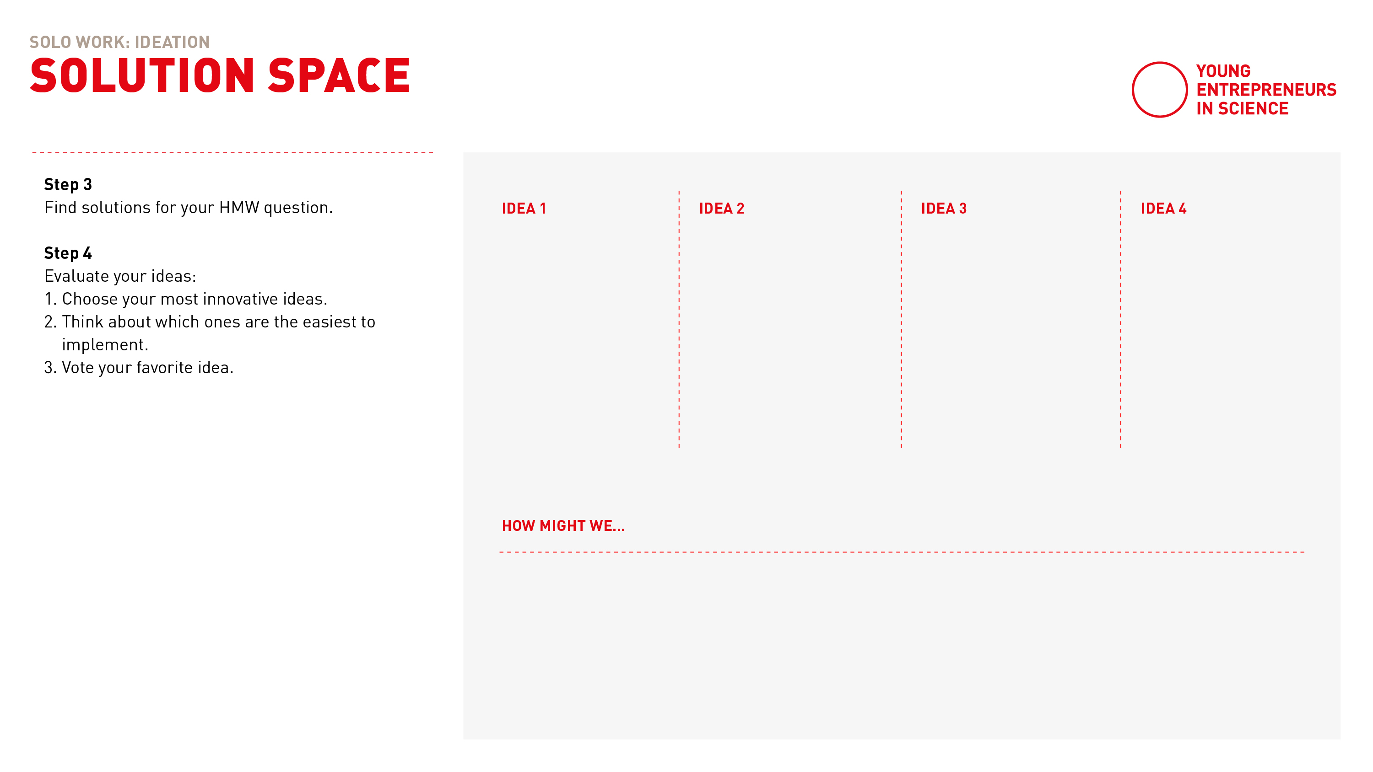
Solution Space
Notes:
… and step 3 and 4 covered on the second page.
You can simply adapt for instance the filters to your project if those are not applicable.
Wow, and with this there is a well-deversed break. And afterwards we will dive into our pitch training!

Slide 71

BREAK

Slide 72

PITCH TRAINING
Notes:
Welcome back to the last module of our workshop and welcome to the pitch training.

Slide 73
Learning goals
Getting to know a relevant structure for a pitch
Learning about how to pitch online
Building a pitch on your own
Practise to hold a pitch in front of an audience
Notes:
So far you have thought about how you might translate your redearch into a start-up use case.
And this morning we have worked on developing an idea that is solving a user problem.
So now it‘s time to have a look at how to communicate this idea in a way that it is remembered!
Our learning goals for the next part are [read out loud and explain]

Slide 74

PITCH & STORYTELLING
Notes:
Let‘s go!

Slide 75
What is pitching?
A short but effective explanation that is intended to persuade someone to buy a product or accept an idea.
Cambridge Dictionary
Notes:
So, let‘s have a look at what a pitch actually is: [read out definition]
Why pitch? The goal ist to win new customers, investors ot other supporters for your business.
The question is: what needs to be in a pitch to make it on point?
We have prepared 7 steps that we think is important to include.
The good thing: this structure of presenting your idea can also help to talk about it in generall.
So you should have these facts ready to talk about your idea.
And talking about the idea is super important to learn about it and develop it.

Slide 76
How to build a pitch
Problem
Target Group
Notes:
Let‘s take a look at the steps:
Problem: Come up with one sentence about what the problem you are solving with your problem is When you have a problem you are solving, I am sure that s.o. is also affected by that problem:
Target group: Who is this person? For whom are you trying to solve the problem? Who is your target group? Who will be using it? It‘s always tempting to say: it‘s for everyone. Really make sure to make it concrete and define a clear user group.

Slide 77
How to build a pitch
Problem
Target Group
The solutions
User experience: how does it work?
Notes:
Next...
Present your solution: Explain the product and tell how it works. Make sure you define a good problem-solution fit: means: those aspects should really work well together: make sure your solution ANSWERS your problem Keep youe explanation short & simple. Especially with tech. solutions: It is tempting to deep dive into technical details. Don‘t do it. People will ask if they have questions. This is a pitch: You want to keep the attention of the audience
User experience: You can show a prototype, ask s.o. to try your product or make a video of s.o. interacting with it.

Slide 78
How to build a pitch
Problem
Target Group
The solutions
User experience: how does it work?
Create trust (team / market / finances)
Notes:
Create trust: Show that you know what you are doing when developing the idea Who is working on the idea? Which people do you have for it in the team? Why is your team a great fit? Show that you know the market you are operation in: What is the competition? Present an overview of your financial plan: Make it transparent what happens with the money. Show them how you plan on growing the business financially.

Slide 79
How to build a pitch
Problem
Target Group
The solutions
User experience: how does it work?
Create trust (team / market / finances)
Punchline
Notes:
The come up with a little wrap-up/reminder:
The Punchline: In one sentence: Tell the mame of the product and what it does.
Keep it short and simple for everyone to remember!

Slide 80
How to build a pitch
Problem
Target Group
The solutions
User experience: how does it work?
Create trust (team / market / finances)
Punchline
Call to action
Notes:
And as step 7: Include a call to action!
Call to action = a small assignment.
Communicate what it is you want from the audience, eg:
to sign up for my newsletter?
to come over and ask questions?
to invest into a beta-version?
To formulate a call to action - make sure to really know whom your pitch is aiming at: What is your audience? What do you want from those poeple?
Keep in mind that there is a difference between pitching in front of an investor or a customer!
So much for the differnt steps... 1-7

Slide 81
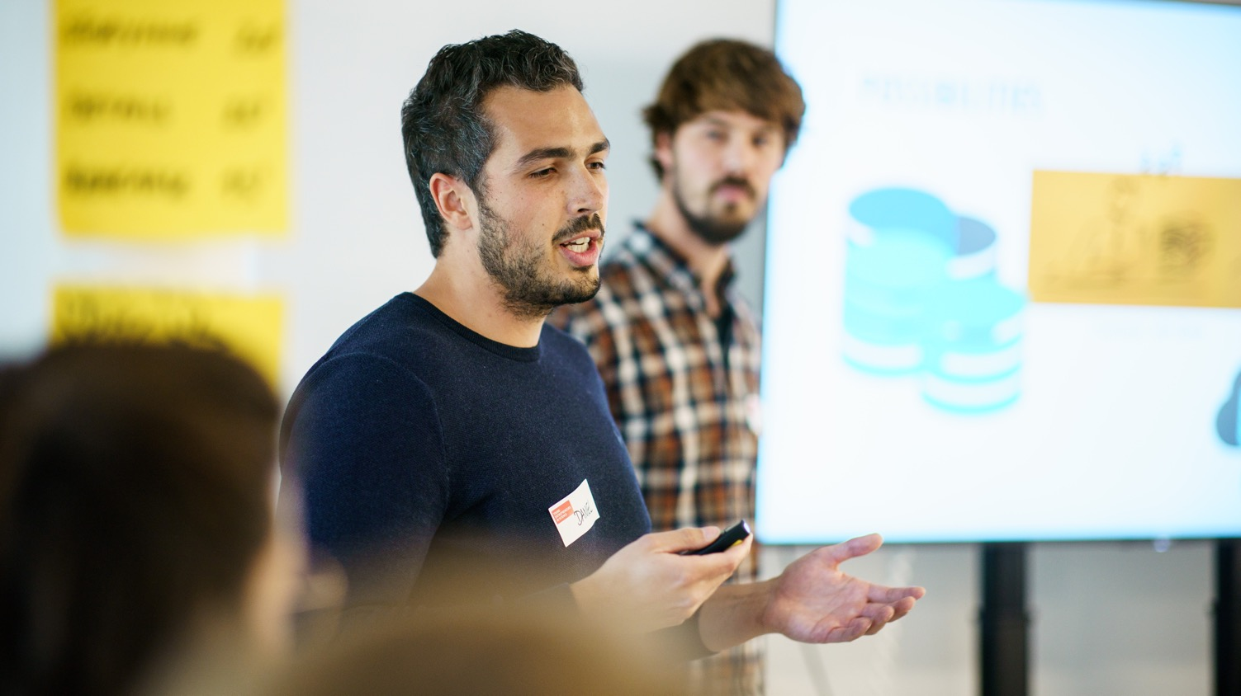
STORYTELLING
Notes:
Now that you have the facts, ist time to think about a good story/anecdote which introduces your pitch
You could for example introduce a hero or person that is really affected by the problem
(… once upon a time there was...)
Then show how big that probplem really is for the target group
Make sure the audience can feel the pain of the affected person.
Expecially as scientists this embedding of emotions and surprises might really feel weird because you leave out quite a lot of facts that you would usually include in a presentation.
But – once again – keep in mind that your aim is to keep the attention and interest of the audience
Also it‘s important to find your own style when presenting. Therefore you need to practise pitching quite a few times to find with which story you feel comfortable and authentic.

Slide 82
Why tell stories?
… because they draw us in emotionally
… because we can learn from them
… because they connect us
… because it’s easier this way for our brain to understand connections
… because they help us remember
Notes:
But why is storytelling so important?
Like I just said:
Especially as scientists, it might feel strange to focus on stories and emotions rather than raw data or detailed explanations.
But remember, stories draw us in emotionally, which keeps the audience connected to your message and helps maintain their attention.
Our brains are wired to understand patterns and connections better when they are simplified.
Therefore stories make it easier for us to grasp complex ideas, not because they remove facts, but because they present them in a more relatable and structured ways
Finally, stories stick with us: They help us remember information better because they activate more areas of the brain – emotion, imagery, and context – which makes the content far more memorable than a list of facts or data points.
Let‘s have a look at how this looks in the real world…

Slide 83
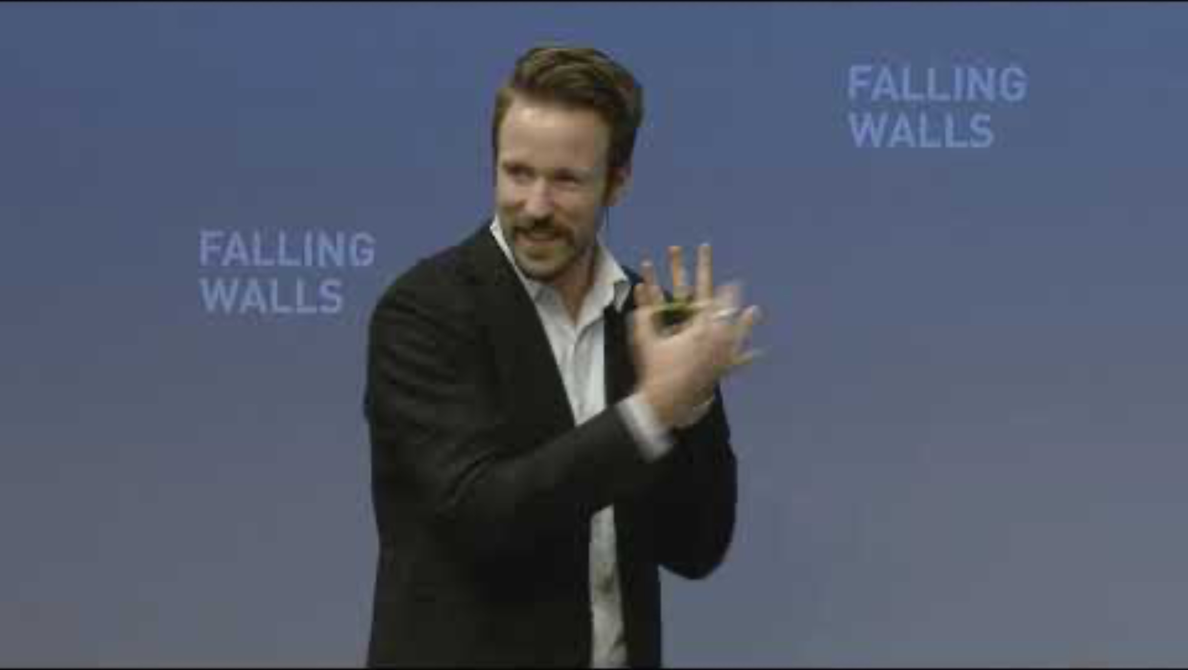
Notes:
…. Next we‘ll show you a video (around 3 mins) by Tom Bieling, Falling Walls Young Innovator of the Year 2014
He‘ll pitch his ides around the topic of Deaf-Blind Isolation.
Tom has developed a communication device for the deaf-blind, allowing to communicate with anybody, anytime.
Important: When you look at the video: It‘s not so much about the content, rather look at the structure & how the pitch is build / what the storyline is.
[after showing the clip: interaction with the participants]
___________________________________
Tom Bieling and his team at the Design Research Lab developed a communication technology for deaf-blind people, through which they can interact with anyone at any time. The Lorm Hand is an installation, which connects deaf-blind people with twitter or other social networks. Using touch sensory technology, the Lorm Hand enables deaf-blind people to compose text messages by applying the tactile hand-touch alphabet LORM, a common way of communication used by the deaf-blind. After typing a message on the Lorm Hand, it can immediately be tweeted or shared with social networks.

Slide 84
In summary …
… everybody needs to find her/his own style based on the storyline!
Notes:
[refer to what has been said]
Make sure to take time to find your own style and your own storyline that you feel comfortable with.

Slide 85
What is next …
PART 1 Build your pitch individually
PART 2 Test your pitch and get feedback in groups
Notes:
The next exercise is divided into two parts:
Part I: You will have the chance to work on your skills on how to build a 2-minutes pitch and put it in an engaging story. This part will be an exercise you will work on by yourself.
Part II: If you remember what we been talking about yesterday: The entrepreneurial mindset is all about getting feedback, learning by doing and iterating your idea? And this is what we will do in part two: You‘ll have the chance to actually test your pitch right away. You‘ll work in teams of 3, test your pitch and then get immidiate feedback from your team.

Slide 86
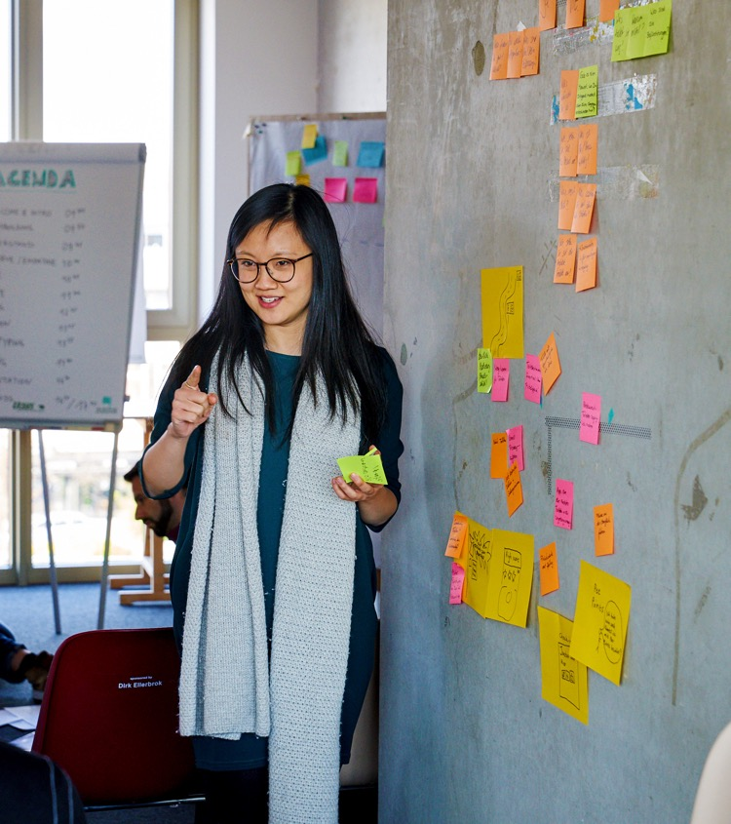
Build your pitch
Notes:
Let‘s go!

Slide 87
Build your pitch
Choose the topic of your pitch.
Your own startup idea
Your PhD topic
Notes:
In order to build a pitch of course you first of all need an idea or project that you actually want to pitch
We know that some of you already have ideas or projects, that they are working on and others not yet.
Since this webinar is about learning methods and skills you don‘t need to have a real project in order to learn how to pitch!
So when it comes to WHAT it is that you want to pitch today, you have options to choose from:
You can either chosse to go with your own idea
OR you just choose an object in in your direct environment that somehow speaks to you, like a pen or a book for example

Slide 88
Build your pitch
Step 1: Problem-solution-fit
Based on what we just learned, build the foundation of your pitch.
Problem & target group
Solution & how it works
Call to Action
Notes:
Let‘s have a look at step 1:
So once you know what you want to pitch, let‘s have a look on how to build a pitch!
Since we will not have the time to build your pitch step by step all togethter today, we will focous an the core of each pitch:
The most important aspect of a pitch is a strong »problem-solution fit«
Who are your users?
What is their problem?
How is your idea/product solving that problem?

Slide 89
Build your pitch
Step 2: Storyline
Based on your foundation (problem-solution-fit) think about how to transport this in an emotional story!
Who is your protagonist?
What’s his/her problem in what context?
How do you make his/her life better?
Make it tangible and relatable for your audience!
Notes:
Step 2: Once you defined the problem-solution-fit it‘s all about putting together a story, that people can relate to and that people will remember.
Now your might be thinking: »How the hell should I work on that if I don‘t have my own idea yet?«
Well, you can wonderfully practise your pitching skills by pitching a random object and pretend that you just had the idea to develop that exact object and you now want to pitch it to potential investors.
Just give it a try and if you have any questions – we are here for you!!

Slide 90
Solo work
Build your pitch
10 min
Stay in main room
Prepare your 2 min pitch
Problem-solution-fit
Emotional storyline
Countdown for last minute
Notes:
[read out slide]
[emphasise that the pitch should be 2 minutes long]

Slide 91
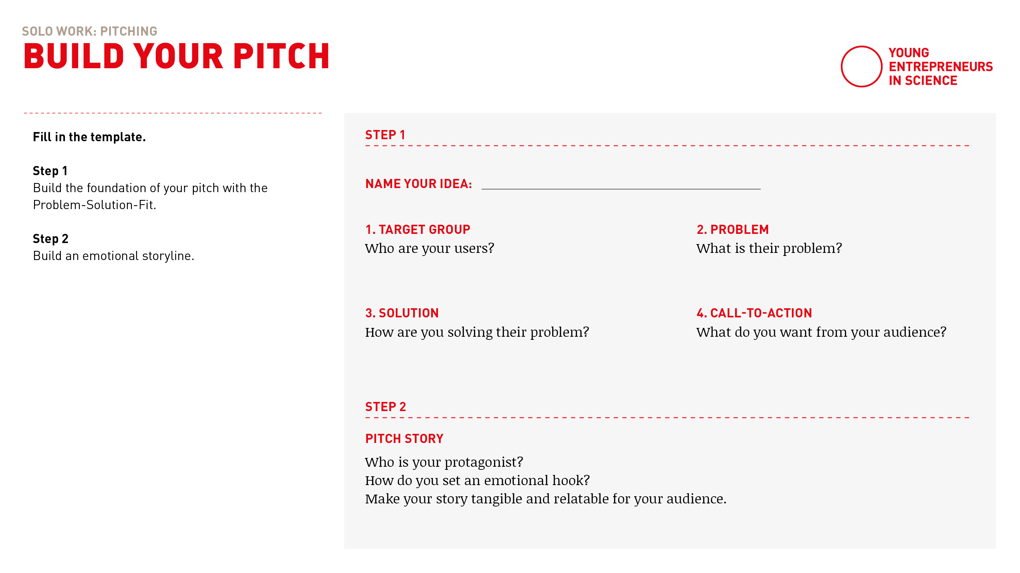
Build your pitch
Notes:
Take a piece of paper
Work your way through step 1 first
and based on that then build an engaging storyline in step 2!
You have got 10 minutes in total.
Stay in main room please, if you want to you can turn off the camera. We will stay here and give you a heads up, when 5 minutes are over

Slide 92

Test your pitch & get feedback
Notes:
Now we would like to give you some time to get into the groove and practise your pitch with the group.
As you will give and receive feedback – here is a little how to to do this in en effective way.

Slide 93

How to give feedback
Notes:
Some basic ground rules:
Make sure your feedback is clear and actionable, so please highlight what could be improved and why.
Feedback should address actions and outcomes, not personal traits. This makes the feedback easier to accept and act upon.
Begin with something positive to build trust. This way the recipient can accept critical feedback way better.

Slide 94
Feedback grid
I like …
I wish …
New ideas
Open questions
Notes:
We love to use this feedback grid when giving and receiving feedback:
1. I Like: Highlight what works well, e.g., “I like how clear and engaging your storyline was.”
2. I Wish: Suggest areas for improvement, e.g., “I wish the call to cation summarized your key message more clearly.”
3. New Ideas: Offer creative suggestions, e.g., “You could try to make the person more tangible to make your message more relatable.”
4. Open Questions: Pose questions for reflection and further development, e.g., “How might you make your pitch more interactive for the audience?”

Slide 95
How to receive feedback
Embrace feedback!
Understand feedback as a learning opportunity
Don’t defend your idea or your pitch (listen and learn!)
Take notes
Notes:
But giving feedback is only one side of the medal. As you will also give your pitch it‘s also important for you to embrace the feedback you get.
So:
Understand feedback as a learning opportunity
Don’t defend your idea or your pitch (listen and learn!)
Take notes

Slide 96
Teamwork
Test your pitch & get feedback
15 min
Transfer into digital breakout rooms
Automatic transfer back
One after another:
Pitch your pitch (2 min)
Get feedback (2 min)
2 min for self-introduction
12 min for three pitches & feedback
Countdown for last minute
Notes:
[read out instuctions]
TIME YOUR OWN PITCH! THEY SHOULD BE 2 MINUTES LONG!
We will transfer you to your breakout rooms with 3 people in the next step
If you have any questions – like always: please call us in!
Have fun and see you back here in 15 minutes!

Slide 97
Let’s go!

Slide 98
Notes:
Everybody is back? All went well?
Thumbs up if you’re with me please!

Slide 99
After the break …
PART 1 How to pitch digitally
PART 2 Pitches and expert feedback
Notes:
It‘s time for a break! Let‘s more. Around and refesh!
After the break we‘ll introduce to you how to pitch digitally.
And we’ll also have some guests with us [introduce guests].
Up to 6 people will be able to practice and give their pitch in front of our experts that will join us.
They will also give you some feedback on how to improve
We know this might sound frightening, but we can assure you – this is a very safe setting to try this!
We are all here for you and there is no pressure at all to be “perfect”

Slide 100
Who is pitching?
Please type into the group chat:
Your name + your pitch title
Notes:
Up to 6 participants can pitch 2 min pitch – 3 min feedback
First come, first serve
If you would like to pitch:
Please type into the group chat:
Your name + your pitch title

Slide 101
It’s coffee o’ clock!
Notes:
M1: ONBOARDING EXPERTS in separate breakout room:
After the break, there will be a short input »Pitch digitally«
Then we will introduce you as the experts.
Each of you will have 2 minutes to introduce yourself individually (please also explain your function & why/what you are here as)
After that:
Max. 6 pitches
We introduce the pitches and hand over to the participants:
2 minutes pitch, then GONG
2-3 minutes feedback of you, then GONG
Please clarify who of you starts with feedback
Note that the pitches were created in a short time and which steps should be included (problem/solution fit, target audience, call to action, storyline)
Please give feedback on the pitch rather than on the idea: I like / I wish / open questions / new ideas
After that, everyone in the main room and max. 10 minutes input from the start-up centers: What is your offer? What could be the next steps for the participants?
We will explains setting & gong in the room
_______
M2: List/order for the pitches/breakouts

Slide 102
Notes:
Everybody is back? All went well?
Thumbs up if you’re with me please!

Slide 103

HOW TO PITCH … DIGITALLY!
Notes:
Now before we start…
… let‘s have a look at how to pitch in a digital setting!

Slide 104
Technical setting
Test technical setup prior to your pitch: sound, camera, internet connection
How do you want to show your idea?
What medium fits best to you and your product:
Slidedeck?
Digital/analogue prototype?
Notes:
Always test your sound, camera, and internet connection beforehand to avoid technical issues during your pitch.
Think about how you want to present your idea: What medium works best for you and your product?
Would a slidedeck show your idea clearly, or is a digital/analog prototype more effective to bring it to life? To really make it tangible?

Slide 105
Framing
The art of focus on perspective and framing … GONE WRONG!
Notes:
[Show these camera setups live to show everyone how not to do it]
Not: the giant (camera from below)
Not: Closeup (Just nose in the picture)
Not: The conceptual artist (half on camera with lamp in artistic setting)
Not: The Guru (the mystical one with lots of backlight)

Slide 106
Framing
The art of focus on perspective and framing … DOING IT RIGHT
Webcam should be positioned at the same height as your eyes
Leave some room in the upper part of the shot
Now you can decide where to be in the shot: frontal or three quarters with head facing the camera
Notes:
The art of focus on perspective and framing
Let‘s do it right and please follow along everyone:
Webcam should be positioned at the same height as your eyes
Leave some room in the upper part of the shot
Now you can decide where to be in the shot: frontal or three quarters and letting the face front (looks like a painting to me)

Slide 107
Background
The background is just as important as you, because it helps to define the composition of the shot.
Avoid big windows behind you
Avoid big flat walls behind you, because they literally flatten your image
Create depth – it’s always nice to bring some space between you and your background
Notes:
And a little about the background…
Avoid big windows behind you (remember – guru effect?)
Avoid big flat walls behind you, because they flatten your image, its always nice to feel some air between the subject and the background

Slide 108
Behavior & interaction
Remember to speak slowly and work with pauses
Look directly into the camera every now and then
Ask your audience to interact with you (thumbs up, etc.)
People do not tend to smile when they watch you digitally – don’t be irritated and have fun!
Notes:
And how about behaviour and interaction?
People tend to speed up their speech when they are nervous.
Aim to speak a little slower than normal, and it should be perfect!
Look directly into the camera every now and then.
Remember: The camera is NOT your screen! Ist a difference [show difference when looking directly into the camera or on screen]
Last but not least:
People do not tend to smile when they watch you digitally – don’t be irritated and have fun!

Slide 109

The pitches!
Notes:
You may have already notices some new faces here with us after the break …

Slide 110

PLEASE WELCOME OUR EXPERTS!
Notes:
… Please meet our experts! It‘s lovely to have you with us
Dear guests: Could you please briefly introduce yourselves?
[interaction with the guests so everyone feeld welcome]

Slide 111
Main room
Pitch presentations
2 min each
Pitches in the main room
2 min pitch each 2-3 min expert feedback
Moderators will set a timer
Notes:
Let‘s have a look at how how this will work:
Our pitching volunteers: We will call your name, say ready stead go! And from then on you‘ll have 2 minutes for your pitch
After 2 minutes you‘ll here a GONG – this is when your time is over
Then we will start the feedback round for another 3 minutes.
After 3 minutes you‘ll hear the GONG again and the next pitch has its turn

Slide 112

Let’s go!

Slide 113
OUR EXPERTS CAN OFFER …
Notes:
[Info zu den Gründerzentren/ Info about the incubators]
[If necessary, switch here to the guests' slides]
[Say thank you an good bye to the guests]

Slide 114

Your Power, your Story
Online

Slide 115


Time for feedback!
Please, follow the link in the chat window.
Notes:
Voting Link:
https://www.menti.com/v9peuuzor4
Live Results:
https://www.mentimeter.com/s/d2103d5f8c21f37ba61c7f97bf8930ef/b2a82eab8ce3

Slide 116

Wrapping up!
I like, I wish, I take away…
Notes:
Ggf. Menti-Link für Teilnehmende: https://www.menti.com/alaxnctncdyz

Slide 117

Sharing
Are there any comments, thoughts or questions you would like to share? Raise your hand.

Slide 118


Stay connected with the YES community
Join our LinkedIn group
Take part in other (Online-) Workshops
Tell your peers and spread the word via social media
Stay active in our Alumni-Community
Keep learning from each other on your entrepreneurial journey
Notes:
Hinweis für die Coaches:
Die Einladung zu dem netzwerk FW Connect erhalten die TN nach dem Workshop in einer Email, genauso wie alle weiteren, genaueren Infos, wie sie sich connecten können und Teil unserer Community werden können.

Slide 119


Boost your career with your YES experience
Connect with YES and fellow participants on LinkedIn
Share your YES certificate on Social Media
Add YES to your trainings on LinkedIn and your CV
… and carry the entrepreneurial spirit further.
Notes:
Hinweis für die Coaches:
Die Einladung zu dem netzwerk FW Connect erhalten die TN nach dem Workshop in einer Email, genauso wie alle weiteren, genaueren Infos, wie sie sich connecten können und Teil unserer Community werden können.

Slide 120


Time for feedback!
Notes:
Link
Bitte auf folgendes bei der Tonspur eingehen, um die Notwendigkeit der Evaluation zu betonen (Anmerkungen von YES):
Your feedback is key/We highly appreciate your feedback!
It is crucial not only for the constant improvement of our workshops, but also with regards to the future funding of our programme.
Future funding means more offers for you as alumni community (additional workshops, webinars, networking opportunities)
Thank you for taking the time (approx. 4 min)!

Slide 121




Thank you!
Connect with us and each other via Social Media …
LinkedIn Page
LinkedIn Group
Instagram @sciencepreneurs
Newsletter
©️ Young Entrepreneurs in Science, 2025
Notes:
That‘s it!
Thanks a lot for participating
We hope you had fun
You will be added to the YES newsletter list to stay updated with the project and to read exciting alumni stories as well as get invited to our network Falling Walls Connect, to make contact with each other and take part in alumni webinars!
Please spread the word!!!
Instagram
https://www.instagram.com/sciencepreneurs/
LinkedIn Seite
https://www.linkedin.com/company/young-entrepreneurs-in-science/
LinkedIn Gruppe
https://www.linkedin.com/groups/8902012/
Newsletter
https://youngentrepreneursinscience.com/newsletter-registration/
Everybody else: Goodbye, have a nice day and see you soon!

Slide 122

THE END

