Slide 1

STORYTELLING FOR IMPACT

Slide 2
Agenda
Part I
Part II
Check-In
The power of stories
Exercise 1: Define your impact
Exercise 2: Create your stories’ protagonist
Exercise 3: Create your 3-minutes story
Exercise 4: Captivating Storytelling
Share & Inspire
Summary & Check-Out

Slide 3
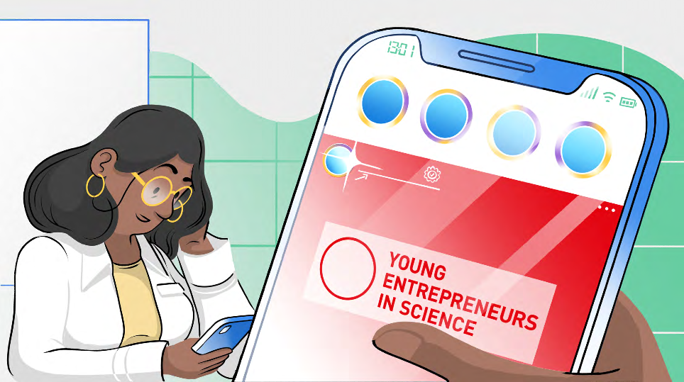


Learning goals
Notes:
Usually, we bring the learning goals for each modul in bullet points. Today we brought the learning goal story:
1. This is Toni. She's a researcher and really passionate about her research.
2. One day she sees an advertisement of Falling Walls calling for the science breakthrough for next years' Science s
Summit in Berlin on Instagram
3. Toni thinks: "oh no, with my data-driven research I'll never stand on a stage and wow an audience, let alone win an award.”

Slide 4



Learning goals
Notes:
4. All over sudden Tonis colleague Kim steps into the lab, very excited: He just finished a training on storytelling and says: "Toni you should really sign up too!"
5. Toni gives in, goes online and signs up for the next training. "Okay, why not try it myself", she thinks
6. The day of the training arrives, tony meets fellow researchers and connects with new people

Slide 5



Learning goals
Notes:
7. In the first part of the training Toni is very doubtful if storytelling is something she will ever master.
8. And when it is time to hands-on define her impact she wants to create in the world and based on that write her own story, she is very nervous. But she decides to be playful for once and just give it a try!
9. At the end of the workshop Toni is in awe of her own creativity and imagination that helped her craft that emotional story to communicate her research to the world. Finally!

Slide 6



Learning goals
Notes:
10. After the training, she is so inspired that she sits down straight away and embellished her story further.
11. It's not easy, but with the feedback she got from her fellow researchers during the training she is able to add the finishing touch to her story and her storytelling.
12. With the impact-story in her pocket, she now not only found the courage to apply as a candidate for the Falling Walls science breakthrough, But can finally also convey her friends why she is so passionate about her research and even her family finally understands why she is doing what she's doing.

Slide 7



Learning goals
Define your own desired impact
Getting to know the power of storytelling and emotions
in communicating your own scientific ideas
Conveying content in such a way that it sticks and creates
an impact–even outside of science
Notes:
So, let‘s sum-up our learning goals for todays‘ workshop…

Slide 8

Getting to know each other
Notes:
Today you will work by yourself but also with a partner. To know who is with you in the workshop we‘ll do a little warm-up to get to know each other a little better.

Slide 9
Solo work
2 truths, 1 lie
2 min
By yourself
Come up with 3 short stories about yourself.
2 of them are true, 1 is a lie!
Write them down on
a piece of paper.

Slide 10
Teamwork
2 truths, 1 lie
10 min
Team of 3
Take turns:
First person shares the 3 facts about him-/herself and the other 2 guess which one is the lie
Take turns until everyone
has shared.
Take care of microtiming!

Slide 12

The power of stories
Notes:
Now… As you have already told little stories about yourself, let me tell you a little bit about the power of stories:
Stories are a very powerful vehicle to convey your ideas.
Today we want to specifically look at how you can make use of them in order to create the impact you want to create.
So let´s start with a quick look a the very beginning:
What are stories to humans and why are we as a species so responsive to them?

Slide 13
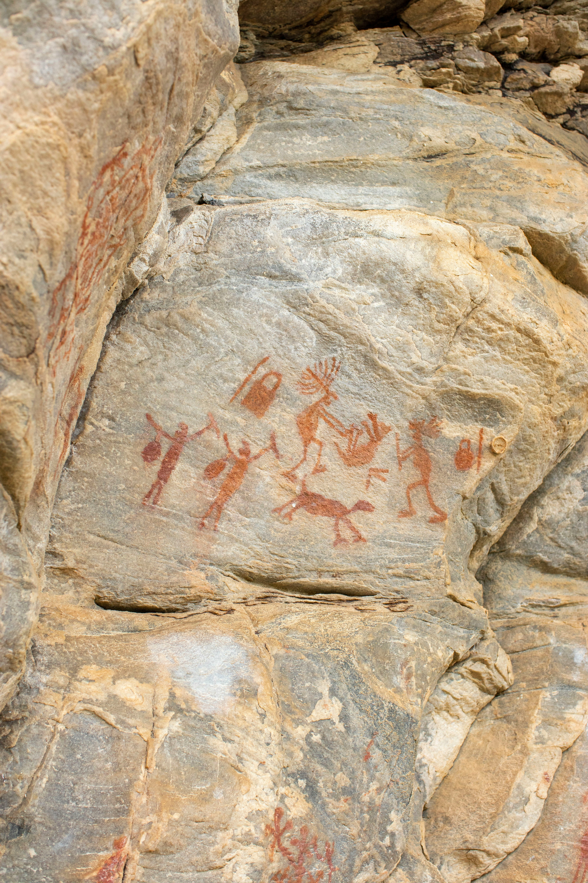
The origins of storytelling
A story is a “primal form of human communication”.
Dieter Georg Herbst
(Lecturer at the Leipzig School of Medicine)
Notes:
Exciting storytelling - following a traditional recipe for thousands of years
Once upon a time ... about 500,000 years ago. The first humans made sounds that formed into words. Language was born.
Within a few hundred thousand years people began to tell stories.: Of hunts, ancestors and the creation of the world.
Storytelling arose.
Around 40,000 years ago, people began to paint on the walls of caves, recording the lives and myths of their tribe in pictures.
Around 35,000 years later the first writing was developed. The first stories were recorded on clay tablets, later on papyrus.
Since then Storytelling has been used worldwide for thousands of years as a method of imparting knowledge, entertainment and preserving historical events.
---
Background info on Dieter:
Dieter Georg Herbst, lecturer at the Leipzig School of Media (LSoM) and one of the leading communication scientists in the field, rightly sees history as "a primal form of human communication".

Slide 14
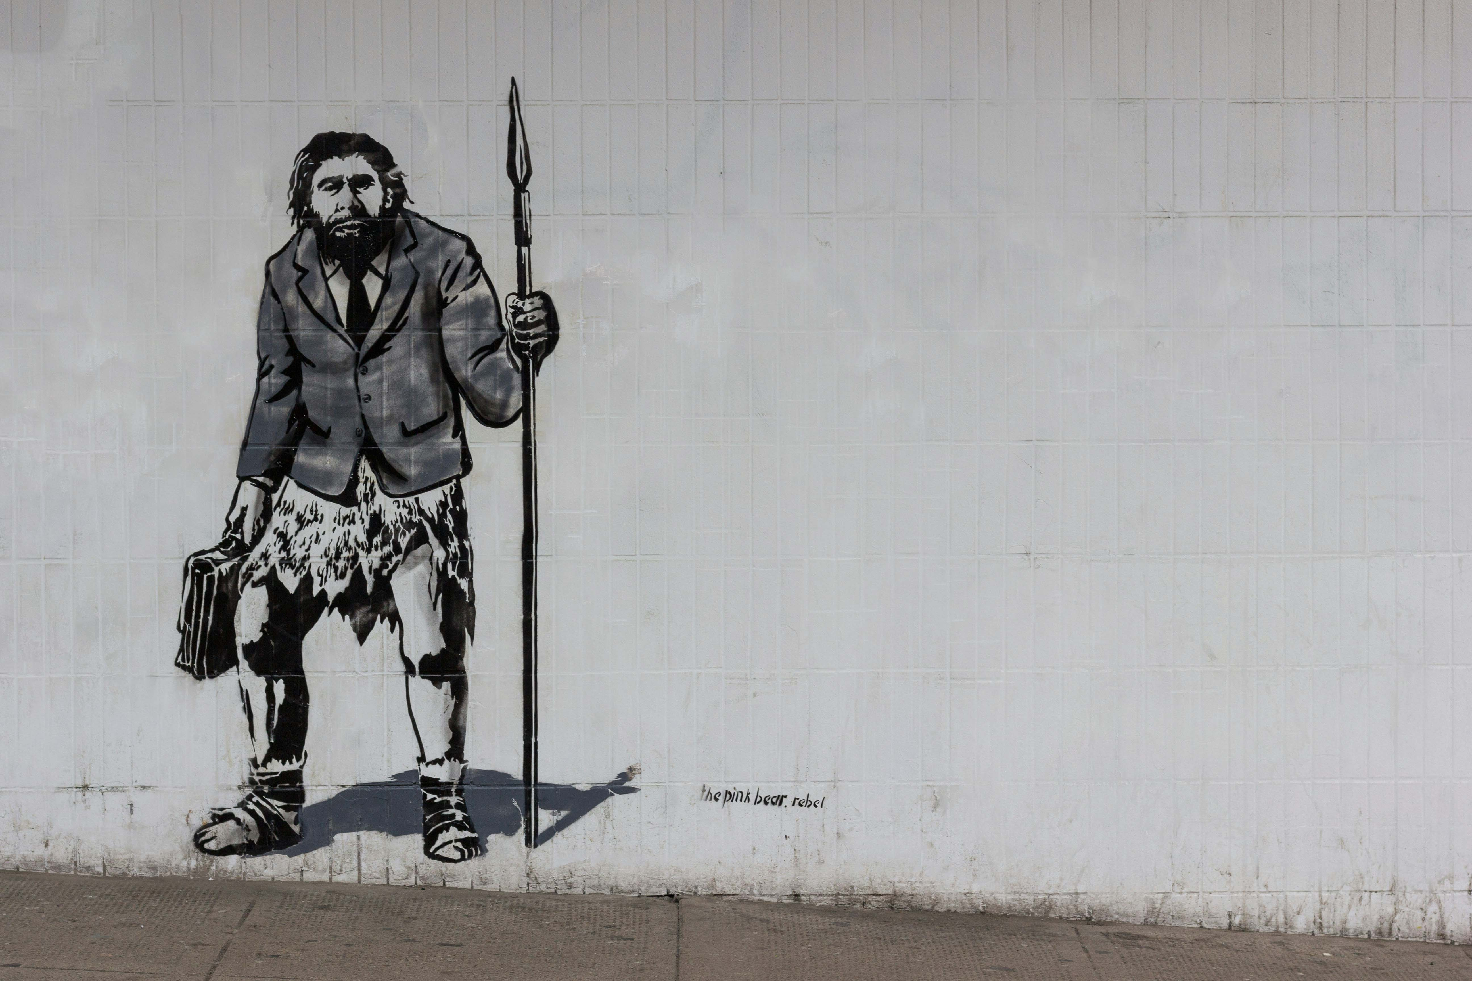
Why we developed stories
Unlike the neanderthal, the sapiens had quickly developed complex language and was able to convey abstract concepts, beliefs, and myths.
These stories helped the sapiens to collaborate in large groups, coordinate activities and share common goals and beliefs.
Based on “Sapiens – A Brief History of Humankind” by Yuval Noah Harari
Notes:
Why do we tell stories, create myths and narratives?
In his best-selling book Sapiens the historian Yuval Noah Harari shares the hypothesis:
Unlike the neanderthal, the sapiens had quickly developed complex language and was able to convey abstract concepts, beliefs and myths.
These stories helped the sapiens to collaborate in large groups, coordinate activities and share common goals an befiefs.
By creating imagined realities they were able to strategize, and therefor adapt to a changing environement better that the neanderthal
that enabled them to also win battles against the Neaderthaler – although they were bigger and stronger.
•In harraris idea: the better a group was at telling good and compelling stories, the stronger their chances of survival.
•A quick sidenote here, there are scholars that disagree with Harari and postualte that the neandertahl also told stories since they buried their dead and had death rituals which ponits to the belive in an afterlive which in turn is also a story being told.
- But Both of these hypotheses show that stories are used to form culture
__
Take for example the concept of money, religion or nationalities: if you think about it, they are not palpable things you can´t touch them, nor eat them. They are a successful story somebody has told and that work, because most people beleave in the story an they play along. „Yes, I beleve that this little piece of paper that says Euro has the same value as a meal or a mounth woth of living in my house…“

Slide 15



Storytelling in the now
https://dieatemrauber.de/die-geschichte-der-geschichte
Notes:
Storytelling surrounds us everywhere we go – It's at the heart of literature, film and journalism and is increasingly becoming a core element of brand management, corporate communication and talks on the big stages
----------
Quelle:
https://dieatemraeuber.de/die-geschichte-der-geschichte

Slide 16
The way stories work
We remember stories 22 better than data.
Study led by Jennifer Aaker,
Stanford Graduate School of Business (2013)
Notes:
In fact research foung, that we remember stories 22 times better than facts.
____
Ressources to share in the chat:
Jennifer Aaker: Harnessing the Power of Stories: https://www.youtube.com/watch?v=9X0weDMh9C4
Jennifer Aaker: The Power of Story: https://www.youtube.com/watch?v=CdO9a41WUss
____
Background info:
Stanford in March 2013: a professor uploads a video. It tells the story of an experiment she conducted with her students. Her name is Jennifer Aaker, she teaches marketing at the Stanford Graduate School of Business.
Aaker asks the students to take part in a pitch. Everyone is asked to convince their fellow students of an idea. The pitch lasts one minute.
The students prepare their short presentations and present in turn. Aaker asks the students 20 minutes later what they can remember from the pitches and asks them to write it down. The result shows: Pitches that tell a short story are best remembered. Purely fact-based pitches, on the other hand - the presentation form of choice for the vast majority of students - are poorly remembered. The factor by which story-based pitches are remembered compared to fact-based pitches is 22
(https://www.focus.de/finanzen/experts/pyczak/erfolgreicher-pitch-geschichten-schlagen-fakten_id_7410388.html)

Slide 17

The way stories work
Notes:
But why is that?
We brought you a little TED talk given by Karen Eber, shes a Leadership Development professional
And ist about how the brain responds to stories.
____
VIDEO IST EINGEBUNDEN
____
Hintergrund Info für Coaches bei Interesse:
Geschichten wirken unbewusst
Eine Studie von Christian Schleier unter dem Titel "Neuromarketing – Über den Mehrwert der Hirnforschung für das Marketing" weist darauf hin, dass unser Gehirn 95 Prozent der einströmenden Informationen unbewusst und nur fünf Prozent bewusst verarbeitet. Sozialpsychologen unterscheiden hier zwischen dem expliziten und dem impliziten Bewusstsein. Sie fanden heraus, dass unbewusste Informationen viel schneller und weitgehend ohne Energieverlust verarbeitet werden, weil das Unbewusste dafür auf bekannte Muster und Erfahrungen zurückgreift: Je erfahrener ein Mensch, desto weniger Zeit und Information braucht er, um eine Entscheidung zu treffen.
Auf dieselbe Art und Weise funktionieren auch Geschichten. Sie beziehen sich strukturell auf bereits Gelerntes, das heißt Muster, Handlungen, Rollen, Schlüsselinformationen. Dieser Bezug wird vor allem in der „Moral der Geschichte“ deutlich – einem auf das eigene Leben anwendbaren Fazit der Story.
Geschichten lösen starke Gefühle aus
Je emotionaler die Story, desto größer die Wahrscheinlichkeit, dass sie uns berührt und ihre Botschaft für uns bedeutend wird. Emotionen werden durch das sogenannte limbische System verarbeitet, dem Sitz unserer emotionalen Intelligenz. Es entscheidet ob und wie emotional und relevant eine Information für uns selbst ist und hat damit maßgeblichen Einfluss auf die gesamte Hirnaktivität. So bewirkt das limbische System, dass bedeutungslose und langweilige Informationen lediglich im Kurzzeitgedächtnis gespeichert werden und im Zweifelsfall nicht einmal dahin durchdringen. Weckt eine Botschaft jedoch Emotionen, indem sie beispielsweise an Erfahrungen anknüpft, gelangt sie in das Langzeitgedächtnis. Das limbische System wird besonders von Geschichten, Bildern und emotional aufgeladenen Worten wie etwa „Tod“ oder „Liebe“ angesprochen, schreibt Annie Murphy Paul in der "New York Times". Darüber hinaus kann das limbische System durch sogenannte Trigger direkt aktiviert werden, wie Petra Sammer in ihrem Buch "Storytelling erklärt.
Geschichten stellen Identifikation her
Jede emotional aufgeladene Geschichte hat gleichzeitig auch das Potenzial, Identifikation mit dem Protagonisten herzustellen. Sie lädt dazu ein, die Figur mit ihren Handlungen oder Charakterzügen leichter zu verstehen und sich in ihre Situation hineinzuversetzen. Wir leiden, weinen und freuen uns mit dem Helden.
Doch wie ist das möglich? Auch hierfür gibt es eine neurowissenschaftliche Erklärung: die so genannten Spiegelneuronen. Damit werden Nervenzellen bezeichnet, die dafür sorgen, dass wir uns in Andere hineinversetzen können, indem wir ihre Gefühle reproduzieren, also spiegeln. Auf das Storytelling übertragen sorgen die Spiegelneuronen dafür, dass mit-erlebte Handlungen bis zu einem gewissen Grad als die eigenen Handlungen wahrgenommen werden.
So kann Storytelling bewusst dafür verwendet werden, um Identifikation mit einem Ereignis, einer Organisation oder einer Person herzustellen. Dabei gilt: Je stärker die Geschichte, umso höher ist die Identifikation der Rezipienten und damit die Glaubwürdigkeit der vermittelten Informationen. Auf dieser Grundlage können nicht zuletzt Argumente, Botschaften und komplexe Sinnzusammenhänge vermittelt werden, die als rein sachliche Argumente oder Fakten kein Gehör finden würden.
Geschichten werden in inneren Bildern gespeichert
Der Mensch ist visuell geprägt. So werden über 80 Prozent aller Informationen über den Sehsinn aufgenommen und 60 Prozent der Gehirntätigkeit ist dem Wahrnehmen, Verarbeiten und Speichern von Bildern gewidmet. Auch Geschichten entfalten eine starke visuelle Wirkung, selbst wenn Sie als Text verfasst sind. Dies mag zunächst verwundern, da Texte optisch verschlüsselt sind und nicht direkt die visuellen Zentren des Gehirns ansprechen. Dagegen werden Bilder automatisch mit einer geringen gedanklichen Beteiligung verarbeitet und vermitteln leichter emotionale Erlebnisse.
Die Trennung von Bild und Text greift jedoch beim Storytelling zu kurz. Durch ihren Bezug auf Erfahrungen und Muster, ihre Emotionalität und ihr inhärentes Identifikationsangebot erzeugen Geschichten innere Bilder in den Köpfen ihrer Rezipienten und wirken damit wesentlich stärker, als rein faktische Texte.
Ted Talk: 2:30 – 4:48
»But in my work with leaderes ...«
To share in the chat
TED Talk by Karen Eber: How your brain responds to stories -- and why they're crucial for leaders:
https://www.ted.com/talks/karen_eber_how_your_brain_responds_to_stories_and_why_they_re_crucial_for_leaders

Slide 18
Storytelling and impact
It is rousing stories that motivate and drive people forward
When we hear a rousing story, a spark is ignited in us
We are inspired and fascinated, for some people, this spark turns into a fire
Driven by it, they change the world
“The most powerful person in the world is the storyteller. The storyteller sets the vision, values and agenda of an entire generation that is to come.”
Steve Jobs
Notes:
So you can see that stories and storytelling is a very powerful tool in a leader's arsenal.
It is rousing stories that motivate and drive people forward.
When we hear a rousing story, a spark is ignited in us. We are inspired and fascinated. For some people, this spark turns into a wildfire.
Driven by it, they change the world.
It's debatable which category Apple co-founder Steve Jobs belongs in.
He was certainly not a scientist, but an inventor or visionary entrepreneur,
Jobs aptly stated: "The most powerful person in the world is the storyteller. The storyteller sets the vision, values and agenda of an entire generation that is to come."
_____
Quelle:
https://dieatemraeuber.de/geschichten-veraendern-die-welt

Slide 19


Storytelling and your research
If you want to get your ideas out into the world, inspire others with your vision, and create impact. Then storytelling is a very important tool for you as a researcher.
That’s why today we want to focus less on generating a new start-up idea and more on the craft of storytelling!
Notes:
So if you want to get your ideas out into the world and inspire others with your vision, then storytelling is a very important tool for you as a researcher.
That's why today we want to focus less on the content of your research or perhaps even your start-up idea and more on the craft of storytelling!
--> Klar machen, dass die TN ihr eigenes Storytelling erarbeiten (an ihrem Thema), es geht also nicht um ein "Ideenbrainstorming"

Slide 20

EXERCISE
Define your impact
Notes:
So as a first step we want to understand: What change is it that you want to bring to the world? What impact do you want to have?
In order to tell story: first you have to know what this story is about.
- so, what is the message you would like to send?
- as scientists you are all working on important topics for our world
- that‘s why we want to start by giving you a bit of time to define the impact you want to bring into the world.
- this will be the foundation for the storytelling exercise afterwards

Slide 21
Solo work
Define your impact
15 min
Use the first template
Step 1: Define your impact
In regards to your research topic, brainstorm:
Where have you been able to inspire?
What do you want to improve in the world for the better with your research?
Who is impacted by your research topic?
Wrap it up in one sentence:
For … I want to achieve this change
in the world: … because … .
Notes:
How?
- solo work
- work on individual templates on miro
What?
- brainstorm and define sentence
Why? Goal of the exercise:
- become clear about your own message
- Clearly define the message to be conveyed to the listener

Slide 22
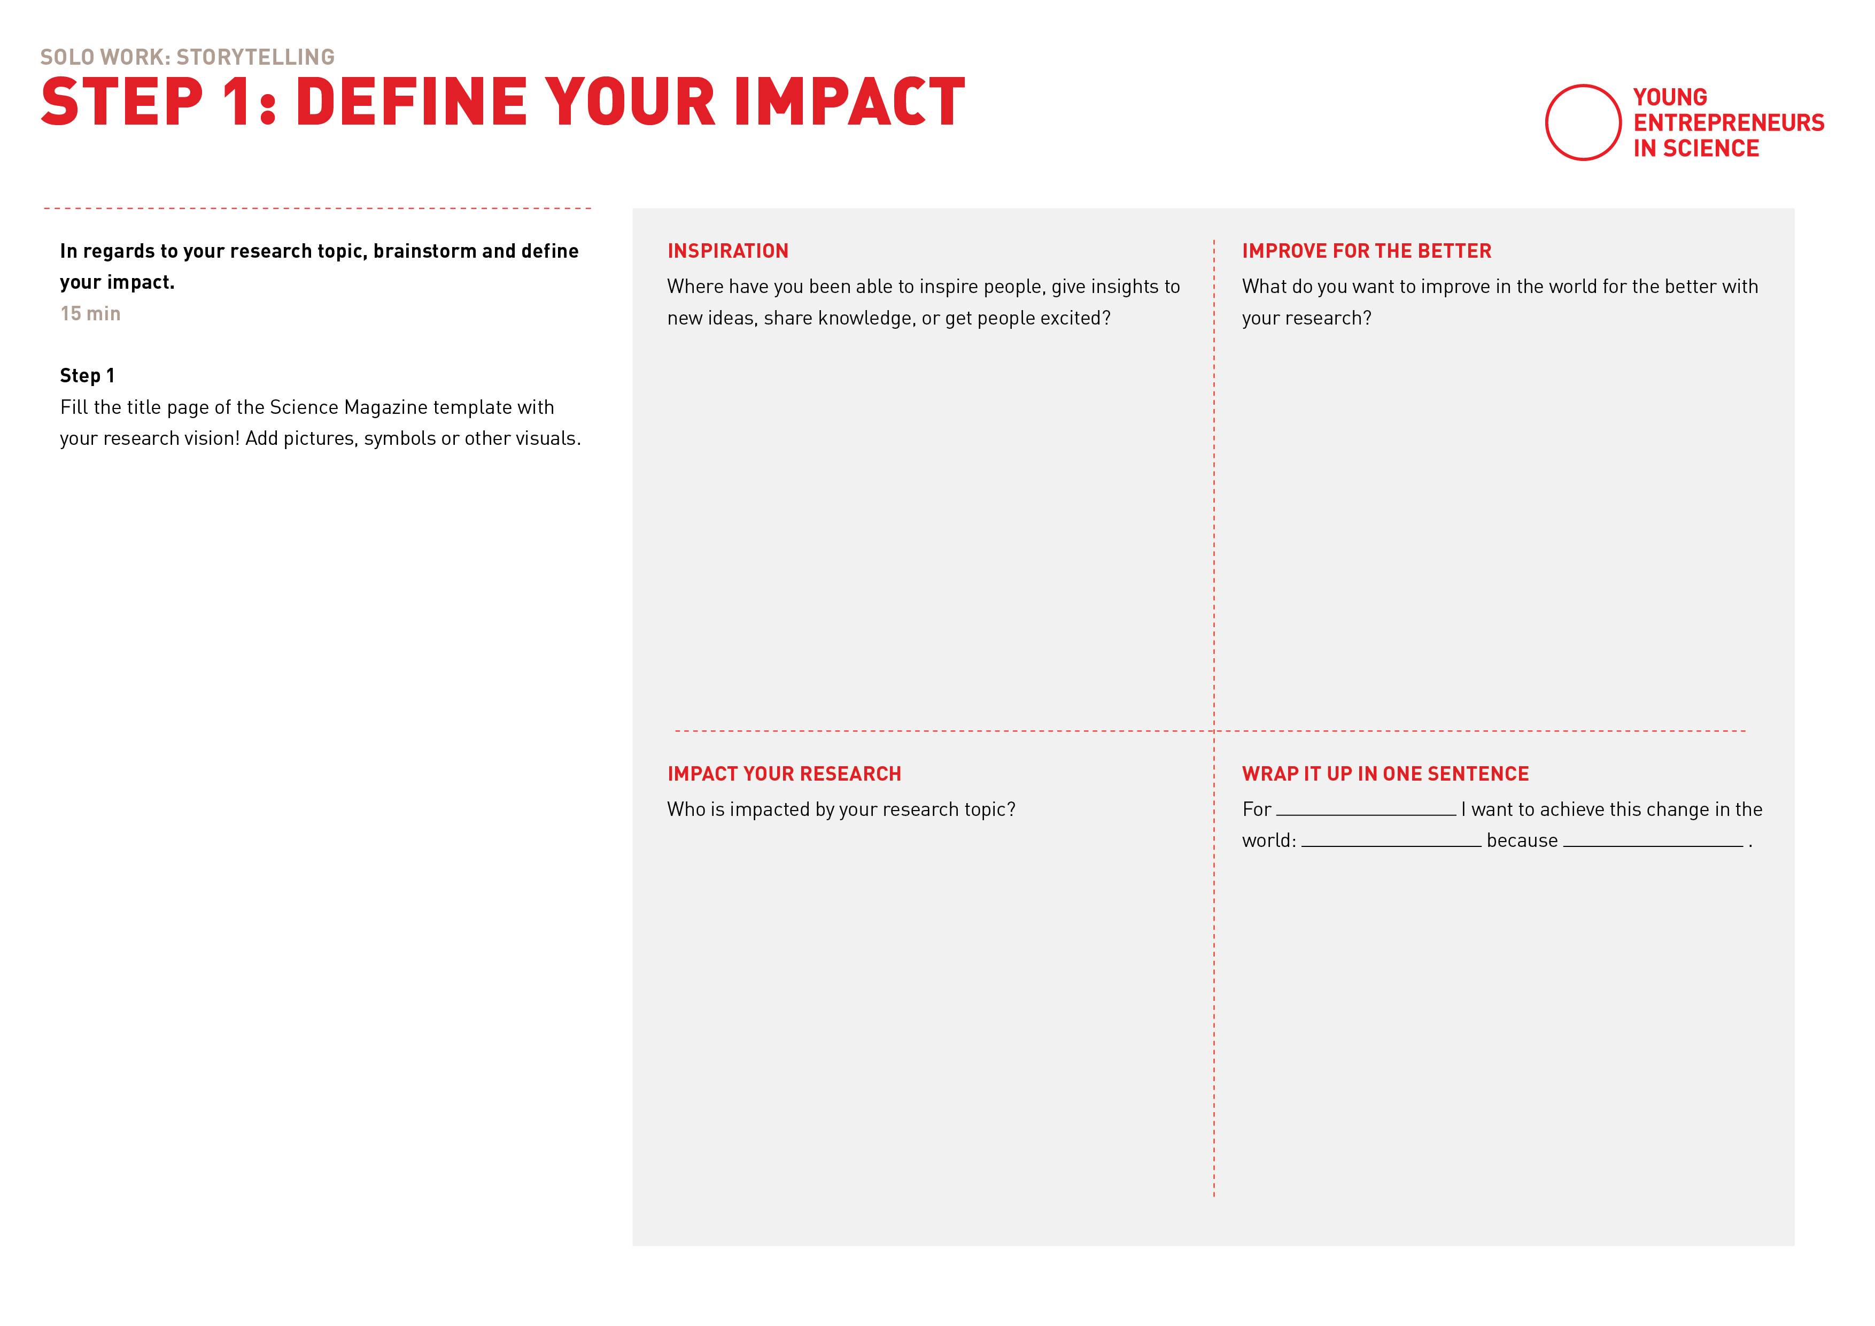
Define your impact

Slide 24

The Storytelling Framework

Slide 25

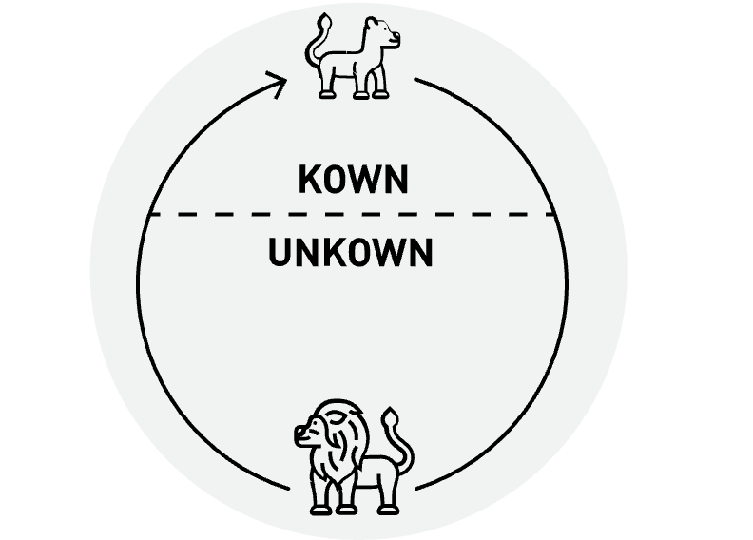

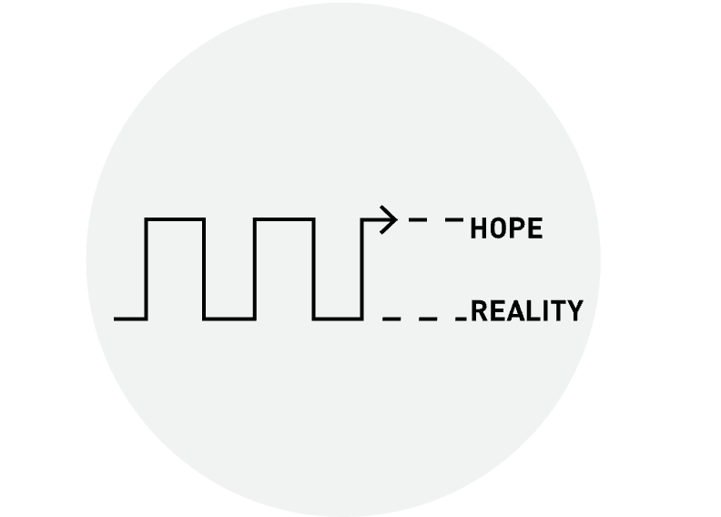
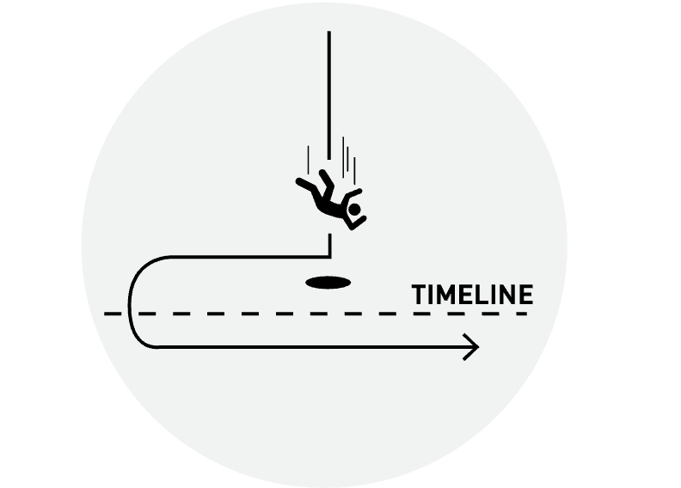
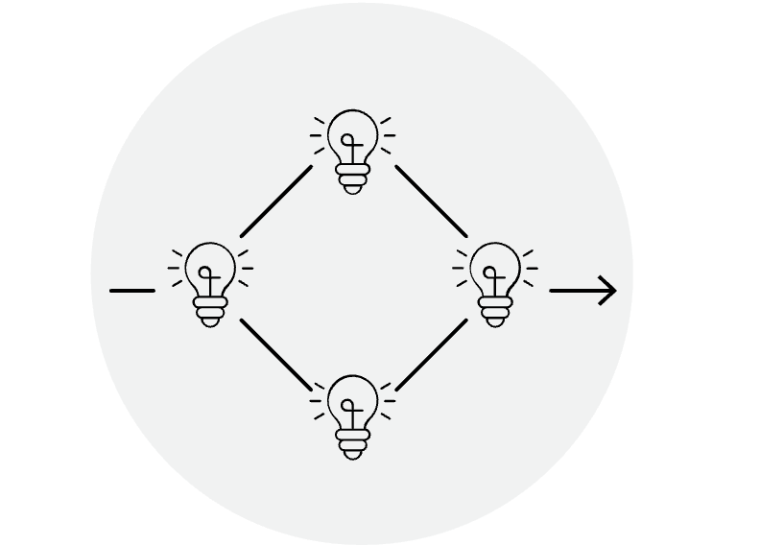


Different storytelling frameworks
The Mountain
Monomyth
Nested Loops
Sparklines
In Medias Res
Converging Ideas
False Start
Petal Structure
Notes:
Many different ways and approaches to tell stories
Just to give you an idea - here are some of them (nicht einzeln erklären!)
They are structures in which you create your stories.
(wenn ihr euch einlest, könnt ihr auch kurz in ein paar Sätzen auf die Frameworks eingehen, sowas wie:
„nestles loop framework: layers 3 or more narratives together or skarklines is an approach often used in speechwriting“
Ist aber kein Muss!)
_____
Background Info (nur zum Reinlesen für die Coaches)
1. Monomyth
The monomyth (also called the hero's journey), is a story structure that's found in many folk tales, myths and religious writings from around the world.
In a monomyth, the hero is called to leave their home and sets out on a difficult journey. They move from somewhere they know into a threatening unknown place.
2. The mountain
The mountain structure is a way of mapping the tension and drama in a story. It's similar to the monomyth because it helps us to plot when certain events occur in a story.
It's different because it doesn't necessarily have a happy ending. The first part of the story is given to setting the scene, and is followed by just a series of small challenges and rising action before a climactic conclusion.
It's a bit like a TV series – each episode has its ups and downs, all building up to a big finale at the end of the season
3. Nested loops
Nested loops is a storytelling technique where you layer three or more narratives within each other.
You place your most important story – the core of your message – in the centre, and use the stories around it to elaborate or explain that central principle. The first story you begin is the last story you finish, the second story you start is second to last, etc.
Nested loops works a bit like a friend telling you about a wise person in their life, someone who taught them an important lesson. The first loops are your friend's story, the second loops are the wise person's story. At the centre is the important lesson.
4. Sparklines
Sparklines are a way of mapping presentation structures. Graphic designer Nancy Duarte uses sparklines to analyse famous speeches graphically in her book Resonate.
She argues that the very best speeches succeed because they contrast our ordinary world with an ideal, improved world. They compare what is with what could be.
5. In media res
In medias res storytelling is when you begin your narrative in the heat of the action, before starting over at the beginning to explain how you got there.
By dropping your audience right into the most exciting part of your story they'll be gripped from the beginning and will stay engaged to find out what happens.
But be careful – you don't want to give away too much of the action straight away. Try hinting at something bizarre or unexpected – something that needs more explanation. Give your audience just enough information to keep them hooked, as you go back and set the scene of your story.
6. Converging ideas
Converging ideas is a speech structure that shows the audience how different strands of thinking came together to form one product or idea.
It can be used to show the birth of a movement. Or explain how a single idea was the culmination of several great minds working towards one goal.
Converging ideas is similar to the nested loops structure, but rather than framing one story with complementary stories, it can show how several equally important stories came to a single strong conclusion.
7. False start
A 'false start' story is when you begin to tell a seemingly predictable story, before unexpectedly disrupting it and beginning it over again. You lure your audience into a false sense of security, and then shock them by turning the tables.
This format is great for talking about a time that you failed in something and were forced to 'go back to the start' and reassess. It's ideal for talking about the things that you learnt from that experience. Or the innovative way that you solved your problem.
8. Petal structure
The petal structure is a way of organising multiple speakers or stories around one central concept. It's useful if you have several unconnected stories you want to tell or things you want to reveal – that all relate back to a single message. You tell your stories one by one before returning back to the centre. The petals can overlap as one story introduces the next but each should be a complete narrative in itself.
https://blog.sparkol.com/8-classic-storytelling-techniques-for-engaging-presentations

Slide 26
Different storytelling frameworks
The Mountain
Monomyth
Nested Loops
Sparklines
In Medias Res
Converging Ideas
False Start
Petal Structure
Notes:
The most common and most used is the monomyth as well know as the Hero's journey and we want to focus on it today!

Slide 27

Elements of the hero’s journey
Ordinary World
Return with the Elixir
Call to Adventure
Refuse the Call
Resurrection
Meet the Mentor
The Road Back
Cross the First Treshold
Reward
Tests, Allies, Enemies
Ordeal
Innermost Cave
https://blog.reedsy.com/guide/story-structure/heros-journey/
Notes:
Hero's Journey is a model for both plot points and character development: as the Hero traverses the world, they'll undergo inner and outer transformation at each stage of the journey.
Believe it or not, this story structure also applies across mediums and genres (and also works when your protagonist is an anti-hero!).
Let's dive into it. The 12 steps of the hero's journey are:
1. The Ordinary World. We meet our hero.
2. Call to Adventure. Will they meet the challenge?
3. Refusal of the Call. They resist the adventure.
4. Meeting the Mentor. A teacher arrives. Wise character. They reassure and give something to the hero, information or a tool.
5. Crossing the First Threshold. The hero leaves their comfort zone. Steps into the unknow, the prep is done, now the hero is going for it.
6. Tests, Allies, Enemies. Making friends and facing roadblocks.
7. Approach to the Inmost Cave. Getting closer to our goal.
8. Ordeal. The hero’s biggest test yet!
9. Reward. Light at the end of the tunnel
10. The Road Back. We aren’t safe yet.
11. Resurrection. The final hurdle is reached.
12. Return with the Elixir. The hero heads home, triumphant.
------------------
https://blog.reedsy.com/guide/story-structure/heros-journey/
IN DETAIL (just for further information)
1. Ordinary World
In which we meet the character that the story is about as well as the world they live in. This is where you set the stage for your audience.
Before our Hero discovers a strange new world, we must first understand who they are and how they act. Importantly, it lets readers identify with the Hero as a “normal” person in a “normal” setting, before the journey begins. There has to be a clue of a problem in order to get the audience involved.
2. Call to Adventure
This is where you announce to the audience that there is a problem to be solved, so they know, there is someone how is like me, and they need to solve a problem. They can relate and get involved.
The call to adventure is about booting the Hero out of their comfort zone. In this stage, they are generally confronted with a problem or challenge they can't ignore. This catalyst can take many forms, as Campbell points out in Hero with a Thousand Faces. The Hero can, for instance:
Decide to move forward on their own;
Theseus upon arriving in Athens.
Be sent abroad by a benign or malignant agent;
Odysseus setting off on his ship in The Odyssey.
Stumble upon the adventure as a result of a mere blunder;
Dorothy when she’s swept up in a tornado in The Wizard of Oz.
Be casually strolling when some passing phenomenon catches the wandering eye and lures one away from the frequented paths of man.
Elliot in E.T. upon discovering a lost alien in the tool shed.
The stakes of the adventure and the Hero's goals become clear. The only question: will he rise to the challenge?
3. Refusal of the Call
The hero doesn´t want to go or it is made difficult for them to go.
And this is to tell the audience that this is scary. They express fear because they are pushed out of their comfort zone, which is natural, and we can relate to that. It’s risky and there are perils — like spiders, trolls, or perhaps a creepy uncle waiting back at Pride Rock. It’s enough to give anyone pause. In Star Wars, for instance, Luke Skywalker initially refuses to join Obi-Wan on his mission to rescue the princess. It’s only when he discovers that his aunt and uncle have been killed by stormtroopers that he changes his mind. In Harry Potter, all the letters from Hogwarts get stolen by his uncle and aunt, until the hole house gets fludded and they cannot ignore them anymore.
4. Meeting the Mentor
In which the Hero acquires a personal trainer.
The Hero's decided to go on the adventure — but they’re not ready to spread their wings yet. They're much too inexperienced at this point and we don't want them to do a fabulous belly-flop off the cliff.
Enter the mentor: someone who helps the Hero, so that they don't make a total fool of themselves (or get themselves killed). The mentor provides practical training, profound wisdom, a kick up the posterior, or something abstract like grit and self-confidence.
5. Crossing the First Threshold
In which the Hero enters the other world in earnest.
Now the Hero is ready — and committed — to the journey. This marks the end of the Departure stage and is when the adventure really kicks into the next gear. As Vogler writes: “This is the moment that the balloon goes up, the ship sails, the romance begins, the wagon gets rolling.”
From this point on, there’s no turning back.
Like our Hero, you should think of this stage as a checkpoint for your story. Pause and re-assess your bearings before you continue into unfamiliar territory.
6. Tests, Allies, Enemies
In which the Hero faces new challenges and gets a squad.
When we step into the Special World, we notice a definite shift. The Hero might be confused by this unfamiliar reality and its new rules. This is generally one of the longest stages in the story, as our protagonist gets to grips with this new world.
(Kathy added: It´s like being in a place you don´t know much about but you get tested right away. But you only get little test on your skills and abilities. Yet the rules are different than you know, there´re wired creatures and you have to figure out who you can trust and who can help you.)
This makes a prime hunting ground for the series of tests to pass! Luckily, there are many ways for the Hero to get into trouble:
In Jumanji: Welcome to the Jungle, Spencer, Bethany, “Fridge,” and Martha get off to a bad start when they bump into a herd of bloodthirsty hippos.
In his first few months at Hogwarts, Harry Potter manages to fight a troll, almost fall from a broomstick and die, and get horribly lost in the Forbidden Forest.
Marlin and Dory encounter three “reformed” sharks, get shocked by jellyfish, and are swallowed by a blue whale en route to finding Nemo.
This stage often expands the cast of characters. Once the protagonist is in the Special World, he will meet allies and enemies — or foes that turn out to be friends and vice versa. He will learn a new set of rules from them. Saloons and seedy bars are popular places for these transactions, as Vogler points out (so long as the Hero survives them).
7. Approach to the Inmost Cave
In which the Hero gets closer to his goal.
This isn’t a physical cave. Instead, the “inmost cave” refers to the most dangerous spot in the other realm — whether that’s the villain’s chambers, the lair of the fearsome dragon, or the Death Star. Almost always, it is where the ultimate goal of the quest is located.
Note that the protagonist hasn’t entered the Inmost Cave just yet. This stage is all about the approach to it. It covers all the prep work that's needed in order to defeat the villain.
(Kathy added: Periode of travelling to the centre of it all, hero an his crew are travelling there, they get to know each other better, first impressions change, friendships get deeper oder might get tested, a time for comedy or comedy.)
All leading up to the heart of it all:
8. Ordeal
In which the Hero faces his biggest test of all thus far.
Of all the tests the Hero has faced, none have made them hit rock bottom — until now. Vogler describes this phase as a “black moment.” Campbell refers to it as the “belly of the whale.” Both indicate some grim news for the Hero.
The protagonist must now confront their greatest fear. If they survive it, they will emerge transformed. This is a critical moment in the story, as Vogler explains that it will “inform every decision that the Hero makes from this point forward.”
The Ordeal is sometimes not the climax of the story. There’s more to come. But you can think of it as the main event of the second act — the one in which the Hero actually earns the title of “Hero.”
(Kathy added: It is often written as a near death experience and rebirth of the hero, where they symbolically let go of something old in order to make room for something new. There ist blood on the floor. Sometimes heros are dragged into the underwold but then they get a second shot at life. Or they just lose something dear to them. The hero becomes aware of strengths that they were not aware of before. They feel differently about themselves now.)
9. Reward (Seizing the Sword)
In which the Hero sees light at the end of the tunnel. (Moment of self reflection, often hero looks in a mirror.)
Our Hero’s been through a lot. However, the fruits of their labor are now at hand — if they can just reach out and grab them! The “reward” is the object or knowledge the Hero has fought throughout the entire journey to hold.
Once the protagonist has it in their possession, it generally has greater ramifications for the story. Vogler offers a few examples of it in action:
Luke rescues Princess Leia and captures the plans of the Death Star — keys to defeating Darth Vader.
Dorothy escapes from the Wicked Witch’s castle with the broomstick and the ruby slippers — keys to getting back home.
10. The Road Back
In which the light at the end of the tunnel might be a little further than the Hero thought.
The story's not over just yet, as this phase marks the beginning of Act Three. Now that he's seized the reward, the Hero tries to return to the Ordinary World, but more dangers (inconveniently) arise on the road back from the Inmost Cave.
More precisely, the Hero must deal with the consequences and aftermath of the previous act: the dragon, enraged by the Hero who’s just stolen a treasure from under his nose, starts the hunt. Or perhaps the opposing army gathers to pursue the Hero across a crowded battlefield. All further obstacles for the Hero, who must face them down before they can return home.
11. Resurrection
In which the last test is met.
Here is the true climax of the story. Everything that happened prior to this stage culminates in a crowning test for the Hero, as the Dark Side gets one last chance to triumph over the Hero.
Vogler refers to this as a “final exam” for the Hero — they must be “tested once more to see if they have really learned the lessons of the Ordeal.” It’s in this Final Battle that the protagonist goes through one more “resurrection.” As a result, this is where you’ll get most of your miraculous near-death escapes, à la James Bond's dashing deliverances. If the Hero survives, they can start looking forward to a sweet ending.
12. Return with the Elixir
In which our Hero has a triumphant homecoming.
Finally, the Hero gets to return home. However, they go back a different person than when they started out: they’ve grown and matured as a result of the journey they’ve taken.
But we’ve got to see them bring home the bacon, right? That’s why the protagonist must return with the “Elixir,” or the prize won during the journey, whether that’s an object or knowledge and insight gained.
Of course, it’s possible for a story to end on an Elixir-less note — but then the Hero would be doomed to repeat the entire adventure.
https://tvtropes.org/pmwiki/pmwiki.php/Main/TheHerosJourney?from=Main.Monomyth

Slide 28

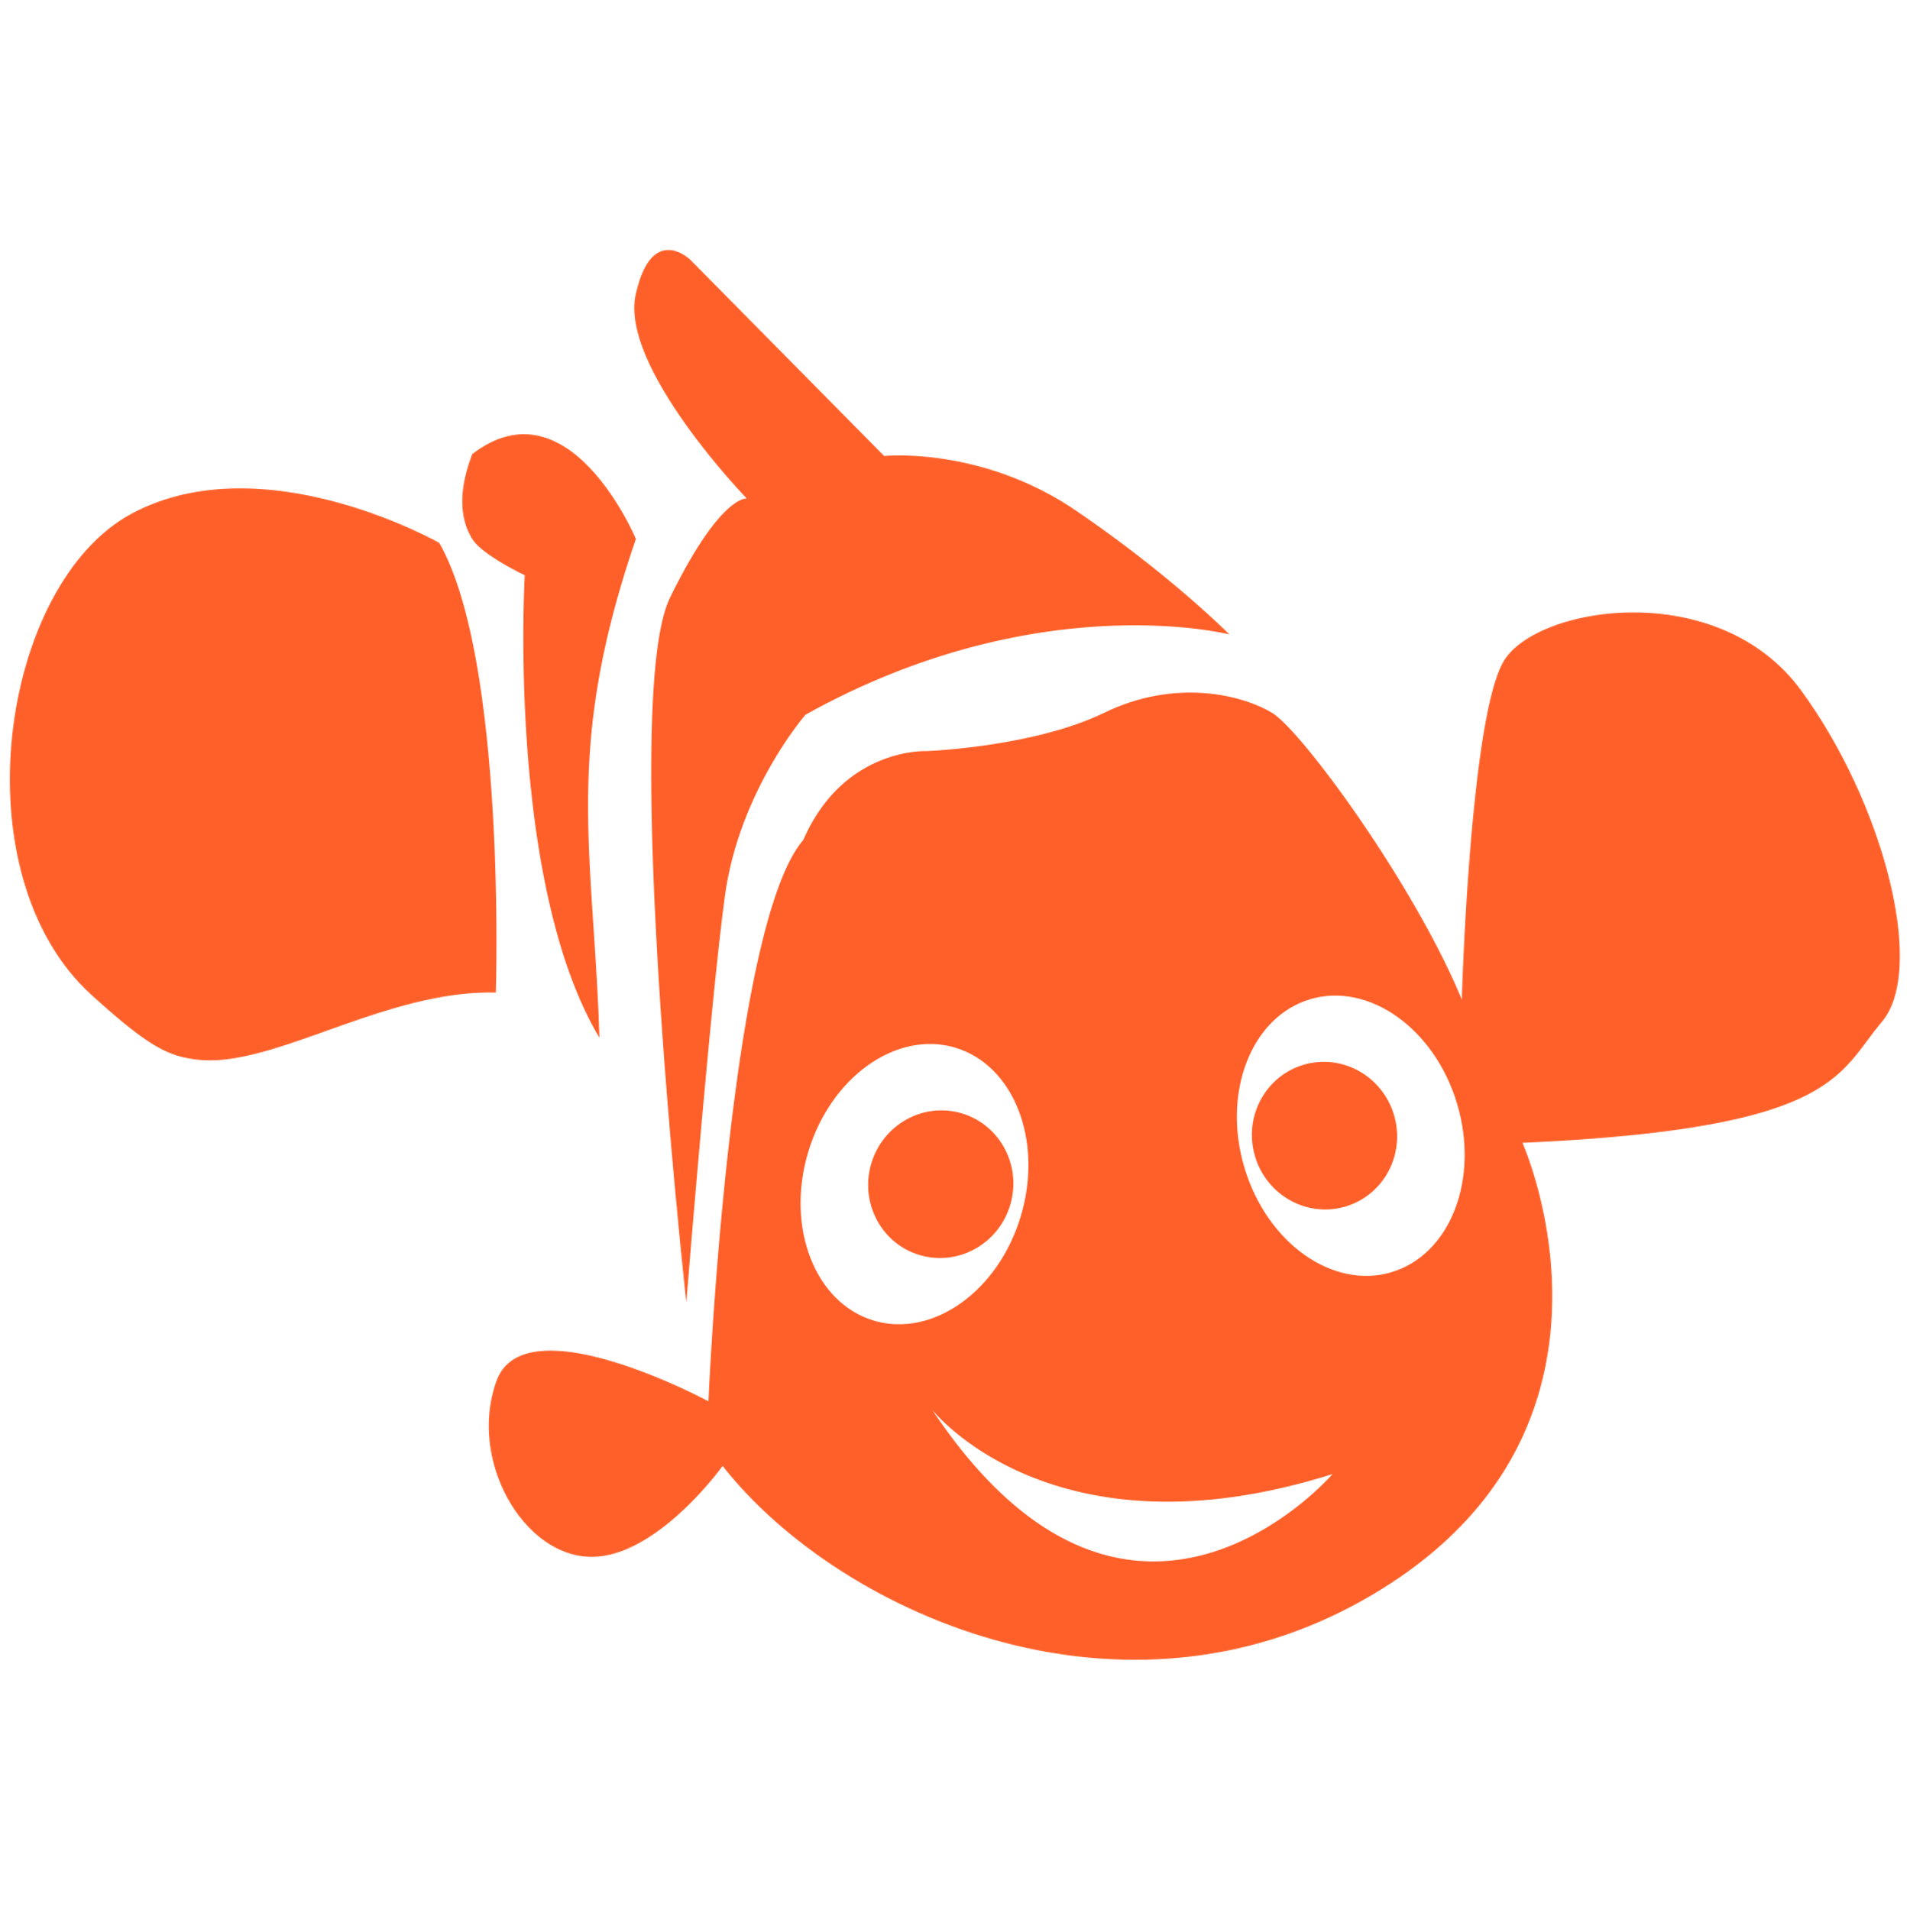
An example: Nemo
Notes:
Let‘s make this a bit more practical to understand…
Who of you knows the Movie „Finding Nemo“?

Slide 29

An example: Nemo
Ordinary World
Call to Adventure
Refuse the Call
Meet the Mentor
https://nemojourney.weebly.com/heros-journey.html
Notes:
The ordinary world: Marlin is excited about a new home, waiting for new eggs to hatch. Nemo is anxious to go to school. Marlin is very protective and is afraid to leave him alone.
The call to adventure: Nemo adventure’s out to the “Butt” to prove that he is brave. Problem: Nemo is out in the open ocean and is caught by the men in the boat. Challenge: Marlin has to rescue him.
Refusal of the call: Marlin is afraid to go after Nemo because, he is afraid of the open sea.
Meeting with the mentor: The mentor is Dory who plays the part of a good trickster, using her humor to overcome her weakness as a forgetful character. (physical memory loss) Through Dory, Marlin will learn how to NOT be afraid and to learn to let go and let Nemo take some risk. He must learn to believe in Nemo.

Slide 30

An example: Nemo
Ordinary World
Call to Adventure
Refuse the Call
Meet the Mentor
Cross the First Threshold
Reward
Tests, Allies, Enemies
Ordeal
Innermost Cave
https://nemojourney.weebly.com/heros-journey.html
Notes:
Crossing the threshold: Marlin leaves his comfortable safe zone and swims after Nemo. He continues to follow the boat, even in the wide open ocean.
Test, Allies, and Enemies: The sharks who says they are friends. Dory: Smart when she can remember, but often is brainless
Crush- Helps Marlin travel through the currents to get to Nemo, Fish in tank befriends Nemo and help him to escape, Darla does not know how to treat animals. She is mean to them, Pelican: Takes Marlin to Nemo, The Whale; The test: Nemo has to let go and trust. The lesson learned in the Whale is the lesson Marlin needs to apply to Nemo. “Let him go”
Innermost cave: Marlin believes Nemo is dead. He tells Dory goodbye and swims away. But, Dory rekindles Marlin’s hope when she finds Nemo. Nemo Also has a set back. Does not get out of the fish tank and has to reorganize.
The ordeal: Marlin returns to save Dory from the jellies. The jellyfish stings Marlin and almost dies, but he survives and recovers and gets help from Crush to make it through the currents. He experiences a rebirth to continue his journey. Marlin also is able to witness how crush is able to let his son go and take risk when the boy turtles get knocked out of the current.
The reward: Nemo gets out of the tank and his free in the ocean. Dory and Marlin think he is dead, but Nemo survives death (from the hands of Darla) Dory helps him find his dad, who returns when he hears Nemo’s cry. Marlin and Nemo are united.

Slide 31
An example: Nemo
Ordinary World
Return with the Elixir
Call to Adventure
Refuse the Call
Resurrection
Meet the Mentor
The Road Back
Cross the First Threshold
Reward
Tests, Allies, Enemies
Ordeal
Innermost Cave
https://nemojourney.weebly.com/heros-journey.html
Notes:
The road back: Marlins is put to the test to see if he has learned his lesson. Dory is caught in a net and Nemo wants to save her, but Marlin is reluctant to let Nemo go. He finally realized that he must let Nemo grow up and take some risk. He must also have confidence in Nemo that he can save Dory. Nemo draws from his lessons in the tank and uses an idea that Gil used to break away from the net.
The resurrection: Marlin must now apply everything he has learned when he thinks that Nemo is dead. Marlin realizes his mistake. He apologizes to Nemo for not believe in him. Marlin learns to let go and believe that all will work out in
the end.
The return: Marlin brings Nemo back to the ordinary world and applies the lessons he has learned. He allows Nemo to go to school without fear, which allows him to live a happier life. The lesson learned is that the challenges of life can be applied to everyday living in the ordinary world.

Slide 32

Your impact
World A
Ordinary world
(as of today)
World B
World with the impact you have made
Notes:
We want to use this storytelling framework to let you create a story of how your impact changes the “ordinary world” as of today to the world with the trace of your impact

Slide 33
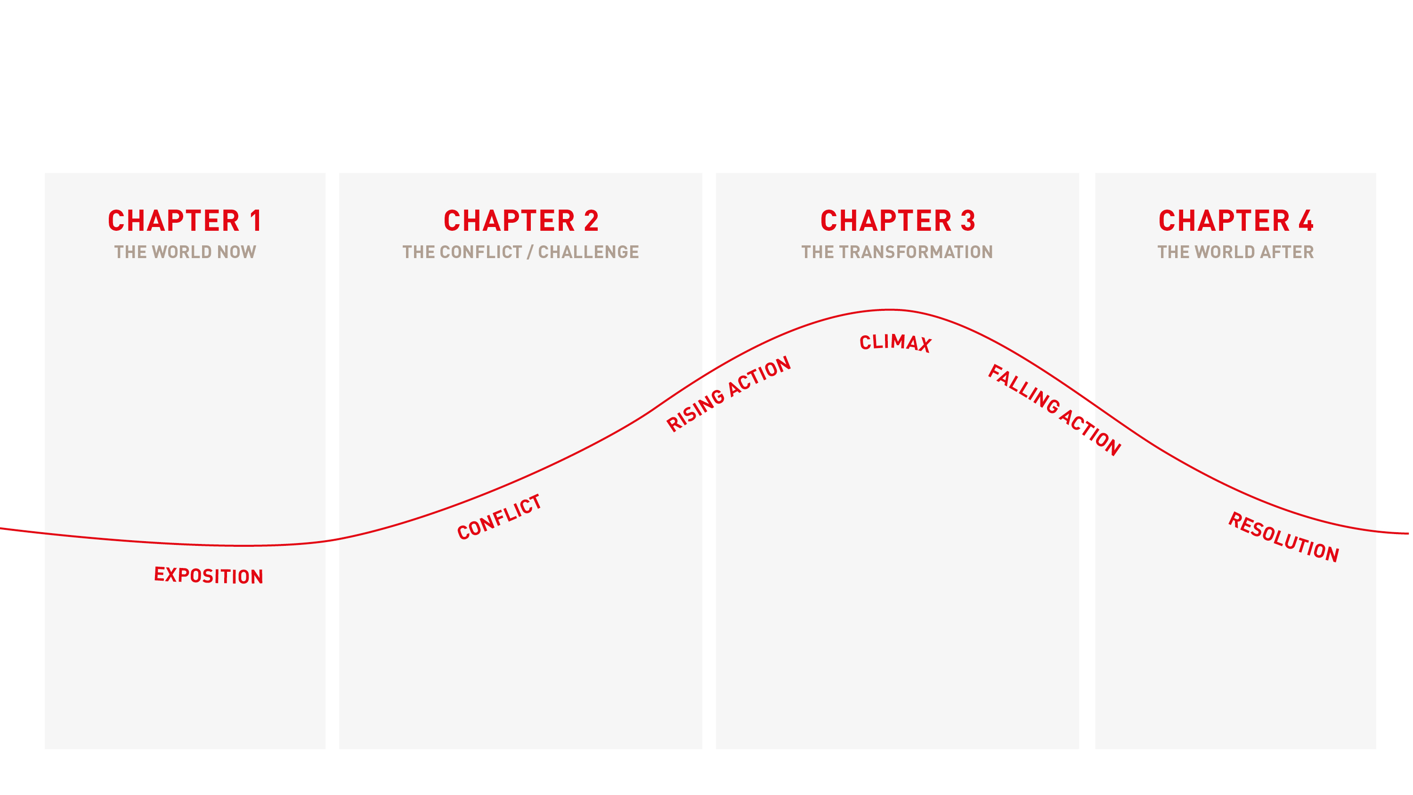
Creating a story
Notes:
Since we dont have the time to write a whole Hollywood script today, we are using a condensed version of the heros journey framework today. Here is a brief look at it but we‘ll introduce our framework in a little bit properly!
And before we do that we need something very important for the story: a protagonist!
-----
Background info – wird später im Modul erklärt
Exposition: Introduce the setting for your impact story (the world now), and the main “characters”
Conflict: Describe the problem (the issue your research is working to address) that your “characters” face.
Rising Action: Show how you work/your research works and the steps that lead to the impact your make. If you can: Include input and output data as supporting evidence.
Climax: Your climax is the turning point in your impact story, the peak of the action, and the point at which a path to a resolution is realized. If you can - use your outcomes and impact data to show how the hero of your storyis better off as a result of your activities.
Falling Action & Resolution: Your resolution should leave your audience with a connection between their emotions and you (as well as steps they can take to support your mission.)
https://www.sureimpact.com/post/impact-story
-----
Additional info:
Suspense is essential and is built continuously from the very beginning to the end.
The climax should ideally be an applicable conclusion to one's own life: the moral of the story.
The structure not only garners more attention but also fosters a connection and identification with the events. Listeners immerse themselves in the situation, feel it, and view things from the protagonist's perspective.

Slide 34
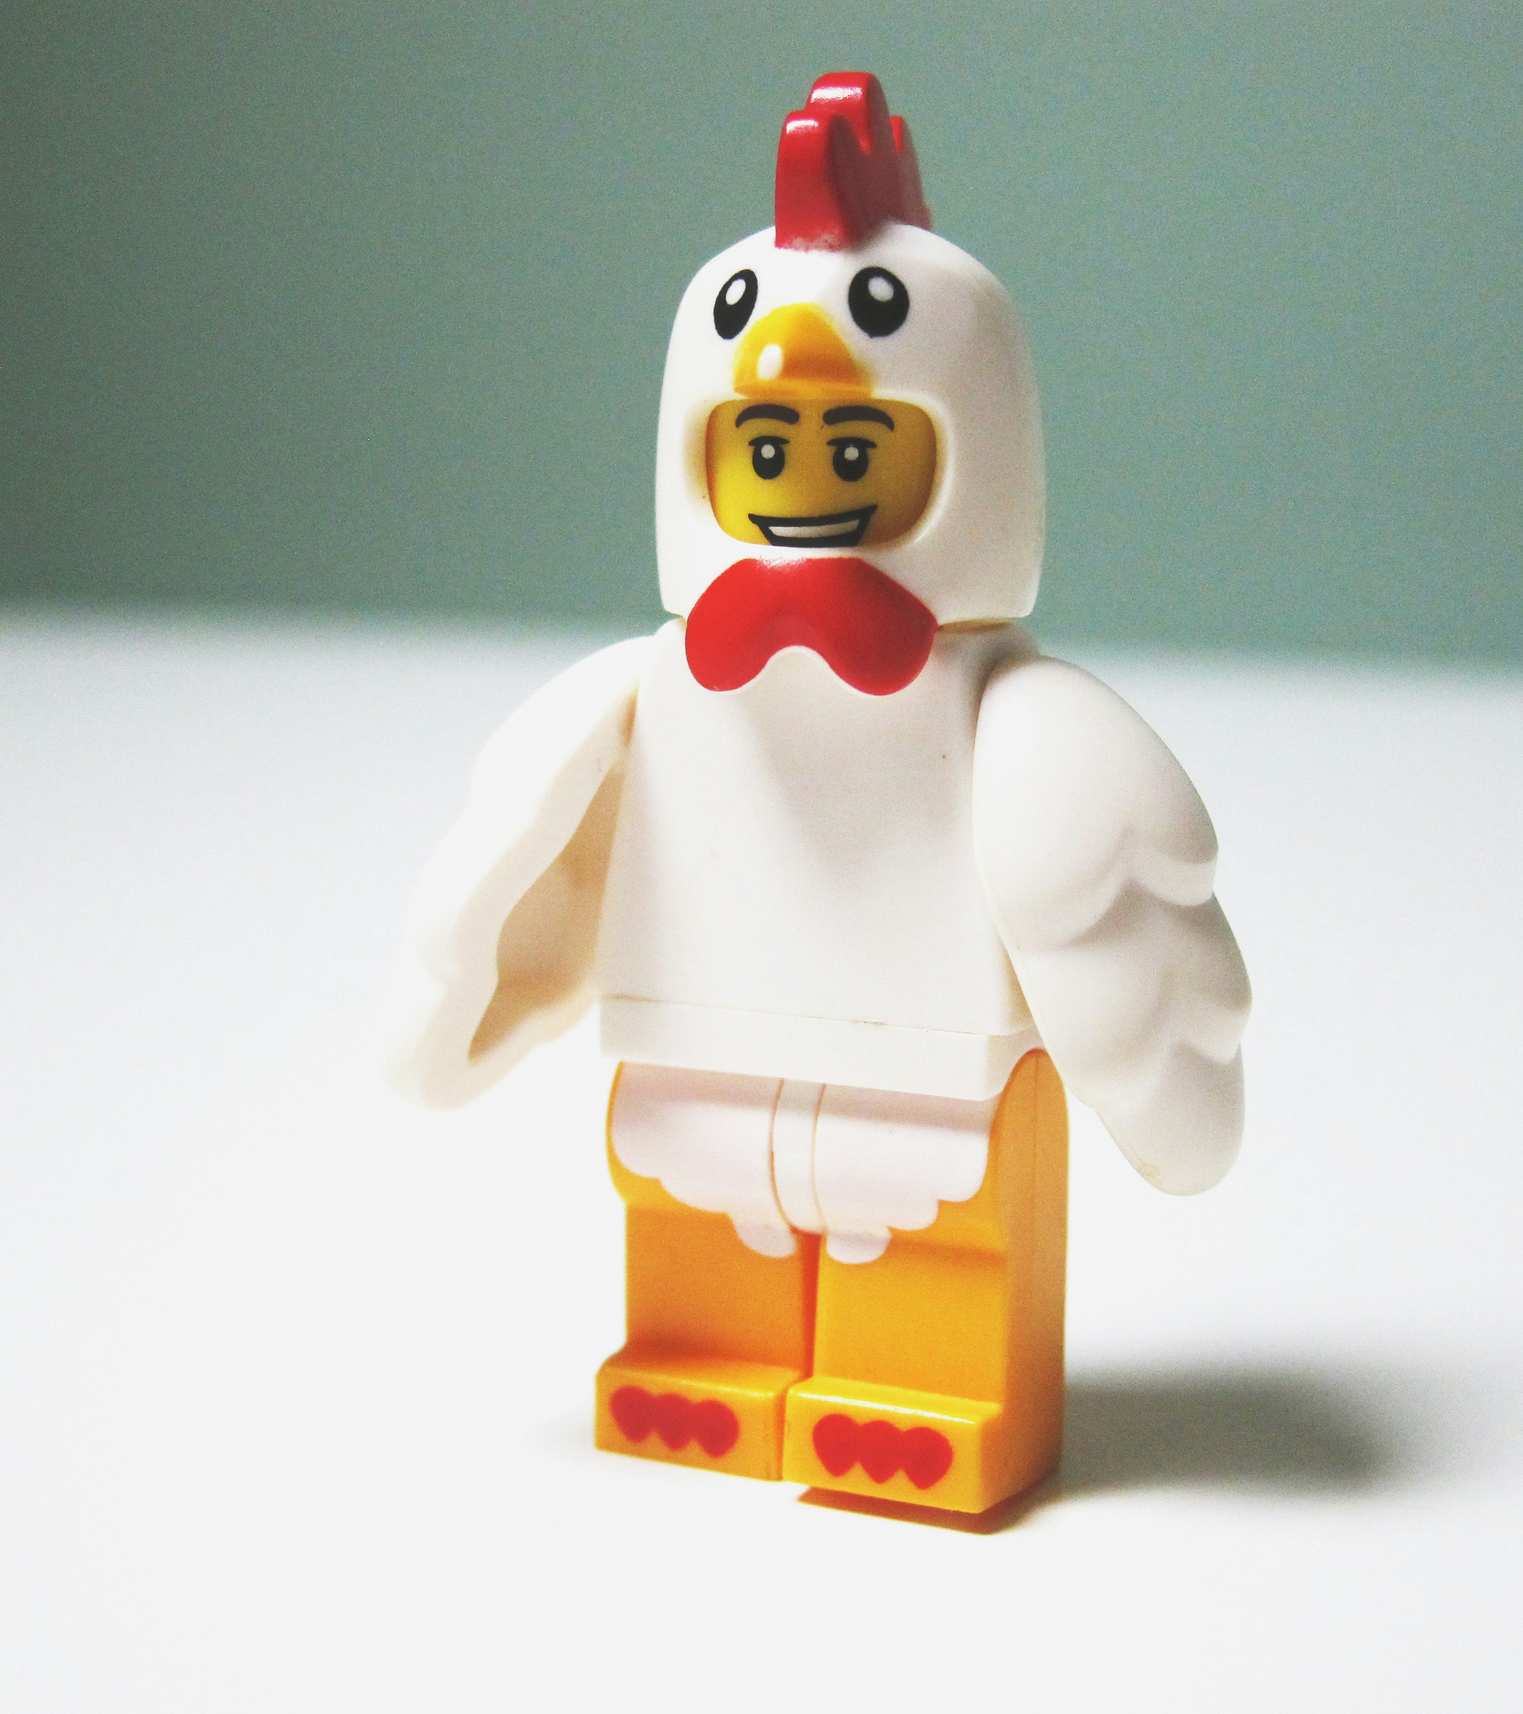
EXERCISE
Create the protagonist of your story
Notes:
- Let‘s go – you have defined your impact so far.
- now let‘s start mapping out a story that makes people care!
- let‘s begin by creating the protagonist of your story – so that person that‘s truely affected by the problem
- this can be a human or an animal or any kind of creature that you feel is fitting to carry the story

Slide 35



Protagonist: An example
YOUR IMPACT: Freeing the ocean from plastic
ocean biologist
fisherman:woman
Turtle
Notes:
You can create many different protagonists for.a story.
If your impact is: Freeing the ocean from plastic, then you could choose one of those protagonists, for example:
ocean biologist
fisherman:woman
Turtle
Which one will you choose for your story? The most sympathetic person? The most emotional? The one that triggers most?

Slide 36
Solo work
Create a relatable character
10 min
Use the second template
Step 2: Bring your protagonist
Who is affected by your problem?
Come up with a character.
Bring it to life by enriching it with information (template).
Give it a name/nickname and a look.
Be visual.
Give a first clue about the Problem to be solved (impact).
Notes:
How?
- solo work
- work on individual templates
What?
- come up with a relatable character that is affected by your problem (can also be a non-human character)
- make it relatable by giving it colour (detailed information)
Why? Goal of the exercise:
- character is the going to transform during the storytelling

Slide 37
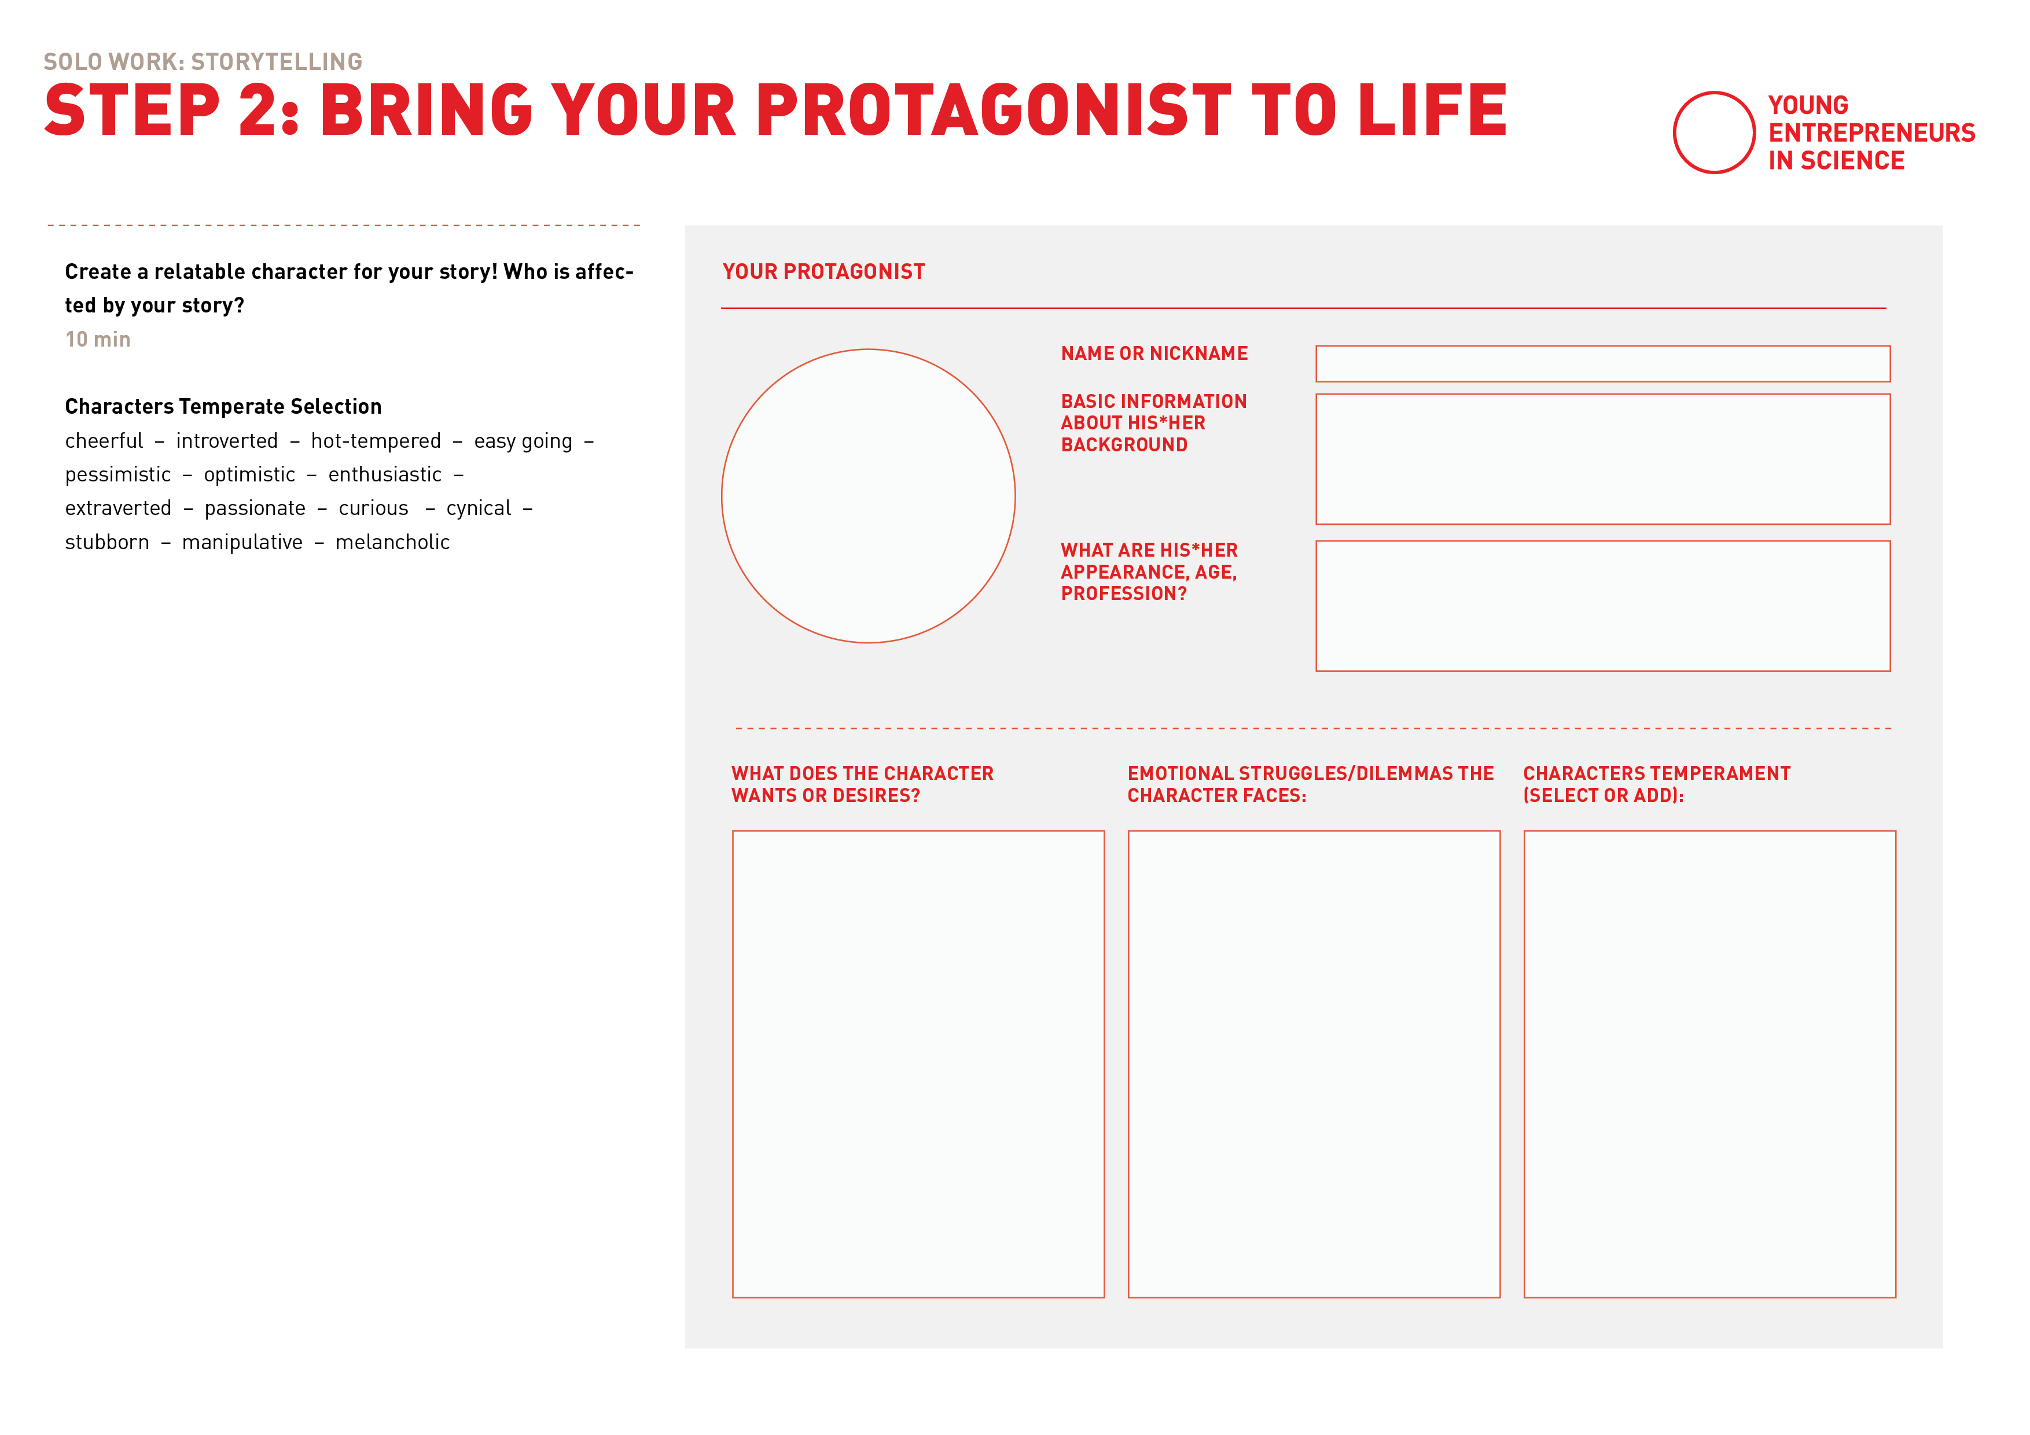
Bring your protagonist to life
Notes:
Reminder where do you find what (inkl. Legende)
Hier noch mal Screenshare in kurz erklären

Slide 38

Example
Niva
She is an atom.
Age unknown, appears as a shy and introvert being.
Wants to be important and achieve something.
Isn’t confident and rather hesitant because of her weaknesses.
Introverted, curious, pessimistic, enthusiastic
Notes:
Reminder where do you find what (inkl. Legende)
Hier noch mal Screenshare in kurz erklären
A former participant from a YES Workshop did his PhD in the developement of advanced NMR analysis techniques for nano-scale or single cell applications. To make this more tangible, he created an Atom as the protagonist of the story, that later on went on a metaphorical journey.

Slide 40

EXERCISE
Create your story
Notes:
Let‘s get adventourous!

Slide 41
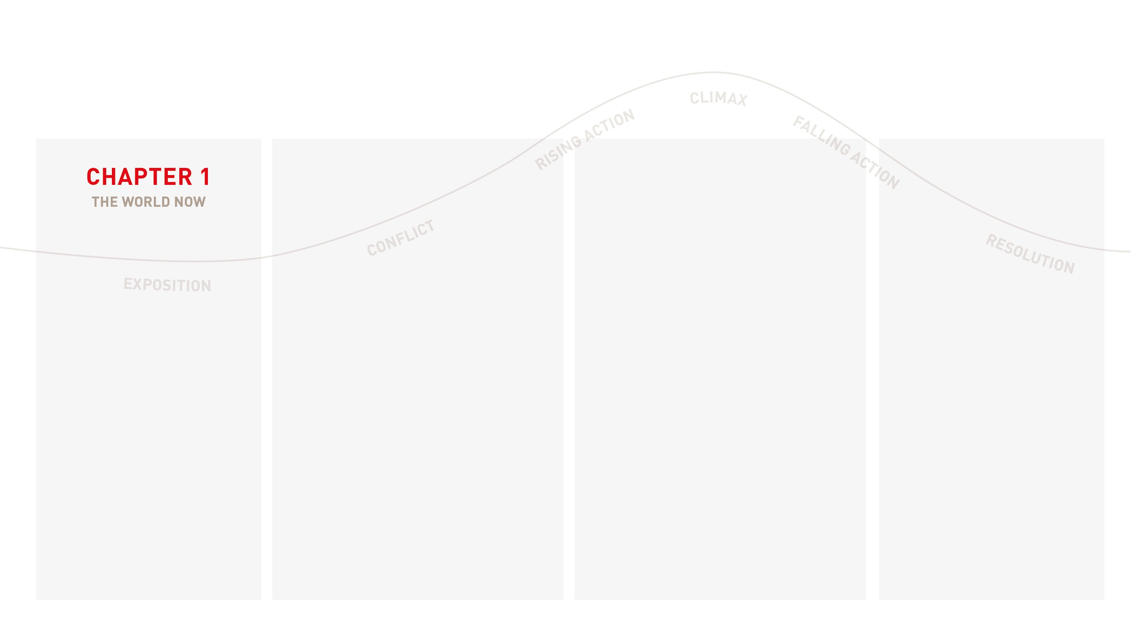
Creating your story
Come up with short and tangible description of the world your protagonist lives in.
Notes:
Since we dont have the time to write a whole Hollywood script today,
we are using a condensed version of the heros journey framework today:
Exposition: Introduce the setting for your impact story (the world now), and the main “characters”

Slide 42
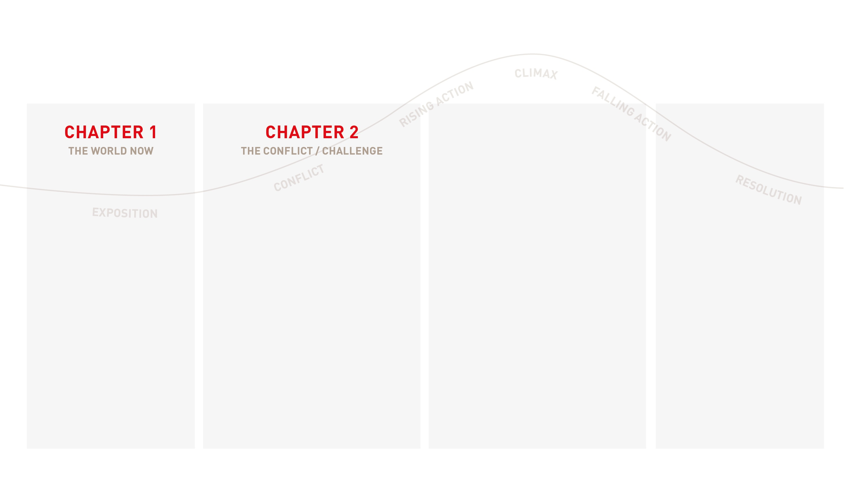
Creating your story
Come up with short and tangible description of the world your protagonist lives in.
A conflict arises! Describe the challenge your protagonist is facing using an illustrative situation.
How is she/he emotionally reacting to it?
Notes:
Conflict: Describe the problem (the issue your research is working to address) that your “characters” face.
Rising Action: Show how you work/your research works and the steps that lead to the impact your make. If you can: Include input and output data as supporting evidence.

Slide 43
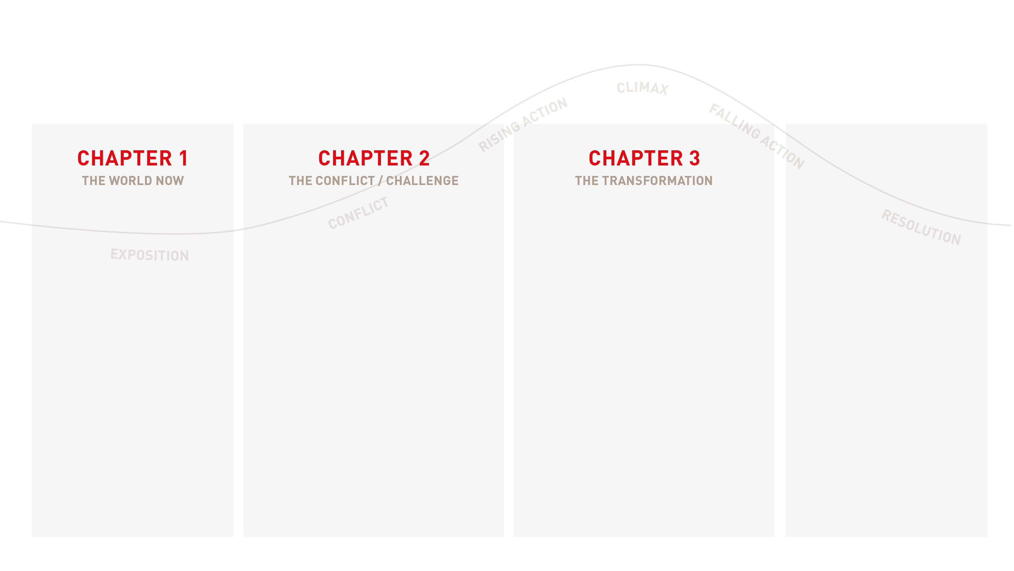
Creating your story
Come up with short and tangible description of the world your protagonist lives in.
A conflict arises! Describe the challenge your protagonist is facing using an illustrative situation.
How is she/he emotionally reacting to it?
How is the challenge solved for your protagonist? Describe how you help the character to achieve their goals.
Notes:
Climax: Your climax is the turning point in your impact story, the peak of the action, and the point at which a path to a resolution is realized. If you can - use your outcomes and impact data to show how the hero of your storyis better off as a result of your activities.

Slide 44
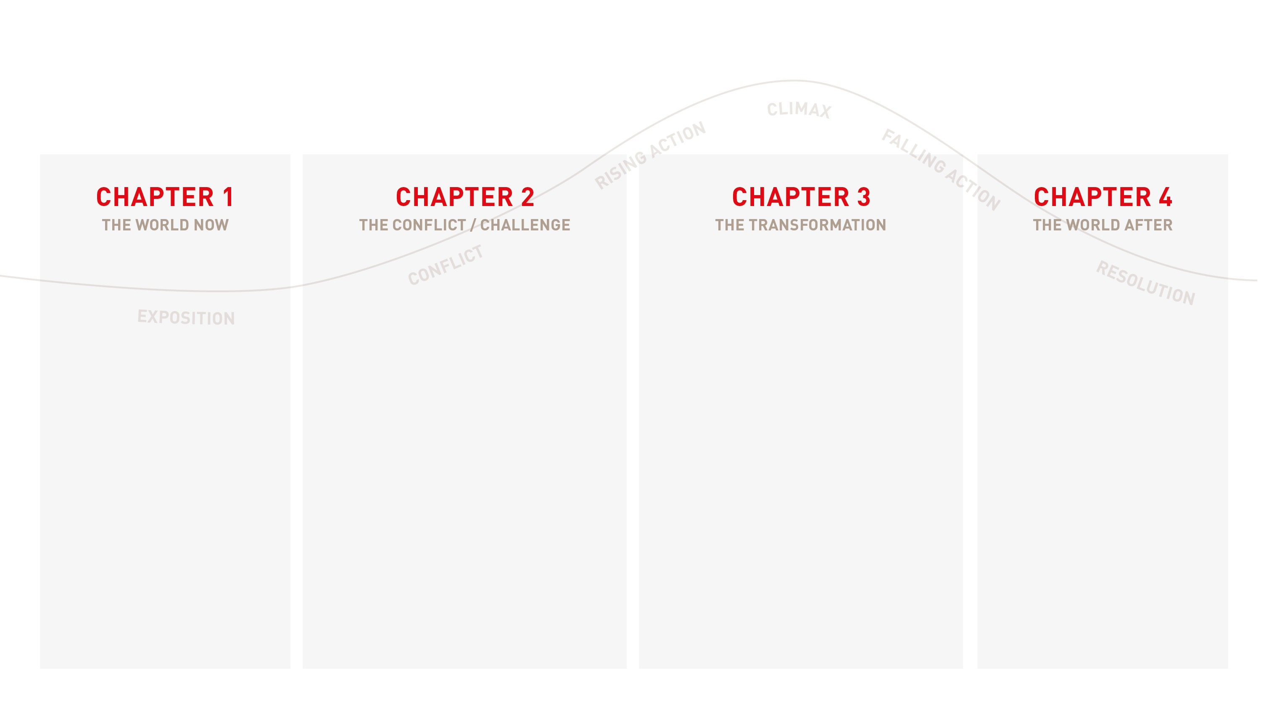
Creating your story
Come up with short and tangible description of the world your protagonist lives in.
A conflict arises! Describe the challenge your protagonist is facing using an illustrative situation.
How is she/he emotionally reacting to it?
How is the challenge solved for your protagonist? Describe how you help the character to achieve their goals.
Towards the end of the story, highlight how now your protagonists‘ world has changedfor the better (your impact).
Notes:
Falling Action & Resolution: Your resolution should leave your audience with a connection between their emotions and you (as well as steps they can take to support your mission.)

Slide 45
Creating your story
Notes:
Am Beispiel mit der „Learning Goals Story“ siehe Start oder Extra-Dok: „Learning Goals Story – For Print“

Slide 46



How to make your audience care
Create situations where the audience can empathize with the character’s experiences. Make
their challenges and reactions relatable to real-life situations.
Use descriptive language to convey their emotional state, such as body language, facial expressions, and tone of voice.
Use key emotional moments in the character’s journey, such as moments of joy, sorrow, anger, love, or fear.
Use simple language. Imagine reading your story to a child.
Notes:
There are some tipps on how to do that:

Slide 47

EXERCISE
How to come up with a story

Slide 48
Teamwork
Let’s create together
10 min
In pairs of two
Person A: The narrator
Person B: The “ringer”
(use a glass and a pen to “ring.”)
Person A: tells a freely improvised story, begin with “Once upon a time…”.
Person B: rings the bell when he/she wants to take over. Person A repeats the last word of his/her story and continues to tell the story.
Now Person A gets to ring the bell…
Notes:
Warmup: Improvise a story!
'Goal: get relaxed and creative, generating new ideas and letting go of the old ones, learning how to build elements on top of each other, be spontaneous!
-- moderation: give an example // act it out in front of the participants
Person A: The narrator
Person B: The "ringer" // The ringer has a bell in his hand (a glass and a pen)
The narrator tells a freely improvised story that begins with “Once upon a time…”. Whenever person B rings the bell, the narrator revises the last word of his story and comes up with a new one.
Important to observe:
- the narrator should actually only repeat the last word of his sentence and not the entire last sentence.
- it's really fun when person B rings the bell often in succession, forcing the narrator to really let go of his ideas and simply let himself be surprised at how the story he is telling continues.

Slide 49

It’s coffee
o’ clock!

Slide 50
EXERCISE
Create your story
Notes:
Let‘s get adventourous!

Slide 51
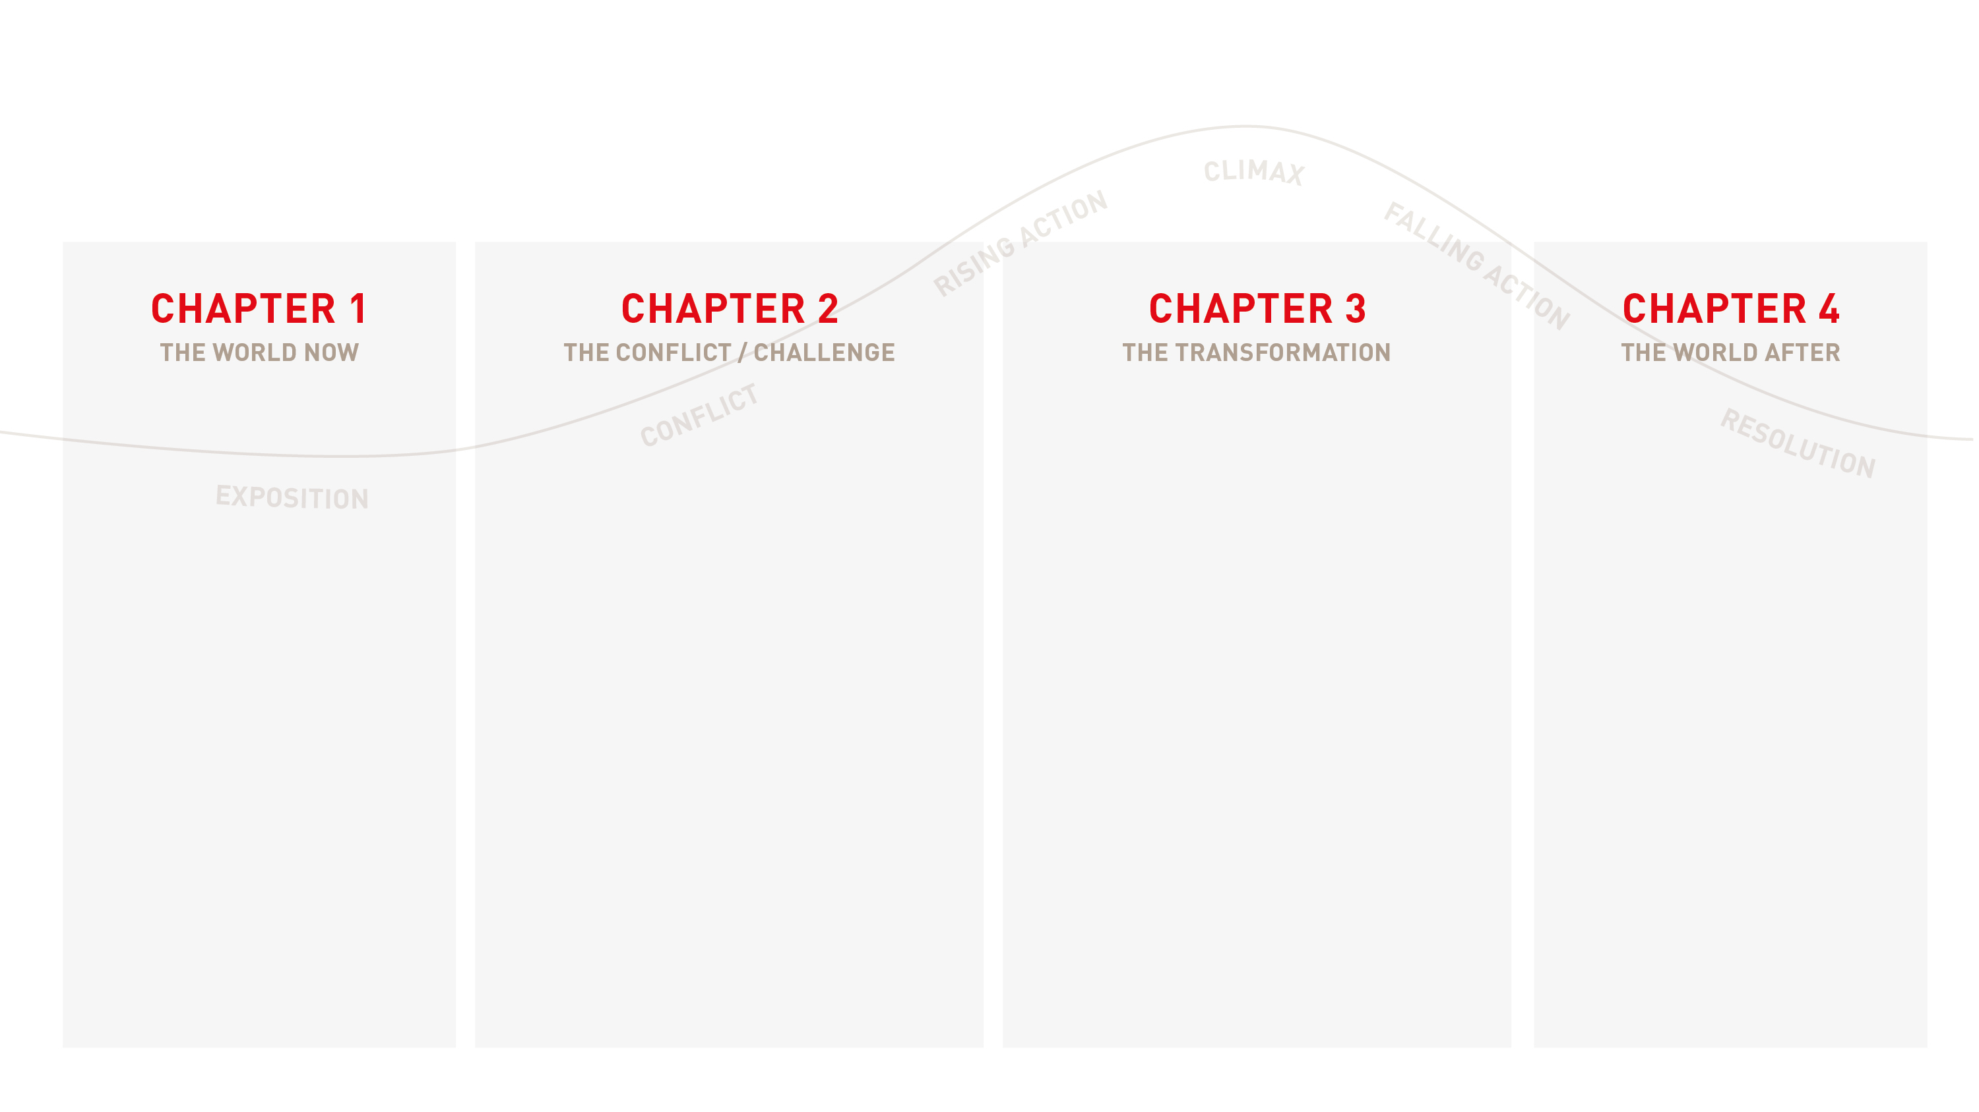
Creating your story
Come up with short and tangible description of the world your protagonist lives in.
A conflict arises! Describe the challenge your protagonist is facing using an illustrative situation.
How is she/he emotionally reacting to it?
How is the challenge solved for your protagonist? Describe how you help the character to achieve their goals.
Towards the end of the story, highlight how now your protagonists‘ world has changedfor the better (your impact).
Notes:
Falling Action & Resolution: Your resolution should leave your audience with a connection between their emotions and you (as well as steps they can take to support your mission.)

Slide 52
Solo work
Create your
3-minutes story
15 min
Use the third template
Step 3: Create your story!
Map out your story by letting your protagonist experience 4 chapters:
The world now
The conflict / challenge
The transformation
The world after

Slide 53
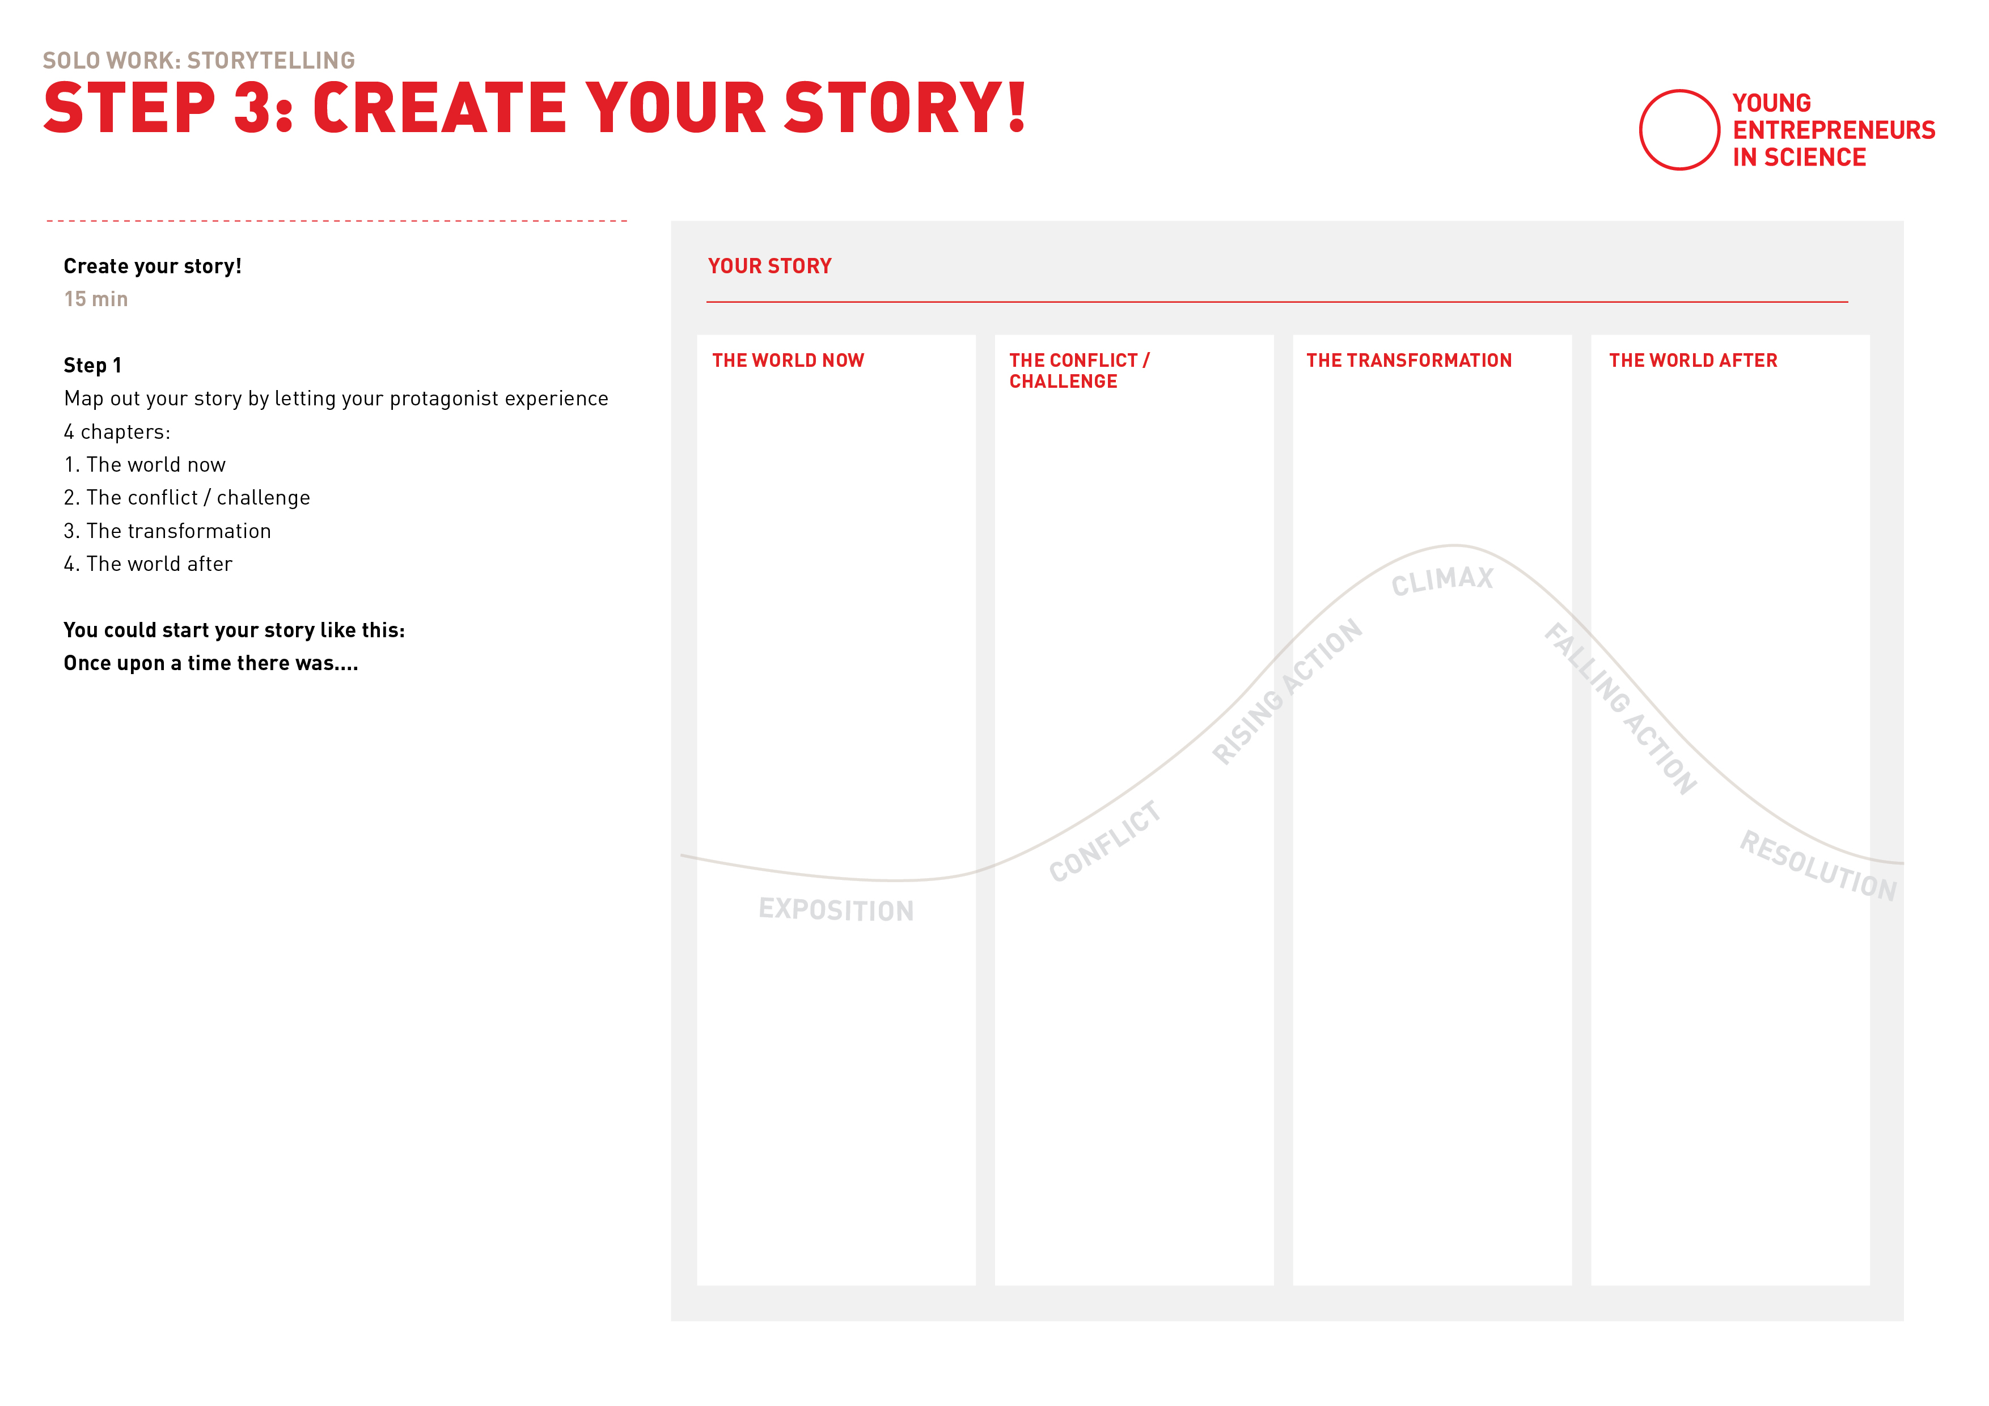
Create your story!
Notes:
This is how the template looks like…

Slide 54
Create your Story: Tips
Storytelling Tips
Create situations where the audience can empathize with the character's experiences. Make their challenges and reactions relatable to real-life situations.
Use descriptive language to convey their emotional state, such as body language, facial expressions, and tone of voice.
Use key emotional moments in the character's journey, such as moments of joy, sorrow, anger, love, or fear.
Use descriptive language!
Notes:
This is how the Miro board looks like…

Slide 55
How did it go?
Which difficulties were there during writing?
Notes:
Inhalte als Überleitung für die kommende Übung nehmen

Slide 56
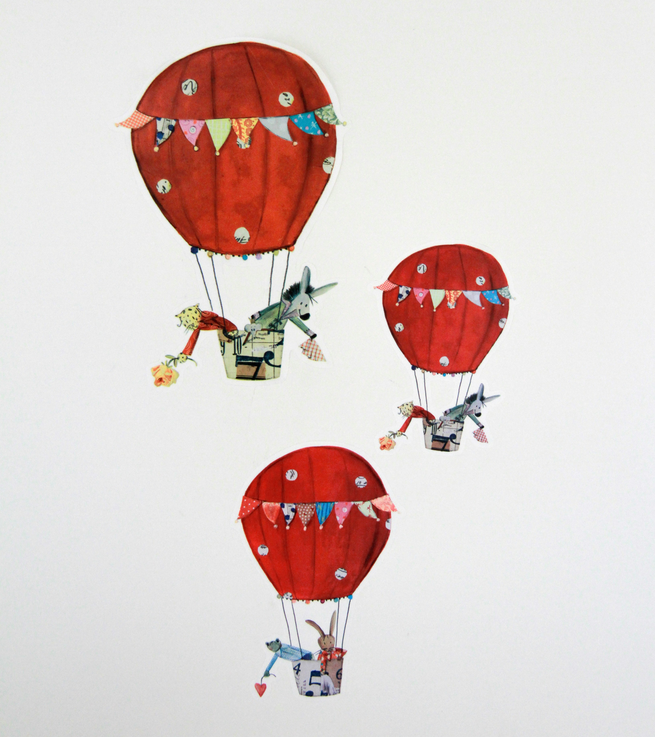
EXERCISE
Captivating Storytelling
Notes:
Vivid Description:
When does a story move forward, and when does the scene remain descriptive?
The right balance of both makes the story exciting and alive.
And that's what we want to practice now!

Slide 57


Let’s tell that story!
Exercise: Stop and go
A starts telling their story.
When B feels like they want more context regarding the scene: “Stop”.
A then describes the scene in more detail, like a screenshot.
Use adjectives!
When B feels like the context is described enough: “Go​”.
A continues the story.
A
B
Again, when Person B feels like they want more context regarding the scene: “Stop”.
Incorporate new insights from the exercise into your own story.
Notes:
Explain by doing the exercise together as co-moderators and then give an example:
A: "So I went up the mountain and could already see the summit"
B: "Stop"
A: - describes the scene - "It was so difficult to get up there. My sneakers had loose soles, I kept slipping and the sun was beating down on me. It was so quiet on the mountain that you couldn't hear anything else but that own breath..."
B: "Go"
A: - continues with the story - "When I reached the summit cross after half an hour, my friends were already waiting for me. We unpacked our packed lunch..."

Slide 58
Teamwork
Let’s tell that story!
20 min
In pairs of two
Do 2 rounds of the
“Stop and Go”-exercise.
7 min: Round 1
Person A tells a story and
Person B says Stop/Go
7 min: Round 2
Switch.
6 min: Both
Incorporate new insights from the exercise into your own story.

Slide 60

WARMUP
“Soundball”
Notes:
Let‘s get adventourous!

Slide 61

WARMUP
“Shhhhhhh”
Notes:
Let‘s get adventourous!

Slide 62

Let’s hear your stories!
Notes:
6 people max

Slide 63

Any questions?

