Slide 1
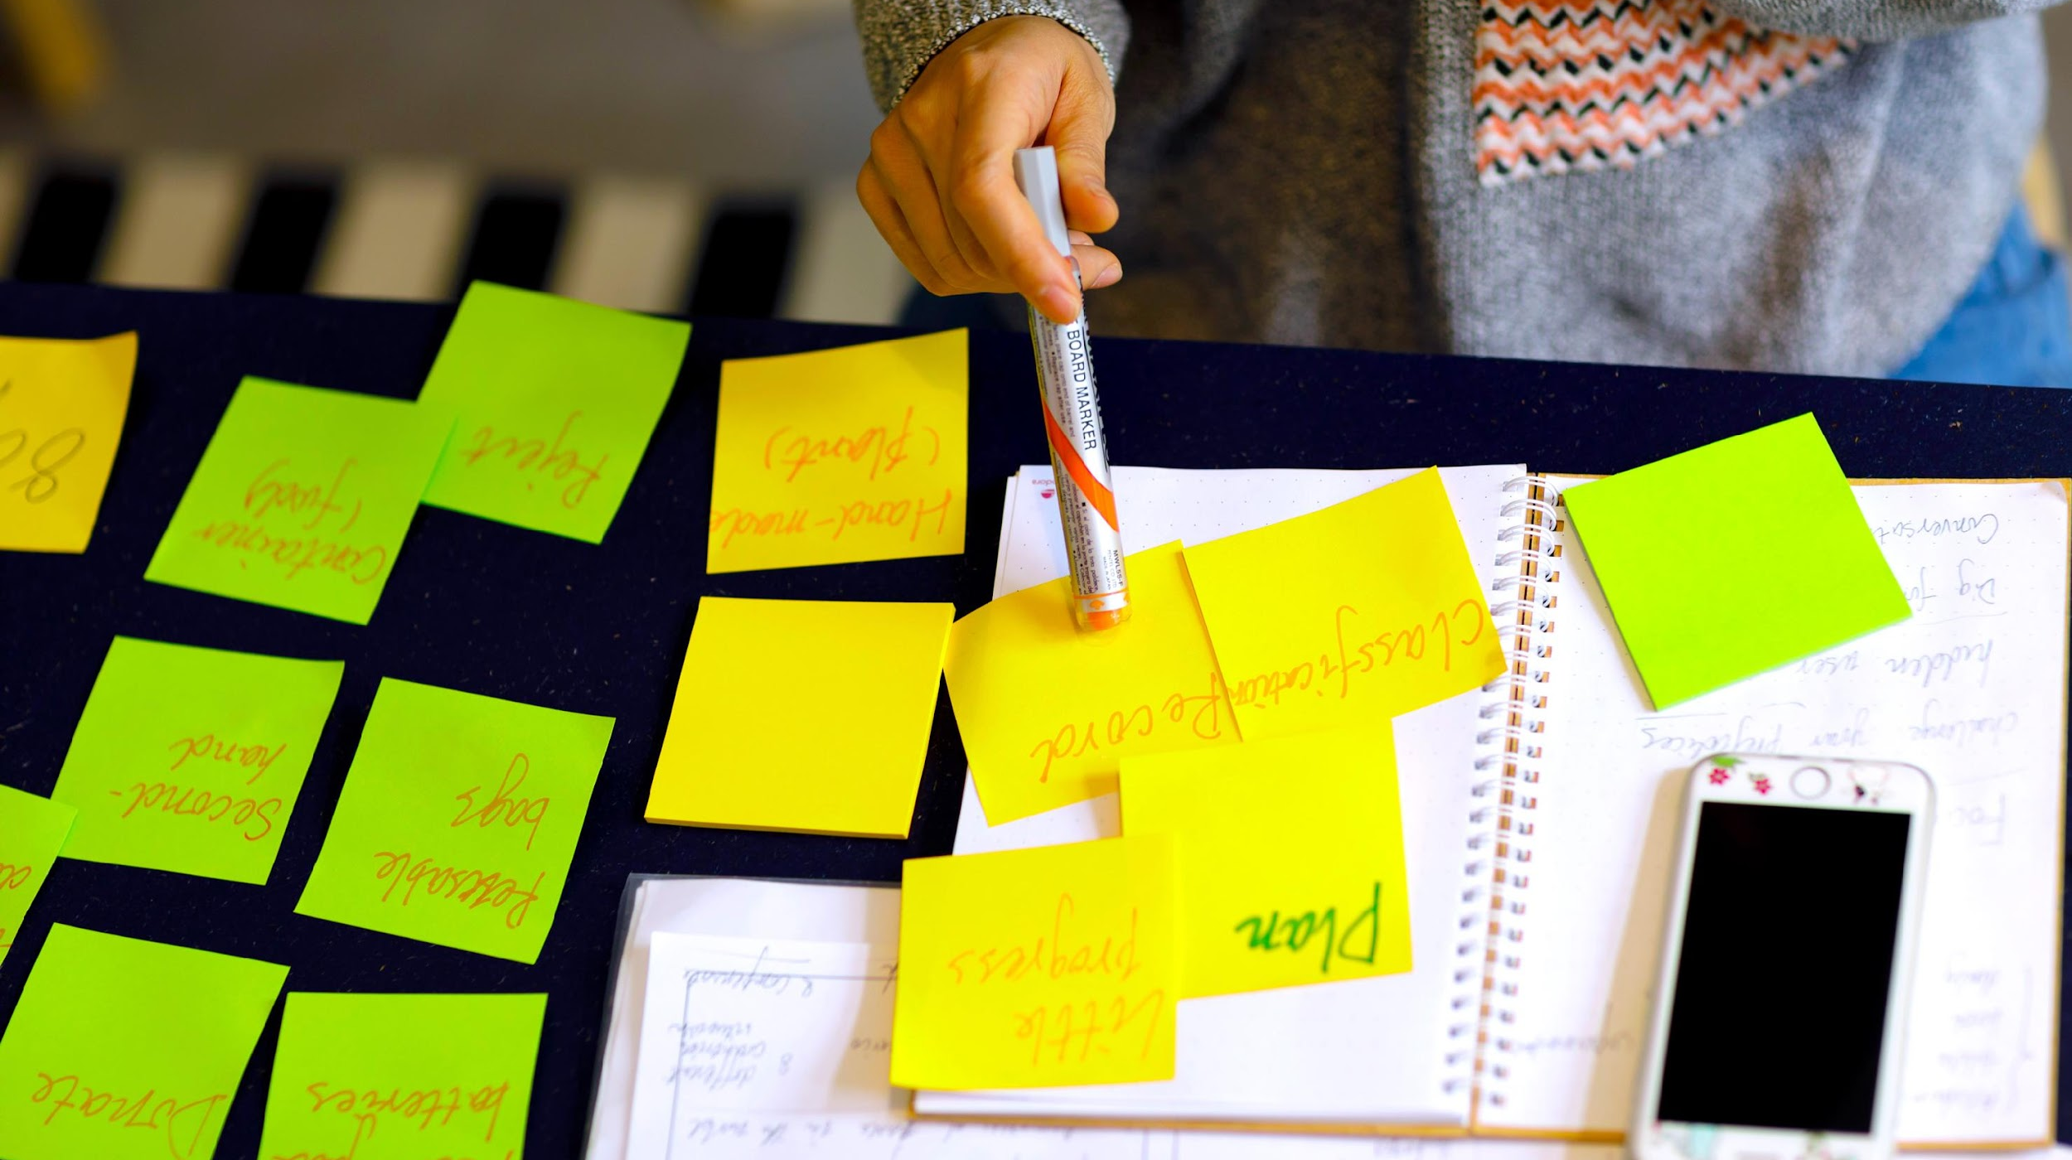
DESIGN THINKING PROCESS III

Slide 2
The Design Thinking Process: Part III
Prototyping & Testing

Slide 3
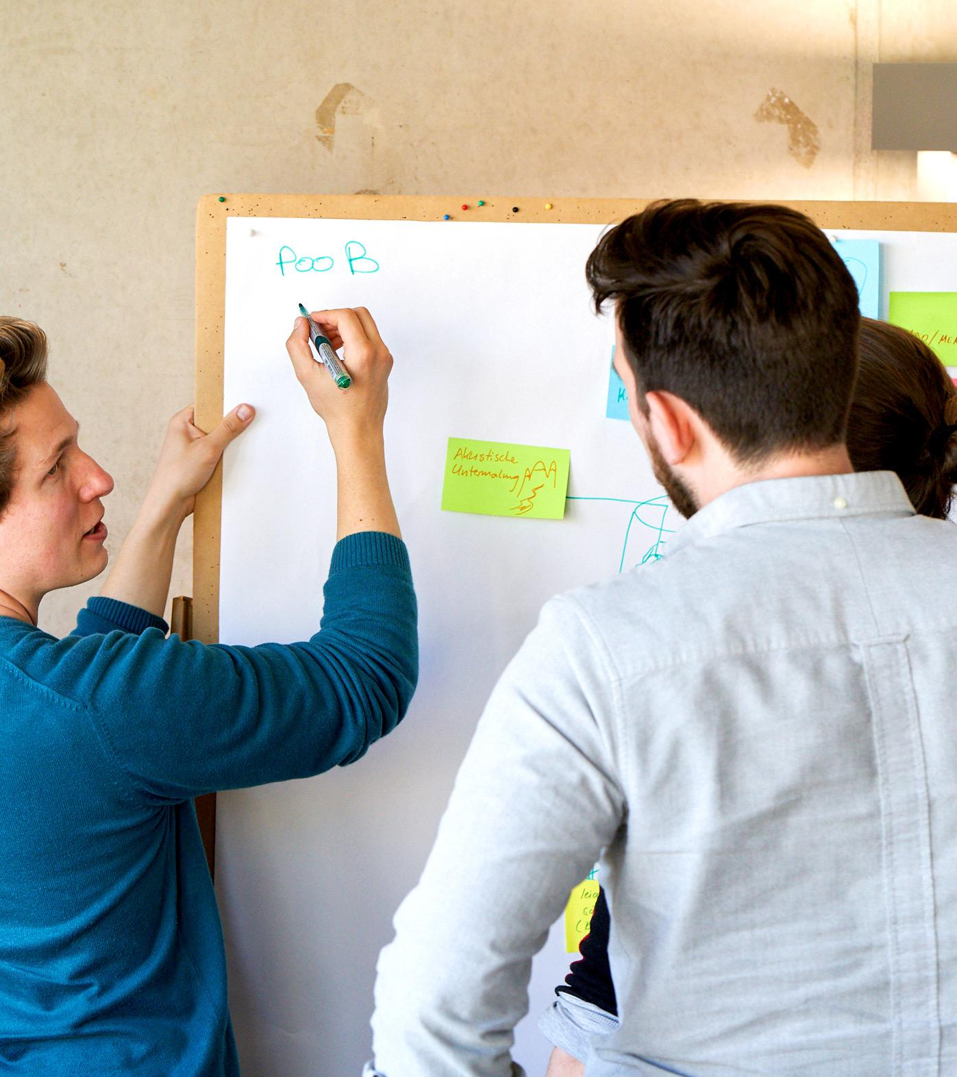
Let’s evaluate our ideas!
Notes:
So now we have a variety of answers to our question and plenty of possible solutions for the problem.
The next step is to choose which idea to develop and invest more energy into!
This step is about narrowing down our options, focusing on the most promising ideas, and deciding where to dedicate our resources and creativity moving forward.
It’s not just about picking the most obvious solution – it’s about identifying the idea that best aligns with the users’ needs and the challenge at hand.

Slide 4
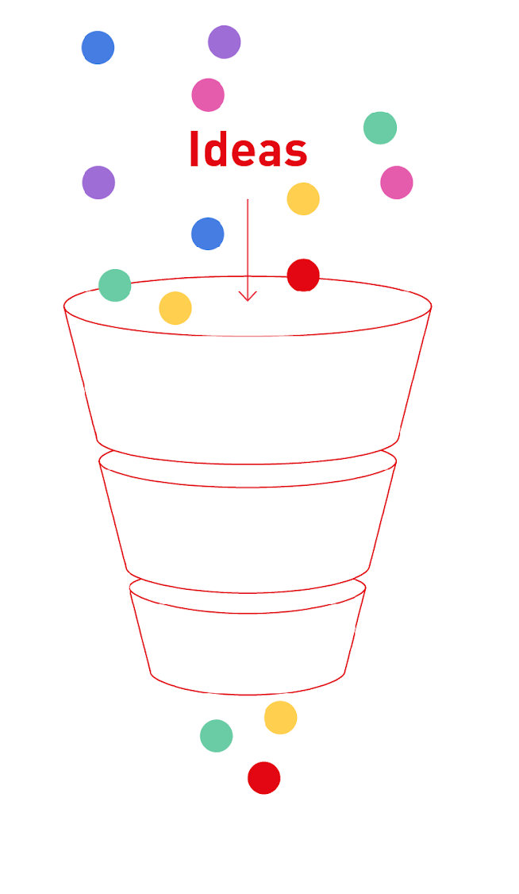
The idea filter
Use the idea filter to find the best idea.
User-centred: Which idea addresses your user’s pain/need best?
Degree of novelty: Which idea is the innovative one?
Favourite idea: Which idea are you most excited about?
Notes:
Filtering Ideas
A tool that helps us focus and refine our options is the so-called idea filter.
The idea filter is a simple yet effective tool to evaluate and prioritize ideas based on three levels.
These levels help assess the potential of each idea systematically, ensuring that the best options are selected for further development.
There are various level criteria you could define, based on what makes most sense in your specific context.
For today we are going to use the following three level:
User-centricity
Degree of novelty
Favorite idea
And this is exactly what we will do next!
By applying these filters, we’ll identify the ideas that have the most potential and are worth developing further.

Slide 5
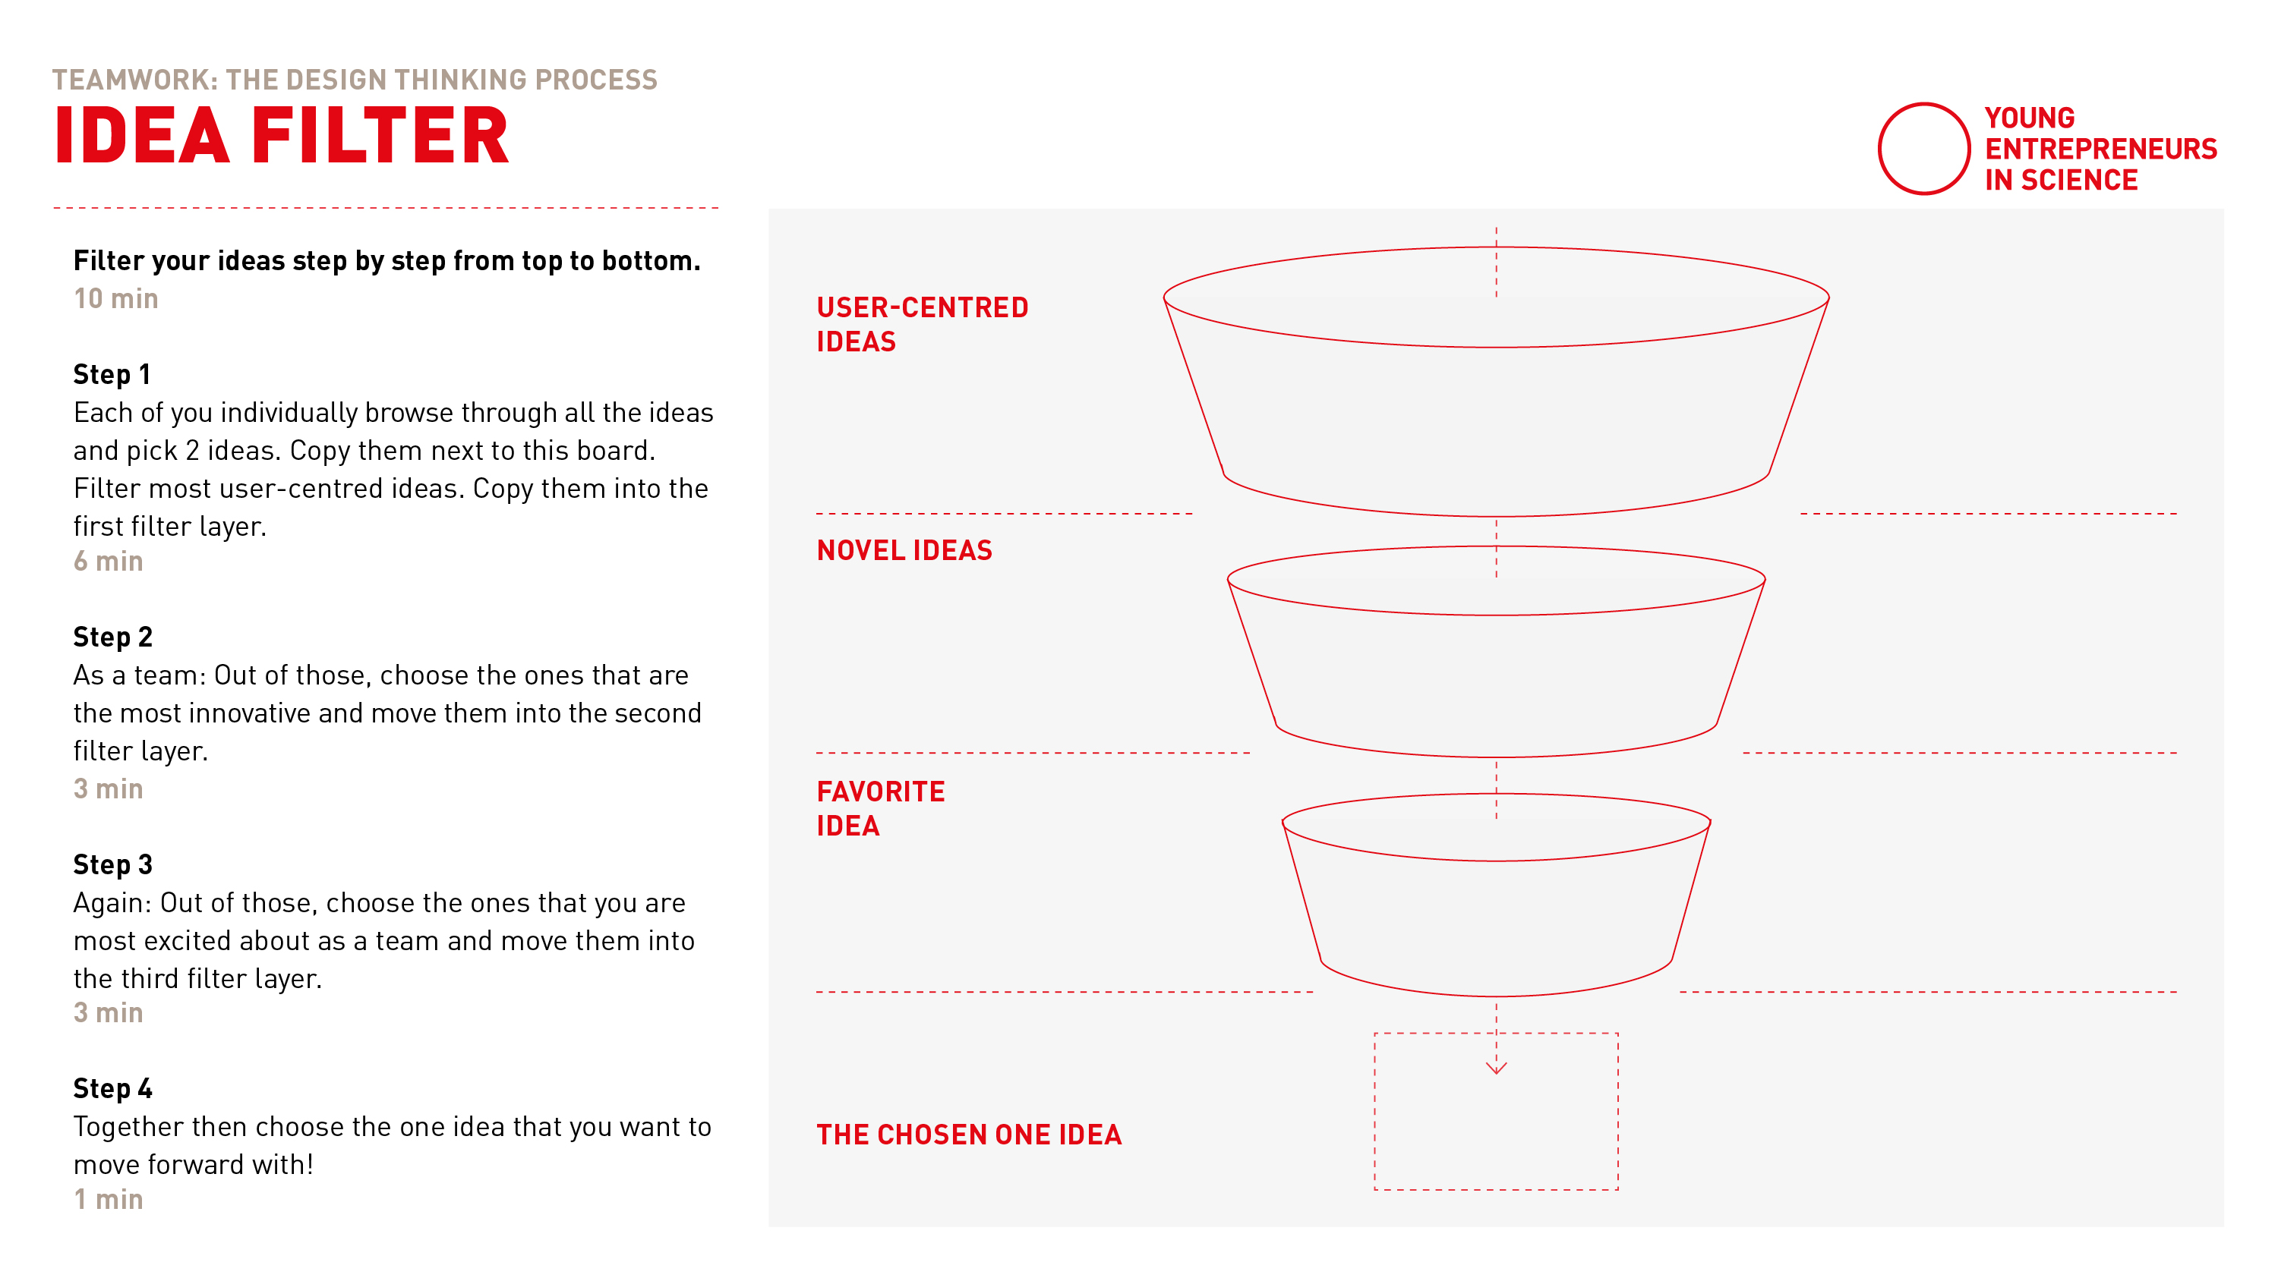
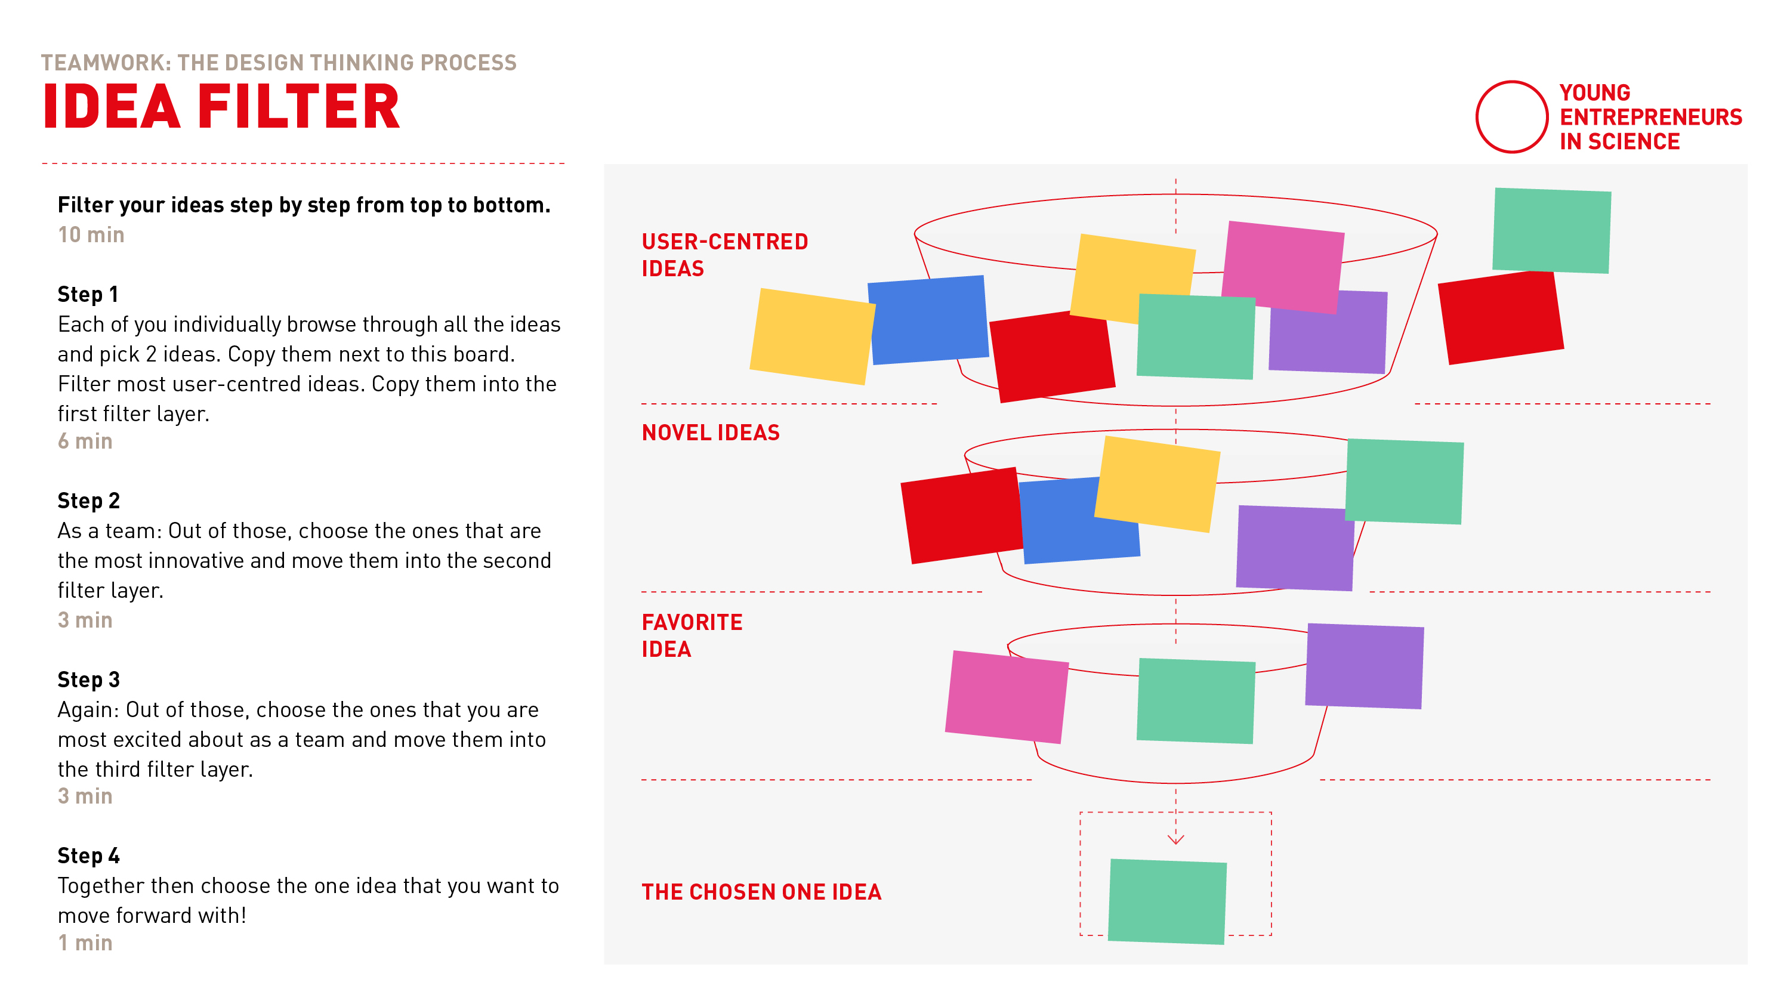
The idea filter
Notes:
Idea Filter Explained
All ideas go into the filter at the top. No idea is excluded at this stage.
Ideas are evaluated against the first criterion (e.g. user-centriciry). Only those that meet this criterion move forward.
Remaining ideas are then assessed against the second criterion (e.g., Novelty). Again, only qualifying ideas advance.
Finally, ideas are filtered by the third criterion (e.g., Favorite), leaving you with the best idea at the bottom of the filter.

Slide 6
Teamwork
Idea filter
10 min
Separate breakout rooms
Find your team corner in Miro and go to template 10
Automatic transfer back
Filter your brainstorming ideas through the idea filter from top to bottom.
Timekeeper: Keep track of time
3 min: Pick two ideas each​
3 min: Filter most user centred ideas​
3 min: Filter most novel ideas​
1 min: Choose the favourite idea​
Countdown for last minute​
Notes:
Here is how it works
Once your back in your breakout-room, find your tean corner and template 10.
As a first step for 3 min: Each of you individually browse through all the ideas and pick the 2 ideas that adress your user needs/pains best.
Copy them into the first filter layer.
As a second step for 3min: Out of those, as a team choose the ones that are the most innovative and move them into the second filter layer.
As a third step for 3min: Out of those, choose the ones that you are most excited about as a team and move them into the third filter layer.
As a last step for 1 min: Together then choose the one idea that you want to move forward with!

Slide 7
Let’s go!

Slide 9
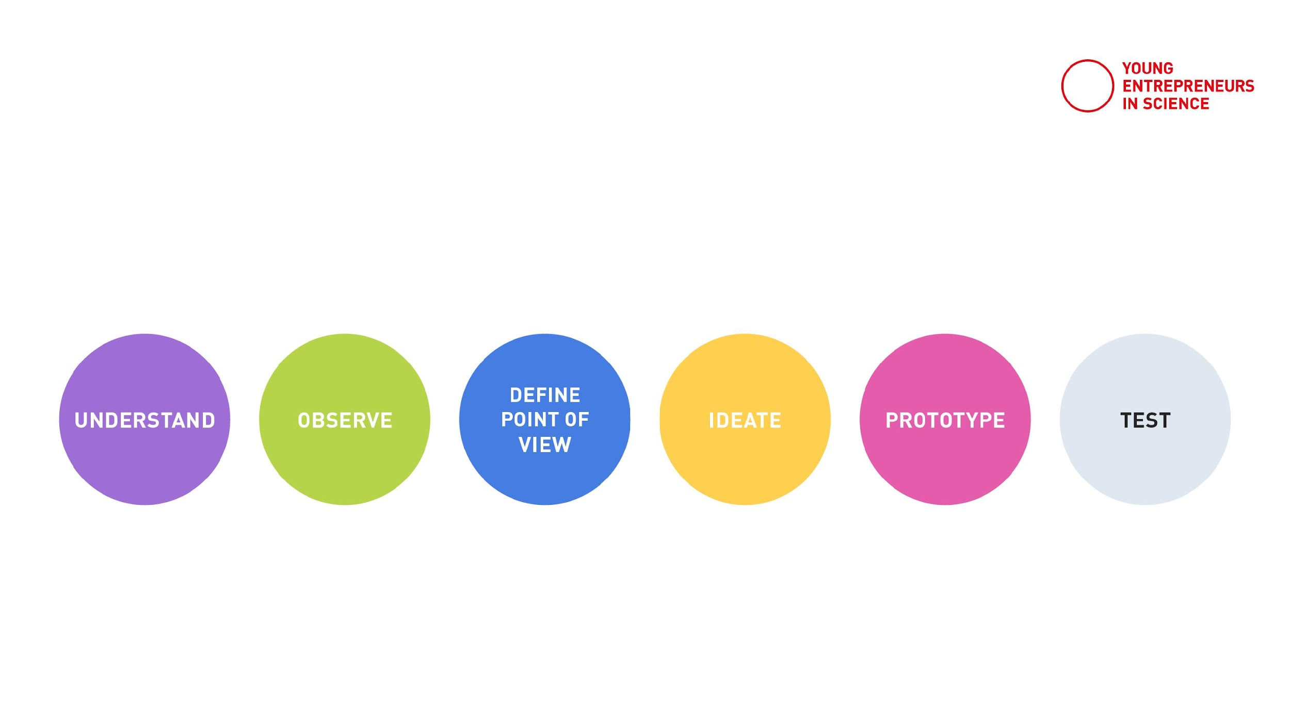
Prototype
Make idea tangible and testable
Think with your hands
Develop your idea further
Notes:
The "Prototype" Phase of the Design Thinking Process
The fifth phase in the design thinking process is „Prototype“.
This phase is all about bringing ideas to life in tangible, low-fidelity forms.
After generating and selecting ideas, we now create prototypes – simple, inexpensive models or mockups that represent our solution.
The goal is to test and explore ideas quickly without investing too many resources upfront.
Prototypes are not meant to be perfect; they are tools for learning and improvement.
We ask ourselves:
How can we make the idea real in a simple way?
What do we need to show or test to better understand its strengths and weaknesses?
This phase is not about finalizing solutions – it’s about experimenting, learning, and gathering feedback from users.
The insights gained from the prototype phase will guide further iterations and ensure that the solution evolves to truly meet user needs.

Slide 10
Building the prototype
The vague idea turns into more concrete shapes
The team synchronises
The idea gets tangible and therefore ready to be tested
Notes:
Why do we prototype?
Prototyping helps us turn ideas into tangible forms that can be tested and explored. Its all about learning, experimenting, and improving.
When we prototype, we:
Align the team by creating a shared understanding of the idea.
Make the idea concrete, turning abstract concepts into something real and interactive.
Test and validate the idea with users, gaining feedback that helps refine the solution.
Prototyping allows us to fail fast and learn fast, ensuring that we invest our energy into solutions that truly work for the users.

Slide 11



Building the prototype
What?
Make the idea tangible
How?
Quick and dirty
Why?
Understand and test
Notes:
So in a nutshell: We make ideas tangible in a quick manner in order to test our solution and learn more about our users.

Slide 12
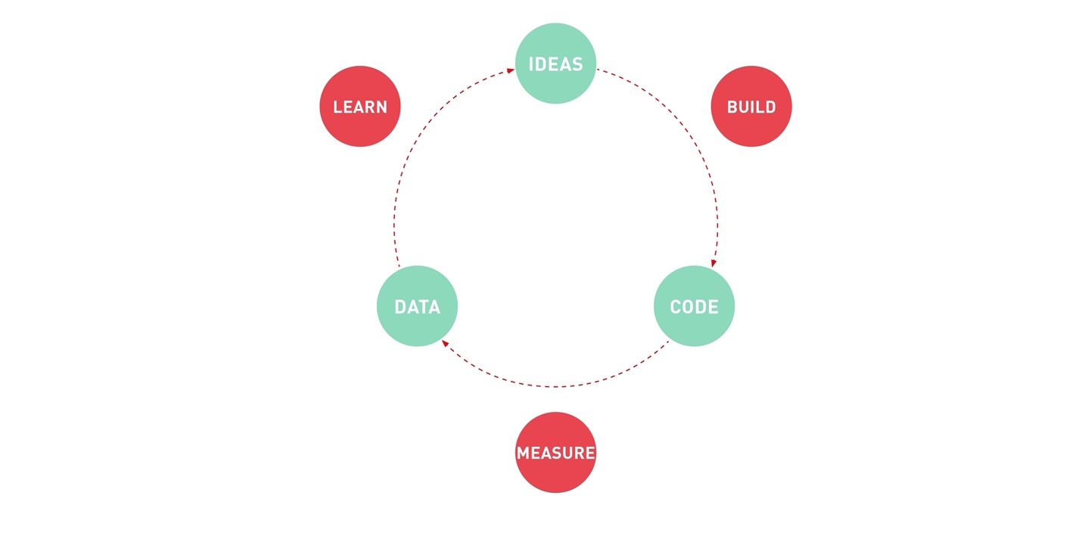
Lean startup
Notes:
This approach aligns closely with the principles of the Lean Startup (Eric Ries)
In the Lean Startup Concept creating a Minimum Viable Product (MVP) is key to testing assumptions quickly and gathering feedback early.
Through repeated cycles of the steps "Build," "Measure," and "Learn," initial ideas are continuously improved.
Prototypes function as an MVP within the design process, allowing us to test ideas with minimal resources.
Moderator-Note: If you want to share some info/links in the chat, so participants can research more if they are interested

Slide 13
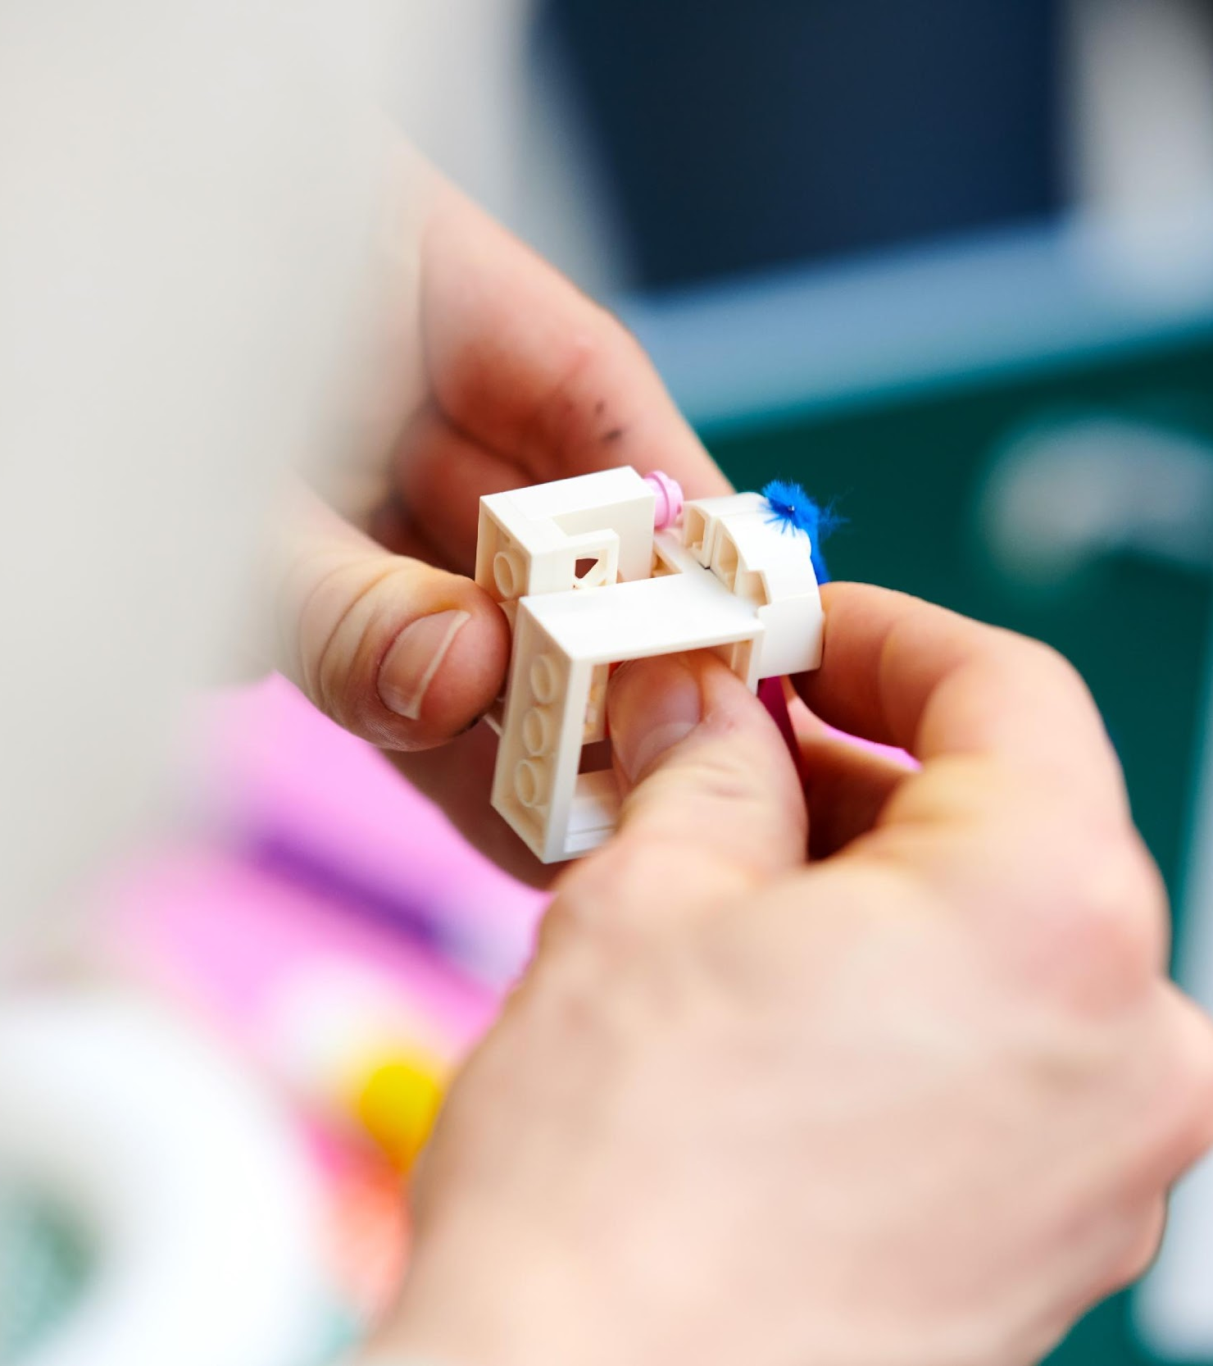
There are different kinds of prototypes …
Notes:
Now that we understand the importance of prototyping and its iterative process, it’s time to explore that there are different types of prototyping.
Each type serves a specific purpose depending on the stage of development, the level of detail needed, and the resources available.
Let’s take a look at the different approaches to prototyping.

Slide 14
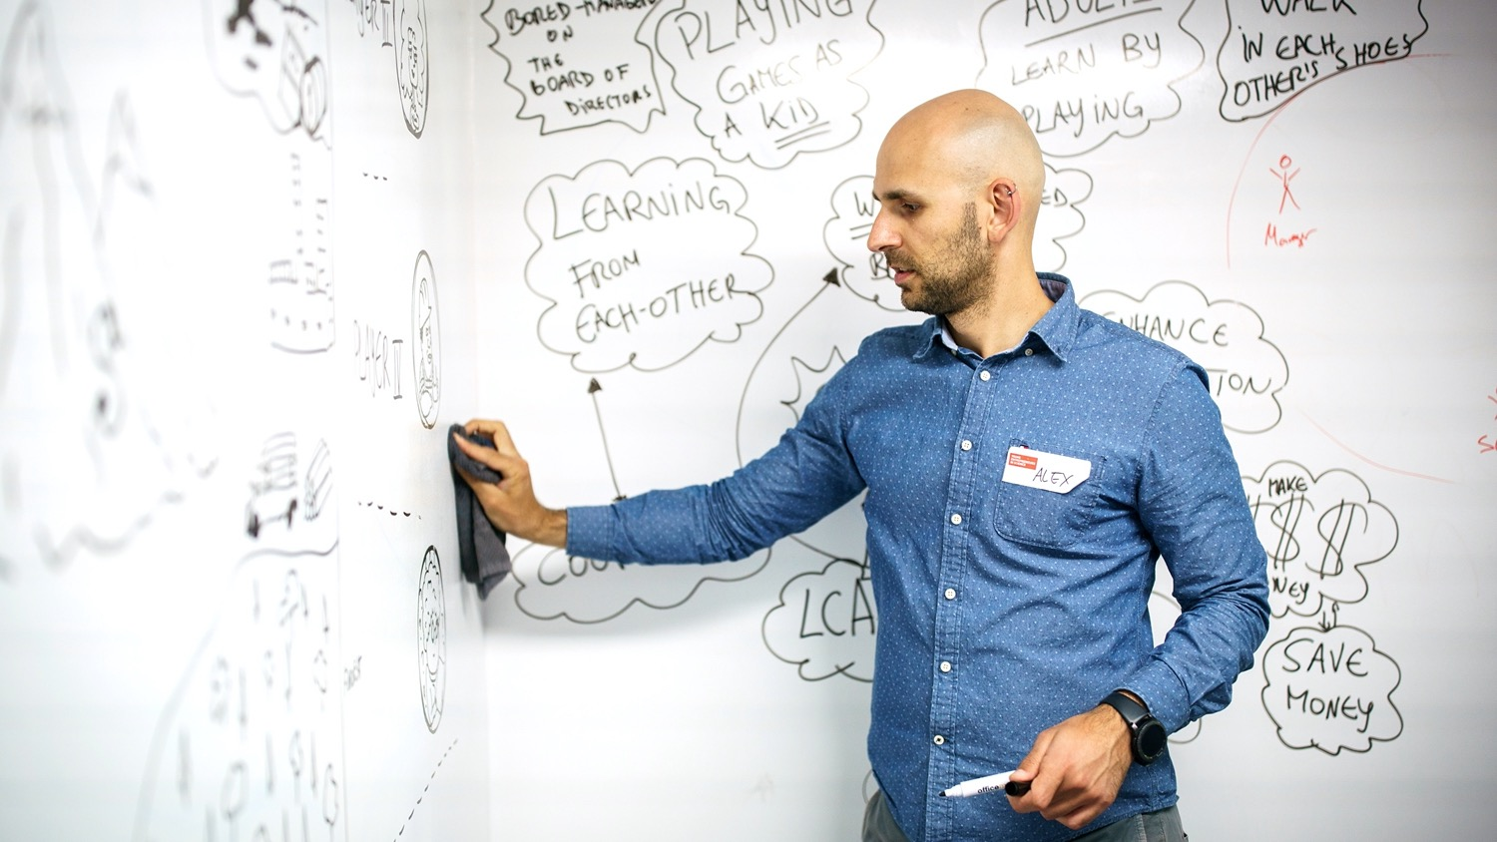
SKETCH
Notes:
Sketching as a Form of Prototyping
Sketching is a fast and cost-effective way to create prototypes, enabling you to quickly visualize and iterate on ideas.
It helps focus on the big picture without getting bogged down in details, making it ideal for the early stages of a prototype.

Slide 15
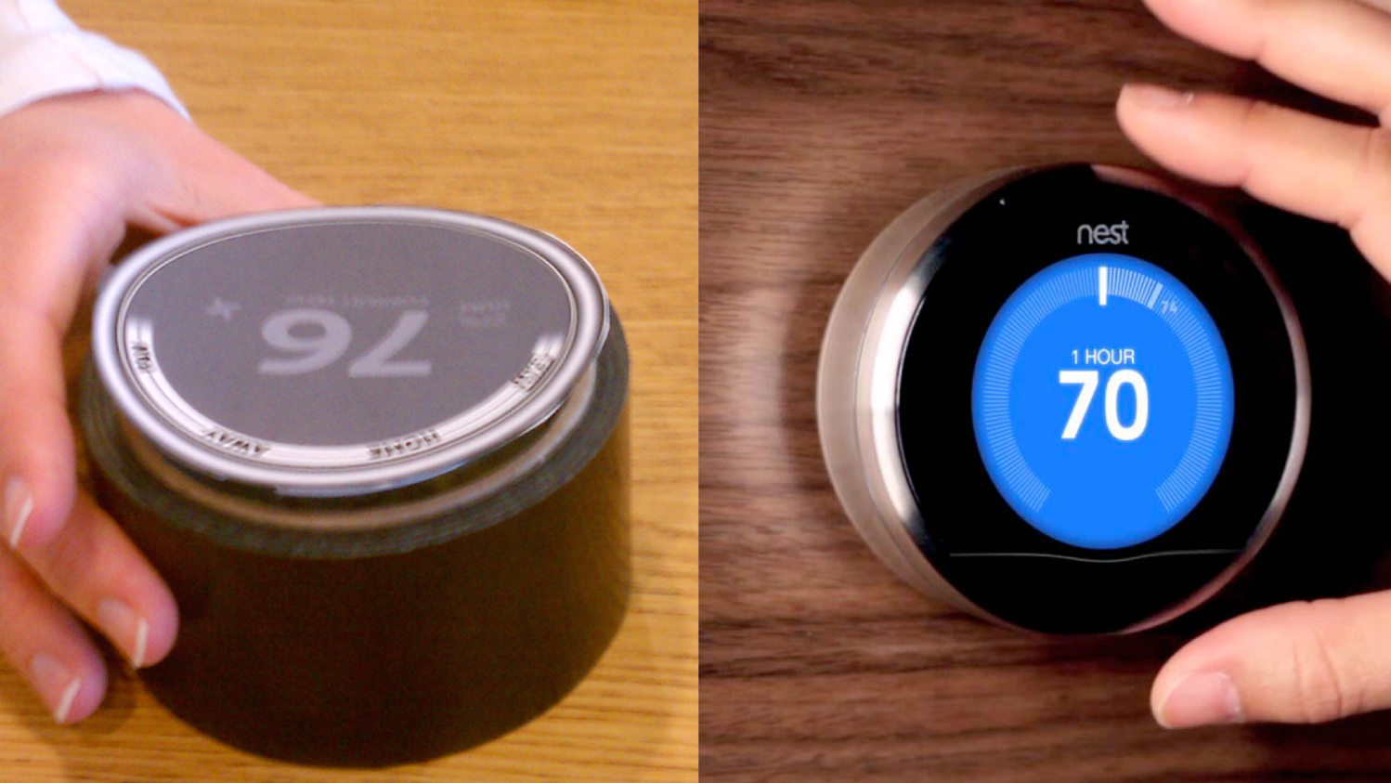
MOCK-UP
Notes:
Mockups as a Form of Prototyping
Mockups are more refined than sketches, providing a more detailed and realistic representation of a product’s design.
They help visualize the user interface and user experience, often offering a static, but lifelike version of the product.
Mockups allow teams to test and validate design elements, layouts, and interactions before developing a fully functional product.
An example of mockup prototyping comes form Nest.
The first prototype of the Nest thermostat (now owned by Google) was created using a simple roll of duct tape and a paper cutout for the interface.
This early mockup was designed to test how users would interact with the device – specifically, how they would feel using a simple dial to control the heating in their home.
Despite being low-tech, this prototype allowed Nest to explore critical functions before investing in a final design.
This approach highlights the importance of testing core features early in the process, ensuring that user needs and expectations are met.

Slide 16
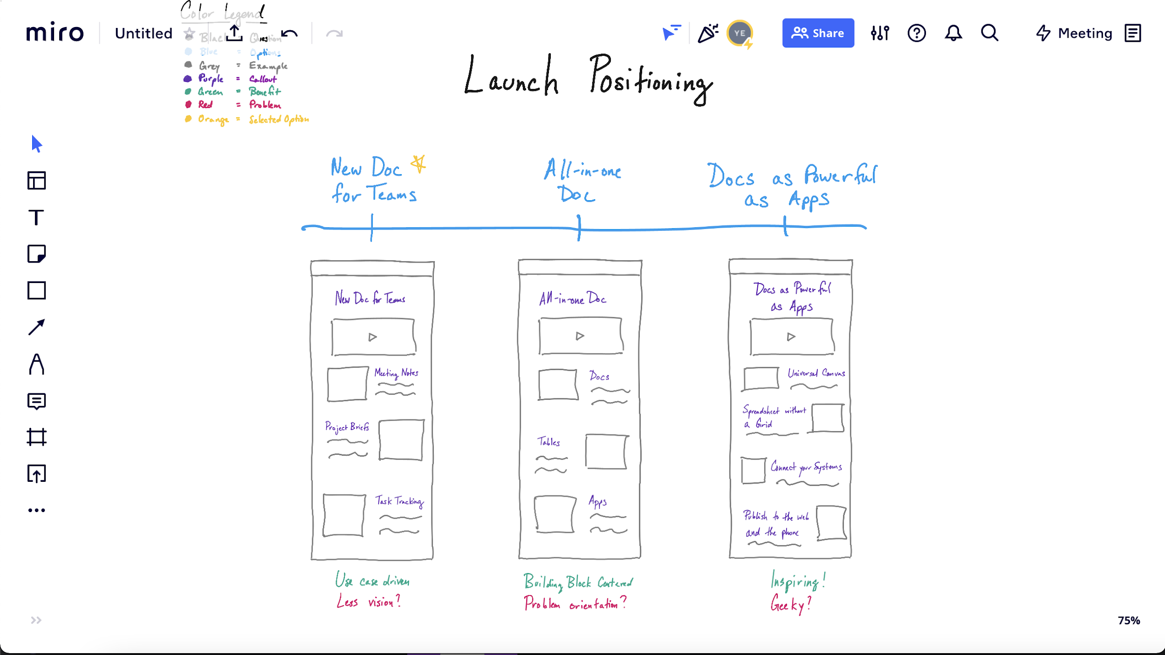
DIGITAL WIREFRAME
Notes:
Wireframing as a Form of Prototyping
Wireframing is a form of prototyping that focuses on the basic structure and layout of a product, often without detailed design elements.
It typically features simple lines, shapes, and placeholders to represent the different components of a user interface.
Wireframes are used to test and refine the flow and functionality of a product/service, ensuring that the layout works logically before adding any visual or interactive complexity.
Wireframes are a valuable tool in the early stages, providing a low-cost, low-fidelity way to explore and communicate ideas.
They allow teams to focus on essential user interactions and content organization without getting distracted by visual details.

Slide 17
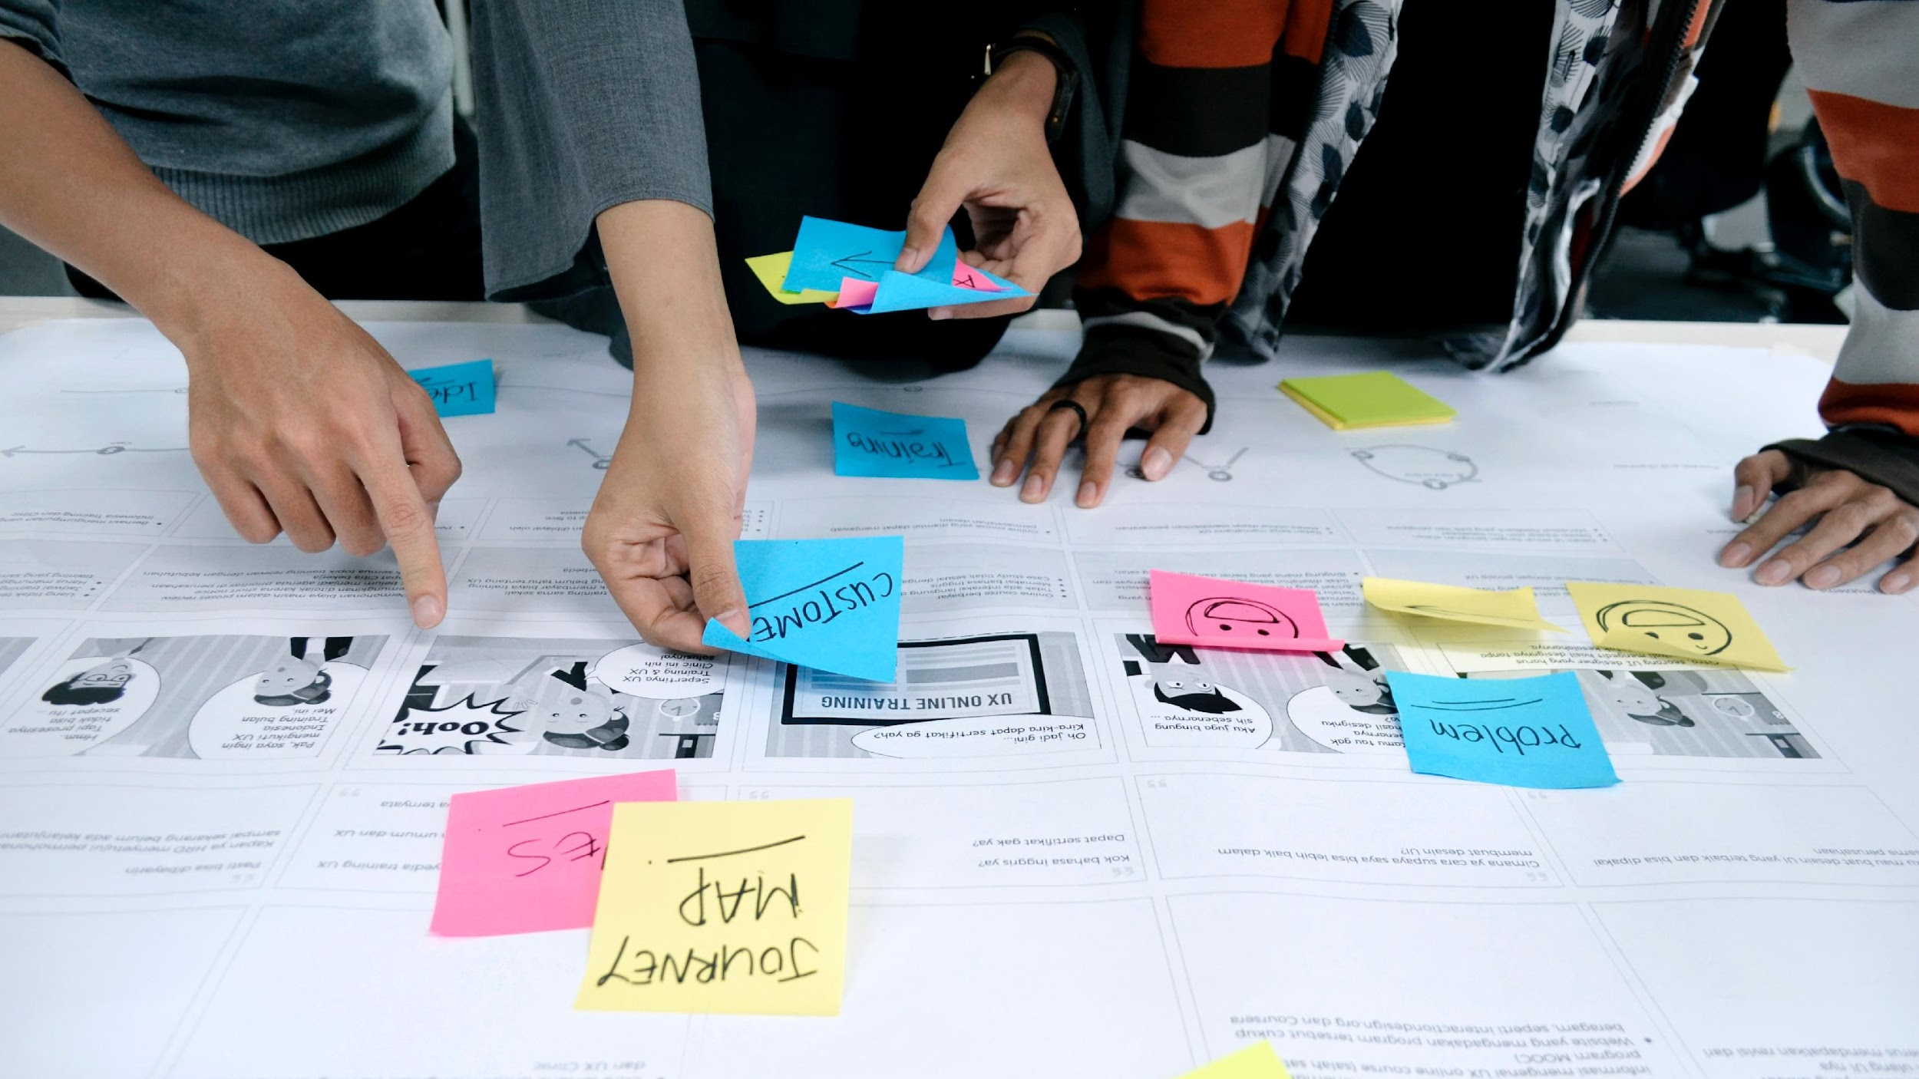
USER JOURNEY
Notes:
Journey Mapping as a Form of Prototyping
Journey mapping is a form of prototyping that focuses on visualizing and understanding the user's experience across various touchpoints with a product or service.
It helps identify user emotions, pain points, and needs throughout their interaction journey.
By mapping out these experiences, teams can prototype how a user might feel and behave at different stages and anticipate challenges they may face.
Journey mapping is especially useful for aligning the team on the user's needs and uncovering opportunities for improvement in the overall experience.

Slide 18

ROLE PLAY
Notes:
Roleplay as a Form of Prototyping
Roleplay is a dynamic form of prototyping where team members act out scenarios to simulate user experiences and interactions with a product or service.
It helps explore how users might react in real-world situations and provides insights into emotional responses, behaviors, and potential challenges.
By interacting with the user, team members can gain new insights regarding the the user’s perspective, uncovering new insights and improving the service.
This method is especially useful for testing interactions, understanding user needs, and identifying gaps in the user journey.
Roleplay enables teams to refine concepts in a realistic, interactive way without needing a physical prototype.

Slide 19
In summary …
… think about what (hypothesis) you want to test with your users first.
Based on that, build the prototype as simple as possible.
Notes:
Building a Simple Prototype Based on Hypotheses
Start by defining a hypothesis: what do you want to test with your users?
This could be a feature, design, or user behavior you want to explore.
Then, build your prototype as simply as possible, focusing on the core elements to test your hypothesis.
The goal is to validate your assumptions quickly and gather feedback, without investing too many resources. This allows for fast iteration and refinement based on real user insights.

Slide 20
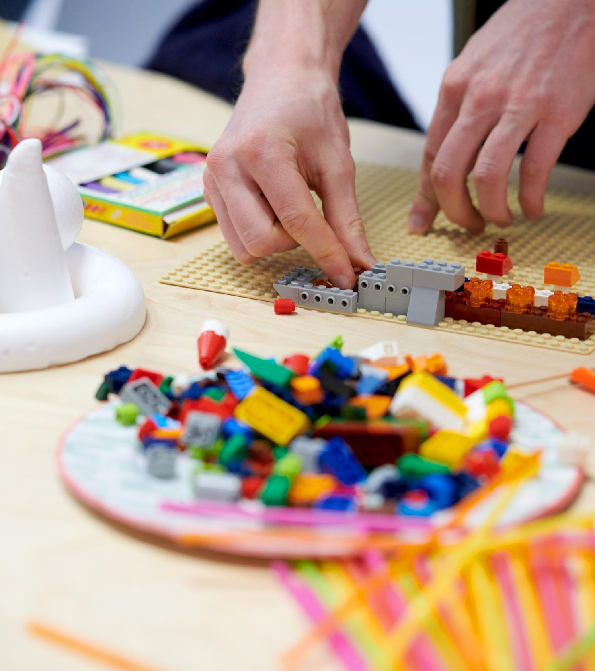
Build your digital prototype!
Notes:
Now its time for you to think with your hands and build prototypes!

Slide 21
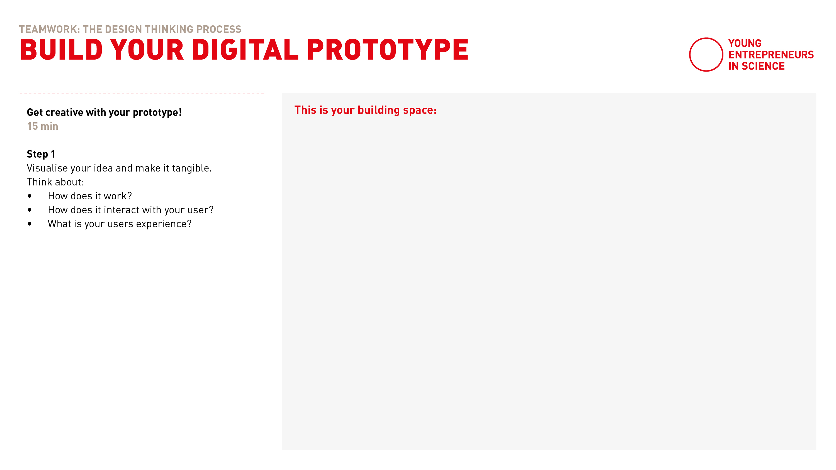
Build your digital prototype
Notes:
Today, we're working in Miro, but as a team, you have a variety of tools at your disposal.
Online platforms like Miro allow you to easily drag and drop visuals, making your ideas even more tangible and interactive.
Feel free to explore different visuals, images, and elements to enhance your process and bring your concepts to life!

Slide 22
Teamwork
Digital Prototype
20 min
Separate breakout rooms
Find your team corner in Miro and go to template 11
Automatic transfer back
Visualise your idea and make it tangible.
Think about:
How does your idea work?
What do you want to get feedback on?
How does it interact with your user?
Countdown for last minute
Notes:
Here is how it works
Once your back in your breakout-room, find your team corner and template 11.
It‘s time to get creative!
As a team you have 20 minutes to build your digital prototype and make your chosen idea tangible!
Therefore think about:
How does your idea work?
What do you want to learn and get feedback on?
What is the user experience and interaction?

Slide 23
Let’s go!

Slide 25
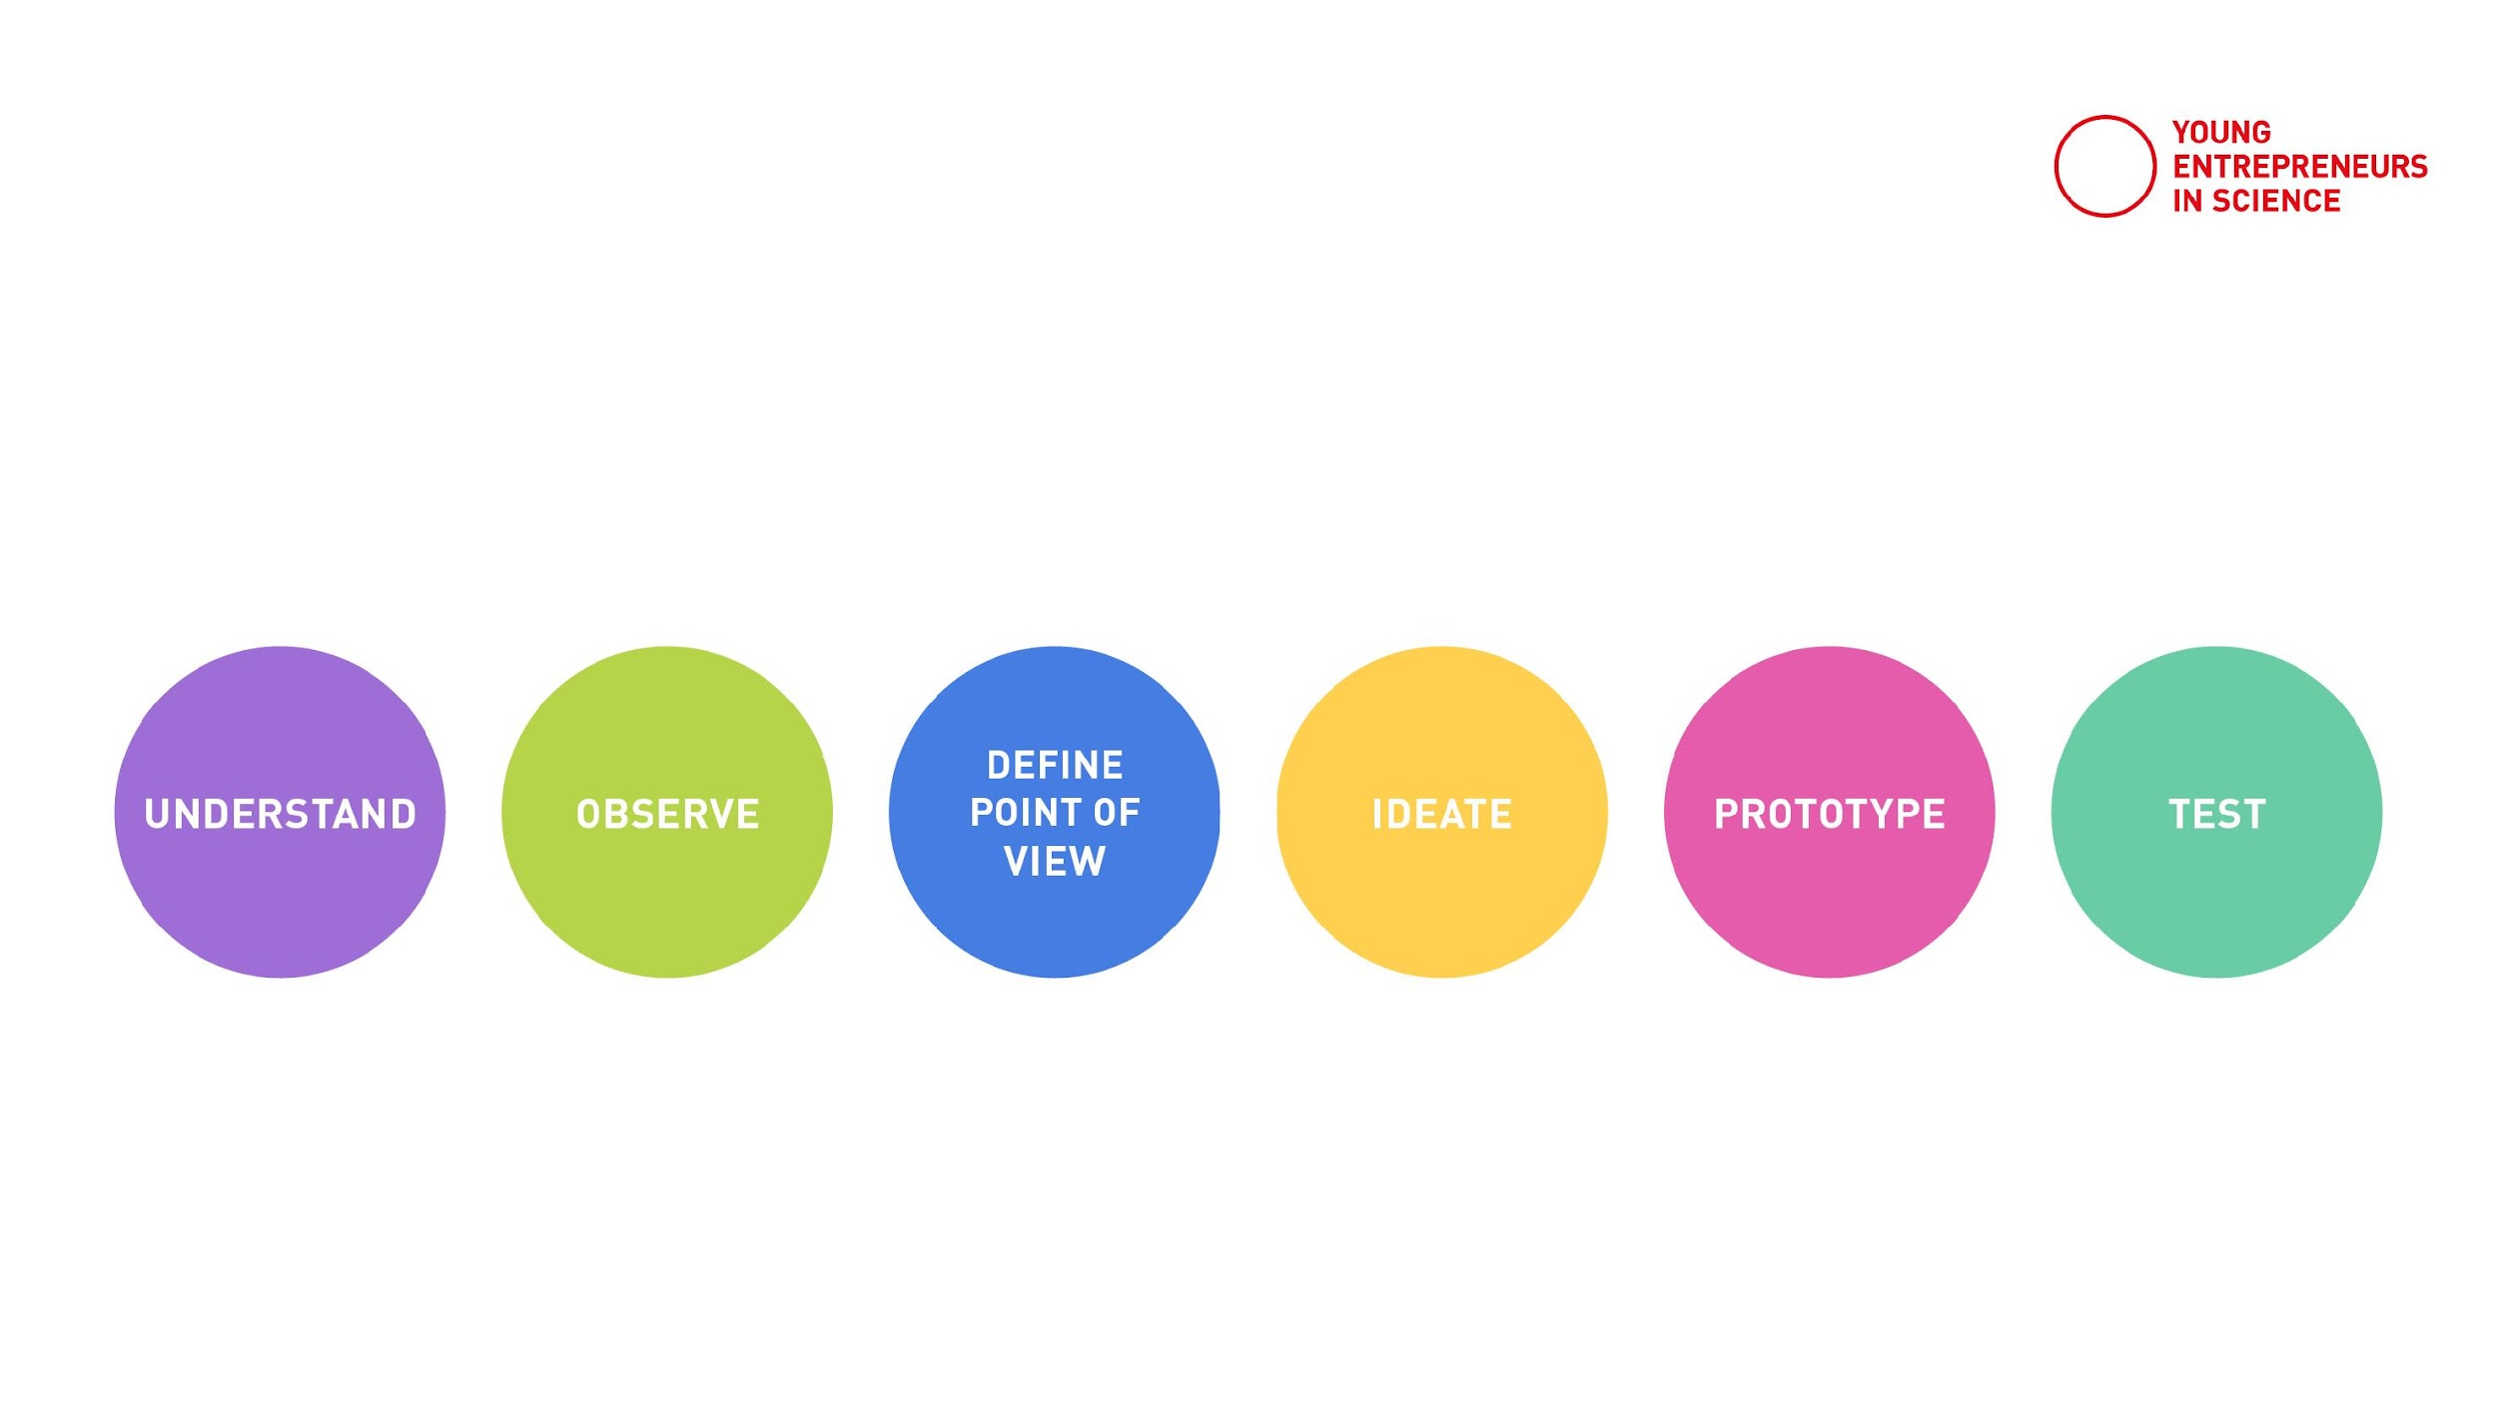
Testing
Get direct user feedback
Find your blind spots
Find the starting point for your next iteration
Notes:
The "Test" Phase of the Design Thinking Process
The fifth phase in the design thinking process is “Test”.
This phase involves putting our prototypes to the test with real users to validate our ideas and assumptions.
After ideating and prototyping, we now need to gather feedback to understand if we’re on the right track.
We ask ourselves: Do users understand the product? What excites them about the solution, what doesn‘t?
The goal is to refine and improve the prototype based on user feedback, not to confirm that the solution is perfect.
It's a crucial step to ensure the product meets real user needs and solves the right problem.
The insights we gain from testing shape the direction for further iterations, making sure we deliver a meaningful and effective solution.

Slide 26
Lean startup
Notes:
Like introduced earlier: innovation approaches often go in loops.
Yesterday you built your prototype
Now it‘s time to learn how to get honest feedback and learn about the blind spots about your idea.
This you can then use to improve your product/idea.

Slide 27
How to: Testing
Show! Don’t tell.
Testing is not presenting
Don’t try to sell your idea!
Let your user interact with your prototype
Notes:
How to Test in the Design Thinking Process
Testing is about showing, not telling.
It’s important to remember that testing is not presenting.
Don’t try to sell your idea or convince users of its value!
Instead, let your users interact with the prototype and observe how they use it, where they struggle, and where they find value.
The goal is to understand their experience, not to influence their opinion.
By stepping back and allowing users to engage freely, you gather honest feedback.

Slide 28
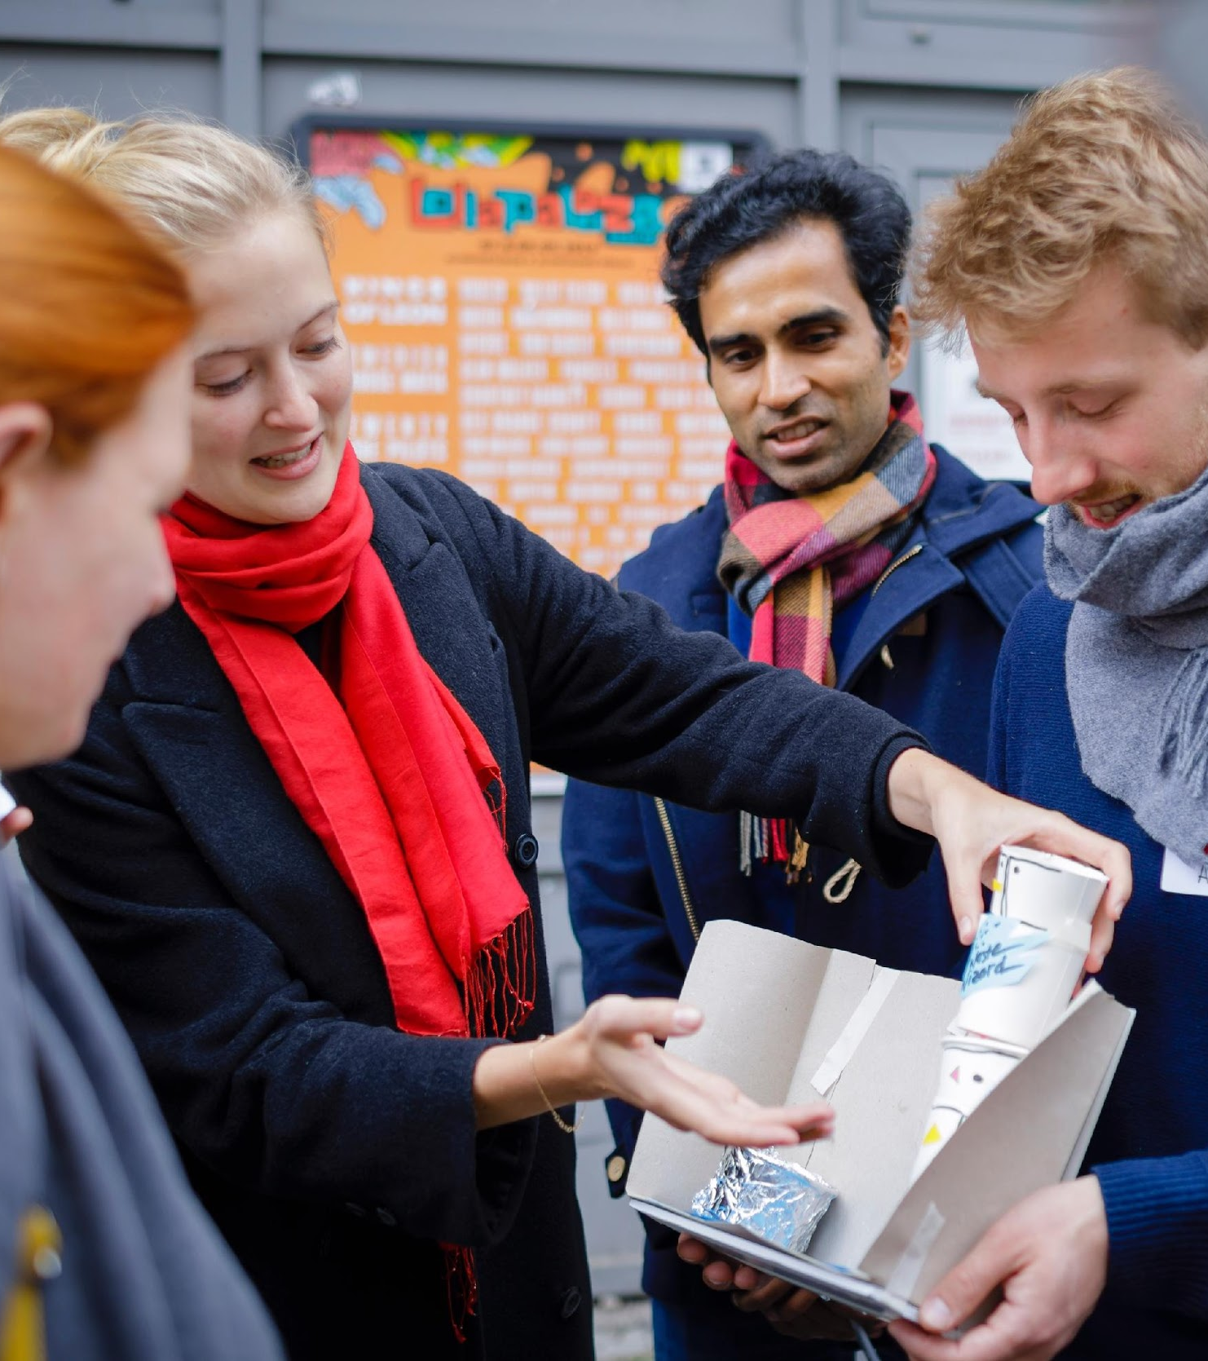
Prepare a test scenario
Notes:
So lets have a look on how to prepare a test scenario.

Slide 29
Planning a test scenario
A
What do you want to learn from your user? Think about:
your test objectives/hypotheses
B
How do you want to test your prototype? Think about:
what equipment you might need
how to document results & feedback
where to test your idea
Notes:
How to Prepare a Test Scenario
When preparing a test scenario, it's essential to have a clear understanding of what you want to learn from your users.
Start by defining your test objectives or hypotheses. What assumptions are you trying to validate? Are you testing usability, functionality, or user preferences?
This focus will guide the entire testing process.
Next, think about how you want to test your prototype:
What equipment might you need? Consider tools such as a laptop, screen, or testing device depending on your prototype.
How will you document results and feedback? Decide whether you will use notes, video recordings, or feedback forms to capture insights.
Where will you conduct the test? Will it be in a controlled environment, such as a usability lab, or in the user's natural environment?
By carefully considering these aspects, you’ll be well-prepared to gather valuable insights that will drive the next steps of your design process.

Slide 30

Test presentations
Notes:
Since today we unfortunately don’t have the time to go out there and test with real users, we will adapt the approach.
Instead of a traditional test scenario, we will conduct a test presentation.
In this format, you will present what you’ve been working on as a team, and the others will provide you with valuable feedback.
In a real-world design thinking process, we wouldn't exchange the testing with a presentation, so don't skip it once you transfer the approach to one of your projects!

Slide 31
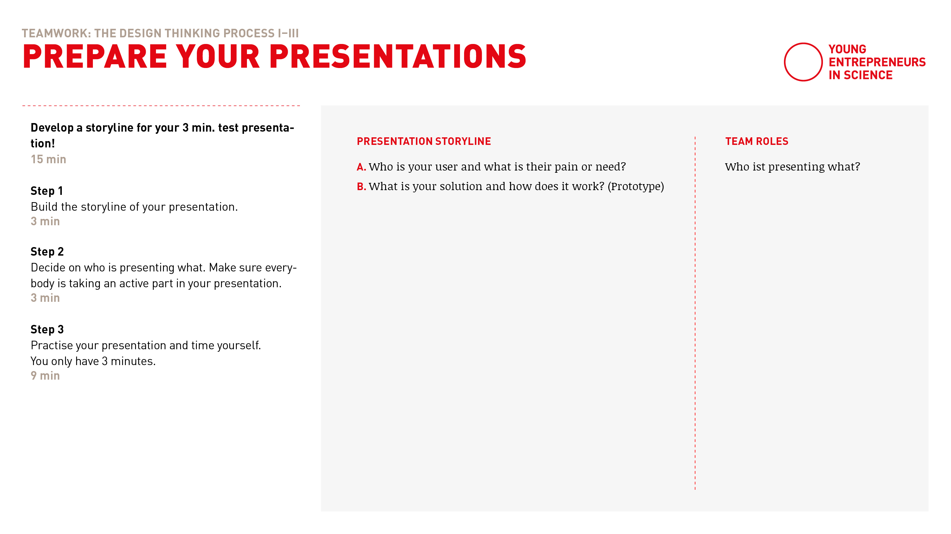
Test presentations
Notes:
As a next step you will have some minutes to prepare your presentation as a team.
The presentations will be max. 3 minutes each
We would like to learn form each team:
Who is your user and what is the main need/insight you found a solution for?
Was is your solution and how does it work (show us your prototype)
After you developed your presentation storyline please decide who of you ist presenting what part

Slide 32
Teamwork
Prepare your test presentation
15 min
Separate breakout rooms
Find your team corner in Miro and go to template 12
Automatic transfer back
Build the storyline of your 3 min presentation and decide on who is presenting what.
Practise your presentations.
Timekeeper: Keep track of time
6 min: Storyline
2 min: Who and what
7 min: Practise the presentation
Countdown for last minute
Notes:
Here is how it works
Once your back in your breakout-room, find your team corner and template 12.
As a first step for 6 min: Build the storyline of your presentation
As a second step for 2 min: Decide on who is presenting what. Make sure everybody is taking an active part in your presentation!
Use the last 9 min to practice your presentation and time yourself. You only have 3 minutes for the presentation as a whole team.

Slide 33
Let’s go!

Slide 35

It’s coffee o’ clock!

Slide 36

How to give feedback
Notes:
Before we start with the presentations, let me share a few words on how to give effective feedback.
Giving feedback is like giving a present.
It’s about offering something valuable that helps the other person improve and grow.
Be gentle and considerate, as learning can sometimes be challenging.
The goal is not to criticize but to guide, so everyone can learn and improve.

Slide 37
Feedback grid
I like …
I wish …
New ideas
Open questions
Notes:
We find the structure of the feedback grid very helpful because it provides a clear and organized way to deliver feedback.
The grid typically breaks feedback into categories such as:
I like about the idea ...
I wish/what could be improved ...
New ideas I have ...
Open questions that came up ...
This helps ensure that feedback is balanced, specific, and actionable, making it easier for the receiver to understand and act on.

Slide 38
Giving feedback
Be sensitive!
Keep in mind your varied cultural backgrounds
Keep a sense of mutual respect
Practise clear and constructive feedback
Notes:
A few more words on the art of giving feedback:
Be sensitive! Always be mindful of how your feedback might be received. What might seem like helpful advice to one person could be perceived differently by another, so be considerate in your approach.
Keep in mind your varied cultural backgrounds. People from different cultures may have different communication styles and sensitivities. Make sure to adapt your feedback to be respectful and mindful of these differences.
Keep a sense of mutual respect. Feedback should always be given with respect, as it's meant to support growth, not to criticize.
Finally, practice clear and constructive feedback. Make sure your comments are specific, actionable, and framed positively.

Slide 39
Receiving feedback
Embrace feedback!
Understand feedback as a learning opportunity
Try not to defend yourself or explain too much
Take notes!
Practise listening with curiosity and openness
Notes:
A few words on how to receive feedback, as it's also an art form:
Embrace feedback! View it as a valuable opportunity to learn and grow, not as criticism.
Understand feedback as a learning opportunity. It’s meant to help you improve and refine your work, not to undermine you.
Try not to defend yourself or explain too much. Instead of justifying your choices, stay open and receptive to what’s being said.
Take notes! Writing down the feedback helps you absorb it and refer back to it later.
Finally, practice listening with curiosity and openness. Approach the feedback with a genuine desire to understand the perspectives of others and how you can use their insights to improve.

Slide 40
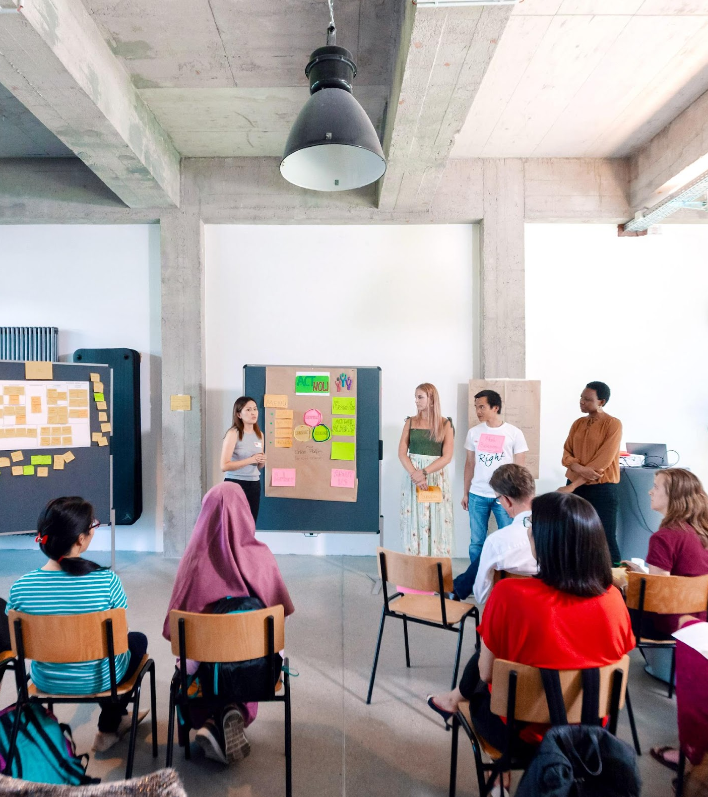
Presentations
Notes:
Okay, now that we know how to give and receive feedback, let‘s go!

Slide 41


How it works …
3 min Presentation
2 min Feedback
Notes:
Here’s how the presentation session will work:
Each team will present for 3 minutes. Once the time is up, I will interrupt to keep things moving.
After the presentation, we’ll open the floor for 2 minutes of feedback from everyone.
Please keep your feedback short and to the point so we can hear as many perspectives as possible.
Remember to use the feedback grid, start with “I like...”, followed by “I wish...” to keep it constructive and focused.
Moderators note: 4 teams can present (more info in agenda).

Slide 42
The stage is yours!
Notes:
And now the stage is yours!
Moderators note: stop screenshare and highlight presentators or share their prototype, whatever makes most sense

Slide 43
Recap
Notes:
Today, we quickly went through the Design Thinking process using a sample challenge as an example.
Starting with Empathizing to understand the users, followed by Defining the problem, Ideating possible solutions, Prototyping ideas, and finally Testing them through presentations and feedback.

Slide 44

Transfer…
Think about your own research:
What would be a good starting point to start into the innovation process?
Notes:
In the next step, we want to give you the opportunity to think about your own research work and consider what would be a good starting point for the process for you.
Take 5 minutes to reflect individually, then we’ll do a quick round of sharing in the group.

Slide 45

Sharing…
Share your transfer insights with the group: ​
What are your next steps? ​
Which open questions do you have?​
Notes:
Share your transfer insights with the group:
What are your next steps? ​
Which open questions do you have?​

