Slide 1
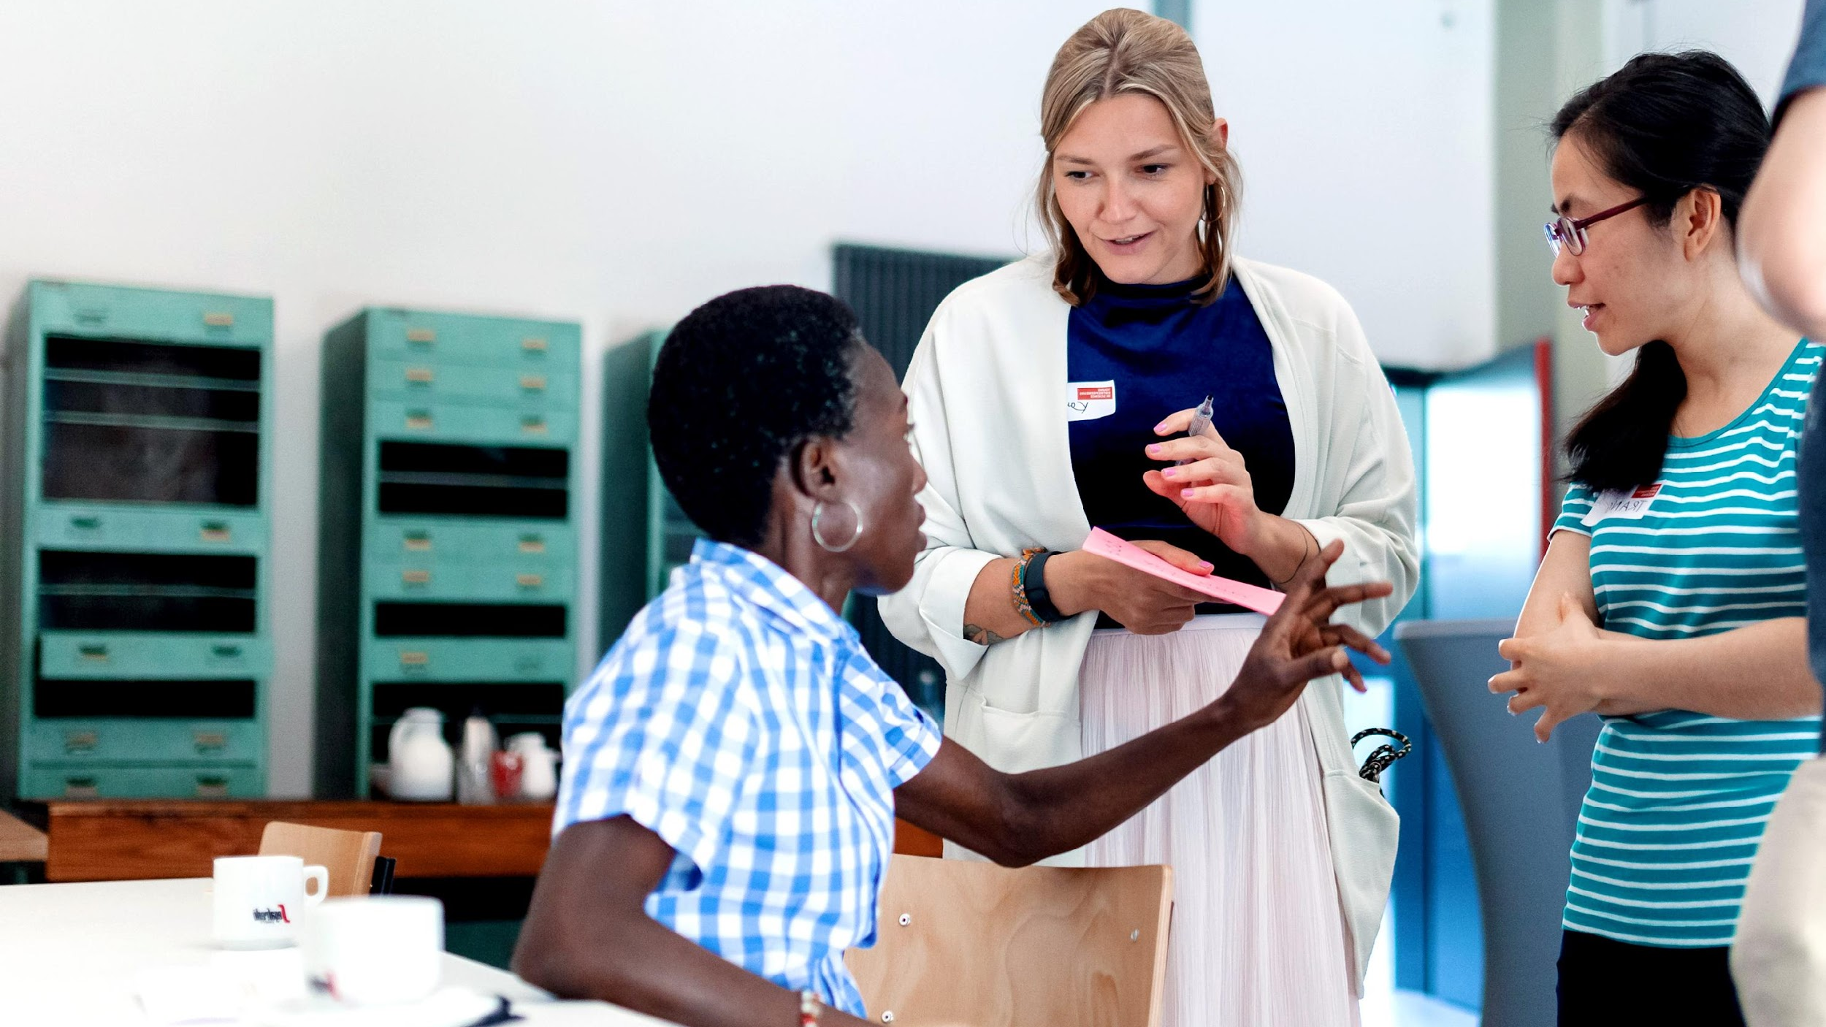
YOUR INNOVATION SKILLS

Slide 2
Learning goals
Breaking the entrepreneurial stereotype
Reflecting upon your personal innovative skillset with the help of the Entrepreneurship Competence Wheel
Understanding how your skills contribute to a team and defining your entrepreneurial superpowers

Slide 3
The entrepreneur
What comes to mind when you think about an entrepreneur?
Notes:
Interactive

Slide 4




The “Entrepreeur” stereotype
Notes:
What happens most of the time, when we think about entrepreneurs, we immediately have a picture like that one in our head: Because ist still very prominent in the media:
Male, energetic driven, superhero

Slide 5
This is what the media says …
Here are 15 characteristics you must improve to become a successful entrepreneur!
Creativity
Passion
Motivation
Product or service knowledge
Ability to network
Self-confidence
Optimism
Vision
Goal mindset
Risk-taking
Persuasiveness
Decision-making
Tenacity
Money management
Adaptability
Notes:
And when we think about someone like that, we often connect this idea with personality traits like …
www.indeed.com/career-advice/finding-a-job/entrepreneur-characteristics

Slide 6


Your entrepreneurial journey
unrealistic
rather realistic
Notes:
and yes. most of those characteristics will definitely be of great use when starting your own business!
But what is important to understand here: > Nobody is born as the start-up superhero with all of these traits or feeling comfortable living all of those traits right in the beginning > And being an entrepreneur is a very individual journey on which you’ll find your own approach on how to live and develop your own entrepreneurial mind- and skillset.
And this is what this module is all about! :)

Slide 7

MY INNOVATIVE SKILLS
Notes:
Co-Mod Training: Slide 7-21
Beginn

Slide 8

Skillset: EntreComp Wheel
Tool to reflect on your personal development of entrepreneurial skills
Developed by the Joint Research Centre (JRC) of the European Commission
Made up of three competence areas: Ideas & Opportunities, Resources, Into Action
Each area includes 5 competences
Bacigalupo, M., Kampylis , P., Punie , Y., Van den Brande, G. (2016). EntreComp : The Entrepreneurship Competence Framework. Luxembourg: Publication Office of the European Union; EUR 27939 EN; doi:10.2791/593884
Notes:
Even though we are not born superheros, we all bring parts of it to the table. What entrepreneurial skills do you already bring or practice everyday in your academic life?
For that we’d love to work with a very comprehensive tool that includes a huge variety of competences that you can use as resources on your entrepreneurial path: the Entrepreneurship Competence Wheel:
Tool to reflect on your personal development of entr. Skills
EntreComp was developed by the Joint Research Centre (JRC) of the European Commission on behalf of the Directorate General for Employment, Social Affairs and Inclusion (DG EMPL)
The EntreComp Framework is made up of 3 competence areas: ‘Ideas and opportunities’, ‘Resources’ and ‘Into action’. Each area includes 5 competences, which, together, are the building blocks of entrepreneurship as a competence. The framework develops the 15 competences along an 8-level progression model
‘Ideas and opportunities’, ‘Resources’ and ‘Into Action’ are the 3 areas of the conceptual model and they have been labelled to stress entrepreneurship competence as the ability to transform ideas and opportunities into action by mobilising resources.
More information:
There is a growing awareness that entrepreneurial skills, knowledge and attitudes can be learned and in turn lead to the widespread development of entrepreneurial mind-sets and culture, which benefit individuals and society as a whole.
producing a common definition of entrepreneurship as a bundle of competences; identify the key components of entrepreneurship as competences;
It thus embraces different types of entrepreneurship, including intrapreneurship, social entrepreneurship, green entrepreneurship and digital entrepreneurship. It applies to individuals.
EntreComp creates a shared understanding of the knowledge, skills and attitudes that make up what it means to be entrepreneurial
The reader is welcome to establish new links among areas and competences to expand the elements of the framework and adapt them to best fit his/her focus.

Slide 9

Ideas & Opportunities
Which ideas & opportunities can you see and develop?
Competence
Hint
Spotting Opportunities
use your imagination and abilities to identify opportunities for creating value
Creativity
develop creative and purposeful ideas
Vision
work towards your vision of the future
Valuing ideas
make the most of ideas and opportunities
Ethical & sustainable thinking
assess the consequences and impact of ideas, opportunities and actions
Bacigalupo, M., Kampylis , P., Punie , Y., Van den Brande, G. (2016). EntreComp : The Entrepreneurship Competence Framework. Luxembourg: Publication Office of the European Union; EUR 27939 EN; doi:10.2791/593884
Notes:
The first category is Ideas & Opportunities. Which ideas & opportunities can you see and develop?
Examples:
- Spotting opportunitites: use your imagination and abilities to identify opportunities for creating value > I can identify a need in my surrounding
- Creativity: develop creative and purposeful ideas > develop ideas, define problems
- Vision: work towards your vision of the future > I can imagine a desirable future; vision to turn ideas into action
- Valuing ideas: make the most of ideas and opportunities > recognising the potential of ideas
- Ethical & sustainable thinking: assess the consequences and impact of ideas, opportunities and actions > assess the consequences of ideas/course of action chosen

Slide 10

Resources
Which resources do you have to transform your ideas into action?
Competence
Hint
Self awareness & self-efficacy
believe in yourself and keep developing
Motivation & perseverance
stay focused and don't give up
Mobilising resources
gather and manage the resources you need
Financial & economic literacy
develop financial and economic know-how
Mobilising others
inspire, enthuse and get other on board
Bacigalupo, M., Kampylis , P., Punie , Y., Van den Brande, G. (2016). EntreComp : The Entrepreneurship Competence Framework. Luxembourg: Publication Office of the European Union; EUR 27939 EN; doi:10.2791/593884
Notes:
The second category are Resources – which resources do you have to transform your ideas into action?
Examples:
- Self awareness & self-efficacy: believe in yourself and keep developing > reflect on own needs and aspirations
- Motivation & Perseverance: stay focused and don't give up > being resilient under pressure; be determined to turn ideas into action
- Mobilising resources: gather and manage the resources you need > use resources responsibly, get support
- Financial & Economic literacy: manage financial and economic know-how > manage financing and cost of turning ideas into actions
- Mobilising others: inspire, enthuse and get others on board > get support needed by inspiring others

Slide 11

Into Action
Which competences do you bring with you to become active?
Competence
Hint
Taking the initiative
go for it
Planning & management
prioritise, organise and follow up
Coping with uncertainty, ambiguity & risk
make decisions dealing with uncertainty, ambiguity and risk
Working with others
team up, collaborate and network
Learning through experience
learn by doing
Bacigalupo, M., Kampylis , P., Punie , Y., Van den Brande, G. (2016). EntreComp : The Entrepreneurship Competence Framework. Luxembourg: Publication Office of the European Union; EUR 27939 EN; doi:10.2791/593884
Notes:
The last category deals with the question what competences do you need to get active
Examples:
- Taking the initiative: go for it > take challenges, act and work independently
- Planning & management: prioritise, organise and follow up > define priorities and action plans
- Coping with uncertainty, ambiguity & risk: make decisions dealing with uncertainty, ambiguity and risk > make decisions in uncertain situations, handle fast-moving situations flexibly
- Working with others: team up, collaborate and network > listen actively, accept diversity, network and cooperate
- Learning through experience: learn by doing > reflect and learn from success and failure

Slide 12
The wheel can also help you to ...
map your own entrepreneurial competences
assess and develop your entrepreneurial skills
identify individual strengths and weaknesses
build your entrepreneurial team
Notes:
Apart from reflecting about your skills which we will do in a very short time, the tool an also help you to…
Falls die TN nach Quellen fragen, könnt ihr diese hier posten:
https://iefp.eapn.pt/docs/AE1_Quadro_Europeu_competencias_digitais.pdf > pdf on explaning the framework in more detail
https://eige.europa.eu/resources/lfna27939enn.pdf > Report about the Entrepreneurship Competence Framework
https://education.ec.europa.eu/focus-topics/improving-quality/key-competences Platform from the European Union focusing on lifelong learning
https://education.ec.europa.eu/focus-topics/improving-quality-equity/key-competences-lifelong-learning/entrepreneurship - Platform from the European Union focusing on entrepren education

Slide 13

My innovative skills
Notes:
Now it’s your turn…

Slide 14
My innovative skills
Based on what you just learned, think about the different entrepreneurial competences according to the EntreComp Wheel.
Which skills do you already have? Which of them are the most fun for you? Pick 2.
Which skills do you especially use in your research work? Pick 2.
Which skills would you like to develop (more)? Pick 2.
Notes:
Pick two skills for each question from the wheel

Slide 15
Solo work
My innovative skills
12 min
Stay in main room and mute your microphone.
You can turn your camera off.
Reflect on your entrepreneurial skillset with the help of the questions.
Take a look at the Google template if you need the hints for each competence.
4 min for each question
Countdown for last minute

Slide 16
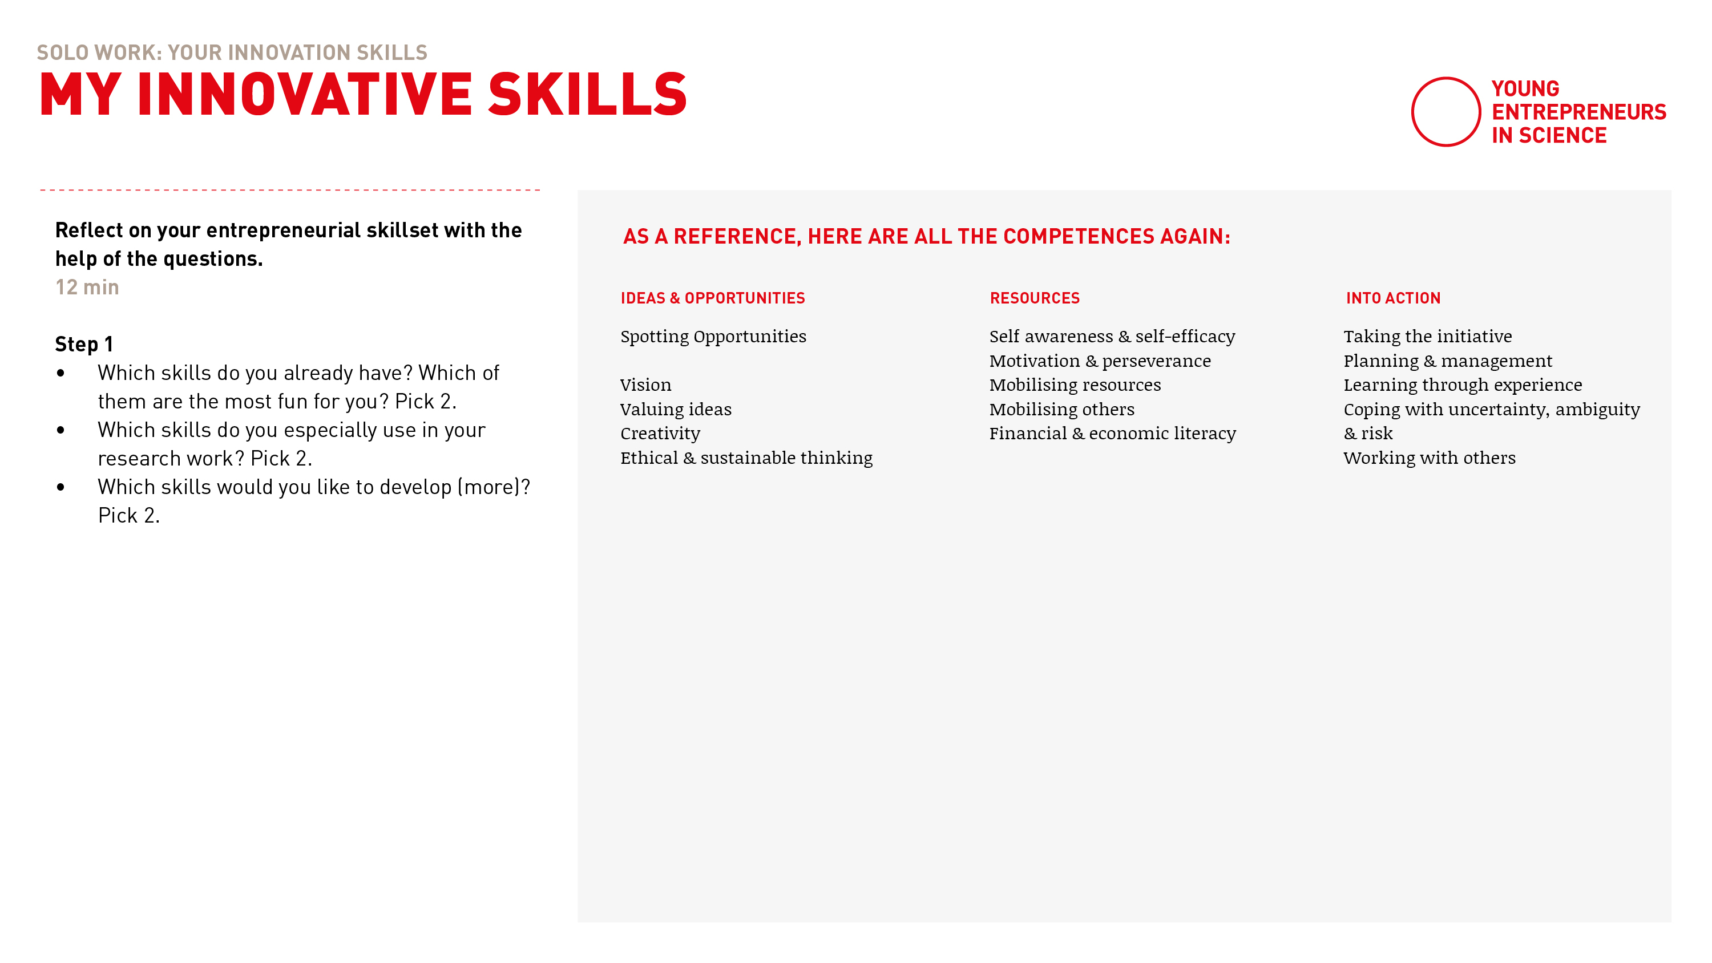
My innovative skills
Notes:
Unbeschreibbare Google Templates → siehe Feinagenda
Erläutern, wie sich die Kompetenzen auffächern und kurze Beispiele/Erklärung geben
Description Aussagen nur in der Tonspur, falls nach mehr Beispielen gefragt wird

Slide 17
Notes:
Welcome back!
Everything went well? Everybody back in the room?
Thumbs up please!

Slide 18
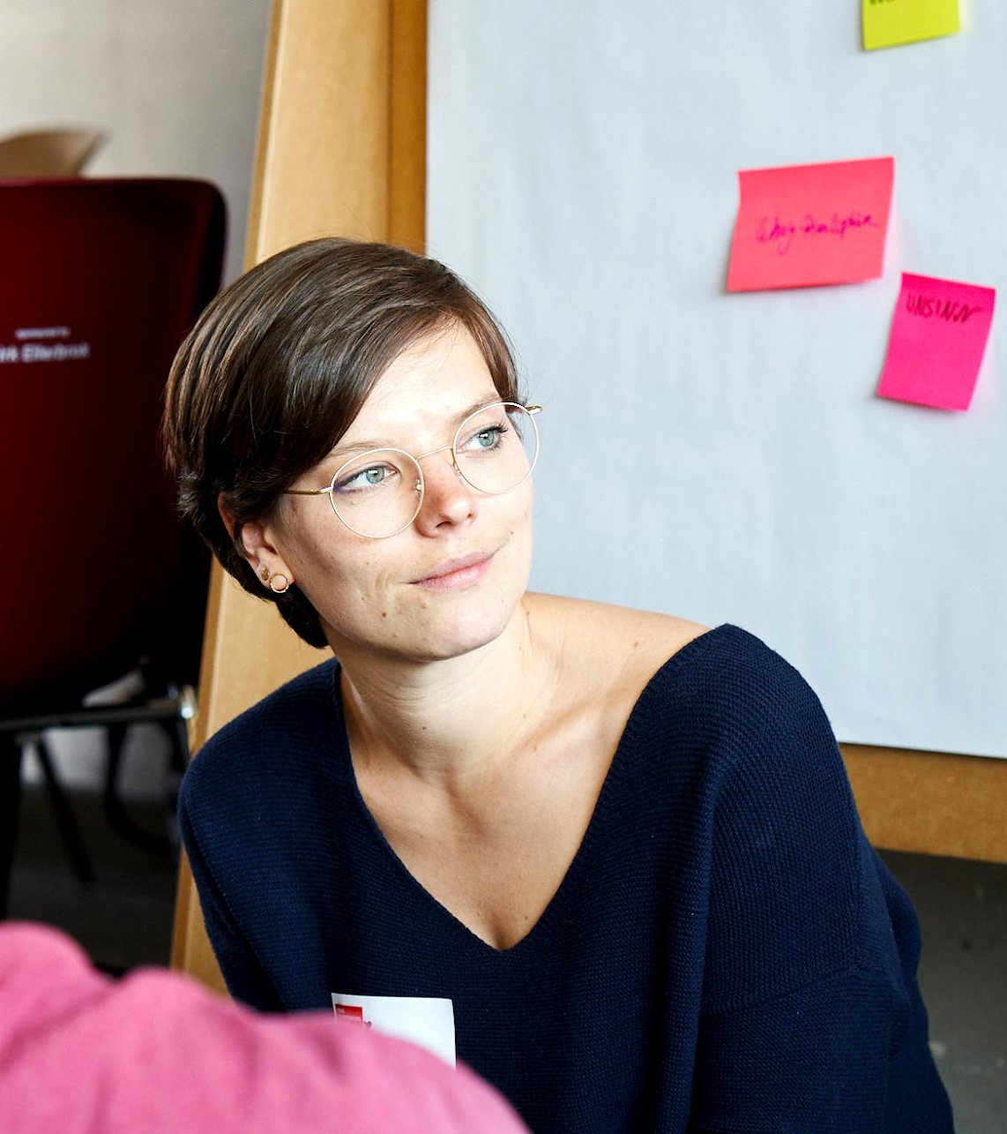
Your entrepreneurial superpower
Notes:
Okay. Next we prepared a teamwork excercise for you

Slide 19
Share with a partner
Based on what you just reflected on, ...
… share your thoughts around your own entrepreneurial skillset with a partner:
One after the other: Listen carefully and find the one »entrepreneurial superpower« of your partner.
Talk about one skill that you would like to develop (further). Together brainstorm ideas how you could do that.

Slide 20
One on one
Your entrepreneurial superpower
15 min
You will meet your partner in a digital breakout room.
Automatic transfer back
Share your thoughts around your own entrepreneurial skillset with a partner.
One after the other: Listen carefully and find the one »entrepreneurial superpower« of your partner.
Talk about one skill that you would like to develop. Together brainstorm ideas how you could do that.
Each person 7 min for sharing, feedback and brainstorming
Countdown for last minute

Slide 21
Let’s go!
Notes:
Co-Mod Training: Ende

Slide 22
Notes:
Welcome back!
Everything went well? Everybody back in the room?
Thumbs up please!

Slide 23
What thoughts have come up during the reflection?
Notes:
With which ideas did you come up for developing your skills?

Slide 24

It’s coffee o’ clock!
Notes:
but first: Break ☺

Slide 25

Combine your individual strengths …

Slide 26

… and form the ultimate team!

Slide 27
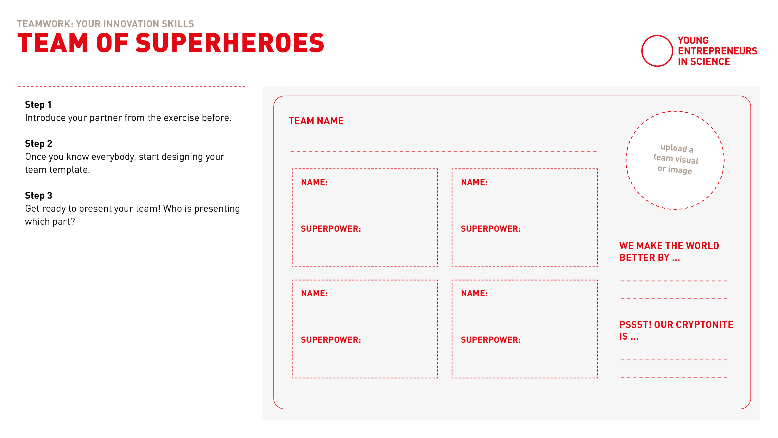
Team of superheroes
Notes:
Google Document → siehe Feinagenda

Slide 28
Teamwork
Team of Superheroes
25 min
Small teams in seperate Breakout rooms.
Find the Google Sheet number according to your breakout room number.
Introduce yourself and your entrepreneurial superpower
Create your team of superheroes.
Get ready to present your team! Who is presenting which part?
each 3 min for introduction of superpowers
12 min for designing your team template
1 min for choosing a presenter
Countdown for last minute
Automatic transfer back

Slide 29
Let’s go!

Slide 30
Notes:
Welcome back!
Everything went well? Everybody back in the room?
Thumbs up please!

Slide 31
Please introduce to us ... … your entrepreneurial superteams!
Notes:
Screenshare aus, M2 nimmt ran

Slide 32

Transfer your superpower
Notes:
Now that you‘ve identified your superpower(s) think about a situation in the next days/weeks in whcih you can conciously take advantage of it/use it…

Slide 33
Solo work
Transfer your superpower
5 minutes
Please, stay in the main room and mute your microphone.
Grab a piece of paper and a pencil.
Think about a moment/ situation within the next week in which you can consciously use your superpower.
Or think about how you could develop/strengthen a skill that you are still missing during the next weeks.

