Slide 1

YOUR ENTREPRENEURIAL CAREER
Notes:
Okay, now let us dive into the topic of your entrepreneurial career.

Slide 2
Learning goals
Getting to know the concept of entre- and intrapreneurship
Reflecting on your own potential entrepreneurial journey
Exchange with and learn from young entrepreneurs
Notes:
The learning goals for this module are:
Getting to know the concept of entre- and intrapreneurship: These might be completely new terms for some of you. So we want to shed some light here.
Reflecting on your own potential entrepreneurial journey: We aim to open up career perspectives to you and invite you to reflect the option of an entrepreneurial career. It is important for us to say: If you feel after those two days that this really is not your cup of tea: That is totally fine! We just want to inspire you, but we are not here to convince anyone!
Exchange with and learn from young entrepreneurs. We are happy to welcome (a) role model(s) that will join us later today. This is someone that left science to build up an own business and is willing to share their experiences and answers to your questions.

Slide 3
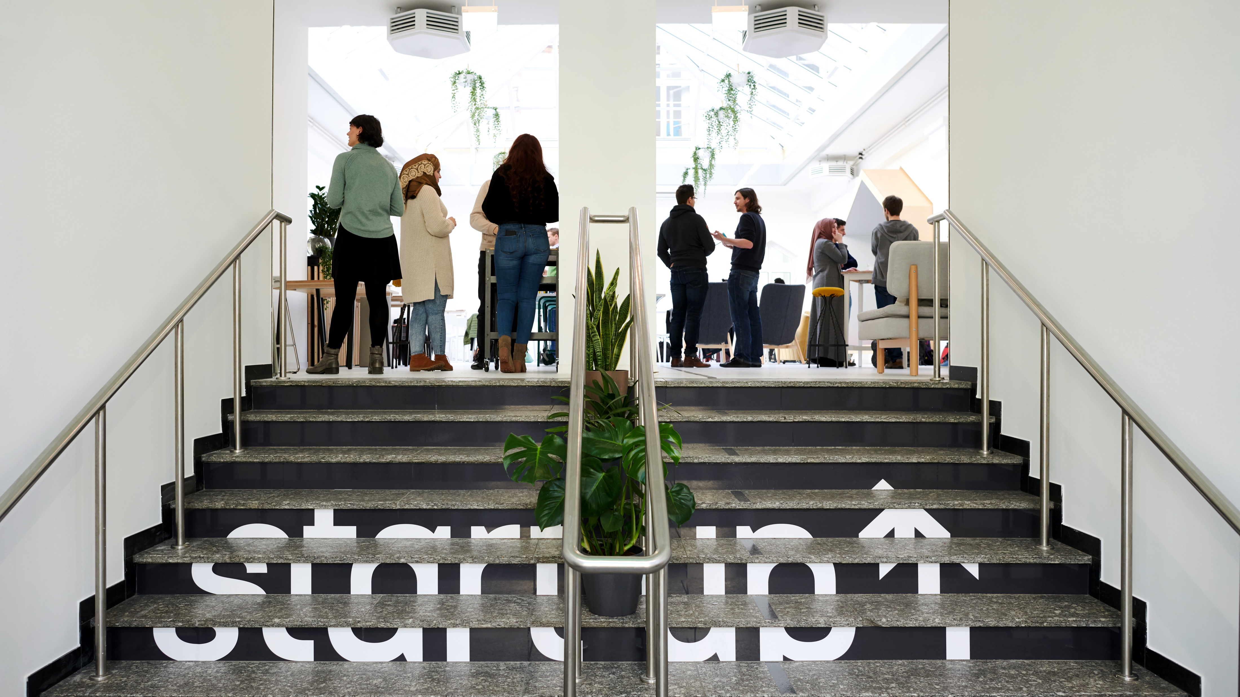
ENTREPRENEURSHIP
Notes:
Let’s go and start with the term entrepreneurship…

Slide 4
What is entrepreneurship?
Skill in starting new businesses, especially when this involves seeing new opportunities.
Cambridge Dictionary
Notes:
… By definition: What is entrepreneurship?
The Cambridge Dictionary says: It‘s a skill in starting new businesses, especially when it involves seeing new opportunities.
And this is what I like about this definition. It‘s a skill. You can learn it. - I tell you: I know a lot of people that didn‘t know anything about how to start their start-up but developed the necessary skills on the way.
Now that we know one definition of the term entrepreneurship it is also interesting to take a moment to look at different contexts in which entrepreneuship occurs…

Slide 5
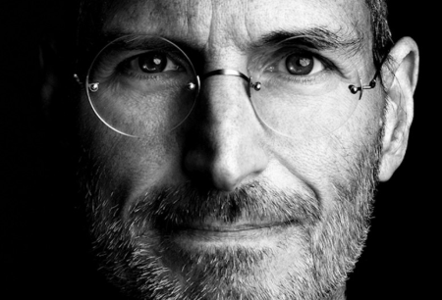

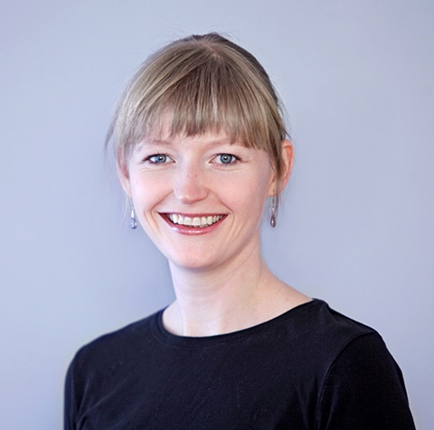
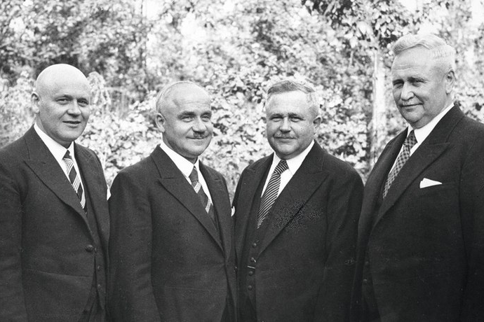
Types of entrepreneurship
Example 1 Start-up founder, Serial Entrepreneur
Example 2 Founder and Serial Entrepreneur
Example 3 Social Entrepreneurs
Example 4 SME’s, Hidden Champions Mittelstand, Family Businesses
Steve Jobs
Apple, NeXT, Pixar
Oprah Winfrey
Harpo Productions, OWN, O Magazine
Dr. Anja Bittner
„Was hab ich?“
August, Franz, Theo & Bernhard Claas
CLAAS
Notes:
When you think of the term Entrepreneur & Entrepreneurship: What does come to your mind?
Entrepreneurship & entrepreneurial Thinking & acting: not only within start-ups, also small/medium enterprises or in family businesses
Many faces to it: Don’t have to be the hip start-up guy to be an entrepreneur.
We would like to start the 4 days with exploring the term: Where does it stem from? What is the scientific understanding? What aspects do belong to it?
_________________________
Was versteht ihr den unter Unternehmertum?
Unternehmertum muss nicht nur Start-Up sein, gibt auch unternehmertum im Mittelstand und z.B. in Familienunternehmen, die von Generation zu Generation weiter gegeben werden
(Auch Unterscheidung in Pull-Faktoren: „Opportunity Entrepreneur“ à ich nutze eine Marktlücke aus und „NecessityEntrepreneurs“ à ich bin ein Existenzgründer und mache das, weil ich sonst z.B.: ggf. arbeitslos werde)
Viele Gesichter, d.h.: mann muss nicht hippe Start-Up Typ sein, um unternehmerisch tätig zu sein. Lasst und doch mal gucken: Woher kommt überhaupt der Begriff Unternehmertum und wie die Wissenschaft mit ihmumgeht?
-----
Who is an entrepreneur?
In modern entrepreneurship-literature, there a tons of diverse definitions.
Also, there are CULTURAL DIFFERENCES THAT LEAD TO DIFFERENT INTERPRETATIONS OF THE TERM „ENTREPRENEURSHIP“
And there are different pictures coming along with entrepreneurship:
.. Like the start up guys. You think of something developing, „innovative“
… if I would ask a friend of mine … entreprenuers are founders of small and medium[-sized] enterprises
…or they run a familiy business. The name is the company, so to say. Thats the founder
(Auch Unterscheidung in Pull-Faktoren: „Opportunity Entrepreneur“ à ich nutze eine Marktlücke aus und „NecessityEntrepreneurs“ à ich bin ein Existenzgründer und mache das, weil ich sonst z.B.: ggf. arbeitslos werde)
So there are a lot of definitions, we would like to share some with you in a bit.
To do this we asked ourselves: Where does the term “entrepreneurship” stem from? Who is important to know when talking about Entrepreneurship?
__________________
come in different shapes and sizes.
And of course there are people like Elon Musk who are serial founders.
But also there are social entrepreneurs like for example Dr. Anja Bittner. She has started a company around translating medical results and is also aiming to better working conditions for doctors.
Then there are also Small and Medium Enterprises and Family businesses like the company CLAAS – one of Young Entrepreneurs in Science’s company partners.. They also need to be entrepreneurs and innovative to stay in their business fields.
German Notes (old):
Aussage: Wenn man an Entrepreneuership denkt, dann denkt man automatischen an den (männlichen weißen) Mitte-hipster im Start-up und Kicker etc. Wir wollen zeigen: Es gibt mehrere Kontexte und Art&Weisen gibt!
Entrepreneurship hat viele Gesichter.
Könnte mit offener Frage beginnen: An was denkt, ihr, wenn ihr Entrepreneuership hört? Genau, an den Startup-Hipster. Keine Angst! Das müsst ihr nicht sein, hat wie gesagt viele Formen und Gesichter.

Slide 6
History of entrepreneurship theory
Sean Baptiste Say
Conceptualisation of entrepreneurs as organisers and leaders in the economy
Israel Kirzner
Entrepreneur as arbitrageur and discoverer of opportunities
Frank Knight
Risk & uncertainty
Scott Shane & Sankaran Venkataraman
Opportunities
1734
1800
1921
1973
2000
1934
1985
2001
Saras D. Sarasvathy
Causation & Effectuation
Joseph Schumpeter
Creative Destruction
Richard Cantillon
First Introduction of the term “Entrepreneur”
Peter Drucker
It’s a discipline
Notes:
Let‘s have a quick look at the history of entrepreneurship.
As you might guess – the term stems from the French word „entreprendre“ – meaning to „undertake“ or „begin something“
The term has been around for nearly 300 years.
Who is familiar with some of the names on this slide? [share verbally or on chat]
The people on this slide have shaped definitions of entrepreneurship from “someone who leads” to entrepreneurship being a discipline.
Don’t worry, we won’t get into much detail with all the different theories. But if you were to look at all of of these definitions in more detail, you would find 3 components all over…
______________________________________________________
Background information on some of the names (in case anyone asks):
1734 Richard Cantillon: Irish-French economist and author of Essai sur la Nature du Commerce en Général. Considered the first representative of economic science and referred to as the "cradle of political economy." He was the first to introduce the term "entrepreneur" as a risk-bearer.
1800 Jean-Baptiste Say: First conceptualized entrepreneurs as organizers and leaders in the economy. In his view, entrepreneurs are intermediaries in the production process who combine productive agents such as land, capital, and labor to meet consumer demand. Consequently, they play a central role in the economy and fulfill a coordinating function.
1921 Frank Knight: Introduced the differentiation between risk and uncertainty. According to him, the economic function of the entrepreneur involves taking on unquantifiable uncertainties.
1973 Israel Kirzner: Defined the entrepreneur as an arbitrageur and a discoverer of opportunities.

Slide 7
Components of entrepreneurship
Innovation
Opportunity
Entrepreneurship
Resources
Notes:
… and these components are: Innovation, Opportunity and Resources. Let‘s have a closer look at them.
Innovation refers to the development of new ideas, processes, or products that create value and drive competitive advantage in entrepreneurial ventures.
Opportunity describes the identification and exploitation of gaps in the market or unmet needs that can be transformed into viable business models or solutions. [Add your own example if you can think of one]
Resources: includes the assets needed to support and sustain entrepreneurial activities. Examples for resources can be: cash, a team, physical or intellectual property, your network and so on.

Slide 8
Components of entrepreneurship
uncertain, changing environment
Innovation
Opportunity
Entrepreneurship
Resources
Notes:
And these three components are located in an uncertain and changing environment.
Because of course the future is uncertain and this is also why sometimes people regard entrepreneurship as something very unsafe.
In Germany there are really good funding options though so we would strongly recommend: If you want to give it a try – let‘s go!

Slide 9
Components of entrepreneurship
Entre- preneur
Intra- preneur
Innovation
Opportunity
Entrepreneurship
Resources
Notes:
But if you have a feeling that you like to work in this field in exploring new ideas and spotting new oportunities but do‘t feel like buildung up an organisation around it, there might also be a differen career field fou you.
And that is the option of becoming an intrapreneur.

Slide 10
What is intrapreneurship?
The willingness or ability of people within a large company to take direct responsibility for turning ideas into profitable new products, services, businesses, etc.
Cambridge Dictionary
Notes:
What is intrapreneurship by definition?
Intrapreneurship is “the willingness and ability of ppl within a large company to turn ideas into profitable new products, services and businesses.“
Really… It is to get into a mindset of exploration, of trying to develop the current business opportunities in contrast to exploiting their current business models.
And to do so, companies - once again - need to look at the before mentiones three components: innovation / opportunity / resources.
So what is the difference between an entrepreneur and an intrapreneur?

Slide 11
Entrepreneur or intrapreneur?
PARAMETER
ENTREPRENEUR
INTRAPRENEUR
Definition
A person who establishes their own company and shoulders risks and rewards involved
A person who works in a company and is responsible for carrying out innovations in products, operations and services
Objective
To introduce sth. in the market that is new and of socio-economic value
To improve the performance and market sustainability of an established enterprise
Nature of enterprise
Recently established
Well-established
Source of capital
Acquired by the
entrepreneur themself
Provided by the company
https://askanydifference.com/difference-between-entrepreneur-and-intrapreneur/
Notes:
[don’t read the whole slide but set a focus that works for you]
Let’s have a look. So far we have learned that both, the entrepreneur and the intrapreneur work in a field of exploring new opportunities.
The Entrepreneur does that by establishing an own business while an Intrapreneur is an employee and helps an established organisation to innovate.
Also the objective differentiates with the Entrepreneur mostly introducing something into a market that is new and the Intrapreneur mostly improving something in an exsiting market
Further differences are the nature of the enterprise: one is recently established, the other one well-established and of course the source of capital. Entrepreneurs acquire their capital themselves, intrapreneurs are provided with resources by the company. But of course – all the development they do is therefore for a third party.
So maybe have a little reflection after the two days: How do you feel about both career paths?
Now I’ve talked quite a bit about differences but there is something that is really much the same in both fields…

Slide 12
It’s about the mindset
Entrepreneurship & Intrapreneurship:
Different environments, same mindset
Notes:
And that is the mindset!

Slide 13

ENTREPRENEURIAL PROCESS
Notes:
Co-Mod Training: Slide 13-24
Beginn
So no matter if you‘re an entrepreneur or an intrapreneur it‘s not all just about the environment.
What connects the different fields of entrepreneurship and intrapreneurship is one shared mindset – the entrepreneurial mindset.
What defines an entrepreneurial mindset and why is that mindset so crucial?
Because it helps you dealing with the emotional challenge of set-backs and stepping into the unknown when it comes to innovation.

Slide 14
Desire
START
INNOVATION
Notes:
Who know this situation? We want to create something new, something innovative – no matter that is as a solo-entrepreneur of a intrapreneur – we often wish for something like shown on this slide:
We start a projekt, plan the steps and milestones and at the end of our roadmap… we‘ll find innnovation!
But ofthen that idea is just wishful thinking. Because what actually happens in reality looks a little more like this … [next slide]

Slide 15

Reality
START
INNOVATION
Notes:
You‘re starting the projekt but you face an obsticle right away, because you for example get critical feedback that forces you to take one step back
If you are not aware that this might happen – it can feel as if you‘re failing
Thus it really is no failure at all but rather an iteration loop which is there so you re-think and re-define – so you work on your idea and make it better!

Slide 16

Iteration
START
INNOVATION
Notes:
So in our experience, this is a rather realistic development process:
You hit opstacles and have to change and adapt you plan whilest you go again and again.
And in the whole process you will continously get feedback, iterate your idea and step by step make it a better one.
And before you even know you‘ll enter the unknown and end up somewhere quite different from what you expected. See how the position of innovation has changed on this slide.
But this is where chances are high to find something truly new and innovative – in the unknown!
And to show you how connected this is to your actual work as researchers, we now want to show you a sequence of a Ted Talk by Uri Alon, who is an Israeli physicist and professor of systems biology at the Weizmann Institute.

Slide 17
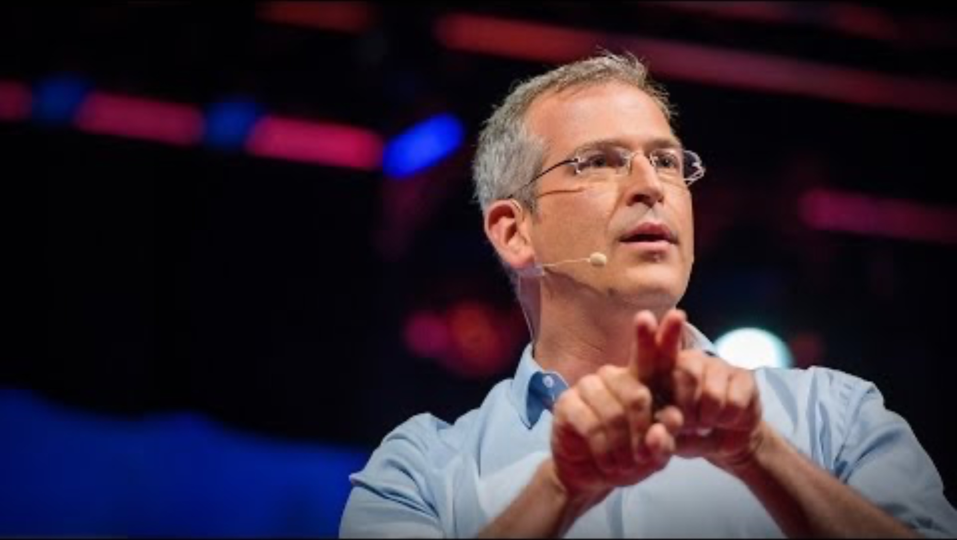
ENTREPRENEURIAL PROCESS
Notes:
Let‘s have a look
[start video; link via agenda; The relevant excerpt starts at the beginning and goes until 6:37 minutes on YouTube. Please introduce the video accordingly.]
… Now tell me: Who of you has faced the cloud before in their academic work? How did it feel? [if time: sharing verbally or in chat]
Let us tell you – it‘s great that you have experience there. Because working as an entrepreneur it‘s great that you already know that feeling!
__________________________________________
Bild von: https://blog.ted.com/scientific-research-and-improv-uri-alon-at-tedglobal-2013/
Ted Video: https://www.youtube.com/watch?v=F1U26PLiXjM

Slide 18

My entrepreneurial journey
Notes:
Now enough from our side and over to you!
Next we prepared a team-excercise for you

Slide 19
My entrepreneurial journey
Based on what you just heard. Write down in prepared templates and discuss with your group:
What do you feel are advantages and challenges of navigating in the two contexts (entrepreneurship / intrapreneurship)?
What feels more appealing to you? What seems more frightening to you? Why?
Where do you feel are your blind spots?
Notes:
Based on what you heard so far:
What do you feel are advantages and challenges of navigating in the two contexts (entrepreneurship / intrapreneurship)?
What feels more appealing to you? What seems more frightening to you? Why?
Where do you feel are your blind spots?

Slide 20
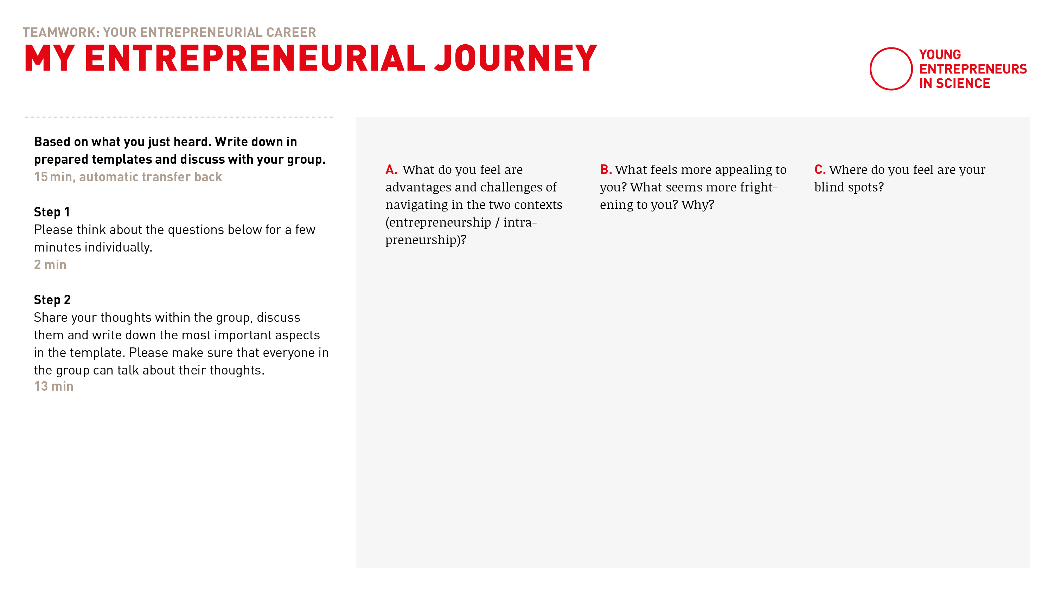
My entrepreneurial journey
Notes:
You will be doing this exercise in teams.
Therefore we prepared a template for you that will help you structure your thoughts and ideas within your team.
A preview of the template is shown on this slide.
On the left you find the instructions for the exercise and the micro-timing.
On top you find the three questions with space underneath to write down your thoughts.
We will post the link to the template into the chat in a few momente so please check if you can open it and give us a feedback (thumbs up/down) so we can help you.
[Link to template in agenda]
__________
Template: https://docs.google.com/presentation/d/1OSIVVaw9gKpdofDBYJLEPsqQiW5Y_dmLyvsQ7SJ-2mo/edit?usp=sharing

Slide 21
Let’s go!
Notes:
Let‘s go!

Slide 22
Notes:
Welcome back!
Everything went well? Everybody back in the room?
Thumbs up please!

Slide 23
Share your insights …
What are your thoughts or insights? What would you like to share with the whole group?
Notes:
Co-Mod Training: Ende
____________________________________________________________
So now - of course – we are curious and it would be great to hear from you!
How was it in the teams?
What are your thoughts or insights?
What would you like to share with the whole group?
[Interact with the participants]

Slide 24
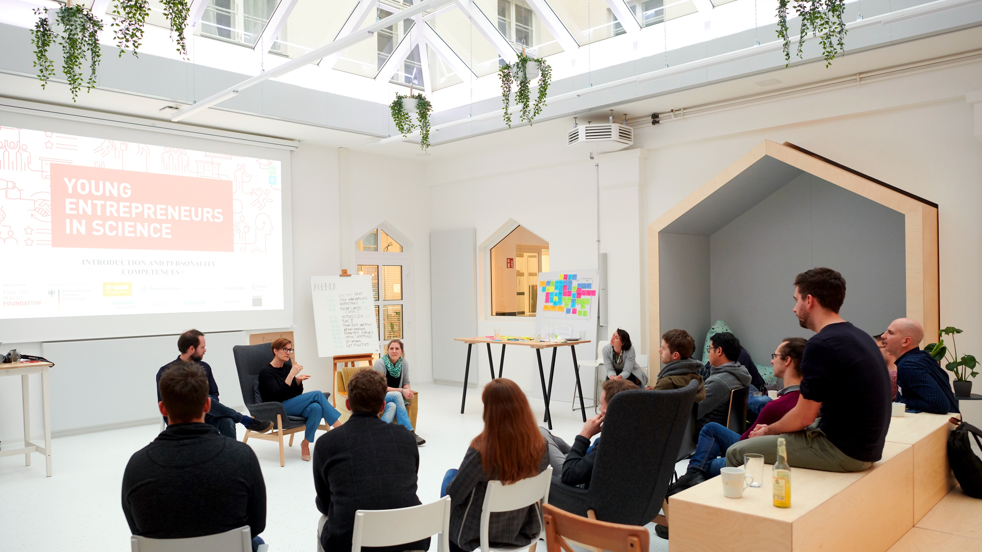
MEET THE ROLE MODELS …
Notes:
[refer to the sharing of the participants]
It was great to listen to your insights.
And to get an even better understanding of the field we have invited [introduce role models] to learn from them about their experiences.
They will join us after a short break and after introducing themselves we’ll have time for a Q&A-session.

Slide 25

Meet the role models
What would you like to ask the role models? Everyone on your own: Reflect and decide what questions you want to bring to the Q&As.
Notes:
In order to prepare for the Q&A-session: Please take a pen and paper and note down for yourself:
What would you like to ask the role models?

Slide 26

It’s coffee o’ clock!
Notes:
Great! Then let‘s head into the break for [number of minutes + write in the chat when to continue]
Please stay in the call and of course you are welcome to turn off your camera and video

Slide 27
MEET THE ROLE MODELS …
Notes:
Welcome back everyone!
Please give me a thumbs up, when you can hear me again and please also turn your cameras back on!

Slide 28
Meet the role models
PART I Introduction of the role models
PART II Breakout sessions Q&A
Notes:
Let‘s welcome our role modesl!
Part 1: We have some time to get to know our guest/s. Please write down for yourself any questions you have for them
Part 2: it‘s your turn to ask them all the questions around entre-&intrapreneruship you got.

Slide 29
PLEASE WELCOME …
Notes:
Backup Questions:
Why did you choose a career in science to become an entre- / intrapreneur?
What was your main motivation in starting your own business?
What was your biggest fear/concern before starting it?
What role plays a team in the process of building a company?
What was the biggest challenge so far in building your own business?
What is the biggest advantage of being an entrepreneur in an already existing company in your opinion?
What opportunitie are companies offer especially for young research in the context of innovation?
What did it take for you to decide on the transition from a scientist to a start-up-founder?

Slide 30
How it works …
Q&A
40 minutes
Two groups Two separate breakout rooms
One role model in each breakout room
Please have your questions ready!
Only unmute your microphone when it’s your turn to ask a question
20 min per role model to ask your questions.
After 20 min the rolemodels will switch the room
Countdown for the last minute
Automatic transfer back to main room after 40 min
Notes:
Let‘s start our Q&A-session
[read out slide]
Once again we will send you into the breakout rooms
Each of us coaches will be in one of the rooms and moderation the sessions.
We sill „swap“ the role models into the other room after 20 minutes so everyone can talk to both guests.
As we can only see who is talking in one room – someone might get interrupted while we transfer – we apologize!
Which open questions are there before we start?
Great! Then let‘s go!

Slide 31

LET’S GO!
Notes:
[We are facilitating the sessions]
Raise your hand if you want to pose a question.
Moderator will take your question by calling you by your name.
If you do not feel like spraking up you can also write your question in the chat..
Unmute the mic, ask your question and go back to mute.

Slide 32
Notes:
Welcome back!
Everything went well? Everybody back in the room?
Thumbs up please!
Thanks a lot to our rolemodels for taking the time to share their personal stories and perspectives with us on becoming and being an entrepreneur or intrapreneur.

Slide 33

Wrapping up …
Dear role models,
What advice/learning from your journey would you like to pass on to everyone?
Notes:
And as one last question to ask our guests:
Dear role models: What one piece of advice/one learning from your journey would you like to pass on to everyone?
[Sharing + say goodbye to the rolemodels]

