Slide 1

THE HUMAN ASPECT OF INNOVATION

Slide 2
Learning goals
Get to know the concept of empathy in human-centred design
Reflect about your own perspectives and mindset
Practise a change of perspective
Assess the potential of empathy in your research or work environment

Slide 3
Let’s talk about empathy…
What does empathy mean for you personally?
2. Do you experience empathy in your work context? How?
Notes:
Voting Link:
Live Results:

Slide 4
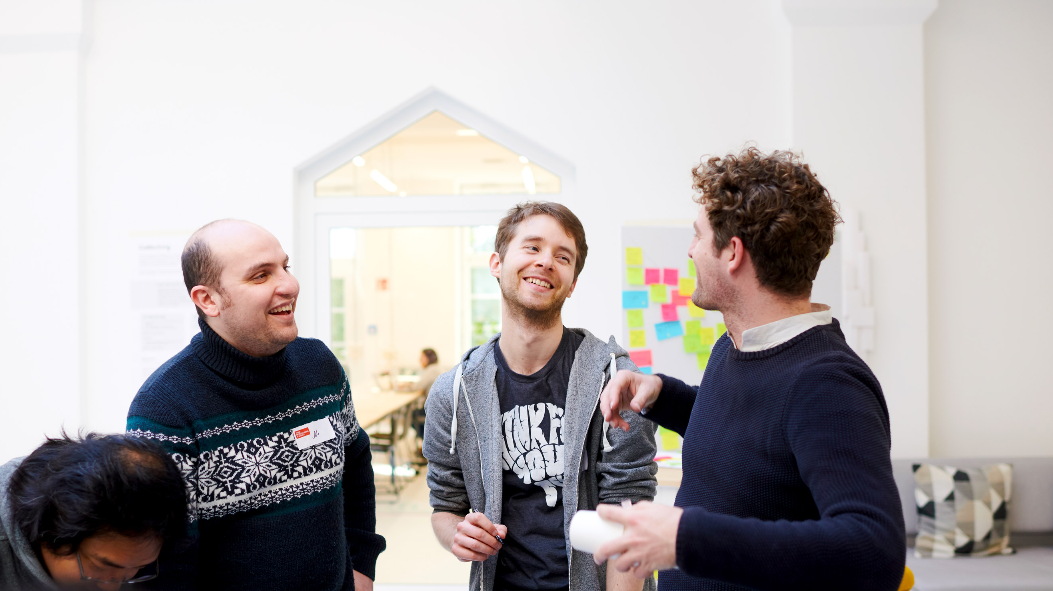
HUMAN-CENTRED DESIGN
Notes:
Why do we actually talk about empathy and different perspectives and what does it have to do with human-centred design?... (Relevanz für das Thema erzeugen)

Slide 5
Overview of human-centred design
I like
HUMAN
(DESIRABLE)
I wish
INNOVATION
FEASIBLE
(TECHNOLOGY)
VIABLE
(BUSINESS)
Notes:
One level more specific, putting things into practice > innovating and creating new ideas > let’s talk about human-centred design…
In order to create innovation we need to put the human into the centre; need to empahtise with our users
an entrepreneurial/innovative mindset needs to put the human into the centre > we really have to get to know and empathise with the humans that we address with our work/research projects/startup ideas in order to meet their needs
The importance of empathy not only in our personal lives but also in business contexts becomes clear by approaches such Human Centered Design also known as Design Thinking.
In human centered design in general, you put the user in the middle of the innovation process.
Besides the technical feasibility and the business viability – what is desired by humans is most important when thinking about innovative ideas.
What are their needs, what are the benefits, the gains they wish for – talking about innovation, you need to address these kind of questions.
And only with all 3 factors taken into account you can find the sweet spot of a great and sustainable innovation!

Slide 6
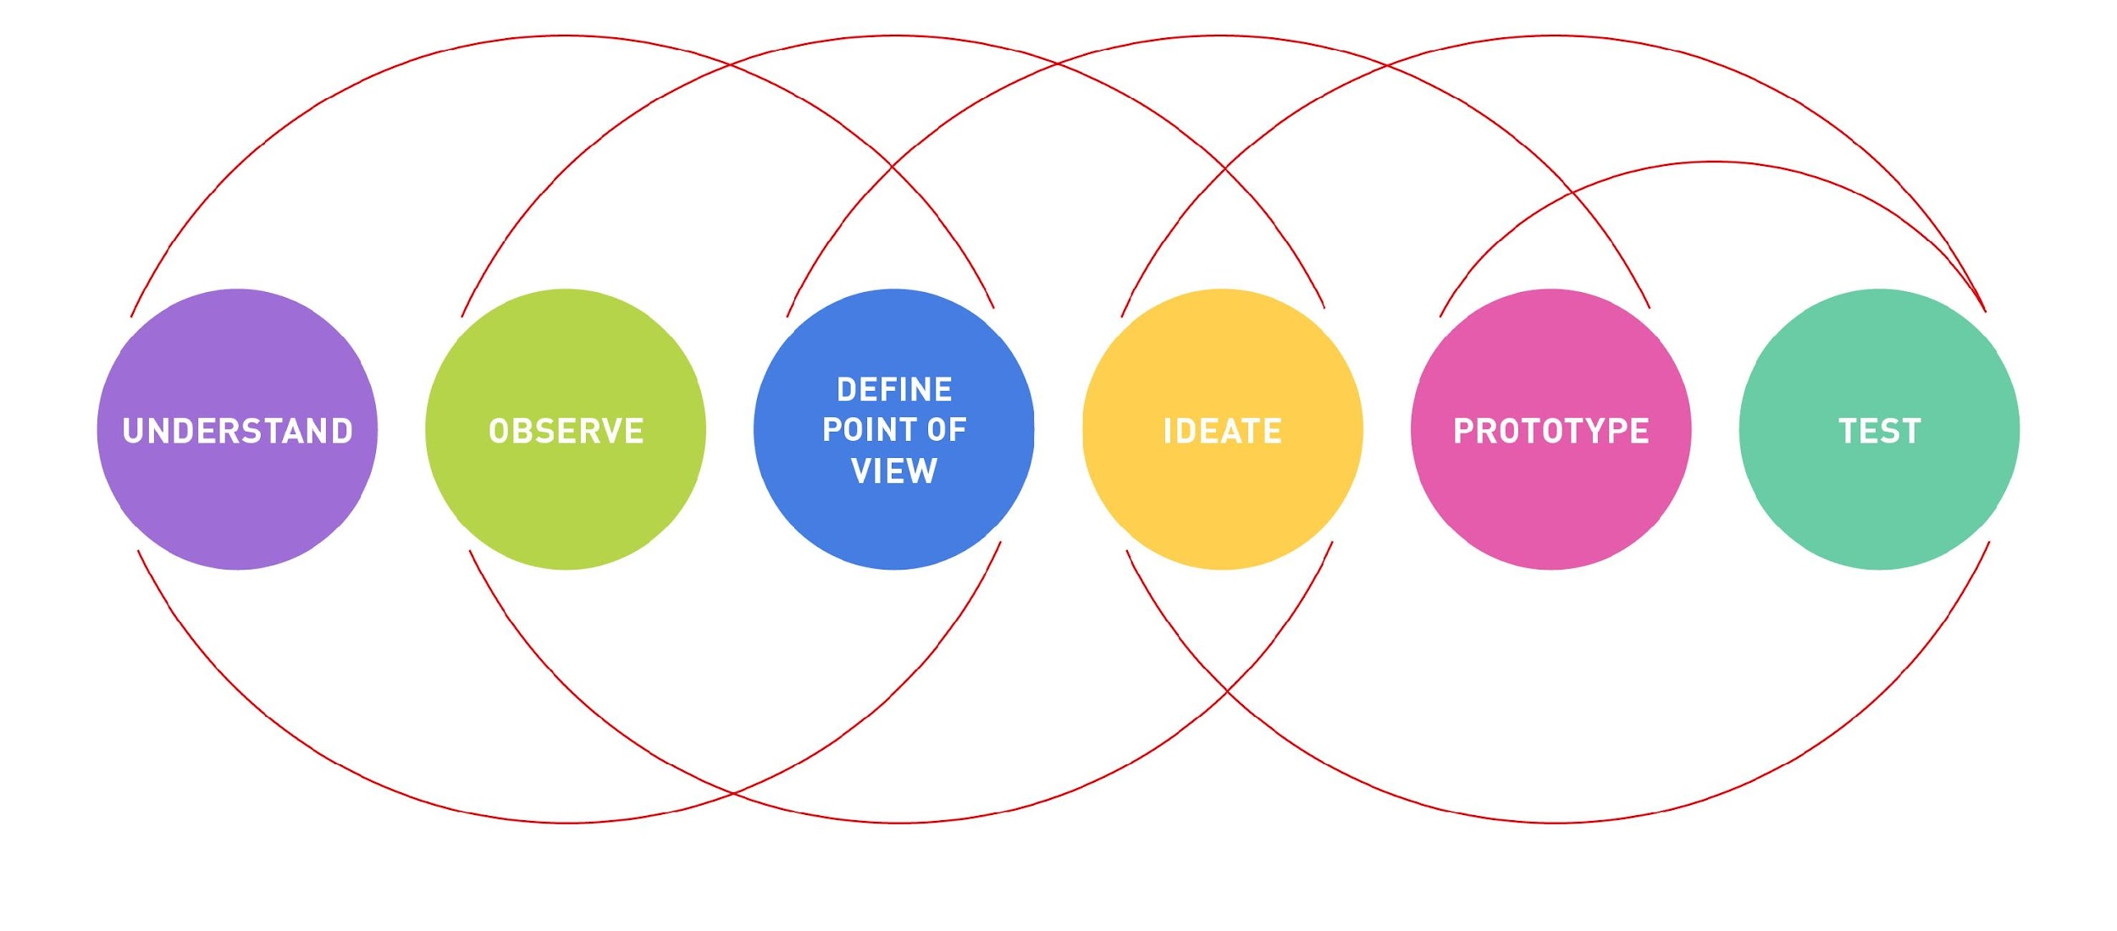
Human-centred design process
Notes:
So let's have a closer look at Human Centered Design!
HCD is better known as Design Thinking – DT is applied in various contexts these days in order to solve complex problems and generate innovative ideas. It's not a method but an approach in which Users became a central part of the development process for innovative projects. DT becomes alive in a process with 6 phases/stages --> today, we will only focus on the first two stages!
First two steps: Understand+observe = empathise
Let‘s have a closer look at the first two steps

Slide 7
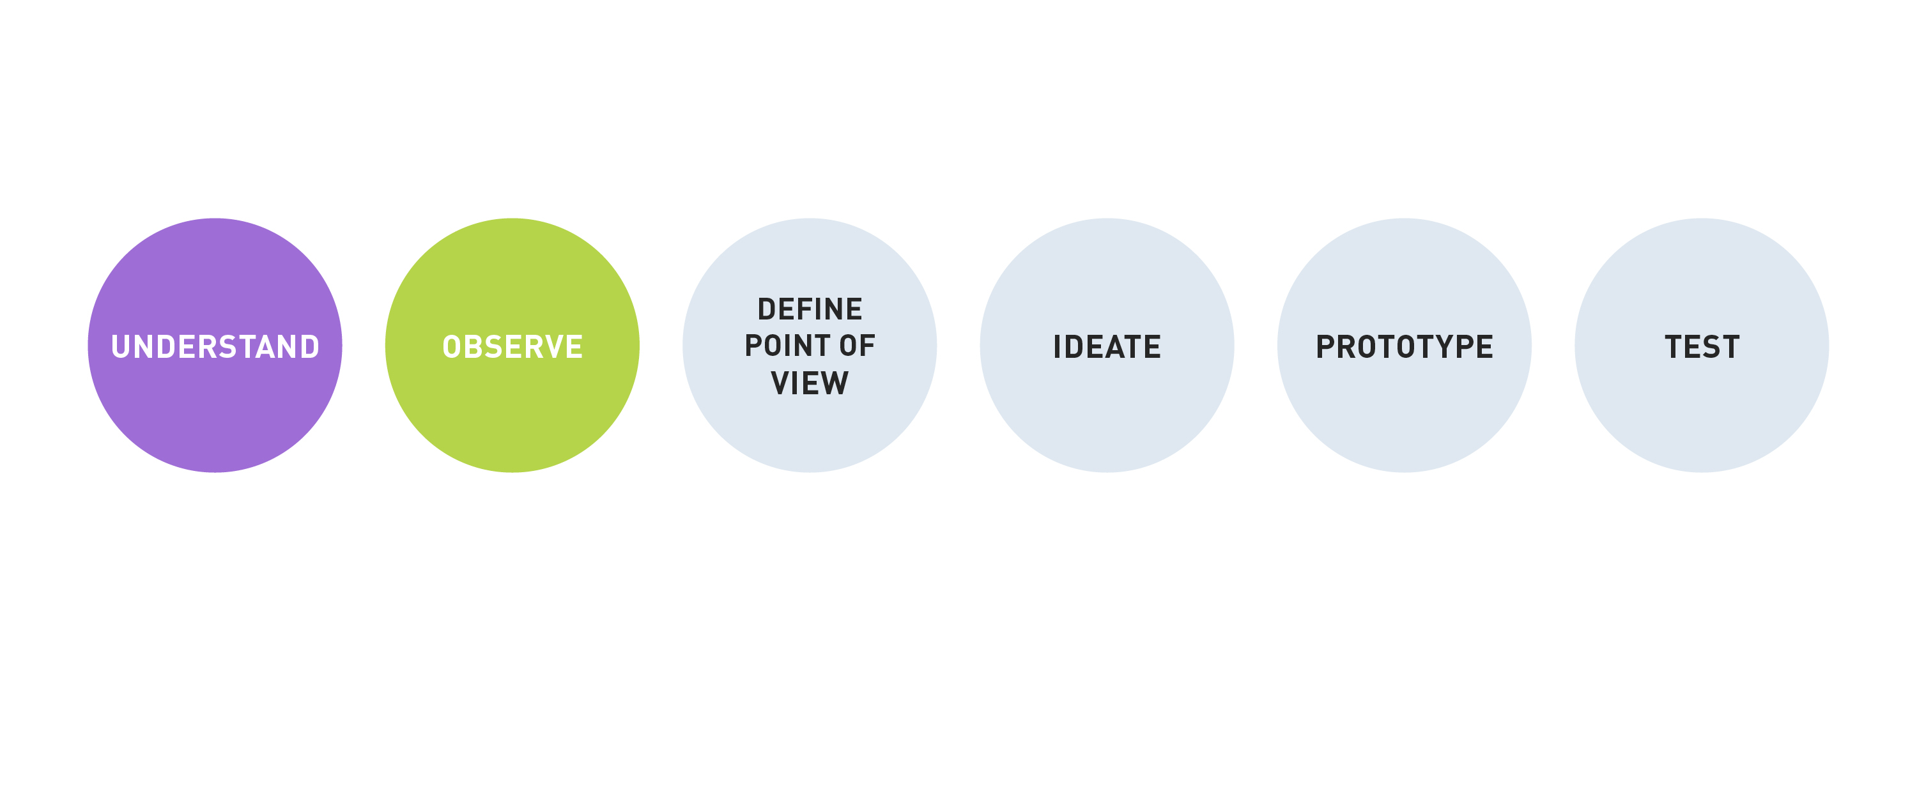
Empathise with your user
Empathise
Notes:
Empathy plays an important role in HCD, it's the foundation of the whole process and is also required throughout the whole process to come back to
In the DT process your team aims at a “deep understanding of the problems and realities of the people you are designing for”
Especially the first two stages (or mode) of the Design Thinking process involve developing a sense of empathy towards the people you are designing for, to gain insights into what they need, what they want, how they behave, feel, and think, and why they demonstrate such behaviors, feelings, and thoughts when interacting with their environment and certain products in a real-world setting
We focus on learning about the difficulties people face, as well as uncovering their latent needs and desires in order to explain their behaviours and develop solutions
Unlike traditional marketing research, empathic research is not concerned with facts about people (such as their weight or the amount of food they eat), but more about their motivations, feelings an thoughts
empathy helps design thinkers to set aside his or her own assumptions about the world in order to gain insight into their users and their needs
Empathy is not a stage: you should extend the empathy activities whenever needed during the process. Product teams that consistently keep customer needs in mind are able to maintain and evolve their products.

Slide 8
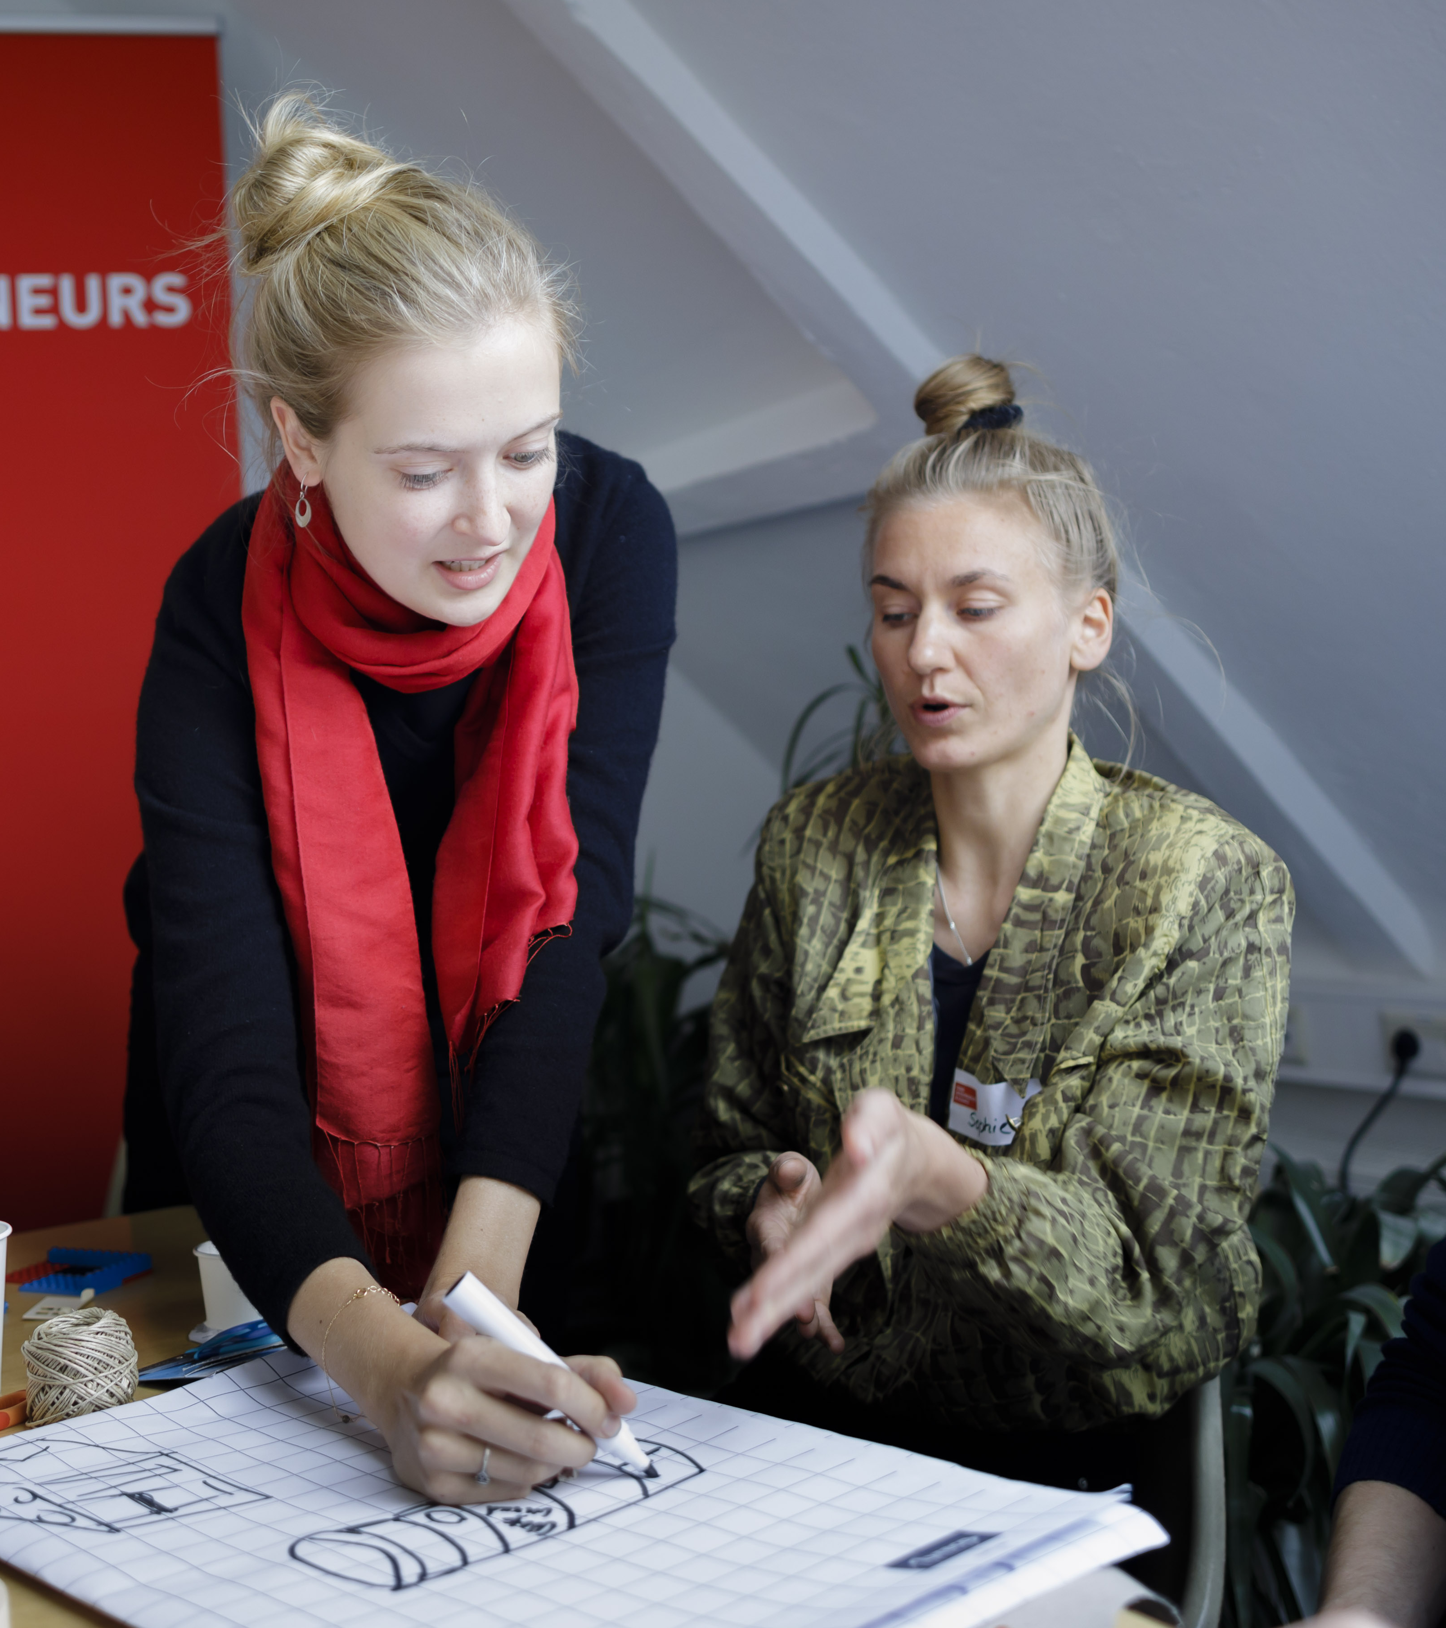
Write down what you observe …
Notes:
Co-Mod Training: Slide 9-25
Beginn
And now we’d like to experience ourselves what different perspectives and practising empathy really means, let’s start with a little exercise…
We’d like to start with a little exercise.
You need paper and pen to take notes.

Slide 9
Solo work
Reflect about the following questions
3 x 2 min
You will see the same image with three different questions
Write down your thoughts on a piece of paper.
Timer after 2 minutes
Notes:
- you will see the same picture 3 times with a different question
- you will have 2min each question; write down what comes to your mind
there will be a bell ringing/sound after 2min
We will share our thoughts after each picture (sharing im Plenum)

Slide 10
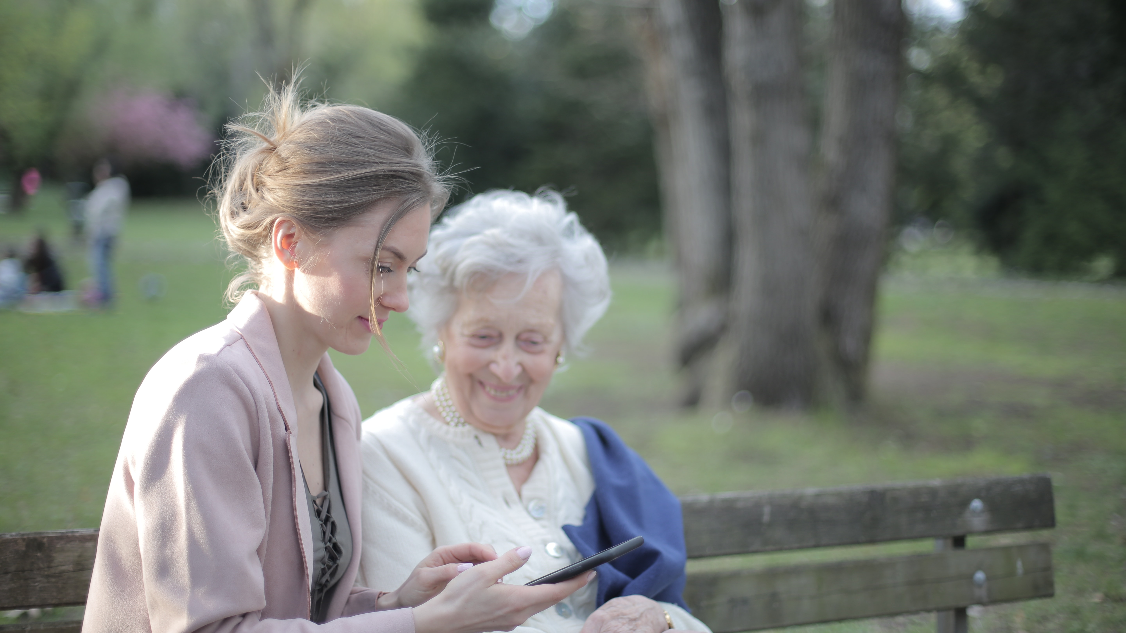
OBSERVE
WHAT DO YOU SEE?
Foto by Andrea Piacquadio via pexels.com
Notes:
Step 1: Only what do you see? No interpretations

Slide 11
OBSERVE
WHAT DO YOU INTERPRET?
Foto by Andrea Piacquadio via pexels.com
Notes:
Step 2:
What do you think when you look at the picture? What comes to your mind? Feelings, emotions, sensations

Slide 12
OBSERVE
WHICH QUESTION
WOULD YOU LIKE
TO ASK NOW?
Foto by Andrea Piacquadio via pexels.com
Notes:
Based on the interpretations, what would you like to ask the people to confirm your hypotheses?
What do you wonder about?
What question would you like to ask now?

Slide 13
What has surprised you, what has resonated with you?
Which differences have you recognised?
Notes:
Please raise your hand if you‘d like to share sth.

Slide 14

We have a limited and subjective view on the world.
Notes:
From this exercise one conclusion could be: We see the world via our own individual glasses; it will never be a complete and full perspective
We have a limited view on the world and what we have also heard from the beginning is that we need empathy in order to understand other perpectives and approaches – but what does empathy actually mean…?

Slide 15

How can empathy support us to take in different perspectives?
Photo by Produtora Midtrack via Pexels
Notes:
…and how can it be supportive.
Achtung: Auf der nächsten Seite folgt ein Video, was eingebettet ist und startet, wenn die nächste Folie angeklickt wird.

Slide 16
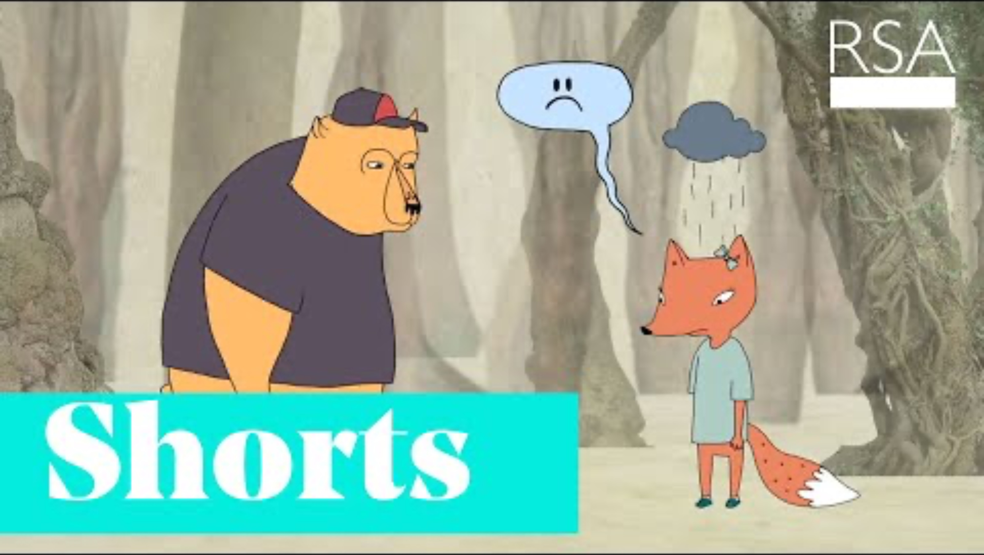
WHAT DOES EMPATHY MEAN?
Notes:
Let‘s have a look what empathy means by watching this video first…
https://www.youtube.com/watch?v=1Evwgu369Jw&t=3s (ca. 3min)
4 aspects of empathy from the video:
- perspective taking
- staying out of judgement
- recognizing emotion of other people
- communicating that
Sympathy: I feel for you
Empathy: I feel with you
Sympathy:
- a word often confused with empathy
more about one's ability to have or show concern for the wellbeing of another, whereas to sympathize does not necessarily require one to experience in a deep way what others experience.
often involves a sense of detachment and superiority; when we sympathise, we tend to project feelings of pity and sorrow for another person.
Empathy:
understanding the people for whom we are designing solutions—for doing something that can help them
not seeking for opportunities to react to the people; rather, we want to absorb what they are going through, and feel what they are feeling.

Slide 17
What does empathy mean?
Empathy is feeling with people. It is about connecting with something in yourself that knows that feeling.
Prof Brené Brown University of Houston
Notes:
Naturally empathethic & able to practice:
In a general sense, empathy is our ability to see the world through other people's eyes, to see what they see, feel what they feel, and experience things as they do. But it doesn‘t mean that you make the other feelings your own (user-centered)
Neuroscientists have recently discovered that empathy is hard-wired into the way humans are made and is an integral part of our physiology. empathy is an innate quality that we can all make use of in order to design for the people around us
We lost connection to empathy (competition, hierarchy etc)
the good news is: we can practice it by putting the human into the centre; we can train it like a muscle…
https://www.interaction-design.org/literature/article/design-thinking-getting-started-with-empathy

Slide 18
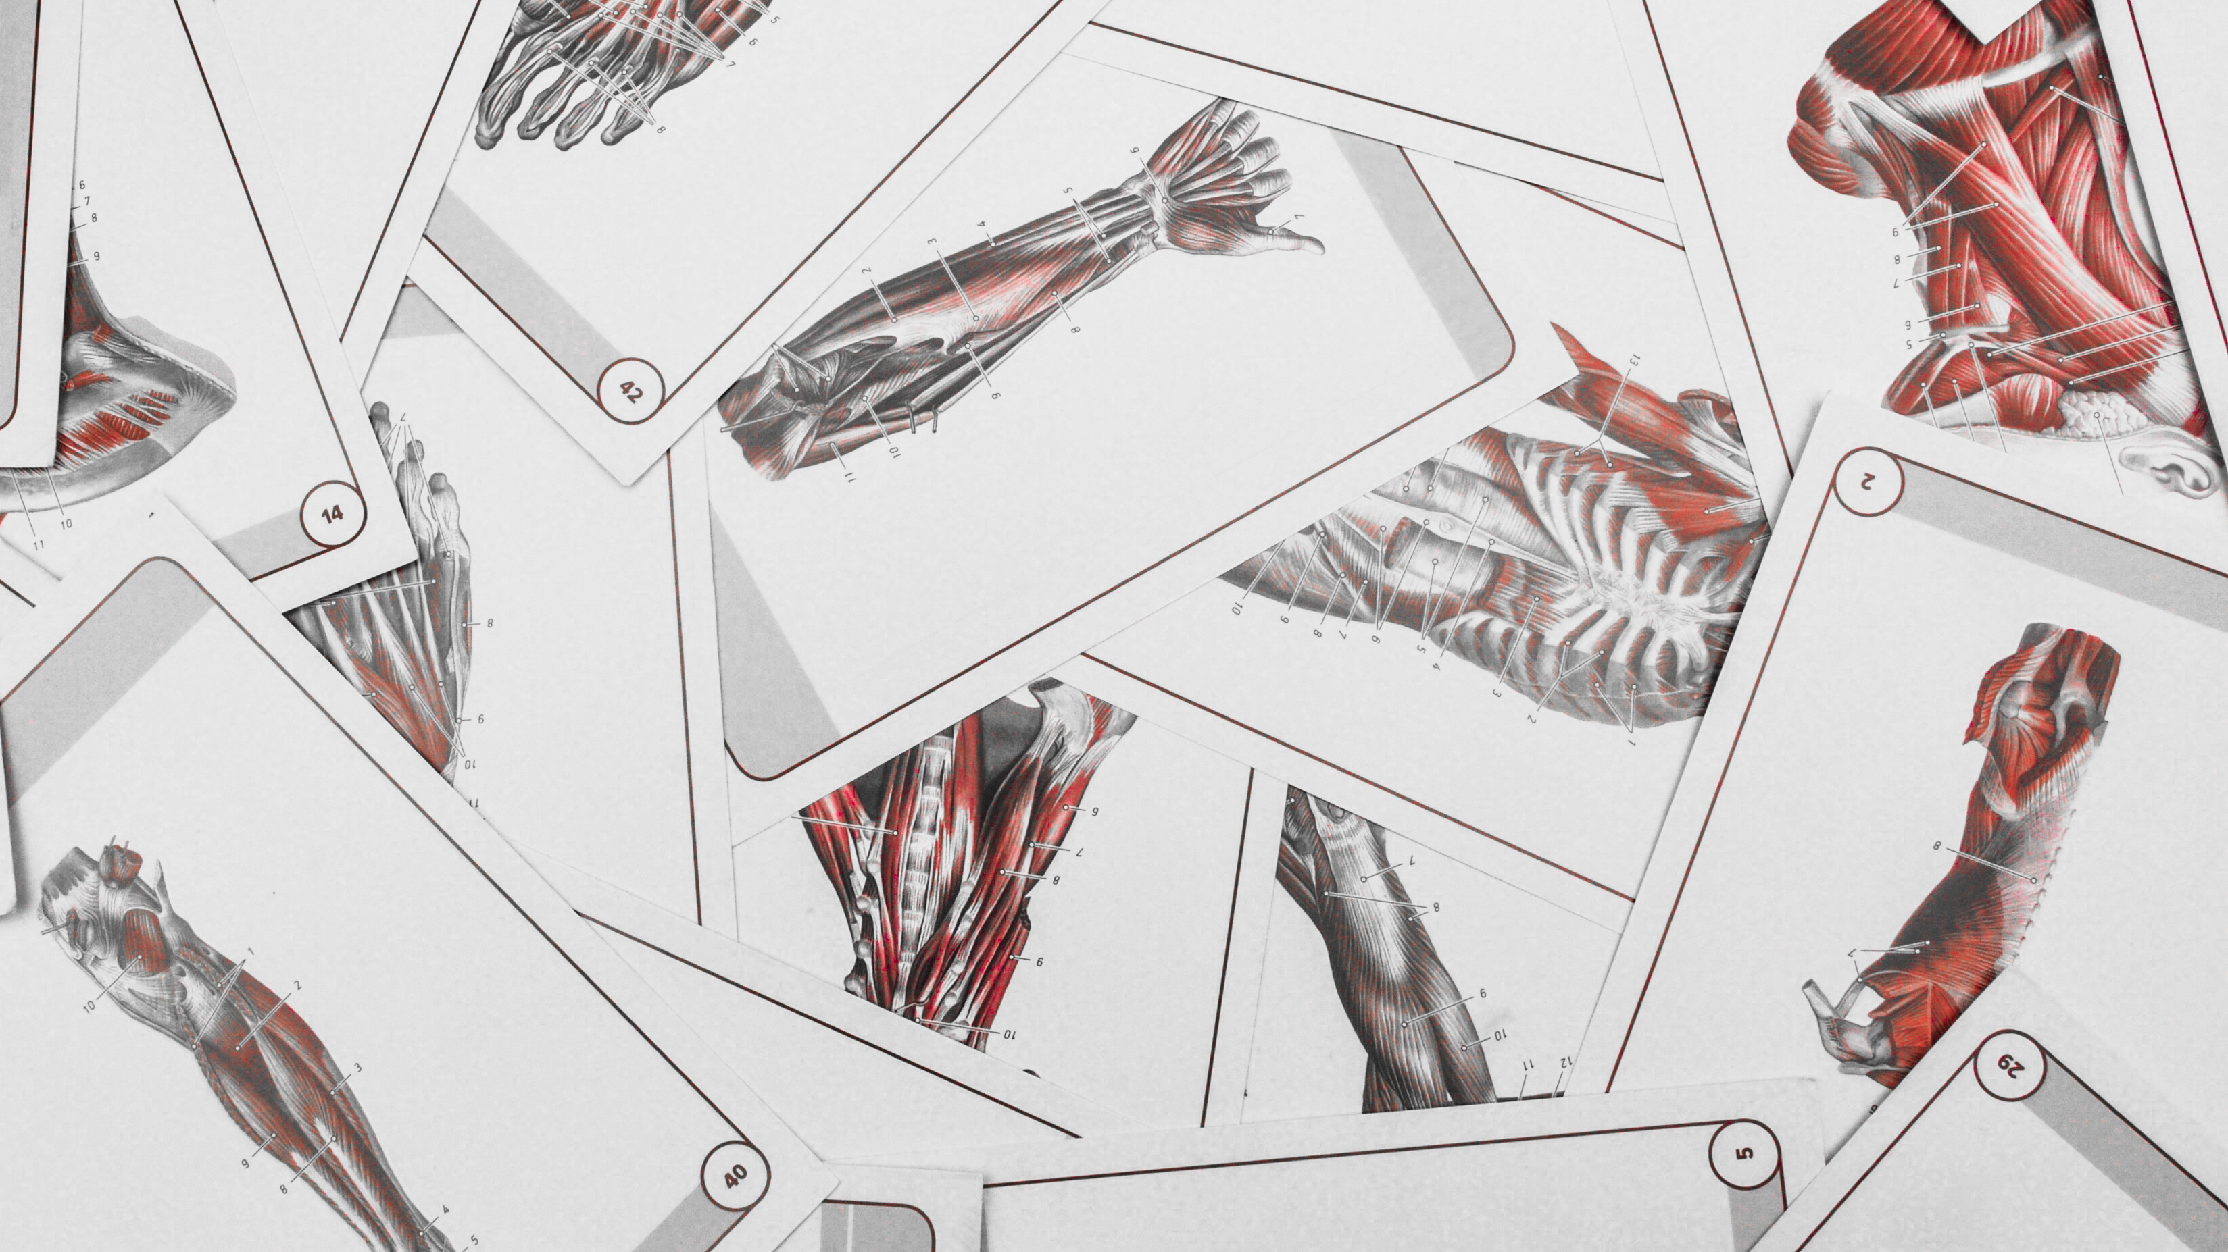
EMPATHY CAN BE TRAINED
Notes:
Empathy can be trained like a muscle and we would like to give you a few examples how that could look like…
https://www.zeit.de/zeit-wissen/2016/01/empathie-fluechtlinge-mensch-evolution/seite-2

Slide 19
Empathise with your user
Empathise
Notes:
As a reminder coming back to this slide from the beginning – we look at the first steps of the hc design process (empathising)

Slide 20
How to practise empathy
Observation
Self Experience
Interview
Notes:
There are various ways that are applied in Human centred design to establish empathy with your user in the observe stage, to understand them thoroughly
Observation:
Observing your users helps to identify needs, motivations, or challenges that they’re not aware of—and therefore not able to articulate.
it’s important to distinguish between what people say they would do in a certain situation, and what they actually do. In reality, users may have habits or desires that they’re not aware of, so it’s essential for the designer to observe the user in action --> looking for 'thoughtless acts'
Observing WHAT and HOW a person is acting/behaving/doing sth and then aasking yourself WHY (assumptionas about motivations/emotions behind that behavior
You can photograph or video them but also ask for photo diaries and do interpretations of their daily life, we call this cultural probes
Interview:
One-on-one interviews can be a productive way to connect with real people and gain insights.
Talking directly to the people you’re designing for may be the best way to understand needs, hopes, desires and goals.
Most of the work happens before the interviews: team members will brainstorm to generate questions to ask users and create themes or topics around the interview questions so they can flow smoothly from one to another.
In DT interviews you aim at asking 'deeper' not 'broader'
The key to an effective empathy interview is to structure it as an open conversation, constantly asking “why?” (even if you think you already know the answer!), asking non-binary questions, encouraging storytelling, and paying attention to nonverbal cues.
Self-Experience: immersion
The most effective way you can gain empathy comes in the form of immersion: direct experience of the lives, contexts, environments, and activities of the people you would like to understand better
Put yourself in the shoes of your user.
physically experiencing a situation in order to immerse oneself fully in the users’ environment.
requires a considerable amount of planning and effort, as the environment must be filled with the artifacts present in the real-world environment, and the general atmosphere/feel must accurately depict the users’ setting.
​
Empathy in general:
With all these approches or techniques, we need to use our intuition, imagination, emotional sensitivity, and creativity in order to dig deeper and thoroughly understand also the non-obvious!
If we are to empathize with users, we should always try to adopt the mindset of a beginner. What this means is that, as designers (or design thinkers), we should always do our best to leave our own assumptions and experiences behind when making observations.
EXAMPLE NEXT

Slide 21
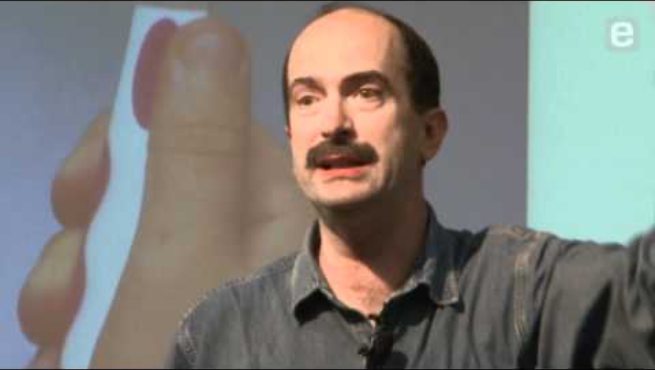
IN PRACTISE
Notes:
In order to give you an example, please watch this video
Video: https://www.youtube.com/watch?v=XrpAveg7ZIg (2:48min)
Summary afterwards:
Turns out, the way kids hold the toothbrush is totally different from adults. Adults have greater dexterity in their hands and tend to use fingers to manipulate the toothbrush with fine movements. On the other hand, kids grab the toothbrush simply in their fist.
One simple insight through observation led to a totally new style of toothbrush: the squishy gripper. It completely changed the kids’ toothbrush space. If you go into any supermarket you see rows and rows of kids’ toothbrushes with fat & squishy handles.
https://medium.com/@NTRPD/wondered-why-toothbrushes-for-kids-are-really-fat-6a586fe12db

Slide 22

WHAT MAY HELP US TO LISTEN
ACTIVELY AND EMPATHICALLY?
Notes:
In all HCD processes talking to people, experiencing and observing plays a crucial role. But not only that it‘s also important how you do that, how you behave in such situations. As we will invite you to a group exercise which puts focus on practising a change of perspectivbes by talking and listening after the break we‘d like to take a closer look at the HOW / before that we‘d like to share some useful tips/ideas with you.
Wenn zeitl. Puffer, Frage von der Slide in die Runde gestellt.

Slide 23
Aspects of communication
Inner Process
Outward Behaviour
Self-Empathy
Self-Expression
(transmitting)
Focus on me
Empathetic Assumption
Active empathetic Listening
Focus on the other/changing perspectives
https://dwarfsandgiants.org/
Notes:
This model is used to structure 4 levels of communication that take place all the time during conversations
Left dimension: what takes place inside me How am I doing? How does it make me feel?
Empathic assumption: how is the other person? Especially important in situations of tension, e.g., does he/she have the capacity to listen or not, etc...; what conclusions do I draw?
Right dimension: What do I give to the outside What do I speak/send, how do I express myself?
Active listening: What do I hear, do I perceive from the other? Nonverbal communication
In empathic listening, the attention is completely on the other person, their experience and their needs.
Das Modell dient dazu, 4 Ebenen von Kommunikation, die ständig stattfinden, zu strukturieren > was man bei einem Gespräch auf dem Schirm haben sollte
Linke Dimension: Was in mir stattfindet
Wie geht’s mir? Wie fühle ich mich dabei?
Empathische Vermutung: wie geht’s dem/r anderen? Insb. bei Spannungssituationen wichtig, z.B., hat er/sie grade Kapazitäten zuzuhören oder nicht etc…; welche conclusions ziehe ich?
Rechte Dimension: Was gebe ich ins Außen
Was spreche /sende ich, wie bringe ich mich zum Ausdruck
Was höre ich, nehme ich vom anderen wahr? Nonverbale Kommunikation
Beim empathischen Zuhören ist die Aufmerksamkeit ganz bei der anderen Person, ihrem Erleben und ihren Bedürfnissen

Slide 24
Exchange with others…
Notes:
We will send you in little breakout rooms for a quick exchange – when do you experience active listening in your daily life, when is it difficult?

Slide 25
Groups of 3
Exchange in the group
10 minutes
Digital Breakout Rooms
Automatic transfer back to main room
When is active listening easy/easier for you?
When is it challenging to listen actively?
Do you have any tips/good practices for active listening?
Countdown for last 30 sec

Slide 26
Notes:
How was this exchange? With what did you come up?

Slide 27
Active Listening
RECOMMENDED
PAY ATTENTION
Be aware of body language
Judge or jump to conclusions
Keep eye contact
Offer advice
Listen to non-verbal cues
Plan your answer
Summarise and paraphrase
Tell your own story
Ask questions
Interrupt and impose
Notes:
Hier Überleitung: those are a few tips that might make it easier to listen actively
http://actforyouth.net/resources/yd/sel-active-listen.pdf

Slide 28

It’s coffee o’ clock!
Notes:
but first: Break ☺

Slide 30
Practise a change of perspective
Notes:
- We've heard a lot about different perspectives, about empathy and how to practice it, now it's your turn.
- We will jump into a group exercise

Slide 31

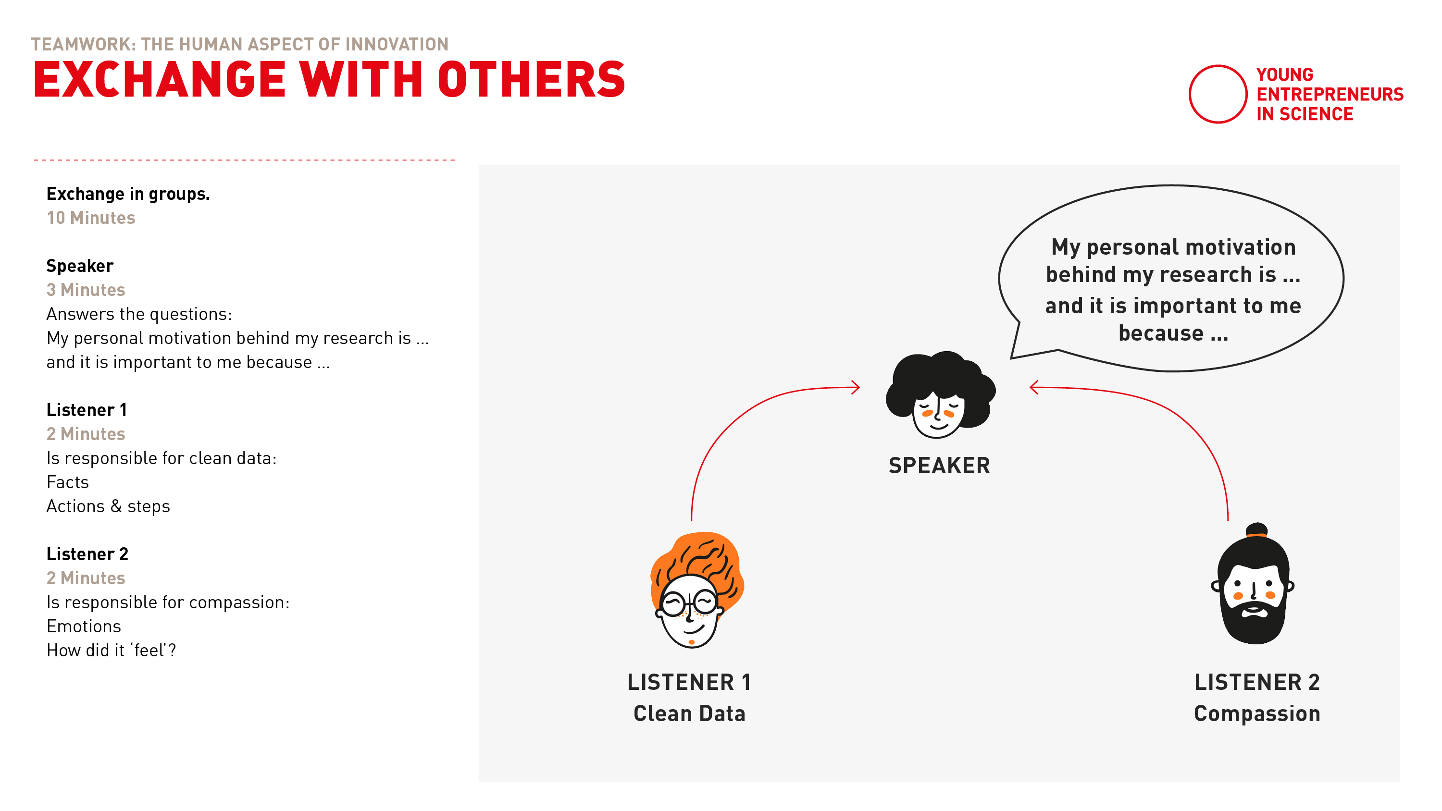
How it works …
Notes:
Google Template: (view only)
https://docs.google.com/presentation/d/1aNo0puXB8M3PDAcmTCZCD5LIqsWg8N1D3gzcilSeWfM/edit?usp=sharing
Explanation:
We will put you into breakouts, in groups of three.
We invite you to spend the first 2 minutes of getting to know each other: Say your name, where and what you are currently working at.
The excercise goes as follows:
There will be three rounds.
Each rounds starts with the speaker who talks about her personal motivation behind her/his research, why her/his research is important to him/her
The speaker talks for 3 minutes and the other two people are simply listening.
They don‘t interrupt, they don‘t ask any questions. They listen with intention!
- Listener 1 listens with the „clean data“ focus. This means this persons focuses especially on the facts the speaker metions and to which extent the speaker has already taken action, steps and actions
- Listener 2 listens with a „compassion“ focus. This person listens to the emotional side, i.e. which emotion did she notice within herself, which emotions did she notice with the speaker.
Take notes!
When the three minutes are over, Listener 1 has 2 minutes to mirror back what she heard. And then listener 2 mirrors back what she heard. When listener 1 and 2 mirror back, the speaker does not interrupt.
Addition: 3min to get feedback from the speaker regarding the observations
Example:
The speaker talks about her current PhD Thesis, her plan to finish it this year, but how difficult it is to combine her work with her family life and her duties at home.
Listener 1 (‚Clean Data‘) listens for the facts: How much time she is currently spending for the thesis, her current role at work, how she organizes her daily family life. And Listener 1 also listens how the speaker has already taken action. Maybe she already talked to her partner how to better organize family life so she has more time for her PhD thesis.
Listener 2 (‚Compassion‘) expresses emotions. She might say things like, when you talked about your planning of your PhD thesis, you seemed quite under pressure. However, wen you told us about your daily yoga practice, I could really feel more lightness, even within myself.
Important:
Treat each other with care and respect
Appoint a time keeper! You are responsible for keeping the time limits in your group.
Use your time fully! Don‘t end early, don‘t go overtime.
For the listeners:
Trust that you hear what‘s important. It is not about perfection, it‘s about being present.
When you mirror back, focus on what has been said. Don‘t give any advice. Stay focused on what the speaker told you. Trust that this simple reflection and mirroring back is exactly what the speaker needs to hear.
In the chat you find a link where you find the exercise in written form in case you want to double check.
Google Template: (view only)
https://docs.google.com/presentation/d/1qjUoREAIBqO2PZj-tQac52E_0tbCPWF1hC8ef12yvFI/edit#slide=id.p
Any questions?

Slide 32
Groups of 3
Practise a change of perspective
30 minutes
Digital Breakout Rooms
Automatic transfer back to main room
2 listeners, 1 speaker
3 rounds
2 min introduce yourselves and set a timekeeper
7 min each round
7 min open feedback in the end
Countdown for last 30 sec
Notes:
Wichtig für die Anmoderation: am Anfang fragen: hat jemand Probleme mit dem Mikro > in anderen Raum schieben (nur Mikro muss funktionieren); bei Problemen > holt euch Hilfe der Coaches

Slide 33
What were your experiences? How did you feel in which role?
Notes:
I know we put you in ice-cold water with this exercise. I am personally a big fan of this exercise and it is very dear to my heart as it creates a space of attention usually not available in our busy, everyday lives.

Slide 34

Plan your next steps
Notes:
Self-reflection

Slide 35
Solo work
Plan your next steps
7 minutes
Please, stay in the main room and mute your microphone.
Grab a piece of paper and a pencil.
What could be specific steps to empathise with your stakeholders in the context of your research or work?
Reflect on the questions on the next slide!
Notes:
Additional: how could it be beneficial in your specific case?
Specific questions and template:
Who are your stakeholders? With whom should you empathise
How could you do this > looking at Design Thinking
Concrete next 3 steps, what do you I need for it. i

Slide 36



Your empathy journey
1
3
Who are relevant stakeholders you should empathise with?
2
What is needed to realise those steps?
What are 3 concrete next steps you can take to implement your learnings?
Notes:
Pick one stakeholder (group) > with regards to your work environment/your research
2. 3 concrete next steps (think of immerse, interview, observe)
3. What resources do you need (also thinking of challenges you reflected on before)

Slide 37
Notes:
Everybody is back? All went well?
Thumbs up if you’re with me please!

Slide 38
Looking at your (work) environment what would be your next step now?
Notes:
I know we put you in ice-cold water with this exercise. I am personally a big fan of this exercise and it is very dear to my heart as it creates a space of attention usually not available in our busy, everyday lives.

