Slide 1
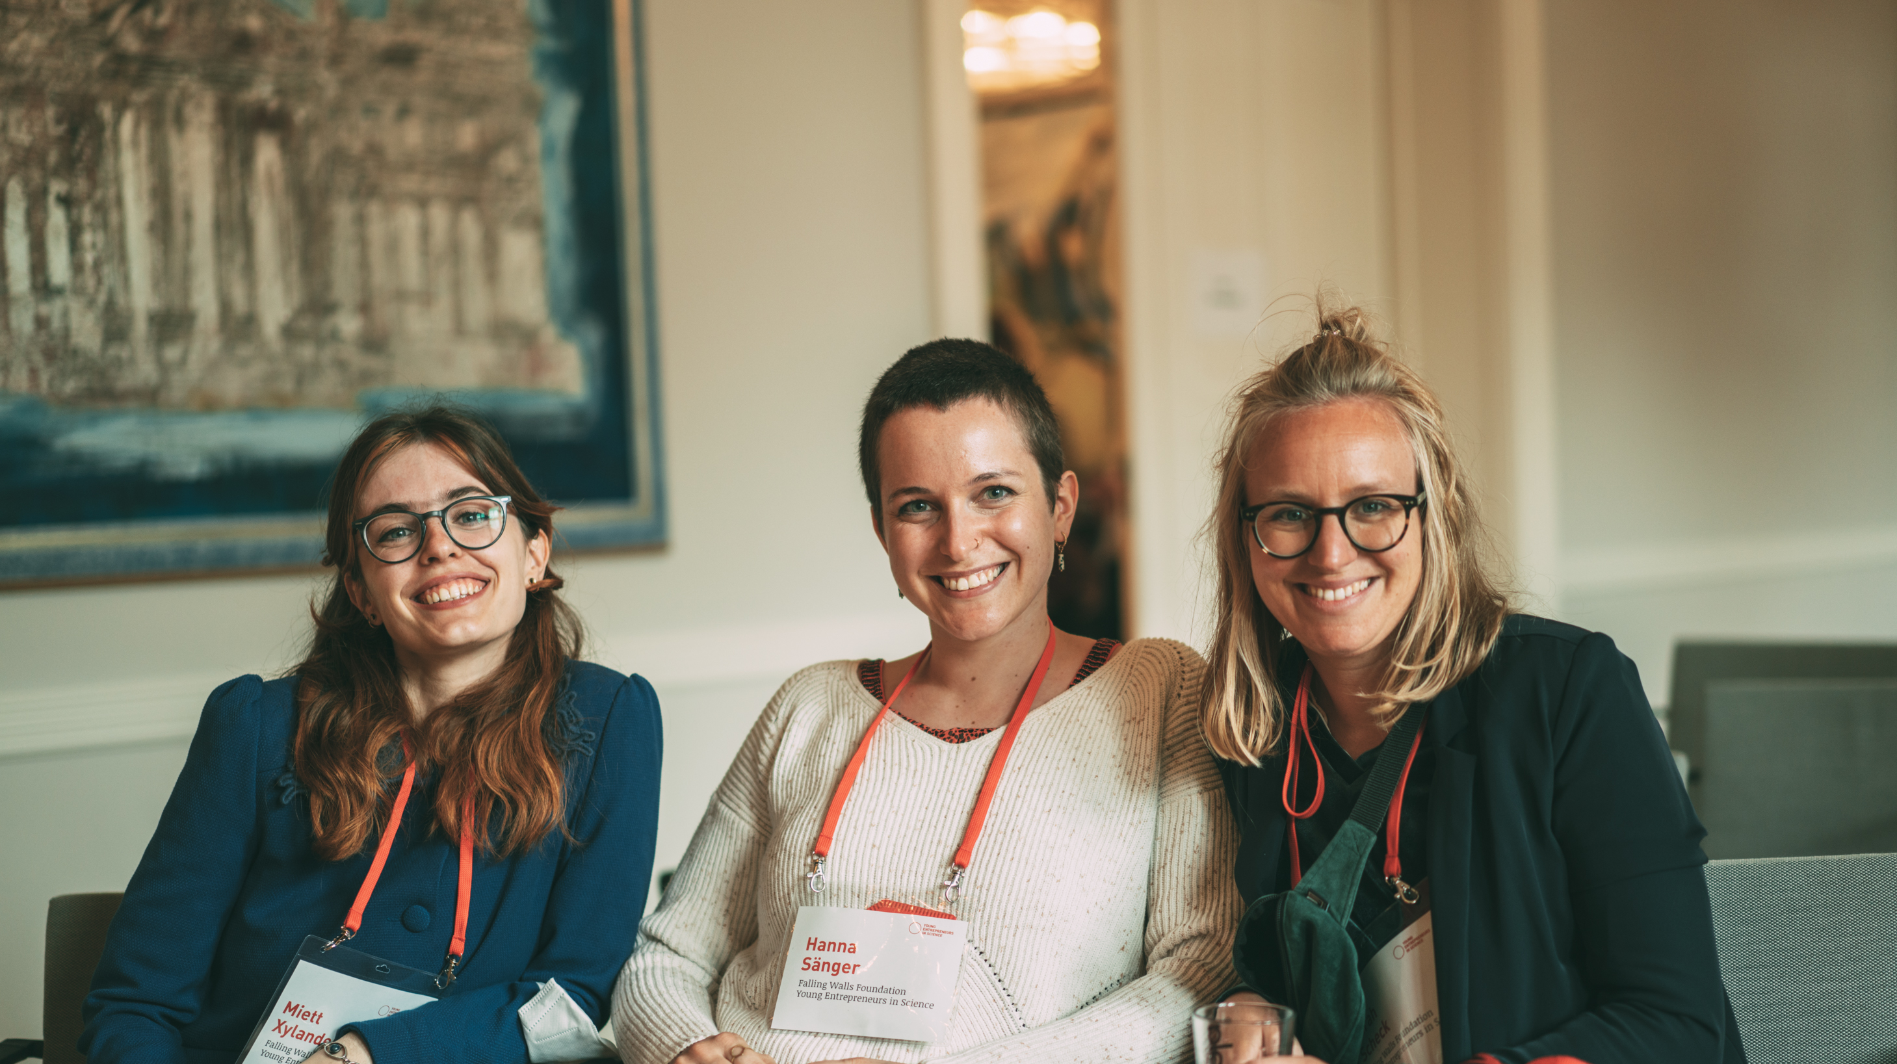
YOUR ENTREPRENEURIAL
EMPOWERMENT
Notes:
KATHRIN
Bitte folgende Punkte am Anfang des WSs sagen:
Before we start, a couple of technical/organisational aspects:
we are a group of different people today > this is a workshop for women and everyone who identifies themselves as women > if you don‘t feel addressed now, we kindly asky you to leave this room and check out all the other YES Workshops for mixed gender (thanks for your understanding)
if you want to, feel free to put your pronoun behind your name in Zoom

Slide 2
Learning goals
Gain confidence for yourself on the subject of founding
Reflect on your own resources and potential support
Get inspired by female founder personalities

Slide 3



Up for the journey?
+
MIRO
(Digital Whiteboard)
Short videos from
women founders
Notes:
Our training setting for today:
Work on MIRO for those who don't know it
Get inspired by short videos from women founders with scientific background
Any questions so far?

Slide 4
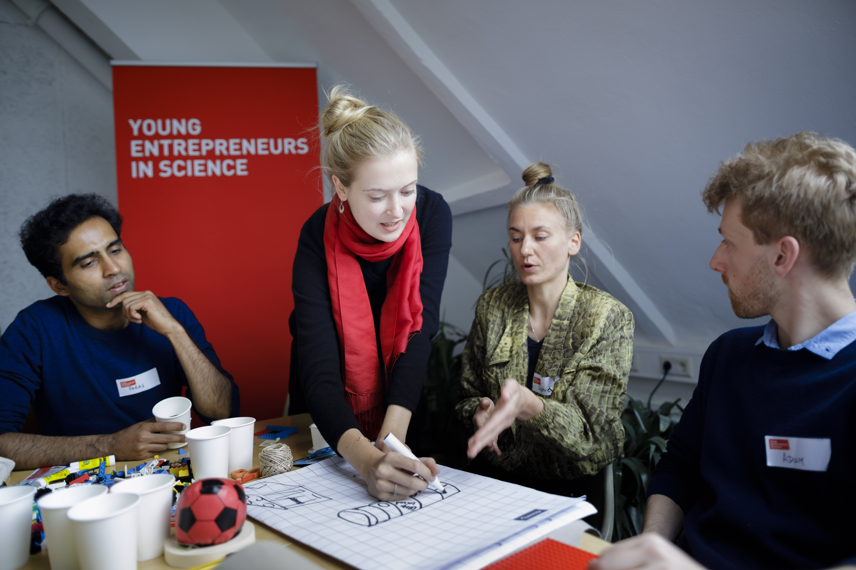
Let’s look at
the context …
Notes:
There is a big need to support and promote entrepreneurship for women…and why is that…let’s look at following graph.

Slide 5
Please guess ...
91%
85%
81%
68%
51%
54%
32%
49%
46%
19%
6%
1%
Total population
Secondary school
graduates
Venture capital volume
Source: Female Founders Monitor 2025, p. 13
Notes:
It’s time for you to guess here – you see two lines that touch each other on the left side and that move further and further apart to the right. On the left you see the total population and secondary school graduates, on the very right you see the percentage of venture capital volume or said differently external investment. What do you believe do those two lines represent? And what could the other figures represent?

Slide 6
Please guess ...
91%
85%
81%
68%
51%
54%
32%
49%
46%
19%
6%
1%
Total population
Secondary school
graduates
Students interested in founding
Startup
Founders
Venture capital deals
Venture capital volume
Source: Female Founders Monitor 2025, p. 13
Notes:
Gender gap in startup formation:
Already visible among students
Widens significantly at the point of business creation
Grows even further over the course of a startup development
The line above (green) shows the percentage of men and the line below (purple) the percentage of women in different phases (total population, secondary school graduates, students interested in founding, founders of start-ups/compared to self-employment/freelancing, number of venture capital deals, venture capital volume)
Definition startups: young startups (less than 10 years) with a highly innovative/scalable business model, growth-oriented
Definition of self-employment/freelancing: any kind of self-employment
You can recognize this huge gap and it is high time to close it.
Not only a matter of fairness – it’s a serious economic concern. Germany needs innovation urgently. And start-ups play a crucial role here.
That’s why we are here today to reflect on the topic of entrepreneurship for women and all those that identify themselves as female and share your thoughts, ideas and concerns with each other.
One important thing that needs to be said: in the current statistics, sources and papers you’ll only find a binary division (men, women), all data showing gender identity is binary > this unfortunately cannot represent the whole reality, nevertheless we use the data to show the tendency.
More information if necessary:
Gender stereotypes influence the educational preferences of girls and boys from an early age and lead to different educational trajectories.
the educational path already lays the foundation for the fact that women more often start up in areas where the activity is freelance and the entrepreneurial activity is less characterized by technical innovation.
Differences in the choice of field of study may explain gender-specific start-up activities.
For example, the high proportion of women graduating in medicine, law or literature and linguistics is a determining factor for the fact that women are so strongly represented in start-ups in the liberal professions.
their lower proportion in engineering and computer science is one reason why women are less likely to be found among the founders of startups
Due to the increased level of technology and digitization of innovative business models in recent years ("software is eating the world"), these disciplines are of particular importance for startups.
Women are more likely to start up as sideline entrepreneurs, less likely to be part of a founding team and less likely to have employees, more likely to be in the service sector, less likely to have a focus on end customers and less likely to want to grow, etc.
Women tend to start businesses later than men and often have a different risk profile – not due to a lack of skills, but because of a lack of role models and the persistence of limiting stereotypes.
Schools and universities should promote entrepreneurship more actively and make successful role models more visible, helping to shape a founder mindset early on.
Founding a startup often coincides with starting a family. That’s why work-life balance is a critical factor for many women. Solutions include expanding reliable, full-day childcare for preschool and primary school children, along with broader reforms. These could include stronger maternity protections for self-employed women, more flexible parental leave policies tailored to founders, and full tax deductibility for childcare costs.
Expanding access to capital for female founders: More than 90 % of venture capital still flows to all-male founding teams – a trend that must change. The Emerging Manager Facility, a KfW Capital initiative aimed at increasing gender diversity in fund management, is a step in the right direction. But broader efforts are also needed, including raising awareness of unconscious bias among fund managers and other key players. While many promising initiatives have been launched in recent years, they must now be strengthened.

Slide 7
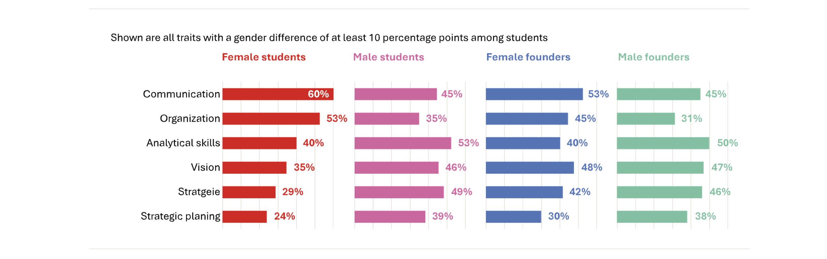
Self-reported strengths compared
Source: Female Founders Monitor 2025, p. 14
Notes:
In the startup world, a founder’s ability to inspire confidence – particularly among investors – is often just as important as the underlying idea.
These traits are not solely skills that can be learned; they are also shaped by personality, social conditioning and cultural norms.
When asked to identify their strengths, female students were most likely to highlight two traditionally “feminine” traits: communication and organizational skills.
Male students, by contrast, tended to position themselves as prototypical entrepreneurs, describing themselves as strategic thinkers with strong analytical skills, vision and a high tolerance for risk.
Among female founders, attributes like vision, strategic thinking and risk appetite were reported much more frequently than among female students.
These findings highlight how deeply embedded stereotypes and traditional gender roles continue to shape self-perception – even among today’s students – and influence women’s willingness to consider entrepreneurship.
The increase in entrepreneurial traits between female students and female founders points to a combination of self-selection and a shift in mindset that develops over the course of one’s career.

Slide 8
Female founders’ have high impact potential
Of all female founder teams:
90%
89%
81%
Are profitable
Have high societal or ecological impact
Grow rapidly
Source: Female Founders Monitor 2022, p. 21
Notes:
The statistics show – there is great innovative and impact potential when women found startups…and this is also what our female founders say.
Women who start up are less visible but no less successful than their male counterparts.
Companies run by women are more stable and tend to stay on the market longer.
And: They have different, more impact oriented motives for founding than men.
Women's teams are characterized by a stronger focus on sustainability in their corporate strategy,
61% also identify with the area of social entrepreneurship.
Almost half of the female founders orient their company to societal or social issues. For men, the figure is just over one-third.
Money also plays a more decisive role for men: While economic success is essential for almost three quarters, only slightly more than half of the female founders are primarily interested in it.
Women identify particularly strongly with sustainability objectives. (Green Startup Monitor 2023)
There is great potential in this, and it also shows that women are needed to tackle major societal problems and, of course, earn money at the same time.
Today, we'll talk about why, in addition to the big structural issues, it's also about how you look at the issue yourself and create awareness about it....
Wichtig: Videos immer eine Slide früher ankündigen, da sie automatisch abgespielt werden
But let‘s first introduce you to our female founders and in a second following video you will hear why they believe that we need mor women entrepreneurship out of science…

Slide 9

Videosnippet:
Intro Role Models +
We need more Sciencepreneurship by women because…
Notes:
But let‘s first introduce them to you…

Slide 10
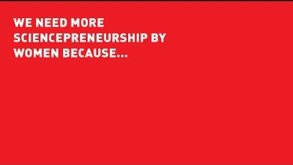
Notes:
And now let‘s hear why they believe we need more entrepreneurship by women…

Slide 11
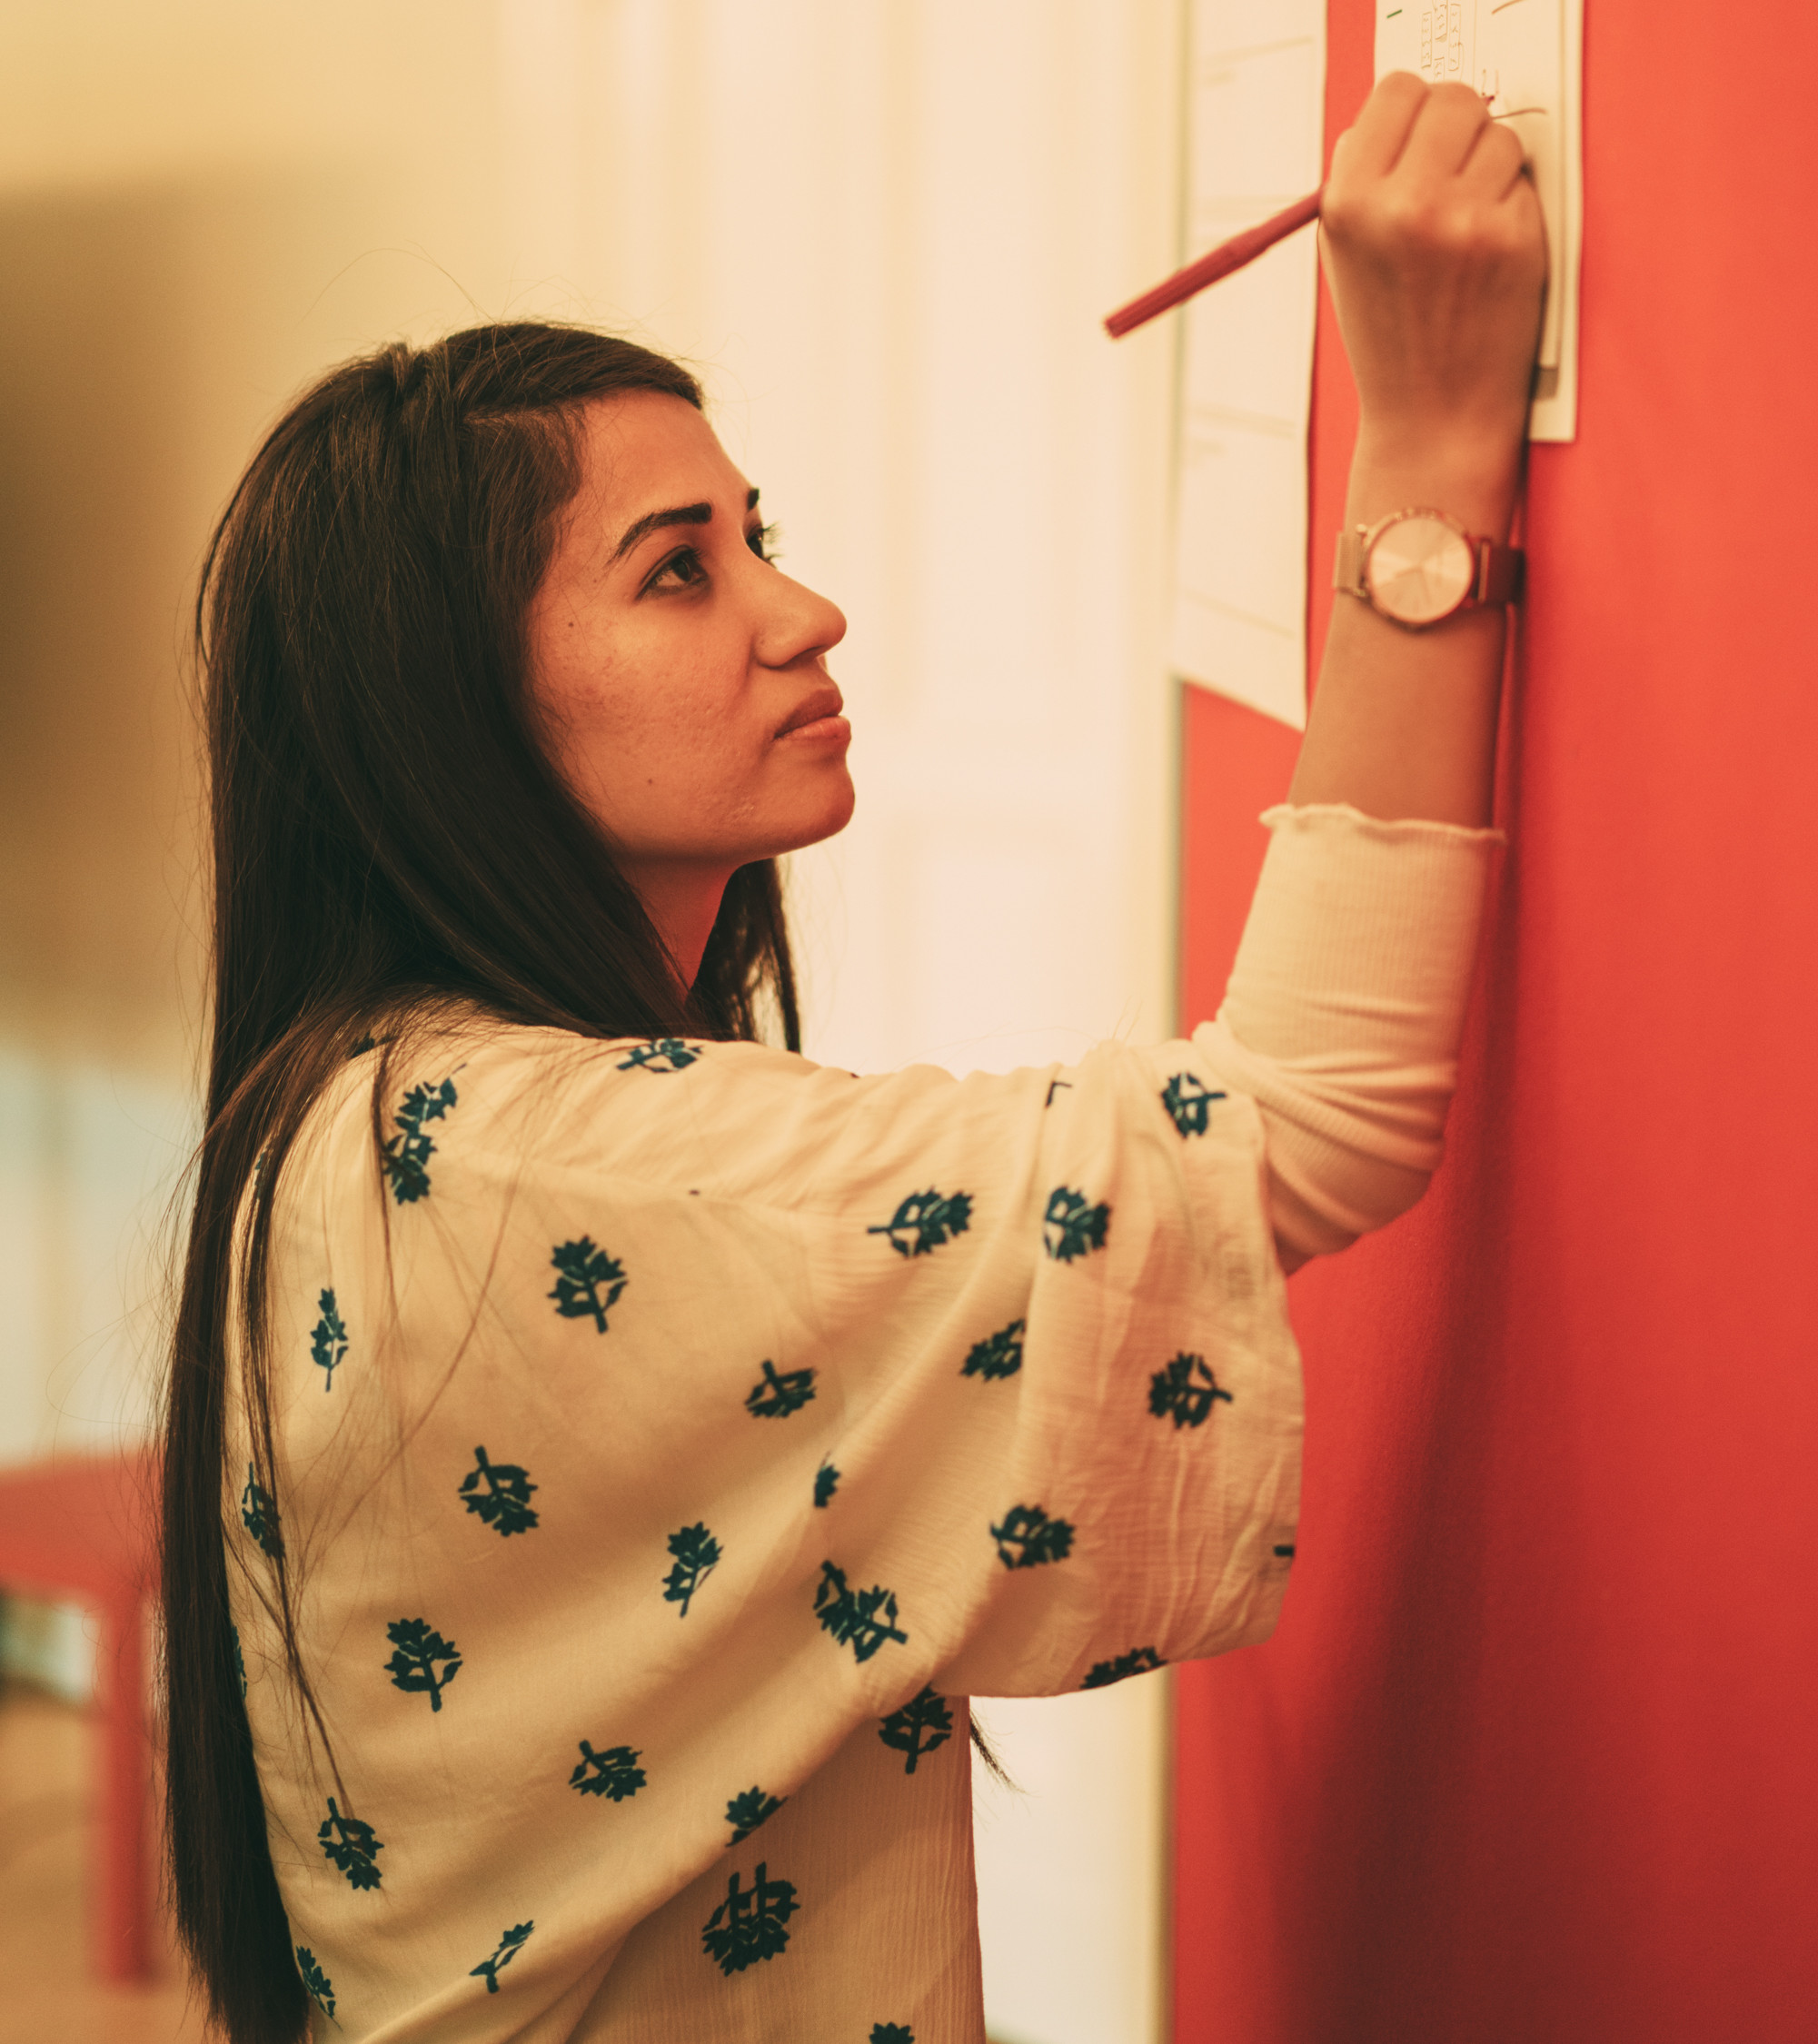
Your entrepreneurial empowerment journey

Slide 12






Our journey today…
1
3
2
4
My beliefs about entrepreneurship
My sources
of support
My entrepreneurial resources
Retro &
next steps
Notes:
Together we will go on an entrepreneurial empowerment journey the next 2 hours and we’ll shortly want to introduce you the steps included.
1. We’ll talk and share about the associations that you have on entrepreneurship
2. You will have time to look at the resources that you already have and to build your entrepreneurial profile
3. We want to support each other and learn what cooperation and support could be helpful for our own projects
4. We will look back and reflect on potential next steps
In the end: share with each other your takeaways from this workshop

Slide 13
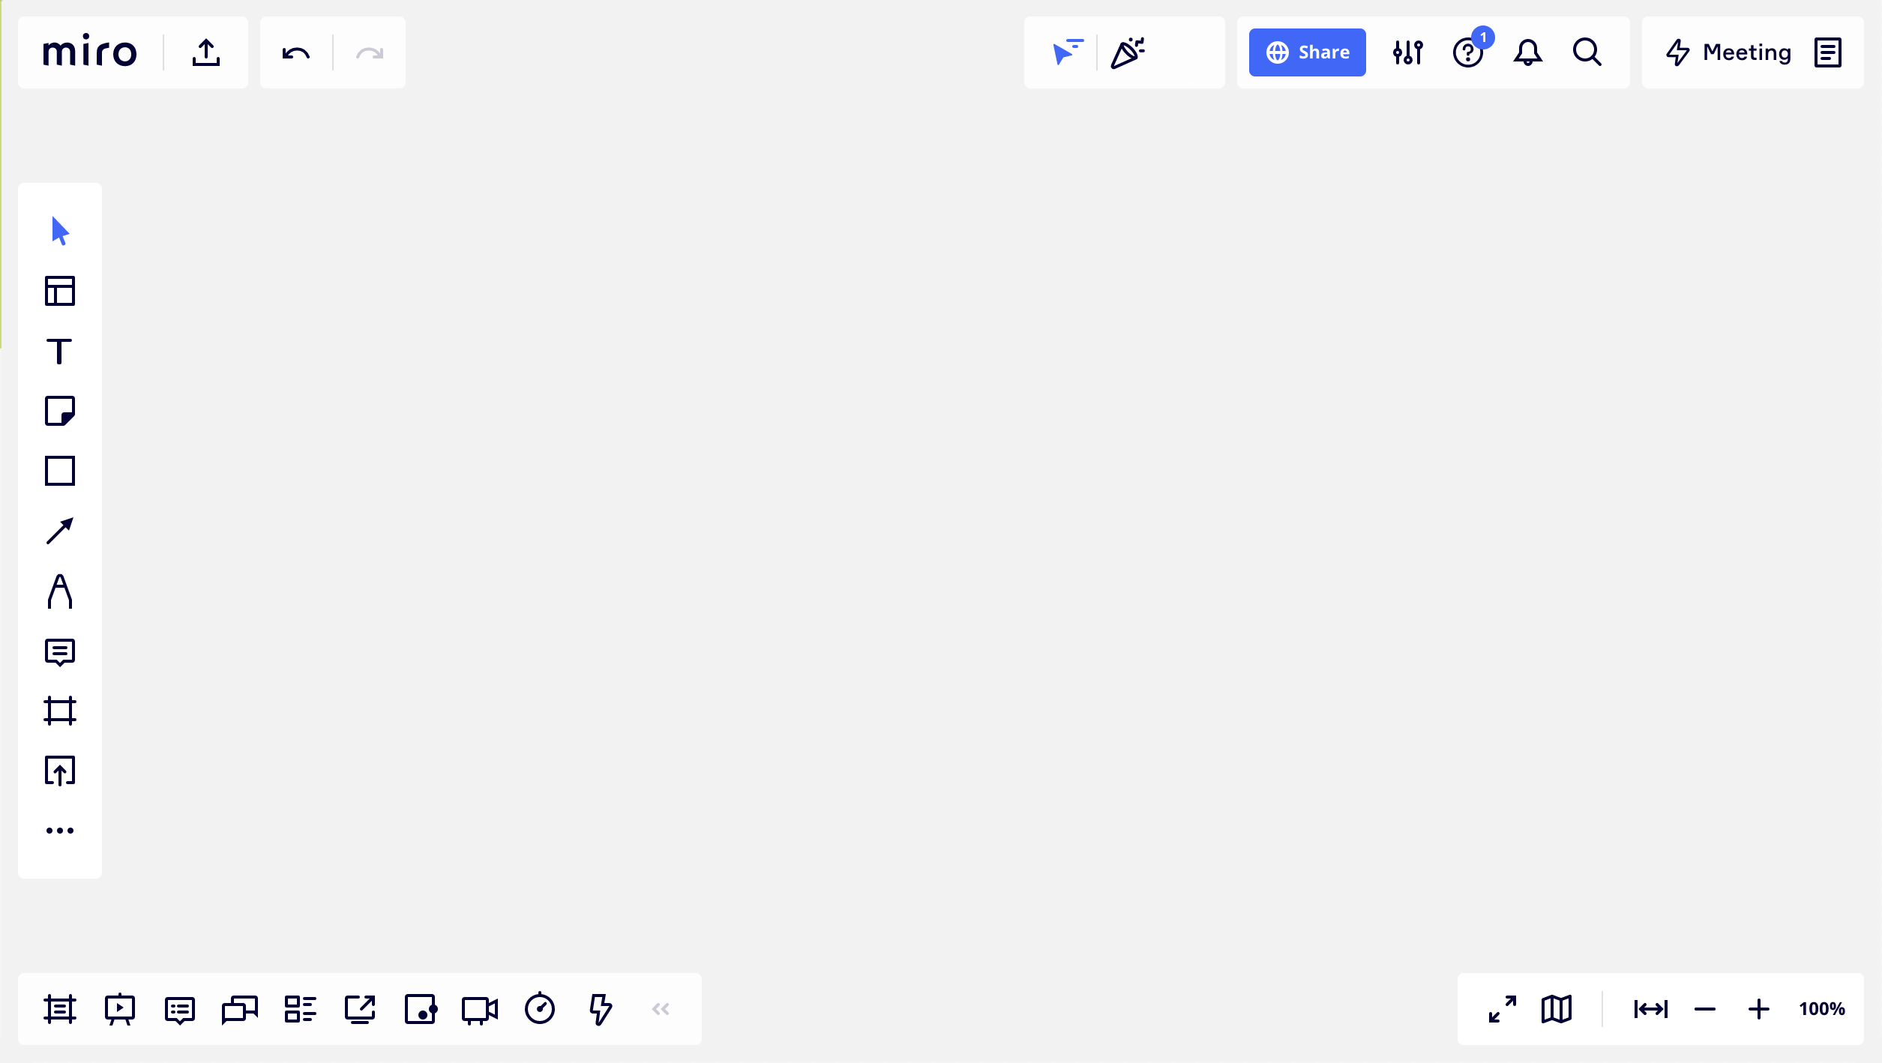
Welcome to miro …
text
sticky notes
navigation map
more functions, like stickers and emojis
zoom
Notes:
Short intro to Miro and most relevant features > ask: who of you has used Miro before?

Slide 14

Experience miro
Play around with sticky notes and write down your favorite women personality.
Notes:
In order to practice working with Miro a bit: Write down one female character/person that you admire/that inspired you (can be a founder or not)

Slide 15
Solo work
Warm up with MIRO
5 minutes
Transfer to MIRO and
find the Miro experience board on the top
Take a sticky note and post it in the template frame
Write down your favorite women personality
Change the size, the color and the shape of the sticky note

Slide 16




Beginning with step 1
1
3
2
4
My beliefs about entrepreneurship
My sources
of support
My entrepreneurial resources
Retro &
Next steps
Notes:
Together we will go on an entrepreneurial empowerment journey the next 2 hours and we’ll shortly want to introduce you the steps included.
1. We’ll talk and share about the associations that you have on entrepreneurship
2. You will have time to look at the resources that you already have and to build your entrepreneurial profile
3. We want to support each other and learn how what cooperation and support could be helpful for our own projects
4. We will look back and reflect on potential next steps
In the end: share with each other your takeaways from this workshop

Slide 17
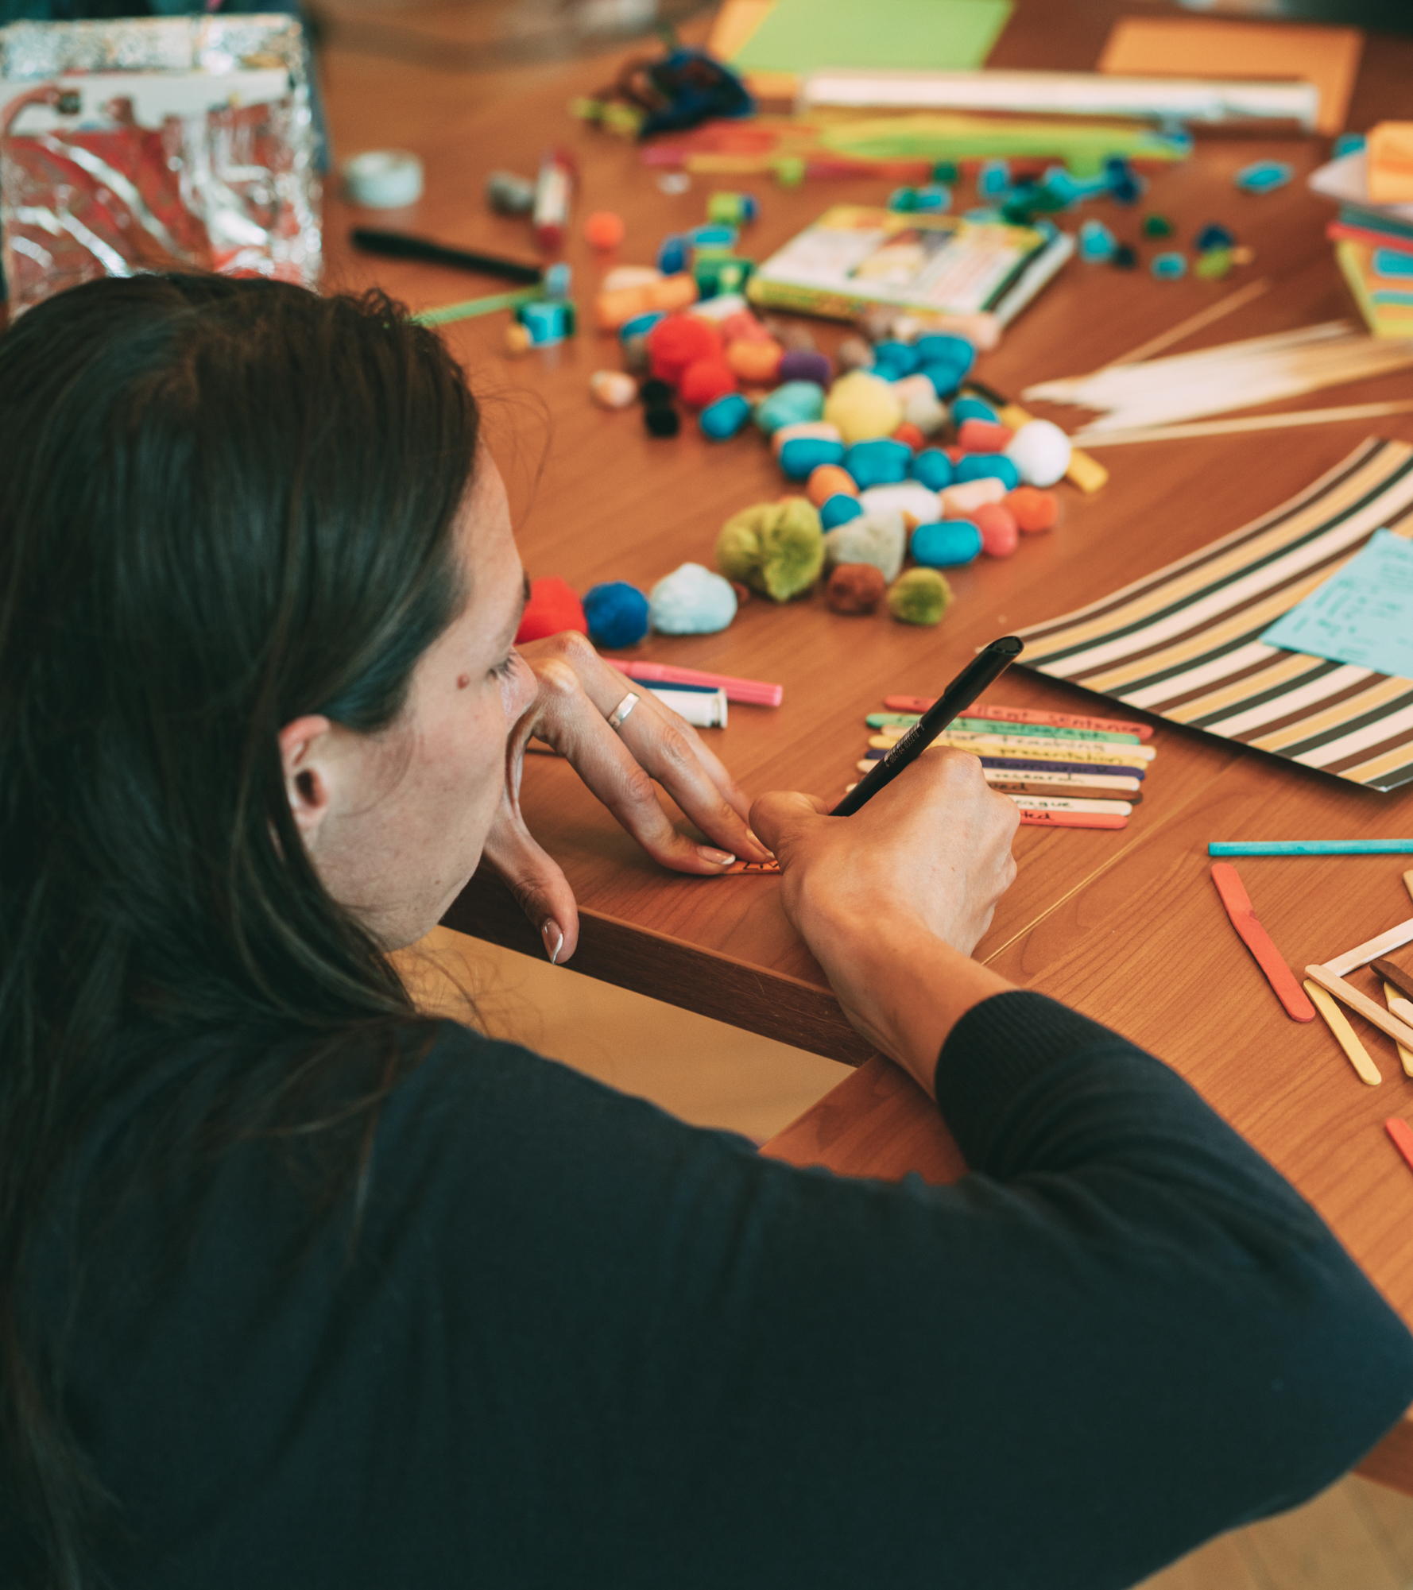
Step 1:
Your beliefs
Notes:
Let’s now begin with our journey and walk the first (baby) steps – what do you actually associate with entrepreneurship. We want to dedicate a moment to this question.

Slide 18





Step 1
When I think of entrepreneurship,
what comes to my mind is…
Notes:
Reflect on this question – what comes to your mind, when you think of entrepreneurship
What pulls me there and what pushes me away?
You‘re also invited to post any fears or negative thoughts there.

Slide 19
Solo work
Your beliefs:
5 minutes
Stay in main room
and mute yourself.
Use the Miro template
for Step 1.
Take a moment and write down all your thoughts to following sentence:
When I think of entrepreneurship, what comes to my mind is…
Put your sticky notes on the relevant area.

Slide 21
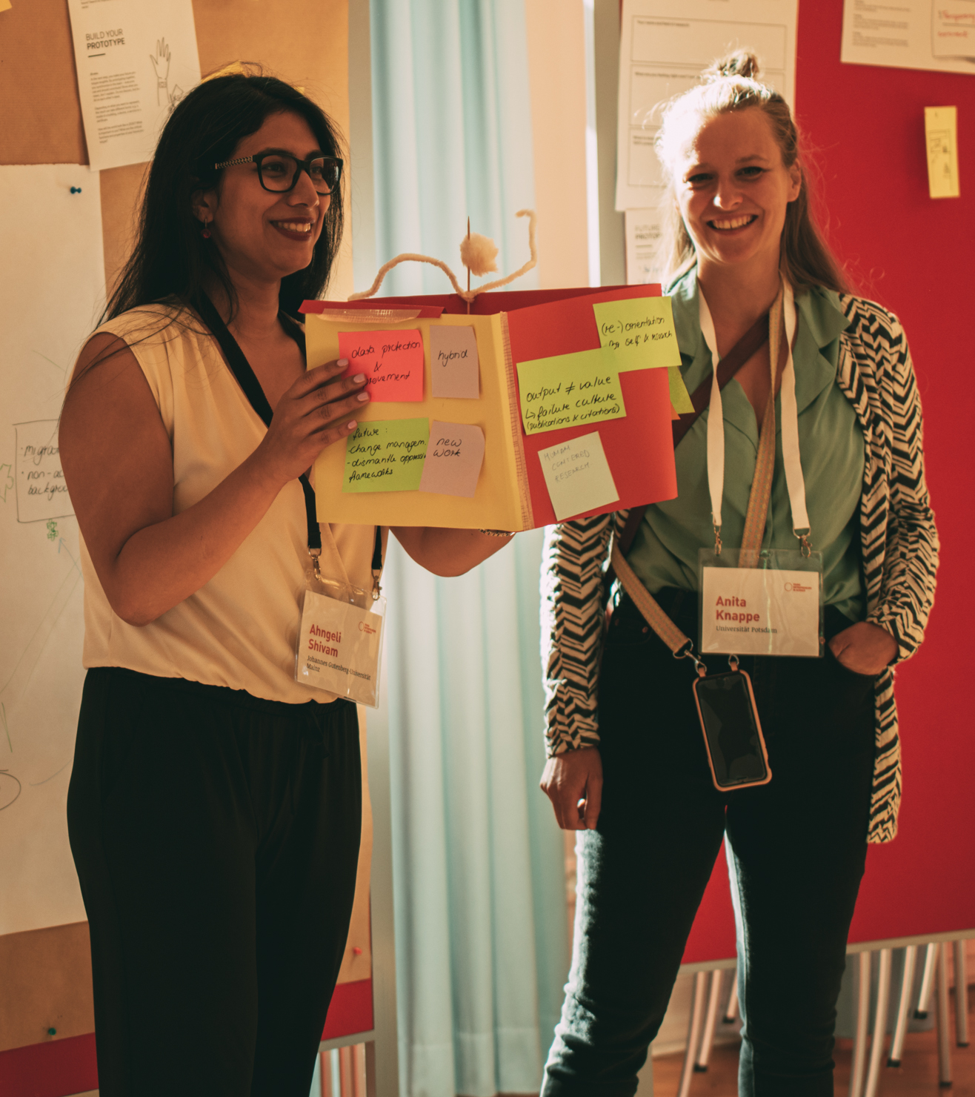

Share your beliefs
Notes:
We want to give you some time to share your thoughts and associations in small groups. For this we will send you in breakouts for 10min.

Slide 22
Teamwork
Share your beliefs:
10 minutes
Digital Breakout Rooms
Use the Miro template
for Step 1.
Share your beliefs in the group and exchange with others.
If you want,
add new sticky notes.

Slide 23
Notes:
Next Video: You might have seen a diversity of different beliefs and thoughts about entrepreneurship, not necessarily reflecting the stereotype that we often have in mind. Now let‘s hear what our female founders say about the meaning of entrepreneurship to them.

Slide 24

Videsnippet: To me entrepreneurship means…
Notes:
You might have seen a diversity of different beliefs and thoughts about entrepreneurship, not necessarily reflecting the stereotype that we often have in mind. Now let‘s hear what our female founders say about the meaning of entrepreneurship to them.

Slide 25
Continuing with step 2
1
3
2
4
My beliefs about entrepreneurship
My sources
of support
My entrepreneurial resources
Retro &
Next steps
Notes:
Let’s walk further on our journey to step 2 – your resources

Slide 26
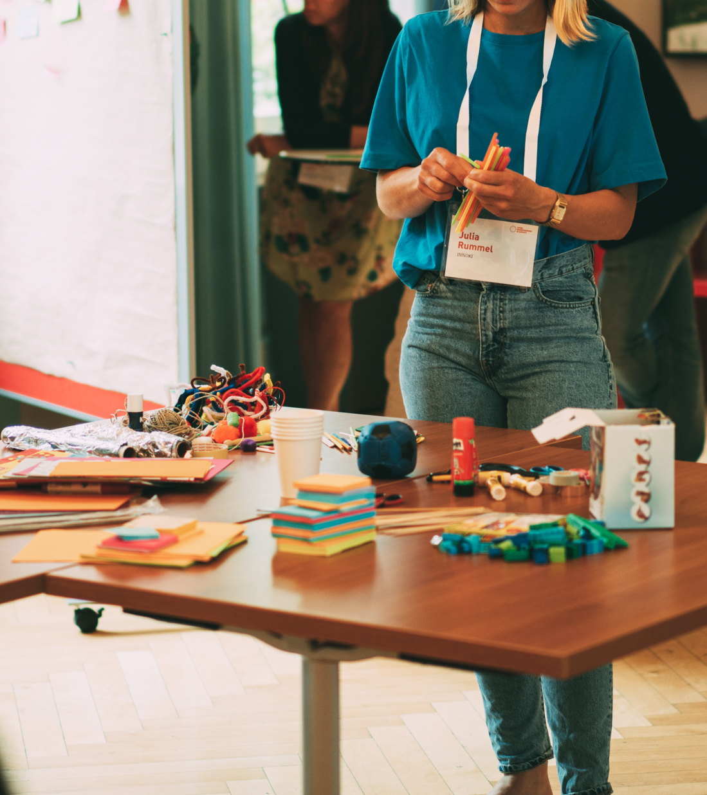

Step 2:
Your resources
Notes:
Next video: We would like to start again with a little video snippet by our female founders on their resources and gifts they bring to the world as an entrepreneur…

Slide 27
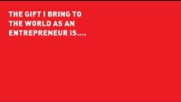
Videsnippet: The gift I bring to the world as an entrepreneur is…
Notes:
We would like to start again with a little video snippet by our female founders on their resources and gifts they bring to the world as an entrepreneur…

Slide 28

Step 2: Your resources profile
My professional & private experiences
My training & background
My expertise & skills
My successes (professional & private)
What I still need…
Notes:
So, gaining awareness for what you already bring to the table, for all your skills and experiences that you have and to know what you are especially good in and what not so much is very important.
It helps to be brave moving forward, to ask for support and be able to reflect on potential fields of improvement. We believe that writing it down, and showing it to others can also feel quite empowering. And that‘s what we invite you to do in the next exercise by filling out your own entrepreneurial profile with your background, experiences, qualitifactions, successes…
If it helps you please look at the example profile on the top on the Miro Board
You don‘t need to fill out the blue box on the bottom > we will come to that later

Slide 29
Solo work
Create your profile:
15 minutes
Stay in main room
and mute yourself.
Use the Miro template
for Step 2.
Fill out your resources profile by using sticky notes.
If you want, add visuals
and icons.

Slide 31
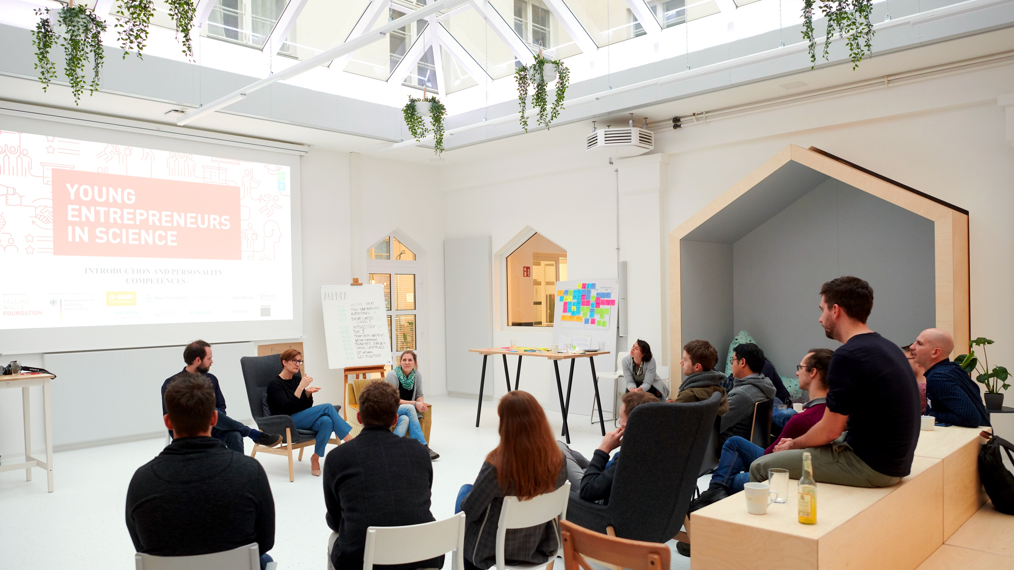
NEXT UP …
Notes:
We gonna have a little break now and will continue with our journey afterwards

Slide 32
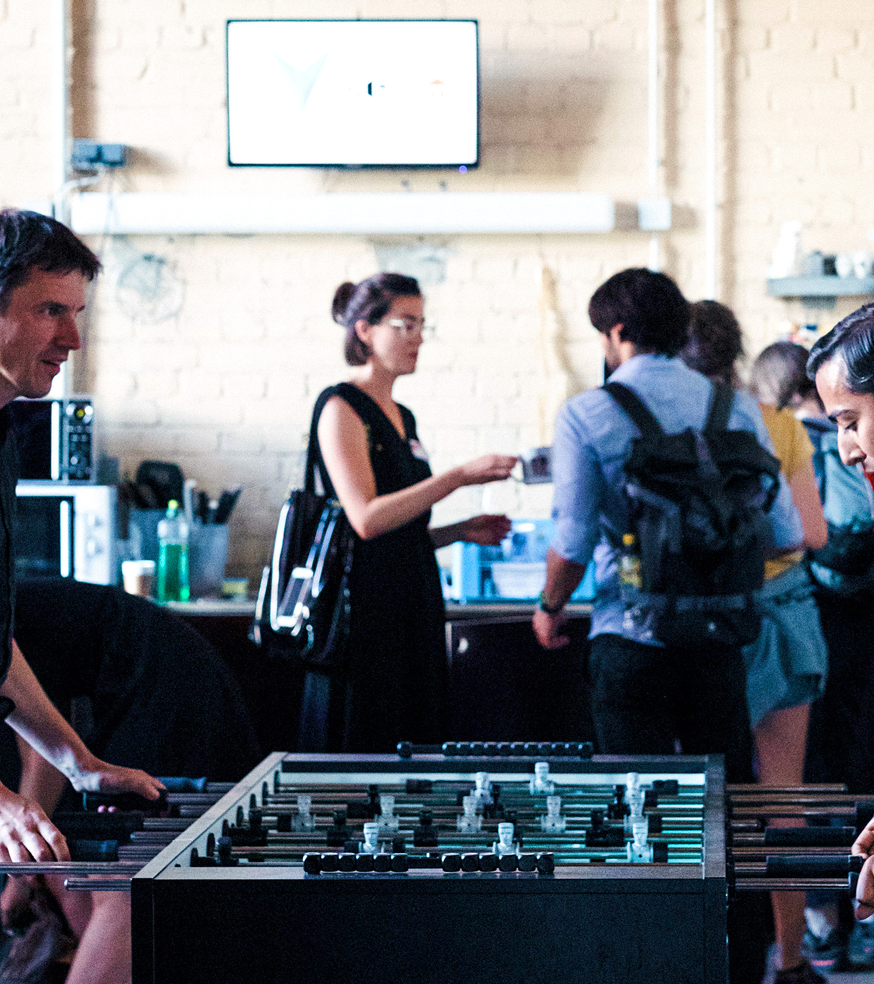
BREAK
Notes:
EVA

Slide 33
On to step 3
1
3
2
4
My beliefs about entrepreneurship
My sources
of support
My entrepreneurial resources
Retro &
next steps
Notes:
Let’s walk further on our journey to step 3 – your sources of support

Slide 34
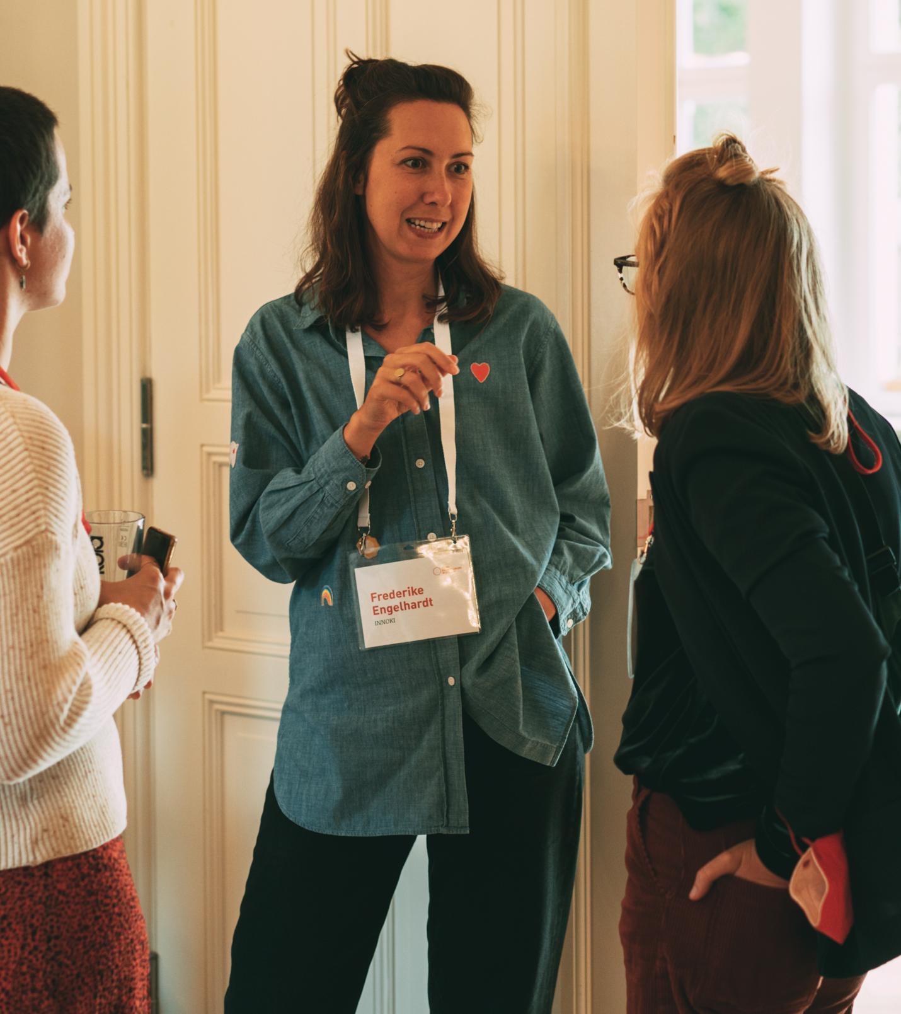
Step 3:
Your sources
of support
Notes:
Support and cooperation is something everybody needs and depends on when going an entrepreneurial path (or in general in life). You do not have to do it all by yourself and it’s allowed to ask for help ☺
Statistics also show that women in entrepreneurship have less access to networks but in case they do have access to networking opportunities they evaluate the effects of it as more positive than men.
We believe that cooperation and support also amongst women is a key aspect in order to foster female entrepreneurship in general.
Let‘s have a look at our next video snippet because all of our female founders were dependent on support from outside.

Slide 35
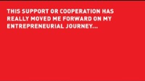
Videsnippet: What support or cooperation has really moved me forward…?
Notes:
Let‘s have a look at our next video snippet because all of our female founders were dependent on support from outside.

Slide 36


Let’s start with exercise 1
Exercise 1
Exercise 2
Appreciate the
other profiles
Brainstorm together on potential sources of support
Notes:
The idea is to support each other on the way; we also want to do that today here in this group in two exercises.

Slide 37
Solo work
Value the other profiles:
10 minutes
Stay in main room
and mute yourself.
Go to the entrepreneurial profiles on Miro.
Look through the resources profiles of the others.
Appreciate the other profiles with comments or visuals.
Notes:
Let‘s start with the first little exercise…
Feel free to use the appreciation icons in the star on the top – please copy paste instead of moving the icons

Slide 39


On to Exercise 2
Exercise 1
Exercise 2
Appreciate the
other profiles
Brainstorm together on potential sources of support
Notes:
The idea is to support each other on the way; we also want to do that today here in this group in two exercises.

Slide 40
Teamwork
Exchange with others:
15 minutes
Digital Breakout Rooms of 3
Go to the template on Miro
for Step 3.
Everyone, shortly introduce yourself and your project.
Brainstorm together, what support do you need to move your project(s) forward?
Write them on sticky notes
on the board.
Do you have any advise for
the other persons?
appr. 5 min brainstorming
for each person
Notes:
Thinking about a situation in which you‘re working on our own idea, you want to push it forward (maybe that‘s happening already, maybe not > future scenario) > what could be sources of support in this case? What kind of sources you can think of?
Examples for options of support to mention: closest friends to talk to, family/partner, mentor or coach, institutions like universities for infrastructure and equipment, startup communities, female founder communities – could be technical support, support with expertise, mental support…

Slide 42
Finishing with step 4
1
3
2
4
My beliefs about entrepreneurship
My sources
of support
My entrepreneurial resources
Retro &
next steps
Notes:
Let’s walk further on our journey to step 4 – looking back to what has happened in this workshop and looking forward, what are potential next steps?

Slide 43
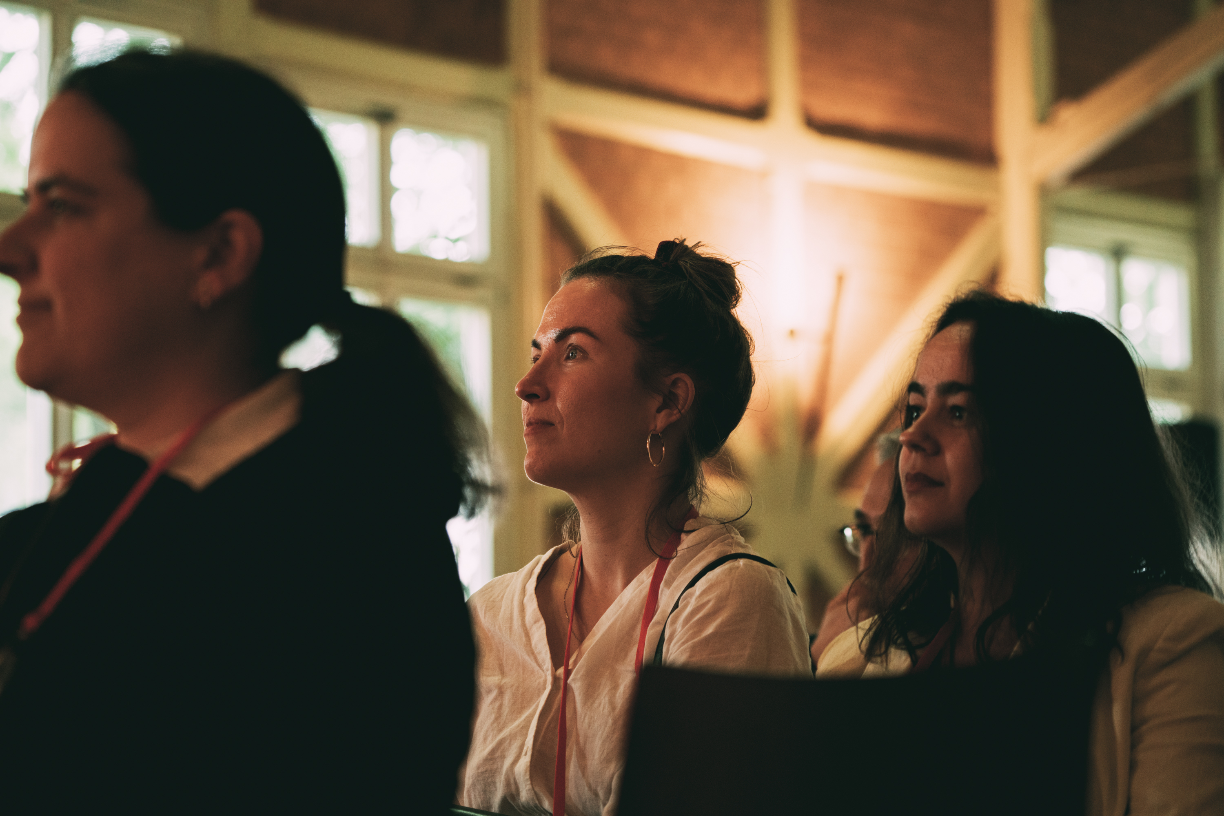
Step 4:
Retro & next steps
Notes:
But before you are doing that, llet‘s see what our female founders say….what would they have done differently on their journey

Slide 44
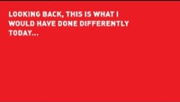
Videsnippet:
This is what I would have done differently today…
Notes:
Let‘s see what our female founders say….

Slide 45


Look back and look forward
1
2
Pick the aspects from the steps
before that are most relevant to you,
note them down.
What are the next 1 or 2 concrete steps to take after this workshop?
Notes:
Examples for the second step: contacting one of the persons in this digital room, talking to your friend about this workshop, sharing your project/ideas with someone close, visiting another female entrepreneurship event and learn more about it, taking a deeper look into your skills…

Slide 46
Solo work
Retro & next steps
5 minutes
Stay in main room
and mute yourself.
Go to the template on Miro
for Step 4.
Take a moment and make notes to following questions:
Looking back at the journey, what were the most relevant aspects to you?
What are the next one or two concrete steps that you can take tomorrow?
Notes:
Step 1: could also be notes and impulses from the others in the group
Examples: contact a person in this group…
Wichtig zu sagen, da es sonst sehr allgemein wird: be as concrete as possible > what exactly could you do tomorrow?

Slide 47
Share with us what you take away!
Notes:
One last time, let‘s hear the wishes from our founders to all women from science/to you

Slide 48
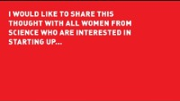
Notes:
One last time, let‘s hear the wishes from our founders to all women from science/to you

