Slide 1

DISCOVER YOUR RESILIENCE

Slide 2
Today’s Agenda
Part I
Part II
Check-in
Why should we train resilience?
What can we learn from Malala?
Exercise 1: Doors Closed, Doors Open
How to find your resilience strategies
Exercise 2: Your Sources of Resilience
Share & Inspire
Summary & Checkout
Notes:
Here’s what we’ll be diving into today:
Part 1:
Check-in: Setting the stage.
Why should we train resilience? Understanding its importance and what we can learn from inspiring figures like Malala.
Exercise 1: Doors Closed, Doors Open: Reflecting on challenges and opportunities in our lives.
Part 2:
How to find your resilience strategies: Building a toolkit for navigating difficulties.
Exercise 2: Your Sources of Resilience: Identifying and strengthening your personal resilience sources.
Share & Inspire: Learning from each other’s experiences and insights.
We’ll wrap up with a Summary & Checkout to reflect on what we’ve learned.

Slide 3
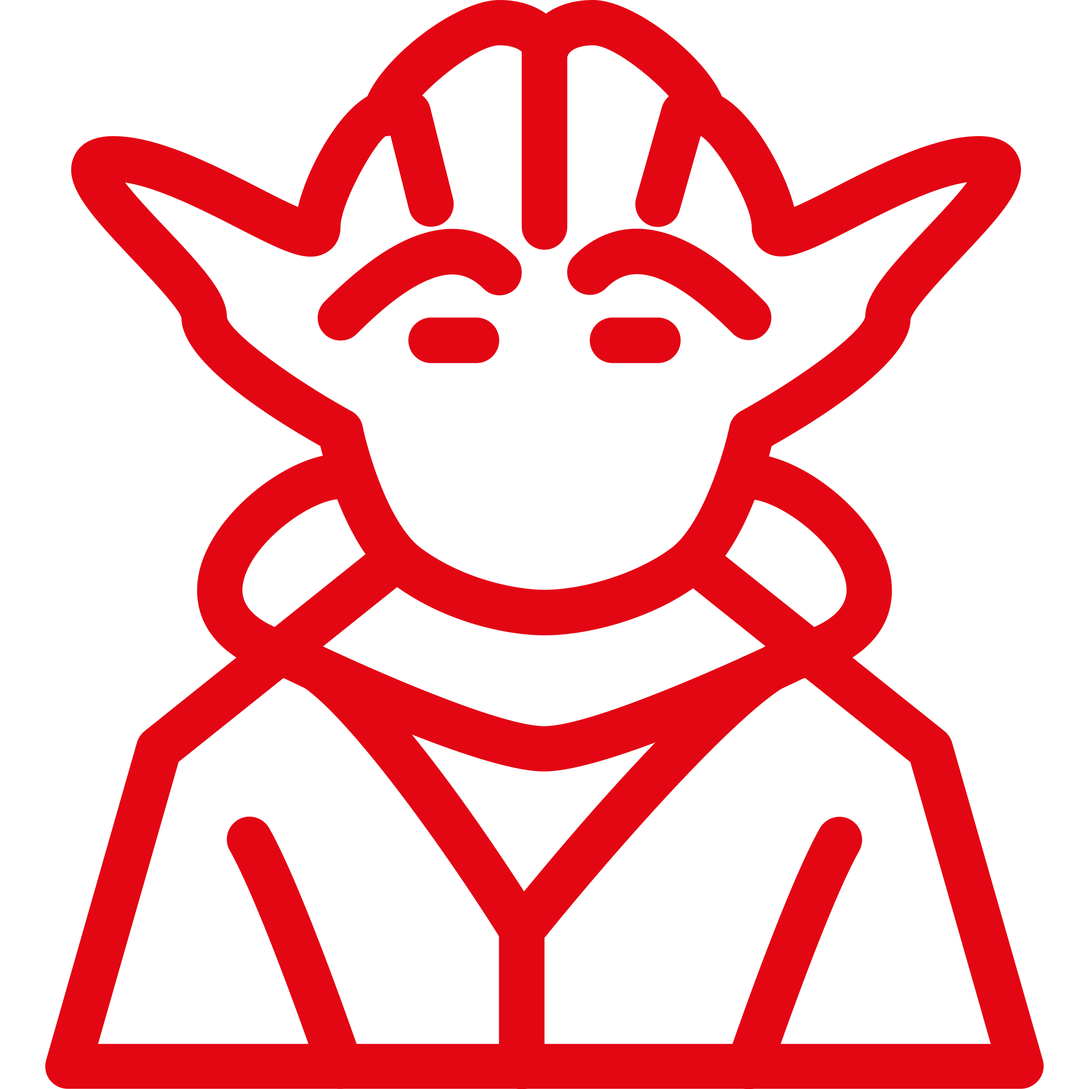


Learning goals
Learn about useful mindsets to cope with stressful situations.
Practise creating room for positive perspectives.
Develop resilience strategies that suit your needs.
Notes:
Our Learing goals for today are:
Learn about useful mindsets to cope with stressful situations: Discover approaches to stay grounded and adaptable when facing challenges, building a foundation for resilience.
Practise creating room for positive perspectives: Learn how to reframe situations and foster optimism.
Develop resilience strategies that suit your needs: Identify and tailor techniques that work best for you, creating a personalized toolkit for navigating difficult times.
One important note: We kindly ask everyone to treat everything discussed here today with confidentiality. At the same time, we invite you to share only what you feel comfortable with. Please remember to take care of yourself and prioritize your well-being throughout the session.

Slide 4
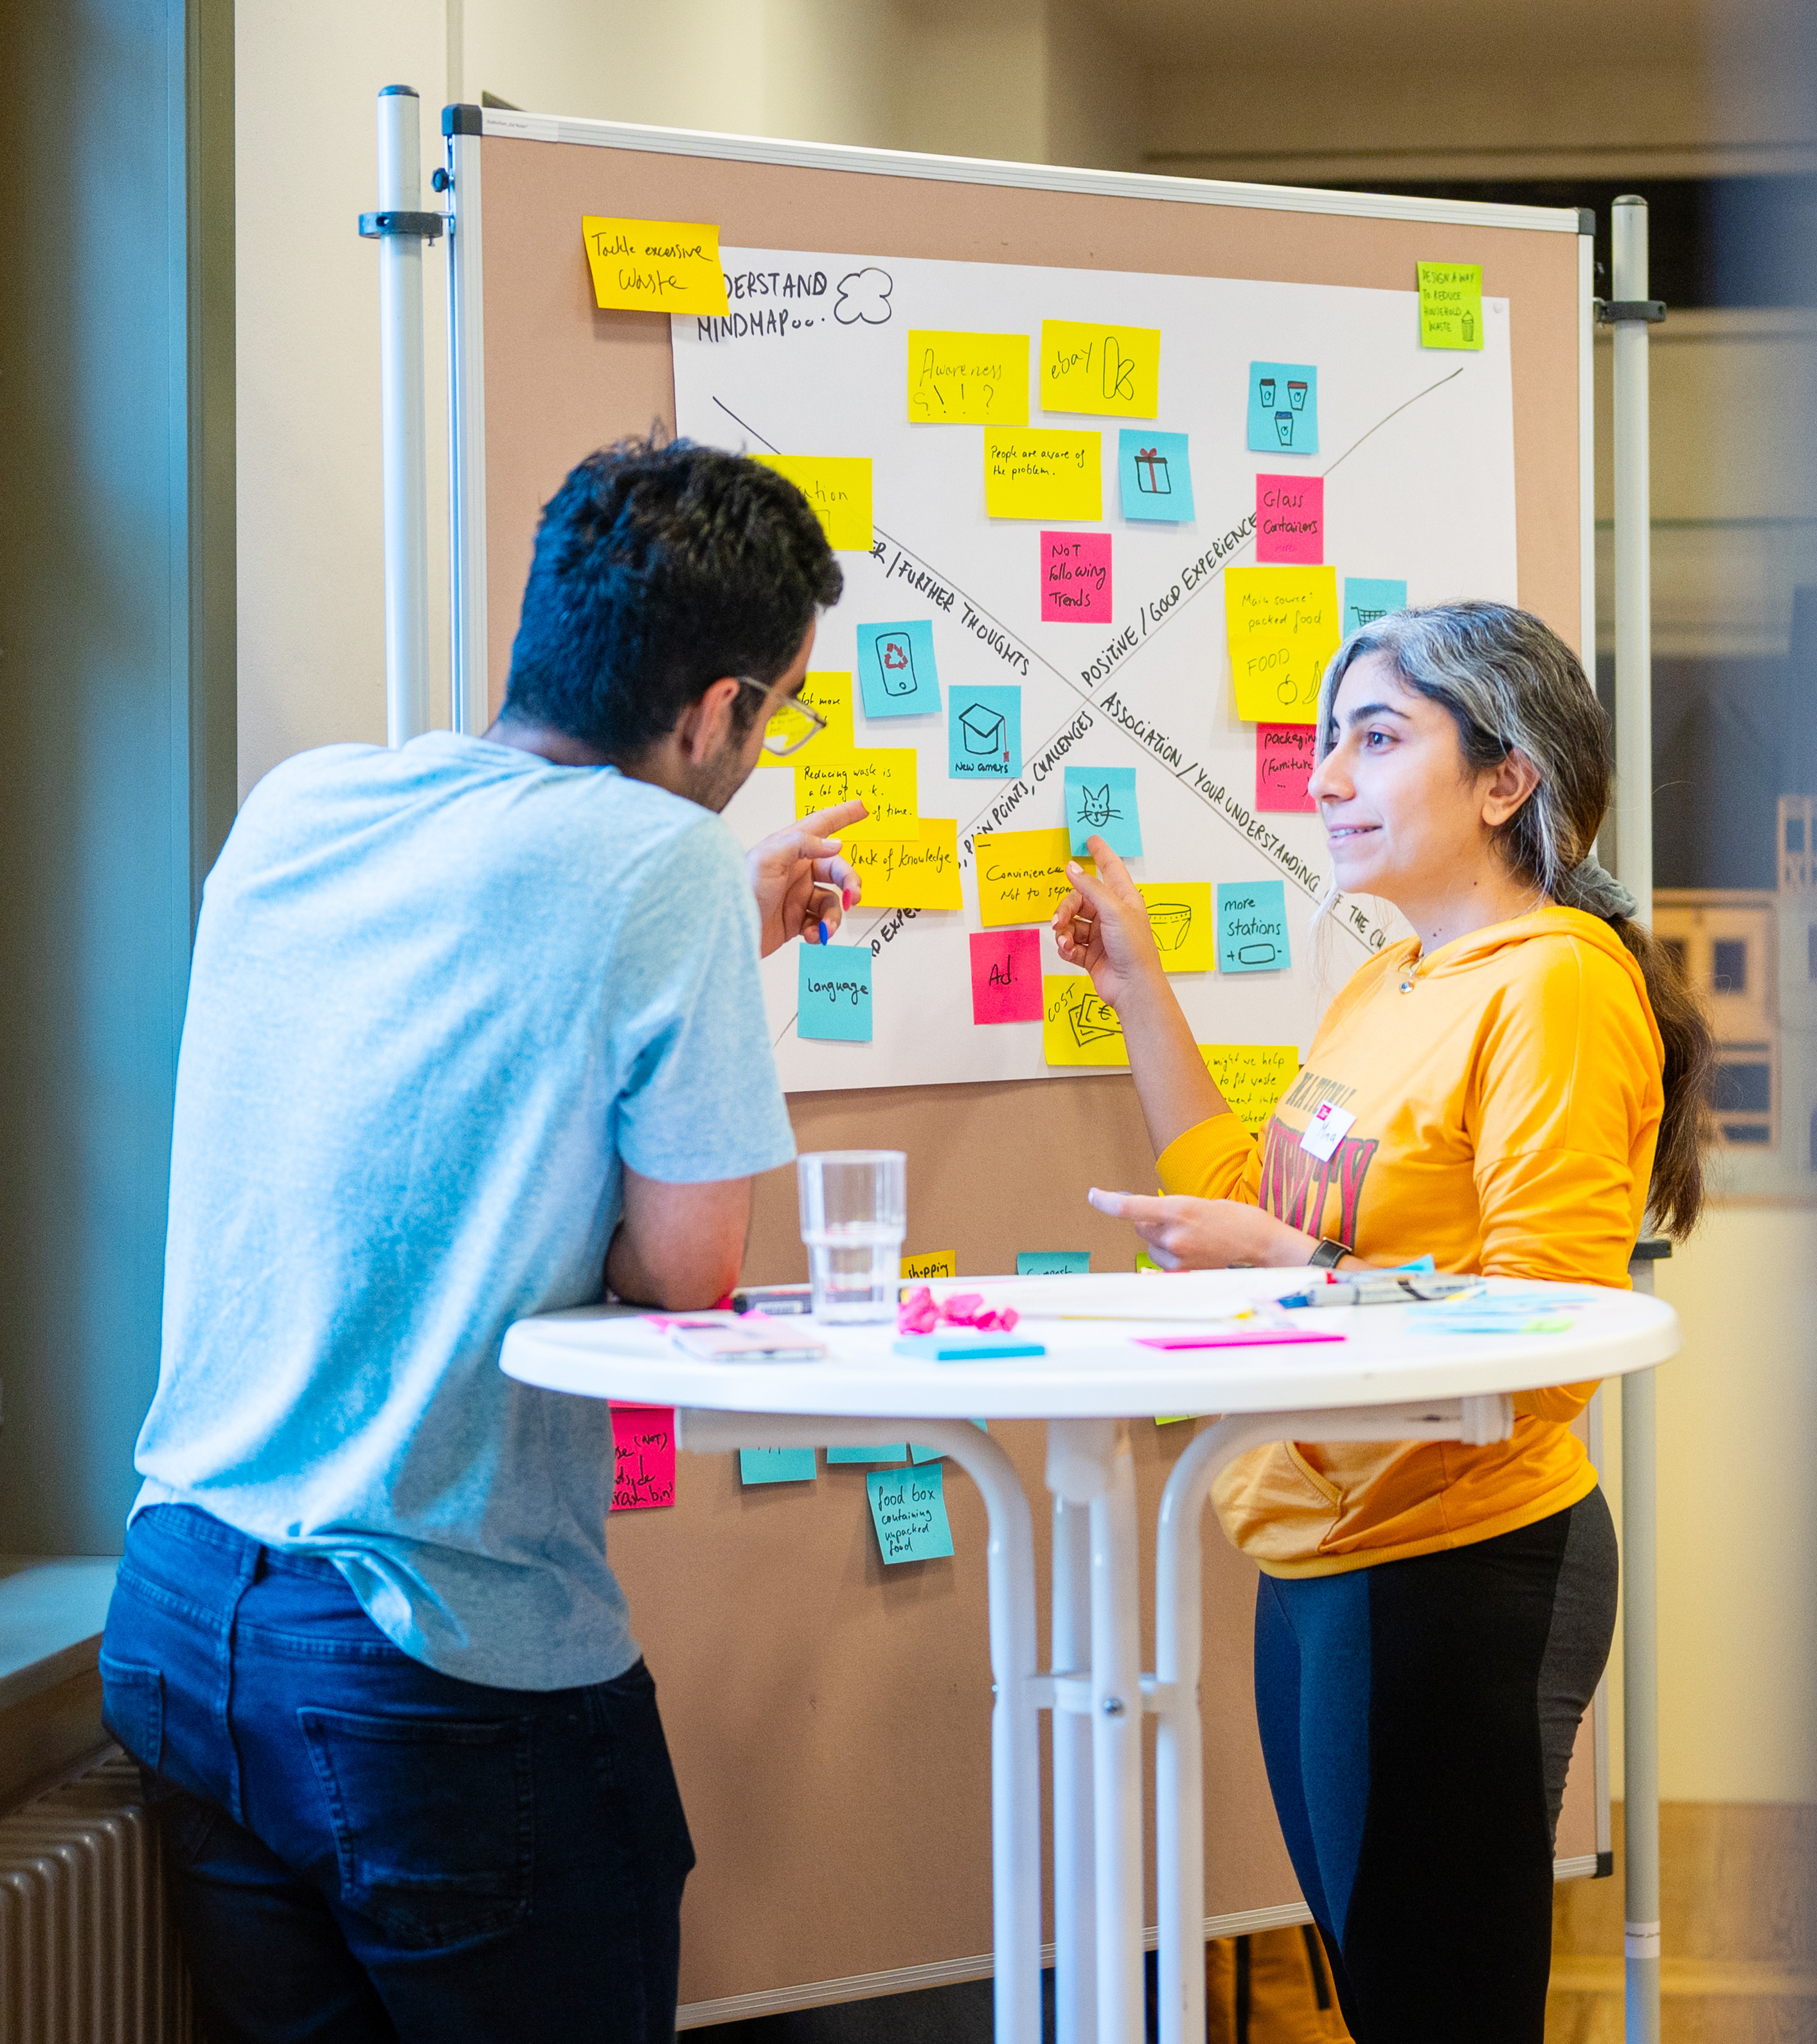
Your Skills as an Entrepreneur and Researcher
Notes:
Before diving into the topic, we’d like to show you how resilience fits within the skillset of a researcher and/or entrepreneur.

Slide 5

Skillset: EntreComp Wheel
Tool to reflect on your personal development of entrepreneurial skills
Developed by the Joint Research Centre (JRC) of the European Commission
Made up of three competence areas: Ideas & Opportunities, Resources, Into Action
Each area includes 5 competences
Bacigalupo, M., Kampylis , P., Punie , Y., Van den Brande, G. (2016). EntreComp : The Entrepreneurship Competence Framework. Luxembourg: Publication Office of the European Union; EUR 27939 EN; doi:10.2791/593884
Notes:
Resilience is a vital skill for entrepreneurs, helping them navigate challenges and uncertainties.
The EntreComp framework, developed by the Joint Research Centre (JRC) of the European Commission on behalf of the Directorate-General for Employment, Social Affairs, and Inclusion, provides a comprehensive perspective on entrepreneurial skills, including resilience.
This framework is organized into three competence areas: ‘Ideas and Opportunities,’ ‘Resources,’ and ‘Into Action.’
Each area comprises five competences, creating a holistic view of the skills needed for entrepreneurship.

Slide 6

Resources
Which resources do you have to transform your ideas into action?
Competence
Hint
Self awareness & self-efficacy
believe in yourself and keep developing
Motivation & perseverance
stay focused and don't give up
Mobilising resources
gather and manage the resources you need
Financial & economic literacy
develop financial and economic know-how
Mobilising others
inspire, enthuse and get other on board
Bacigalupo, M., Kampylis , P., Punie , Y., Van den Brande, G. (2016). EntreComp : The Entrepreneurship Competence Framework. Luxembourg: Publication Office of the European Union; EUR 27939 EN; doi:10.2791/593884
Notes:
In today’s workshop, we’ll focus on the bottom part of the EntreComp wheel: Your Resources.
Resilience is embedded within this framework as part of the ability to mobilize resources, adapt to challenges, and sustain efforts to turn ideas into
These are the foundations that help you thrive as a researcher, turn your ideas into action, and grow as an entrepreneur.
Some examples of these resources include:
Self-awareness & self-efficacy: Believe in yourself and commit to ongoing development. Reflect on your needs and aspirations, and understand your strengths.
Motivation & perseverance: Stay focused and resilient under pressure. Cultivate determination to transform your ideas into action.
Mobilizing resources: Effectively gather and manage the resources you need. Use your own resources responsibly and know where to seek support when needed.
This might sound like abstract input, but it’s essential for building a case for resilience. To make it more relatable, let me share some inspiration on the topic…

Slide 7
Quote
“By far the most difficult skill I learned as a CEO was the ability to manage my own psychology. Organizational design, process design, metrics, hiring and firing were all relatively straightforward skills to master compared with keeping my mind in check.” Ben Horowitz serial founder
Notes:
I love this quote because it highlights that mastering hard skills alone isn’t enough for true success.
As an entrepreneur and scientist, what will ultimately push you forward and help you achieve your goals depends on more than technical expertis.
It’s also about understand and manage your own psychology.
To reach that point, you can learn to navigate obstacles with greater ease, grow from challenges, and emerge stronger.
This is where resilience becomes essential.
While Ben Horowitz might not be the first person who comes to mind when thinking about resilience, his insight is a powerful reminder of its importance.
Quelle: https://beruhmte-zitate.de/zitate/1850610-ben-horowitz-by-far-the-most-difficult-skill-i-learned-as-a-c/

Slide 8


What can we learn from Malala Yousafzai?
Notes:
Malala Yousafzai, the youngest Nobel laureate, survived a Taliban attack at just 15 while advocating for girls' education in Pakistan.
After a long recovery, she turned her personal tragedy into a global movement for education and women’s rights.
We can learn from Malala in several ways:
Finding purpose through pain: Malala transformed her hardship into a mission for change, using the attack to amplify her message. Relying on support systems: Her resilience was strengthened by her family’s encouragement and international support, highlighting the importance of relationships and networks in overcoming challenges.
Staying optimistic and hopeful: Through adversity, Malala maintained hope and belief in the possibility of change.
Malala’s journey is a powerful example of resilience in pursuit of a meaningful goal.
Now, let’s shift the focus to your lives – your goals, challenges, and aspirations.
As PhD students and aspiring entrepreneurs, let’s explore how you can strengthen your resilience to navigate these pivotal phases.

Slide 9
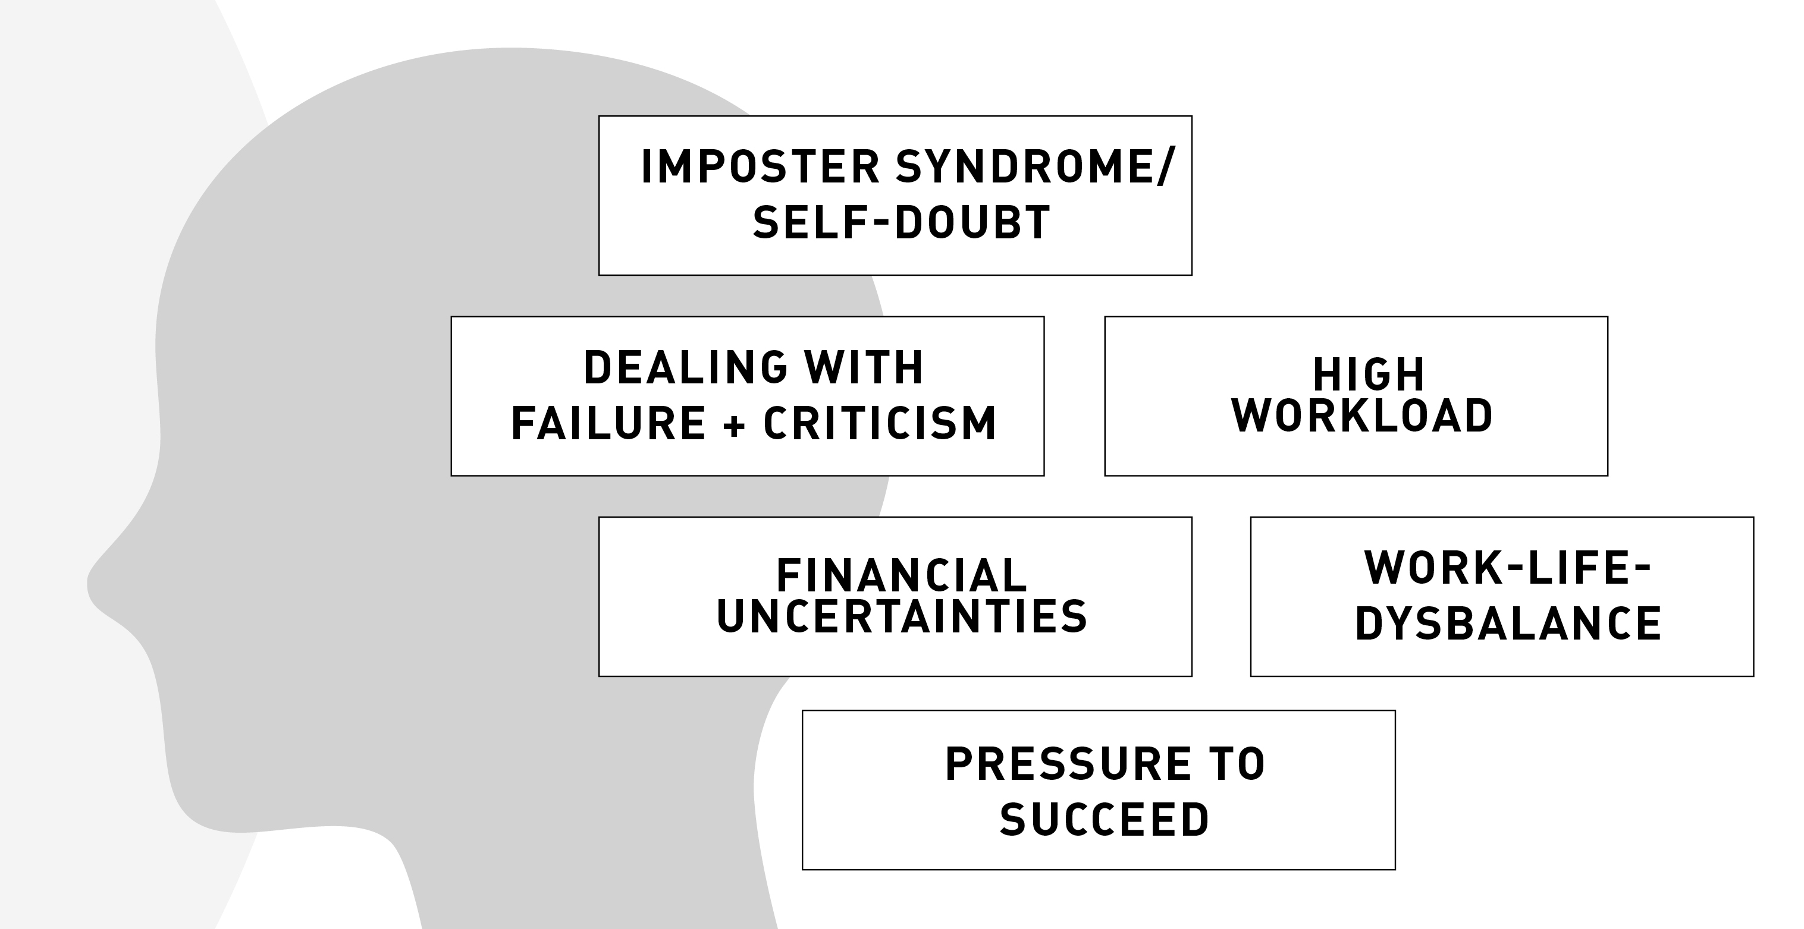
Resilience & adaptability are important traits in research and in founding
Doing a PhD is a special time in your life as well is founding
We work in VUCA environments: volatile, uncertain, complex, ambiguous
Both, founding & research rely heavily on moving past obstacles
And in both worlds: High performance becomes easier when we are balanced & content
Notes:
Resilience and adaptability are key in both research and entrepreneurship, especially in environments where outcomes are uncertain.
These are VUCA environments – Volatile, Uncertain, Complex, and Ambiguous – where change is fast, and decision-making is complex.
In these settings, success relies on overcoming daily challenges.
This is where resilience comes in, helping you stay focused, adapt to change, and push forward despite uncertainty and other challenges, like self-doubt, high workload.

Slide 10
What does resilience mean?
The process and outcome of successfully adapting to difficult or challenging life experiences, especially through mental, emotional, and behavioral flexibility and adjustment to external and internal demands.
The American Psychological Association
Notes:
What does resilience mean?
Resilience, originally a term from engineering for durable materials, refers to how well people adapt to adversity.
Key factors include:
How you view and engage with the world
The quality of social support
Coping strategies
Psychological research shows that resilience can be cultivated and strengthened through practice.

Slide 11

What does resilience mean?
Notes:
Lets try to make it more tangible
Resilience is like a tennis ball that, when hit hard against the ground, bounces back with energy.
Initially, resilience was defined as the ability to recover quickly from setbacks, much like the ball regaining its shape and continuing its bounce.
Similarly, resilient individuals are able to rebound from life's challenges.

Slide 12


What does resilience mean?
Notes:
Resilience is now often compared to a plant growing along a wall, persistently seeking light despite limited resources.
The plant adapts by using what it has: relying on the wall for support and twisting to find sunlight.
Similarly, resilient individuals adapt and utilize available resources, growing stronger over time through consistent effort and adaptability.

Slide 13

What resilience is not:
Thinking I won’t face difficulty or distress
Something I was or wasn‘t born with
Avoiding emotional distress The good news: Resilience can be learned – and trained like a muscle!
Notes:
It’s important to understand what resilience is NOT:
Being resilient doesn’t mean avoiding difficulties or never feeling stressed.
In fact, building resilience often involves experiencing and managing distress.
For example, when founding a startup, you’ll face both moments of joy and challenging times.
Your resilience grows through handling these challenges.
Resilience isn’t something only certain people have – it’s a skill anyone can develop.
Just like becoming a scientist or entrepreneur, resilience is built over time, not something you’re born with.
Lastly, resilience isn’t about avoiding emotional distress.
Like building physical strength, increasing resilience requires time and effort, but don’t intentionally add stress to your life.
Focus on challenges you can handle and learn from them.

Slide 14
Raise your hand or write in the chat:
What behaviours or traits do you associate with resilience?
Notes:
Now that we’ve covered what resilience is and isn’t, let’s dive deeper.
I invite you to brainstorm as a group:
What characteristics define a resilient person?
How do they behave? What perspectives do they hold – about themselves, others, and problems?
What’s their view of the future?
(Stop screen share)

Slide 15




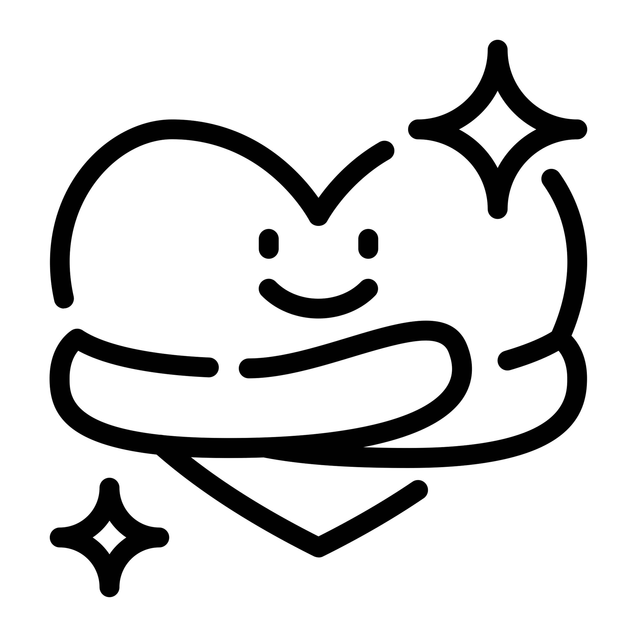

Six Indicators of Resilience
Self-care
Positive view of yourself
Healthy eating & sufficient sleep
Time to recover and relax
Regular physical activity
RESILIENCE
...and many more.
Notes:
Great insights, everyone! Now, let’s explore six key indicators of resilience that can help us understand the main building blocks for reslience, that we can develop and strengthen to enhance our own resilience. Let’s take a closer look.
The first indicator of resilience is self-care.
It includes maintaining a positive view of yourself, believing in your abilities, and building confidence.
Self-care also means prioritizing healthy eating and sufficient sleep, which are essential for both physical and mental well-being.
Make time to recover and relax, ensuring you recharge when needed.
Regular physical activity is also key, helping to manage stress and keep your body strong.
https://afsa.org/enhancing-resilience

Slide 16
Six Indicators of Resilience
Self-care
Positive view of yourself
Healthy eating & sufficient sleep
Time to recover and relax
Regular physical activity
Optimistic Outlook
Maintain a positive outlook
Keep things in perspective
Accept that change is part of living
RESILIENCE
...and many more.
Notes:
The second indicator of resilience is optimistic outlook.
This means striving to maintain a positive outlook even in difficult situations.
It’s about focusing on solutions and opportunities rather than dwelling on problems.
Equally important is the ability to keep things in perspective.
Challenges are part of life, and sometimes stepping back helps you see the bigger picture.
Lastly, accept that change is part of living.
Resilient individuals embrace change, knowing it brings growth and new possibilities, rather than seeing it as a threat.

Slide 17
Six Indicators of Resilience
Self-care
Positive view of yourself
Healthy eating & sufficient sleep
Time to recover and relax
Regular physical activity
Optimistic Outlook
Maintain a positive outlook
Keep things in perspective
Accept that change is part of living
RESILIENCE
Social Support
Build and maintain deep relationships
...and many more.
Notes:
The third indicator of resilience is social support.
Resilient people know that building and maintaining deep relationships is key to navigating tough times.
These connections provide emotional support, practical help, and a sense of belonging.
It’s important to surround yourself with people who encourage and uplift you, and to be there for others in return.
Strong social support creates a network that helps you face challenges with confidence.

Slide 18
Six Indicators of Resilience
Self-care
Positive view of yourself
Healthy eating & sufficient sleep
Time to recover and relax
Regular physical activity
Active Problem Solving
Reframe crises into solveable problems
Maintain a sense of control and influence and let go of things outside of your control
Take decisive action
Optimistic Outlook
Maintain a positive outlook
Keep things in perspective
Accept that change is part of living
RESILIENCE
Social Support
Build and maintain deep relationships
...and many more.
Notes:
The fourth indicator of resilience is active problem solving.
Resilient individuals are able to reframe crises as solvable problems.
They focus on maintaining a sense of control over what they can influence and let go of things outside their control.
Rather than feeling overwhelmed, they take decisive action and focus on the steps they can take to address the issue at hand.

Slide 19
Six Indicators of Resilience
Self-care
Positive view of yourself
Healthy eating & sufficient sleep
Time to recover and relax
Regular physical activity
Active Problem Solving
Reframe crises into solveable problems
Maintain a sense of control and influence and let go of things outside of your control
Take decisive action
Optimistic Outlook
Maintain a positive outlook
Keep things in perspective
Accept that change is part of living
RESILIENCE
Move toward your goals
Make realistic plans
Look for opportunities of self-discovery
Social Support
Build and maintain deep relationships
...and many more.
Notes:
The fifth indicator of resilience is moving toward your goals.
Resilient individuals are proactive in setting clear and realistic plans to reach their objectives, while remaining flexible in their approach.
They seek opportunities for self-discovery along the way, viewing challenges as chances to learn and grow.

Slide 20
Six Indicators of Resilience
Self-care
Positive view of yourself
Healthy eating & sufficient sleep
Time to recover and relax
Regular physical activity
Active Problem Solving
Reframe crises into solveable problems
Maintain a sense of control and influence and let go of things outside of your control
Take decisive action
Optimistic Outlook
Maintain a positive outlook
Keep things in perspective
Accept that change is part of living
RESILIENCE
Move toward your goals
Make realistic plans
Look for opportunities of self-discovery
Social Support
Build and maintain deep relationships
Meaning and Purpose
Find activities with meaning and purpose outside work
...and many more.
Notes:
The sixth indicator of resilience is meaning and purpose.
Resilient individuals find strength by engaging in activities that provide a sense of meaning and fulfillment beyond work.
This might include pursuing passions, volunteering, or spending time with loved ones.
Having a sense of purpose outside of your professional life creates a strong foundation, helping you stay motivated and grounded, especially during tough times.

Slide 21
Daniel’s Resilience Pattern
Self-care
Positive view of yourself
Healthy eating & sufficient sleep
Time to recover and relax
Regular physical activity
Active Problem Solving
Reframe crises into solveable problems
Maintain a sense of control and influence and let go of things outside of your control
Take decisive action
Optimistic Outlook
Maintain a positive outlook
Keep things in perspective
Accept that change is part of living
RESILIENCE
Move toward your goals
Make realistic plans
Look for opportunities of self-discovery
Social Support
Build and maintain deep relationships
Meaning and Purpose
Find activities with meaning and purpose outside work
...and many more.
Notes:
Everyone's resilience is unique, shaped by individual patterns.
Understanding your own resilience is a key step in self-awareness.
By reflecting on how you've handled challenges in the past, you can identify areas to strengthen.
Looking at each resilience factor allows you to pinpoint specific actions for growth in different situations.

Slide 22

How to train your resilience
Notes:
Now that we've explored the key indicators of resilience, let's dive into how you can actively train and strengthen your own resilience.

Slide 23
Mindset: Circle of Influence
CONCERN
Circle of Concern
Wide range of concerns
INFLUENCE
Circle of Influence
The concerns we can do something about
CONTROL
Circle of Control
What we can directly control
Stephen Covey
Notes:
The "Circle of Influence" is a concept that helps us distinguish between things we can control, things we can influence, and things we cannot control at all. Let me give you an example:
Concern: Things like the weather, politics, climate change, or the strategy of your research institute are concerns, but we can't directly control them.
Influence: Work relationships, family dynamics, or the behaviors of people around us fall into the influence category. We can't control them fully, but we can influence them through communication, actions, and engagement.
Control: Finally, things we can directly control include our self-care practices, personal goals, boundaries, priorities, and how we respond to people or events.
The key is to focus our energies on what we can control and influence, while letting go of what lies outside of our control.
Now, moving on to the exercise, one thing we can always change – because it's in our circle of control – is our perspective on things!

Slide 24

EXERCISE Doors closed, doors open
Notes:
When we face obstacles, it can feel like a door is closing, limiting our possibilities.
This exercise invites you to recognize that the end of something can also signal the beginning of something new – a door opening with fresh possibilities.
It’s about shifting your perspective to create room for a more positive outlook.
The goal is not to downplay the negative event, but to become aware of the positive potential that can arise from it.
Grab a pen and paper, and let’s begin!

Slide 25
Solo work
Doors closed, doors open
8 min
Stay in the main room.
Think of 2 instances that felt like setbacks
Which factors helped overcome the setback? What made you think more optimistic?
What doors opened after those events?
Notes:
This is how it works
Think of two instances that felt like setbacks:
What factors helped you overcome these setbacks?
What made you feel more optimistic during those times?
What doors opened after those events?
Take 8 minutes to reflect on these questions and write down your thoughts on your piece of paper.
Please stay in the main room, you can switch off your camera if you want to.
After the time is up I‘ll give you a sign and we continue.

Slide 26
What strengthened your resilience in the situation that felt like a setback?
What can you do next time to feel more resilient in times of resignation?
Notes:
Now, let’s move into the sharing part.
Reflecting on your experiences, I’d like to invite you to share with the group:
What strengthened your resilience in the situations that felt like setbacks?
What can you do next time to feel more resilient in moments of resignation?
Feel free to share any insights or strategies that helped you move forward.

Slide 27

ANY QUESTIONS?
Notes:
Are there any open question from your side?

Slide 28

It’s coffee o’ clock!
Notes:
Lets have a coffee breakt and we meet back here at ...

Slide 29
Notes:
Welcome back!

Slide 30

Discover your personal resources
Notes:
In our first exercise, you practiced shifting your perspective.
Now, we’ll focus on discovering your personal strategies for handling stressful situations.
As Ben Horowitz mentioned, managing your own mindset can often be more challenging than mastering traditional "hard skills."

Slide 31

On managing emotions
“On many occasions, our emotions are not the problem, but our unwillingness to feel them and the little training we have on how to process them constructively.” VICTORIA AMO OLEA
Founder of InsightApp Young Entrepreneurs in Science Alumna
Notes:
Managing our emotions in difficult times is a key aspect of resilience.
It's important not to downplay or constantly avoid negative feelings.
It's okay to acknowledge, "I feel sad, I'm angry, I want this sorted out!"
However, while recognizing these emotions is healthy, you shouldn't let them paralyze you.
In the next exercise, we’ll focus on personal coping strategies and how you can learn from your past experiences.

Slide 32
You already have most of the skills you need
One way to train your resilience is to tap into past challenges and your personal learnings. Explore your personal strengths!
What skills or knowledge have you forgotten that you can rediscover?
Which supports and strategies could you rely on before?
Notes:
We already possess many of the skills needed to cope with stress, but often we're not aware of them or don't use them effectively.
That's why it's important to bring them to the surface and train them.
In difficult situations, our initial reaction is often feeling overwhelmed, hopeless, and unable to see other perspectives or solutions.
One effective way to build resilience is by reflecting on past challenges and personal learnings.
Explore your ressource – skills or strategies you've used in the past, whether from previous jobs, internships, or even childhood:
What skills or knowledge have you overlooked that you can rediscover?
Which supports and strategies helped you before?

Slide 33

EXERCISE
Three steps towards your resilience plan
Notes:
This exercise has three steps:
In the first two steps, you will work individually. You can therefore choose a past or present stressful situation that fits the questions I'll give you shortly.
In the third part, you'll be in a breakout room with two other participants to discuss your strategies. I mention this now in case it influences your choice of situation.
It’s important to note: Share only what you're comfortable with.
You can focus on your strategies and leave out details about the situation if you prefer.
Everyone should feel comfortable with what they share, and stepping out of your comfort zone is entirely your choice.

Slide 34
Step 1:
My past resources of resilience
Recall a recent example of resilience
Identify which indicators of resilience are especially important for you
This tool was created by Dr. Lucinda Poole and Dr. Hugo Alberts.
Notes:
For step 1:
Choose one stressful situation that you want to reflect on. You can use an example from Exercise 1, or choose a different one that feels relevant to you.
Next, you can use the 6 indicators of resilience that we discussed earlier to explore which resources you already have in these areas and can draw upon in similar situations.
Grab a pen and paper!

Slide 35
Six Indicators of Resilience
Self-care
Positive view of yourself
Healthy eating & sufficient sleep
Time to recover and relax
Regular physical activity
Active Problem Solving
Reframe crises into solveable problems
Maintain a sense of control and influence and let go of things outside of your control
Take decisive action
Optimistic Outlook
Maintain a positive outlook
Keep things in perspective
Accept that change is part of living
RESILIENCE
Move toward your goals
Make realistic plans
Look for opportunities of self-discovery
Social Support
Build and maintain deep relationships
Meaning and Purpose
Find activities with meaning and purpose outside work
...and many more.
Notes:
Now, before we dive into the reflection, let's quickly remind ourselves of the 6 indicators of resilience we discussed earlier:
Self-care
Optimistic
Social support
Active problem solving
Move toward your goals
Meaning and purpose

Slide 36
Six Indicators of Resilience
Self-care
I remembered my strengths
I went for a walk and to the gym
Active Problem Solving
I asked an experienced colleague for help
I looked up other methods for my research problem
Optimistic Outlook
I remembered that I can grow from mistakes
RESILIENCE
Move toward your goals
I kept my main goals in focus
Social Support
I talked to my best friend over coffee
I called my dad
Meaning and Purpose
I called my grandmother to ask her how she is
...and many more.
Notes:
Here's an example of how you could structure your reflection and what it could look like.
(read out 2-3 examples)
Remember each of us has different resources and strategies, and all of them are beautiful.

Slide 37
Solo work
Your past resources
8 minutes
Stay in the main room.
Recall a recent example of resilience, e.g. from one of the situations in exercise 1
Identify your past resources
Notes:
This is how it works
recall a recent example and identify your resources.
Take 8 minutes to work your way through the 6 indicatores and write down your thoughts on your piece of paper.
Please stay in the main room, you can switch off your camera if you want to.
After the time is up I‘ll give you a sign and we continue.

Slide 38

Let’s go!
RESILIENCE

Slide 39
Six Indicators of Resilience
Self-care
I remembered my strengths
I went for a walk and to the gym
Active Problem Solving
I asked an experienced colleague for help
I looked up other methods for my research problem
Optimistic Outlook
I remembered that I can grow from mistakes
RESILIENCE
Move toward your goals
I kept my main goals in focus
Social Support
I talked to my best friend over coffee
I called my dad
Meaning and Purpose
I called my grandmother to ask her how she is
...and many more.
Notes:
We will leave this on screen share for your orientation.

Slide 40
Step 2: My resilience plan
Describe a current difficulty
Create your personal resilience plan to the current difficulty
Carry out your resilience plan
Evaluate your resilience plan
This tool was created by Dr. Lucinda Poole and Dr. Hugo Alberts.
Notes:
Step 2: My resilience plan
Now that we’ve explored your strategies in past situations, let’s shift the focus to your present and future resilience.
In this next step of the exercise, you’ll take a current difficulty or challenge and work on developing a personal resilience plan.
The aim is to reflect on how you can actively apply what you’ve learned about yourself and your resources to handle this situation.
This exercise has four steps:
Describe a current difficulty you are facing.
Create your personal resilience plan by using your identified resources to address the current challenge.
Carry out your resilience plan after the workshop, applying these strategies in real life.
Evaluate your resilience plan to reflect on what worked and what you might want to adjust for future challenges.
For now, we’ll focus on the first two steps.
Steps 3 and 4 will be for you to work on independently afterward.

Slide 41
Solo work
Your current plan
8 minutes
Stay in the main room.
Describe a current difficulty
Apply your resources to this situation
Notes:
This is how it works
Grab a pen and paper, take 8 minutes to reflect on these questions and write down your thoughts on your piece of paper.
Please stay in the main room, you can switch off your camera if you want to.
After the time is up I‘ll give you a sign and we continue.

Slide 42
Step 2: My resilience plan
Describe a current difficulty
Create your personal resilience plan to the current difficulty
Carry out your resilience plan
Evaluate your resilience plan
This tool was created by Dr. Lucinda Poole and Dr. Hugo Alberts.
Notes:
We will leave this on screen share for your orientation.

Slide 43
Let’s go!
RESILIENCE

Slide 44
Step 3: Share & inspire in groups of 2-3
One after another, present your resilience plan to your partner. Then discuss:
Which strategies do you find especially helpful?
What inspired you about your partner‘s plan?
Would you like to add anything to your own plan?
This tool was created by Dr. Lucinda Poole and Dr. Hugo Alberts.
Notes:
Now we’re moving into the third step of this exercise.
You’ll be placed in breakout rooms with two/three other participants to discuss your strategies.
This is an opportunity to share your reflections, hear other perspectives, and maybe even gain some new ideas for handling challenges.
Remember, you decide what you’re comfortable sharing. You can focus entirely on your strategies and skip the details about the situation if you prefer.
The goal here is to learn from each other and explore how different approaches can inspire your own resilience practices.

Slide 45
Teamwork
Share your strategies
15 min
Meet your partner(s) in a separate breakout room.
Share your strategies with your partner(s).
What can you learn from each other’s strategies?
3 min each to present your resources & strategies
3-5 min for discussion & learnings
Countdown for last minute
Automatic transfer back
Notes:
This is how it works
Once you’re in your breakout rooms, take turns sharing what you’ve reflected on and listen actively to your partners.
You have around 3 minutes each to share your resilience plan, please time yourself!
After everybody shared you have another 3-5 minutes for a shared discussion.
If you need support you can always klick on the help button and we will join your breakout so assist.
Let’s get started!

Slide 46

Let’s go!

Slide 47
Notes:
Welcome back!
Everything went well? Everybody back in the room?
Thumbs up please!

Slide 48

Sharing …
Are there any comments, thoughts or questions you would like to share? Raise your hand.
Notes:
You now have a practical tool to help you navigate stressful situations or challenges.
While this plan is tailored to a specific scenario, you can also use it as a general guide to overcome future obstacles.
By doing this exercise, you've taken a big step toward gaining more control over your mindset in difficult moments.
To wrap things up, I’d like to open the floor for anyone who wants to share comments, thoughts, or insights with the group.
(as many questions as time allows, check agenda)

Slide 49
Resources
Which resources do you have to transform your ideas into action?
Competence
Hint
Self awareness & self-efficacy
believe in yourself and keep developing
Motivation & perseverance
stay focused and don't give up
Mobilising resources
gather and manage the resources you need
Financial & economic literacy
develop financial and economic know-how
Mobilising others
inspire, enthuse and get other on board
Bacigalupo, M., Kampylis , P., Punie , Y., Van den Brande, G. (2016). EntreComp : The Entrepreneurship Competence Framework. Luxembourg: Publication Office of the European Union; EUR 27939 EN; doi:10.2791/593884

Slide 50
Skillset: EntreComp Wheel
Tool to reflect on your personal development of entrepreneurial skills
Developed by the Joint Research Centre (JRC) of the European Commission
Made up of three competence areas: Ideas & Opportunities, Resources, Into Action
Each area includes 5 competences
Bacigalupo, M., Kampylis , P., Punie , Y., Van den Brande, G. (2016). EntreComp : The Entrepreneurship Competence Framework. Luxembourg: Publication Office of the European Union; EUR 27939 EN; doi:10.2791/593884

Slide 51
Psychological counselling in your city
Studentenwerk Leipzig: Psychosoziale Beratung – Studentenwerk Leipzig (studentenwerk-leipzig.de)
Links to Sozialpsychatrischer Dienst Leipzig & to the psycho-social community centres: https://www.leipzig.de/jugend-familie-und-soziales/gesundheit/psychiatrische-und-psychosoziale-hilfe/beratungsangebote-fuer-menschen-mit-psychischen-problemen
List of emergency & crisis hotlines: https://www.leipzig.de/jugend-familie-und-soziales/gesundheit/psychiatrische-und-psychosoziale-hilfe#c26703
Notes:
We’ve spent time reflecting on challenging situations – some of which may have been emotionally demanding or even felt like personal crises.
It’s important to remember that you don’t have to navigate these difficulties alone.
If you (or someone close to you) are in need, you don’t have to figure out where to turn on your own.
The support centers listed here are available to help, so don’t hesitate to reach out!
Moderators note: This slide is customized by YES for each workshop location, it will not be part of the handout.
____
Post in chat:
Psychological/psychosocial counselling in your respective city, here are some examples for Leipzig:
Studentenwerk Leipzig:
Psychosoziale Beratung – Studentenwerk Leipzig (studentenwerk-leipzig.de)
Links to Sozialpsychatrischer Dienst Leipzig & to the psycho-social community centres:
https://www.leipzig.de/jugend-familie-und-soziales/gesundheit/psychiatrische-und-psychosoziale-hilfe/beratungsangebote-fuer-menschen-mit-psychischen-problemen
List of emergency & crisis hotlines:
https://www.leipzig.de/jugend-familie-und-soziales/gesundheit/psychiatrische-und-psychosoziale-hilfe#c26703

